Slide 1
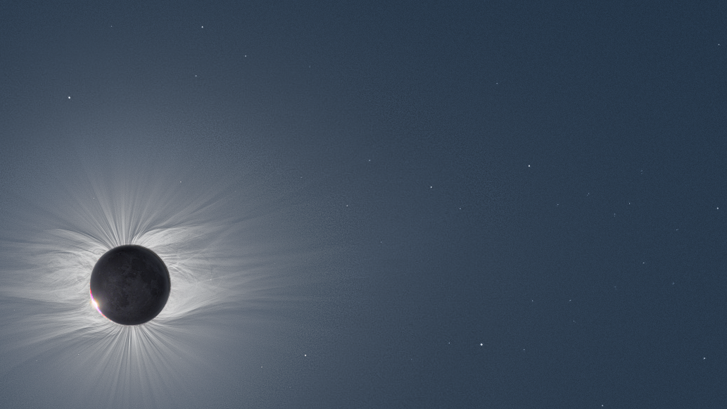
Quantifying CME arrival time uncertainty with mega ensembles (In 3 slides, so apologies for the lack of references and background)
Space and Atmospheric Electricity group
Department of Meteorology
Mathew Owens

Slide 2
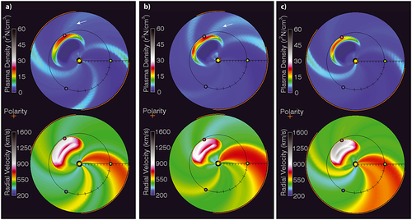
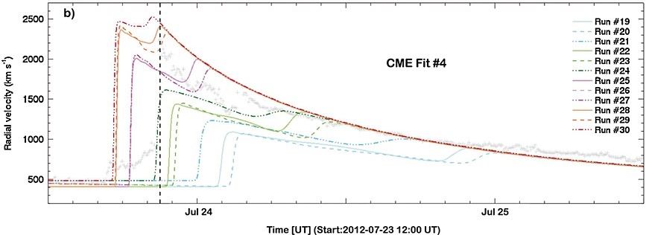
Forecasting CMEs
Current approach: 3D MHD
Multiple fits to CME observed in coronagraphs
Multiple background solar wind solutions
Run model many times
Computationally expensive – only ~10-100 ensemble members.
Cash et al., Space Weather, 2015
See also: Mays et al., Sol Phys, 2015

Slide 3
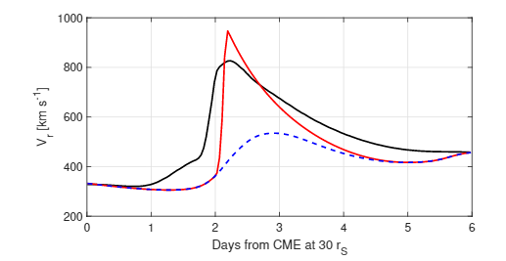
Reduced-physics model
3D MHD HUXt
How simple can you make a solar wind model and it still be useful? “HUXt” is
Hydrodynamic
Incompressible
1-dimensional
For CME arrival time, HUXt replicates 3D MHD very closely
Orders of magnitude faster
This is
a movie
3D MHD
HUXt (no CME)
HUXt (CME)
Owens et al., Sol. Phys., 2020

Slide 4
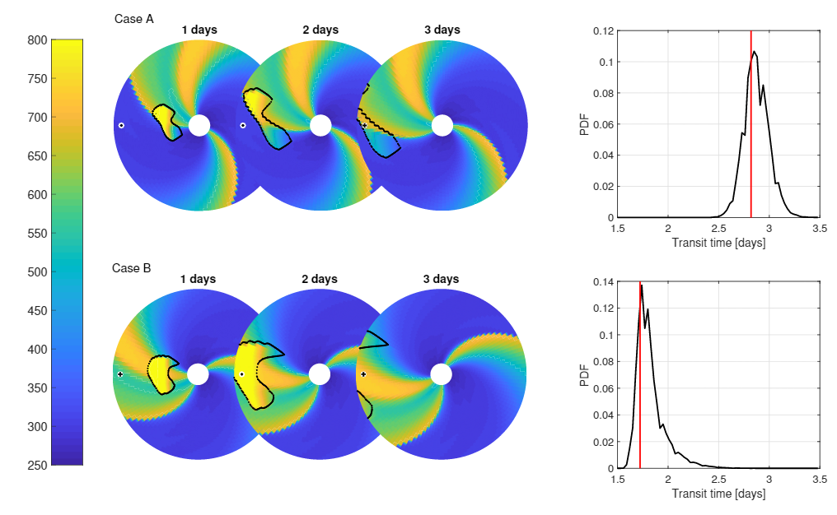
Mega ensembles
Can run 10⁵ – 10⁶ CME arrival time estimates with HUXt
Perturb CME properties & background solar wind
Fully quantify uncertainty
HUXt is open source, written in python: https://github.com/University-of-Reading-Space-Science/HUXt
Same CME launched into different ambient solar wind: Different mean arrival times and different spread

