Slide 1


Tectonic uplift rate in the northern coast of the South China sea: insight from the ¹⁰Be exposure dating of marine terrace in southeastern China
Hao Liang*, Ke Zhang, Zihao Chen, Ping Huang, Zhongyun Li, Zhen Chen
Sun Yat-sen University, Guangzhou, China
Southern Marine Science and Engineering Guangdong Laboratory, Zhuhai, China
* liangh27@mail2.sysu.edu.cn

Slide 2
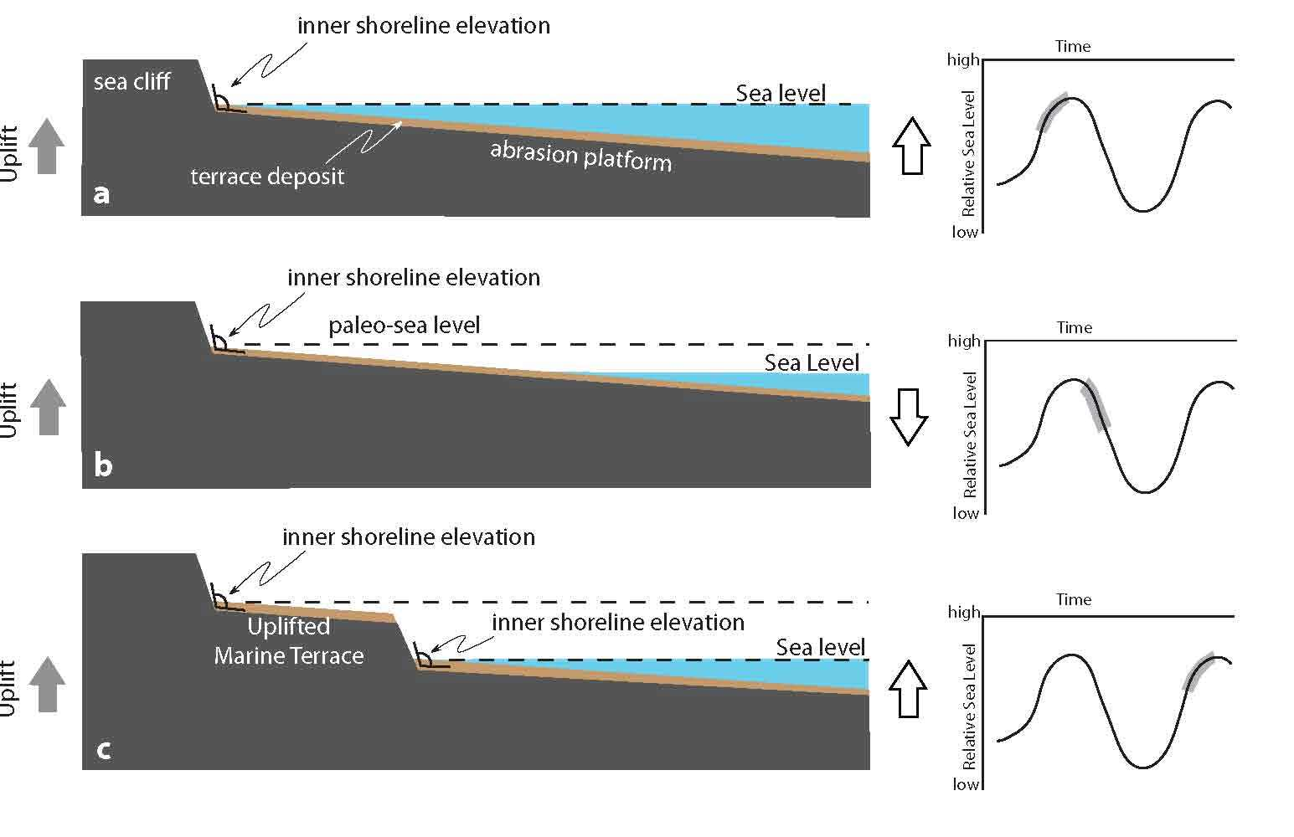
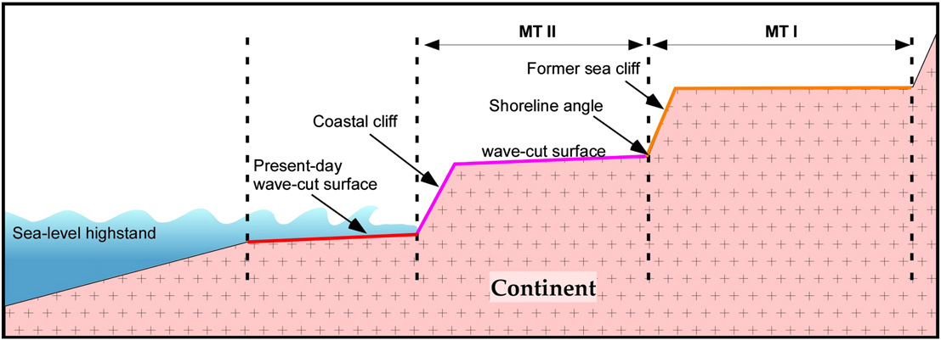
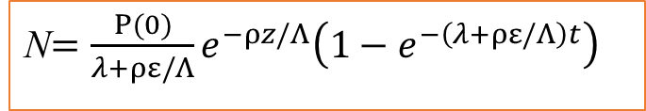
Marine terraces (paleo-shorelines) are iteration of glacio-eustatic sea-level change and tectonic uplift
Cosmogenic nuclide exposure dating
Marine terraces (paleo-shorelines) often preserve little sediment for dating
N$=\frac{P(0)}{λ+ρε/Λ}e^{−ρz​/Λ}\left(1−e^{−\left(λ+ρε/Λ\right)t}\right)$
N-nuclide concentration
P(0)-surface production rate
ε-surface erosion rate
Λ-attenuation length
t-exposure time
𝜆-decay constant
ρ-rock density
Saillard et al., 2011
Nalin et al., (2007)

Slide 3
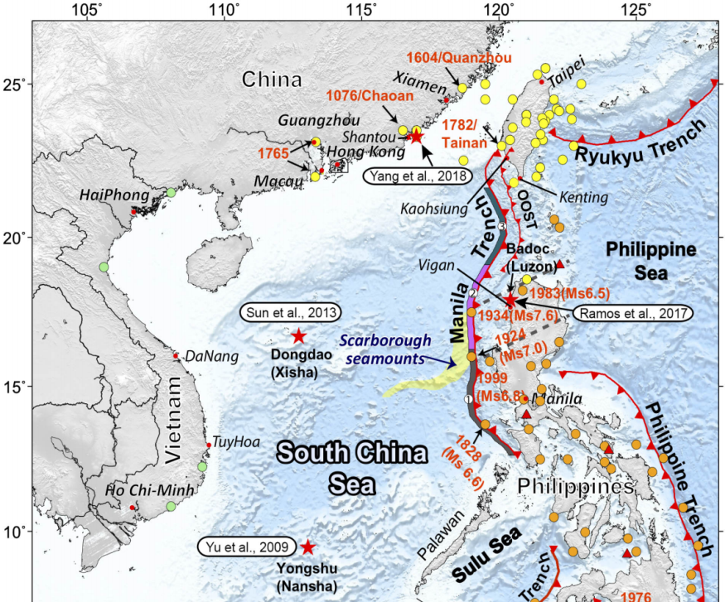
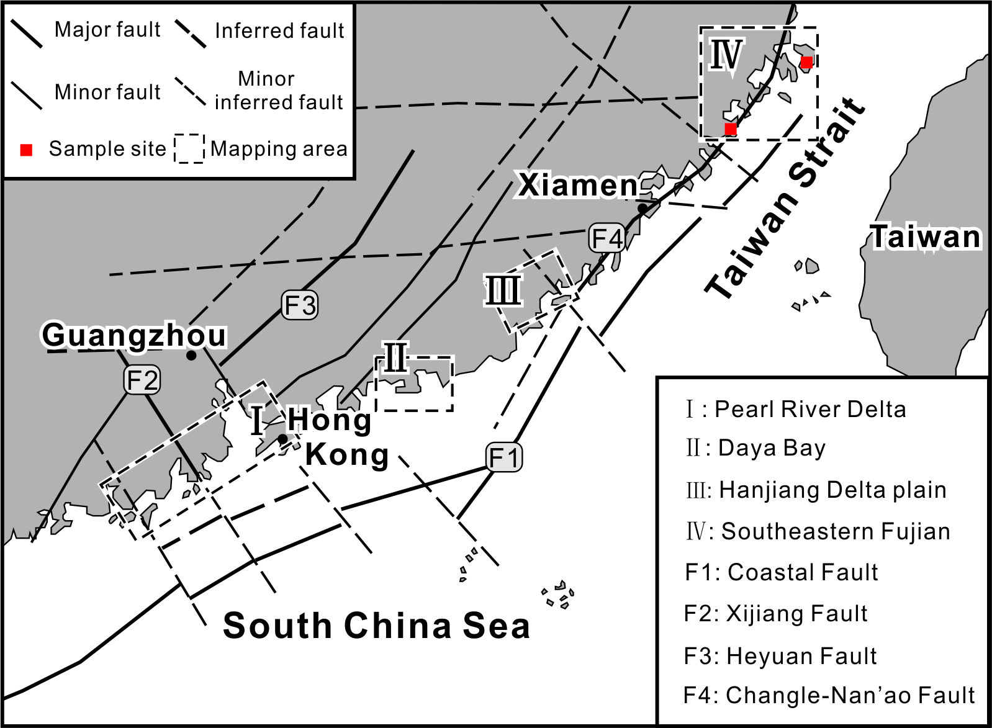
crustal extension processes occurring in SE China by subduction of Pacific plate have been deforming marine terrace (paleo-shoreline) through the late Quaternary via a series of normal faults
Long-term tectonic activity of normal faults is not well-known because of paucity of chronologic constraint
(Qiu et al., 2019)

Slide 4
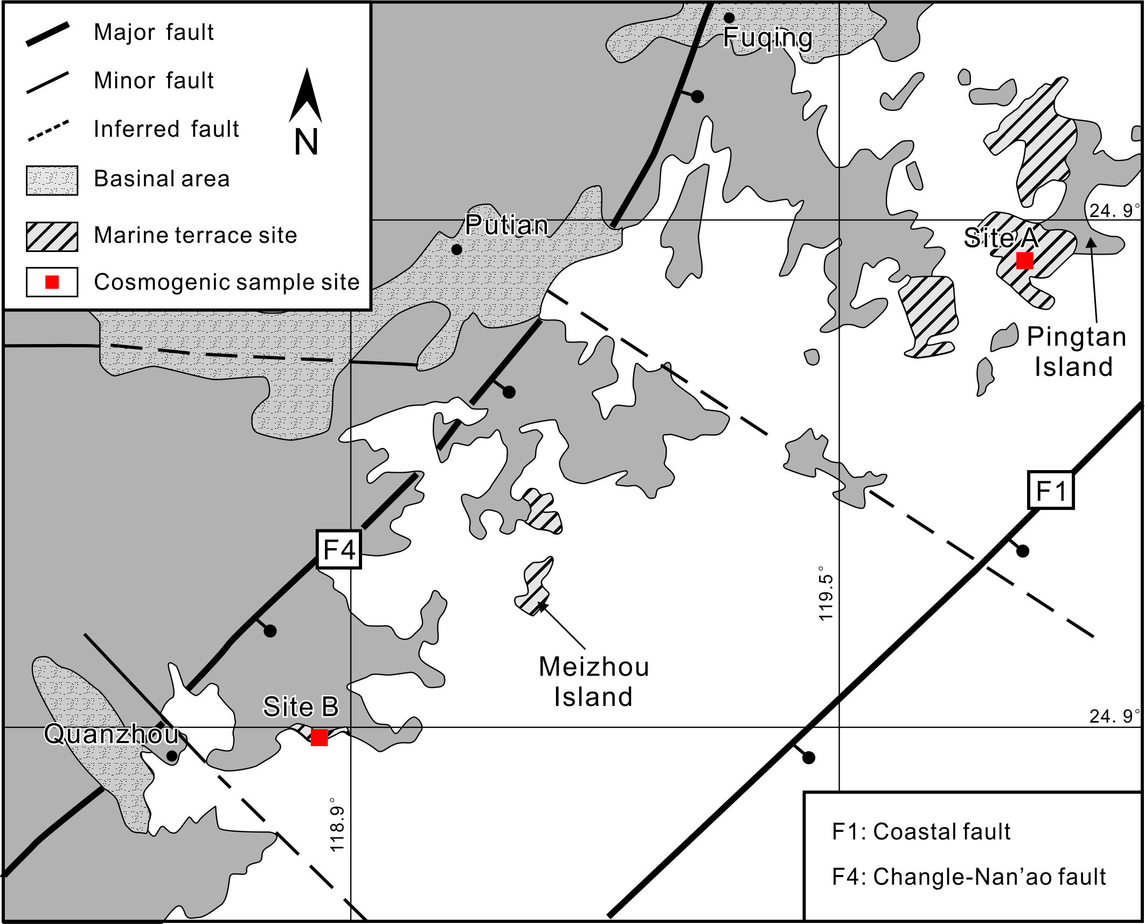
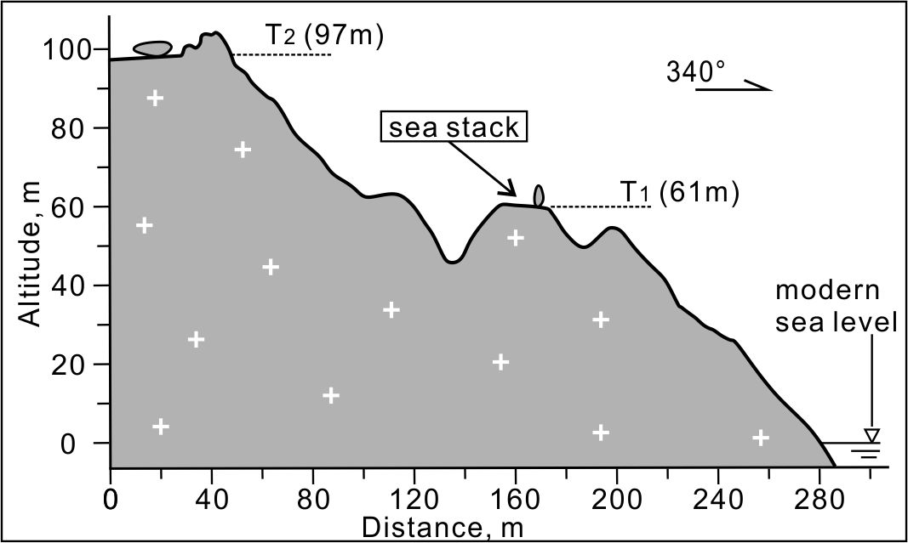
Two typical marine terraces are observed at Site A
Cosmogenic ¹⁰Be depth profile samples are collected in T₁ (61m) terrace
Some lower terraces might be eroded
Site A
T1-61m
Sea stack
Wave-cut platform

Slide 5
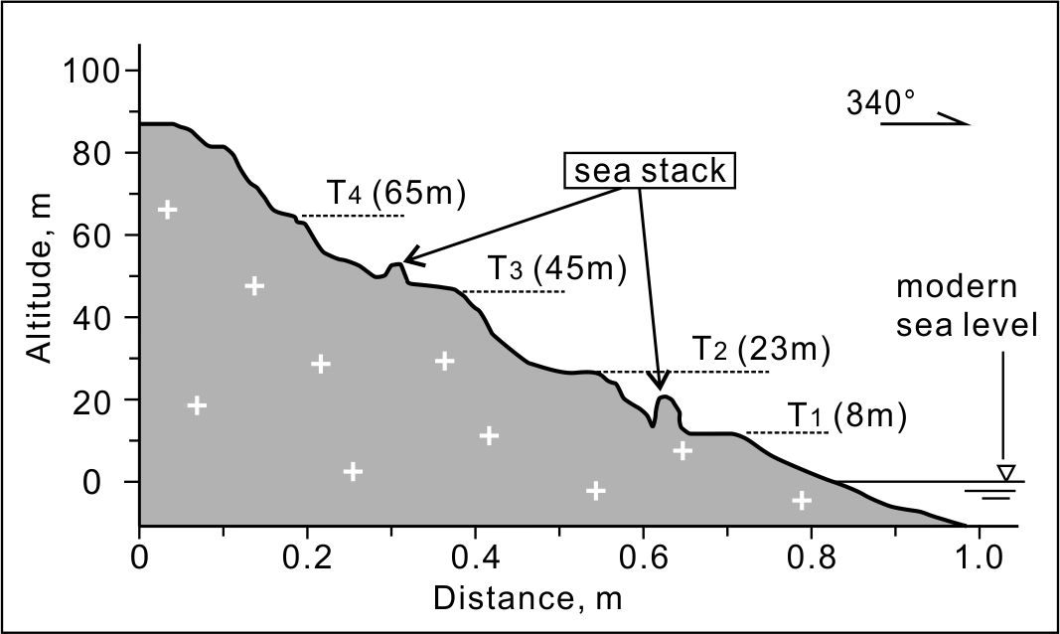
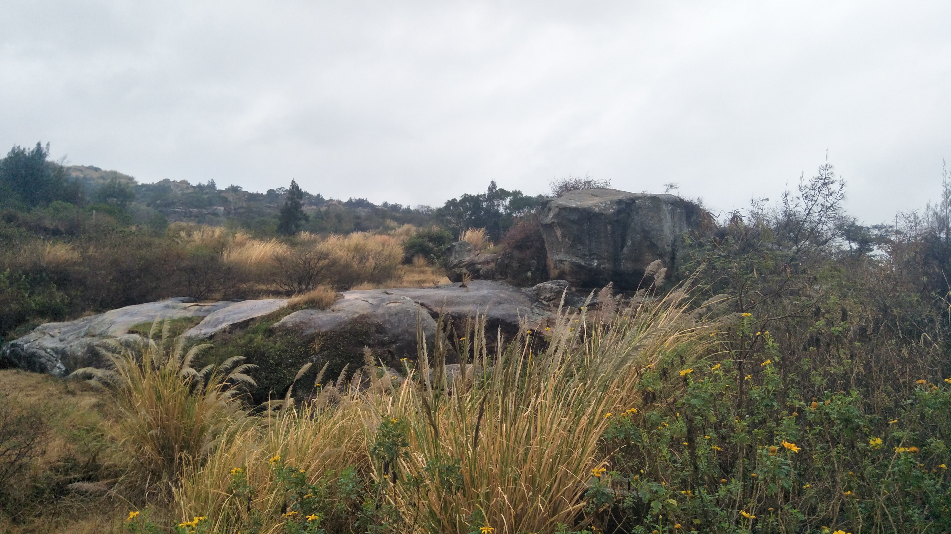
· Four typical marine terraces are observed at Site B
· Cosmogenic ¹⁰Be surface samples and depth profile are collected in T₁ (8m) and T₃ (45m)terrace, respectively
Site B
T1-8m
Sea stack
Wave-cut platform

Slide 6

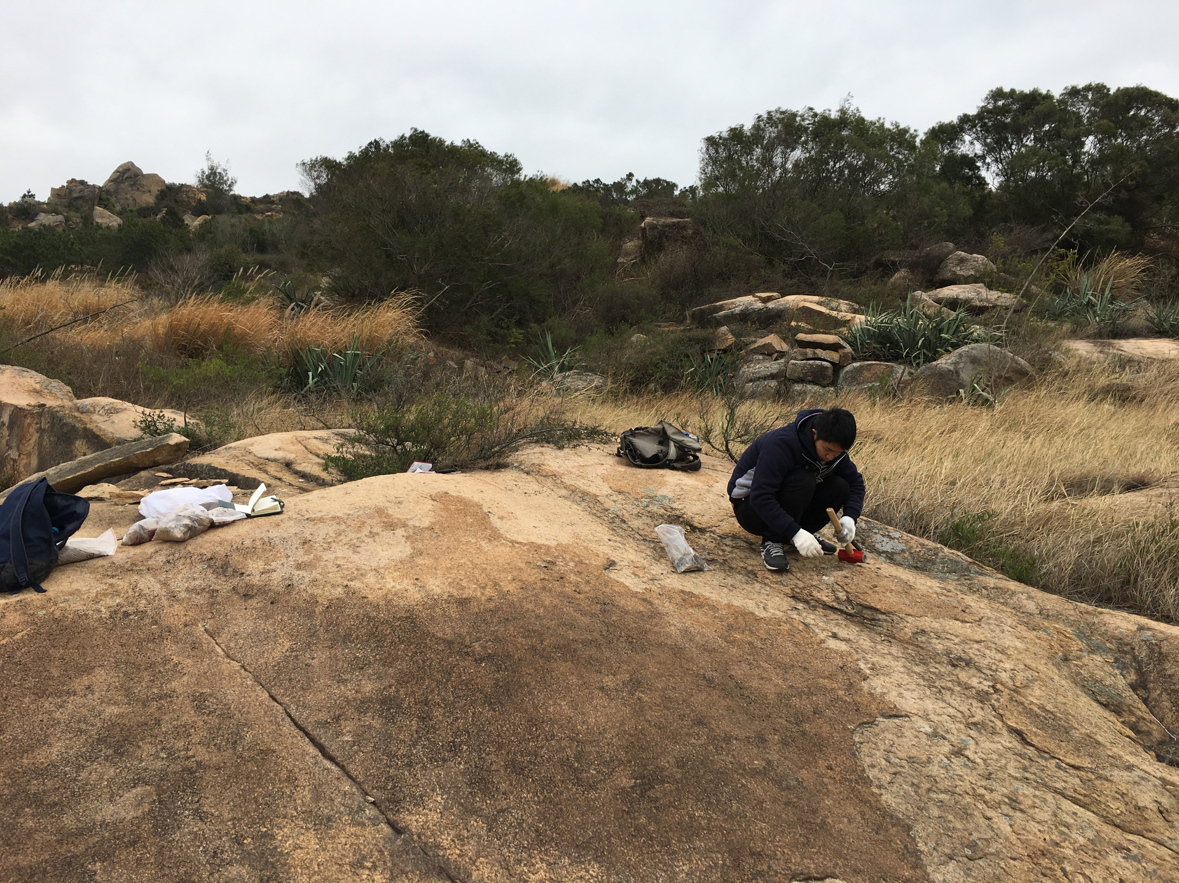
Four typical marine terraces are observed at Site B
Cosmogenic ¹⁰Be surface samples and depth profile are collected in T₁ (8m) and T₃ (45m) terrace, respectively
Site B
T3-45m
Wave-cut platform

Slide 7
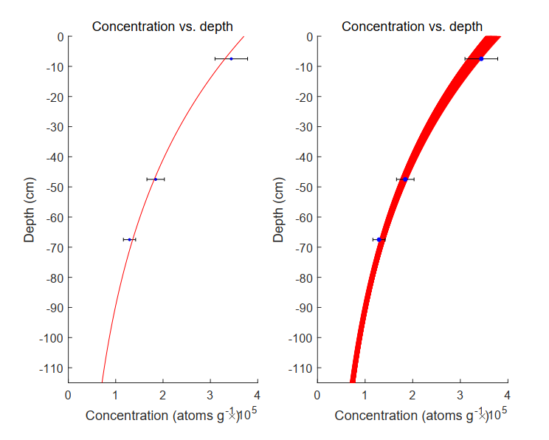
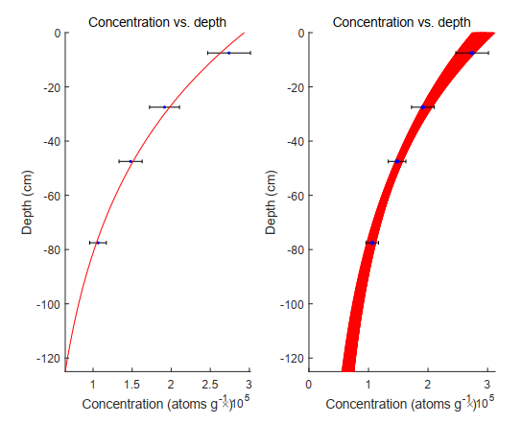
¹⁰Be cosmogenic exposure age of marine terraces
location | terrace | altitude(m) | Exposure age (ka) | MIS | Sample style
Site A | T1 | 61 | 87.9±3.5 | 5a | depth profile
Site B | T1 | 8 | 51.0±1.9 | 3 | surface
 | T3 | 45 | 66.2±2.9 | 3 | depth profile
Method from Hidy et al. (2009)
Cosmogenic depth profile of T1 at Site A
Cosmogenic depth profile of T3 at Site B

Slide 8
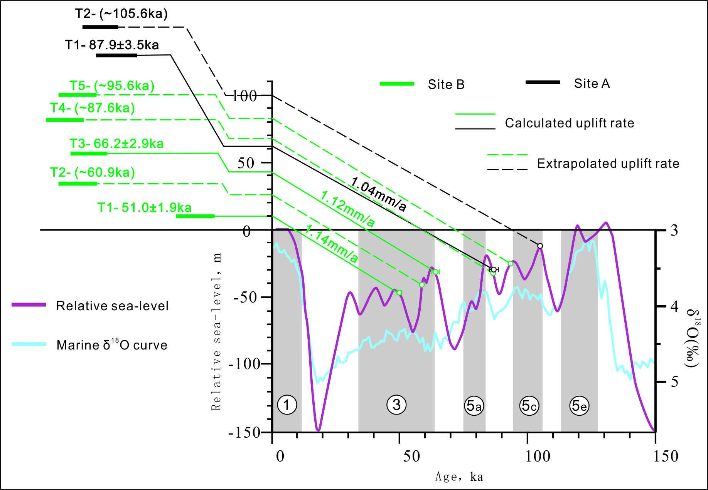
· Correlation of the marine terraces to the late Quaternary global sea level curve (Lambeck & Chappell, 2001) suggest a mean tectonic uplift rate of 1.04mm/a at Site A and 1.12-1.14mm/a at Site B
· Extrapolated uplift rate by mean uplift rates are correlated to sea high-stands in late Quaternary

Slide 9
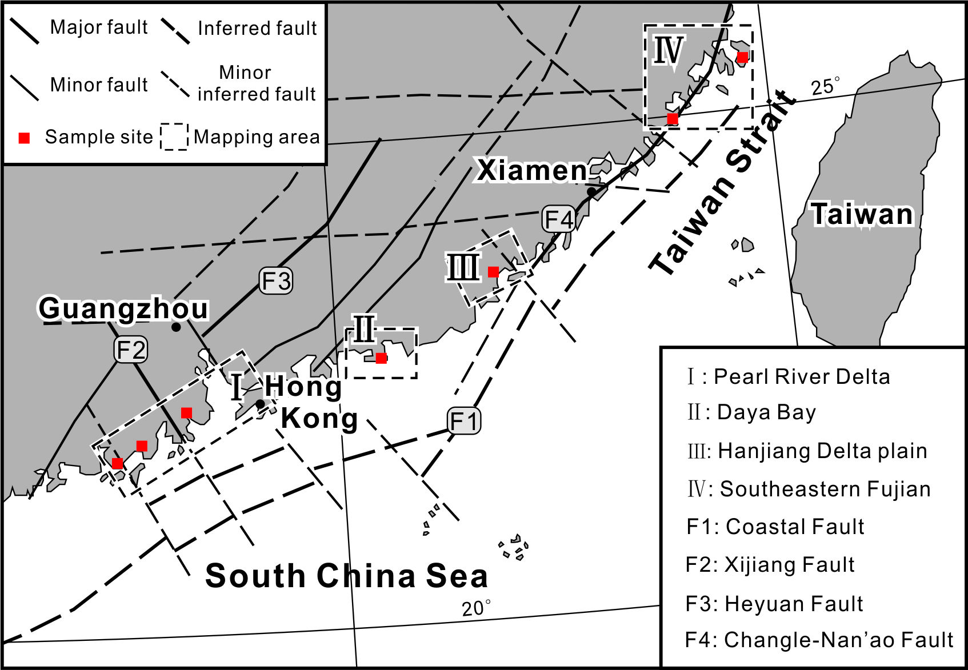
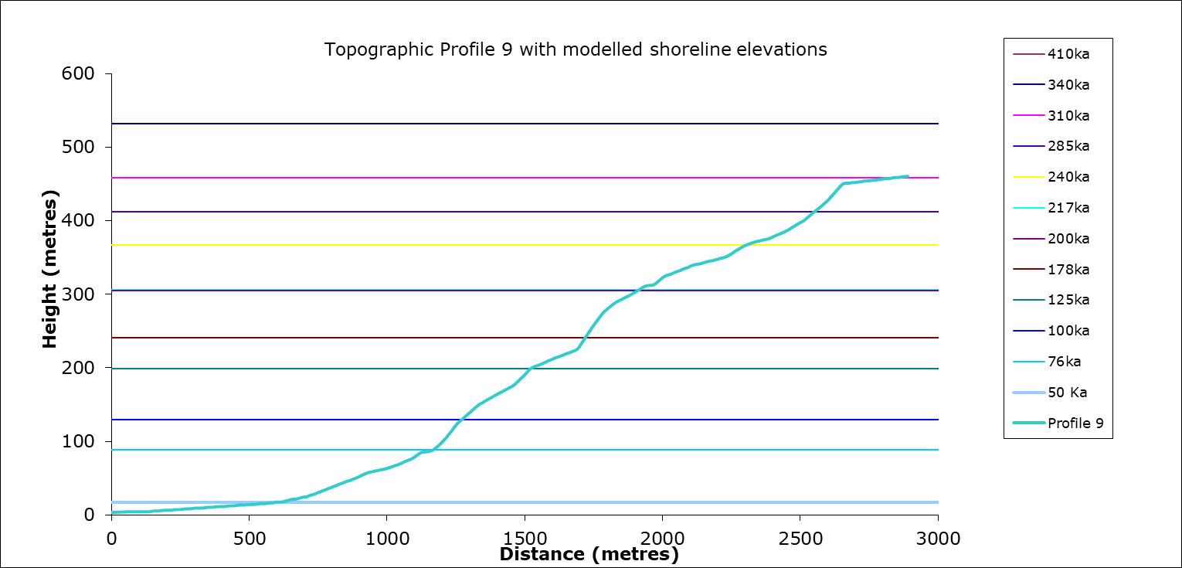
Subsequent work
1. detailed mapping of marine terraces and fault
2. correlation of regional marine terraces
Synchronous correlation, method from Roberts et al. (2009)

Slide 10
Reference
Nalin R, Massari F, Zecchin M. Superimposed cycles of composite marine terraces: the example of Cutro terrace (Calabria, Southern Italy)[J]. Journal of Sedimentary Research, 2007, 77(4): 340-354.
Saillard M, Hall S R, Audin L, et al. Andean coastal uplift and active tectonics in southern Peru: 10Be surface exposure dating of differentially uplifted marine terrace sequences (San Juan de Marcona,~ 15.4 S)[J]. Geomorphology, 2011, 128(3-4): 178-190.
Qiu Q, Li L, Hsu Y J, et al. Revised earthquake sources along Manila trench for tsunami hazard assessment in the South China Sea[J]. 2019.
Hidy A J, Gosse J C, Pederson J L, et al. A geologically constrained Monte Carlo approach to modeling exposure ages from profiles of cosmogenic nuclides: An example from Lees Ferry, Arizona[J]. Geochemistry, Geophysics, Geosystems, 2010, 11(9).
Lambeck K, Chappell J. Sea level change through the last glacial cycle[J]. Science, 2001, 292(5517): 679-686.
Roberts, G.P., Houghton, S.L., Underwood, C., Papanikolaou, I., Cowie, P.A., Van Calsteren, P., Wigley, T., Cooper, F.J., McArthur, J.M., 2009. Localization of Qua- ternary slip rates in an active rift in 105 years: an example from central Greece constrained by 234Ue230Th coral dates from uplifted paleoshorelines. J. Geophys. Res. 114, B10406.

Slide 11
Thank you！

