Slide 1



ON THE MORPHODYNAMIC
EQUILIBRIUM OF TIDAL BIFURCATIONS
Niccolò Ragno, Nicoletta Tambroni, and Michele Bolla Pittaluga

Slide 2
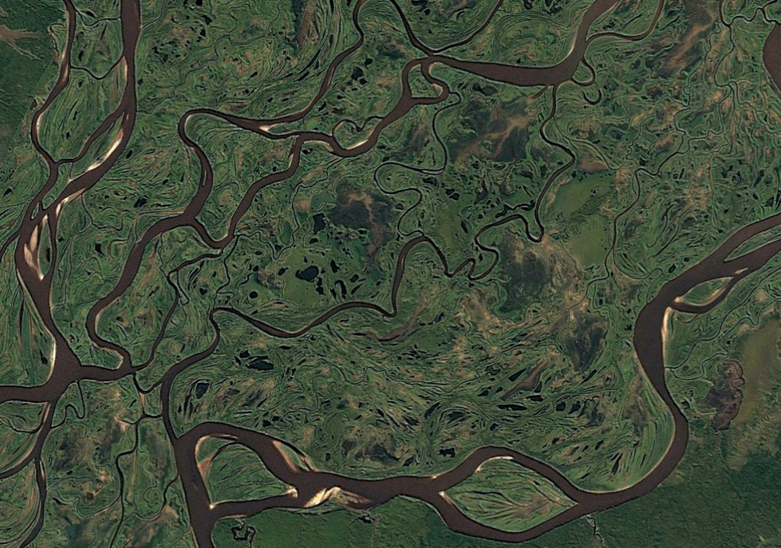
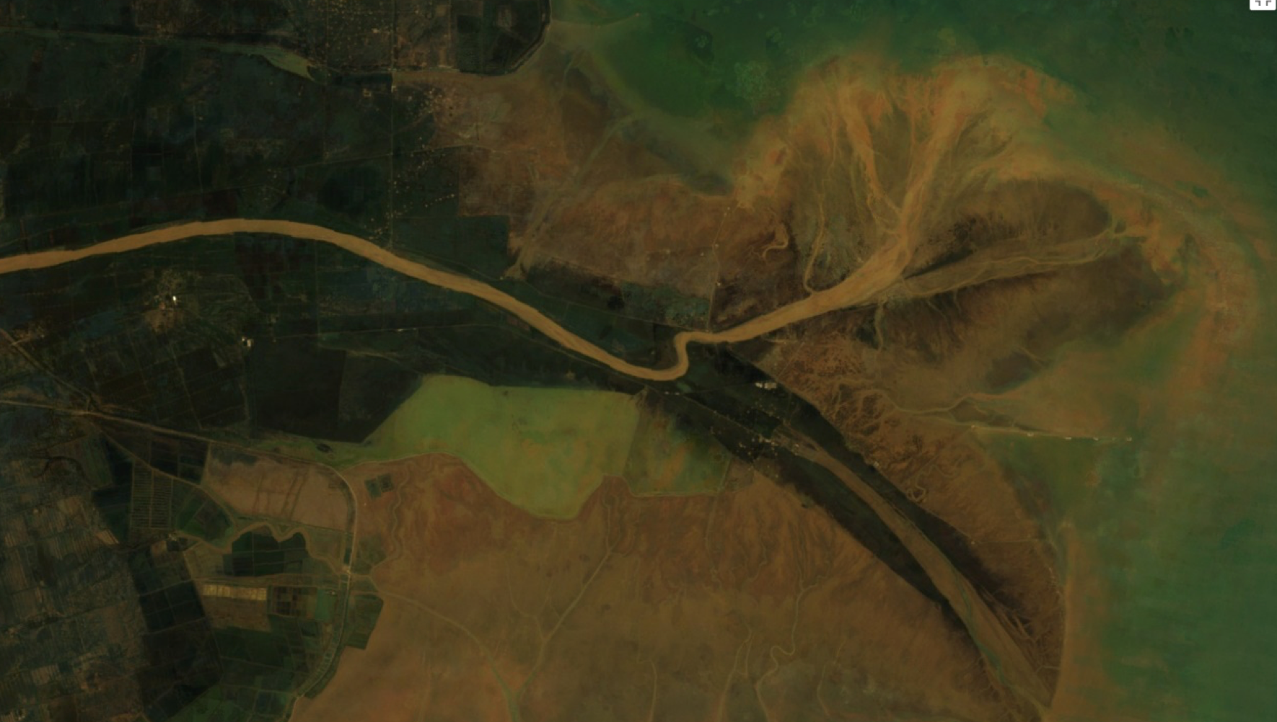
INTRODUCTION
Bifurcations are ubiquitous features of multi-thread systems (braided rivers, deltas, river restoration solutions)
Ob River (Russia)
Yellow River (China)
Why are bifurcations important?

Slide 3
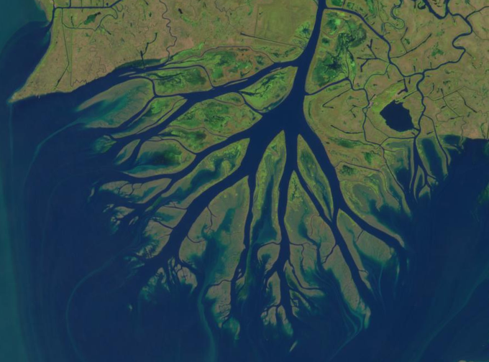
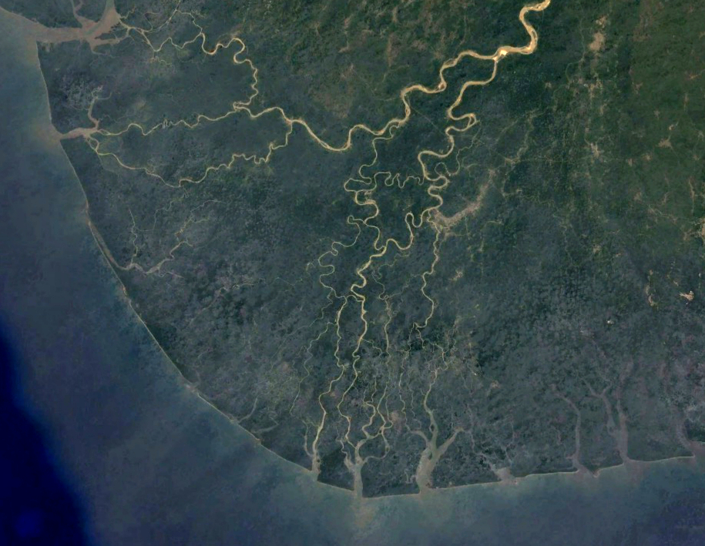
INTRODUCTION
Bifurcations govern the downstream distribution of water and sediment fluxes
  They can determine the flooding risk, the availability of water resources, the loss and gain pattern of land in fluvio-deltaic systems, the management of channel inlets and marshes in estuarine environments and lagoons
Wax Lake Delta (USA)
Niger River (Nigeria)

Slide 4
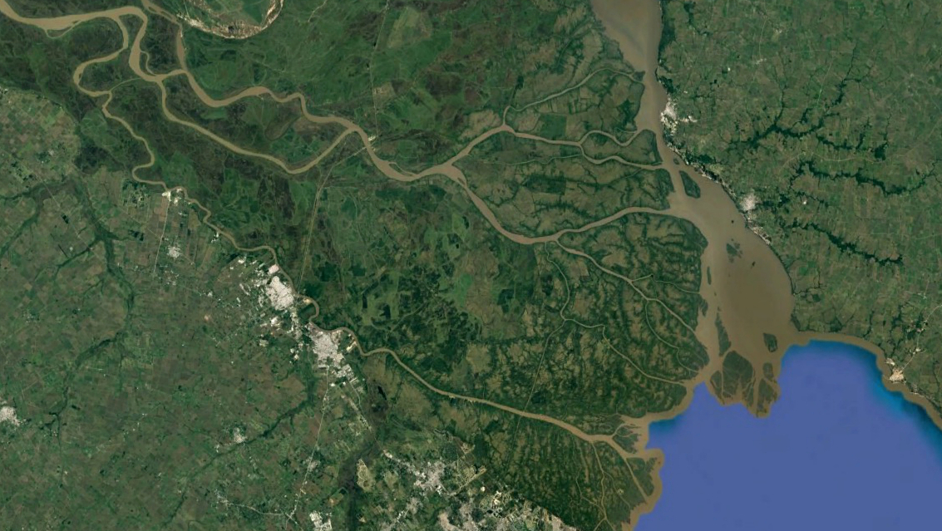
AIMS OF THE WORK
Bifurcations are often not isolated but they are part of more complex systems (e.g. in presence of a tidal environment)
Recent studies highlight that bifurcations can be highly influenced by variations of downstream boundary conditions [Salter et al., 2018; Redolfi et al., 2019]
Tide-influenced deltas have the tendency to less but
more stable branches in comparison to their riverine counterpart
[Hoitink et al., 2017]
RESEARCH QUESTIONS:
  How does the tides affect the morphodynamics
  equilibrium of bifurcations in micro-tidal deltas?
  What are the controlling parameters?
METHODS:
  Development of an idealized 1-D model, coupling the two-cell bifurcation model of Bolla Pittaluga et al. (2003), with the solution of Seminara et al. (2012) for the long term equilibrium of river-dominated estuaries
Paranà River (Argentina)

Slide 5
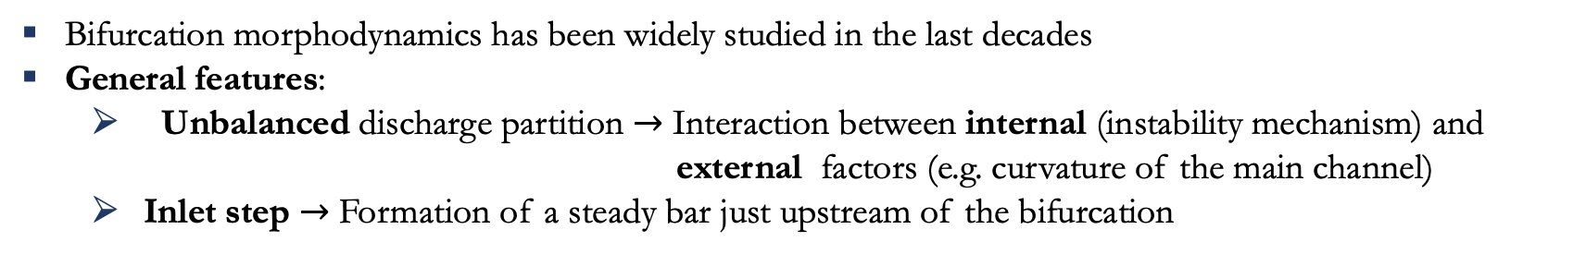

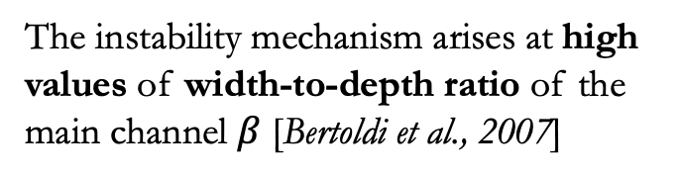
THE BIFURCATION MORPHODYNAMICS
Bifurcation morphodynamics has been widely studied in the last decades
General features:
  Unbalanced discharge partition $→$ Interaction between internal (instability mechanism) and external factors (e.g. curvature of the main channel)
  Inlet step $→$ Formation of a steady bar just upstream of the bifurcation
EQUILIBRIUM
The instability mechanism arises at high values of width-to-depth ratio of the main channel $β$ [Bertoldi et al., 2007]
$$β_{cr}$$
From Redolfi et al. (2019)

Slide 6
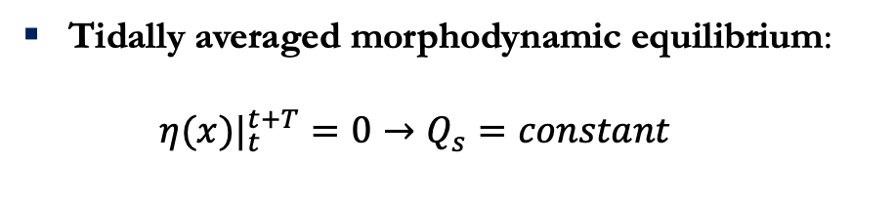

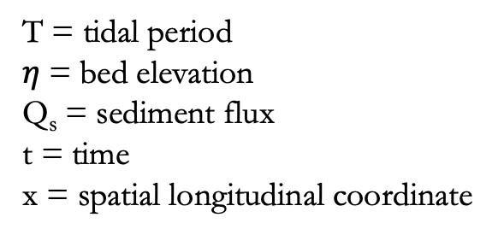
EQUILIBRIUM OF TIDAL ESTUARIES
The solution of Seminara et al., (2012)
Assumptions:
  Cohesionless bed
  Fixed banks
  Uniform grain size
  “Small” tidal oscillations (no flow reversal)
Perturbation analysis: $ε=\frac{Tidal amplitude}{Uniform flow depth}≪1$
Tidally averaged morphodynamic equilibrium:
  $$η(x)|_{t}^{t+T}=0→Q_{s}=constant$$
T = tidal period
$η$= bed elevation
Q_{s} = sediment flux
t = time
x = spatial longitudinal coordinate

Slide 7
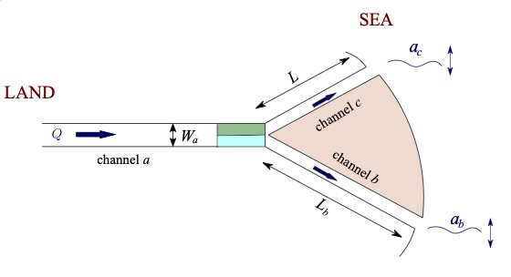
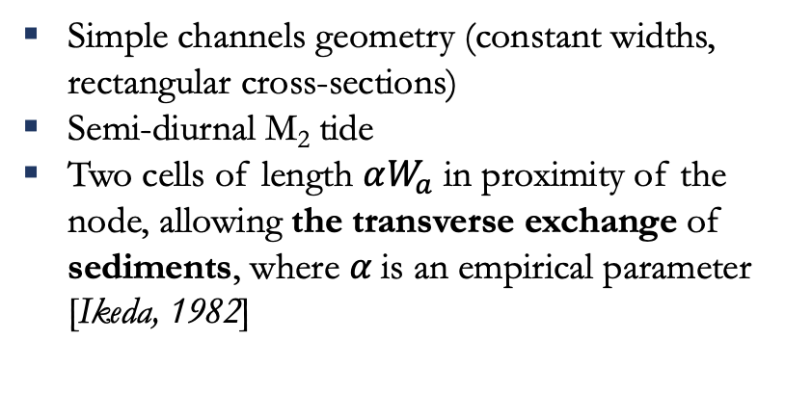
MODEL FORMULATION
Simple channels geometry (constant widths, rectangular cross-sections)
Semi-diurnal M₂ tide
Two cells of length $αW_{a}$ in proximity of the node, allowing the transverse exchange of sediments, where $α$is an empirical parameter [Ikeda, 1982]
L = channels length
a = tidal amplitude
W = channels width
Q = flow discharge
c
c
Engelund & Hansen (1967)’s predictor for the computation of the solid discharge
a
a
We need to solve an algebraic non-linear system formed by
the following six equations: conservation of water and
sediment fluxes (2), energy conservation (1), a nodal point relation [Bolla Pittaluga et al., 2003] which allows the transverse exchange of sediment (1), and two equations for the local water depths at the node provided by Seminara et al. (2012)
Linear stability analysis
Numerical solution of the full non-linear system

Slide 8
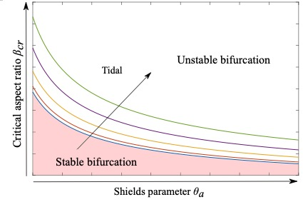

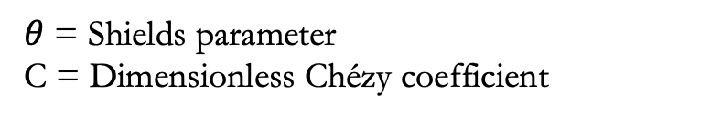
RESULTS
Linear analysis
We can compute the value of the width-to-depth ratio which makes the bifurcation stable:
$$\boxed{β_{cr}=ℱ(θ,C,a,L)}$$
$θ$ = Shields parameter
C = Dimensionless Chézy coefficient
amplitude
Intrinsically unstable bifurcations tend to be stable when the tidal amplitude is sufficiently high and the length of the bifurcates sufficiently short

Slide 9
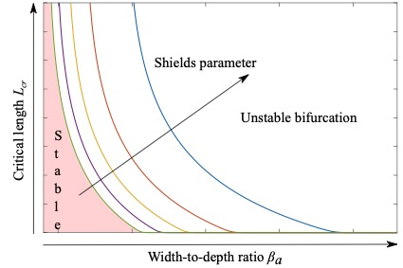

RESULTS
Linear analysis
We can compute the value of the length of the branches which makes the bifurcation stable:
$$\boxed{L_{cr}=ℱ(θ,C,a,β)}$$
$θ$ = Shields parameter
C = Dimensionless Chézy coefficient
Intrinsically unstable bifurcations tend to be stable when the tidal amplitude is sufficiently high and the length of the bifurcates sufficiently short

Slide 10
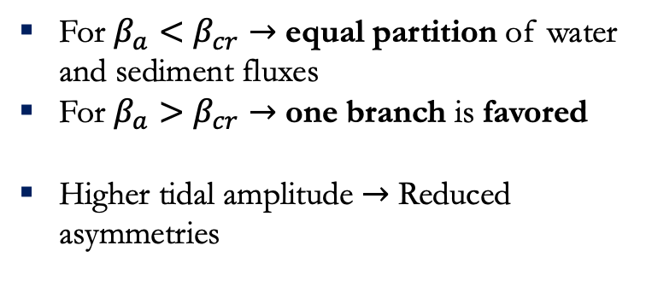
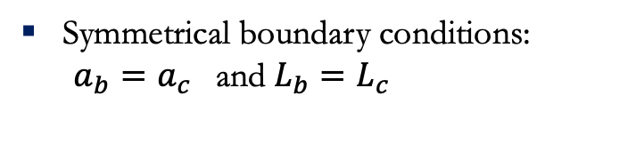

RESULTS
Numerical solution
Symmetrical boundary conditions:
$a_{b}=a_{c}$ and $L_{b}=L_{c}$
For $β_{a}<β_{cr}→$ equal partition of water and sediment fluxes
For $β_{a}>β_{cr}→$ one branch is favored
Higher tidal amplitude $→$ Reduced asymmetries
$$∆Q=\frac{Q_{b}−Q_{c}}{Q_{a}}$$
Discharge asymmetry:

Slide 11
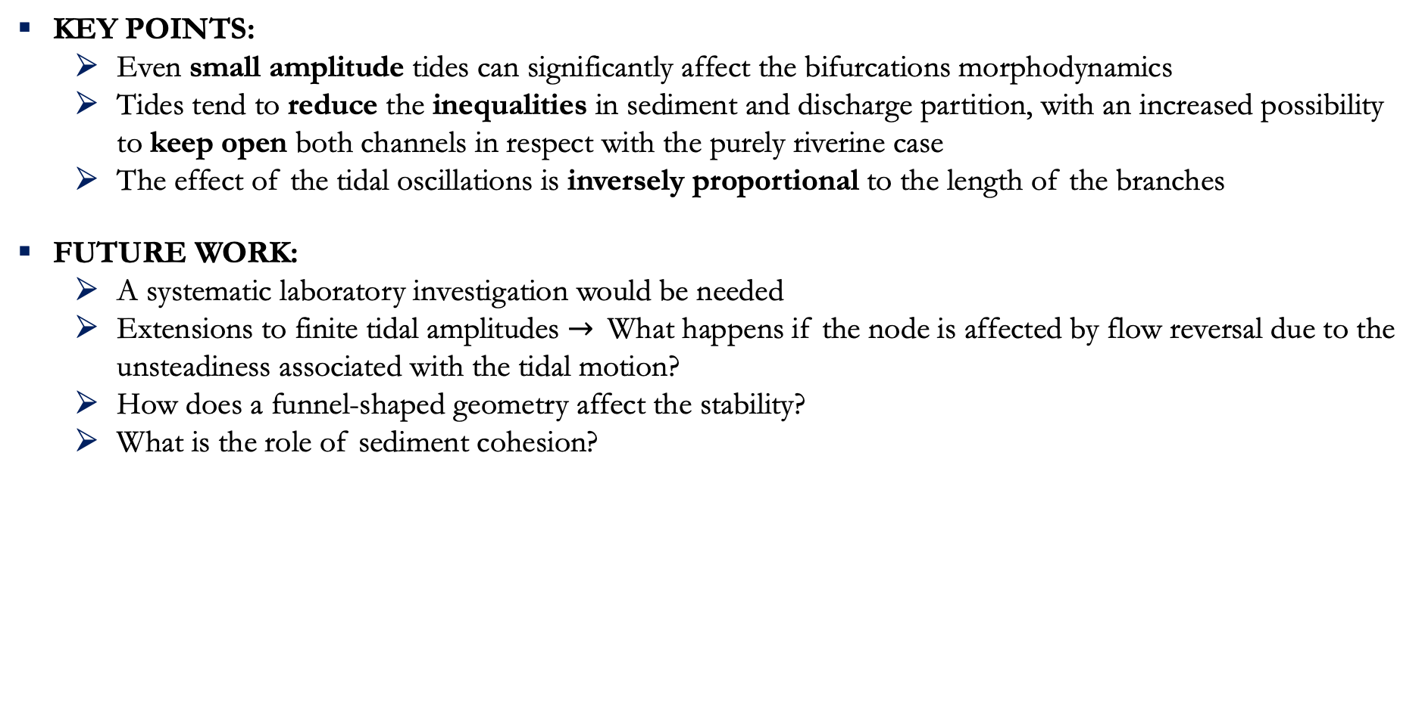
CONCLUSIONS
KEY POINTS:
  Even small amplitude tides can significantly affect the bifurcations morphodynamics
  Tides tend to reduce the inequalities in sediment and discharge partition, with an increased possibility to keep open both channels in respect with the purely riverine case
  The effect of the tidal oscillations is inversely proportional to the length of the branches
FUTURE WORK:
  A systematic laboratory investigation would be needed
  Extensions to finite tidal amplitudes $→$What happens if the node is affected by flow reversal due to the unsteadiness associated with the tidal motion?
  How does a funnel-shaped geometry affect the stability?
  What is the role of sediment cohesion?

Slide 12

THANK YOU FOR THE ATTENTION!

