Slide 1



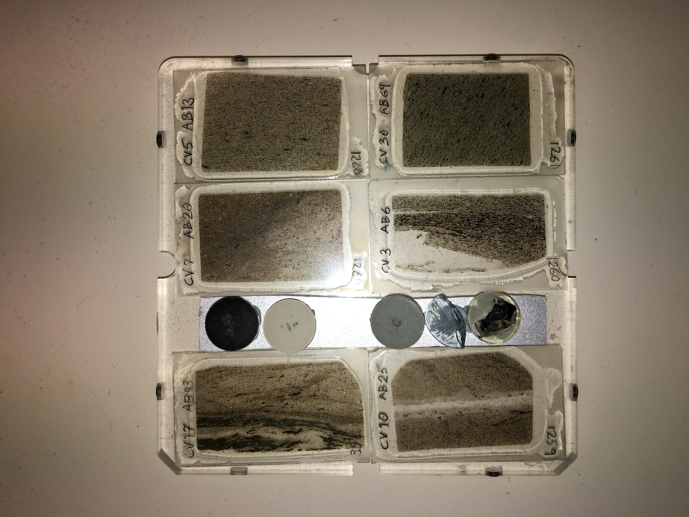
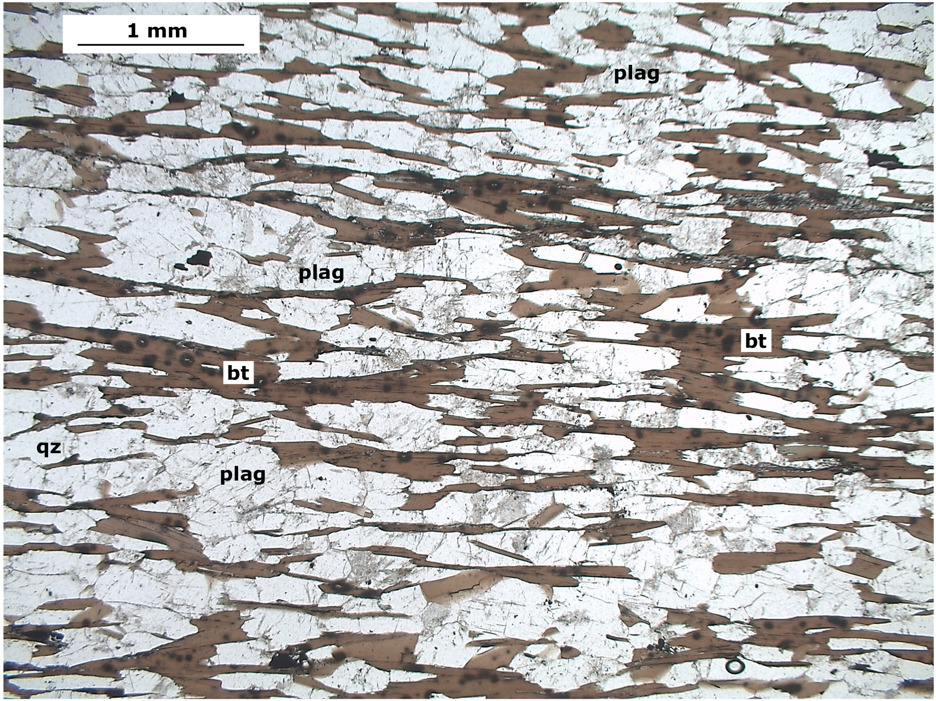
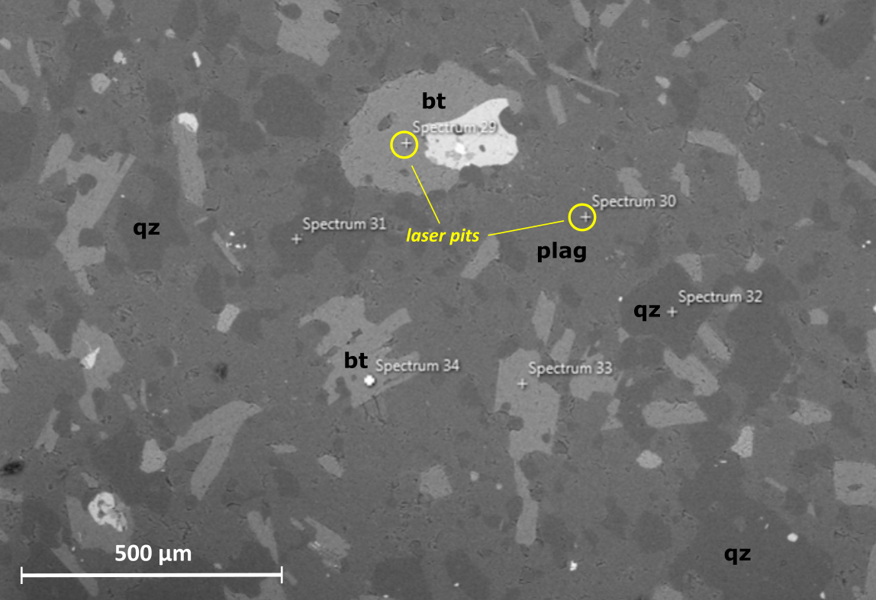
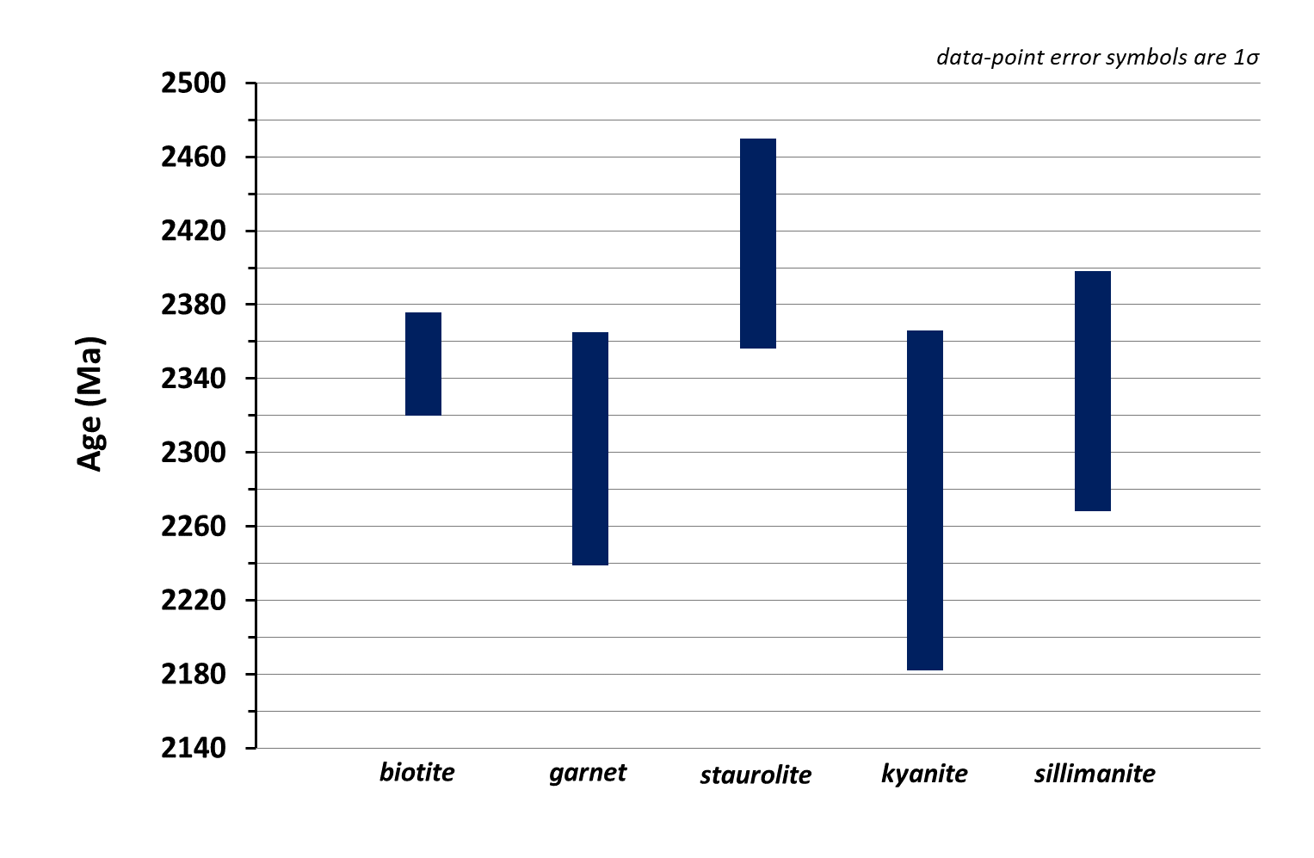
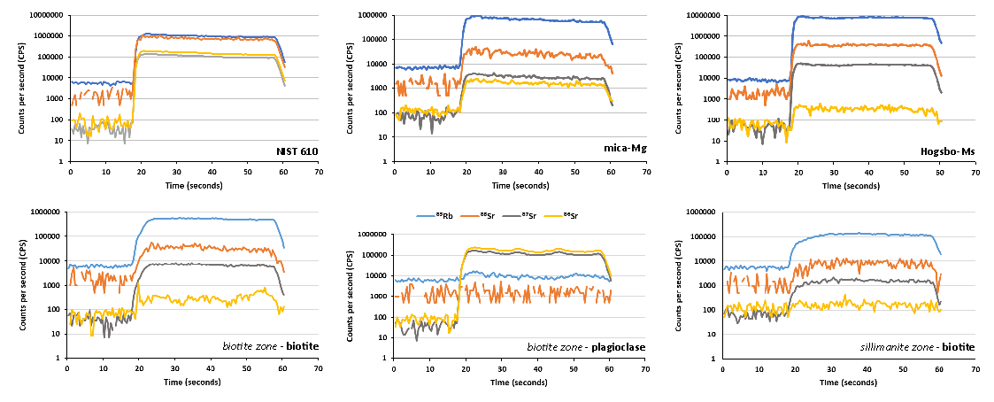
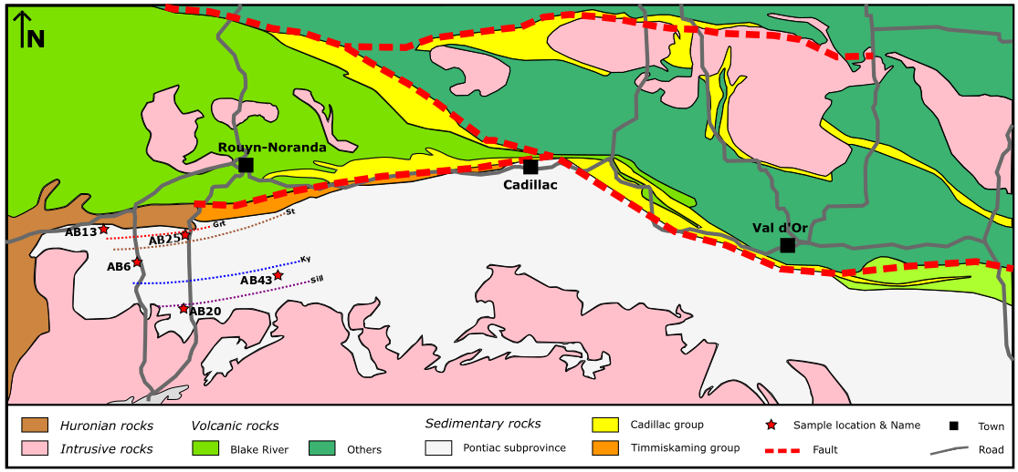
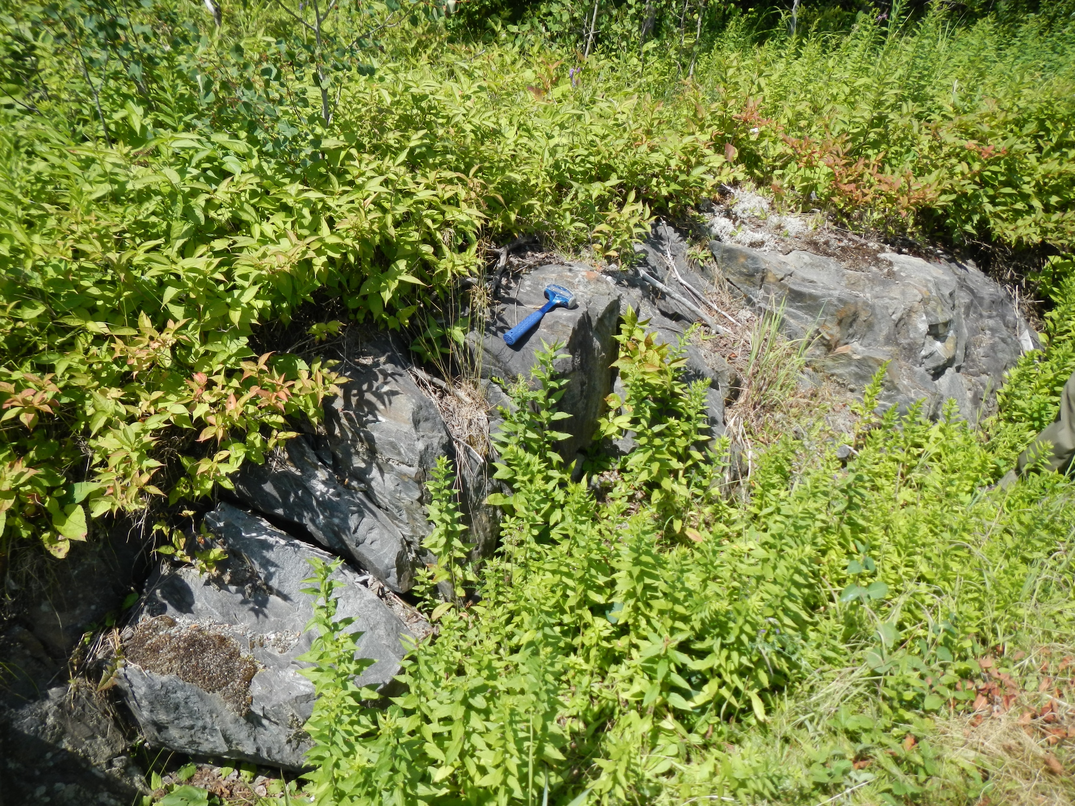
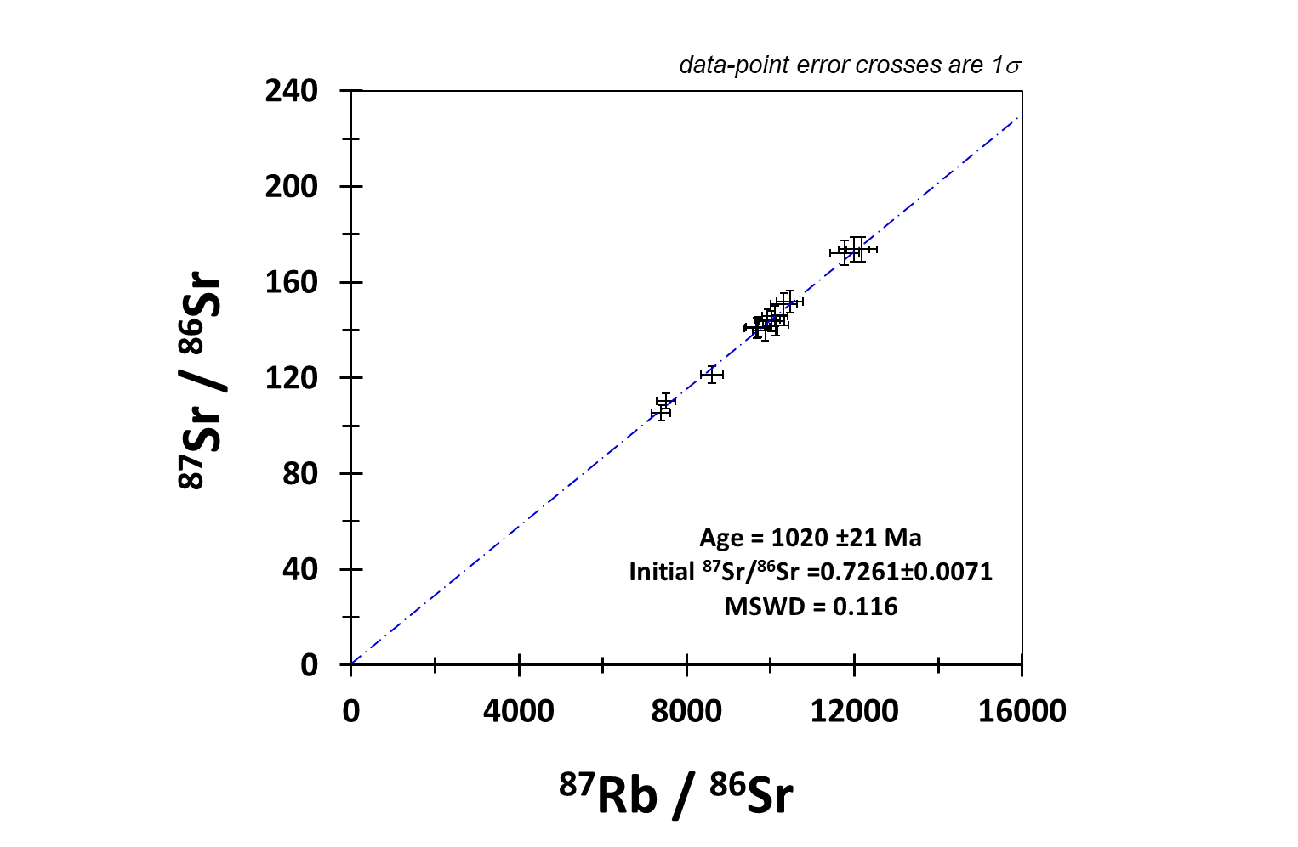


First in-situ Rb-Sr dating of metasedimentary rocks from the Pontiac subprovince, Superior Craton, Canada.
Implications towards the regional metamorphic evolution of the sequence.
Leventis, N.¹*, Zack, T.², Pitcairn, I.¹, Högmalm, K. J.²
¹ Department of Geological Sciences, Stockholm University, Stockholm, Sweden
² Department of Earth Sciences, University of Gothenburg, Gothenburg, Sweden
Introduction
Methods
Discussion
In-situ Rb-Sr dating performed directly in thin sections is a recently developed method in LA-ICP-MS/MS (Zack & Hogmalm, 2016). In this study, we present Rb-Sr dates of metamorphic rocks from the Pontiac subprovince in the south Superior Craton, Canada following an efficient, new analytical protocol (Hogmalm et al., 2017). The selected samples span in metamorphic facies from biotite-zone to sillimanite-zone conditions. This project comprises a test of these methods in biotite-rich Archean rocks and it is also the first in-situ Rb-Sr date constraints of rocks from the Pontiac subprovince. The ages obtained aim to provide further insights about the regional metamorphism in the area and accompany previous studies in the region.
Five (5) metasedimentary rocks were sampled from each metamorphic zone (bt-grt-st-ky-sill) in NW Pontiac subprovince (Figure 1).
Petrography → mineral assemblages
SEM-EDS analysis → bt + plag targeting
in-situ LA-ICP-MS analysis in biotites, plagioclase and reference materials (NIST610, NIST612, BCR-2G, Hogsbo-Ms & mica-Mg)
Are these dates recording prolonged cooling of the sequence or later metamorphic/hydrothermal event?
What is the influence (if any) from the MMGS and GMG plutons in the south?
⁴⁰Ar/³⁹Ar constraints in biotites from similar metasedimentary rocks in the Pontiac yield 2557 ±8 Ma and 2541 ±9 Ma. A biotite from the MMGS in the Pontiac is dated 2476 ±9 Ma (Feng et al., 1992).
Resetting of various isotopic systems has been previously reported and was attributed to later thermal events (fluid infiltration, underthrusting of the Pontiac beneath southern Abitibi and S-type GMGs generation) (Feng et al., 1992).
Age constraints in rocks adjacent to the CLLfz show that the fault was active for more than 400 Ma, until ≈2250 Ma (Feng et al., 1992).
Geological Setting
The Pontiac subprovince in southern Superior Province, Canada is composed of greywackes and pelites, plutons and interlayered ultramafic rocks of Archean age (Davis et al., 2002; Feng et al., 1992). It is located south of the Cadillac-Larder Lake fault zone (CLLfz) and this long deformation zone also separates it from the southern Abitibi Greenstone Belt which consists of volcanic rocks and plutons of variable ages (2720-2700 Ma) (Figure 1).
The Pontiac sediments show a southward increase in metamorphic grade, from biotite-zone to sillimanite-zone conditions. Deposition of these sediments occurred at 2685 ±3 Ma in an accretionary prism or foreland basin at a convergent plate margin and provenance studies show that the material was mostly derived from rocks tectonically related to the Abitibi volcanic rocks and an older >3 Ga terrane (Davis, 2002; Frieman et al., 2019). The sequence experienced prograde near-peak metamorphic conditions (5-6 kbar, 550-600 °C) at 2657.5 ±4.4 Ma based on Lu-Hf ages in garnets (Piette-Lauziere et al., 2019). In the south, plutons of the MMGS and GMG series occur, with ages of crystallization 2682.4 ±1 Ma and 2644 ±14 Ma respectively (Feng et al., 1992).
Conclusions
Figure 3: Samples and reference materials set-up for in-situ analysis.
Figure 4: Characteristic lepidoblastic biotite from the staurolite zone
Figure 5: SEM micro-photograph with in-situ analysis spots in yellow.
this work comprises the first in-situ Rb-Sr dating of metasedimentary rocks from the Pontiac subprovince in Canada
Results
no significant differences are observed in the outcome data with any method of data handling (data pooling, drift correction, repetition rate correction)
biotite Rb-Sr dates in biotite are ≈300 Ma younger than the regional metamorphism
These dates most likely represent cooling ages with Tc for Sr in biotite ≈300C
References
Figure 6 : Ablation patterns from reference materials and selected samples.
Davis, D.W., 2002. Precambrian Res. 115, 97–117. https://doi.org/10.1016/S0301-9268(02)00007-4
Feng, R., Kerrich, R., McBride, S., Farrar, E., 1992. Can. J. Earth Sci. 29, 1389–1411. https://doi.org/10.1139/e92-112
Frieman, B.M., Kuiper, Y.D., Kelly, N.M., Monecke, T., Kylander-Clark, A., 2017. Precambrian Res. 292, 398–416. https://doi.org/10.1016/j.precamres.2017.01.027
Hogmalm, K.J., Zack, T., Karlsson, A.K.O., Sjöqvist, A.S.L., Garbe-Schönberg, D., 2017. J. Anal. At. Spectrom. 32, 305–313. https://doi.org/10.1039/C6JA00362A
Piette-Lauzière, N., Guilmette, C., Bouvier, A., Perrouty, S., Pilote, P., Gaillard, N., Lypaczewski, P., Linnen, R.L., Olivo, G.R., 2019. Precambrian Res. 320, 111–136. https://doi.org/10.1016/j.precamres.2018.10.016
Zack, T., Hogmalm, K.J., 2016. Chem. Geol. 437, 120–133. https://doi.org/10.1016/j.chemgeo.2016.05.027
Figure 1: Geological map of the study area and the location of dated samples (modified from Frieman et al., 2017).
Figure 2: Sampled outcrop in the kyanite zone
Figure 7: Högsbo-Ms age constraint.
Acknowledgements
Natural Resources Canada (NRCAN) – Targeted Geoscience Initiative (TGI) 5

