Slide 1
EGU General Assembly 2020
(EGU2020-2712)
Impacts of model spatial resolution on intense and heavy precipitation events over the Mediterranean region.
Authors: Dario Conte (1), Piero Lionello(1,2) and Silvio Gualdi(1).
CMCC, Italy (dario.conte@cmcc.it, silvio.gualdi@cmcc.it),
(2) Univ. of Salento - DiSTeBA, Lecce, Italy (piero.lionello@unisalento.it).
Online 4-8 may 2020

Slide 2
Abstract
Dynamical downscaling through coupled regional climate model plays an important role to improve climate information at regional fine-scale, since it modulates information produced by GCM, combining planetary scale processes with regional scale processes.
This study describes the impact of climate change on rainfall over the Mediterranean region, downscaling, at two different horizontal grid resolutions (0.44 and 0.11 degs), a Global Climate Model (GCM at 0.75 degs) by means of a coupled Regional Climate System Models (RCSM). We analyze the effect of adopting model version with different horizontal resolutions (0.11, 0.44 e 0.75 degs), considering two climate representative concentration pathways (rcp4.5 and rcp8.5). The spatial pattern on different aspects of precipitation climatology are investigated such as increase/decrease in the intensity of precipitation events, extremes and annual amount of wet days. Moreover, since the grid models cover a wide and complex climate geographic area, the rainfall probability over six sub-regions are calculated: (1) Alps, (2) North-Western coast, (2) South Italy, (3) central part of the Mediterranean sea, (4) Greece Anatolia peninsula and Levantine basin. Although, the evaluation of RCSM downscaling is complex and depends on several factors such as: variables considered, geographic area, topography, model configuration and so on, the results show that it produces an significant improvement, adding information with regards to fine-scale spatial pattern, respect to that provided by GCM.

Slide 3
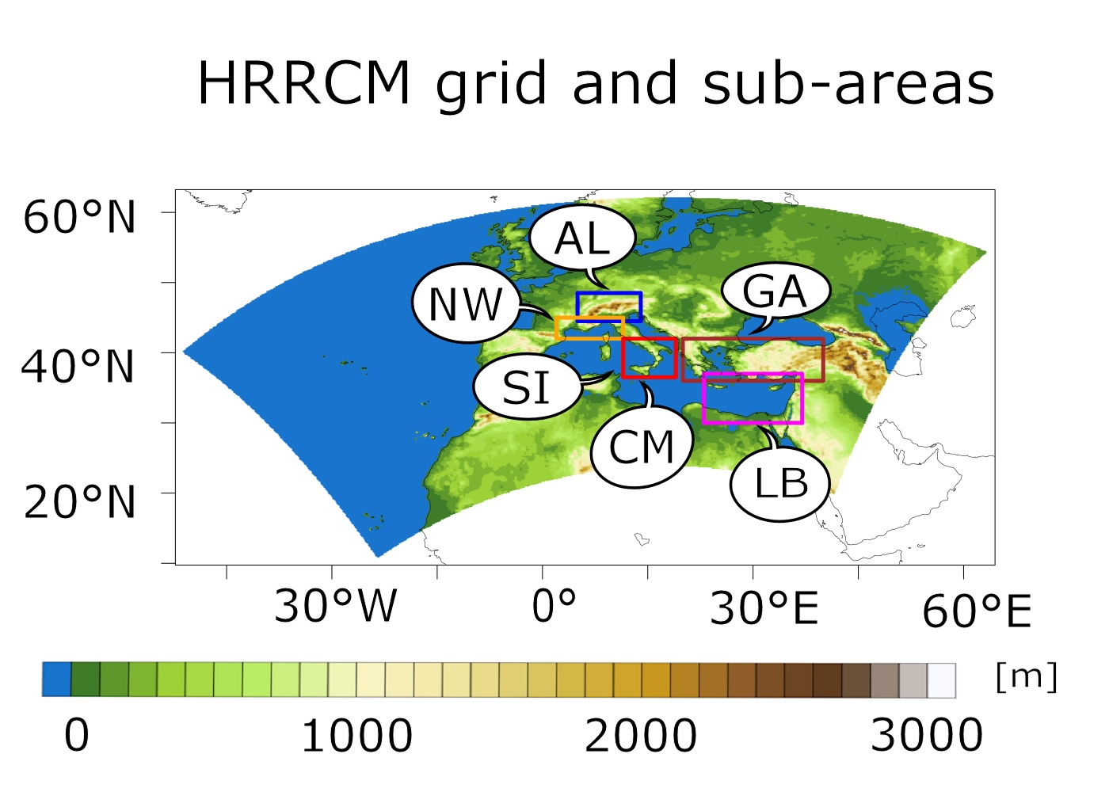
Fig.1: RCM domain with six sub-regions used for computing the precipitation probability: Alps region (AL, blue rectangle); North-West Mediterranean coast (NW, orange rectangle); South Italy and Central Mediterranean Sea (SI and CM, red rectangle); Greece and Anatolian Peninsula (GA, brown rectangle); Levantine Basin (LB, magenta rectangle).

Slide 4
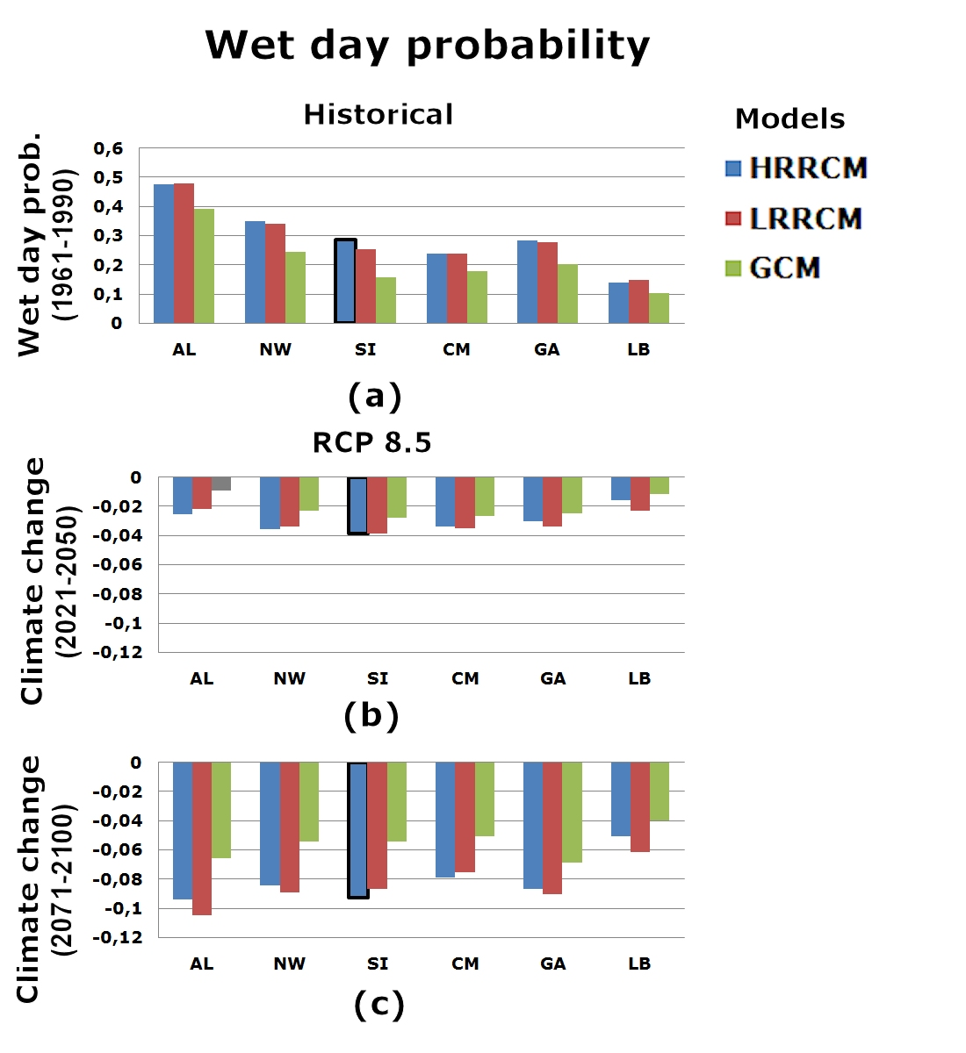
Fig.2: wet day probability value and their changes with global warming for the six boxes shown in Figure 1c and for the three simulations HRRCM (blue), LRRCM(red) , GCM (green). Panel (a) shows the probability of rainy days in the reference period (1961-1990). The panels b and c show the probability differences for the long term (2071-2100) with respect to the reference period (1961-1990) for the scenario RCP8.5. Grey bars indicate that the climate change signal is not statistically significant (Alps, panel b). Bold borders of the HRRCM bars for the South Italy box denote that its results are statistically different with respect to the LRRCM.

Slide 5
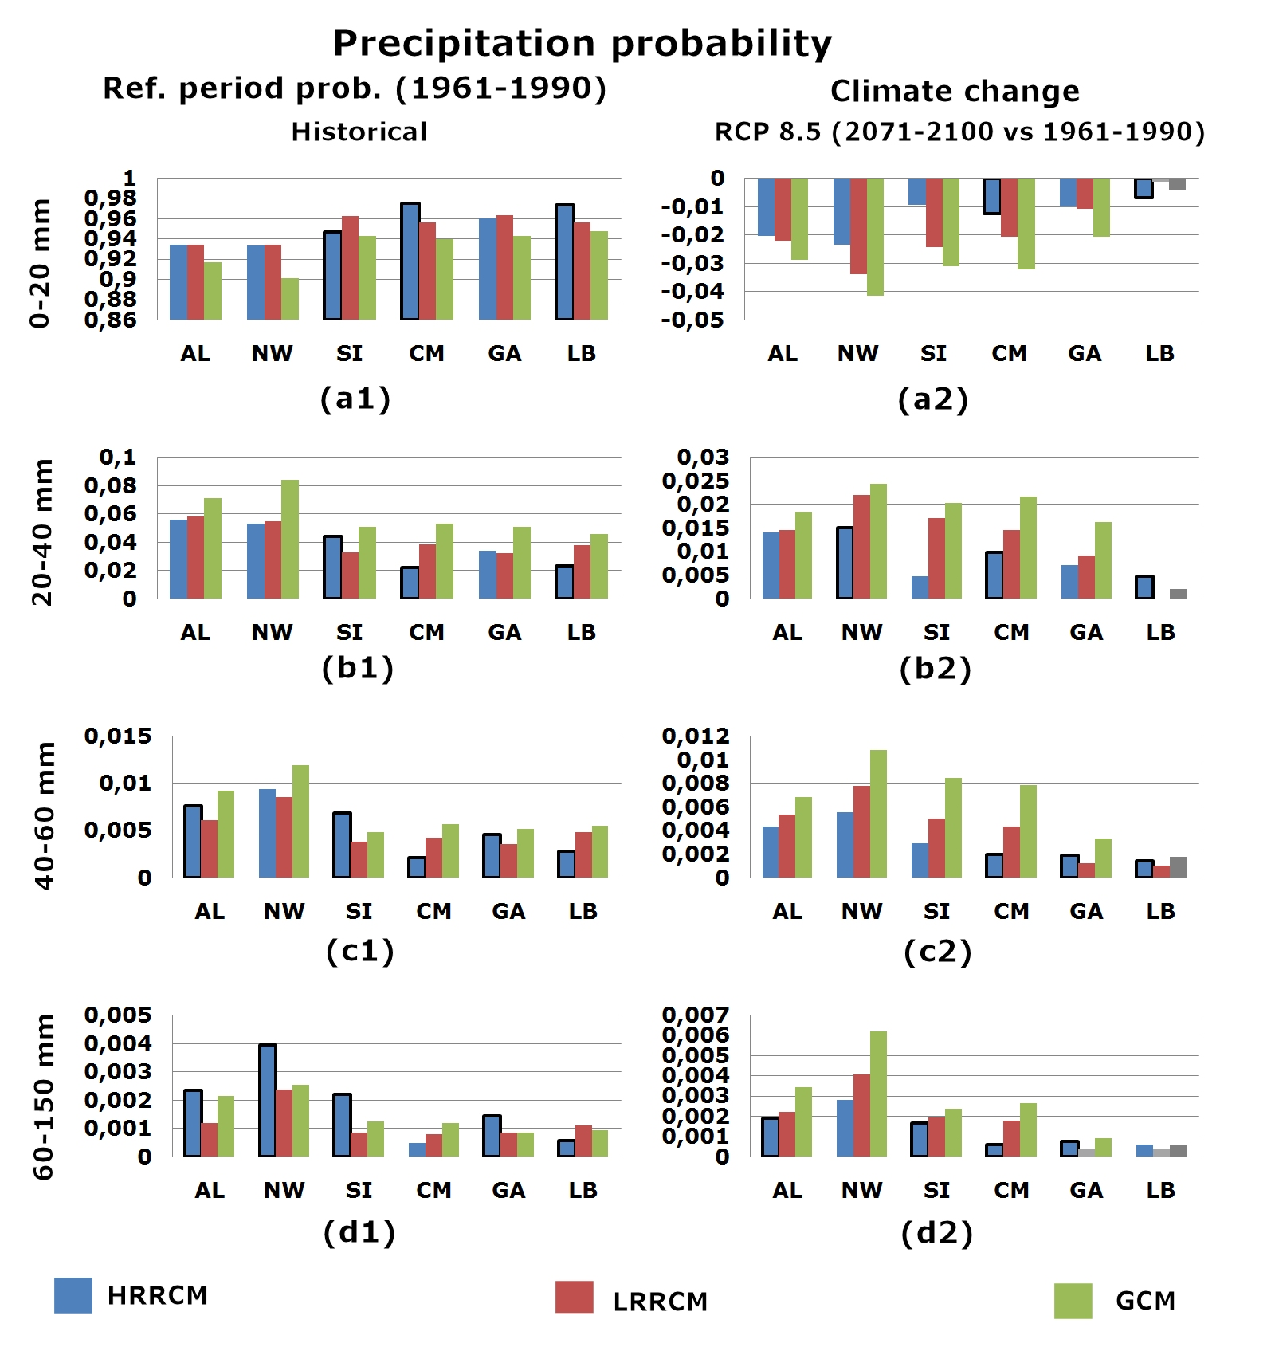
Fig.3: probability of daily precipitation as function of intensity range and its variation with climate change. Al values are computed under the condition of day being a wet day. Panels a1–d1 (first column) show a discrete Probability Density Function (PDF) of rain for the reference period (1961-1990) considering 4 ranges of intensity: weak (0-20mm), medium (20-40mm), strong (40-60mm) and intense (above 60 mm). Second column shows the PDF change for the RCP8.5 (long term 2071-2100) scenarios with respect to the reference period(1961-1990) Grey bars denote differences that are not statistically significant. A bold border of blue bars denote differences between HRRCM and LRRCM that are statistically significant. the South Italy box denote that its results are statistically different with respect to the LRRCM.

Slide 6
ACKNOWLEDGEMENT
This contribution is based on work conducted by the authors within the SOCLIMPACT project, that has received funding from the European Union’s Horizon 2020 research and innovation programme under grant agreement No 776661. The fullname of the project is "DownScaling CLImate ImPACTs and decarbonization pathways in EU islands, and enhancing socioeconomic and non-market evaluation of Climate Change for Europe, for 2050 and Beyond". The opinions expressed are those of the author(s) only and should not be considered as representative of the European Commission’s official position.
Keywords: widespread heavy rainfall, coupled numerical models, daily rainfall, climate scenarios, climatology of heavy rainfall.

