Slide 1
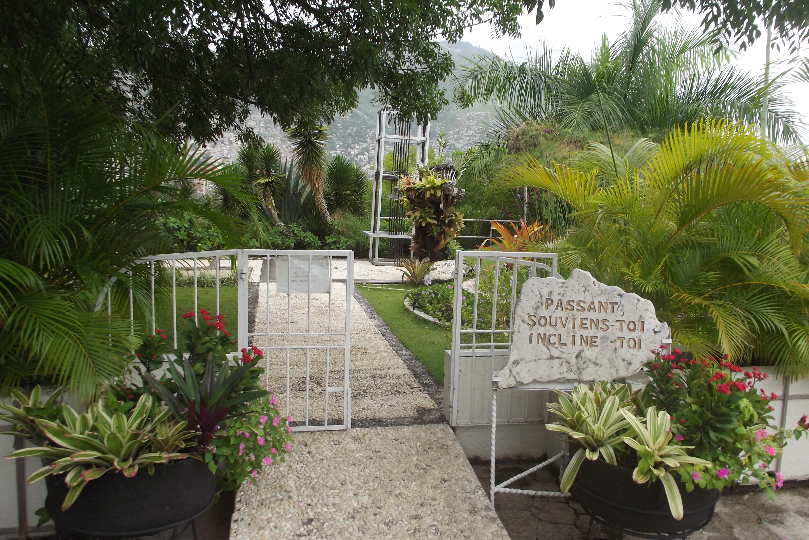

Geoscience in collaboration with religion to save lives and livelihoods in seismic risk regions: a case study from Haiti
Rev. Dr. Roger Abbott, Senior Research Associate in Natural Disasters, The Faraday Institute for Science & Religion, Cambridge, UK.

Slide 2

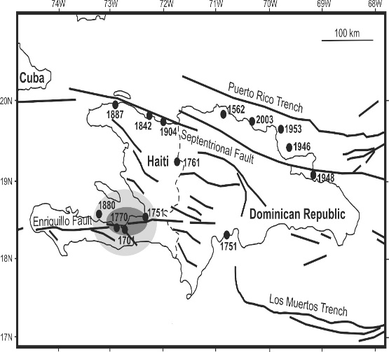
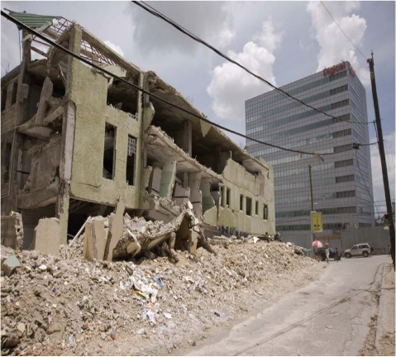
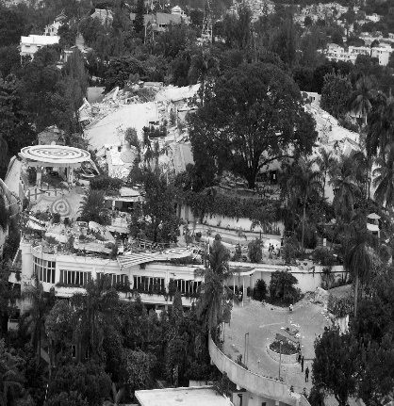
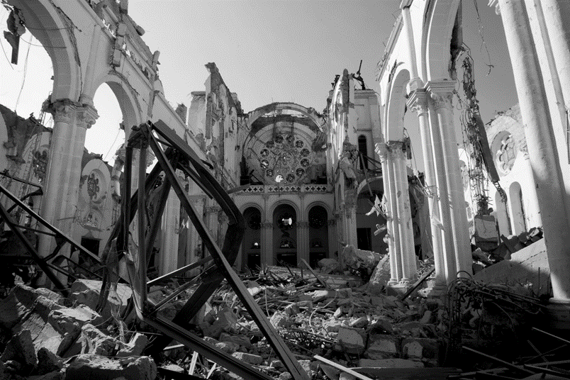

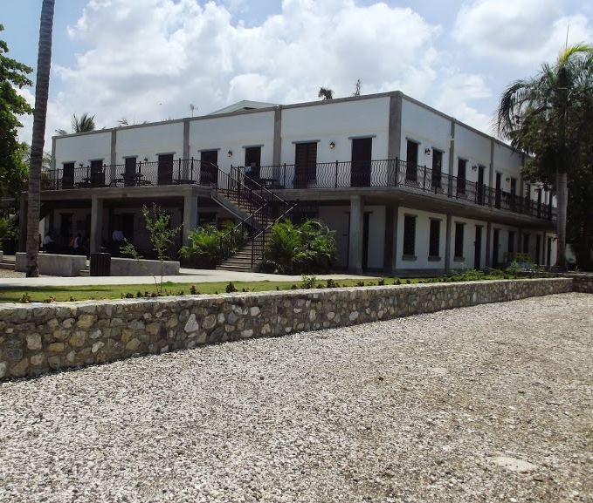
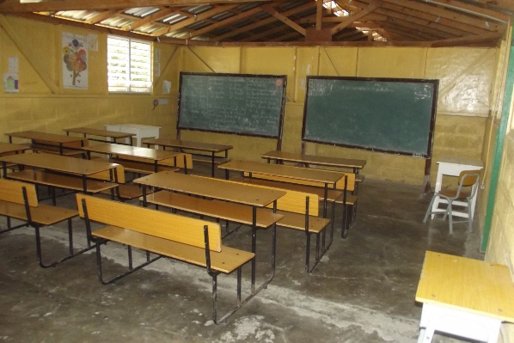
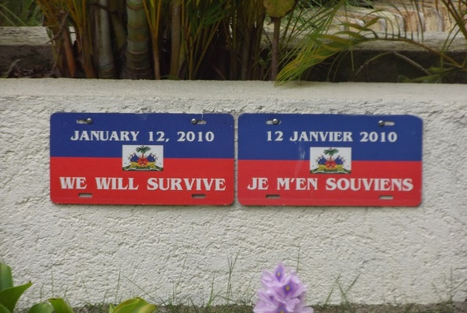
Geoscience
Religion
Culture and context.
Coping and Resilience
Interpretation and understanding.
Narratives for a therapeutic recovery from trauma
MIND THE GAP!
Percentages of Haitians indicating that the statement was ‘very true’
Such education as there was, coming mainly from the Bible and from the Church, was a significant factor in providing a degree of assurance to survivors, contributing to their resilience.
Wow! I’m sorry. I didn’t realise how important your faith was, and how helpful. Let’s work together.
Pastor Yve: “And a lot of the parents and relatives of a student, they would even sell their own clothing, and they would rather walk bare foot, so they could have money, so their kids can have an education.”
Wow! I love education. Tell me more. I respect you. Let’s work together!
Religious education, though pastorally beneficial, did little to help hazard awareness and disaster risk mitigation.
Geoscience
Education
Religion

Slide 3
“While there is a compelling need for disciplinary research within the social sciences, physical sciences, and engineering, there is a similar need for collaborative research across disciplines. Simply put, hazards and disasters pose problems that require multidisciplinary and interdisciplinary solutions. The challenges are major and the opportunities to meet them merit careful consideration.” [1]

Slide 4
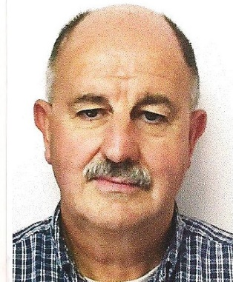
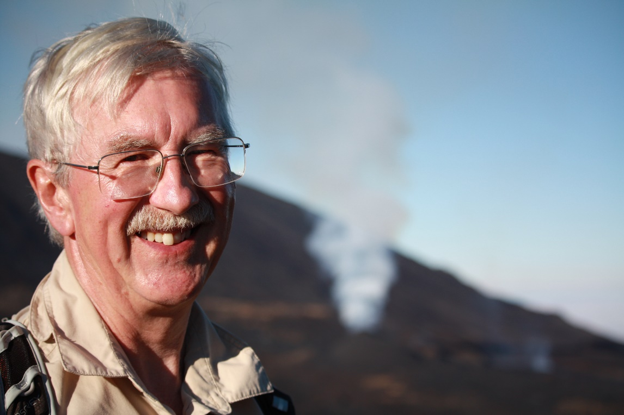
In this presentation, we argue the case for a greater focus by geoscientists upon collaborations with local religious education communities in the interests of mutual trust of information about, and acceptance of, geoscientific data and its conclusions for informing the public responses to natural hazards, in the interests of saving lives and livelihoods in vulnerable communities in Low Income Countries.
Rev. Dr. Roger Abbott: practical theologian
Prof. Robert White, FRS: geologist

Slide 5
Introduction
Studies have shown that in the region of 80% of the world’s population would self-identify as being religious.[2] Furthermore, studies also show that a great majority of this 80% is made up of people living in Low Income Countries and in areas exposed to major geo-hazards, where the majority of the world’s population also live.
Our work in Haiti is a case in point. Historic factors of economic imperialism by Haitian and foreign stakeholders have contributed to the majority population remaining trapped in poverty, with little access to education and to science in particular. Imperialist factors have also contributed to a distrust of science as something Western, an aspect of the imperialists’ agenda to subvert Haiti. Religion, on the other hand has frequently provided immense strength and resilience to the Haitian people, whether through the Christian faith or through the symbiotic religion of Vodou.[3]

Slide 6
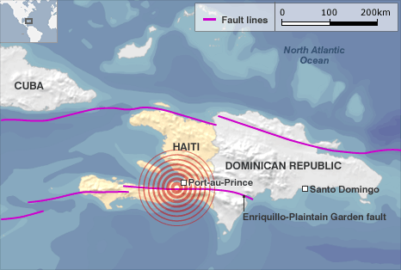
Case study: HAITI EARTHQUAKE
January 12th, 2010, 16.53 hr. 7.0 Mw
“And I’m sitting in my desk, back at Purdue, and I get the automated email, you know, from the USGS that says 7.0 southern Haiti. I look at the location on the map, I look at the depth, the magnitude, and I, and then I know instantly that it’s going to, it’s, it’s, it’s a catastrophe.” (Geologist) [4]
c.230,000 dead
300,000 injured
>1m displaced

Slide 7

“Everything, ever since I think bad about the earthquake, make me feel, you know I saw, is only time I saw most of my people, of my nation, dead in the street, like pigs! Now it's like I remember the time I went back to the town in Léogâne on January thirteen… it was like sand - people was like sand on the beach, as a lot of people dead, lot of them. So many people, squashed and broken.”
“There was this little girl who had just got in from school, and a house or business collapsed on her. And me, I almost got hit by a car while running to cross a street. And when I did cross the street, on the other side of the street I saw that houses had fallen and there were people trapped under them.”
January 12th, 2010, 16.53 hr. 7.0 Mw – survivor’s religious stories
“I did not receive any information concerning geology, but based on the bible we know that there would be disasters that will shake the earth…Our faith was not affected because we knew that this sort of event would be happening, were going to be happening.”
“We as Christians knew that this can happen, because in Matthew twenty-four it says that people will experience earthquakes and people will get into conflict one with another and suffer all kinds of trauma.”

Slide 8
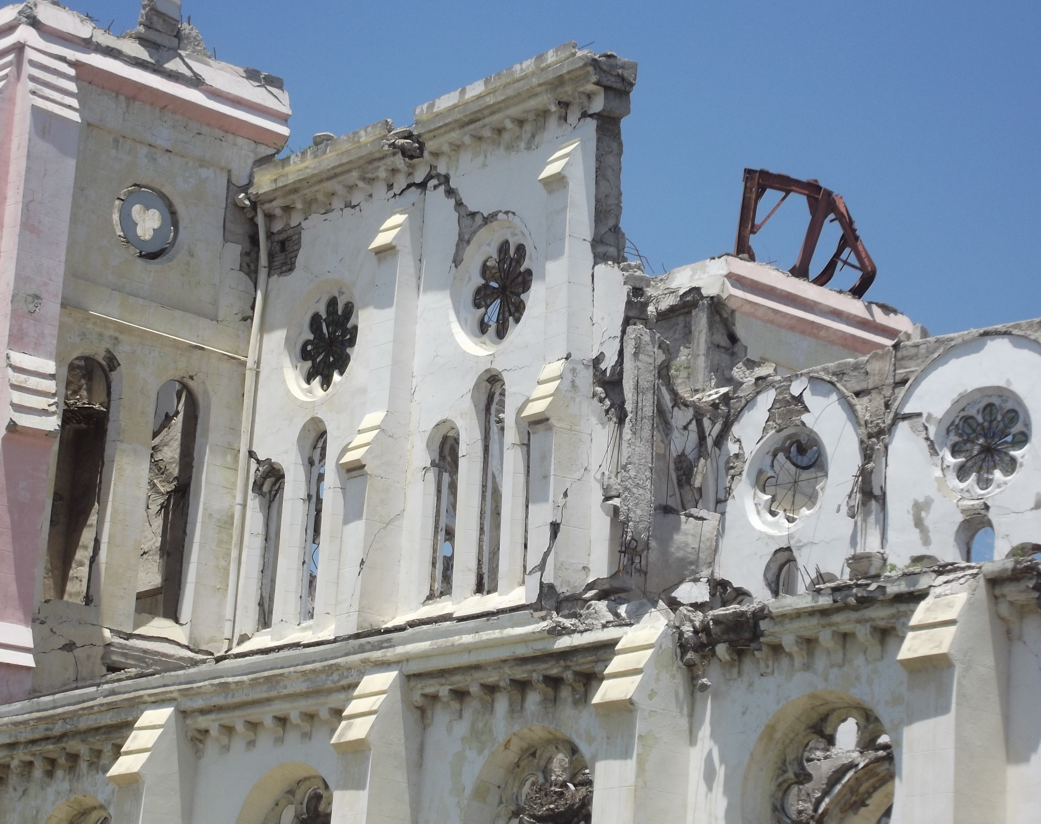
THE DIFFERENCE EDUCATION & RELIGION CAN MEAN IN HAITI
CASE STUDY: HAITI EARTHQUAKE

Slide 9
CASE STUDY: HAITI EARTHQUAKE
Haiti and the problem for state education since the earthquake
[Source of recipients and figures: Ramachandran and Walz, 2015] [6] *Excluding flash appeal
** Under flash appeal

Slide 10
CASE STUDY: HAITI EARTHQUAKE
Haiti and the problem for education
“The systemic problems regarding access to education in Haiti were exposed by the cruel fact that although the vast majority of the population were terrorised by a natural hazard, they had little or no understanding of it, or of how to mitigate its impact. This is despite there being at least two major active faults running through the country, which occasionally give due notice of their presence through earth tremors.” [7]
“The kids cannot stay in school the way they should be, because sometimes the directors will send them back home because I cannot pay the full amount; and the reason that is, [is] because if I plant a crop – we have what's call 'wind' – sometimes water and hurricane destroy part of it, and I can't get the full amount of what I invested in the crops.” (Haitian interviewee)
Haiti and the passion for education
“One of the things that gives me hope is that the youth, they love school. And a lot of the parents and relatives of a student, they would even sell their own clothing, and they would rather walk bare foot, so they could have money, so their kids can have an education.”
Our research shows that there is a real hunger for education in disaster mitigation among vulnerable communities hampered by poverty. We found that poverty-restricted access to education does not equate to poverty of interest in seismic risk or to any lack of desire to be proactive in taking mitigation measures: indeed, quite the reverse.”[8]

Slide 11
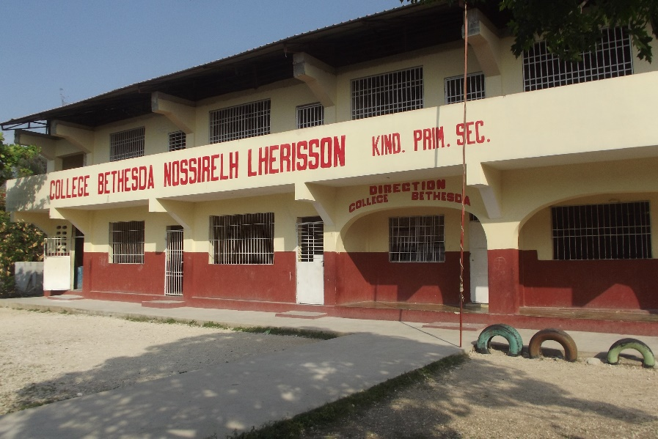
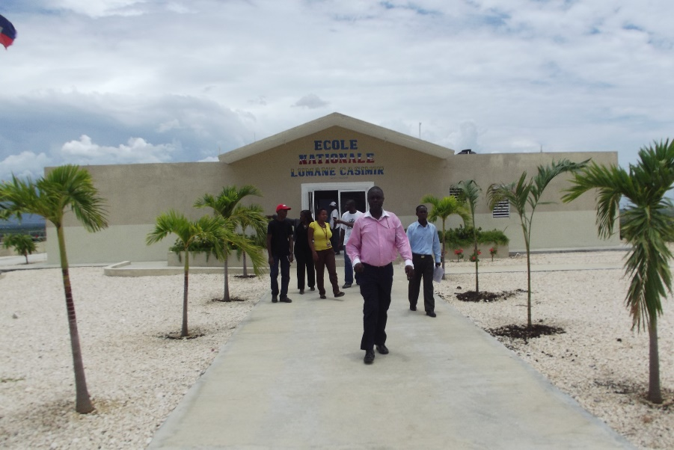

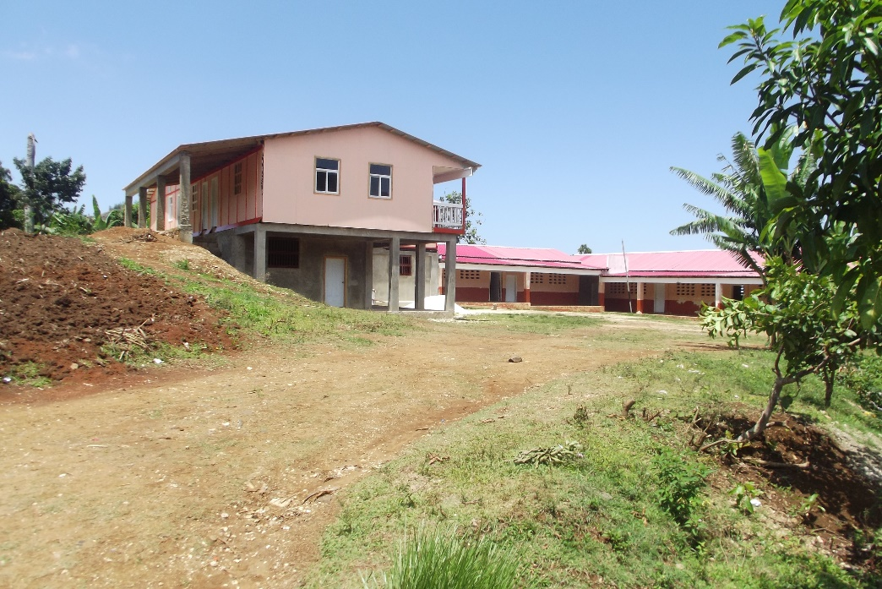
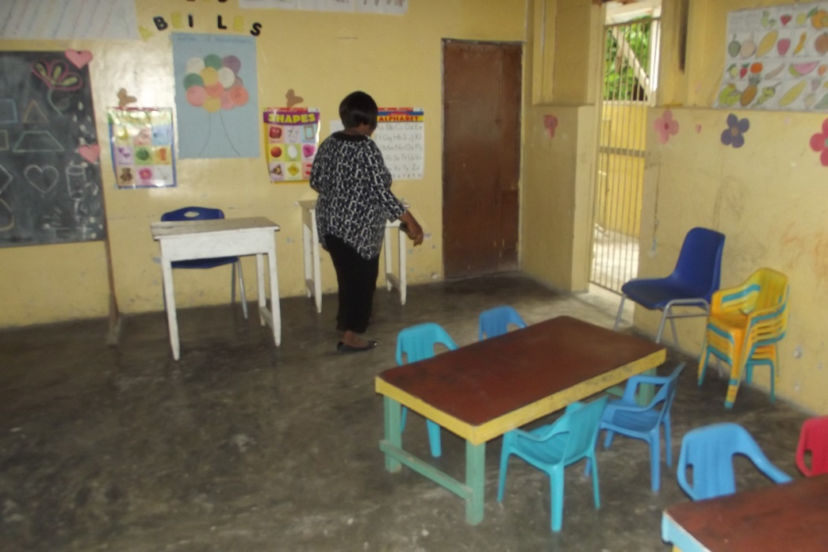
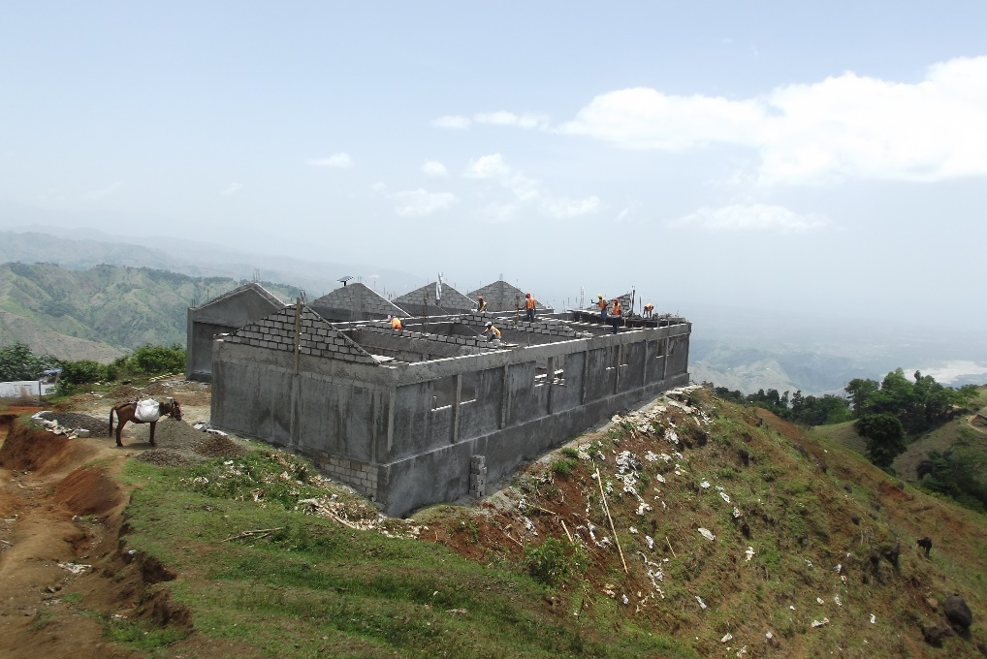
CASE STUDY: HAITI EARTHQUAKE
Haiti and the passion for education

Slide 12
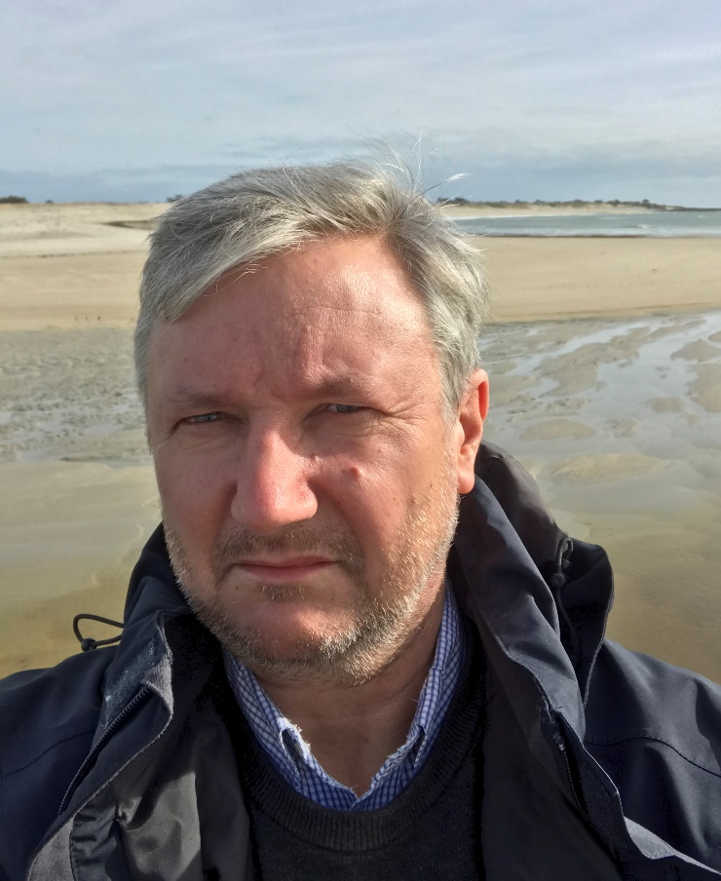
CASE STUDY: HAITI EARTHQUAKE
A Project Proposal for Seismic Education in Haiti
A problem?

Slide 13
A Project Proposal for Seismic Education in Haiti
1. Calais et al, «A socio-seismology experiment in Haiti.» [9]
Objective:
  “To test, through a participatory seismology experiment, whether public or community involvement through the production and usage of seismic information can improve earthquake awareness and, perhaps, induce grassroots protection initiatives.”
Methodology:
  Implementation of preliminary survey for evaluating public awareness of seismic risk in Haiti
  Implementation of low cost seismological stations among the public (Rasberry Shake seismometers)
  Dissemination of information through mobile social networks
Early results on interest in seismic education:
  “Despite the trauma still present, interest in the subject is noticeable among the respondents, with more than 90% answering that they are “interested in better understanding earthquakes”. This interest was also reported by the field investigators who noted that the respondents were eager to speak about earthquakes. This is confirmed by the length of the write-ups in the open questions.”

Slide 14
A Project Proposal for Seismic Education in Haiti
1. Calais et al, «A socio-seismology experiment in Haiti.» [8]
  Early results on the place of religion
    “Religious institutions appear not to be trusted very much either.”[10]
Questionnaire, “socio-sismologie” [9]

Slide 15
A Project Proposal for Seismic Education in Haiti
1. Abbott and White, «A theo-seismology experiment in Haiti.» Addressing the gap
  Based on Calais et al’s early results on the place of religion
  “This juxtaposition of faith and science also happens in places where magic or fiction can lead people to react in a way that can worsen vulnerability. For instance, during the cholera epidemic of late 2010, close to 50 vodou priests were killed by mobs on the accusation that they were using “black magic” to spread diseases. That cholera had been brought to Haiti by Nepalese UN soldiers (Frerichs et al., 2012) was suspected, but not yet demonstrated at the time.” (9)
  “Sometimes plate tectonics and an alternative explanation were answered together by the same respondent…Survey answers show, in a significant number of cases, answers that are dual: there is a scientific explanation, but also a divine one. Understanding how individuals may be able to juxtapose these two views without conflict is an interesting topic for future research. “ (9)

Slide 16
A Project Proposal for Seismic Education in Haiti
1. Abbott and White, «A theo-seismology experiment in Haiti.»
EDUCATION MODULE
Addressing the ‘conflict thesis’ in the context of Haitian culture
A theo-seismology experiment among religious educators and scholars in faith-based schools
  Development of an educational manual for teachers
  Development of a handbook for scholars
  Deployment, and informed use, of ‘Raspberry Shake’ seismometers in schools and homes
  Collection and evaluation of the impact of this module on scholars and their families
POTENTIAL OUTCOMES
Measurable rates of character formation in students and staff
Greater natural hazard awareness and understanding
Greater wisdom for living with natural hazards
Greater community (Creole: lakou, similar to ubuntu) cohesion and interest in disaster awareness
and hazard risk reduction
Many lives and livelihoods saved and skills developed
Enhanced benefits from collaborative working in Low Income Countries

Slide 17
A Project Proposal for Seismic Education in Haiti
1. Abbott and White, «A theo-seismology experiment in Haiti.»
EDUCATION MODULE
A complimentarity model for science and religion
Available from
https://www.faraday-institute.org/Papers.php

Slide 18
The Complementarity/ Integration Model
Two areas of knowledge
One reality
e.g. understanding the nature of the human individual
    cell biology,
    physiology,
    psychology,
    anthropology,
    ecology…
A larger reality
RELIGION
SCIENCE

Slide 19
The Complementarity Model
Both accounts do justice to the phenomenon
Both accounts take the other seriously
Both accounts are necessary to do justice to all the data
This approach helps us become integrated individuals
The complementarity model
Subverts Fusion models which blur the boundaries between discrete areas of knowledge
Subverts the Conflict model – not rivals but necessary explanations
Subverts the NOMA* model – because both explanations are necessary
* None-Overlapping Magisteria – Stephen Jay Gould

Slide 20
References
1. See National Research Council (2006). Facing Hazards and Disasters: Understanding Human Dimensions. Washington, DC: The National Academies Press: 26-34 (33).
2. Source: “Global Religious Landscape,” A Report on the Size and Distribution of the World’s Major Religious Groups as of 2010. Pew Templeton Religious Futures, 2012. Online: https://assets.pewresearch.org/wp content/uploads/sites/11/2014/01/globalreligion-full.pdf Accessed: 19/11/2019. See also R. Stark, (1999), “Secularization: RIP,” Sociology of Religion 60:249–73.
3. Roger P. Abbott and Robert S. White,(2019), Narratives of Faith from the Haitian Earthquake: Religion, Natural Hazards, and Disaster Response, (New York: Routledge).
4. Professor Eric Calais (Geologist).Interview at Ecole normale supérieure, Paris, 2015 . Calais has been working on seismology in Haiti since 1984.
5. Neil Smith, “There’s no such thing as a natural disaster”, June 11, 2006. Online: understandingkatrina.ssrc org/Smith/
6. Vijaya Ramachandran and Julie Walz, “Where Has All the Money Gone?“ Journal of Haitian Studies, 1(1) Spring 2015):33
7. Abbott and White, Narratives,
8. Abbott and White, Narratives,
9. Eric Calais, Dominique Boisson, Steeve Symithe, Claude Prépetit, Betonus Pierre, Sophia Ulyse, Laennec Hurbon, Alain Gilles, Jean-Marie Théodat, Tony Monfret, Anne Deschamps, Françoise Courboulex, Jérome Cheze, Fabrice Peix, Etienne Bertrand, Jean Paul Ampuero, Bertrand Mercier de Lépinay, Julien Balestra, Jean-Luc Berenguer, Remy Bossu, Laura Fallou, Valérie Clouard. “A socio-seismology experiment in Haiti.” Citizen Science, Submitted March 2020.
10. Eric Calais, Questionnaire, “socio-sismologie” (With permission).

