Slide 1
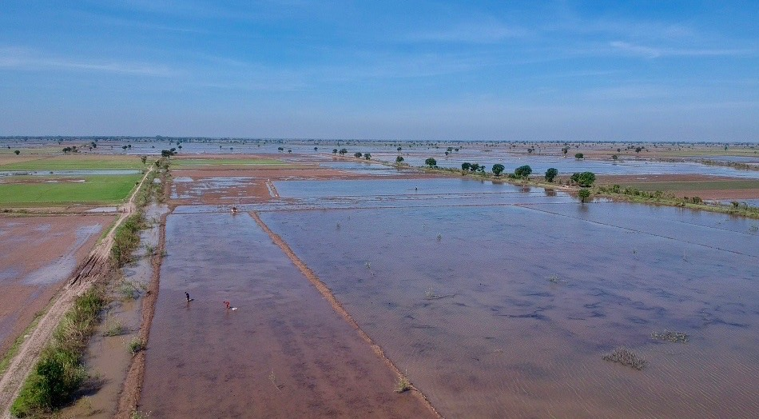
Multi-Use Water Systems of the Cambodian Mekong Delta
C. Orieschnig, G. Belaud, J.P. Venot, S. Massuel
Assessing changes in ecosystem services for rural communities under wide-ranging rehabilitation plans.

Slide 2
Overview
Context – Deltas, Ecohydrology, and the Factors of Change
Preks – Shaping the Cambodian Mekong Delta
Assessing Prek Ecosystem Services, Changes and Challenges
Methodology and Limitations
Preliminary Results
Discussion
Outlook

Slide 3
Context Deltas, Ecohydrology and the Factors of Change

Slide 4
Context
Deltas: home to 7% of the world population, only make up 1% of the earth’s surface (Ericson et al. 2006)
Generally fertile, biodiverse, and agriculturally productive
Under pressure from a multitude of stressors (Kondolf et al. 2017)
Hydropower dams (Hecht et al. 2019) => changed hydrological regime, sediment retention
Land use changes
Rising sea levels => salinity intrusion
Sediment mining
Land subsidence
Changing temperature and precipitation patterns due to global warming
Mekong Delta:
Delta of the Mekong, Southeast Asia’s largest river
Starts at Phnom Penh, and fans out over southern Cambodia and Vietnam
Home to 18 Million people (Nguyen et al. 2018), but agricultural products and fisheries feed 200 million (Minderhoud et al. 2017), and are a major export factor
Fertility depends on annual monsoon inundations: wet season from June until October, dry season from November until May
Inundations deposit nutrient-laden sediments, recharge water storage for wet season
Cambodian Mekong Delta: home to unique canal infrastructure – Preks

Slide 5
Preks Shaping the Cambodian Mekong Delta

Slide 6
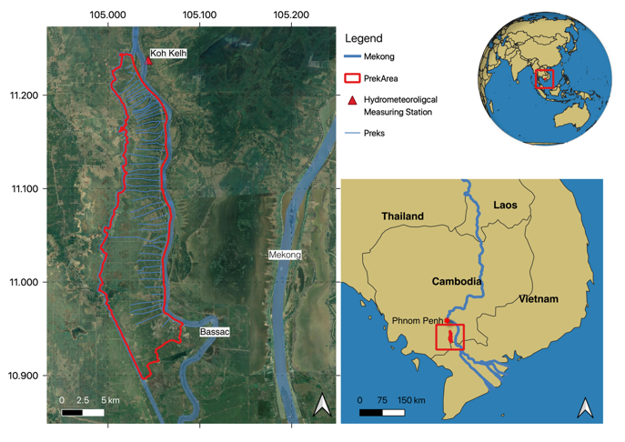
Where are we?
The Mekong Delta begins at the Cambodian capital city, Phnom Penh, where the Tonle Sap river flows into the Mekong, and a few km further, the Bassac river debranches from the main stream.
The banks of the Mekong and the Bassac are lined with Preks.
The study area is located on the right bank of the Bassac, in Kandal Province, ca. 70 km south of the capital city, Phnom Penh.
The study area begins where a side branch, the Prek Ambel, debranches from the Bassac, and eventually flows into the Takeo river, which has been turned into a canal in Vietnam
© Google

Slide 7
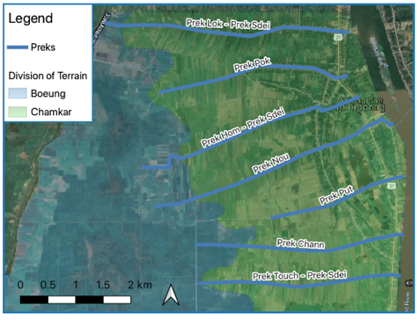
Preks – What are they anyways?
Trapezoidal channels
Diverge perpendicularly from the mainstream
Connect the river to the lowland areas (=‘Boeungs’), via a breach in the river banks (elevated due to sedimentation)
Major vectors of flooding and drainage
Originally constructed during the French colonial period (1863-1953) to raise land through sedimentation
Actually more accurate to talk of Prek System consisting of:
Chamkars: ‘highlands’, rarely flooded, created through sedimentation
Boeungs: ‘lowlands’, frequently flooded, rice cultivation
Prek channels
© Google

Slide 8
Preks – What are they anyways?
Lowlands = Boeungs
Prek
© C. Orieschnig

Slide 9
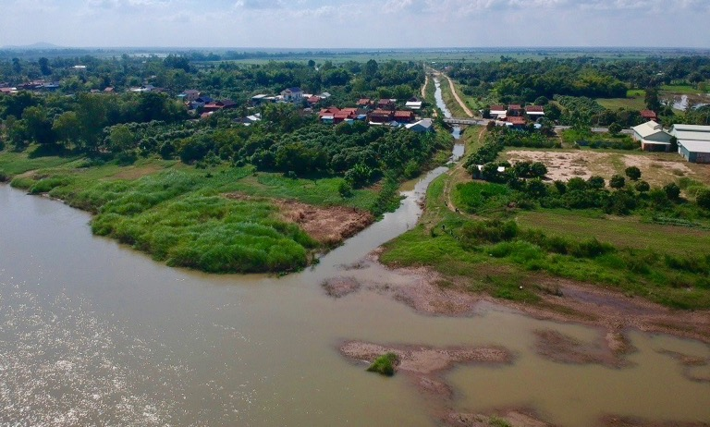
Preks – What are they anyways?
Lowlands = Boeungs
Highlands
= Chamkar
Prek
Bassac mainstream
© C. Orieschnig

Slide 10
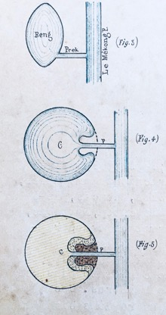
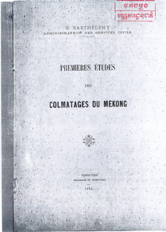
Preks – What are they anyways?
Hand-drawn figures explaining the functioning of the Preks, from a 1912 report by colonial French engineer Lt. Barthélemy.
Removal of embankment material to build Prek and connect the mainstream to the lowlands
Sediment deposition in the Boeungs
Reproduced with Permission from the National Archives of Cambodia

Slide 11
Assessing Prek Ecosystem Services, Changes and Challenges

Slide 12
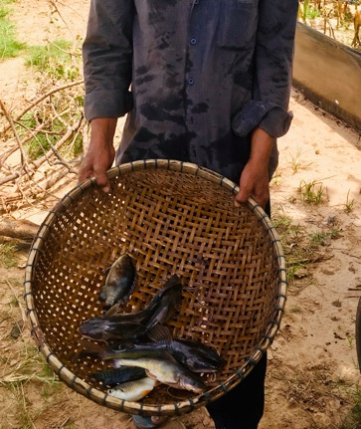
Preks and Ecosystem Services
Provisioning
Water for irrigation => agricultural production
Fishery
Natural vegetation (food, fuel, fodder …)
Water for household purposes
Regulating
Flooding/drainage
Sediment and nutrient deposition
Cultural
© C. Orieschnig

Slide 13
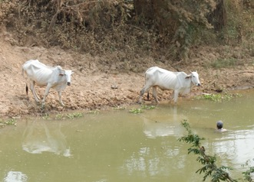
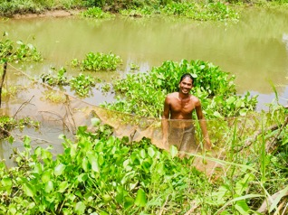
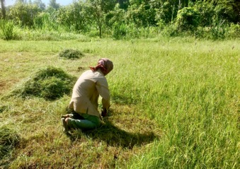
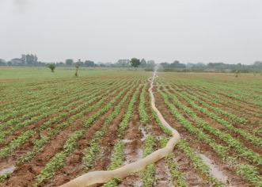
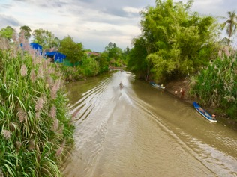
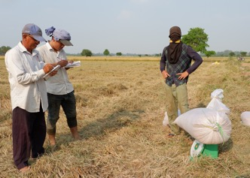
Preks and Ecosystem Services
© C. Orieschnig

Slide 14
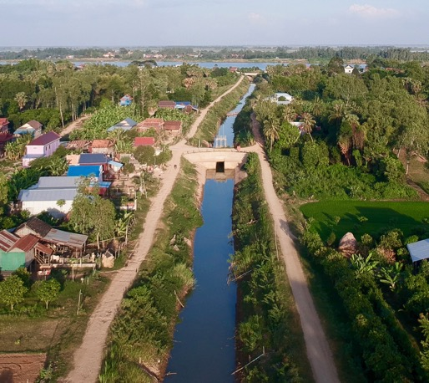
The Rehabilitation of the Preks
Many Preks affected by sedimentation and erosion – can no longer fulfil their function
Since the 1990s: international development agencies invest in the rehabilitation of Preks
Rehabilitation:
Deepening Preks
Re-establishing trapezoidal profile
Enlarging profile
Removing vegetation
In some cases, constructing gates
Establishment of Prek User Communities (PUCs to manage Preks)
Problems: bank collapses, gate operation
© C. Orieschnig

Slide 15
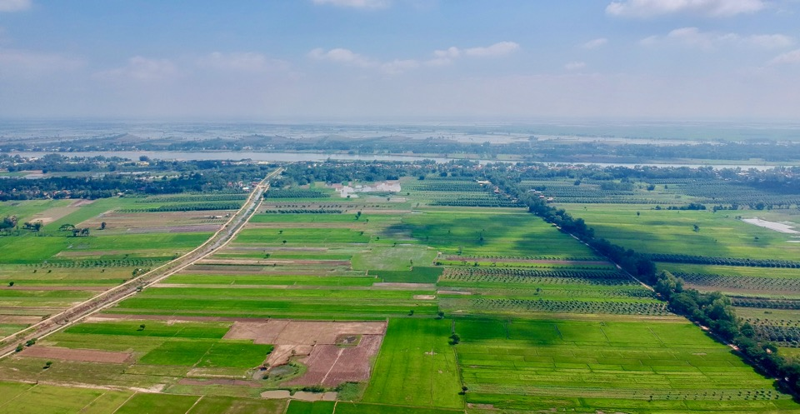
The Rehabilitation of the Preks
Bassac
Rehabilitated Prek
Unrehabilitated Prek
© C. Orieschnig

Slide 16
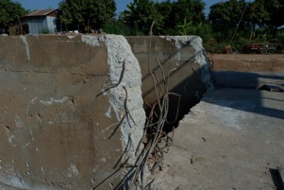
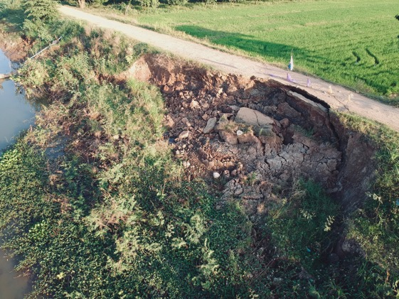
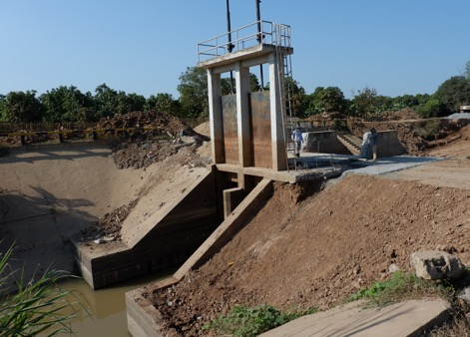
The Rehabilitation of the Preks: Problems
© C. Orieschnig

Slide 17
Research Questions and Objectives

Slide 18
Research Questions
What is the influence of Prek rehabilitation on ecohydrology?
What are the shifts in water availability subsequent to rehabilitation?
What are the impacts of rehabilitation on vegetation patterns (crops + natural vegetation)?
How are the ecosystem services provided by the Prek system changed by rehabilitation?

Slide 19
Research Objectives
Understanding the overall impact of rehabilitation on the ecohydrology of the Prek system, and the ecosystem services provided
Identifying problems of rehabilitation in this regard, and finding solutions to improve future projects

Slide 20
Methods

Slide 21
Methods
GPS-points set in-situ for calibration and validation
Remote sensing analysis
Interviews with farmers, village chiefs, PUC chiefs etc. on-site
Understanding shifts in inundation extents
Analysing changes in cropping patterns and NDVI
Understanding local farming and water management practises
Analysing attitudes to rehabilitation
Quantifying ecosystem services and water flows
input
Eco-hydrological model in OpenFLUID
Water level and rainfall data measured in-situ for calibration and validation
Detailed analyses of flows and ES
Simulations of future scenarios

Slide 22
Methods – Remote Sensing Analysis
Using Sentinel 1 and 2 imagery
10 m spatial resolution
5 day return period
Sentinel 1 for flood mapping
Sentinel 2 for NDVI calculation and land cover classification
Calculation of :
Inundation extents in two and three classes (2 classes: flooded – dry I 3 classes: flooded – flooded vegetation – dry)
Mean Normalized Difference Vegetation Index (NDVI)
Land cover classes (urban – water – fallow – rice – fruit trees – vegetables)
Over:
Chamkar areas of rehabilitated and not rehabilitated Prek systems
Focus on Chamkar areas because they depend directly on one Prek, whereas the Boeung areas are connected to several Preks and canals, which makes differences caused by the rehabilitation of singe Preks more difficult to observe
During:
15.04.2016-14.04.2017 and 15.04.2018-14.04.2019
Because Mid-April as a starting point because it represents the height of the dry season, has the lowest water levels, ‘reset’ point of the inundation cycle

Slide 23
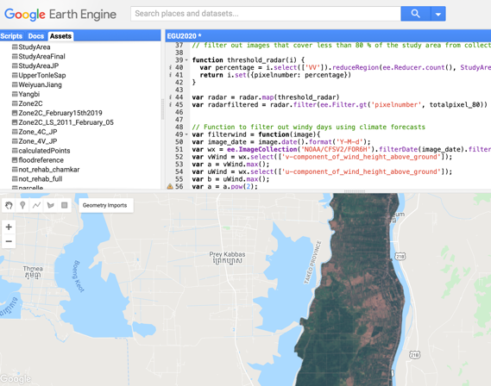
Methods – Remote Sensing Analysis
Conducted on cloud computing platform Google Earth Engine (GEE, Gorelick et al. 2017)
No image download necessary
Flexible modification of time period and area of interest
© Google Earth Engine

Slide 24
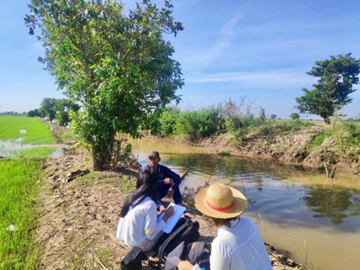
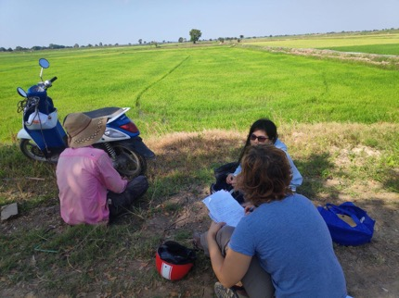
Methods – Interviews
Semi-structured, questionnaire-based interviews conducted in February and March 2020
Focussed on agricultural practices, ecosystem services and agro-economics
Average interview duration of two hours
© C. Orieschnig
© C. Orieschnig

Slide 25
Preliminary Results

Slide 26
Preliminary Results – General Observations
Rehabilitation generally entails (temporary) removal of accompanying vegetation of Prek
apparent in remote sensing analysis through better detection of water pixels in Prek channels
loss of ES provided by this vegetation (use of vegetation for food, fuel, fish traps etc.)
Please note: results are truly preliminary since field data collection was interrupted by COVID-19, restricted number of interviews, and calibration/validation points for remote sensing analysis

Slide 27
Preliminary Results – Interviews
Prek rehabilitation generally seen in a positive light, despite problems with bank collapses
Future water supply security during dry season primary concern
Water quality increases also noted by local residents – use of Prek water for non-dietary household needs now possible
Some farmers at rehabilitated Preks have implemented an additional rice crop, as well as vegetable crops post-rehabilitation
One interviewee noted that agricultural productivity along rehabilitated Preks has noticeably improved, and that populations of both fish and water snails have flourished since the completion of rehabilitation
Operation of gate seen as a major concern, especially by village chiefs – erosion damage at some gates, operation now to balance minimized water flow velocities with agricultural concerns (protection of crops at the beginning of the wet season)
Loss of natural vegetation along Preks not mentioned as a detrimental effect by interviewees, despite frequent use of it for food, fuel, construction material, and the building of fish traps. Natural vegetation growth on Chamkars and Boeungs enhanced by increased water availability – but negative interaction with increased pesticide use due to agricultural intensification following rehabilitation.

Slide 28
Preliminary Results – Remote Sensing
T-test chart of flooded vegetation extent on Chamkars by rehabilitation April 2019
Significant differences between Chamkar areas at rehabilitated vs. not rehabilitated Preks in 2018-19
Especially during peak dry season months: March and April
flooded vegetation (closely corresponding to irrigated area) is significantly** higher at rehabilitated Preks
significantly** more land is lying fallow at not rehabilitated Preks during this time
trend seems to be towards more cultivation of vegetables during these months at rehabilitated Preks
% of Chamkar area
T-test chart of vegetable cultivation extent on Chamkars by rehabilitation April 2019
18,4 ± 5,7
23,9 ± 7,3
0
05,00
10,00
15,00
20,00
25,00
30,00
35,00
40,00
45,00
% of Chamkar area

Slide 29
Preliminary Results – Remote sensing
Sentinel- based and cover and inundation maps for dry season 2019

Slide 30
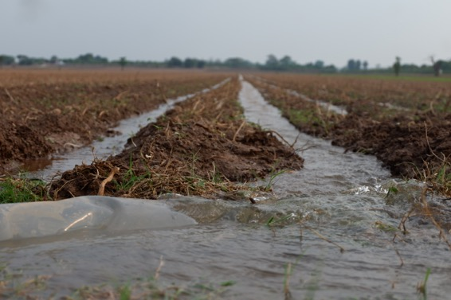
Preliminary Results
Dry unrehabilitated Prek, and irrigation using Prek water at rehabilitated Prek, early March 2020
© C. Orieschnig
© C. Orieschnig

Slide 31
Discussion and Outlook

Slide 32
Discussion
Preliminary interview results evidence positive perception of rehabilitation projects, despite side effects. Water availability as primary concern.
Preliminary remote sensing results indicate ameliorated water availability and higher agricultural productivity, especially in March and April, at rehabilitated Preks
Natural vegetation could not be captured separately using RS analysis (ground points necessary)
But:
Lag time in adjustment of crops to changed water availability
Agro-economical factors at play, including widespread switch to fruit trees (especially mango) 3-10 years ago, often due to higher rentability and lower water needs
Decisions to cultivate certain crops also based on factors such as market price, availability of equipment etc.
Variations of large-scale hydrological conditions (drought in 2019)

Slide 33
Outlook
Multi-factor analysis necessary that also takes into account:
economic framework conditions
large-scale hydrological conditions in the period before / after rehabilitation (e.g. flood delay in 2019/20 wet season)
Integration of results of remote sensing analysis with:
results of interviews (fieldwork interrupted by COVID-19)
Combination of results of interviews and remote sensing analysis into holistic, distributed model in OpenFLUID
Use of remote sensing analysis for zonation of modelling units, cross-validation data for distributed modelling
assessment of decision structures, and estimation of flow magnitudes from interview results

Slide 34
References
Barthélemy, R. 1912. Premières études sur les colmatages du Mékong. Phnom Penh.
Ericson, J.P., Vörösmarty, C.J., Dingman, S.L., Ward, L.G. and Meybeck, M., 2006. Effective sea-level rise and deltas: causes of change and human dimension implications. Global and Planetary Change, 50(1-2), pp.63-82.
Gorelick, N., Hancher, M., Dixon, M., Ilyushchenko, S., Thau, D. and Moore, R., 2017. Google Earth Engine: Planetary-scale geospatial analysis for everyone. Remote sensing of Environment, 202, pp.18-27.
Hecht, J.S., Lacombe, G., Arias, M.E., Dang, T.D. and Piman, T., 2019. Hydropower dams of the Mekong River basin: A review of their hydrological impacts. Journal of hydrology, 568, pp.285-300.
Kondolf, G., Schmitt, R., Carling, P.A., Darby, S.E., Arias, M.E., Bizzi, S., Castelletti, A., Cochrane, T.A., Gibson, S., Kummu, M. and Rubin, Z., 2017. Losing ground in mega-deltas: basin-scale response to existential threats to the Mekong Delta. In American Geophysical Union 2017.
Nguyen, T.L.C., Phan, D. and Kyncl, M., 2018. Water supply status in rural areas of the Mekong delta and development measures.
Minderhoud, P.S.J., Erkens, G., Pham, V.H., Bui, V.T., Erban, L., Kooi, H. and Stouthamer, E., 2017. Impacts of 25 years of groundwater extraction on subsidence in the Mekong delta, Vietnam. Environmental Research Letters, 12(6), p.064006.

