Slide 1
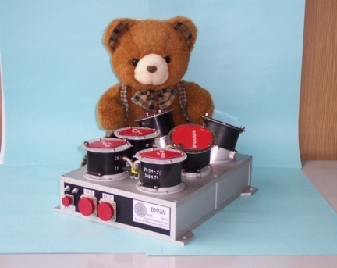
(Non)radial propagation of the solar wind flow
Zdeněk Němeček, Tereza Ďurovcová, Jana Šafránková
Charles University, Faculty of Mathematics and Physics, Prague, Czech Republic
John D. Richardson
Kavli Center for Astrophysics and Space Science, MIT, Cambridge, USA
Jiří Šimůnek
Institute of Atmospheric Physics, Czech Academy of Sciences, Prague, Czech Republic
Michael L. Stevens
Smithsonian Astrophysical Observatory, Cambridge, USA
EGU General Assembly, May 2020
Moscow, February 16–20, 2015

Slide 2
Motivation
The reviewer’s question on the submitted article on foreshock velocity variations: “the authors should explain why the peaks of Vy is centered around +20 km/s instead of +30 km/s expected from the Earth's orbital motion”
The solar wind non-radial velocity components observed beyond the Alfven point are usually attributed to waves, the interaction of different streams, or other transient phenomena and thus the mean value would be zero.
However, Earth-orbiting spacecraft as well as monitors at L1 indicate systematic deviations of the wind velocity from the radial direction.
Since these deviations are of the order of several degrees, the calibration of the instruments is often under question.
This paper investigates for the first time the evolution of non-radial components of the solar wind flow along the path from 0.17 to 10 AU.

Slide 3
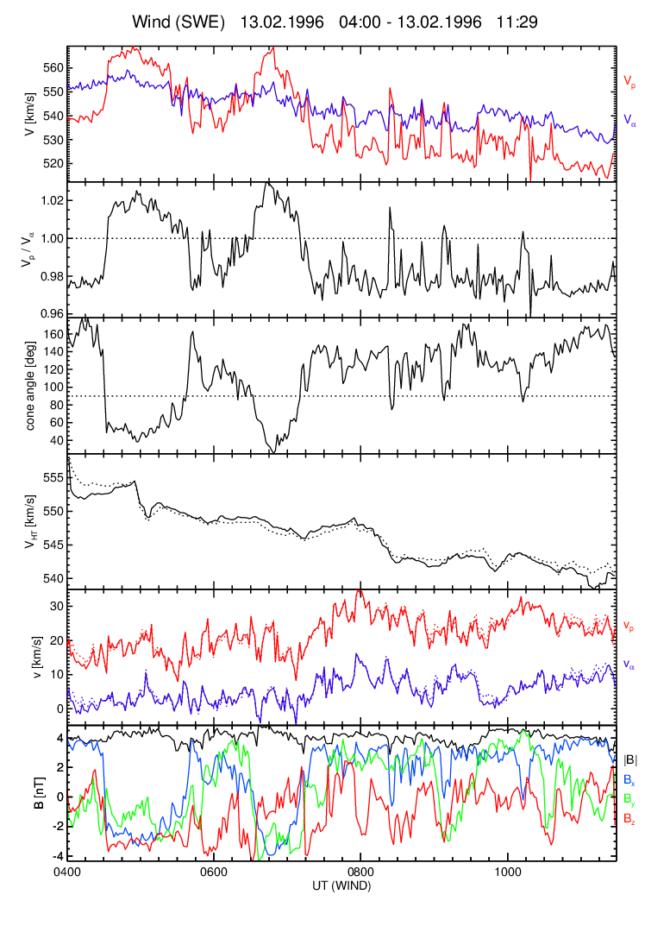
What is the solar wind speed?
Motion of the solar wind is influenced by waves that produce large velocity components perpendicular to the ambient magnetic field that would be mostly radial close to Sun
The solar wind consists of several weakly interacting ion populations (proton core and beam, alpha particle core and beam, and heavier ions) that move with their own velocities
Nemecek et al. (2020) proposed the velocity of minimum motional electric field frame (de Hoffmann-Teller frame, V_{HT}) because:
this velocity is identical for all ion species,
the velocity of alpha particles can serve as a good approximation of V_{HT}
it is closely related to the wave frame.
V_{alpha}
V_{proton}
VHT from protons
VHT from alphas
The figure demonstrates above points (1, 2, 3). In spite of large Alfvenic fluctuations of proton speed, V_{HT} computed from protons changes smoothly, it is not affected by waves, and it is identical for protons and alphas.
Nemecek et al. (ApJ, 2020)

Slide 4
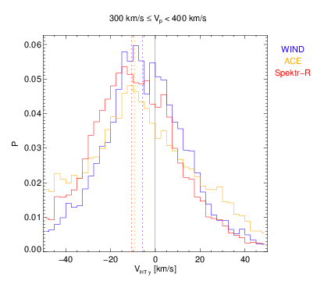
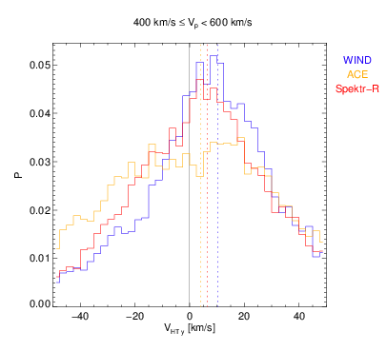
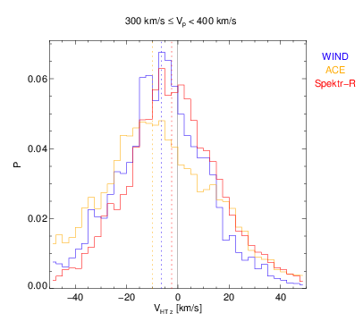
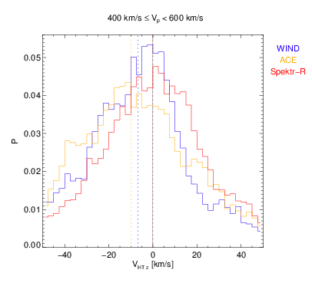
Multi-spacecraft observations at 1 AU
GSE coordinates are used
Limited statistics of observations of three spacecraft and three different instruments shows relatively good correspondence of V_{HT}y
Calibration issues can be excluded
Average V_{HT}y changes its sign – it is negative in slow and positive in fast wind.
V_{HT}z is always small and negative
V_{HT}y – Slow wind
V_{HT}y– Fast wind
V_{HT}z– Slow wind
V_{HT}z– Fast wind

Slide 5
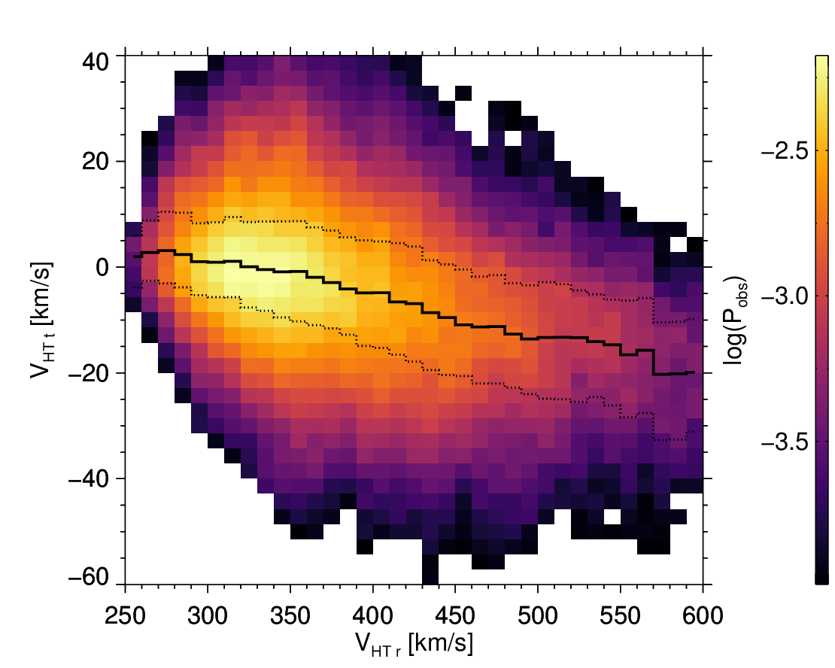
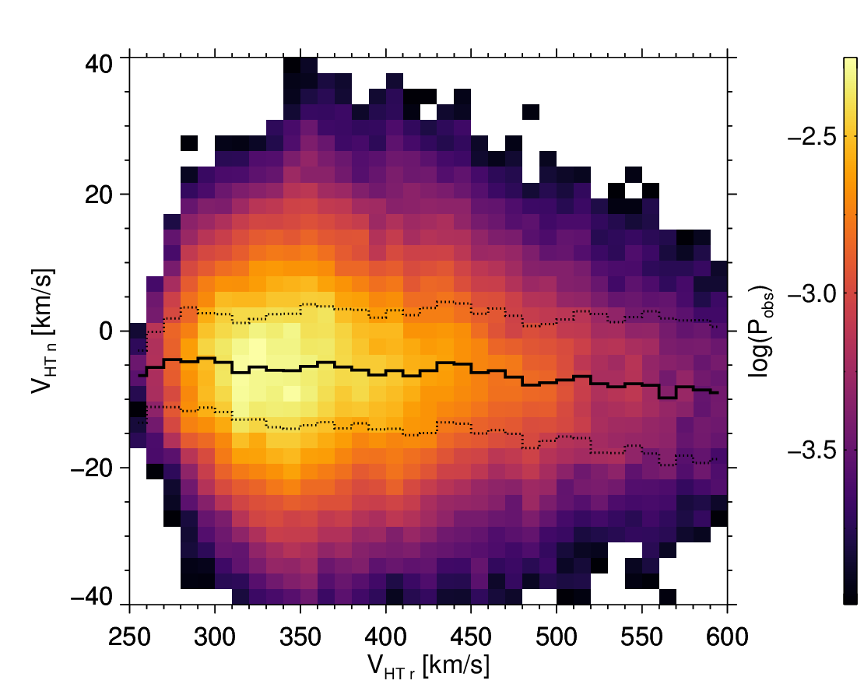
Comprehensive analysis at 1 AU
20 years of Wind data
RTN coordinates for a further comparison through the heliosphere
r_{RTN} ~ -x_{GSE}, t_{RTN}~-y_{GSE}, nRTN~z_{GSE}
V_{HT}t decreases with the speed
V_{HT}n is small and negative and does not depend on the speed

Slide 6
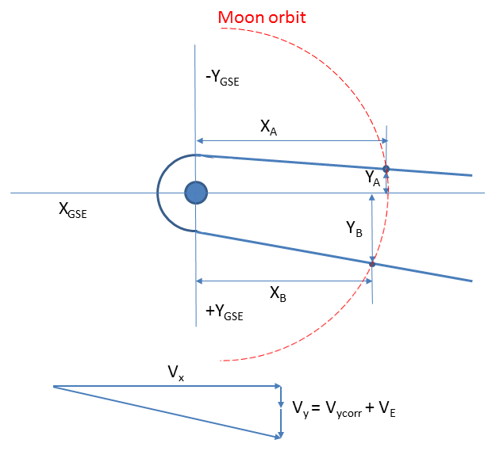
Independent confirmation at 1 AU
The magnetopause tail is aligned with the solar wind speed
9 years of ARTEMIS magnetopause crossings at the Moon orbit
If the Earth’s orbital velocity is substracted (Vy_corr) the slow wind has Vy component close to zero whereas it is as large as 17 km/s in the fast wind
It is fully consistent with the direct analysis of the Wind velocity
This analysis completely excludes any calibration issues!!
 | Flank | X (Q1/Q3) [Re] | Y (Q1/Q3) [Re] | V_{x} (Q1/Q3) [km/s] | V_{y} [km/s] | V_{y_corr}
Slow wind | A | -55.52 (58/53) | -21.86 (24/18) | -350.9 (380/322) | 28.85 | -0.93
 | B | -53.27 (56/50) | 28.82 (25/32) | -349.4 (370/331)
Fast wind | A | -57.21 (62/52) | -22.54 (25/18) | -583.8 (643/531) | 47.91 | 17.73
 | B | -51.8 (55/48) | 31.51 (28/34) | -575.0 (637/538)

Slide 7
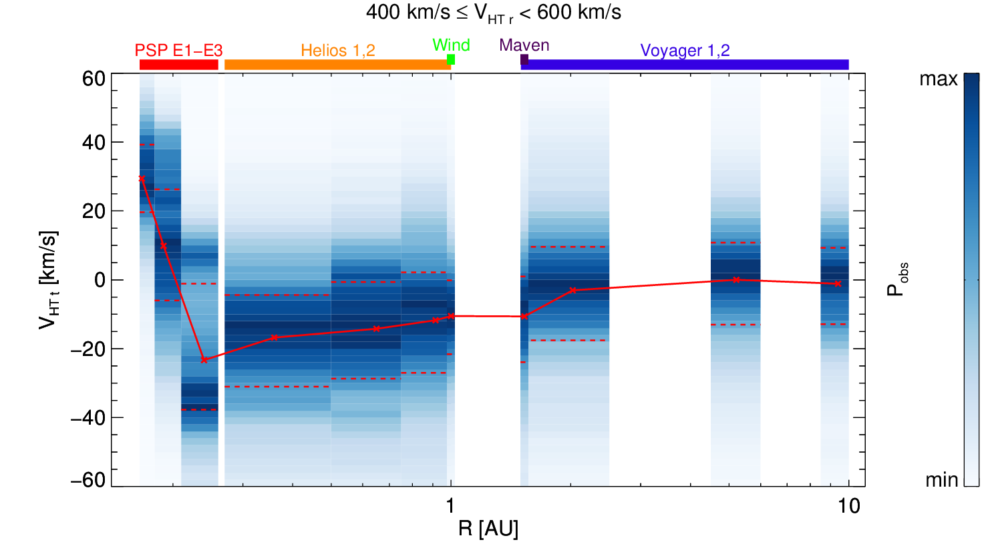
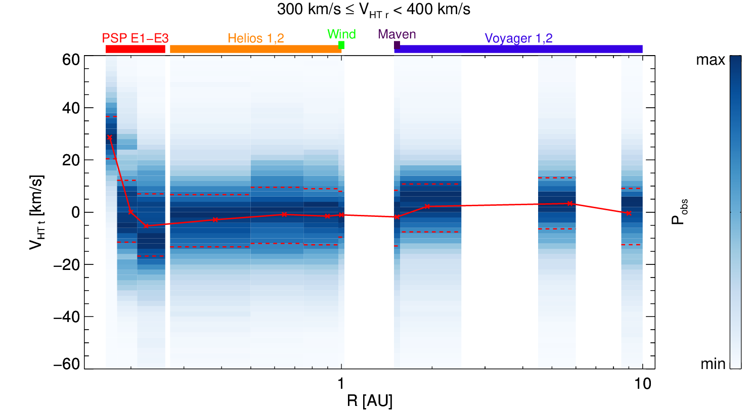
Evolution through the heliosphere
The figure combines data gathered in the last four decades by PSP, Helios 1 and 2, Wind, Maven, and Voyager 1 and 2.
V_{HT}t in the fast wind undergoes a rapid evolution in the solar corona from the co-rotating regime below 0.17 AU (+30 km/s) to the opposite direction at larger distances.
The peak (-25 km/s) is reached at ~0.25 AU and a gradual decrease is observed at distances below 2 AU when the flow becomes more radial.
Similar but not so distinct features are observed also in the slow wind.

Slide 8
Conclusion
We present the statistical analysis of non-radial velocity components. The results can be summarized as it follows:
We combine the data from different spacecraft gathered over the past 40 years
We analyze the motion of the HT frame in order to suppress effects connected with large-amplitude waves
The data reliability is confirmed also by an analysis of the tail magnetopause tilt because we employ the magnetopause as an independent instrument providing information on the average solar wind direction
V_{HT}t velocity component is as high as -25 km/s around 0.25 AU and gradually decreases with the radial distance to about -10 km/s at 1 AU
This decrease continues and V_{HT}t becomes close to zero at 5-10 AU
The solar wind co-rotates with the Sun between 0.17 and 0.26 AU but Vt changes sign at larger distances.
Forces leading to this reversal will be further investigated.
Nemecek et al. (ApJL, 2020, submitted)

