Slide 1
Spatial and temporal analysis of precipitation extremities of Eastern Nepal in the last two decades (1997–2016)
Sunil Subba^{1, 2}, Yaoming Ma^{1, 2, 3} , Weiqiang Ma^{1, 2, 3}
¹ Institute of Tibetan Plateau Research, Chinese Academy of Sciences, Beijing, 100101, China
² University of Chinese Academy of Sciences, Beijing, 100864, China
³ CAS Center for Excellence in Tibetan Plateau Earth Sciences, CAS, Beijing 100101, China

Slide 2
This work is licensed under the Creative Commons Attribution 4.0 International License:

Slide 3
Outline
Introduction
Significance of study
Study area
Data analysis
Results and discussion
Conclusions

Slide 4
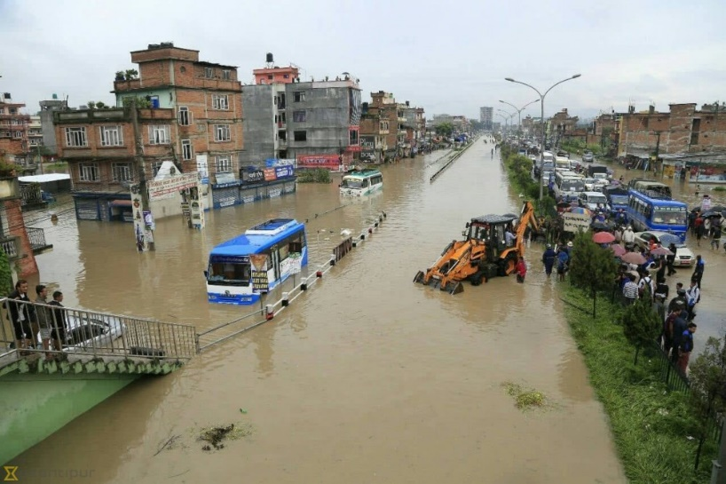
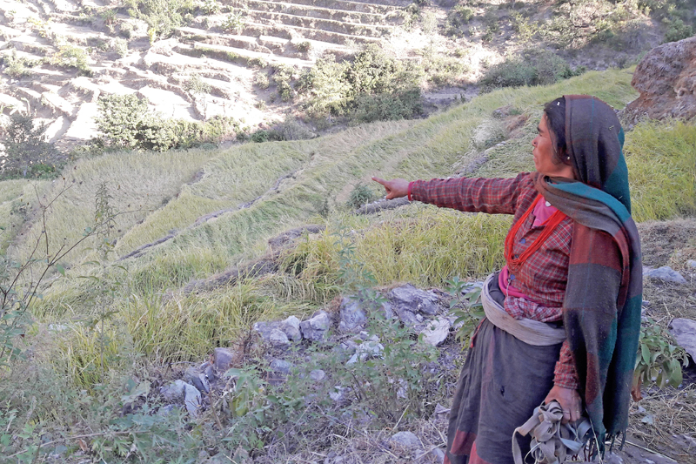
Introduction
precipitation is one of the most important environmental elements to diagnose climate change (Cannarozzo et al., 2006)
Yavuz & Erdoğan (2012) emphasized - spatial and temporal rainfall pattern : improve water resources management,
extremities brought about by precipitation favors natural disasters; disfavors the socioeconomic development of the region
Flood in Bhaktapur (©The Kathmandu Post)
Drought in 2016 (©THT, 2016)

Slide 5
Significance of the study
1
2
3
few studies that observed the past trends of the climate extremes, suggesting that more relevant studies in the issue will give a clear vision about already ongoing climate change in the past scenario.
precipitation and temperature extreme indices (1901 to 2010) on a global scale found that most of the places are getting wetter, implying global precipitation is experiencing an increase in average Donat et al. (2013).
however, Turner and Annamalai (2012) showcased an abrupt decrease of South Asian monsoon during summer since the 1950s
5
4
furthermore, the Special Report on Extreme Events of the IPCC (2012) and the AR5 (2014) highlighted about the increasing traits of these extreme precipitation events in the most part of the Earth
specifically,
Sheikh et al. (2014) analyzed the trends of extreme precipitation indices from 265 stations of the South Asian region (1961 to 2000) and found the trends to be consistent to the increase in the global average

Slide 6
6
7
8
Baidya et al. (2008) analyzed the precipitation events of Nepal (1961 to 2006) using RClimdex software and found the increased precipitation extremes trend in total and heavy precipitation events
But, Bohlinger and Sorteberg (2017) analyzed the precipitation events of 98 meteorological stations of Nepal (1971 to 2010) and found neither significant increase nor decrease in precipitation amount and number of extreme events per station
Contrary to these aforementioned researches, Shrestha et al. (2016) and Sigdel and Ma (2016) utilized precipitation extreme indices by the ETCCDI: same as in this study; and found increase in most of the precipitation indices with weaker statistical significance
with the overview of these indifferent findings, this study aims to analyze the spatial and temporal variation of extreme precipitation indices for the last two decades (1997–2016) in Eastern Nepal.
also emphasized by the study of Shrestha et al. (2016) which noted very few studies have been carried out about the climate extremes, its spatial and temporal variations throughout the region, especially in the basin wise concept on the Nepalese Himalayas

Slide 7
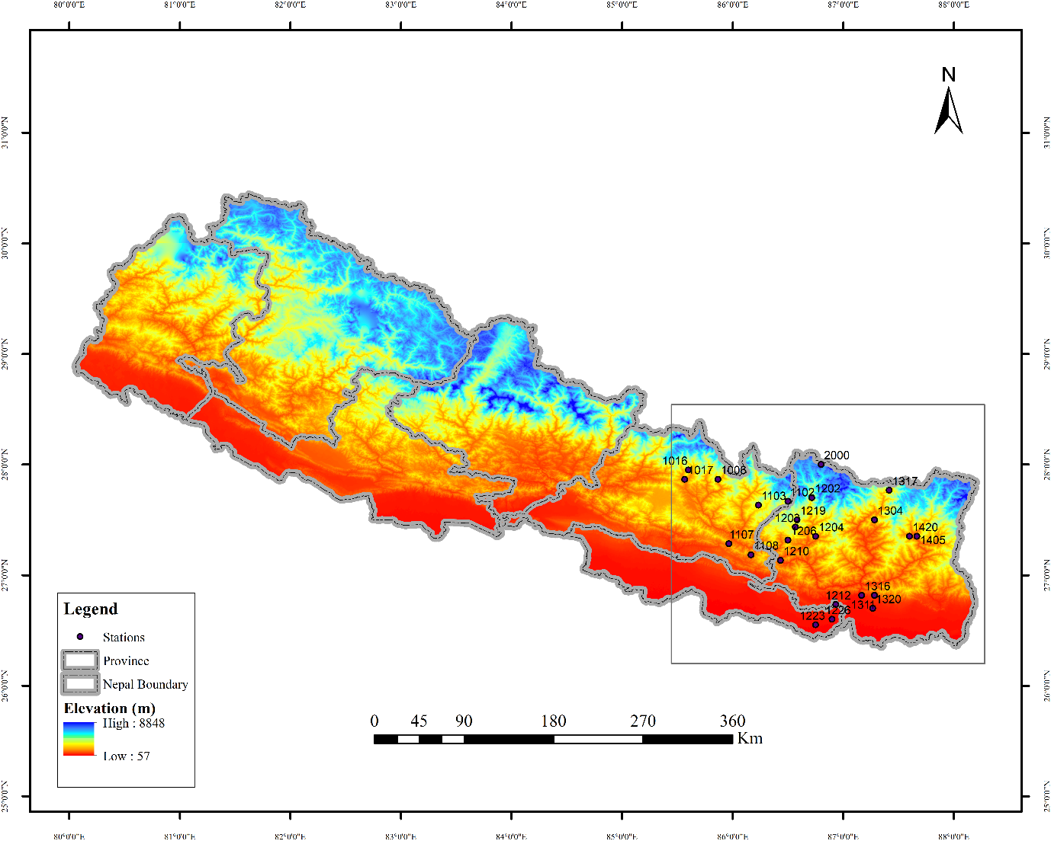
Study Area
Fact file
24 districts of Eastern Nepal
70 stations under study (preliminary)
Elevation (85 to 5050 m asl)
All physiographic regions of Nepal
climatic makeup ranging from tropical in the Terai Plains and Low River Valleys to arctic conditions on mountain peaks, and passes through warm temperate, cool temperate, and alpine conditions with the increase in altitude
Topographical map of Nepal showing Eastern Nepal within the rectangular box with the locations of stations
under study. Source: DHM, Nepal.

Slide 8
Data analysis
1. Quality control
all 70 stations data
visual checks of data plots (MS Excel and RClimDex)
2. Homogenization
Rhtest software package
out of 70 stations, 24 stations yielded high quality
3. Precipitation indices analysis
RClimDex software under R
indices desgined and recommended by ETCCDI
out of 27 indices, 11 are for assessment of extreme precipitation
further classified as Frequency Indices and Intensity Indices (Klein et al. (2009) {WMO (2009)} and Santos et al. (2012))
4. Trend detection
Mann-Kendall test (95% Confidence interval)
5. Comparison with satellite product
TRMM 3B42 V7 satellite derived precipitation data product
quantitative comparison (R,rBIAS, MAE, MBE, RMSE, and EB)
more than 5% of missing data (discarded)

Slide 9
List of indices as recommended by ETCCDI and adapted from WMO (2009) and Santos et al (2009)
Indices | ID | Name of Index | Definition | Unit
Frequency Indices | CDD | Consecutive dry days | Maximum number of consecutive dry days (precipitation of <1 mm) | days
 | CWD | Consecutive wet days | Maximum number of consecutive wet days (precipitation of >1 mm) | days
 | R10mm | Number of heavy precipitation days | Annual count of days when precipitation is >10 mm | days
 | R20mm | Number of very heavy precipitation days | Annual count of days when precipitation is >20 mm | days
 | R25mm | Number of extremely heavy precipitation days | Annual count of days when precipitation is >25 mm | days
Intensity Indices | RX1day | Max 1-day precipitation amount | Annual maximum 1-day precipitation | mm
 | RX5day | Max 5-day precipitation amount | Annual maximum consecutive 5-day precipitation | mm
 | PRCPTOT | Annual total wet-day precipitation | Annual total from days >1 mm precipitation | mm
 | R95p | Very wet days | Annual total precipitation of days in >95th percentile | mm
 | R99p | Extremely wet days | Annual precipitation of days in >99th percentile | mm
 | SDII | Simple daily intensity index | Ratio of annual total to WD in a year | mm/day

Slide 10
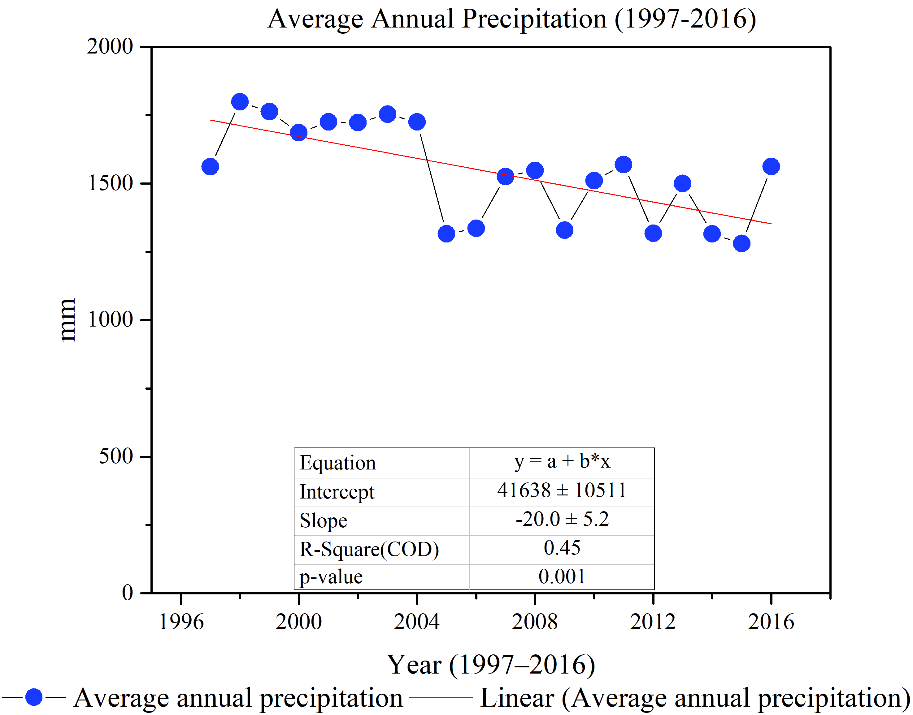
Results and discussion
Season | 1st decade (1997–2006) |  |  |  | 2nd decade (2007–2016)
 | Mean (mm) | Standard Deviation | CV % | Skewness | Mean (mm) | Standard Deviation | CV% | Skewness
Winter | 14.67 | 7.39 | 50.35 | 1.27 | 26.37 | 16.99 | 64.44 | 1.68
Pre-monsoon | 102.41 | 39.05 | 38.13 | 0.51 | 12.00 | 8.11 | 67.60 | 1.95
Monsoon | 530.29 | 186.36 | 35.14 | 1.10 | 480.32 | 176.10 | 36.66 | 0.86
Post-monsoon | 35.17 | 15.35 | 43.63 | 0.96 | 83.68 | 34.54 | 41.28 | 0.41
Annual | 682.54 | 231.71 | 33.95 | 1.05 | 602.37 | 210.14 | 34.89 | 0.44
Trend analysis of average annual precipitation within Eastern Nepal as shown by station data for the period of 1997 to 2016.
Precipitation statistics at the different seasons and annual scale for the study area.
Notes:
The monthly precipitation behavior highlighted the highest share of rainfall in the monsoon season for both
of the decades. There was a share of 78% and 80% of monsoon rainfall for the first decade and second decade,
with only 2% share of winter precipitation for both the decades' tenure. This finding is consistent
with the study by Shrestha (2000), who highlighted on the significant influence of Southern Oscillation in
Nepal and found that the influence is much higher in the eastern region of Nepal with more than 80% of
annual rainfall during the summer monsoon. The study by DHM (2017) also showed similar results

Slide 11
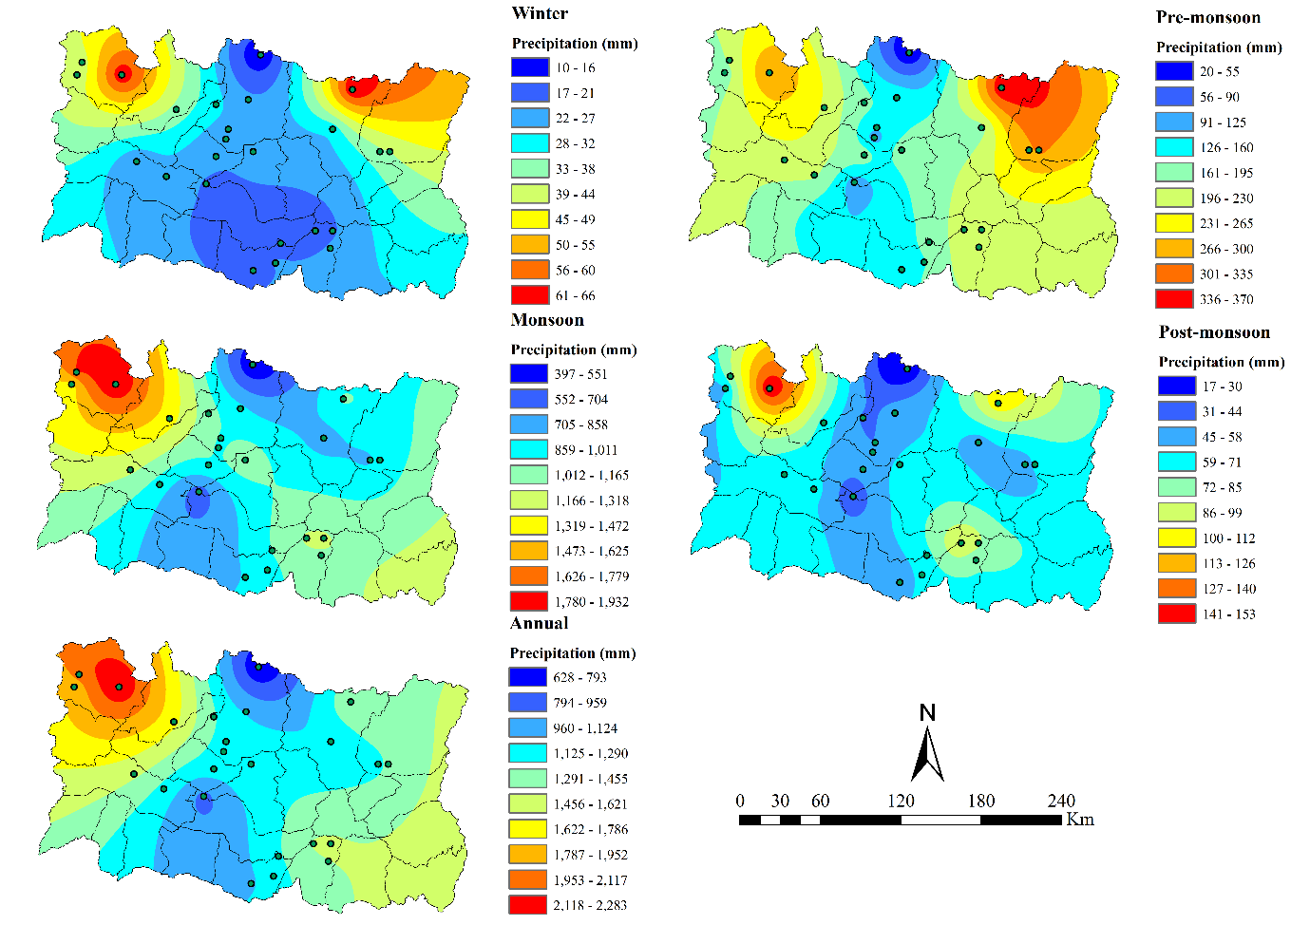
Spatial Distribution of Seasonal and Annual Precipitation
annual precipitation in Eastern Nepal was in the range between 138 to 1,233 mm, with a rather unique pocket of its intensity.
this unique pocket situation might be due to the large orographic differences as the northernmost part of Eastern Nepal lies in the windward side of Makalu range.
one should focus not only on the large‐scale weather system that is affecting Nepal's precipitation regime (Gaire et al., 2017; Shrestha et al., 2000; Sigdel & Ikeda, 2009) but also the local topography of mountainous basins (Barry, 2008; Kansakar et al., 2004).

Slide 12
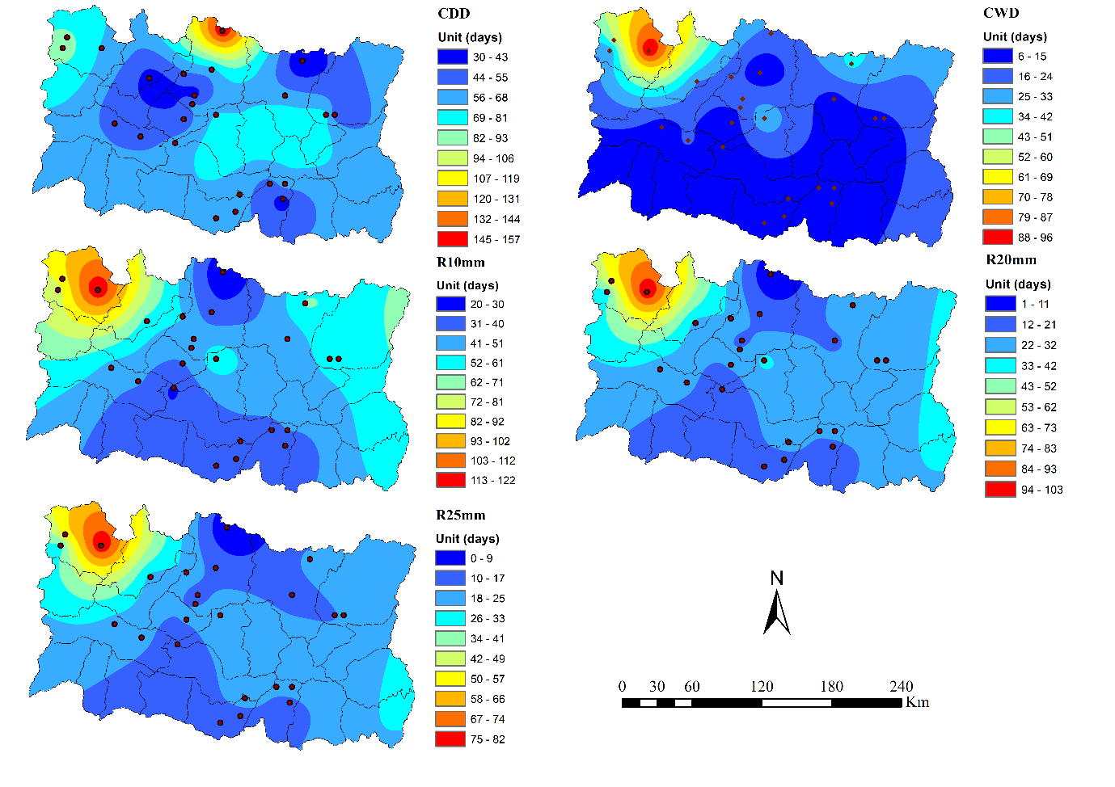
Spatial Distribution of Frequency Indices of Extreme Precipitation Indices
Indices | Range
CDD | 30 to 143 days each year
CWD | 7 to 84 days each year
R10mm | 8 to 137 days each year
R20mm | 1 to 93 days each year
R25mm | 0 to 74 days each year

Slide 13
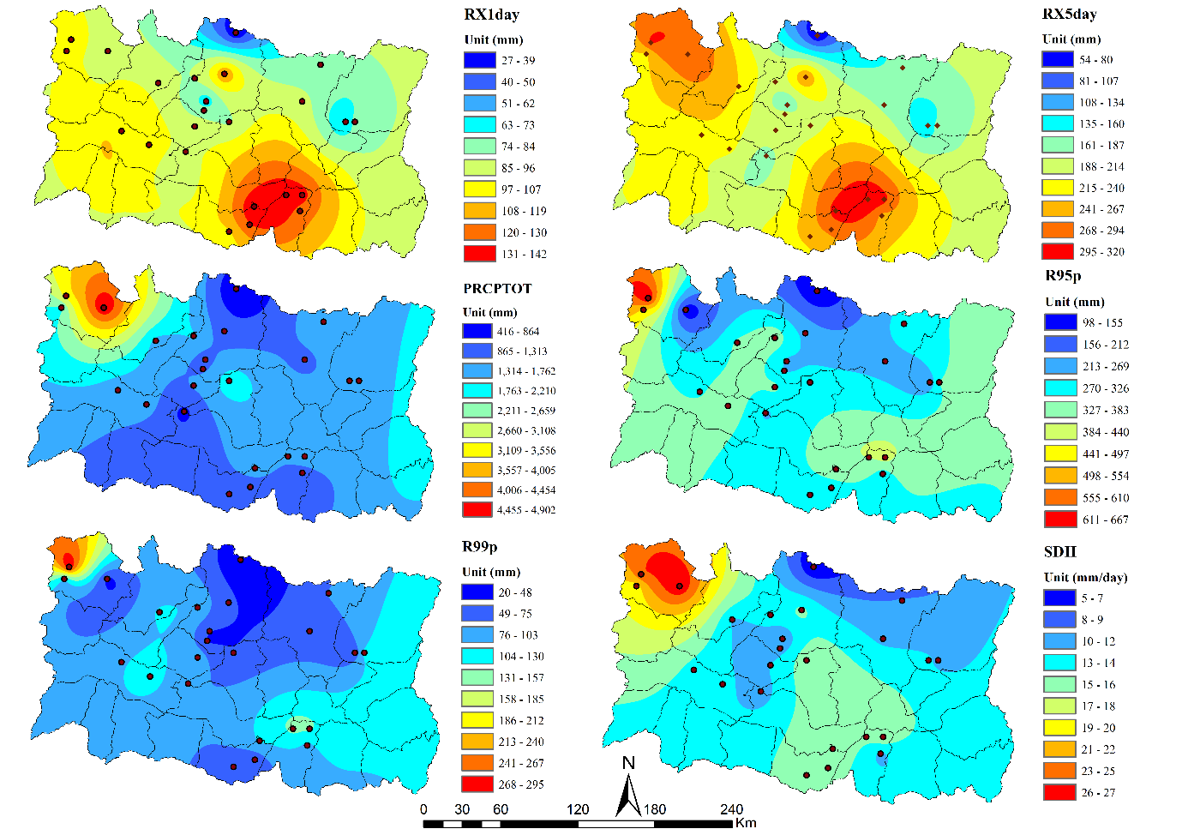
Spatial Distribution of Intensity Indices of Extreme Precipitation Indices
Indices | Range
RX1day | 27 to 142 mm each year
RX5day | 54 to 320 mm each year
PRCPTOT | 416 to 4902 mm each year
R95p | 98 to 667 mm each year
R99p | 20 to 295 mm each year
SDII | 5 to 27 mm per day each year

Slide 14
Temporal variation of extreme precipitation indices
Indices | Trend | Intensity
CDD | Increasing | 0.3 days/year
CWD | Decreasing | -0.1 days/year
R10mm | Decreasing | -0.5 days/year
R20mm | Decreasing | -0.4 days/year
R25mm | Decreasing | -0.3 days/year
RX1day | Decreasing | -0.9 mm/year
RX5day | Decreasing | -2.2 mm/year
PRCPTOT | Decreasing | -23.8 mm/year
R95p | Decreasing | -4.6 mm/year
R99p | Decreasing | -1.5 mm/year
SDII | Decreasing | -0.1 mm/days/year
prolonged and intense dryness and wetness can affect the agricultural activities; threatens their sustenance with natural hazards like droughts and floods (Dahal et al., 2015).
high mountains acts as a barrier to check warm moisture carrying precipitation (Salerno et al., 2015; Shrestha et al., 2019; Wang et al., 2008; Xu et al., 2008)
Notes:
First for Frequency indices (Except CDD all decreasing)
Second for intensity indices(All decreasing)

Slide 15
Temporal trend of extreme precipitation indices
Station | Frequency Indices |  |  |  |  | Intensity Indices
 | CDD | CWD | R10mm | R20mm | R25mm | RX1day | RX5day | PRCPTOT | R95p | R99p | SDII
1006 | 0.6 | -0.9 | -1.8 | -3.5 | -3.7 | 3.1 | -3.2 | -140.0 | -66.7 | -23.2 | -0.8
1016 | 1.8 | 0.4 | 0.4 | 0.4 | 0.3 | 3.8 | 4.7 | 49.1 | 56.4 | 35.6 | 0.4
1017 | 1.9 | -0.6 | -1.9 | -0.7 | -0.4 | -1.7 | -1.2 | -54.2 | -20.5 | -10.4 | 0.1
1102 | 1.0 | -0.1 | -0.8 | -0.6 | -0.2 | 1.1 | 0.4 | -20.0 | -11.7 | -1.0 | 0.0
1103 | 0.4 | 0.5 | -0.3 | 0.1 | 0.0 | 0.1 | -2.2 | -5.8 | 2.0 | -2.3 | 0.0
1107 | -0.9 | 0.1 | -1.1 | -0.6 | -0.4 | -14.9 | -19.8 | -61.3 | -45.0 | -19.6 | -0.3
1108 | 3.0 | -0.2 | -0.4 | -0.2 | -0.2 | -4.5 | -5.4 | -23.7 | -9.9 | -5.2 | -0.1
1202 | 2.4 | -0.4 | -0.8 | -0.6 | -0.6 | -2.7 | -4.1 | -38.1 | -15.1 | -1.9 | 0.0
1203 | 3.0 | 0.3 | -0.7 | -0.3 | -0.2 | -0.2 | -0.1 | -22.7 | -14.5 | -2.8 | 0.0
1204 | 1.7 | -0.5 | -0.4 | -0.8 | -0.6 | -2.3 | -3.9 | -40.2 | -30.8 | -9.7 | -0.3
1206 | 0.5 | 0.1 | -0.5 | -0.3 | -0.2 | -0.6 | 0.3 | -15.1 | -4.1 | -7.0 | -0.1
1210 | 0.8 | -0.1 | -0.3 | -0.4 | -0.2 | -2.7 | -5.3 | -19.0 | -9.7 | -7.5 | -0.3
1212 | -1.7 | 0.0 | 0.0 | -0.1 | -0.3 | -1.7 | -5.1 | -11.5 | -8.5 | -5.0 | -0.3
1219 | 2.4 | -2.2 | 0.5 | -0.5 | -0.3 | -1.6 | -2.7 | -11.9 | -13.3 | -9.4 | 0.2
1223 | -0.2 | -0.1 | -0.7 | -0.5 | -0.4 | -2.8 | -8.8 | -32.4 | -28.0 | -11.9 | -0.4
1226 | 2.4 | -0.4 | -0.8 | -0.6 | -0.6 | -2.7 | -4.1 | -38.1 | -15.1 | -1.9 | 0.0
1304 | 2.4 | 0.2 | 0.4 | 0.3 | 0.2 | -1.9 | -2.8 | 8.3 | -0.7 | -1.8 | 0.1
1311 | -1.5 | 0.2 | -0.1 | 0.0 | -0.1 | -1.3 | -5.8 | -10.7 | -21.2 | -10.4 | -0.3
1316 | -0.2 | 0.0 | -0.7 | -0.1 | 0.0 | 0.4 | 0.9 | -2.1 | 0.1 | 12.6 | 0.0
1317 | 0.9 | 2.5 | 0.0 | 0.6 | 0.2 | 1.8 | 2.0 | 10.5 | 21.4 | 11.8 | 0.1
1320 | 2.4 | 0.3 | -0.2 | -0.4 | -0.4 | -1.6 | 4.7 | 1.3 | 15.8 | 15.9 | -0.1
1405 | 1.9 | -0.1 | -0.5 | 0.0 | -0.2 | 1.3 | 2.0 | -1.0 | 11.6 | 6.9 | 0.0
1420 | 0.4 | 0.5 | -0.5 | 0.0 | -0.1 | 0.3 | -0.3 | -11.9 | -3.7 | -2.0 | 0.0
2000 | 2.5 | -0.8 | -0.3 | 0.1 | 0.0 | 0.0 | -0.3 | -10.4 | -3.0 | 0.6 | 0.0
Average | 1.2 | -0.05 | -0.5 | -0.4 | -0.3 | -1.3 | -2.5 | -20.9 | -8.9 | -2.1 | -0.1
Note: Red numbers indicate statistically significant at 5%
Notes:
Mostly significant increase in CDD, suggesting Eastern Nepal is getting significantly drier in the last two decades

Slide 16
Percentage of stations from the studied stations with different trends of extreme precipitation indices in the Eastern Nepal.

Slide 17
Comparison with satellite data
TRMM 3B42 V7 data for whole Nepal, at a daily temporal resolution compiled from the 3‐hourly precipitation product from 1998 to 2017
Indicator | Value | Unit
R | 0.82
rBIAS | -0.01
MAE | 87 | mm
MBE | -12 | mm
RMSE | 111 | mm
EB | -0.80 | %

Slide 18
Conclusions
Eastern Nepal is experiencing some significant drier days as the events of heavy, very heavy, and extremely heavy precipitation events are decreasing in some regards
TRMM 3B42 V7 precipitation data product also depicted the phenomenon of decreasing precipitation in Nepal comprising our study area
Extreme precipitation trends as seen in the TRMM 3B42 V7 resembles with the trend of extreme precipitation indices shown by the station data
the influences of local topographic situations, onset and offset of monsoons, and their
mechanisms are very essential to be studied yet very complicated at the same time
1
2
3
4
Limitation

Slide 19
Acknowledgements
Technical acknowledgement
Department of Hydrology and Meteorology, Government of Nepal (http://www.dhm.gov.np/)
EvK2CNR Committee (http://www.evk2cnr.org/cms/en/research/integrated_programs/share)
NASA GES DISC (https://pmm.nasa.gov/data-access/downloads/TRMM)

Slide 20
Financial Support
This research was funded by the Strategic Priority Research Program (A) of the Chinese Academy of Sciences (XDA20060101), the Second Tibetan Plateau Scientific Expedition and Research (STEP) program (2019QZKK0103), the National Natural Science Foundation of China (41661144043, 91637312, and 41830650), and the Chinese Academy of Sciences (Grant QYZDJ‐SSW‐DQC019).

Slide 21
Thank You
Any Comments and Suggestions are Highly Solicited

