Slide 1
Disturbance of the Front Region of Magentic Reconnection Outflow Jets due to the LHDI
EGU2020-2848
Takuma (T.K.M.) Nakamura (IWF/OeAW), Takayuki Umeda (Nagoya Univ.), Rumi Nakamura (IWF), Huishan Fu (Beihang Univ.) and Mitsuo Oka (SSL/Univ. of California, Berkeley )
Computers: FX100 (Nagoya Univ.)
Leo1 (IWF/OeAW)

Slide 2
Simulation Setup
Performed a 3-D fully kinetic (PIC) simulation of anti-parallel reconnection.
Setup the Harris sheet:
B_{x}(z)=B_{b}tanh(z/D₀) & n(z)=n₀sech²(z/D₀)+n_{b,}
where D₀=0.8d_{i} and n_{b}/n₀=0.05
T_{i}/T_{e}=2.5, m_{i}/m_{e} = 256, ω_{pe}/ω_{ce} = 1.25
System size: L_{x}×L_{y}×L_{z}=51.2×2.4×25.6 di³=2048×96×1024 cells with ~0.5x10¹¹ particles
Periodic along x and y, with conducting walls along z

Slide 3
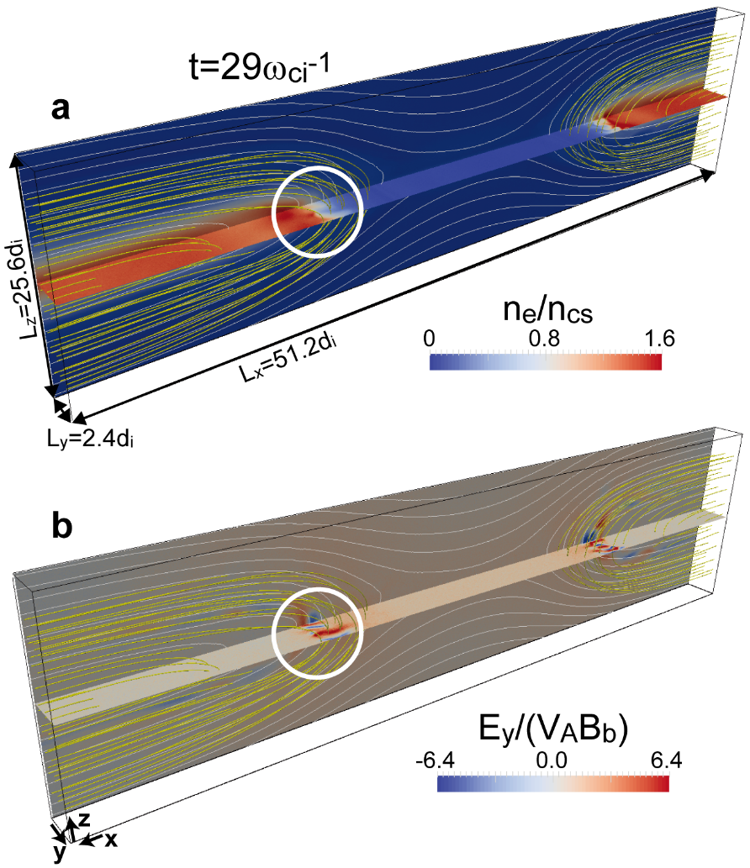
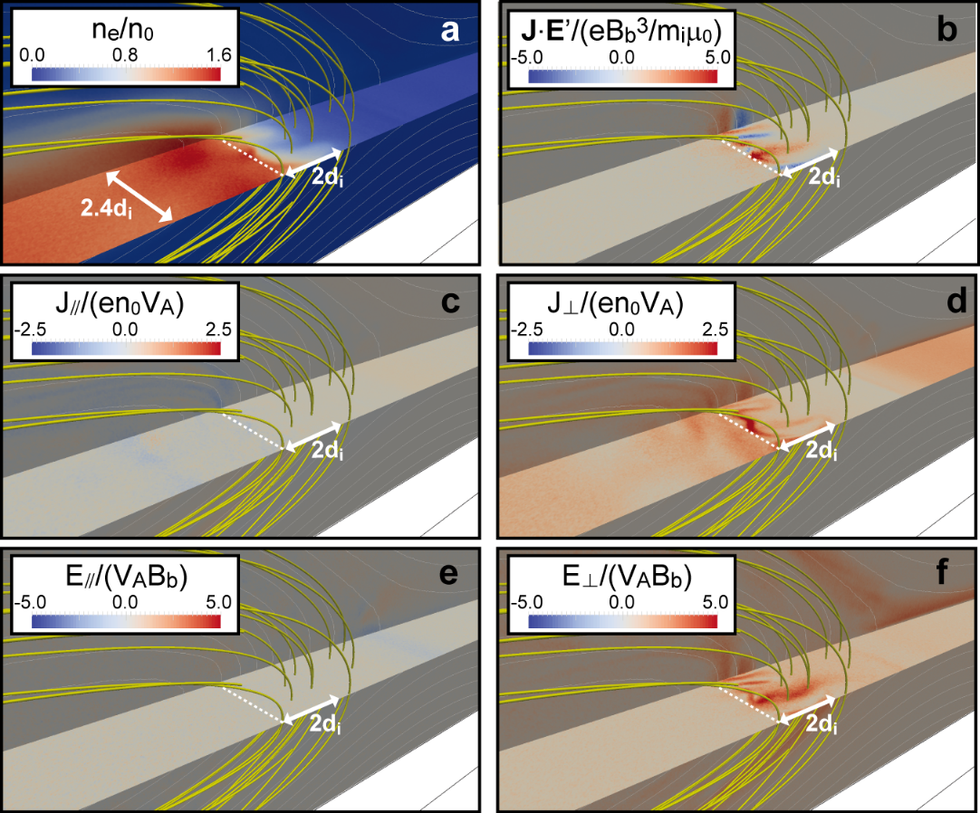
LHDI at Jet fronts in simulation
LHDI is driven at the leading edge of outflow jets. [e.g., Vapirev+,2013; Divin+, 2015; Nakamura+, 2016; Lapenta+, 2020]
→ leading to stong J.E fluctuations.

Slide 4
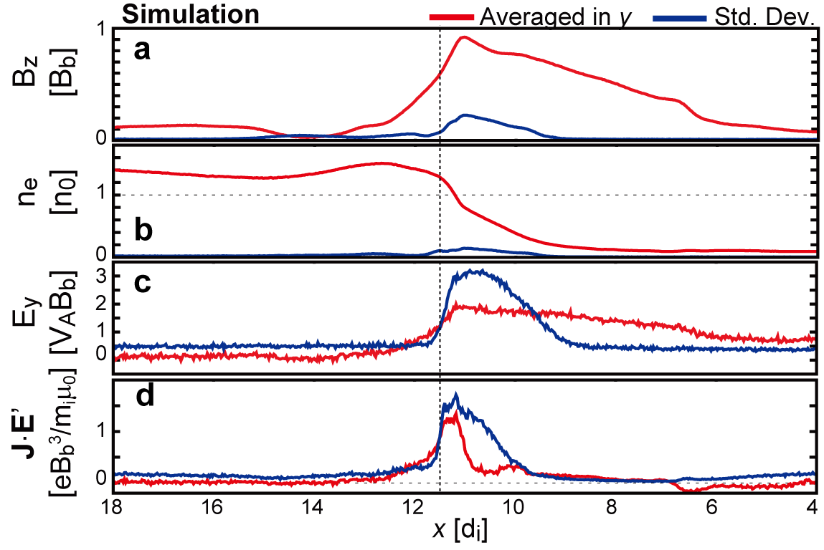
LHDI at Jet fronts in simulation
The fluctuations are seen mainly at the ion-scale density gradient layer.

Slide 5
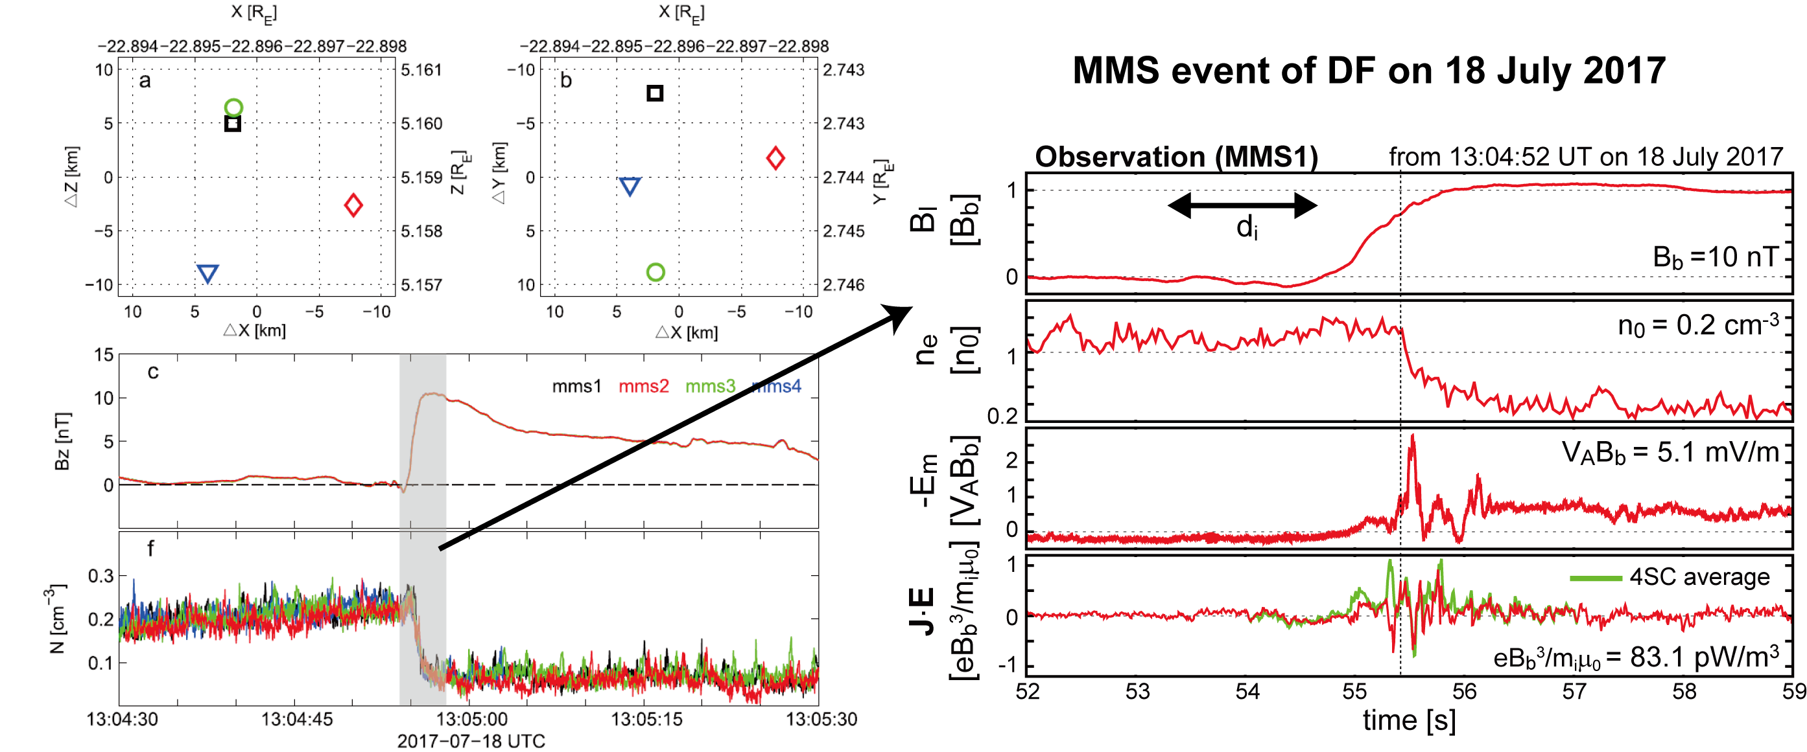
LH waves at Jet fronts in MMS
LH waves in Em & J.E were ovserved at DF by MMS [Liu+, 2018].
The fluctuations were seen mainly at the ion-scale density gradient layer.

Slide 6
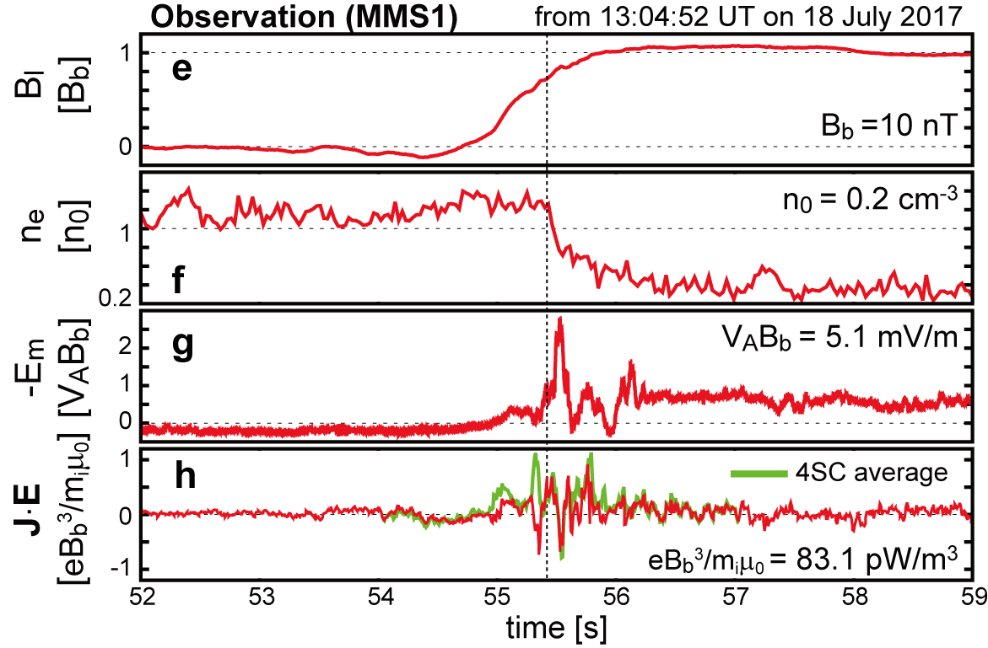
Simulation V.S. MMS
The location and normalized amplitudes of the fluctuations are reasonably consistent between the simulation and MMS observations.

Slide 7
Linear alalysis
- A linear dispersion relation solver for fully kinetic plasma with a perpendicular drift, developed in Umeda+ (2018), is applied.
 | m_{i}/m_{e} | T_{i}/T_{e} | ω_{pe}/ω_{ce} | V_{di}/V_{thi} | V_{de}/V_{the} | V_{di}-V_{de} | V_{ti}/c | V_{te}/c | β
Case-(a) | 256 | 2.6 | 1.8 | 0.30 | 0.06 | 0.79V_{A} | 0.030 | 0.30 | 2.12
Case-(b) | 1836 | 2.9 | 16.4 | 0.75 | 0.06 | 2.10V_{A} | 0.001 | 0.03 | 2.34
Case-(c) | 1836 | 0.5 | 16.4 | 1.80 | 0.06 | 2.10V_{A} | 0.0002 | 0.03 | 0.9
Case-(d) | 1836 | 4.6 | 20.0 | 0.10 | 0.10 | 3.00V_{A} | 0.002 | 0.03 | 4.97
The LHDI turbulence at reconnection jet fronts are expected in a wide parameter range [Nakamura+, PRL, 2019].

Slide 8
Discussions
The LHDI turbulence would occur under conditions with V_{d}~V_{A}, a moderate β (~1-5), and a large ω_{pe}/ω_{ce} ($>$1).
V_{d}~V_{A} & β~1 would be common at the d_{i}-scale gradient layer with B_{local}~B_{b} & P_{local}~B_{local}²/2μ₀~B_{p}²/2μ₀.
ω_{pe}/ω_{ce}$\sim$3$∙$(n/1cm⁻³)^{1/2} $∙$(B/100nT)⁻¹ >1 would be satisfied in a wide parameter range.
- Magnetotail with n~1cm⁻³, B~10nT → ω_{pe}/ω_{ce}~10
- Solar flare with n~10⁸⁻¹⁰cm⁻³, B~10⁵⁻⁷nT → ω_{pe}/ω_{ce}~1-10.
The LHDI turbulence may frequently occur in the reconnection jet front regions at many locations in space plasmas including the Earth‘s magnetotail and the solar flare.
For more details, see Nakamura+, PRL, 2019,
https://doi.org/10.1103/PhysRevLett.123.235101

Slide 9
References
Vapirev, A. E., G. Lapenta, A. Divin, S. Markidis, P. Henri, M. Goldman, and D. Newman (2013), Formation of a transient front structure near reconnection point in 3-D PIC simulations, J. Geophys. Res. Space Physics, 118, 1435–1449, doi:10.1002/jgra.50136.
Divin, A., Yu. V. Khotyaintsev, A. Vaivads, M. André, S. Markidis, and G. Lapenta (2015), Evolution of the lower hybrid drift instability at reconnection jet front, J. Geophys. Res. Space Physics, 120, 2675–2690, doi:10.1002/2014JA020503.
Nakamura, T. K. M., R. Nakamura, W. Baumjohann, T. Umeda, and I. Shinohara (2016), Three-dimensional development of front region of plasma jets generated by magnetic reconnection, Geophys. Res. Lett., 43, 8356-8364, doi:10.1002/2016GL070215.
Lapenta, G., F. Pucci, M. V. Goldman, and D. L. Newman (20200), Local Regimes of Turbulence in 3D Magnetic Reconnection, The Astrophysical Journal, 888 104, doi:10.3847/1538-4357/ab5a86
Umeda, T., T.K.M. Nakamura (2018), Electromagnetic linear dispersion relation for plasma with a drift across magnetic field revisited, Phys. Plasmas, 25, 102109, doi:10.1063/1.5050542.
Nakamura, T.K.M., T. Umeda, R. Nakamura, H.S. Fu, M. Oka (2019), Disturbance of the front region of magnetic reconnection outflow jets due to the lower-hybrid drift instability, Phys. Rev. Lett. 123, 235101, doi: 10.1103/PhysRevLett.123.235101.

