Slide 1
Role of Science Communication in Beliefs, Perceptions and Knowledge of Science and Technology among European Citizens “EOS4.4 Science to Action: Communication of Science - Practice, Research and Reflection”
Andrea Rubin*, Giuseppe Pellegrini* and Ľubomír Šottník**
*Observa Science in Society (Italy) ; **Trnava University (Slovakia)
7th May 2020

Slide 2
Science With and For Society
Trustworthiness of science information sources (Italian Science in Society monitor, 2019)
 | Highly/quite trustworthy |  | Little/Not trustworthy |  | DK
 | 2010 | 2018 | 2010 | 2018 | 2010 | 2018
Public lectures by researchers | 76,6 | 81,6 | 14,4 | 16,5 | 9,0 | 4,7
Popular science magazines | 74,3 | 75,1 | 18,5 | 15,2 | 7,2 | 6,6
TV science programmes | 67,3 | 71,9 | 29,7 | 23,8 | 3,0 | 2,3
Radio science programmes | 53,5 | 64,1 | 29,5 | 24,2 | 17,0 | 8,8
Newspapers’ S&T pages | 60,6 | 65,4 | 34,9 | 27,6 | 4,5 | 6,3
Researchers’ blogs | 65,2 | 65,7 | 19,8 | 27,9 | 15,0 | 6,6
7th May 2020

Slide 3
But…
7th May 2020

Slide 4
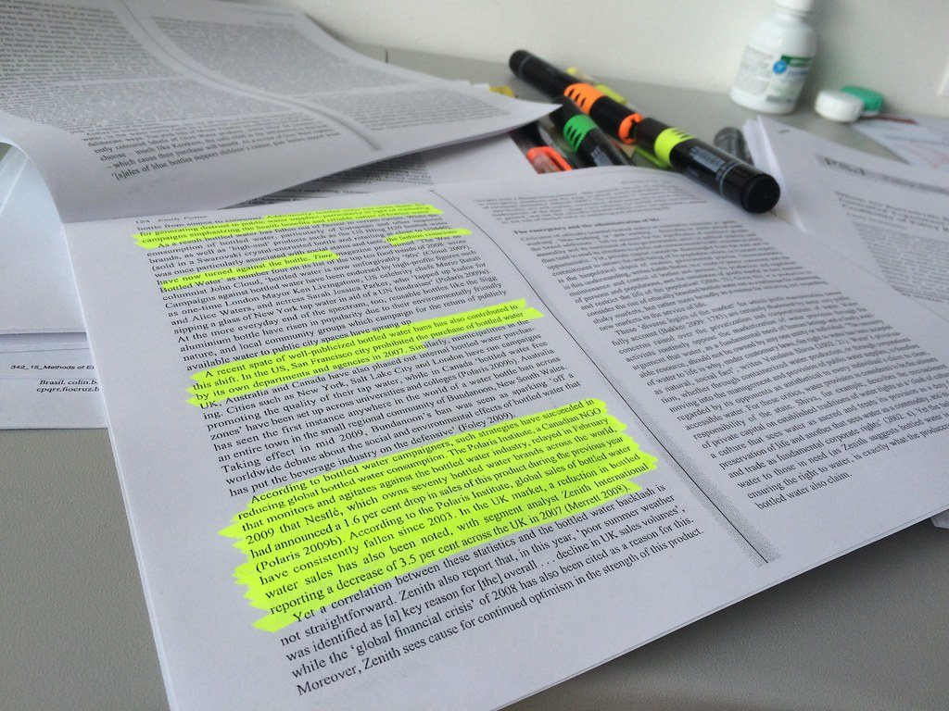
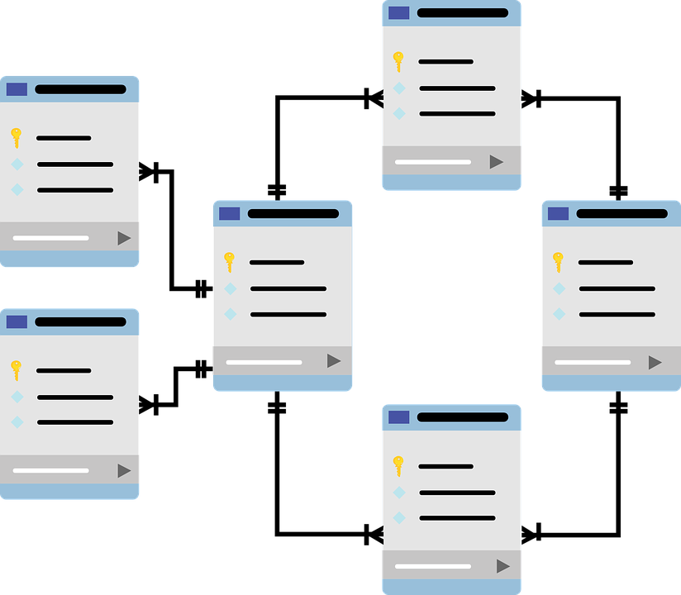
The Project
Almost €1.2 million
2 years
5 countries
9 partners
5 Universities
2 NGOs
2 SMEs
Literature review
Public Consultations
Quantitative and Qualitative Analysis
7th May 2020

Slide 5
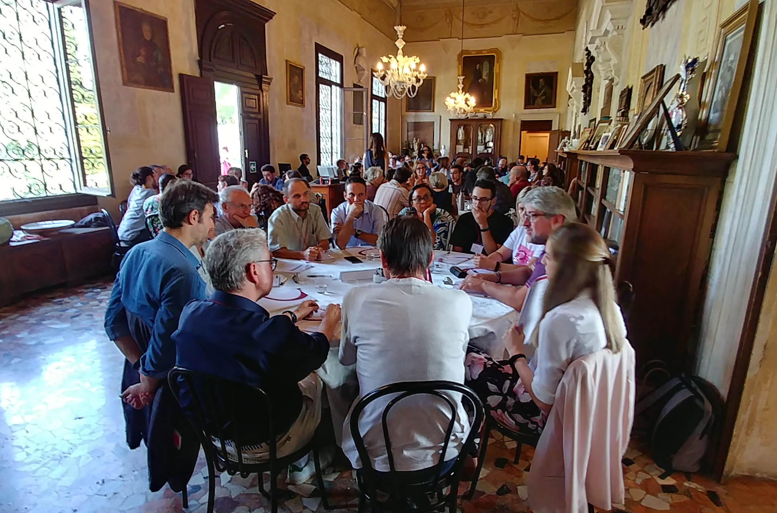
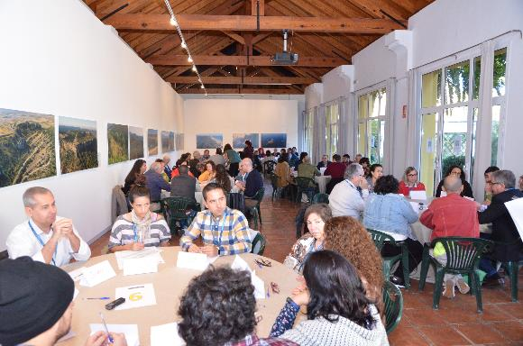
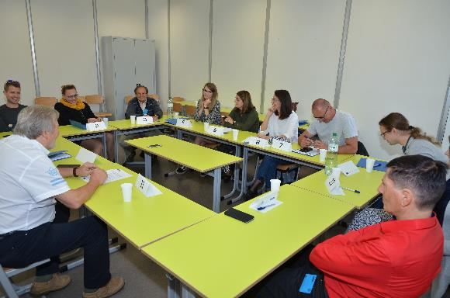
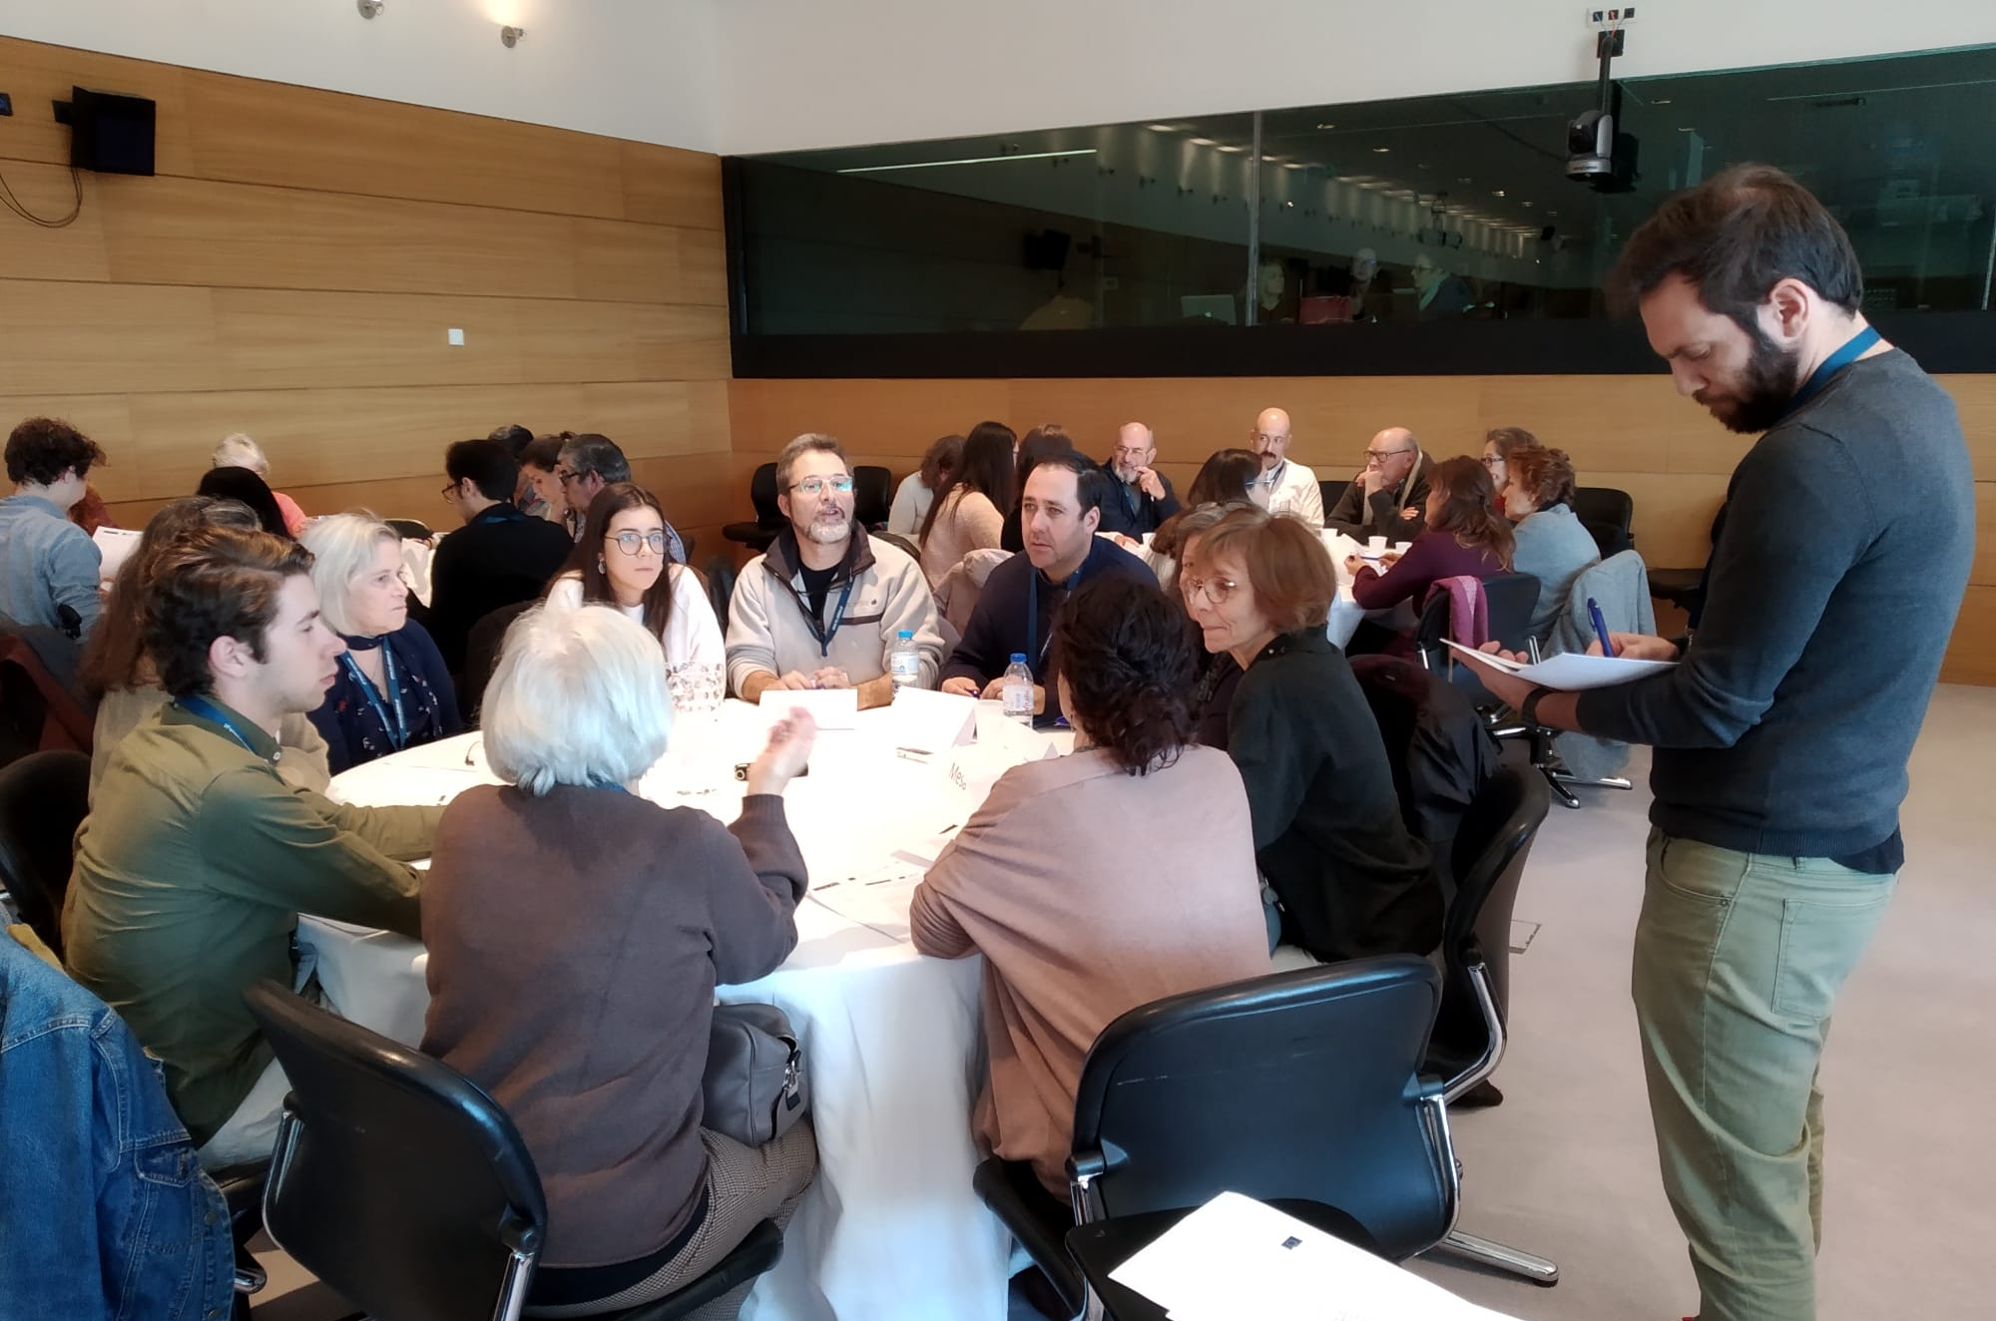
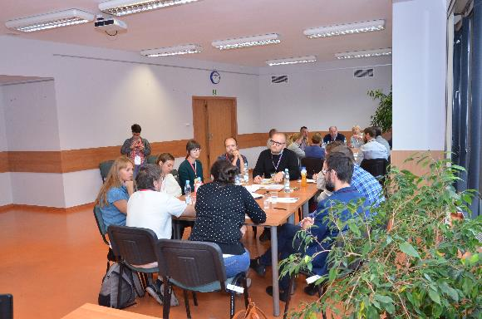
Public Consultations
7th May 2020

Slide 6
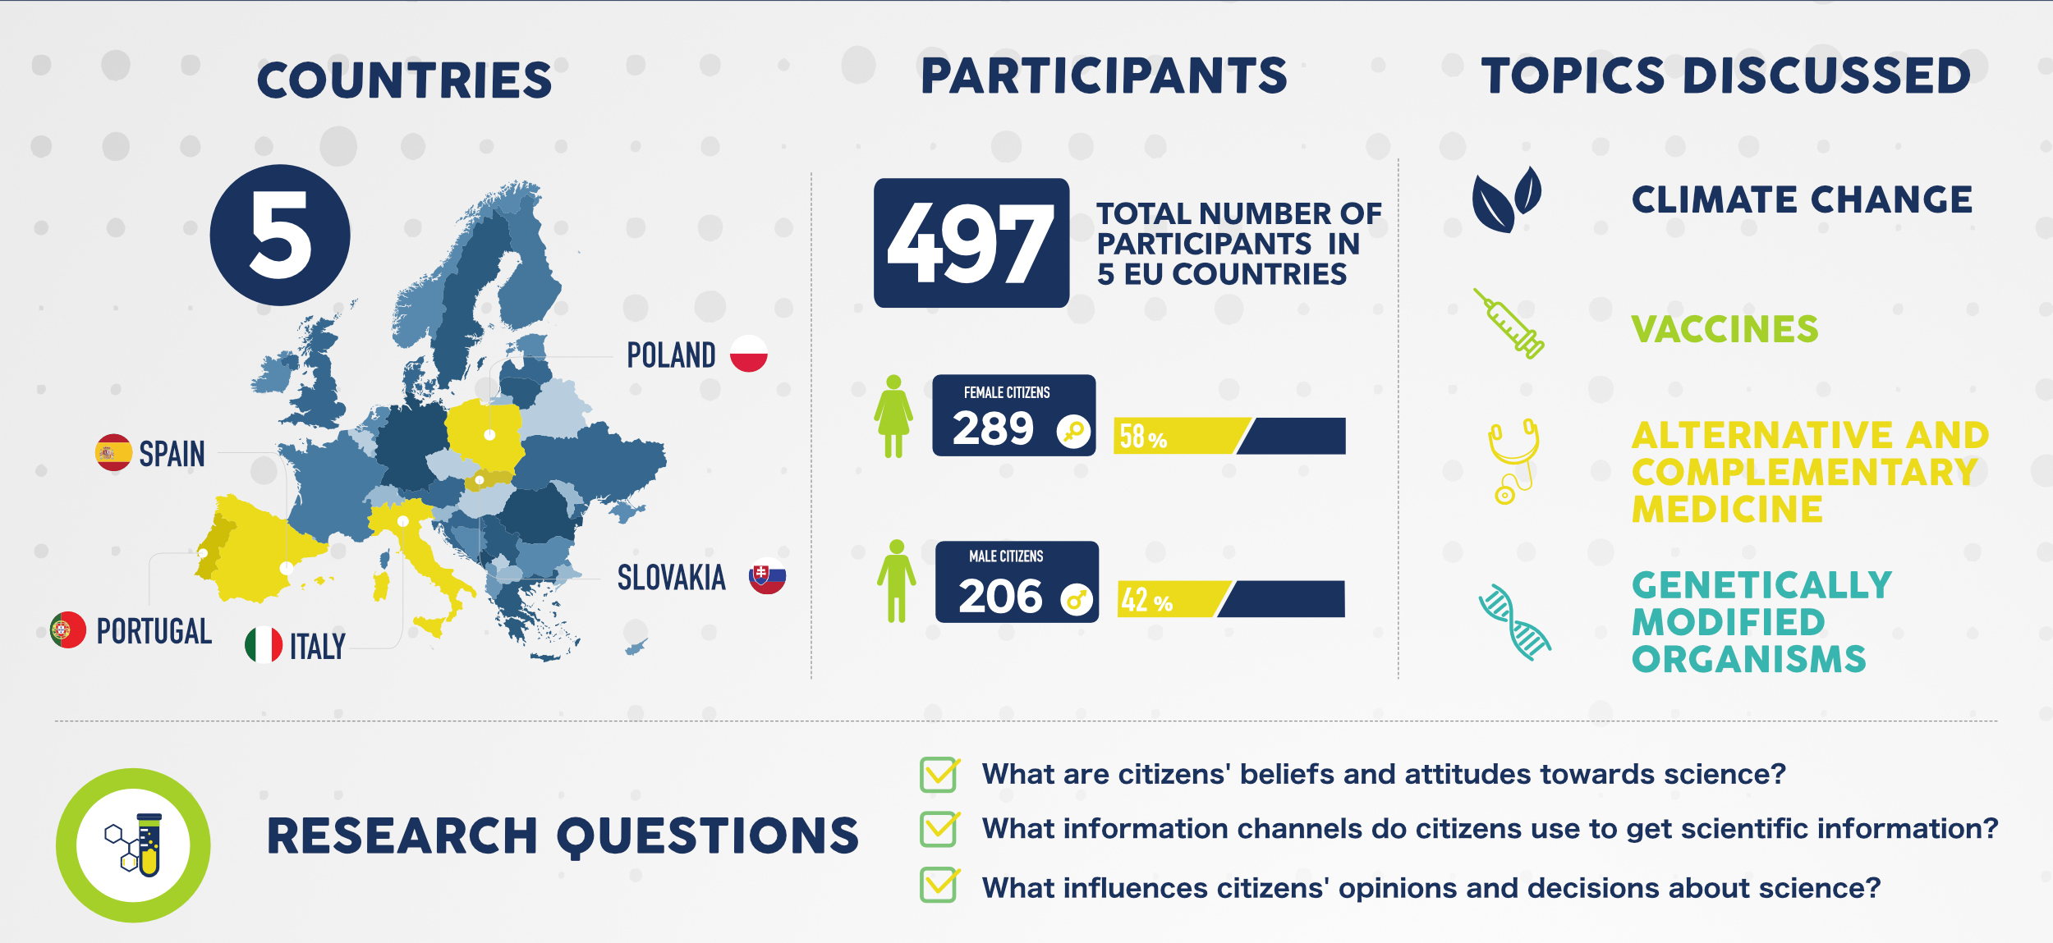
Public Consultations in Numbers
7th May 2020

Slide 7
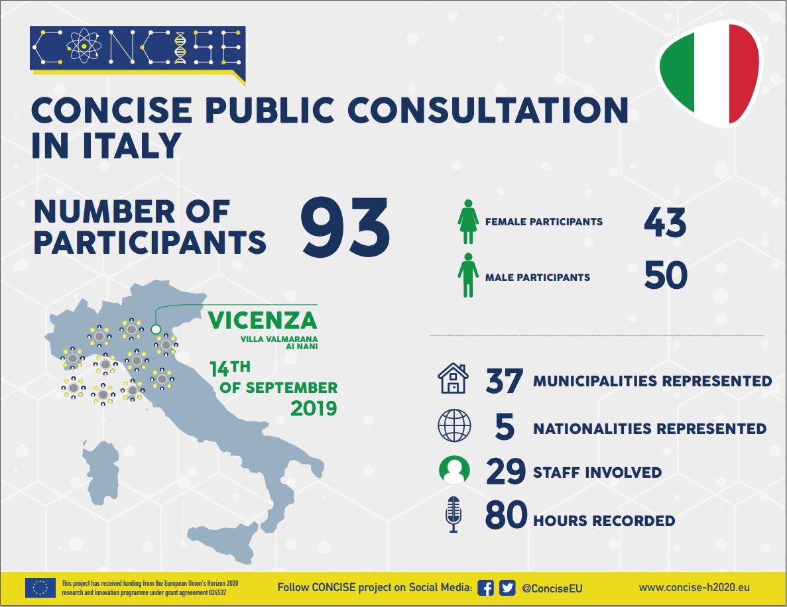
Italian Public Consultation
7th May 2020

Slide 8
Slovak Public Consultation
7th May 2020

Slide 9
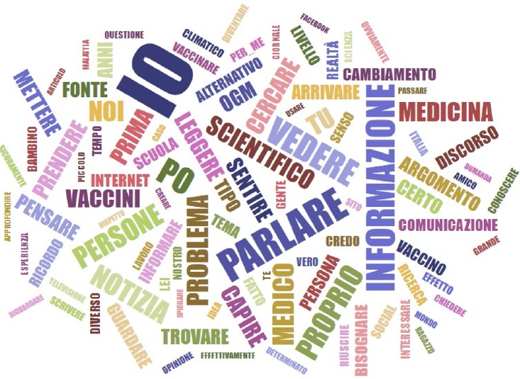
Findings: qualitative analysis
“We use all channels for talking on Climate Change”
“I would prefer to tall personally when I want to consider vaccine’s issues”
“GMO is an expert’s matter and social media are the main channel”
“I would prefer to discuss in a small circle when talking about Complementary and Alternative Medicine”
“Media and Institutions are the most credible sources”
7th May 2020

Slide 10
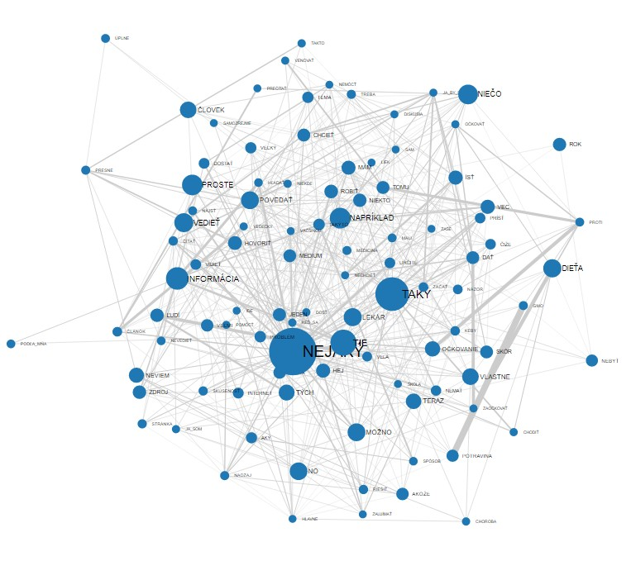
Preliminary findings of Slovak Qualitative analysis
A base of one's conviction is often own experience
Demand for clear, concise communication from experts and government
Increased number of information require more critical approach from citizens and the reform of the educational system
Frequent comparison of the access to information in the former socialist regime and current democratic state
General trust in medical authorities when in doubt
7th May 2020

Slide 11
Findings: quantitative analysis
Interpersonal relationship are still relevant for participants: speak, watch, search, read and listen are the main verbs cited during the discussions
In general, the media role is of entertaining stimulating curiosity
When people talk on Public Science Communication they are considering Communication as a whole
Medical communication are the most relevant for people and expecially the role of experts such clinicians are at the centre of the debate
7th May 2020

Slide 12
Conclusion
Off line and Online domain
Issues does matter (GMOs, Vaccines, Cchange, CAM)
Reliability perception:
Low Awareness:
limited access to information processes
High Awareness:
inadequete communication
Institution-experts
adequete communication
No misleading,
authoritativeness
7th May 2020

Slide 13
Thanks for your attention!
Andrea Rubin
Giuseppe Pellegrini
Lubomir Sottnik
Follow CONCISE project on Social Media @ConciseEU www.concise-h2020.eu
7th May 2020

