Slide 1
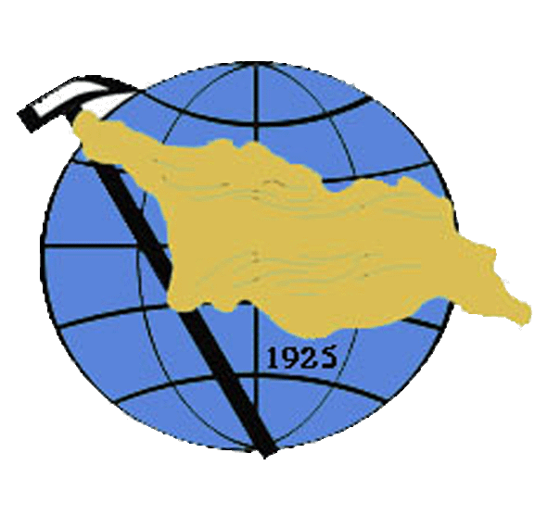
Regional and Contact Metamorphism of the Dizi series (the Greater Caucasus)
Irakli Javakhishvili, Tamara Tsutsunava, David Shengelia,
Giorgi Chichinadze and Giorgi Beridze
irakli.javakhishvili@tsu.ge
Iv. Javakhishvili Tbilisi State University, Al. Janelidze Institute of Geology
(0186, Politkovskaya str. 31, Tbilisi, Georgia)
This work was supported by Shota Rustaveli National Science Foundation (SRNSF) [PHDF-19-159, Regional and Contact metamorphism of the Dizi series].
D1663 | EGU2020-2952

Slide 2
INTRODUCTION
The Greater Caucasus – the complex geological structure of the Caucasus is an integrated part of the Mediterranean (Alpine-Himalayan) collision orogenic belt. The Dizi series is exposed within the Greater Caucasus Southern Slope zone, in the core of Svaneti anticlinorium. It is formed in the conditions of the continental slope and the foot on the southern passive margin of the small ocean basin (Gamkrelidze, Shengelia, 2005). The rocks of the Dizi series are faunistically dated from the Devonian to the Triassic inclusive. It is very difficult to make stratigraphic division of the Dizi series because of its tectonic structure, homogeneous lithological composition and difficult accessibility of the area. The most complete well-grounded division of the series is given by M.L. Somin and A.A. Belov (1976). They have distinguished a number of suites here. The suites are mainly composed of terrigenous phyllitic shales, vary-grained metasandstones, quartzitic aleurolites and lenses and interbeds of marbleized limestones, except of one suite consisting of CaO rich schists, metamorphosed tuff breccias and medium-grained sandstones.
Most researchers based on the presence of above mentioned rocks believe that the Dizi series rocks underwent the low-grade regional metamorphism (Goishvili, 1962; Adamia, 1968; Somin, 1971; Somin, Belov, 1976; Kutelia, 1984; Somin, 2011, et al.). However, some of them consider it as higher-grade metamorphism or even anchimetamorphism (Chikhradze , 2005; Kekelia et al.,2017).
Despite the well-studied stratigraphy and tectonics of the Dizi series, the issues of metamorphism, in compare with the directly adjoining it pre-Alpine crystalline basement of the Greater Caucasus are less studied. There only a petrographic study of rocks was carried out, but determination of rock-forming minerals composition and therefore the establishment of key mineral assemblages were not realized. The authors aimed to fill this gap on the basis of a detailed study of metamorphosed rocks of the Dizi series.
D1663 | EGU2020-2952

Slide 3
Geological scheme of the northwestern part of the Svaneti anticlinorium
(Somin, Belov, 1976; with the authors’ additions)
D1663 | EGU2020-2952

Slide 4
PETROMINERALOGY
Regional-metamorphosed rocks
Regionally metamorphosed rocks of the Dizi series are represented mainly by thin-banded and crenulated terrigenous deposits, various volcanites and marbles. Banding is conditioned by alternation of graphite–sericite–biotite–albite–quartz shales with greywacke metasandstones of actinolite–prehnite–albite–potassium feldspar–quartz composition.
Key mineral assemblages of regional metamorphism of the Disi series rocks are established:
Chl_{0.48} + Ser(Ph) + Ab ± Tur + Qz (metasandstone);
Chl_{0.45} + Ser(Ph_{2.0+1.99; 1.3+1.0}) + Cal + Ab + Qz (carbonaceous phyllite);
(Act_{0.59}→MgHbl_{0.68} + Phr + Ab + Qz (metagraywacke).
Existance of detritus grains of augite (Aug_{0.55}) is recorded in one case. A similar case is described in Taveyanne Formation in Switzerland (Coombs et al., 1976).
Mineral symbols are given according to the classification of D. Whitney and V. Evans (2010). Amphiboles are classified according to F. Hawthorne et al. (Hawthorne et al, 2012). Dark-colored minerals indices correspond to their magnesium numbers (Mg/Mg+Fe² ⁺); arrows indicate changes in magnesium numbers from the center to the periphery in Ca-amphibole crystals; the figures at Pl index show the content of the anortite molecule, and at Ms index - the value of FeO + MgO (in mass.%).
D1663 | EGU2020-2952

Slide 5
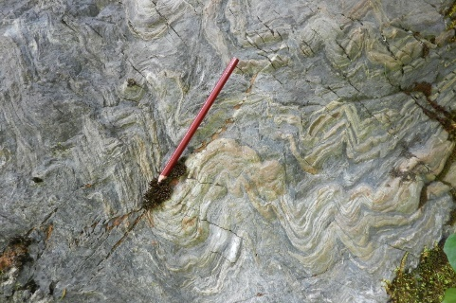
PETROMINERALOGY
All the mineral assemblages of the Dizi series regionally metamorphosed rocks definitely indicate their formation under conditions of chlorite-sericite subfacies of the greenschist facies. Temperature and pressure of metamorphism correspond to 300-340°C and ≈2-2.5 kbar.
The existing equilibrium mineral associations of the regional and contact metamorphism of the Dizi series do not allow application of thermo-barometers. Thus, the assessment of P-T conditions of metamorphism is based on a number of factors – general considerations, the petrogenetic grid, the informative scheme of metamorphic facies of regional and contact metamorphism (Korikovsky, 1979) adopted in the present work, a gradient model elaborated for pre-Alpine metamorphic complexes of the Greater Caucasus (Korikovsky, Shengelia, Somin, 1991) and a comparison of studied region with the other well-studied regions (Reverdatto, 1970; Korikovsky 1984, 1986; Bufe, 2014).
Banded and crenulated sandy-clay rocks
D1663 | EGU2020-2952

Slide 6
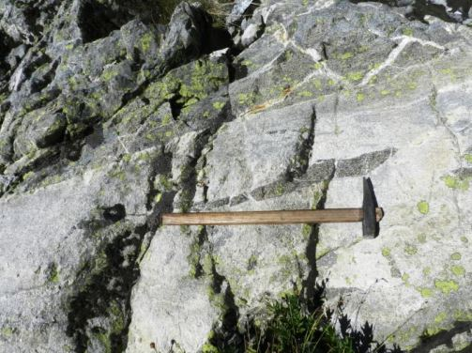
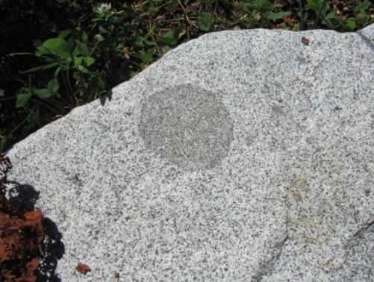
Contact-metamorphosed rocks
Polyphase Bathonian intrusions of the Kirar-Abakuri intrusive complex are intruded into the Dizi series. There two large intrusions, a number of smaller intrusions and dikes with different thickness are mapped. Presumably they represent separate outcrops formed simultaneously from a single magma chamber. The K-Ar age of these intrusives varies between 176-165 Ma and is associated with the Bathonian orogeny (Dudauri, Togonidze, 2016).
According to the results of studies of key mineral assemblages of contact-metamorphosed rocks, three exocontact zones with the corresponding mineral assemblages are distinguished by the authors. They correspond to the albite–epidote–hornfels, andalusite–biotite–muscovite–chlorite–hornfels and andalusite–biotite–muscovite–hornfels subfacies conditions.
Contact transformation aureole reaches ≈350 meters.
Intrusions are represented by gabbros, diorites, quartz diorites, syenite-diorites, syenites and granitoids. Due to the contact-thermal impact of the intrusions on the regionally metamorphosed rocks of the series, various hornfelses, spotted and nodulose schists, marbles, skarns and skarn-like rocks were formed.
Hornfel xenolith in diorite
Autolith in diorite
D1663 | EGU2020-2952

Slide 7
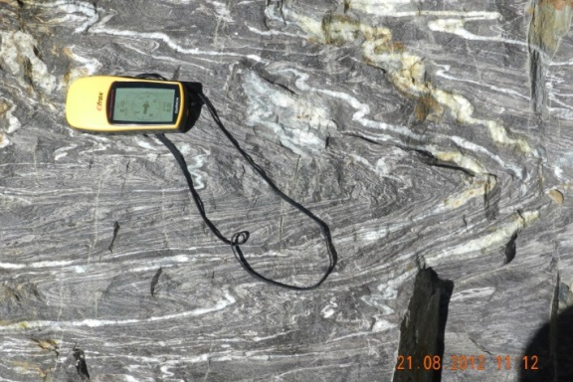
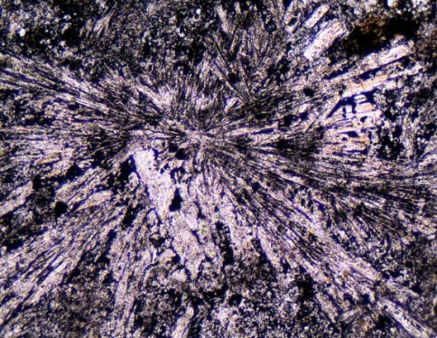
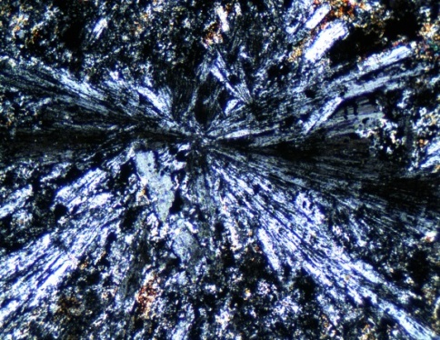
The beginning of zone I – the most low-temperature zone is marked in the first appearance of biotite, also by the formation of nodulose and spotted schists. The rocks of the zone fully retain primary structural and textural features. The thickness of the rocks is within 50-150m.
Mineral assemblages of zone I:
Bt + Ms_{1.35 + 0.89; 1.75 + 1.99} + Pl^{0.46} + Qz;
Bt + Ms + And + Gr + Ab ± Chl_{0.56} ± Qz;
MgHbl_{0.54} + Bt_{0.51‒0.54} + Cal + Pl^{0.82} + Qz;
Cal + Act_{0.52} + Czo; Cal + Cpx + Wo + Gr + Qz.
Contact metamorphism of this zone correspond to the albite-epidote-hornfels facies conditions.
Crenulated hornfels in the Enguri river-canyon
The zone II extends within 40-150 meters. Relics of primary minerals are not observed, although the structural features of the primary rocks are preserved. In contrast to the first zone, the appearance of cordierite, corundum and scapolite, as well as the wide spreading of clinopyroxene marked the second zone.
a
b
Radially fibrous andalusite in hornfels (porphyroblastic schist from metapelites of zone II). a – PPL, b –XPL; 100x
D1663 | EGU2020-2952

Slide 8
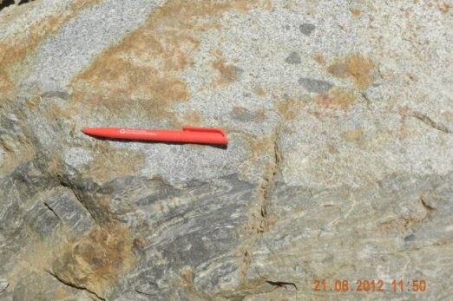
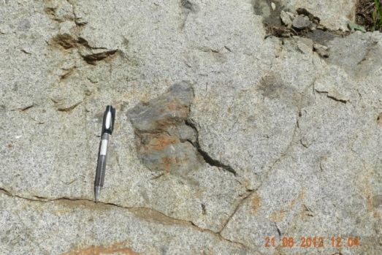
Mineral assemblages of zone II:
And + Bt_{0.51‒0.58} + Crd_{0.60} + Chl_{0.42} + Ms_{1.09 + 1.09} + Pl^{0.34-0.35} + Crn ± Qz;
Bt + Ms + Crn ± Qz; Bt + Ms + Qz;
Bt + Ms + Crn + Chl ± Qz; Act + Pl ± Qz;
Cpx_{0.50} + MgHbl + Act_{0.50‒0.63} + Czo + Pl^{0.41-0.77} + Bt_{0.50} ± Qz; Act + MgHbl + Pl ± Qz; Qz + Cal;
Cpx + MgHbl_{0.50} + Bt_{0.50} + Act + Scp + Cal
Contact metamorphism of the zone correspond to the andalusite–biotite–muscovite–chlorite–hornfels subfacies.
The third, most high-temperature zone III is spread in direct contact with intrusives extending no more than over 10 meters.
a
a – the econtact between syenite-diorites and crenulated hornfels;
b
In the assemblages of this zone, as a rule, no evidences of a partial disintegration of Ms onto And + Kfs are observed. The association – Sil + Kfs was not found in any of the samples, and And + Kfs is observed only in the association with Ms. High-temperature amphiboles also lack there.
b – hornfels xenolith in syenite-diorite.
D1663 | EGU2020-2952

Slide 9
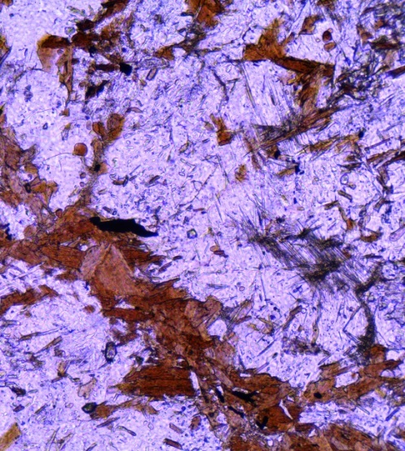
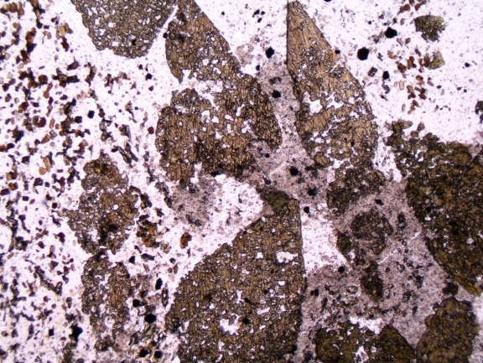
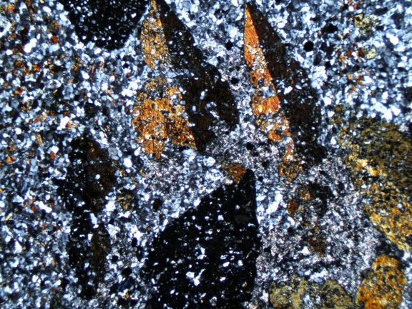
Assemblages of the zone show that they are in the field of stability of Ms with Qz and in the area of stability of andalusite, but near the polymorphic transition line of And→Sil (sporadically, replacement of andalusite or biotite by fibrolite is observed.
Newly formed fibrolites after biotite. PPL, 100x.
a
b
Poikiloblasts of green hornblende in the hornfels. a - PPL, b - XPL; 40x
Idiomorphic hornblende porphyroblasts (1-3 mm) with inclusions of fine idiomorphic grains of quartz and plagioclase are spread in xenoliths, as well as in direct exocontact in biotite–cordierite–andalusite hornfels.
D1663 | EGU2020-2952

Slide 10
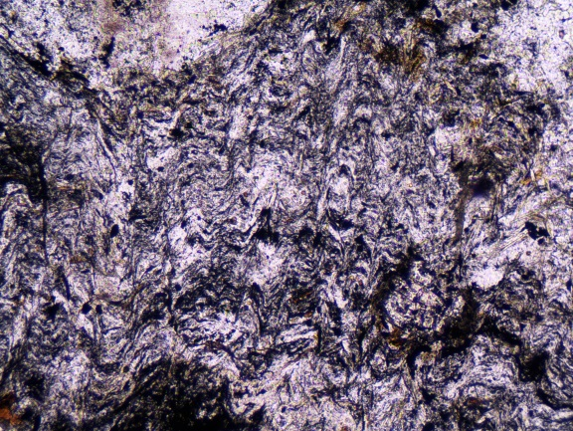
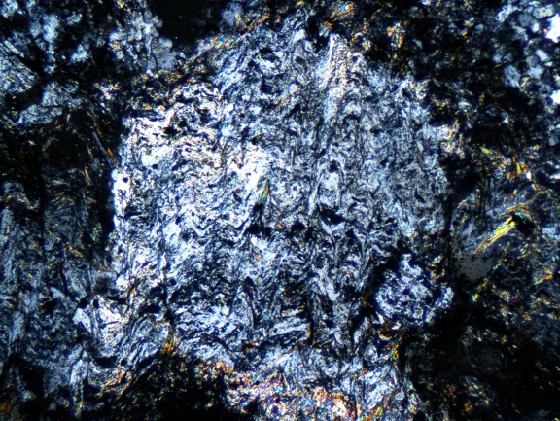
Mineral assemblages of zone III :
And + Bt_{0.46} + Crd_{0.64‒0.65} + Ms_{1.01 + 0.96, 1.28 + 1.28} ± Pl + Qz, And (→ Fi) + Bt_{0.36} + Crd_{0.48} + Ms_{0.90 + 0.38, 1.01 + 0.44} ± Pl + Qz);
And + Bt_{0.36‒0.40} + Crd_{0.48‒0.51} + Ms ± Pl + Qz + Ilm; MgHbl_{0.56‒0.66} + Aug_{0.49‒0.53} + Bt_{0.50} + Czo + Scp + Grt_{Grs-Adr} + Pl^{0.36‒0.54};
Act_{0.70‒0.71; 0.73‒0.75} + Cum_{0.65} + Bt_{0.65} + Pl^{0.49} ± Qz; MgHbl_{0.66} + Cum_{0.62‒0.65} + Bt_{0.64} ± Pl
Contact metamorphism of the zone correspond to the andalusite–biotite–muscovite–hornfels subfacies.
A scheme of progressive changes in minerals of the Dizi series metamorphites was compiled by the authors. In the scheme characteristic features of the minerals compositions are given.
a
b
The hornfels with a helicitic structure. In cordierite porphyroblasts relict crenulation is well preserved: a – PPL, b – XPL; 100x
D1663 | EGU2020-2952

Slide 11
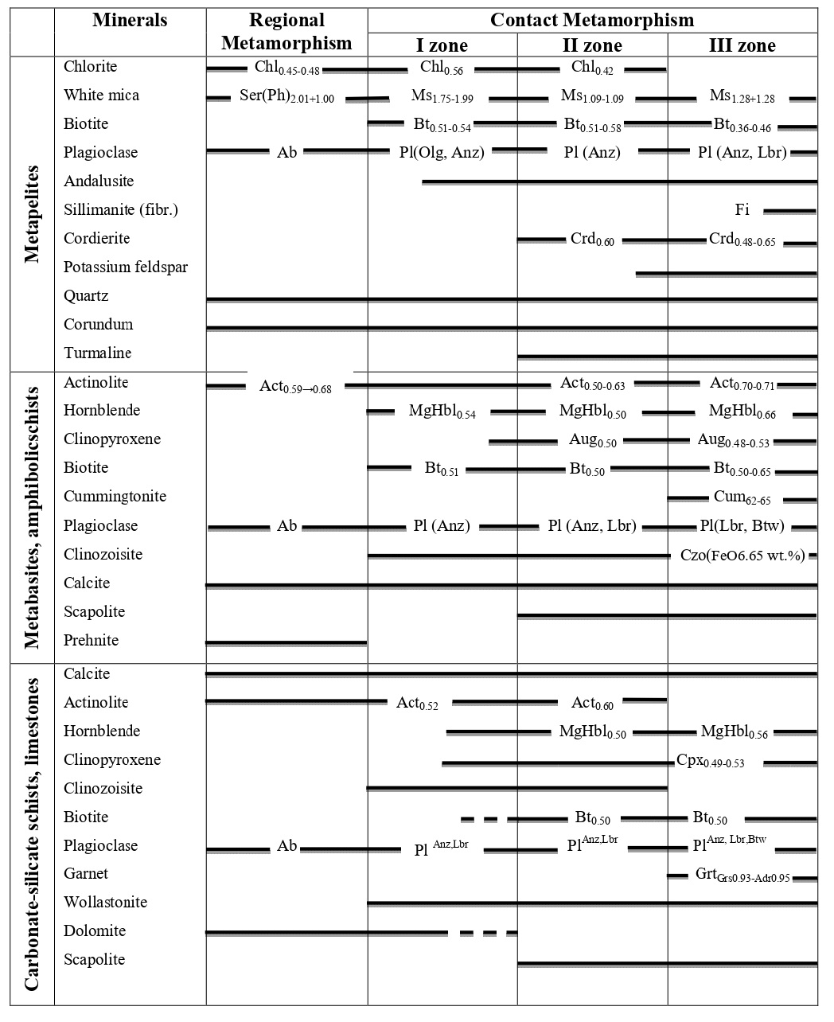
Progressive Changes of Mineral Compositions in the Metamorphites of the Dizi Series
D1663 | EGU2020-2952

Slide 12
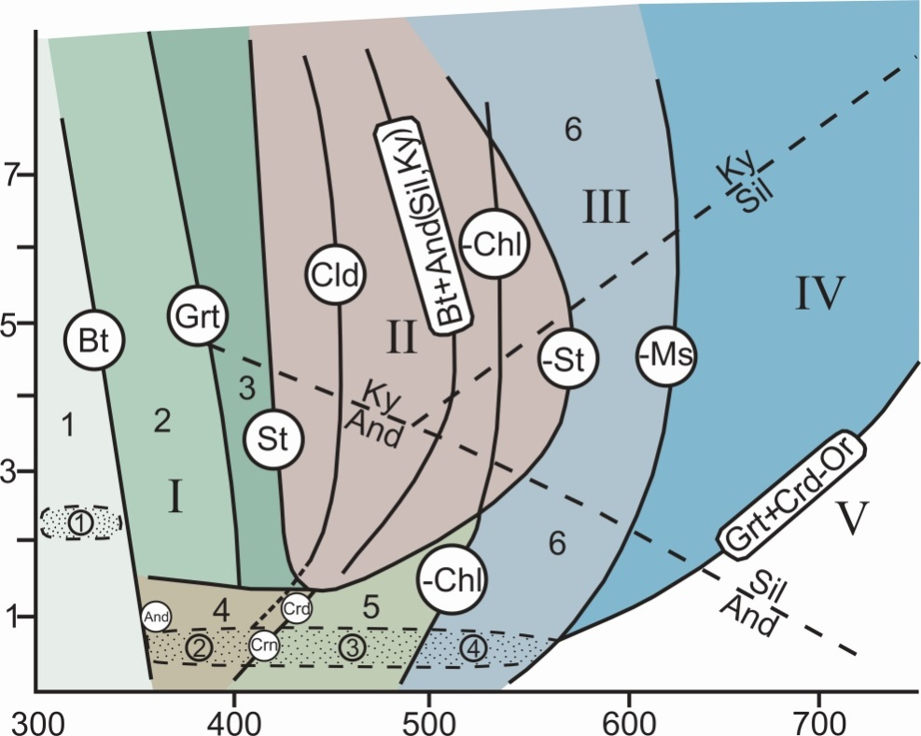
Based on the analysis of the typical mineral assemblages of regional and contact metamorphism of all types of the Dizi series rocks, the authors proposed a scheme of metamorphism facies and subfacies. In the presented scheme, in contrast to the existing similar schemes of regional metamorphism (Korikovsky, 1979, 1991; Korikovsky at al., 1985, 1986, 2018), the fields of facies and subfacies of contact metamorphism are also plotted.
Simplified scheme of the facies and subfacies of regional and contact metamorphism of metapelites (by S.P. Korikovsky, 1991), with additions by the authors.
Roman figures – facies:
I – greenschist, II – staurolite (epidote–amphibolite), III – biotite–muscovite gneisses and hornfels, IV – biotite–sillimanite – K – feldspar, V – garnet–cordierite–orthoclase.
Arabic figures – regional metamorphism subfacies:
1 – chlorite–sericitic (pre–biotitic), 2 – biotitic, 3 – garnet; contact metamorphism subfacies: 4 – albite–epidote–hornfels, 5 – andalusite–biotite–muscovite–chlorite–hornfels, 6 – andalusite–biotite–muscovite–hornfels.
Arabic figures in circles: regionally metamorphosed rocks of the Dizi series – ①; zones of contact – metamorphosed rocks of the Dizi series – zone I ②, zone II ③ and zone III ④. Mineral symbols indicate the reactions of occurrence or disappearance of (–) critical minerals or assemblages.
D1663 | EGU2020-2952

Slide 13
CONCLUSIONS
The rocks of the Dizi series underwent regional metamorphism of chlorite-sericite subfacies of the greenschist facies under a temperature of 300-340°С and pressures of
≈ 2-2.5 kbar.
Due to the contact-thermal impact on the regionally metamorphosed rocks of the Dizi series three exocontact zones corresponding to conditions of albite-epidote-hornfels, andalusite-biotite-muscovite-chlorite-hornfels and andalusite-biotite-muscovite-horn-fels subfacies are distinguished. The maximum temperature of contact metamorphism was ≈ 550°С.
Based on the transformation of compositions of minerals of the Dizi series rocks, graphically in a generalized form distribution of minerals through the metamorphic zones with temperature increase is shown.
The temperature and pressure conditions of regional and contact metamorphism are assessed by the results of analyses of key mineral assemblages and by comparing the obtained data with those of other regions of the world.
A scheme for facies and subfacies of regional metamorphism with low-pressure contact metamorphism areas, added by the authors, is proposed. The fields of both regional and contact metamorphism of the Dizi series rocks are plotted on the scheme as well.
D1663 | EGU2020-2952

Slide 14
REFERENCES
Adamia Sh.A. Pre-Jurassic formations of the Caucasus // Proceedings of Geol. Inst. AN GSSR. 1968. new. Ser., issue 16, 294 p.
Bufe N.A., Holness M.B., Humphreys M. C. Contact metamorphism of Precambrian gneiss by the Skaergaard intrusive. J. Petrology. 2014. 55 №8. P. 1595-1617.
Chikhradze G.A. On the stratigraphy and lithology of the Upper Paleozoic-Triassic deposits of the “Dizi Series” of the Greater Caucasus//Proc. of Georgian Tech. University, 2005. № 2 (456), pp. 88-94.
Coombs D.S., Nakamura V. and Vuagnat M. Pumpellite – Actinolite Facies Schists of the Taveyanne Formation near Loeche, Valais, Switzerland. J. Petrology, 1976. 17 №4. З, p. 440-471.
Dudauri O.Z., Togonidze M.G. Mesozoic magmatism of Georgia. Proceedings of Al.Janelidze Institute of Geology of Iv. Javakhishvili Tbilisi State University., New Series, №128. 2016. 370 p.
Gamkrelidze I.P., Shengelia. D.M. Precambrian-Paleozoic Regional Metamorphism, Granitoid Magmatism and Geodynamics of the Caucasus. “Nauchni Mir”. Moscow. 2005. 479 p. (English summary).
Goishvili B.A. Petrography of magmatic rocks of the Dizi series (Upper Svaneti) // Abstract of a candidate Diss., Tbilisi, Georgian Polytechnic Institute. 1962. 20 p.
Hawthorne F. C., Oberti R., Harlow G. E., Maresch W. V., Martin R. F., Schumacher J. C., Welch M. D. IMA Report. Nomenclature of the amphibolite supergroup. American Mineralogist, 2012. v. 97, pp. 2031-2048.
Kekelia S., Kekelia M., Gagnidze N., Popkhadze N., Mshvenieradze I., Lobzhanidze K., Kharazishvili G. Svaneti Gold Occurences (Kirar-Abakuri Ore Knot) Bulletin of the Georgian National Academy of Sciences, 2017. V.11, N2. Pp.60-68.
Korikovsky S.P. Metamorphism Facies of metapelites. "Nauka", Moscow, 1979. 263p.
Korikovsky S.P. Principles of sub-division of metamorphic sub-facies in zonal aureoles. In: Petrology of the metamorphic complexes of the Greater Caucasus. Moscow. “Nauka”. 1991.Pp. 46-51.
Korikovsky S.P,. Shengelia D.M., Somin M.L. Model of pre-Alpine regional metamorphism of the Greater Caucasus. In: Petrology of the metamorphic complexes of the Greater Caucasus. Moscow. “Nauka”. 1991. Pp. 216-221.
Korikovsky S.P., Tzambel B., Miklosh J., Putish M. Metamorphism of the crystallinikum of the Lesser Carpathians: stages, zonality, relationship with granitoids. Geologicky zbornik. Geologica Carpathica. 1984. T. 35 № 4. С. 437-462.
Korikovsky S.P., Tzambel B., Boronikhin V.A., Putish M., Miklosh J. The phase equilibrium and geothermometry of metapelitic hornfels around the Modra granitic massif (Lesser Carpathians). Geologicky zbornik, Geologica Carpathica.1985. Vol. 36. №1, Bratislava. Pp. 51-74.
Korikovskiy S.P., Yanak M., Boronikhin V.A. Geothermometry and alteration of mineral equilibria during the re-crystallization of garnet-mica schist to cordierite hornfelses in the aureole of Rokhovsky granites (Slovak Highlands, village of Rokhovtse- hut). Geologicky zbornik, Geologica Carpathica. 1986. Vol. 37. №4, Bratislava. Pp. 607-633.
Kutelia Z.A. New data on the stratigraphy of the Dizi series (Svaneti) // Bulletin of Acad. Sci. GSSR. 1984. vol. 109, №3, pp. 29-33.
Reverdatto V.V. Facies of Contact Metamorphism. “Nedra”. Moscow. 1970. 271 p.
Somin M.L. Pre-Jurassic basement of the Main Range and the Southern Slope of the Greater Caucasus. M .: “Nauka”. 1971. 245 p.
Somin M. Pre-Jurassic basement of the Greater Caucasus: Brief Overview. Turkish J. Earth Sci., 2011. vol. 20, pp. 1-65.
Somin M.L., Belov A.A. On the stratigraphic dissection of the Dizi series of Svaneti (Central Caucasus)//Bul. MOIP, Dep. geol., 1976. V.42, is. 1, pp. 16-21.
Withney D.L., Evans B.W. Abbreviations for names of Rock Forming Minerals. American Mineralogist, 2010. vol. 95, pp.185-187.
D1663 | EGU2020-2952

