Slide 1
Atmospheric iodine chemistry from molecular level to 0D/3D simulations: applications to Fukushima nuclear accident
Florent Louis¹, Sonia Taamalli¹, Valérie Fèvre-Nollet¹, Qinyi Li², Carlos A. Cuevas² and Alfonso Saiz-Lopez²
¹Univ. Lille, CNRS, UMR 8522-PC2A, PhysicoChimie des Processus de Combustion et de l´Atmosphère, 59000 Lille, France
²Department of Atmospheric Chemistry and Climate, Institute of Physical Chemistry Rocasolano, CSIC, Madrid 28006, Spain.
EGU2020-3022

Slide 2
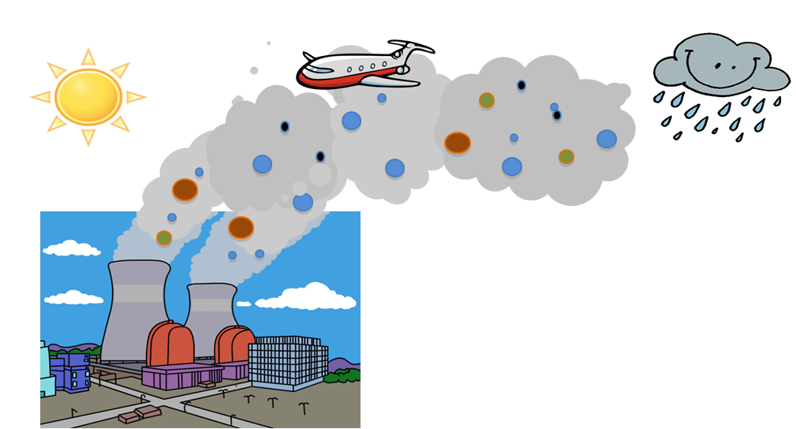
Scientific context
In the case of a severe accident occurring to a Pressurized Water Reactor (PWR)
releases of iodine in the atmosphere
Main scientific objectives
To evaluate the impact of iodine on air quality, health, and climate change
contribution of nuclear power plant ?
contribution of nuclear power plant ?
contribution of nuclear power plant ?
Important part of chemical and physical properties of iodine on
▪ modes of dispersion and deposit
▪ reactivity
▪ source term evaluation
▪ harmful effect on populations
EGU2020-3022

Slide 3
Iodine reaction mechanism: state of the art
# reactions | # organic reactions | # inorganic reactions | # organic photolysis | # inorganic photolysis | Model | Reference
23 | 1 | 13 | 3 | 6 | 0D | McFiggans et al., 2000
39 | 3 | 22 | 6 | 8 | 1D | Pechtl et al., 2006
36 | 1 | 27 | 3 | 5 | 1D | Saiz-Lopez et al., 2008
41 | 1 | 30 | 0 | 10 | 1D | Mahajan et al., 2009
45 | 1 | 33 | 3 | 8 | 0D | Furneaux et al., 2010
42 | 1 | 27 | 4 | 10 | 3D | Ordóñez et al., 2012
58 | 1 | 47 | 0 | 10 | 1D | Sommariva et al., 2012
58 | 3 | 39 | 4 | 12 | 3D | Saiz-Lopez et al., 2014
59 | 3 | 40 | 4 | 12 | 1D/3D | Saiz-Lopez et al., 2016
43 | 1 | 28 | 4 | 10 | 3D | Sherwen et al., 2016
Updated iodine reaction mechanism : 248 reactions
organic iodine: 139 reactions
inorganic iodine: 92 reactions
organic photolysis: 6 réactions
Inorganic photolysis : 11 réactions
EGU2020-3022

Slide 4
0D modelling
Summary of test cases
Parameters | Summer (S)
 | Day (D) |  |  |  |  | Night (N)
Injection | Low (L) |  | Medium (M) | High (H) |  | Low (L) | Medium (M) | High (H)
I₂ (ppt) | 0,98 |  | 98 | 9800 |  | 0,98 | 98 | 9800
CH₃I (ppt) | 1,96 |  | 196 | 19600 |  | 1,96 | 196 | 19600
Hour (h) | 4 |  | 4 | 4 |  | 21 | 21 | 21
Paramètres | Winter (W)
 | Day (D) |  |  |  |  | Night (N)
Injection | Low (L) | Medium (M) |  | High (H) |  | Low (L) | Medium (M) | High (H)
I₂ (ppt) | 0,98 | 98 |  | 9800 |  | 0,98 | 98 | 9800
CH₃I (ppt) | 1,96 | 196 |  | 19600 |  | 1,96 | 196 | 19600
Hour (h) | 7 | 7 |  | 7 |  | 18 | 18 | 18
EGU2020-3022

Slide 5
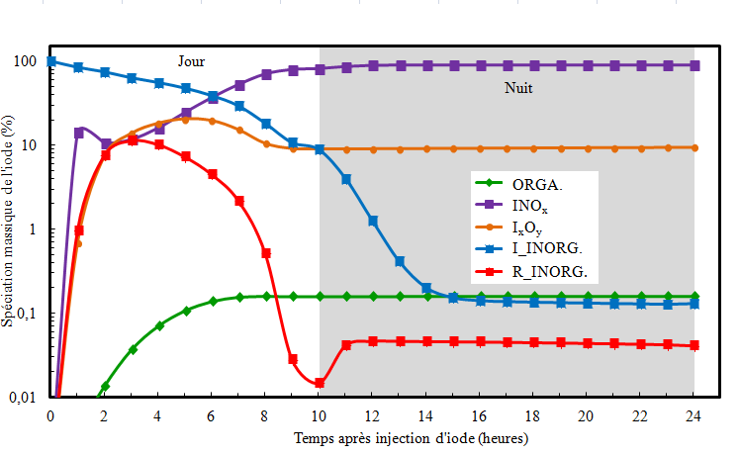
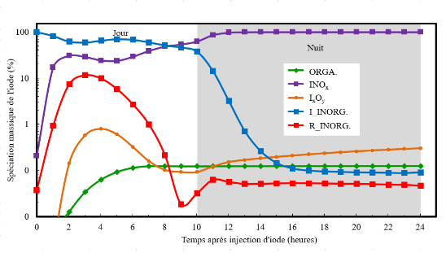
0D modelling
Test case WDM-I₂
Fortin C., Ph-D, University of Lille, 2019
For more details, look at Fortin et al. Atm. Env. 2019, 214, 116838
Saiz-Lopez et al., 2016
EGU2020-3022

Slide 6
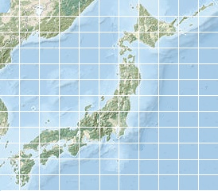
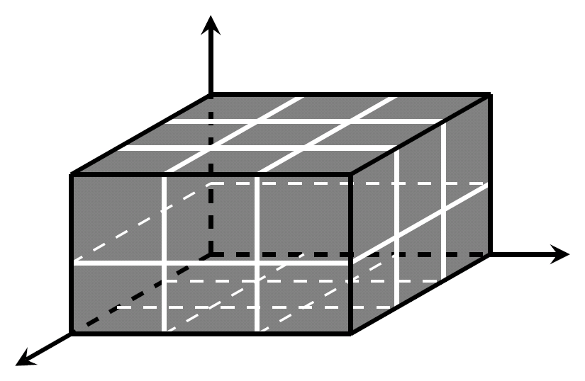
3D modelling
z
Y : Latitude
+ Fukushima Daiichi
y
x
X : Longitude
Z : High level
Representative scheme of a 3D modelling tool
Use of CAM-Chem (a global chemistry climate model, Cuevas et al., 2018) and WRF-Chem (a regional chemical transport model, Li et al., 2020; Badia et al., 2019)
Study of the dispersion of iodine release and its chemical impact on atmospheric composition at local, regional to global scales
A potentially important role of iodine release at the site and its adjacent areas is expect
EGU2020-3022

Slide 7
References
Cuevas, C.A., Maffezzoli, N., Corella, J.P., Spolaor, A., Vallelonga, P., Kjær, H.A., Simonsen, M., Winstrup, M., Vinther, B., Horvat, C. and Fernandez, R.P., 2018. Rapid increase in atmospheric iodine levels in the North Atlantic since the mid-20th century. Nature communications, 9(1), pp.1-6.
Badia, A., Reeves, C.E., Baker, A.R., Saiz-Lopez, A., Volkamer, R., Koenig, T.K., Apel, E.C., Hornbrook, R.S., Carpenter, L.J., Andrews, S.J. and Sherwen, T., 2019. Importance of reactive halogens in the tropical marine atmosphere: a regional modelling study using WRF-Chem. Atmospheric Chemistry and Physics, pp.3161-3189.
Li, Q., Badia, A., Wang, T., Sarwar, G., Fu, X., Zhang, L., Zhang, Q., Fung, J., Cuevas, C.A., Wang, S. and Zhou, B., Potential Effect of Halogens on Atmospheric Oxidation and Air Quality in China. Journal of Geophysical Research: Atmospheres, p.e2019JD032058.
Saiz-Lopez, A., Fernandez, R.P., Ordóñez, C., Kinnison, D.E., Gómez Martín, J.C., Lamarque, J.F. and Tilmes, S., 2014. Iodine chemistry in the troposphere and its effect on ozone. Atmospheric Chemistry and Physics, 14(23), pp.13119-13143.
Fortin, C., Fèvre-Nollet, V., Cousin, F., Lebègue, P., and Louis, F., 2019, Box modelling of gas-phase atmospheric iodine chemical reactivity in case of a nuclear accident. Atmospheric Environment, 214, 116838, 2019.
EGU2020-3022

