Slide 1
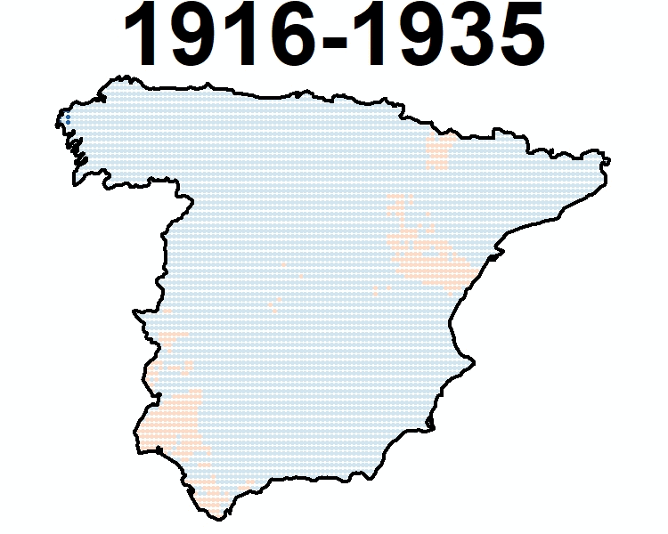
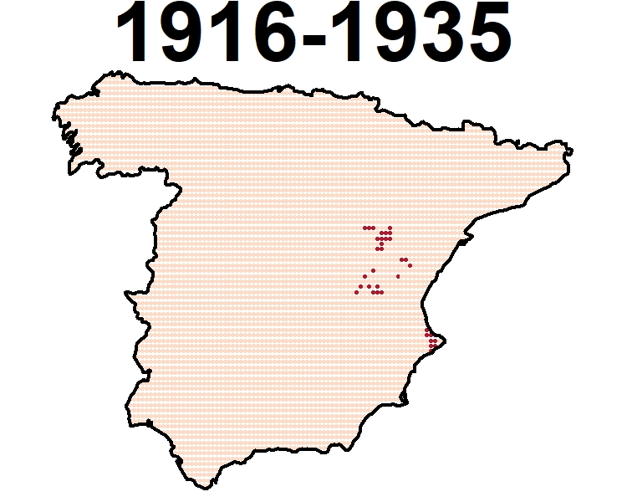
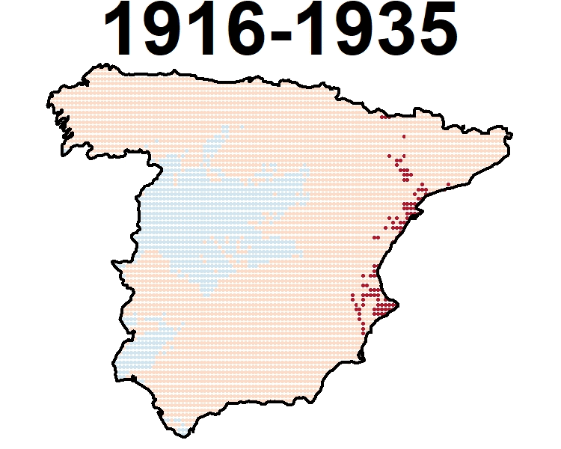
EGU General Assembly 2020, Vienna, Austria
Tmax (Winter)
Tmax (Spring)
Tmax (Summer)
Tmax (Autumn)
MOTEDAS Century Database
Part 2:Spatial Variation of Temperature trend: the UP-TO-Date effect
Instituto Pirenaico de Ecología, CSIC, Zaragoza, SPAIN (dpang@unizar.es)
University of Zaragoza, Geography, Zaragoza, Spain (leiresandonis@unizar.es; jcgh@unizar.es)
Institute of Atmospheric Sciences and Climate (ISAC-CNR), Bologna, Italy (m.brunetti@isap.cnr.it)
Estación Experiemental Aula Dei, CSIC, Zaragoza, Spain (sbegueria@eead.csic.es)
Proyecto “CLICES”, El clima del último siglo en la España Peninsular” (CGL2014-83866-C3-1-R ,CGL2014-83866-C3-3-R). AEI/FEDER, UE. Ministerio de Economía y Competitividad de España. Gobierno Regional de Aragón DGA-FSE
Grupo de Investigación Consolidado ‘Clima, Agua, Cambio Global y Sistemas Naturales’.
Visit clices.unizar.es

Slide 2
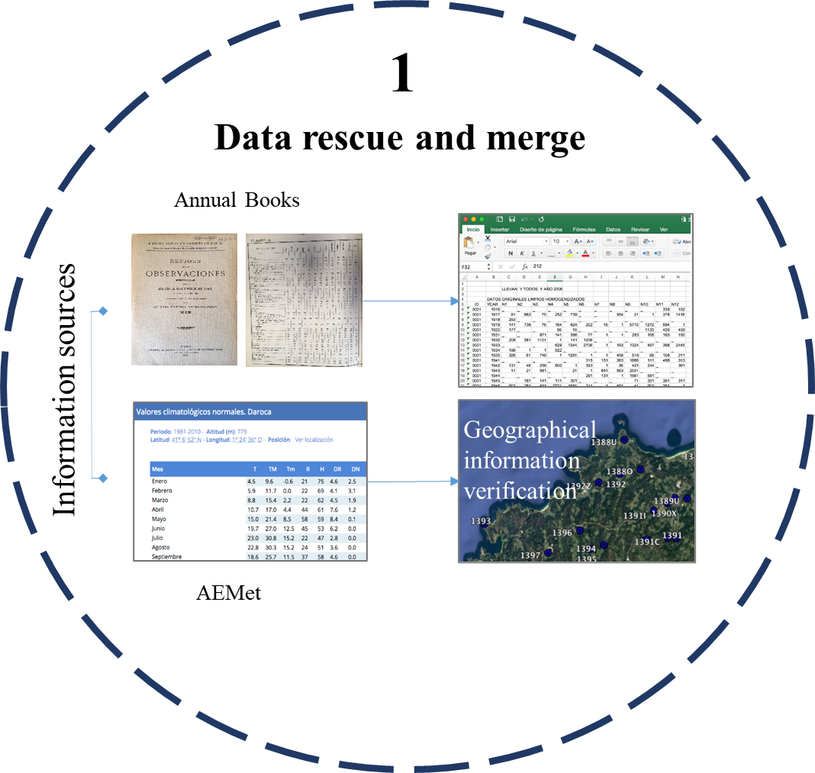
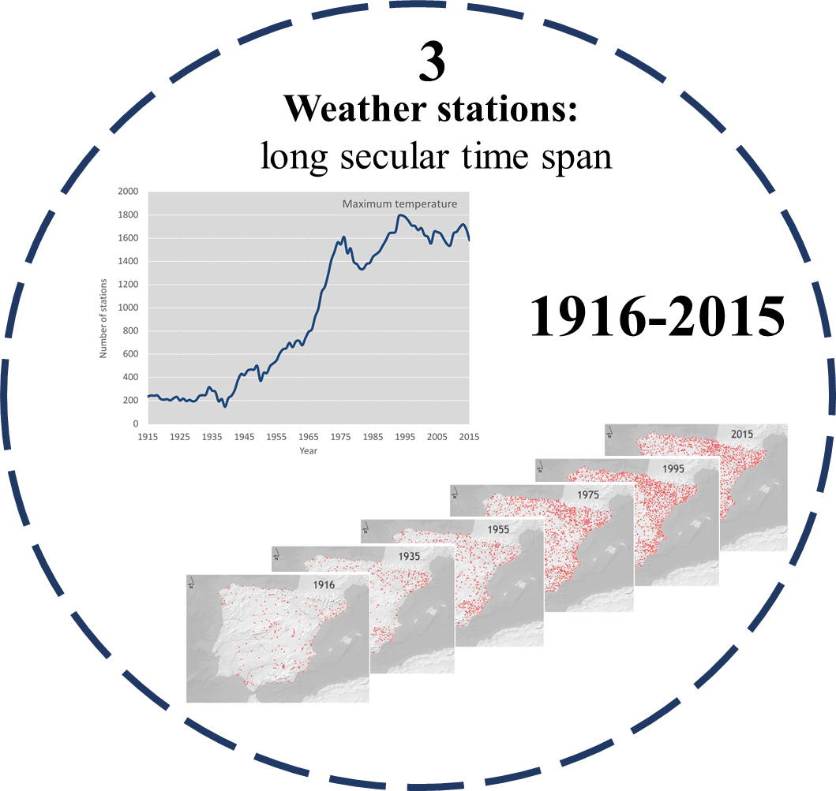
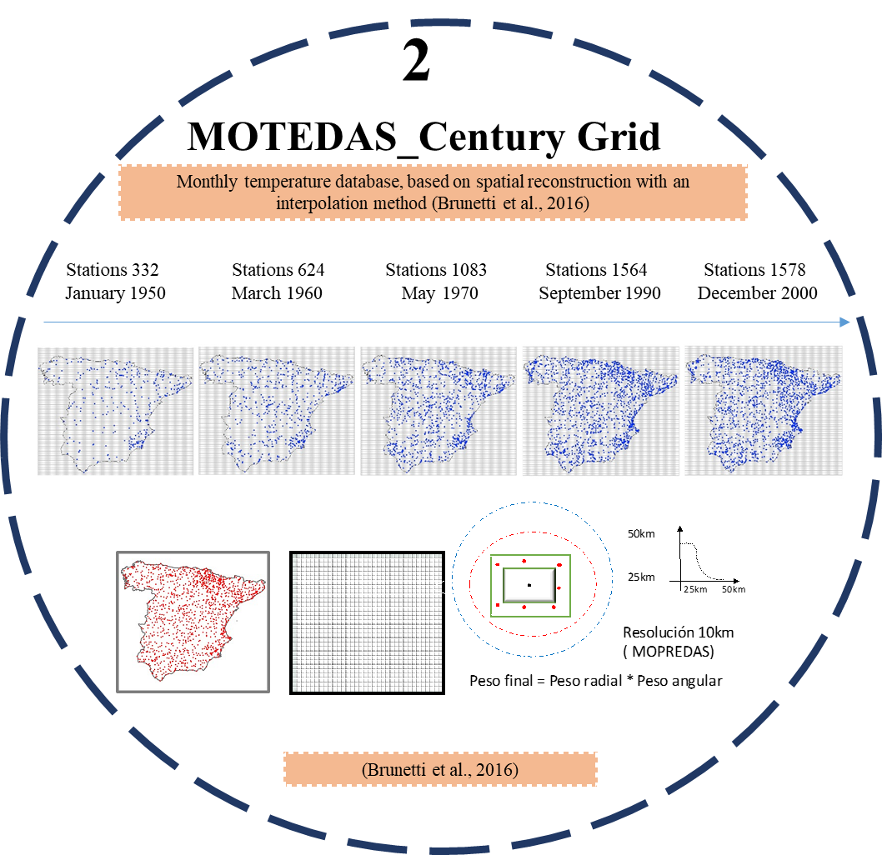
MOTEDAS Century
We have been able to obtain trends in temperatures (Tmax, Tmin) from the early 20th century (1916) to nowadays (2015).
The mains objectives are to detect changes in trend temperature evolution and their spatial variability.

Slide 3
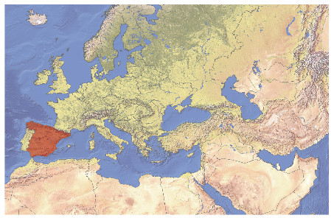
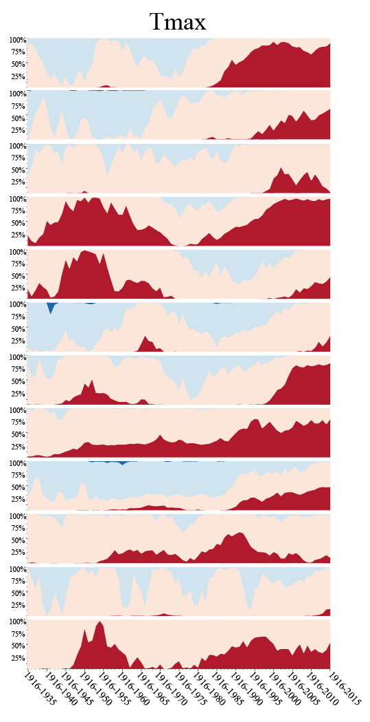
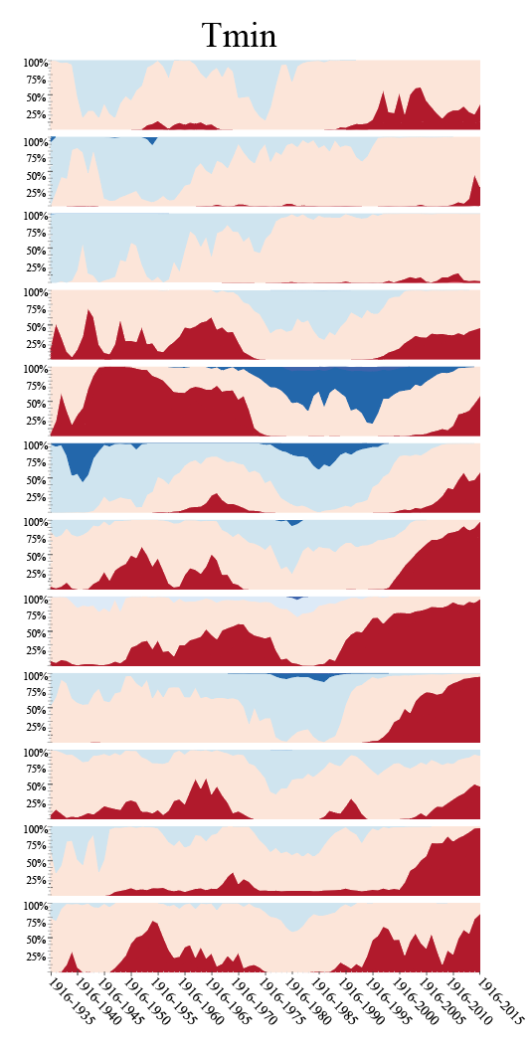
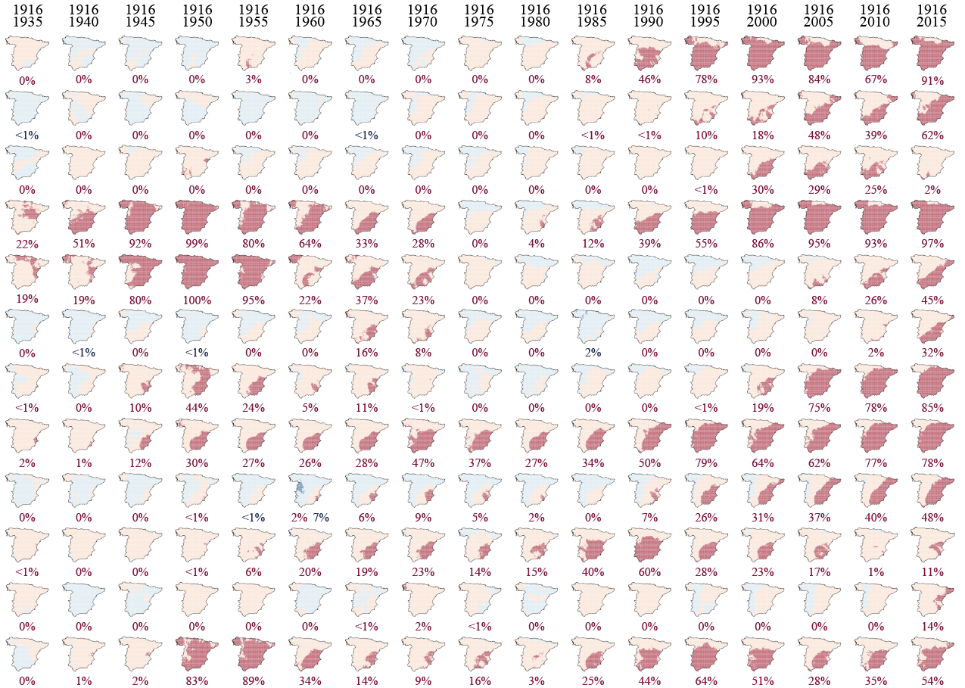
MOTEDAS Century Database
Part 2: Spatial Variation of temperature trend: the UP-TO-DATE effect.
Instituto Pirenaico de Ecología, CSIC, Zaragoza, SPAIN (dpang@unizar.es)
University of Zaragoza, Geography, Zaragoza, Spain (leiresandonis@unizar.es; jcgh@unizar.es)
Institute of Atmospheric Sciences and Climate (ISAC-CNR), Bologna, Italy (m.brunetti@isap.cnr.it)
Estación Experiemental Aula Dei, CSIC, Zaragoza, Spain (sbegueria@eead.csic.es)
Sandonís-Pozo, L.⁽²⁾, Peña-Angulo, D. ⁽¹⁾, Brunetti, M. ⁽³⁾, Beguería. S.⁽⁴⁾, González-Hidalgo, J.C. ⁽²⁾
Proyecto “CLICES”, El clima del último siglo en la España Peninsular” (CGL2017-83866-C3-1-R, CGL2017-83866-C3-3-R). AEI/FEDER, UE Ministerio de Economía y Competitividad de España. Gobierno Regional de Aragón DGA-FSE Grupo de Investigación Consolidado ‘Clima, Agua, Cambio Global y Sistemas Naturales’.
INTRODUCTION AND OBJECTIVES
Due to the long secular time span covered by the new MOTEDAS_Century temperature database in Spanish mainland, we have been able to obtain trends in temperatures from the early 20th century (1916) to nowadays (2015).
The mains objectives are to detect changes in trend temperature evolution and their spatial variability.
Visit clices.unizar.es
HOW TO READ THE MAP COLLECTION AND AREAL FIGURES
We have produced a collection of charts using moving windows and also calculated annually the percentage of land affected by significant/non-significant and positive/negative signal.
Maps show an increasing length period from 1916-1935 to 1916-2015. They show signal of trend by colour (positive red, negative blue). The significance level of probability of Mann Kendall test is given by intensity of colour (p value <0.05).
The analysis of percentage of land affected by different trends, show a highly variability at monthly level; both in Tmax in Tmin.
METHODOLOGY
We have applied the moving window approach to analyse temporal changes of trends of maximum and minimum monthly trend temperatures. We used increasing temporal windows of varying length, from a minimum period of twenty years (1916-1935) to a maximum of 100 years (1916-2015).
The signal and significance (p<0.05) of trends accordingly to a pre-whitened Mann-Kendall test was identified.
Monthly percentage of land accordingly trend
RESULTS
The temperature increase occurred in two pulses separated by the first hiatus of the 20th century, except in winter months.
No significant temperature increases are detected (February), and even significant negative temperature trends are detected (April and May) particularly in Tmin.
The area affected in Tmax expand/contract from E to W (from the Mediterranean to inland); in Tmin the spatial gradient detected is W-E (from the Atlantic to inland).
CONCLUSIONS
The increase of temperatures has not been generalized at the monthly scale, neither synchronous between Tmax-Tmin, and presents different spatial gradients.
Two main pulses of increase temperature both in Tman and Tmin have been identified but they differ at temporal and spatial level.
The evolution of temperature in Spanish mainland is far from being a simple process, and show differences at various spatial and temporal scales.
EGU Genera Assembly 2020, Vienna, Austria

Slide 4
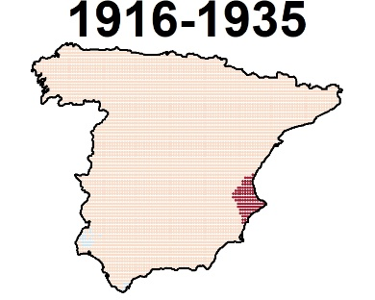
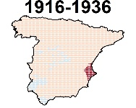
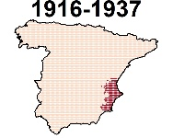
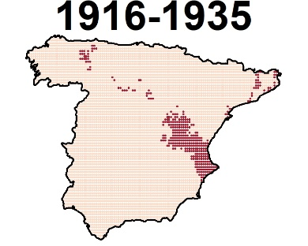
Methodology
July (Tmax)
We have applied the moving window approach to analyse temporal changes of trends of maximum and minimum monthly trend temperatures.
20 YEARS
100 YEARS
+1 year
+1 year
+1 year
…
We used increasing temporal windows of varying length, from a minimum period of twenty years (1916-1935) to a maximum of 100 years (1916-2015).
July (Tmin)
The signal and significance (p<0.05) of trends accordingly to a pre-whitened Mann-Kendall test was identified.
20 YEARS
100 YEARS
+1 year
EGU General Assembly 2020, Vienna, Austria

Slide 5
How to read the map collection and areal figures
We have produced a collection of charts using moving windows and also calculated annually the percentage of land affected by significant/non-significant and positive/negative signal.
% of land
The spatial distribution of percentage of land affected by different trends has been represented
year
They show signal of trend by colour (positive red, negative blue). The significance level of probability of Mann Kendall test is given by Intensity of colour (p value <0.05).
EGU General Assembly 2020, Vienna, Austria

Slide 6
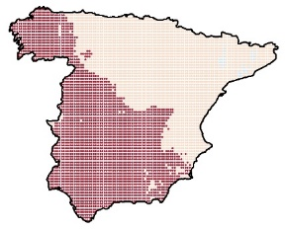
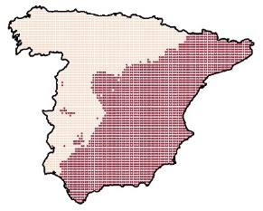
Results
The temperature increase occurred in two pulses separated by the first hiatus of the 20th century, exception: winter months and July (Tmax).
E
E
No significant temperature increases are detected in some months: (February),
Even significant negative temperature trends are detected (April and May) particularly in Tmin.
W
W
The areas affected by positive and significant trends fluctuate:
the area affected in Tmax expand/contract from E to W (from the Mediterranean to inland);
the area affected in Tmin the spatial gradient detected is W-E (from the Atlantic to inland).
Tmin
Tmax
EGU General Assembly 2020, Vienna, Austria

Slide 7
Conclusions
The increase of temperatures has not been generalized at the monthly scale, neither synchronous between Tmax-Tmin, and presents different spatial gradients.
Two main pulses of increase temperature both in Tmax and Tmin have been identified but they differ at temporal and spatial level.
These results show that the evolution of temperature in Spanish mainland is far from being a simple process, and show differences at various spatial and temporal scales.
In the following slides you can find the poster figures in more detail.
EGU General Assembly 2020, Vienna, Austria

Slide 8
Areal figures
Monthly percentage of land accordingly trend
Monthly percentage of land accordingly trend
EGU General Assembly 2020, Vienna, Austria

Slide 9
Tmax
E
W
EGU General Assembly 2020, Vienna, Austria
EGU General Assembly 2020, Vienna, Austria

Slide 10
Tmin
E
W
EGU General Assembly 2020, Vienna, Austria

Slide 11
Visit clices.unizar.es
Notes:
.

Slide 12
EGU General Assembly 2020, Vienna, Austria
Tmax (Winter)
Tmax (Spring)
Tmax (Summer)
Tmax (Autumn)
¡¡¡Thank you for attention!!!
leiresandonis.@unizar.es
Instituto Pirenaico de Ecología, CSIC, Zaragoza, SPAIN (dpang@unizar.es)
University of Zaragoza, Geography, Zaragoza, Spain (leiresandonis@unizar.es; jcgh@unizar.es)
Institute of Atmospheric Sciences and Climate (ISAC-CNR), Bologna, Italy (m.brunetti@isap.cnr.it)
Estación Experiemental Aula Dei, CSIC, Zaragoza, Spain (sbegueria@eead.csic.es)
Proyecto “CLICES”, El clima del último siglo en la España Peninsular” (CGL2014-83866-C3-1-R ,CGL2014-83866-C3-3-R). AEI/FEDER, UE. Ministerio de Economía y Competitividad de España. Gobierno Regional de Aragón DGA-FSE
Grupo de Investigación Consolidado ‘Clima, Agua, Cambio Global y Sistemas Naturales’.

