Slide 1
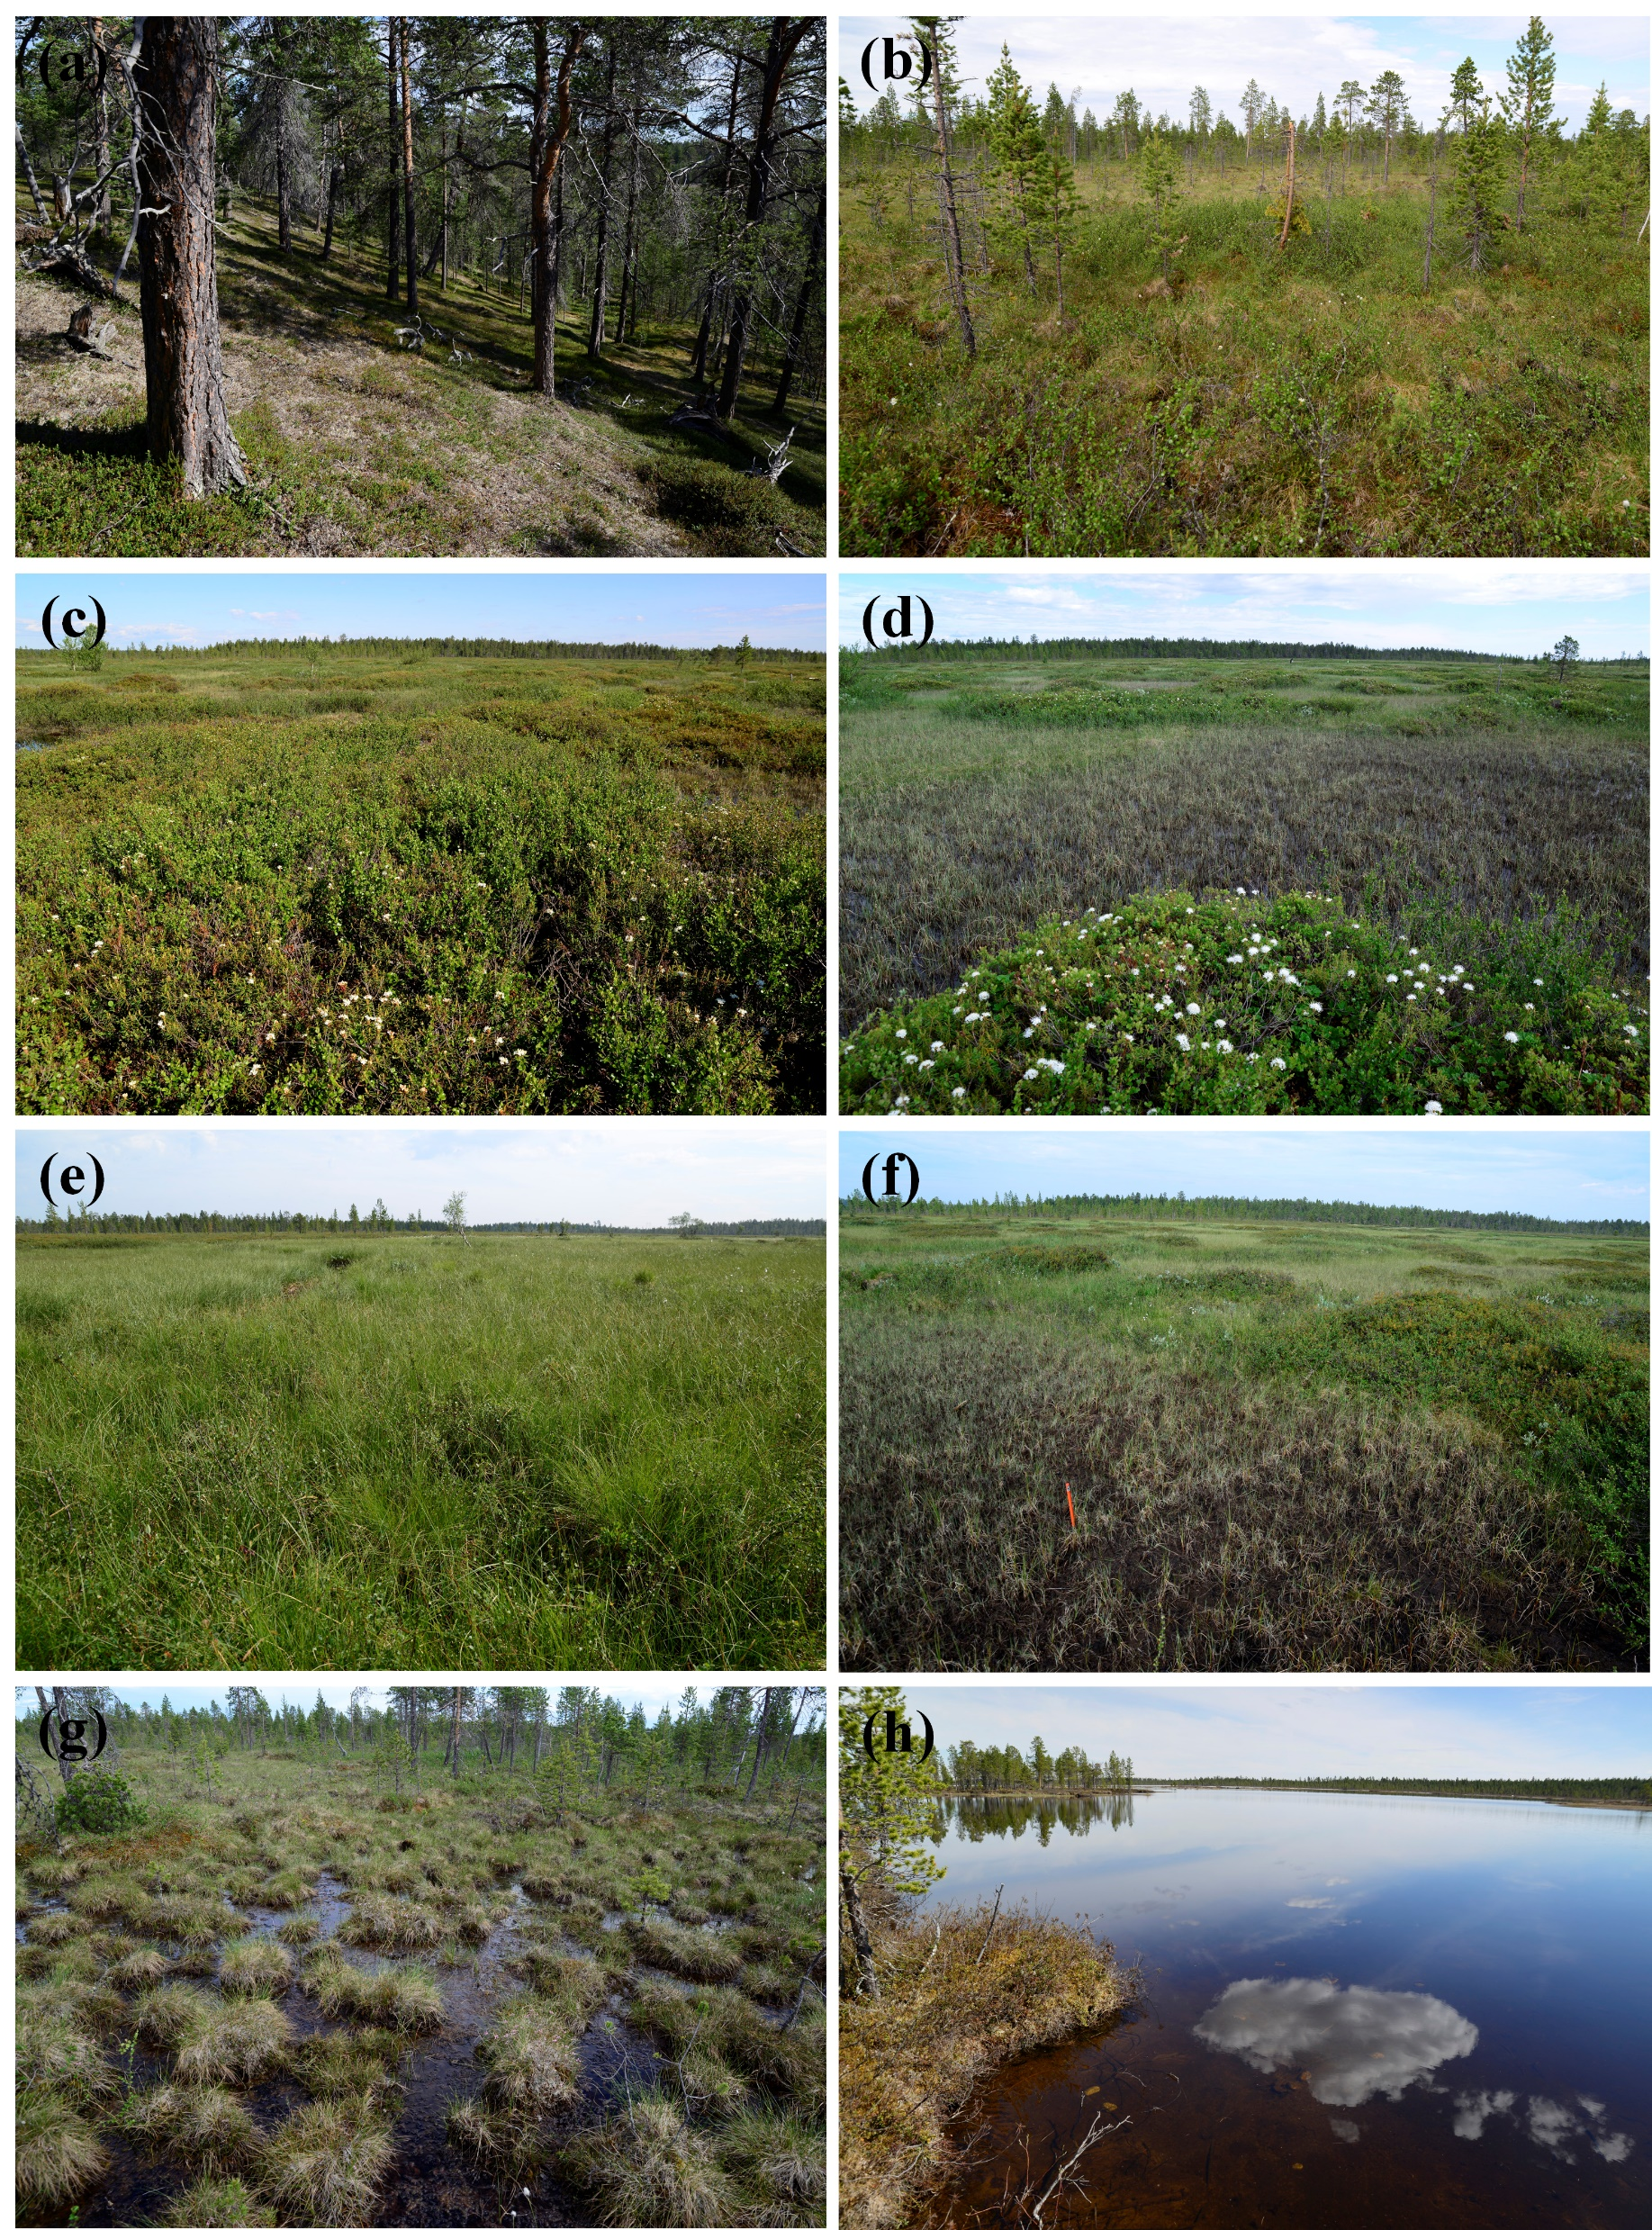
Decadal carbon balance and its response to 2 ºC warming among heterogenous Arctic landscapes
Dan Kou, Tarmo Virtanen, Aleksi Räsänen, Sari Juutinen, Mika Aurela, Lauri Heiskanen, Mingyang Guo, Qianlai Zhuang, Claire Treat, Atte Korhola and Narasinha Shurpali
E-mail: dan.kou@uef.fi
Introduction
Results
The large amount of carbon (C) stored in the Arctic region can strongly interact with the climate system through the exchange of carbon dioxide (CO₂) and methane (CH₄) under the unmitigated environmental changes. Currently, there are still large uncertainties in the C exchange and subsequent C-climate feedbacks between the land and atmosphere across the Arctic region, to which the highly heterogeneous landscapes make a key contribution. However, our knowledge on the present and future ecosystem C balance jointly considering the exchange of CO₂ and CH₄ in the Arctic region with heterogeneous landscapes is still limited.
Figure 3. Observed and the corresponding simulated carbon dioxide (CO₂, a-i) and methane (CH₄, j-l) fluxes in the bog land cover type. The bog land cover type is composed of three subtypes: pine bog (a, d, g, j), string top of open bog (b, e, h, k) and string margin of open bog (c, f, i, l). The CO₂ flux in the three bog land cover types was represented by three indicators: net ecosystem exchange (NEE, a-c), gross primary productivity (GPP, d-f) and ecosystem respiration (ER , g-i). Sim., simulated CO₂ or CH₄ fluxes; Obs., observed CO₂ or CH₄ fluxes; N, the number of observations; Mean_obs., the mean value of observations; RMSE, root mean square error; DOY, day of year. The gray line represents the daily interpolated flux chamber measurements.
Figure 6. Decadal carbon balance, including CO₂, CH₄ and total warming potential, for each land cover type and the whole region in the Kaamanen region under current climate scenarios and 2 ºC warming scenarios.
Methods
Most ecosystems functioned as CO₂ sink and CH₄ source
The fen land cover types tend to accelerate climate warming, while the bog land cover types tend to cool the climate over the past decade
Year 2013
Figure 4, Observed and the corresponding simulated carbon dioxide (CO₂, a-i) and methane (CH₄, j-l) fluxes in the fen land cover type. The fen land cover type is composed of three subtypes: tall sedge fen (a, d, g, j), wet flark fen (b, e, h, k) and wet tussock fen (c, f, i, l). The CO₂ flux in the three fen land cover types was represented by three indicators: net ecosystem exchange (NEE, a-c), gross primary productivity (GPP, d-f) and ecosystem respiration (ER, g-i). Sim., simulated CO₂ or CH₄ fluxes; Obs., observed CO₂ or CH₄ fluxes; N, the number of observations; Mean_obs., the mean value of observations; RMSE, root mean square error; DOY, day of year.
G3
Figure 1. Location and remote-sensing-based land cover types across the studied sub-arctic Forest-Peatland-Lake gradient in northern Finland.
Year 2007
Figure 7. Warming sensitivity of ecosystem CO₂, CH₄ and total warming potential for each land cover type in the Kaamanen region.
Figure 2. Landscape examples for the land cover types across the Forest-Peatland-Lake landscape gradient. (a) pine forest, (b) pine bog, (c) open bog: string top, (d) open bog: string margin, (e) tall sedge fen, (f) wet flark fen, (g) wet tussock fen, and (h) lake.
Figure 5. Observed and the corresponding simulated carbon dioxide in the pine forest. The CO₂ flux in the pine forest was represented by net ecosystem exchange (NEE, a) and cumulative NEE (b). DOY, day of year.
Generally, 2 ºC warming has insignificant effects on NEE, while has significant positive effects on CH₄ fluxes
Conclusions
Most land cover types functioned as CO₂ sink and CH₄ source both under warming and non-warming scenarios
2 ºC warming could significantly increase CH₄ emissions but have little effect on NEE
This work was supported by CAPTURE (Carbon dynamics across Arctic landscape gradients: past, present and future ).

