Slide 1


Paleo-surface ruptures at both sides of a pressure ridge along Alhama de Murcia Fault (SE Spain)
Octavi Gómez-Novell (a), María Ortuño (a), Julián García-Mayordomo (b), Eulàlia Masana (a),
Thomas K. Rockwell (c), Stéphane Baize (d) and Raimon Pallàs (a)
(a) RISKNAT Group, Facultat de Ciències de la Terra, Universitat de Barcelona, 08028 Barcelona, Spain (octgomez@ub.edu)
(b) Instituto Geológico y Minero de España, 28760 Tres Cantos, Spain.
(c) Department of Geological Sciences, San Diego State University, San Diego, CA 92182, USA.
(d) Institut de Radioprotection et Sûreté Nucléaire - Seismic Hazard Division (BERSSIN), BP 17, 92262 Fontenay-aux-Roses,
France.
Session NH4.1 - Seismic hazard based on paleoseismicity, active faulting and surface deformation data - the challenges of FAULT2SHA

Slide 2
1. GEOLOGICAL SETTING
The Alhama de Murcia Fault (AMF) is one of the most seismically active faults in the Iberian Peninsula. It is a left-lateral strike slip fault within the Eastern Betics Shear Zone (EBSZ), a 500 km long fault system that absorbs most part of the convergence between the Eurasian and Nubian plates. This fault system has hosted important earthquakes since historical times, some of them related to the AMF (i.e. 2011 Mw 5.2 Lorca earthquake).
CF: Carboneras Fault; PF: Palomares Fault; CAF: Carrascoy Fault; BSF: Bajo Segura Fault
Session NH4.1

Slide 3
2. STUDY AREA
The section between Lorca and Totana towns (Murcia region, Spain) is the central part of AMF and it shows one of the most marked surface expressions of the whole fault. The fault divides into several branches, the two frontal ones forming a pressure ridge.
Previous paleoseismic studies have mainly focused in this sector of the fault and especially in the Northwestern branch of the pressure ridge, where most of the displacement is strike-slip, while the Southern branch (SAMF) has never been directly observed.
We performed two paleoseismic excavations in two sites on both branches of the pressure ridge: La Hoya and El Saltador sites.
Session NH4.1

Slide 4
Fault mapping of a drone image with the location of the studied paleoseismic sites.
Session NH4.1

Slide 5
3. LA HOYA SITE
Six paleoseismic trenches were excavated in this site in order to identify deformation related to the SE branch of the pressure ridge (SAMF). Clear fault deformation was only identified in Trench 3 (T-3) within the infills of La Salud Creek. The rest of the trenches exposed either highly deformed pre-Quaternary alluvial deposits (T-1 and T-4) or non-deformed recent Quaternary alluvial fan deposits (T-1-5, T2 and T-5).
Session NH4.1

Slide 6
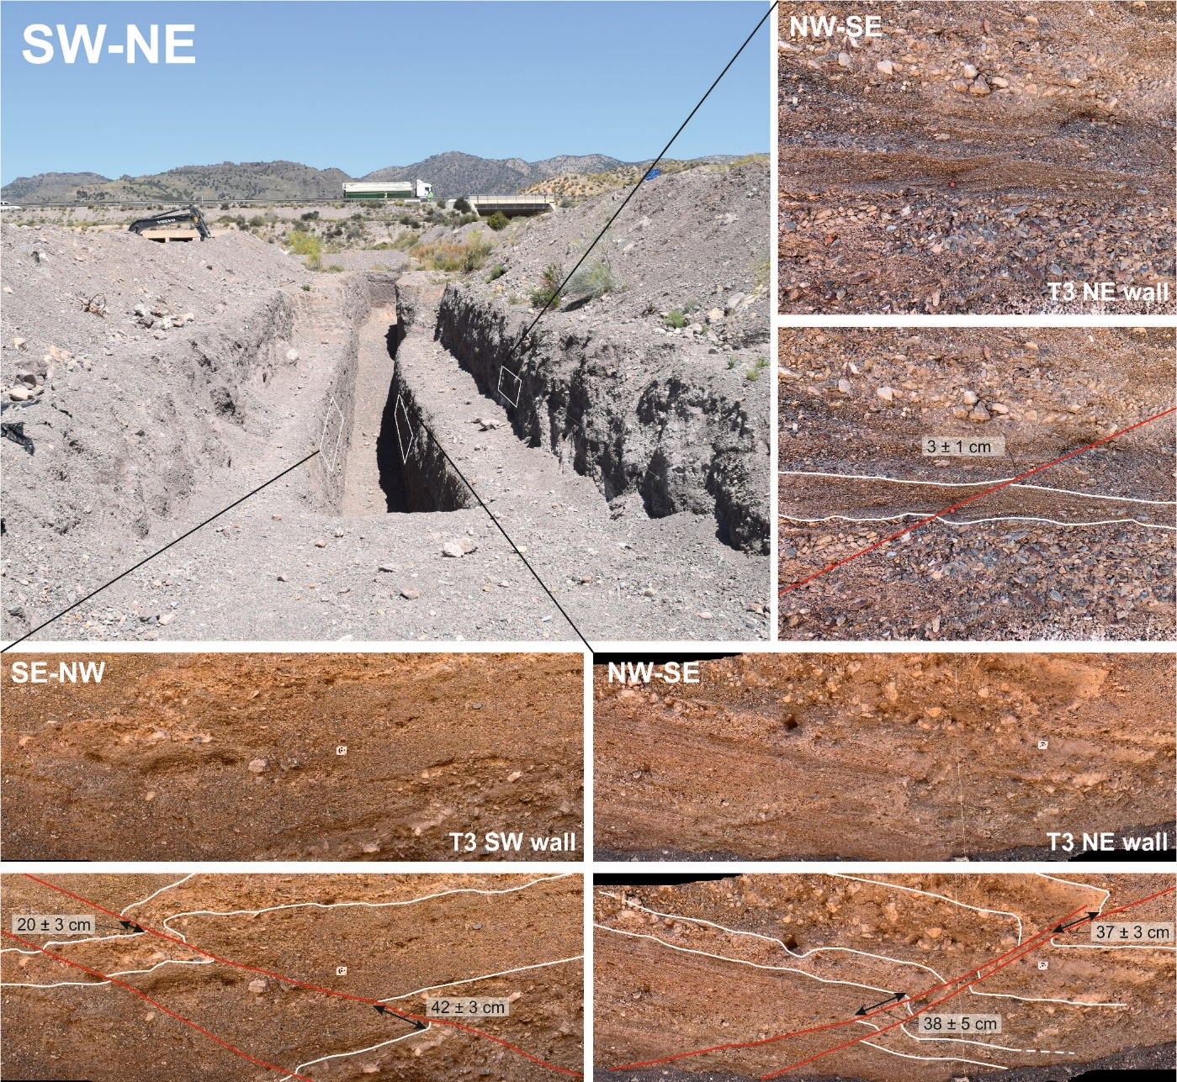
3. LA HOYA SITE: T-3
T-3 exposed the SE branch of the AMF pressure ridge and its related deformation. It is a low angle (~20º dip) reverse fault that accommodates most of the deformation in a flexion that has the approximate size of the trench length (~40 m long). Offsets on the fault plane are a small portion of the total deformation and are higher in the lower units, which evidences recurrent paleoevents.
The criteria applied to identify the paleoseismic events in T3 are:
- Upward fault terminations evidenced by units postdating deformation generated by faults
- Different fault offsets along the stratigraphic sequence, implying recurrent ruptures.
- Angular unconformities due to the syn-tectonic deposition of the alluvial units related to fold-growth.
Session NH4.1
Images of T-3

Slide 7
The mentioned criteria allowed us to interpret at least 5 paleoseismic events, being the last one posterior to 8-9 ka BP according to new radiocarbon dates.
This implies that the SW branch of the pressure ridge is active during the Holocene.
* Yellow discontinuous lines represent event-horizons.
Session NH4.1

Slide 8
Session NH4.1

Slide 9
We calculated the vertical offsets of several units in T-3 by restoring the observed flexion to its depositional slope assuming a symmetric morphology. We performed the analysis considering the depositional slope of La Salud Creek (2.1 ± 0.4º) and considering maximum and minimum positions of the unit contacts as they are irregular due to erosive relationships (i.e. paleochannels). The respective errors have been properly propagated throughout the analysis.
Stratigraphic unit | Vertical offset and their respective errors (m)
Q | 4.9 ± 0.4
M | 2.9 ± 0.2
L | 3.0 ± 0.2
J | 3.6 ± 0.2
I2 | 3.3 ± 0.2
I1 | 3.2 ± 0.2
We calculated the offsets considering the S termination of the trench as the end of the flexion. Since in this part of the trench lower units still show slightly higher dips than the depositional slope, the offsets calculated here are a minimum.
Session NH4.1

Slide 10
La Hoya site overview
This paleoseismic study sheds light for the first time to the Quaternary activity of the frontal branch of AMF pressure ridge. 5 paleoseismic events have been identified, the last one being in the Holocene.
This fault branch accommodates mostly the reverse-dip-slip component of the pressure ridge as it is a low angle thrust. Despite this, the role of a possible lateral component could be explored in 3D trenching studies in the future.
The cummulative vertical offset linked to this fault is around 4-5 m minimum, as inferred from restoration of the stratigraphic sequence in T-3.
OSL dates are being performed at the moment. The forthcoming date results will allow us to establish a crono-sequence of the seismic events identified in T-3 and an uplift rate for the offsets calculated in this trench.
Session NH4.1

Slide 11
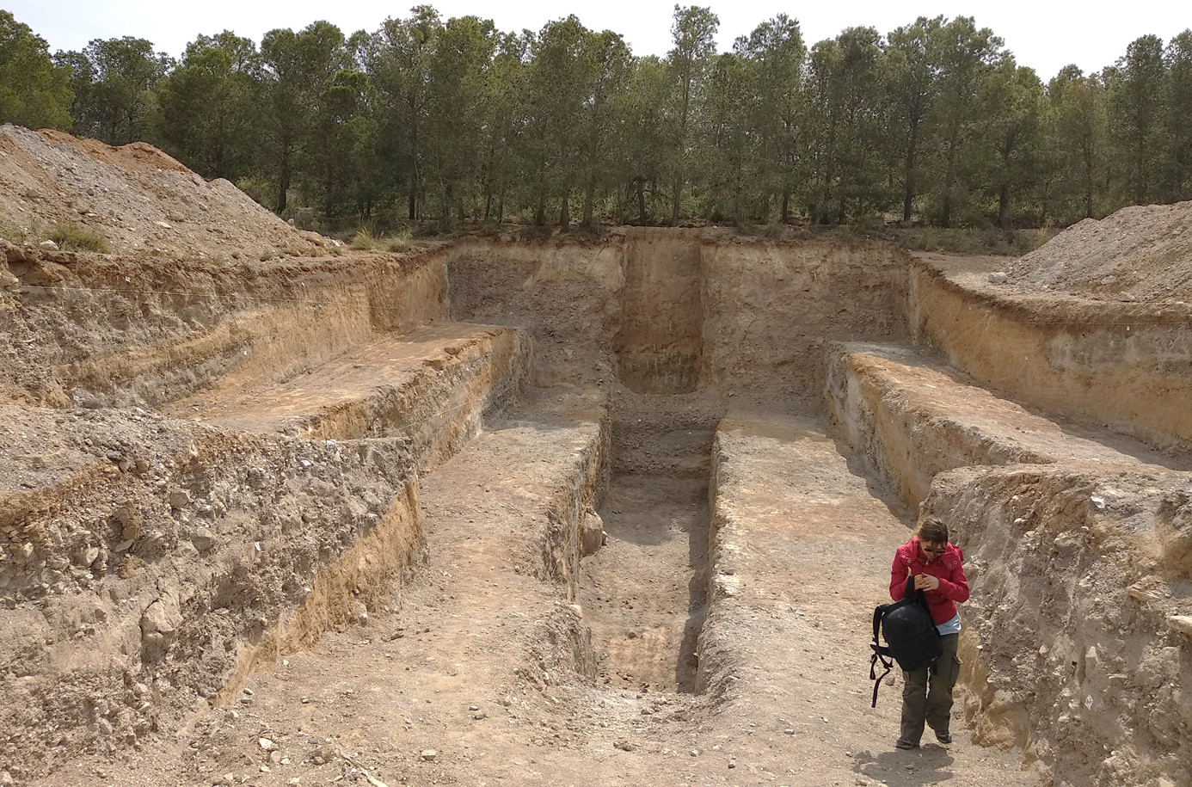
4. EL SALTADOR SITE
El Saltador site is located in the NW branch of the pressure ridge of AMF. It has been object of previous paleoseismic studies, which remarkably include a 3D trenching analysis that allowed estimating the slip rate of the fault (0.9 ± 0.1 mm/yr; Ferrater, 2016) and recognize at least 10 paleoevents with a mean recurrence of 3.5-5.3 ka for the last 59 ka (Ferrater, 2016). We excavated a 7 m deep trench (T-16) in order to enlarge the paleoearthquake record and to have a more complete characterization of earthquake occurrence over the Quaternary in this branch.
Image of T-16
Session NH4.1

Slide 12
4. EL SALTADOR SITE: T-16
Additional to the criteria to mentioned for T-3, in T-16 we also used the lithology and geometry of selected units as evidence of paleoearthquakes (units E, G, J and P; see additional information at the end of the presentation).
Some fine-grained units in the trench are interpreted as mud-flows resulting from the dust generated during earthquakes, hence as coseismic deposits. These kind of deposits have been documented in several trenches in other parts of the world (e.g. Rockwell et al., 2014; Fletcher et al., 2014). During the recent 2011 Mw 5.2 Lorca earthquake, considerable amounts of dust were generated despite its moderate magnitude, therefore the dust generation required for such units is feasible in the study area.
The evidence for our interpretation are (Masana et al., 2014):
These fine grained show red-orange coloration that cannot be correlated with any of the units outcropping in the source areas of the alluvial fans in the site. Moreover their lithology is not common in the context of the site; the alluvial fans are typically formed by gravels related to proximal deposits.
These units usually change their thickness close to the fault and are not present in the uplifted block of the fault suggesting that they were blocked by the coseismic scarp.
Session NH4.1

Slide 13
A total of 13 paleoearthquakes can be identified in T-16, 7 of them with strong evidence. 6 of our paleoearthquakes were not identified in the study by Ferrater (2016).
We enlarged considerably the paleoearthquake record, which is because:
a) The deep trench allowed to enhance the stratigraphic resolution of some units (i.e. Unit N) that appear condensate in shallower levels.
b) The higher depth exposed older units not previously observed.
* Yellow discontinuous lines represent event-horizons.
Session NH4.1

Slide 14
Session NH4.1

Slide 15
El Saltador site overview
The preliminary analysis of T-16 unveiled a long paleoearthquake record of at least 13 paleoearthquakes. This record constitutes one of the largest paleoearthquake records in Southern Europe.
Large sedimentation gaps are found between units in this site (see dates in the stratigraphic column of the additional information), which implies that the number of earthquakes recognized is a minimum.
Although the number of paleoearthquakes is high, the small vertical offsets that can be visually observed in the trench logs, suggest that this fault branch absorbs mostly the strike-slip component of the AMF system, which is consistent with the geomorphic and 3D paleoseismic studies previously carried out in this fault branch (e.g. Ferrater, 2016). Despite this, a restoration analysis of T-16 is needed in order to quantify the uplift generated by this fault.
OSL dates from T16 are currently being performed. New results, together with datings from previous studies in the site, will allow to establish a detailed cronosequence of the events in T-16 and to infer average recurrence intervals for diferent Quaternary periods.
Session NH4.1

Slide 16
5. IMPLICATIONS OF THE STUDY AND PERSPECTIVES
The results of the study presented here are preliminary as the research is still ongoing, however we are able to remark that:
The analysis of the bounding faults of the AMF pressure ridge show that there is a partition of the deformation between both branches; the SE branch absorbs the reverse-dip-slip component and the NW branch, the strike slip component. Both branches are active and show evidence of recurrent morphogenetic earthquakes. The SE branch shows evidence of Holocene activity.
The more complete earthquake catalogues from both sites, together with the forthcoming OSL dating results will allow for a reassessment of the recurrence intervals and slip rates assigned to the fault, and may allow to prove or reject synchronicity of surface ruptures at both sides of the pressure ridge. However, sedimentation gaps are an important feature to consider: in T-16, the Holocene event of T-3 is not identified mainly because the outcropping sequence in the T-16 is pre-Holocene, according to Ferrater (2016) dates; the sedimentation at El Saltador alluvial fan ceased before the Holocene.
The study of both branches allows for a more complete and representative characterization of the AMF, which is very important for the source modelling in PSHA, especially in fault-based approaches. Near-fault regions are the ones that usually suffer the highest ground accelerations (PGAs) during earthquakes, hence a good characterization of the role of every active fault branch in a system is very important for accurate estimations in fault-based PSHA, especially for the regions close to faults.
In order to characterize the whole AMF structure in this sector, new paleoseismic trenching was carried out this year in two of the three remaining branches of the AMF, which are part the northern system of the fault (NAMF; see page 3). Integrating all the results from the multiple branches that conform AMF constitutes a step towards a more complete and reliable characterization of the seismic parameters of this fault, and the seismic hazard assessment of the Murcia region.
Session NH4.1

Slide 17
Summary diagram of the inferred AMF pressure ridge structure and the location of both paleoseismic sites.
Session NH4.1

Slide 18
REFERENCES
Ferrater, M. (2016). Velocitat de desplaçament de la falla d’Alhama de Murcia (Bètiques Orientals); implicacions en el seu potencial sísmic. PhD thesis, University of Barcelona (Spain). Available at: http://www.tesisenred.net/handle/10803/400718 [Accessed January 14, 2019].
Fletcher, J. M., Teran, O.J., Rockwell, T.J., Oskin, M., Hudnut, K.W., Mueller, K., Spelz, R.M., Akciz, S.O., Masana, E., Faneros, G., Morellan, A., Stock, J., Elliott, A., Gold, P., Jing Liu-Zeng., González, A., Lynch, D., Hinojosa, A. and González, J. (2014a). Assembly of a large earthquake from a complex fault system: surface ruptura kinematics of the April4, 2011 El mayor-Cucapah Mw 7.2 earthquake. Geosphere, 10 (3), 1-31.
Masana, E., Martínez-Díaz, J. J., Hernández-Enrile, J. L., and Santanach, P. (2004). The Alhama de Murcia fault (SE Spain), a seismogenic fault in a diffuse plate boundary: Seismotectonic implications for the Ibero-Magrebian region. Journal of Geophysical Research: Solid Earth 109, 1–17. doi:10.1029/2002JB002359.
E. Masana, M. Ortuño, M. Ferrater, H. Perea, S. Baize, A. Echeverria, R. Pallàs, E. García Meléndez, J.J. Martínez-Díaz, T. Rockwell. (2014). Fine grained bodies as evidence of “dusty” paleoearthquakes in the Alhama de Murcia Fault geological record. Resúmenes de la 2ª Reunión Ibérica sobre Fallas Activas y Paleosismología, Lorca, España (2014), 23-26.
Rockwell, T., Ragona, D., Meigs, A., Owen, L., Costa, C. , Ahumada, E. (2014). Inferring a Thrust-Related Earthquake History from Secondary Faulting: A Long Rupture Record of La Laja Fault, San Juan, Argentina. Bulletin of the Seismological Society of America, 104 (1), 269–284.
Session NH4.1

Slide 19
Additional information:
Lithological description of the units identified in the trenches.
Evidence for the paleoearthquakes interpreted in the trenches.
Session NH4.1

Slide 20
A. Lithological description of the units identified in the trenches: T-3
Session NH4.1

Slide 21
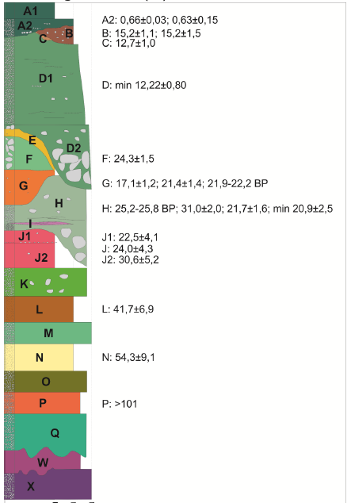
A. Lithological description of the units identified in the trenches: T-16
Estimated dates of the units by Ferrater (2016), some of which
are found in T-16. Modified from Ferrater (2016).
Session NH4.1
*T-16 stratigraphic units

Slide 22
B. Evidence for the paleoearthquakes interpreted in the trenches.
Evidence for the different events identified in T-3:
Unit | Event | Evidence
A
 | E1 | Unit A postdates the fault F2 (b)
B
 | E2 | Unit B postdates the fault F2 (a)
I1
 | E3 | Unit I1 postdates the fault F1 (b). The base of I1 is less offset by the other faults than the underlying units.
I2
J
K
 | E4 | Unit K postdates the fault F3. This event is only observable in the NE wall as the base of unit K coincides with the bench level in the SW wall.
L
M
N
 | E5 | Unit N postdates fault F1(a) and is also less deformed than the underlying units. The base of N constitutes an angular disconformity evidencing differential deformation.
O-V
Session NH4.1

Slide 23
Evidence for the different events identified in T-16:
Unit | Event | Evidence quality | Justification
E
 | E1 | Weak | Unit E is formed by very fine-grained silts, which are interpreted as obturation deposits due to tectonic activity of the fault. Moreover, the base of this unit postdates the fault in other trenches from the previous study by Ferrater (2016).
F
G
 | E2 | Good | The base of unit G is discordant to the underlying units due to a different degree of deformation. Also, the fine-grained lithology of unit G is interpreted as a mud flow resulting from the dust generated by an earthquake.
H
I2
 | E3 | Weak | The internal stratification of unit I2 dips less than the base of the unit J, although it could be a sedimentary onlap. The fault F5(1) reaches at maximum the base of unit I2, although its continuity through unit J is not very clear.
J
 | E4 | Good | Unit J is discordant to the underlying layers which highlights differential deformation. Moreover, its fine-grained lithology is interpreted as a mud flow resulting from the dust generated by an earthquake.
K
 | E5 | Good | Unit K is discordant to the underlying units due to differential degree of deformation. In the SW wall unit K postdates the fault strand F5 (2)
L
 | E6 | Good | Unit L shows an angular disconformity with the underlying layers showing different degrees of deformation.
M
N1
 | E7 | Good | The base of unit N1 shows an angular disconformity with the underlying units and postdates the faults F2 (1, 2) and F3.
Session NH4.1

Slide 24
N2
 | E8 | Good | The base of unit N2 is discordant with the underlying units due to a less degree of deformation. N2 postdates the fault F4, especially visible in the NE wall.
N3
N5a
 | E9 | Weak | The base of unit N5a is discordant to the underlying units, although it is subtle, especially in the NE wall. The fine-grained lithology of the unit can be interpreted as a mud flow from dust generated by earthquakes.
N5b
N5c
 | E10 | Good | Unit N5c postdates the fault F6 and F5 (3) in the SW wall. Moreover, the base of N5c is discordant to the underlying units to the SSE of the trench.
N5d
N6
 | E11 | Weak | The base of unit N6 is more deformed than its top, only observable in the SW wall due to a better exposure of this unit than the NE wall.
O0
P
 | E12 | Very Weak | The fine-grained lithology of the unit can be interpreted as a mud flow from dust generated by earthquakes. No additional evidence is observed.
QO
Q
 | E13 | Weak | Unit Q shows an angular disconformity with the underlying units as units R and S have superior dips. Only observable in the NE wall between the faults F3 and F4.
R
S
Session NH4.1

