Slide 1
How Earth Scientists Communicate With Maps? Márton Pál, Dr. Gáspár Albert ELTE Eötvös Loránd University, Faculty of Informatics Dept. of Cartography and Geoinformatics 29 April, 2020
Supported by the ÚNKP-19-1 New National Excellence Program of the Ministry of Innovation and Technology.

Slide 2
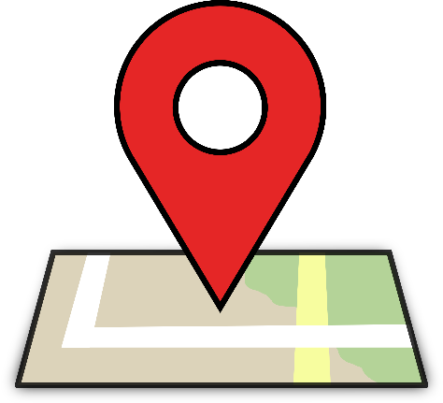
The role of cartography and maps in geoscience
Thematic cartography uses a set of rules representing spatial information. These rules are universal. Although the set of signs and symbols can be different for each area of geosciences.
Geoscientific journals, books, publications also use different types of maps.
A map should enrich the written content of a publication!
The use of basic cartographic and visual rules is fundamental.
A publication can achieve increased readership and wider dissemination with a good map!
Cartography
Geography
Geophysics
Geology
Meteorology

Slide 3
Aims and method of our map analysis
Aim: to determine how correct and useful is the map communication of the geoscientifc branches.
Our study focused on the precision, quality of visual representation and quantity of thematic data.
We have set up an objective system of criteria to assess maps from the publications:*
Visualization: excellent – medium – poor
Type of map: overview – main – detail
Presence of accessorials: coordinates – orientation – scale – legend – name
Topographic content: hypsography – hydrography – road network – boundaries – settlements – geographical names
Coverage type: base map type – thematic content
* The details and descriptions of the evalution system can be found in the Appendix of this PPT.

Slide 4
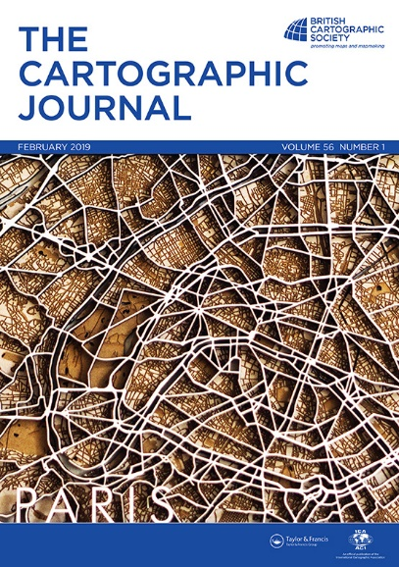
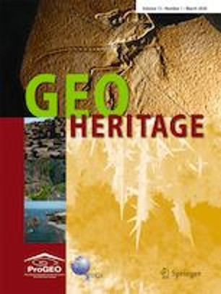
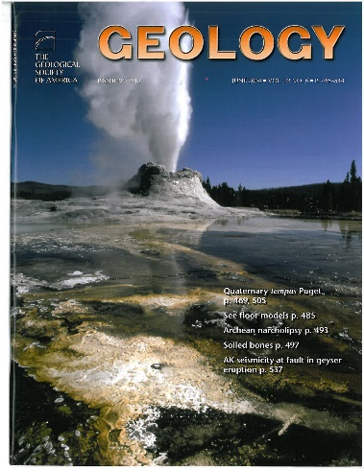
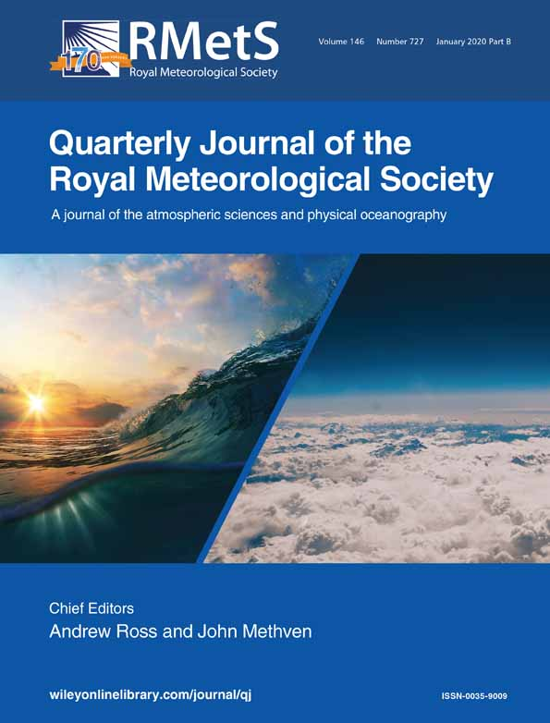
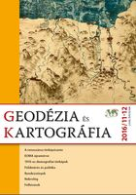
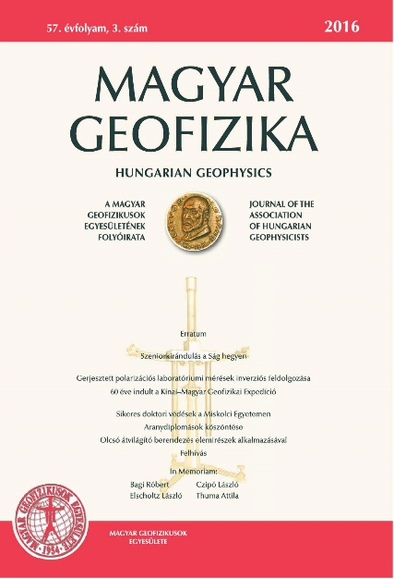
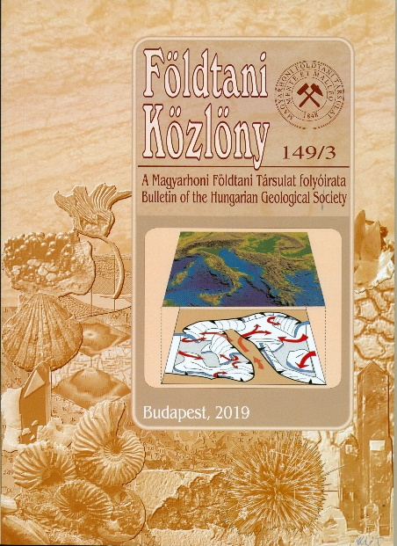
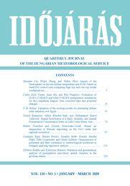
Data collection
We designated 2 scientific papers of each scientific branch: one Hungarian and one international.
Maps from conference posters were also added to each category.
Cartography
Geography
Geophysics
Geology
Meteorology

Slide 5
Data set – 1509 maps evaluated
Cartography
Geography
Geophysics
Geology
Meteorology
The Cartographic Journal
Geodézia és Kartográfia
294 maps
Geoheritage
Földrajzi Közlemények
312 maps
E&P Science Letters
Magyar Geofizika
305 maps
Geology
Földtani Közlöny
300 maps
Q. Journal of the RMetS
Időjárás
298 maps

Slide 6
Results – per science branches

Slide 7
Results – per country
Quality of visualization (%) in countries
with more than 50 maps

Slide 8
Thank you for your attention! Appendix - from the next slide – with additional data & statistics
Supported by the ÚNKP-19-1 New National Excellence Program of the Ministry of Innovation and Technology.

Slide 9
I. Detailed evaluation method 1.
Visualization
Poor: The content is hardly readable due to inappropriate symbols (in vector-based maps), rough resolution (in raster-type maps) or the bad quality of printing.
Medium: The content is readable, but the symbols are not designed to the purpose of the map (e.g. usage of default colors, line types). Base map and thematic coverages are compiled differently. The printing quality matches with the resolution of the map.
Excellent: The map is designed to its purpose. The symbols are unique or appropriately selected to the topic. The base map and the thematic content are in harmony. The printing quality matches with the resolution of the map.
Type
Overview: The map is for showing the location of the study area. It is a small-scale map, which can be solitary, or in pairs with a main map.
Main: The map shows the results of the research subject. It can be solitary, or in pairs with a main-, or a detail map.
Detail: The map shows the results of the research subject in large scale. It is always in pairs with a main map.
*: in case of mixed types, use the * sign for the inferred, and "1" for the dominant type.
Accessorials (coordinates, orientation, scale, legend, name)
Put a "1" mark in the proper column if the accessorial type exists on the map (consider the captions of figures as names in some cases).

Slide 10
I. Detailed evaluation method 2.
D) Topographic content (put a "1" mark in the proper column if the accessorial type exists on the map)
Hypsography: contours, shaded relief, graded hypsometry, etc.
Hydrography: water courses, lakes, rivers, channels, springs, wells, marshes.
Road network: roads, trails, streets, etc. (manmade structures).
Boundaries: delineator signs of administrational territories.
Settlements: signs of human build structures/administrational units (i.e. cities, villages, farms).
Names: geographical names (of natural and manmade objects).
E) Thematic content: in this criterion all existing map type from the evaluated set should be written. In our case:
Geological, geophysical, geographical, geomorphological, meteorological, cartographical, ethnographical or general, if there is no thematic content.
F) Base map type:
Copy unref: Scanned raster from an existing map without citation
Copy ref: Scanned raster from an existing map with citation
Edited: Edited topography/thematic base map content with references to the source of data
Vector: the basemap seems to be edited but the data source is not indicated
No data: the base map exists, but there is no information about it.
No basemap
G) The nationality of the article’s first author

Slide 11
II. Results per science branches I.

Slide 12
II. Results per science branches II.

Slide 13
III. Results per countries 1.
We publish here the data of the countries with more than 20 maps.
 | Visualization: | % | maps | Type: |  | Accessorials: |  |  |  |  | Topographic content
Hungary | excellent | 57,96 | 273 | overview | 310 | coordinates | orientation | scale | legend | name | hypsography | hydrography | road network | boundaries | settelments | geographical names
total: 471 | medium | 38,85 | 183 | main | 260 | 186 | 179 | 212 | 331 | 466 | 96 | 269 | 57 | 259 | 152 | 272
 | poor | 3,18 | 15 | detail | 21
USA | excellent | 84,02 | 142 | overview | 128 | coordinates | orientation | scale | legend | name | hypsography | hydrography | road network | boundaries | settelments | geographical names
total: 169 | medium | 15,98 | 27 | main | 81 | 101 | 91 | 75 | 136 | 166 | 52 | 53 | 5 | 57 | 23 | 96
 | poor | 0,00 | 0 | detail | 9
UK | excellent | 92,50 | 148 | overview | 86 | coordinates | orientation | scale | legend | name | hypsography | hydrography | road network | boundaries | settelments | geographical names
total: 160 | medium | 7,50 | 12 | main | 117 | 113 | 112 | 36 | 136 | 158 | 36 | 36 | 13 | 112 | 19 | 59
 | poor | 0,00 | 0 | detail | 1
China | excellent | 74,04 | 77 | overview | 64 | coordinates | orientation | scale | legend | name | hypsography | hydrography | road network | boundaries | settelments | geographical names
total: 104 | medium | 23,08 | 24 | main | 56 | 63 | 69 | 42 | 86 | 104 | 18 | 24 | 8 | 46 | 22 | 61
 | poor | 2,88 | 3 | detail | 15
Germany | excellent | 83,33 | 50 | overview | 48 | coordinates | orientation | scale | legend | name | hypsography | hydrography | road network | boundaries | settelments | geographical names
total: 60 | medium | 16,67 | 10 | main | 34 | 42 | 44 | 15 | 42 | 57 | 16 | 18 | 8 | 29 | 13 | 30
 | poor | 0,00 | 0 | detail | 0
Italy | excellent | 77,27 | 34 | overview | 31 | coordinates | orientation | scale | legend | name | hypsography | hydrography | road network | boundaries | settelments | geographical names
total: 44 | medium | 22,73 | 10 | main | 21 | 18 | 30 | 31 | 36 | 44 | 16 | 27 | 11 | 10 | 36 | 43
 | poor | 0,00 | 0 | detail | 0
Spain | excellent | 100,00 | 43 | overview | 30 | coordinates | orientation | scale | legend | name | hypsography | hydrography | road network | boundaries | settelments | geographical names
total: 43 | medium | 0,00 | 0 | main | 21 | 9 | 23 | 35 | 26 | 43 | 18 | 20 | 15 | 25 | 22 | 33
 | poor | 0,00 | 0 | detail | 2

Slide 14
III. Results per countries 2.
We publish here the data of the countries with more than 20 maps.
 | Visualization: | % | maps | Type: |  | Accessorials: |  |  |  |  | Topographic content
France | excellent | 88,89 | 32 | overview | 19 | coordinates | orientation | scale | legend | name | hypsography | hydrography | road network | boundaries | settelments | geographical names
total: 36 | medium | 8,33 | 3 | main | 19 | 25 | 16 | 13 | 26 | 36 | 11 | 14 | 5 | 22 | 10 | 21
 | poor | 2,78 | 1 | detail | 1
Poland | excellent | 86,11 | 31 | overview | 18 | coordinates | orientation | scale | legend | name | hypsography | hydrography | road network | boundaries | settelments | geographical names
total: 36 | medium | 13,89 | 5 | main | 24 | 8 | 8 | 15 | 23 | 36 | 6 | 16 | 4 | 20 | 16 | 23
 | poor | 0,00 | 0 | detail | 0
Switzerland | excellent | 76,47 | 26 | overview | 23 | coordinates | orientation | scale | legend | name | hypsography | hydrography | road network | boundaries | settelments | geographical names
total: 34 | medium | 20,59 | 7 | main | 13 | 11 | 15 | 17 | 23 | 34 | 18 | 18 | 5 | 18 | 15 | 27
 | poor | 2,94 | 1 | detail | 0
Australia | excellent | 69,23 | 18 | overview | 21 | coordinates | orientation | scale | legend | name | hypsography | hydrography | road network | boundaries | settelments | geographical names
total: 26 | medium | 30,77 | 8 | main | 5 | 12 | 17 | 16 | 18 | 26 | 3 | 7 | 0 | 11 | 5 | 21
 | poor | 0,00 | 0 | detail | 0
Brazil | excellent | 84,62 | 22 | overview | 18 | coordinates | orientation | scale | legend | name | hypsography | hydrography | road network | boundaries | settelments | geographical names
total: 26 | medium | 15,38 | 4 | main | 12 | 19 | 20 | 21 | 25 | 26 | 0 | 8 | 8 | 18 | 7 | 19
 | poor | 0,00 | 0 | detail | 2
Norway | excellent | 95,24 | 20 | overview | 7 | coordinates | orientation | scale | legend | name | hypsography | hydrography | road network | boundaries | settelments | geographical names
total: 21 | medium | 4,76 | 1 | main | 15 | 3 | 3 | 2 | 16 | 21 | 2 | 1 | 0 | 18 | 0 | 3
 | poor | 0,00 | 0 | detail | 0

