Slide 1


Evaluating the effect of tropical and extratropical Pacific initial errors on two types of El Nino prediction using particle filter approach
Meiyi Hou, Xiefei Zhi
April, 2020

Slide 2


Outline
Introduction
Data and particle filter approach
Experiment strategy
Results for EP- and CP-El Nino
Conclusion

Slide 3
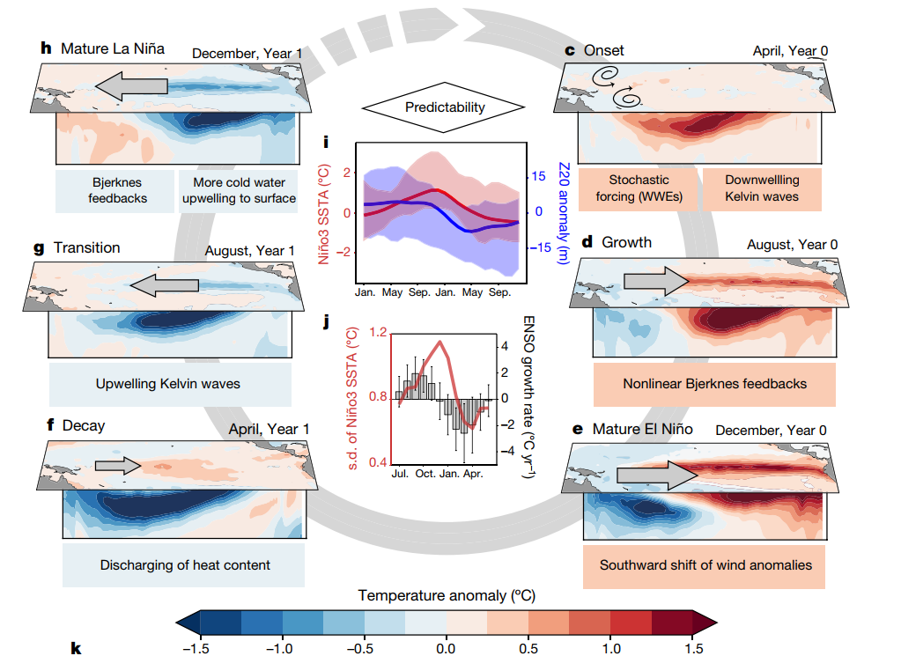
Introduction ---- El Niño events
evolution of El Niño events
（Timmermann A et al. 2018）
In theory, the self-sustained nature of the tropical Pacific ocean-atmosphere system is conducive to better ENSO predictions up to one or two years in advance.

Slide 4
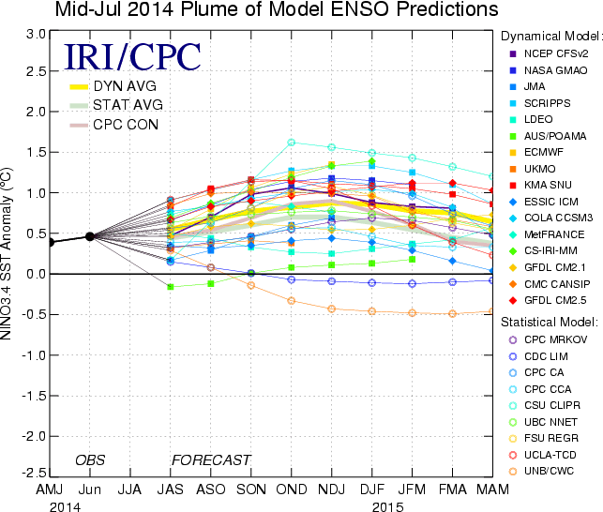
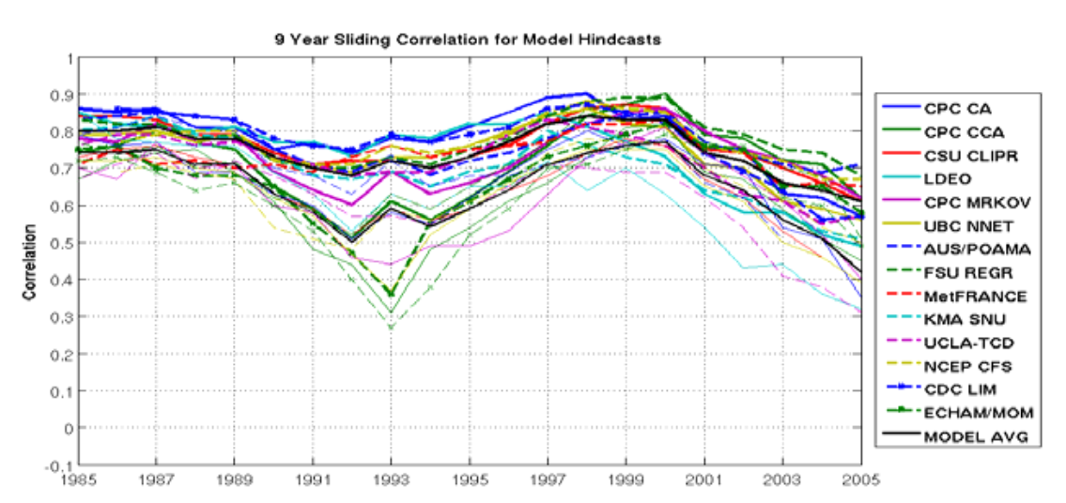
Introduction ---- El Niño prediction
1. Most real-time ENSO predictions nowadays can only provide useful skill two or three seasons ahead
2. There are large uncertainties of the predictions of different models.
（http://iri.columbia.edu/climate/ENSO/currentinfo/update.html）
The 2002-2010 period posed a greater predictive challenge.
（Barnston AG et al. 2012）
El Nino prediction is still a huge challenge.

Slide 5
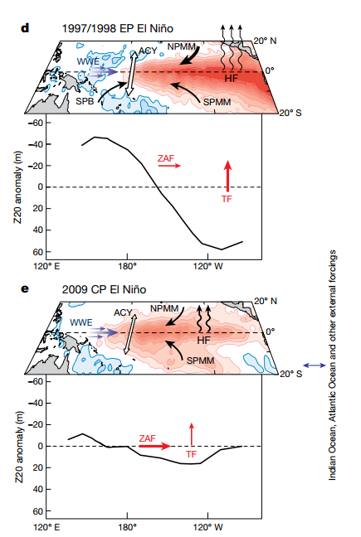
Introduction ---- El Niño diversity
（ Timmermann A et al. 2018 ）
New flavor of El Niño brings a great challenge to ENSO prediction.
Currently, the useful prediction of El Niño types are around four months. (Hendon et al. 2009; Jeong et al. 2012)

Slide 6
Introduction ---- initial errors influencing El Nino predictions
one effective way to improving the ENSO prediction is eliminating initial errors from ENSO prediction
“key areas” that exert largest influences on ENSO prediction:
North Pacific:
Victoria mode
Vimont et al. 2003; Chiang and Vimont, 2004; Ding et al, 2015
South Pacific:
South Pacific Meridional Mode (SPMM; Zhang et al., 2014)
Tropical Pacific:
Dipole pattern along thermocline
Composite of anomalous sea temperature (units: °C) and horizontal wind (units: m/s) components of the CP-type-1 errors. Composites of initial errors not exceeding the 95% significance level are masked.
（ Hou et al. 2019 ）

Slide 7

Questions
To what extent can the EP- and CP-El Nino predictions be improved by removing the initial errors of ocean temperature in the different sensitive areas?
How to remove initial errors by using off-line model data (CMIP5 model data) to evaluate the effect of initial errors in different areas?
Notes:
这三个区域的初始误差对El Nino的

Slide 8
Data and particle filter approach
Comprehensive results Multi-model outputs
Model: pi-control runs from 6 CMIP5 model integrations. (500 years)
Variables: Monthly ocean temperature (at depths of 0-155 m)
These 6 models can reasonably simulate the two types of El Niño events. (Ham and Kug 2012; Kim and Yu 2012; Bellenger et al. 2014)
Model | Institute/Country | Resolution (lon×lat, vertical)
 |  | Atmosphere | Ocean
CCSM4 | NCAR/USA | 288×192, L26 | 320×384, L60
CESM1-BGC | NSF-DOE-NCAR/USA | 288×192, L26 | 320×384, L60
CMCC-CMS | CMCC/Italy | 192×96, L95 | 182×149, L31
CNRM-CM5 | CNRM-CERFACS/France | 256×128, L31 | 362×292, L42
GFDL-CM3 | NOAA GFDL/USA | 144×90, L24 | 360×200, L50
GISS-E2-R | NASA GISS/USA | 144×90, L24 | 288×180, L32
How can we assimilate these off-line data and quantify the effect of different parts of errors on ENSO prediction?

Slide 9
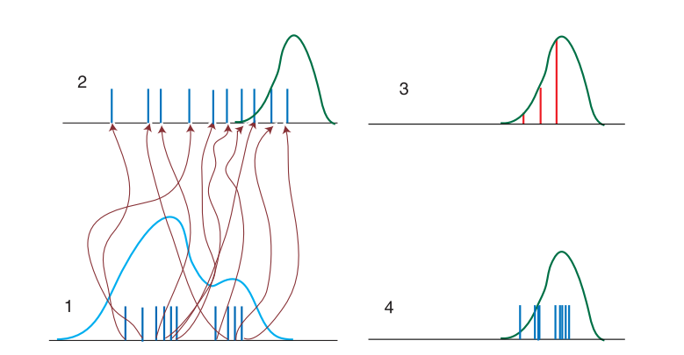

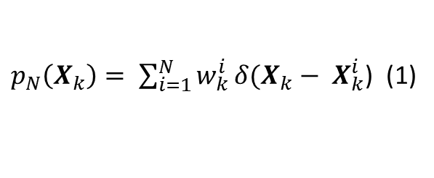




Data and particle filter approach
Schematic diagram of the Sequential Importance Resample particle filter （SIR-PF）approach
（Van Leeuwen. 2010）
$$t=t_{k}$$
“observation”
$$Y_{k}$$
$p_{N}\left(X_{k}\right)= \sum_{i=1}^{N}{w_{k}^{i}}δ(X_{k}− X_{k}^{i}$) (1)
$w_{k}^{i}＝ \frac{p(Y_{k}|X_{k}^{i})}{p\left(Y_{k}\right)}w_{k−1}^{i}$ (2)
$$p_{N}\left(X_{k}\right)$$
resampling
$$X_{k}$$
$p\left(Y_{k} | X_{k}^{i}\right)\sim \exp{[}−\frac{1}{2}{\left(Y_{k}−H\left(X_{k}^{i}\right)\right)}^{T}{(Σ+B)}^{−1}\left(Y_{k}−H\left(X_{k}^{i}\right)\right)]$ (3)
$w_{k}^{i}\sim \exp{[}−\frac{1}{2}{\left(Y_{k}−H\left(X_{k}^{i}\right)\right)}^{T}{(Σ+B)}^{−1}\left(Y_{k}−H\left(X_{k}^{i}\right)\right)]$ (4)
Notes:
.

Slide 10
Experiment strategy
Select 13 typical EP(CP)-El Niño from each model to be 13 one-year “observations”
Kug et al. (2010): with Nino-3 and -4 index measuring EP- and CP-El Nino, respectively
For each one-year “observation”, pick EP(CP)-type-1(2) years (according to Hou et al. 2019) as its ensemble members
One ensemble prediction for one observation
Assimilating the ocean temperature in different target area by using SIR-PF
ACC (Anomaly Correlation Coefficients)
Evaluating the assimilation result
RMSE (Root Mean Square Error)
MAE (Mean Absolute Error)

Slide 11
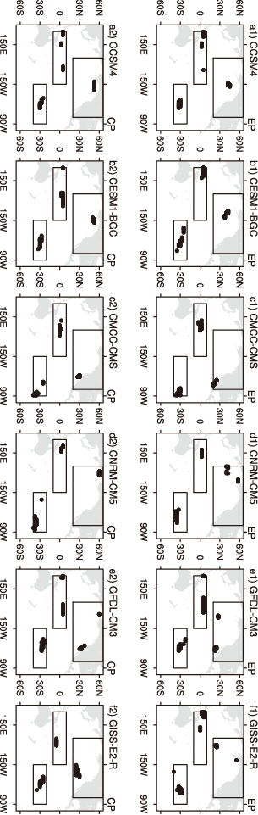
Experiment strategy
Target observations:
EP-type
CP-type
Description of the assimilation experiments based on the particle filter.
Experiment | Description
TP | Assimilate 10 grids in the western subsurface Pacific sensitive area
NP | Assimilate 10 grids in the North Pacific sensitive area
SP | Assimilate 10 grids in the South Pacific sensitive area
TP+NP | Assimilate 20 grids in both western subsurface Pacific and North Pacific sensitive area
TP+SP | Assimilate 20 grids in both western subsurface Pacific and South Pacific sensitive area
SP+NP | Assimilate 20 grids in both South Pacific and North Pacific sensitive area
TP+NP+SP | Assimilate 30 grids in three sensitive area in the Pacific

Slide 12
Assimilating EP-Type-1 ensemble--- TP SSTA in Dec

Slide 13
Assimilating EP-Type-1 ensemble--- TP SSTA in Dec (Taylor Diagram)

Slide 14
Assimilating EP-Type-1 ensemble--- Nino3 SSTA prediction
 | TP | SP | NP | TP+SP | TP+NP | SP+NP | TP+SP+NP
ACC | 0.035 | -0.186 | -0.287 | 0.058 | 0.003 | -0.126 | -0.022
RMSE | 2.6% | -10.4% | -12.7% | -0.5% | -2.1% | -8.8% | -4.5%
MAE (nino3 ssta) | 19.6% | 6.3% | 3.3% | 16.8% | 16.6% | 9.6% | 14.8%
Ratio (nino3 ssta) | 69.2% | 64.1% | 43.6% | 70.5% | 67.9% | 55.1% | 59.0%
MAE (nino4 ssta) | 24.7% | 6.9% | 3.6% | 30.1% | 23.4% | 11.3% | 23.5%
Ratio (nino4 ssta) | 74.4% | 70.5% | 57.7% | 82.1% | 73.1% | 67.9% | 78.2%
PP | 0.50 | 0.46 | 0.48 | 0.76 | 0.75 | 0.71 | 0.85
For the majority of EP-El Nino predictions, the ensemble mean prediction skills are improved after removing part of the initial errors in different area.
If the initial errors are removed from only one target area, the tropical Pacific group get the highest prediction skill. And the north Pacific group show the lowest prediction skill.

Slide 15
Assimilating result of EP-TYPE-1 ensemble
For EP-TYPE-1 initial error
influence
Initial errors in V-mode region in NP
Suppress the expansion of the negative error in tropical central Pacific in Dec
VM+
Initial errors in TP
Contribute to the expansion of the negative error in tropical central-eastern Pacific in Dec
Negative error in WP
Initial errors in SP
Contribute to the expansion of the negative error in tropical central-eastern Pacific in Dec
SPMM+
TP > SP >NP

Slide 16
Assimilating EP-Type-2 ensemble--- TP SSTA in Dec (Taylor Diagram)

Slide 17
Assimilating EP-Type-2 ensemble--- Nino3 SSTA prediction
 | TP | SP | NP | TP+SP | TP+NP | SP+NP | TP+SP+NP
ACC | 0.459 | 0.488 | 0.486 | 0.420 | 0.488 | 0.381 | 0.283
RMSE | 17.0% | 14.0% | 19.3% | 13.7% | 17.0% | 15.2% | 13.0%
MAE (nino3 ssta) | 13.5% | 7.2% | 16.3% | 7.4% | 15.0% | 12.0% | 9.3%
Ratio (nino3 ssta) | 61.5% | 65.4% | 75.6% | 60.3% | 69.2% | 62.8% | 48.7%
MAE (nino4 ssta) | 20.8% | 9.4% | 18.1% | 17.1% | 23.3% | 15.9% | 18.5%
Ratio (nino4 ssta) | 74.4% | 73.1% | 70.5% | 70.5% | 71.8% | 65.4% | 59.0%
PP | 0.50 | 0.38 | 0.46 | 0.71 | 0.70 | 0.70 | 0.81
For the majority of EP-El Nino predictions, the ensemble mean prediction skills are improved after removing part of the initial errors in different area.
If the initial errors are removed from only one target area, the north Pacific group get the highest prediction skill.

Slide 18
Assimilating result of EP-TYPE-2 ensemble
For EP-TYPE-2 initial error
influence
Initial errors in V-mode region in NP
Contribute to the expansion of the negative error in tropical central Pacific in Dec
VM-
Initial errors in TP
Suppress the expansion of the negative error in tropical central-eastern Pacific in Dec
Positive error in WP
Initial errors in SP
Suppress the expansion of the negative error in tropical central-eastern Pacific in Dec
SPMM-
NP > TP >SP

Slide 19
Results for CP-El Nino prediction -- TP SSTA in Dec (Taylor Diagram)

Slide 20
Results for CP-El Nino prediction -- Nino4 SSTA prediction
 | TP | SP | NP | TP+SP | TP+NP | SP+NP | TP+SP+NP
ACC | 0.475 | 0.357 | 0.141 | 0.684 | 0.623 | 0.634 | 0.862
RMSE | 11.2% | 8.8% | 5.3% | 31.1% | 28.0% | 31.1% | 62.2%
MAE (nino4 ssta) | 20.2% | 12.1% | 6.4% | 42.0% | 40.7% | 36.3% | 69.7%
Ratio (nino4 ssta) | 82.1% | 74.4% | 56.4% | 91.0% | 83.3% | 85.9% | 91.0%
MAE (nino3 ssta) | 23.8% | 11.8% | 5.5% | 39.5% | 41.4% | 37.1% | 67.7%
Ratio (nino3 ssta) | 76.9% | 66.7% | 48.7% | 82.1% | 79.5% | 82.1% | 85.9%
PP | 0.28 | 0.35 | 0.29 | 0.72 | 0.67 | 0.71 | 0.90
For the majority of CP-El Nino predictions, the ensemble mean prediction skills are improved after removing part of the initial errors in different area.
If the initial errors are removed from only one target area, the tropical Pacific group get the highest prediction skill.

Slide 21
Results for CP-El Nino prediction
For CP-TYPE-1 initial error
influence
Initial errors in V-mode region in NP
Suppress the expansion of the negative error in tropical central Pacific in Dec
VM+
Initial errors in TP
Contribute to the expansion of the negative error in tropical central-eastern Pacific in Dec
Negative error in WP
Initial errors in SP
Contribute to the expansion of the negative error in tropical central-eastern Pacific in Dec
SPMM+
TP > SP >NP

Slide 22
Assimilating model data to real observation
Nino3.4 SSTA
For CCSM4 model, the assimilated ensemble (after assimilating 3 target area) can provide better prediction of different El Nino events. Though it may predict wrong type of El Nino in some cases.
Not all chosen models can provide better prediction after assimilation.

Slide 23
Conclusions
The lower-layer of the western tropical Pacific is of great importance to both EP-El Nino prediction and CP-El Nino prediction.
The north Pacific is more related to the SSTA prediction in the central equatorial Pacific in December while the south Pacific and the western equatorial Pacific is more related to the SSTA prediction in the central-eastern equatorial Pacific in December.
The prediction skill can still be increased by removing the initial errors though the model is not perfect.

