Slide 1
The relationship between ionospheric parameters and solar proxies is changing – when?
Jan Laštovička
Institute of Atmospheric Physics, Czech Academy of Sciences, Prague, jla@ufa.cas.cz
based on paper J. Lastovicka: Is the Relation Between Ionospheric Parameters and Solar Proxies Stable? GRL, 46 (2019), 14208-14213, https://doi-org/10.1029/2019GL085033

Slide 2
Summary
The relationship between ionospheric parameters and solar activity proxies has broadly been assumed to be stable. However, using 1976-2014 data of foF2 from three European stations and foE from two European stations we show that this assumption is not correct. In more recent years the dependence of ionospheric parameters on solar proxies is steeper than in the past. The change is between 1994 and 1997 for foF2 and after ~2000 for foE. Also the relationships among solar proxies have changed, which might indicate some solar changes perhaps responsible for the observed changes of the relationship between ionospheric parameters and solar proxies with implications to trend and climatological studies, and modeling.

Slide 3
Data
foF2 - data of a north-south chain of European stations Juliusruh (54.6ºN, 13.4ºE), Pruhonice (49.98ºN, 14.55°E) and Rome (41.8ºN, 12.5ºE) are used, 1976-2014
foE - data of some stations have problems with long-term data quality; therefore we use the data of the two best European stations, Slough/Chilton (51.5ºN, 1.3ºW) and again Juliusruh, both located at high midlatitudes, 1976-2014
Ionospheric data are yearly average values computed as average values of monthly medians; monthly medians are calculated from daily medians for 11-13 LT (foF2) and 10-14 LT (foE)
Solar data are yearly average values of F10.7, solar H Lyman-α flux and Mg II index

Slide 4
Solar dependence: foF2(foE) = A + B * solar proxy (1)
Table 1. The percentage of total variance of foF2 (Rome, Pruhonice, Juliusruh) and of foE
(Juliusruh, Chilton) described by solar activity proxies via the simple equation (1). Mostly more
than 95% of the total variance is described by equation (1), which means that the simple equation
(1) may be used. Star (*) indicates data problems.
1976-1995 1996-2014
F10.7 Fα F10.7 Fα Mg II
foF2 Rome 96% 96% 99% 99% 99% foF2 Pruh 98% 97% 99% 98% 99% foF2 Jul 98% 96% 99% 98% 99% foE Jul 99% 95% 88%* 87%* 86%* foE Chil 99% 96% 94%* 93%* 92%*

Slide 5
Table 2. Solar coefficients B (MHz/100s.f.u. for F10.7) from equation (1) and their standard errors for solar proxies F10.7 and Fα. Period I = 1976-1995, period II = 1996-2014. B is systematically higher for Period II.
Period foF2 Rome foF2 Pruh foF2 Jul foE Jul foE Chil
All years F10.7 I 4.1±0.2 3.6±0.1 3.9±0.1 0.49±0.01 0.52±0.01 II 5.0±0.1 4.6±0.1 4.5±0.1 0.57±0.05 0.58±0.04 Fα I 2.68±0.13 2.36±0.10 2.56±0.12 0.313±0.017 0.334±0.016 II 3.08±0.08 2.81±0.09 2.74±0.09 0.352±0.033 0.354±0.024
Years of high solar activity (F10.7 > 152) removed F10.7 I 5.0±0.2 4.1±0.2 4.4±0.2 0.46±0.03 0.50±0.03 II 5.3±0.1 4.8±0.2 4.6±0.2 0.53±0.08 0.56±0.06 Fα I 2.91±0.22 2.31±0.22 2.48±0.24 0.252±0.034 0.278±0.032 II 3.22±0.11 2.98±0.13 2.75±0.15 0.331±0.056 0.352±0.039

Slide 6
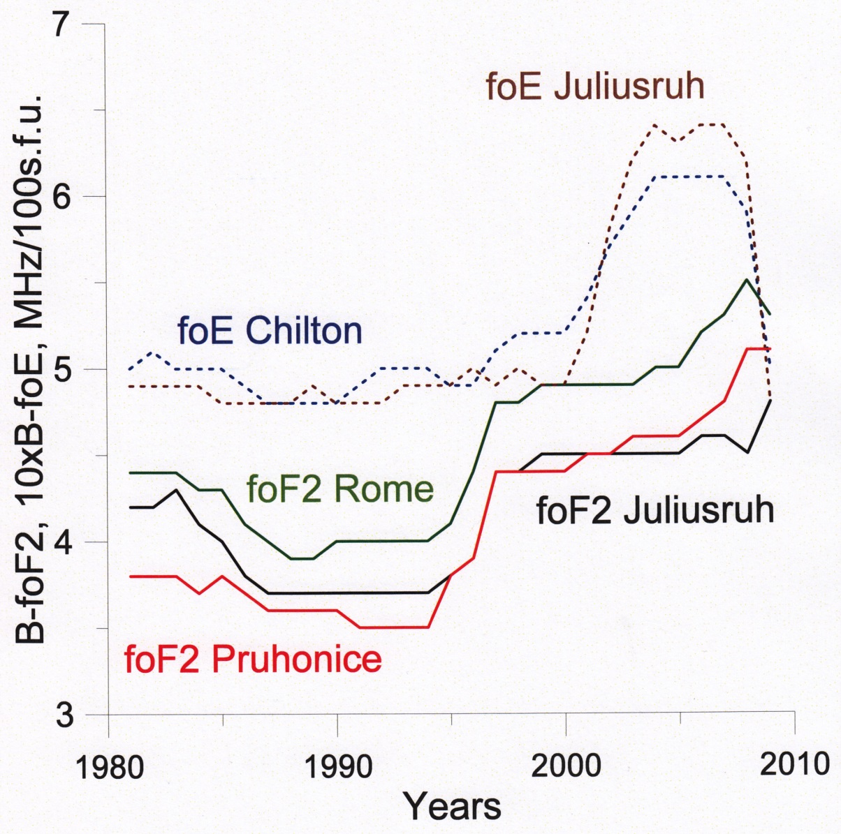
foE – relatively stable level of B until ~2000, then an increase by ~20%
foF2 – main increase of B is between 1994 and 1997; the low level of B in 1988-1993 is due to two years of very high solar activity (effect of hysteresis)
Figure 1. Evolution of the 11-year-long sliding window parameter B (MHz/100s.f.u., F10.7) from equation (1) for foF2 from Juliusruh, Pruhonice and Rome, and of 10xB for foE from Chilton and Juliusruh for intervals centered in years 1981-2009.
foE - last three data points are unreliable due to serious data problems

Slide 7
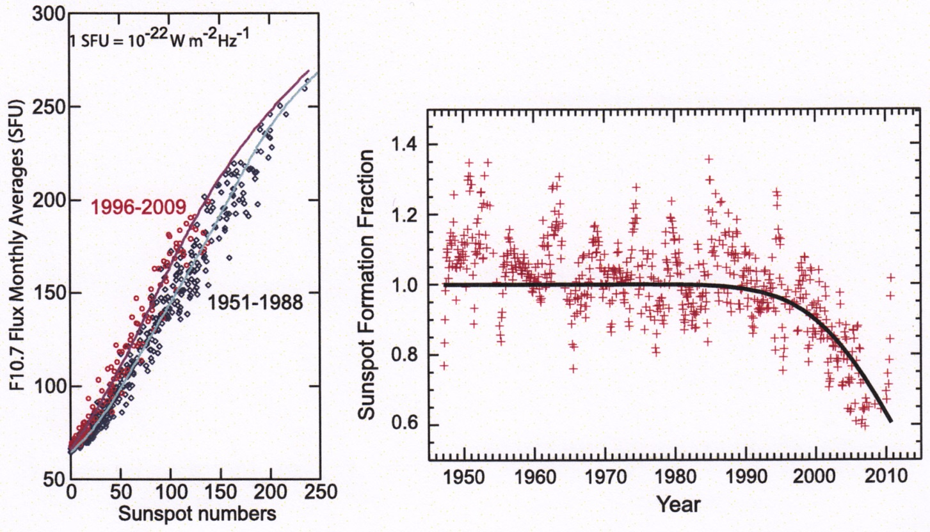
Something is happening with the Sun
Left panel: F10.7 plotted vs. sunspot numbers. Relationship between them has changed significantly during solar cycle 23. Right panel: The sunspot formation fraction parameter changed remarkably during solar cycle 23. Balogh et al. (2014).
Compared to previous solar cycles, the Sun has changed its behavior in cycles 23 and early 24 (present).
The relationships among solar proxies F10.7, Mg II and Fα (solar H Lyman alpha flux) also changed to some extent.

Slide 8
Conclusions
1. The dependence of both foF2 and foE on solar activity proxies is stronger in the period 1996-2014 than in 1976-1995. For foF2 the dependence changes between 1994 and 1997, for foE around 2000. Thus the relationship between solar activity proxies and ionospheric parameters is not stable, which should be taken into account in ionospheric long-term trend and climatological studies as well as in modeling.
2. The yearly average noon-time values of ionospheric parameters are very dominantly controlled by solar activity represented by proxies.
Conclusions are valid for yearly average noontime values and Europe.

