Slide 1



﻿Resolution-dependency of
sinking particles in general circulation models
Peter D. Nooteboom, Philippe Delandmeter, Christian Kehl, Peter K. Bijl,
Erik van Sebille, Henk A. Dijkstra and Anna S. von der Heydt
4 May
[Nooteboom et al., in review]: link
Notes:
Possible applications of sinking particles in GCM:
Sinking aggregates responsible for the carbon flux to the ocean bottom
Sinking plastics

Slide 2
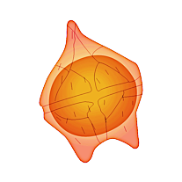


Motivation:
Sinking microplankton which is used for climate reconstruction
ocean
sediment

Slide 3
Motivation:
Take into account lateral advection of sinking microplankton,
to improve model-data comparison
ocean
sediment

Slide 4

Lagrangian tracking of particles
Flow field from an Ocean General Circulation Model
Notes:
The method: flow field is generated by ocean circulation model. Parcels interpolates the flow linearly in time and space, given the location of the particle.
The method was tested in the present day, with eddying model simulations.
What if we want to apply this in an ocean model of the past? The models of the past are different, because less is known of the past, and it takes more model years for them to spin up and get near equilibrium. To reduce computational cost, the ocean models of the past use a grid of much lower resolution than the present-day. Which brings me on my research question…

Slide 5
Lagrangian tracking of particles
Flow field from an Ocean General Circulation Model
Backtrack analysis: Particles are released at the bottom, tracked back in time until they reach the surface
The final particle distribution is representative of the sedimentary particles
Notes:
The method: flow field is generated by ocean circulation model. Parcels interpolates the flow linearly in time and space, given the location of the particle.
The method was tested in the present day, with eddying model simulations.
What if we want to apply this in an ocean model of the past? The models of the past are different, because less is known of the past, and it takes more model years for them to spin up and get near equilibrium. To reduce computational cost, the ocean models of the past use a grid of much lower resolution than the present-day. Which brings me on my research question…

Slide 6
Lagrangian tracking of particles
Flow field from an Ocean General Circulation Model
Backtrack analysis: Particles are released at the bottom, tracked back in time until they reach the surface
The final particle distribution is representative of the sedimentary particles
[van Sebille et al., 2015; Nooteboom et al. 2019]
Eddying present-day models ($∼{0.1}^{∘}$ horizontal resolution)
See also: planktondrift.science.uu.nl
Notes:
The method: flow field is generated by ocean circulation model. Parcels interpolates the flow linearly in time and space, given the location of the particle.
The method was tested in the present day, with eddying model simulations.
What if we want to apply this in an ocean model of the past? The models of the past are different, because less is known of the past, and it takes more model years for them to spin up and get near equilibrium. To reduce computational cost, the ocean models of the past use a grid of much lower resolution than the present-day. Which brings me on my research question…

Slide 7

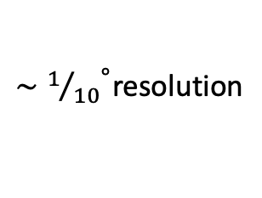
Lagrangian tracking of particles
Flow field from an Ocean General Circulation Model
${∼1/{10}}^{∘}$resolution
${∼1}^{∘ }$resolution
Present
Past
Fully coupled palaeoclimate models require long spin-up times
Palaeoclimate models are not eddying, to reduce computational costs
Notes:
The method: flow field is generated by ocean circulation model. Parcels interpolates the flow linearly in time and space, given the location of the particle.
The method was tested in the present day, with eddying model simulations.
What if we want to apply this in an ocean model of the past? The models of the past are different, because less is known of the past, and it takes more model years for them to spin up and get near equilibrium. To reduce computational cost, the ocean models of the past use a grid of much lower resolution than the present-day. Which brings me on my research question…

Slide 8
Lagrangian tracking of particles
Flow field from an Ocean General Circulation Model
${∼1/{10}}^{∘}$resolution
${∼1}^{∘ }$resolution
Present
Past
Research question:
Do particle trajectories vary in flow fields from models with different resolutions?

Slide 9
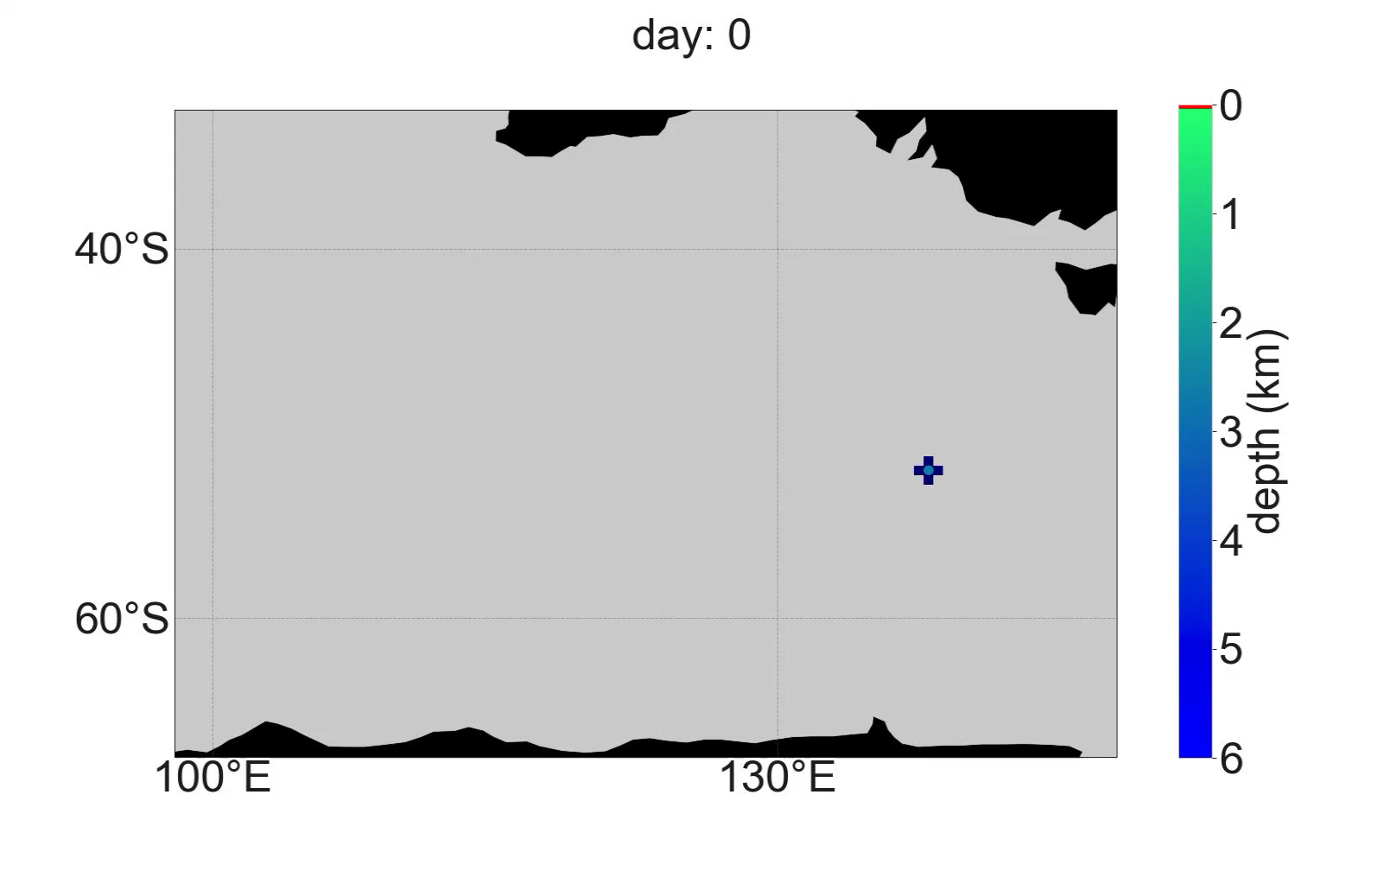
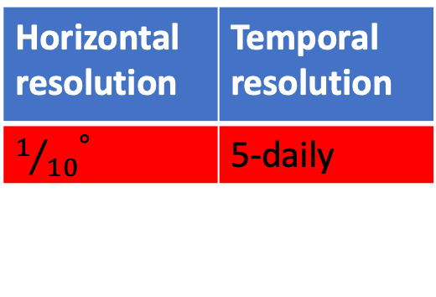
Horizontal resolution | Temporal resolution
${1/{10}}^{∘}$ | 5-daily
Backtrack analysis in the eddying model
Sediment sample in the Southern Ocean
(between Australia and Antarctica)

Slide 10
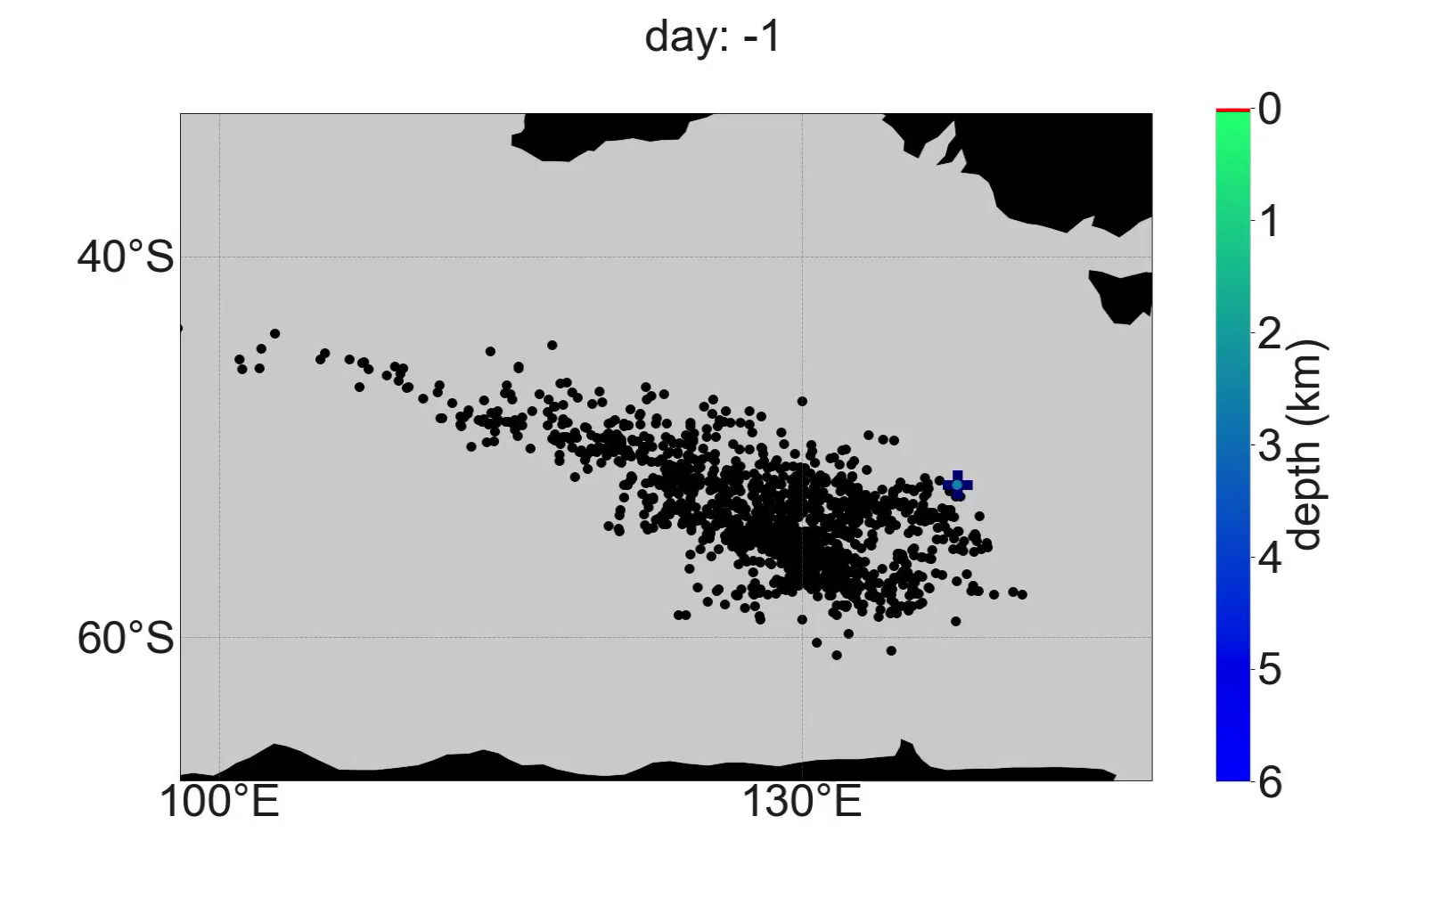
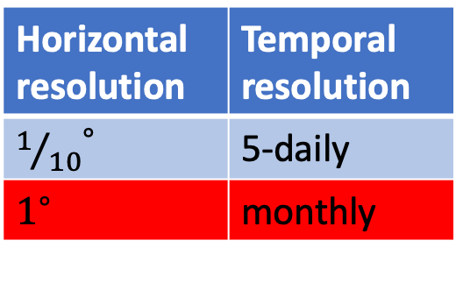
Horizontal resolution | Temporal resolution
${1/{10}}^{∘}$ | 5-daily
$1^{∘}$ | monthly
Backtrack analysis in non-eddying model
Add stochastic noise at every time step,
to represent the fluctuations in the flow
from eddies:
Horizontal
Depends on the flow shear
Horizontally isotropic
(see additional slides for details)

Slide 11
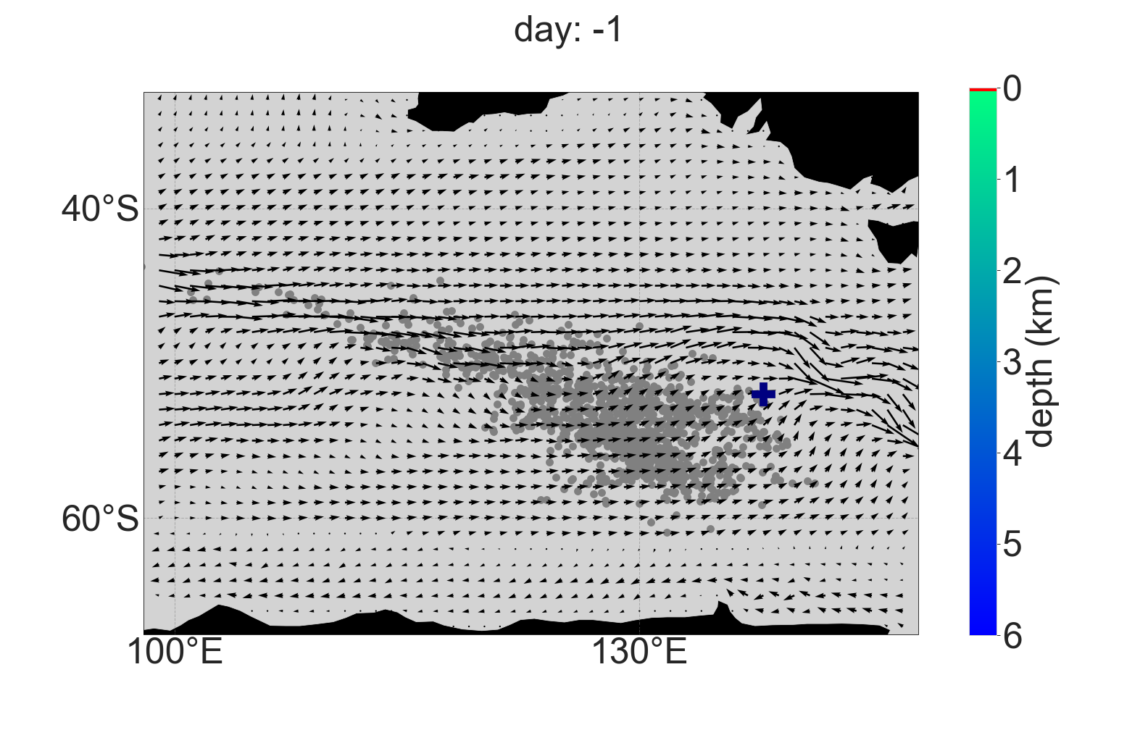
Horizontal resolution | Temporal resolution
${1/{10}}^{∘}$ | 5-daily
$1^{∘}$ | monthly
Backtrack analysis in non-eddying model
with stochastic noise
Snapshot of the surface flow
(flow shear determines noise strength)
Add stochastic noise at every time step,
to represent the fluctuations in the flow
from eddies:
Horizontal
Depends on the flow shear
Horizontally isotropic
(see additional slides for details)
Notes:
Snapshot of the surface flow field in the winter

Slide 12

Horizontal resolution | Temporal resolution
${1/{10}}^{∘}$ | 5-daily
$1^{∘}$ | monthly
Backtrack analysis in non-eddying model
with stochastic noise
The small scale fluctuations from the stochastic noise do not have an effect on the large scale flow
Add stochastic noise at every time step,
to represent the fluctuations in the flow
from eddies:
Horizontal
Depends on the flow shear
Horizontally isotropic
(see additional slides for details)
Notes:
- Small scales have an effect on the mean flow!

Slide 13
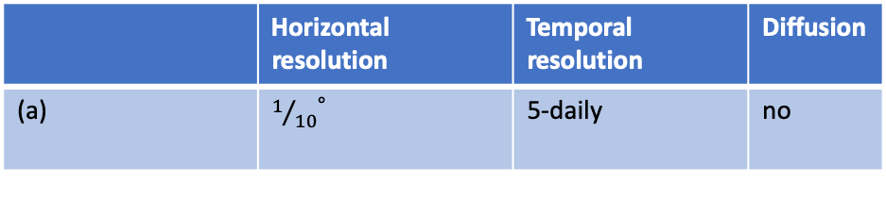
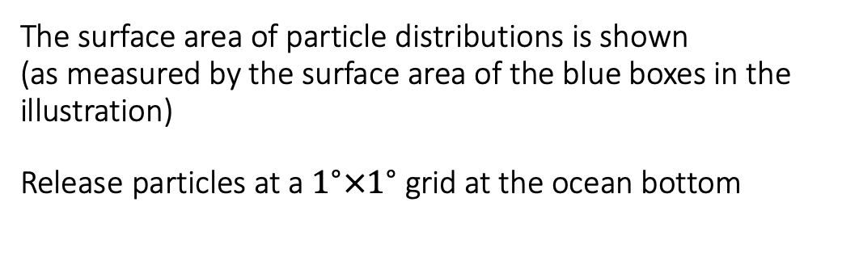
Analysis at more locations
The surface area of particle distributions is shown
(as measured by the surface area of the blue boxes in the illustration)
Release particles at a $1^{∘}×1^{∘}$ grid at the ocean bottom
 | Horizontal resolution | Temporal resolution | Diffusion
(a) | ${1/{10}}^{∘}$ | 5-daily | no
Notes:
The largest surface areas of the particle distributions in the eddying model is when the flow shear is large.

Slide 14
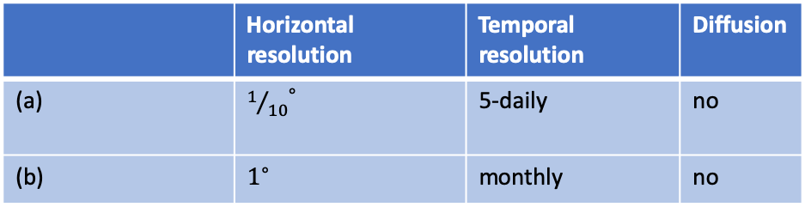
Analysis at more locations
The surface area of particle distributions is shown
(as measured by the surface area of the blue boxes in the illustration)
Release particles at a $1^{∘}×1^{∘}$ grid at the ocean bottom
 | Horizontal resolution | Temporal resolution | Diffusion
(a) | ${1/{10}}^{∘}$ | 5-daily | no
(b) | $1^{∘}$ | monthly | no

Slide 15
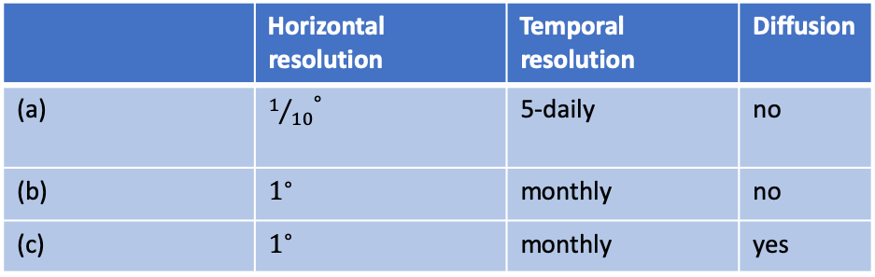
Surface area in more locations
 | Horizontal resolution | Temporal resolution | Diffusion
(a) | ${1/{10}}^{∘}$ | 5-daily | no
(b) | $1^{∘}$ | monthly | no
(c) | $1^{∘}$ | monthly | yes
Notes:
The particle distribution surface area is relatively large near the equator, where the shear is large and the flow mainly zonal. The stochastic noise is large in the non-eddying model near the equator, while the particles are still mainly transported zonally.

Slide 16
Discussion
The sinking particles require eddying circulation models
  Fluctuations in the flow field caused by eddies
  Better representation of the mean flow field
Other types of sub-grid scale parameterisations possible
  Eddy parameterisation is a challenge in ocean modelling (e.g. Fox-Kemper et al. [2019])
    No rectification: Effect from the eddies on the large scale flow

Slide 17
Discussion
The sinking particles require eddying circulation models
  Fluctuations in the flow field caused by eddies
  Better representation of the mean flow field
Other types of sub-grid scale parameterisations possible
  Eddy parameterisation is a challenge in ocean modelling (e.g. Fox-Kemper et al. [2019])
    No rectification: Effect from the eddies on the large scale flow
Outlook
Eddying ocean models of the past for a better comparison between model and microplankton data:
Here we use the spin-up of a fully coupled, non-eddying palaeomodel [Baatsen et al., 2018]
We interpolate the ocean as an initial condition and the atmosphere as a forcing of an ocean model

Slide 18

Online tool to see/download the present-day lateral drift of sinking particles in a location of choice: planktondrift.science.uu.nl/

Slide 19
References
van Sebille, E., Scussolini, P., Durgadoo, J. V., Peeters, F. J. C., Biastoch, A., Weijer, W., et al. (2015). Ocean currents generate large footprints in marine palaeoclimate proxies. Nature Communications, 6, 6521
Nooteboom PD, Bijl PK, Sebille EV, Von Der Heydt AS, Dijkstra HA. Transport Bias by Ocean Currents in Sedimentary Microplankton Assemblages : Implications for Paleoceanographic Reconstructions. Paleoceanogr Paleoclimatology. 2019;34.
Fox-Kemper B, Adcroft A, Bo ̈ning CW, Chassignet EP, Gerdes R, Greatbatch RJ, et al. Challenges and Prospects in Ocean Circulation Models. Front Mar Sci. 2019;6(February):1–29. Baatsen, M., von der Heydt, A. S., Huber, M., Kliphuis, M. A., Bijl, P. K., Sluijs, A., and Dijkstra, H. A.: Equilibrium state and sensitivity of the simulated middle-to-late Eocene climate, Clim. Past Discuss., https://doi.org/10.5194/cp-2018-43, 2018.
Baatsen, M., von der Heydt, A. S., Huber, M., Kliphuis, M. A., Bijl, P. K., Sluijs, A., and Dijkstra, H. A.: Equilibrium state and sensitivity of the simulated middle-to-late Eocene climate, Clim. Past Discuss.
Weijer W, Maltrud ME, Hecht MW, Dijkstra HA, Kliphuis MA. Response of the Atlantic Ocean circulation to Greenland Ice Sheet melting in a strongly-eddying ocean model. Geophys Res Lett. 2012;39(9)
Smagorinsky J. General circulation experiments with the primitive equations. Mon Weather Rev. 1963;91(3):99–163.

Slide 20
Additional slides

Slide 21
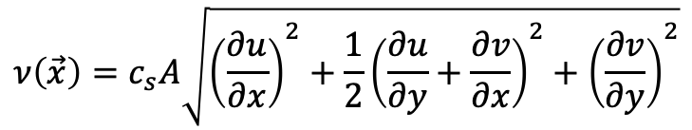
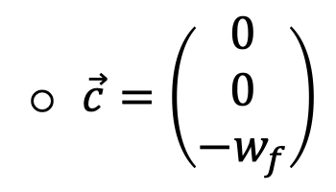
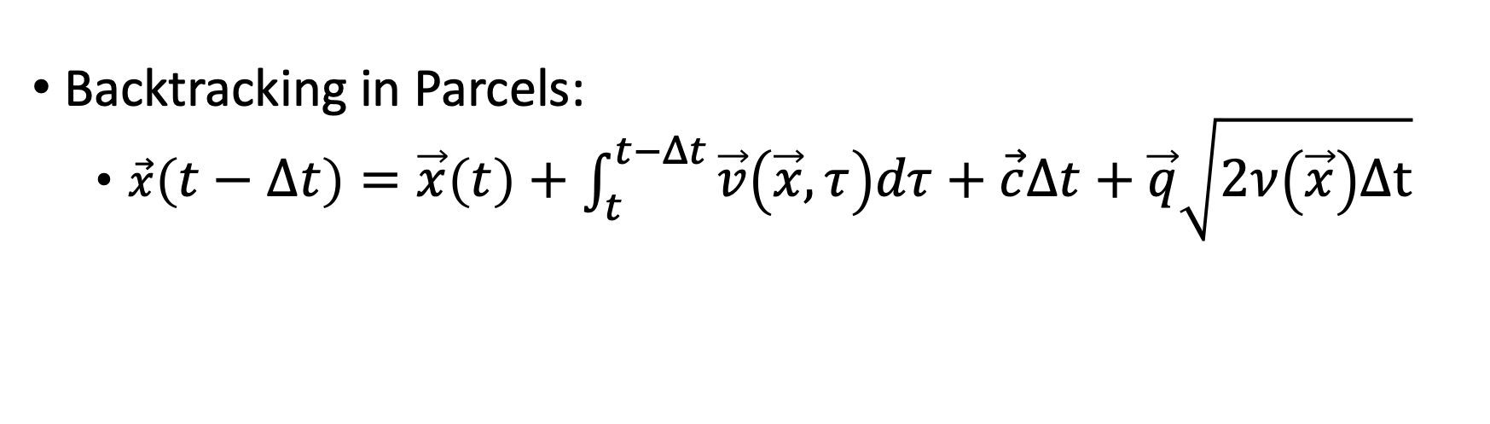
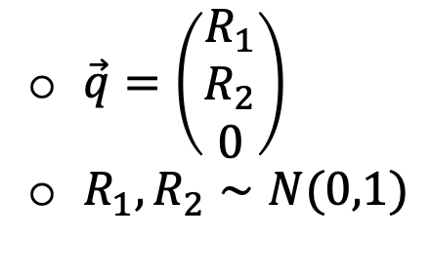
Method
Flow fields from the parallel ocean program (POP) model
(e.g. Weijer et al. [2012])
Backtracking in Parcels:
  $\vec{x}\left(t−Δt\right)=\vec{x}\left(t\right)+\int_{t}^{t−Δt}{\vec{v}\left(\vec{x},τ\right)dτ}+\vec{c}Δt+\vec{q}\sqrt{2ν\left(\vec{x}\right)Δt}$
$\vec{c}=\left(\begin{matrix}0 \\ 0 \\ {−w}_{f}\end{matrix}\right)$
$\vec{q}=\left(\begin{matrix}R_{1} \\ R_{2} \\ 0\end{matrix}\right)$
$R_{1},R_{2}∼N(0,1)$
Sinking
Stochastic noise
$$ν\left(\vec{x}\right)=c_{s}A\sqrt{{\left(\frac{∂u}{∂x}\right)}^{2}+\frac{1}{2}{\left(\frac{∂u}{∂y}+\frac{∂v}{∂x}\right)}^{2}+{\left(\frac{∂v}{∂y}\right)}^{2}}$$
P.D.Nooteboom

Slide 22
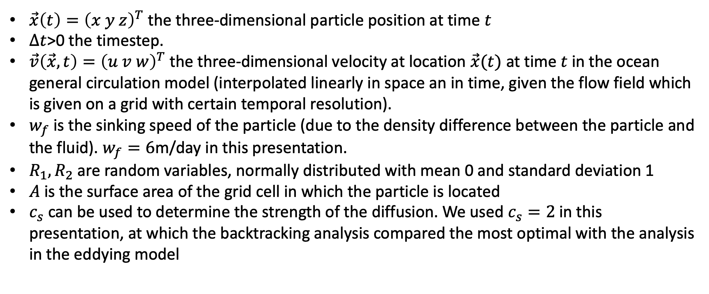
Explanation of the variables
$\vec{x}\left(t\right)={\left(x y z\right)}^{T}$ the three-dimensional particle position at time $t$
$Δt$>0 the timestep.
$\vec{v}\left(\vec{x}, t\right)={\left(u v w\right)}^{T}$ the three-dimensional velocity at location $\vec{x}(t)$ at time $t$ in the ocean general circulation model (interpolated linearly in space an in time, given the flow field which is given on a grid with certain temporal resolution).
$w_{f}$ is the sinking speed of the particle (due to the density difference between the particle and the fluid). $w_{f}=6$m/day in this presentation.
$R_{1}, R_{2}$ are random variables, normally distributed with mean 0 and standard deviation 1
$A$is the surface area of the grid cell in which the particle is located
$c_{s}$ can be used to determine the strength of the diffusion. We used $c_{s}=2$ in this presentation, at which the backtracking analysis compared the most optimal with the analysis in the eddying model

Slide 23
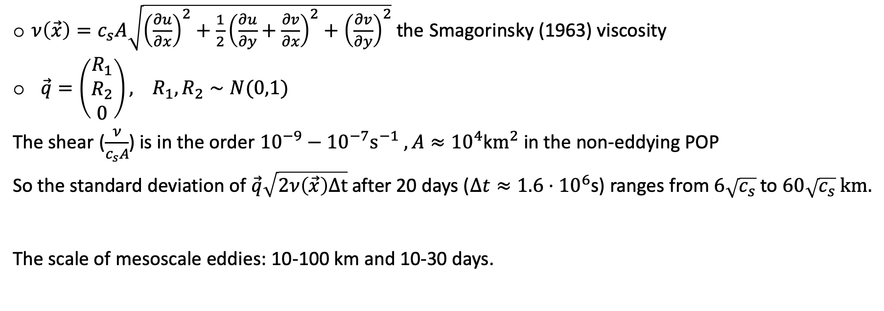
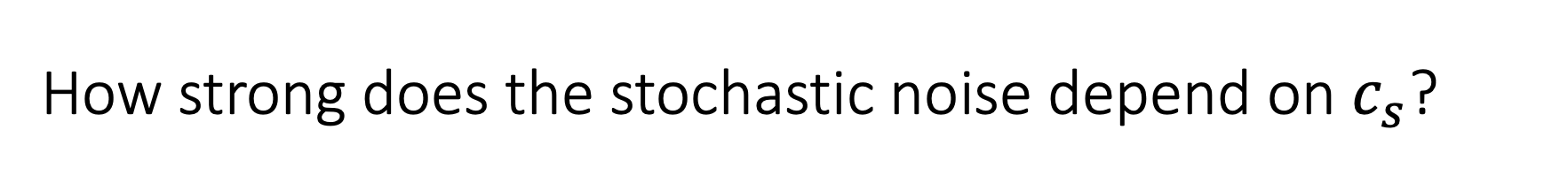

How strong does the stochastic noise depend on $c_{s}$?
$\vec{q}\sqrt{2ν\left(\vec{x}\right)Δt}$ is the stochastic noise term with
$ν\left(\vec{x}\right)=c_{s}A\sqrt{{\left(\frac{∂u}{∂x}\right)}^{2}+\frac{1}{2}{\left(\frac{∂u}{∂y}+\frac{∂v}{∂x}\right)}^{2}+{\left(\frac{∂v}{∂y}\right)}^{2}}$ the Smagorinsky (1963) viscosity
$\vec{q}=\left(\begin{matrix}R_{1} \\ R_{2} \\ 0\end{matrix}\right), R_{1},R_{2}∼N(0,1)$
The shear ($\frac{ν}{c_{s}A}$) is in the order ${10}^{−9}−{10}^{−7}s^{−1} , A≈{10}^{4}$k$m^{2}$ in the non-eddying POP
So the standard deviation of $\vec{q}\sqrt{2ν\left(\vec{x}\right)Δt}$ after 20 days ($Δt≈1.6⋅{10}^{6}$s) ranges from $6\sqrt{c_{s}}$ to $60\sqrt{c_{s}} km.$
The scale of mesoscale eddies: 10-100 km and 10-30 days.

