Slide 1
Where does the water come from? Variations in soil water uptake depth in a beech forest during the 2018 drought
Arthur Gessler^{1,2}, Lukas Bächli¹, Kerstin Treydte¹, Matthias Saurer¹, Matthias Häni¹, Roman Zweifel¹, Andi Rigling^{1,2}, Marcus Schaub¹, Stefan Seeger³, Barbara Herbstritt³, Markus Weiler³, Katrin Meusburger¹
¹Swiss Federal Research Institute WSL, Birmensdorf, Switzerland
²ETH Zurich, Zurich, Switzerland
³University of Freiburg, Freiburg, Germany

Slide 2
Background
Current climate projections predict an increasing variability of precipitation and thus a higher frequency of droughts alternating with extreme precipitation events.
Reduced water availability is the most critical driver for tree mortality and impairment of trees’ functions.
Under variable water supply, both the ability of a plant species to utilize remaining water under drought and to immediately capitalize on soil rewetting from subsequent rainfall events will be crucial for its survival and competitiveness.

Slide 3
Methodology
Schematic representation of the in situ pore water and xylem water isotopic monitoring system. In brief, a carrier gas (N2) is transferred via flow controllers to the probes (either installed in the soil (right hand side) or in the tree trunk (left)). The tips of the probes are made of a water vapour permeable membrane and allow the vapour to enter the probe in isotopic equilibrium with the soil/xylem water. The water vapour is diluted in N₂ gas stream to avoid isotopic fractionation and condensation of water in the tubing system. The water vapour is transported to an isotope laser spectrometer to determine the oxygen and hydrogen isotopologues of water (figures from Volkmann et al. (2016 ab).
Volkmann THM, Haberer K, Gessler A, Weiler M. 2016a. High-resolution isotope measurements resolve rapid ecohydrological dynamics at the soil–plant interface. The New phytologist 210: 839-849.
Volkmann THM, Kühnhammer K, Herbstritt B, Gessler A, Weiler M. 2016b. A method for in situ monitoring of the isotope composition of tree xylem water using laser

Slide 4
¹⁸O in soil water and tree xylem
Transpiration and soil water content
Meteorological parameters

Slide 5
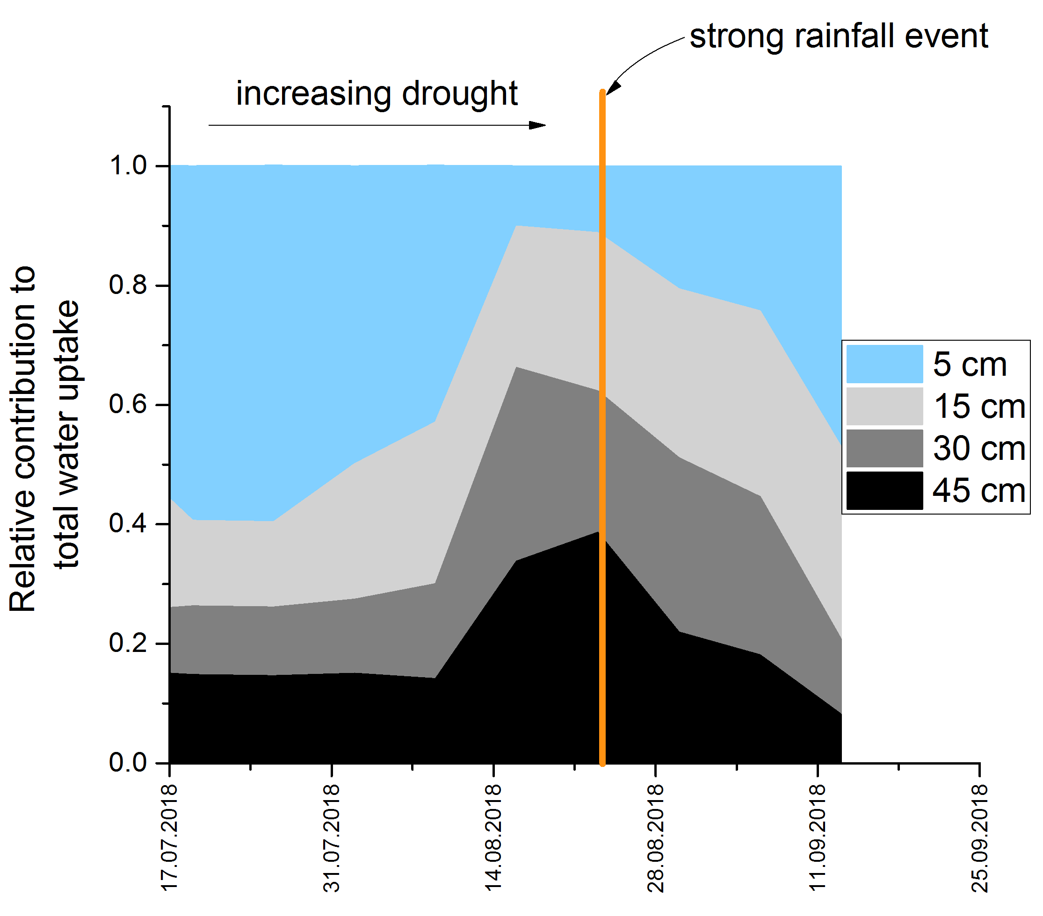
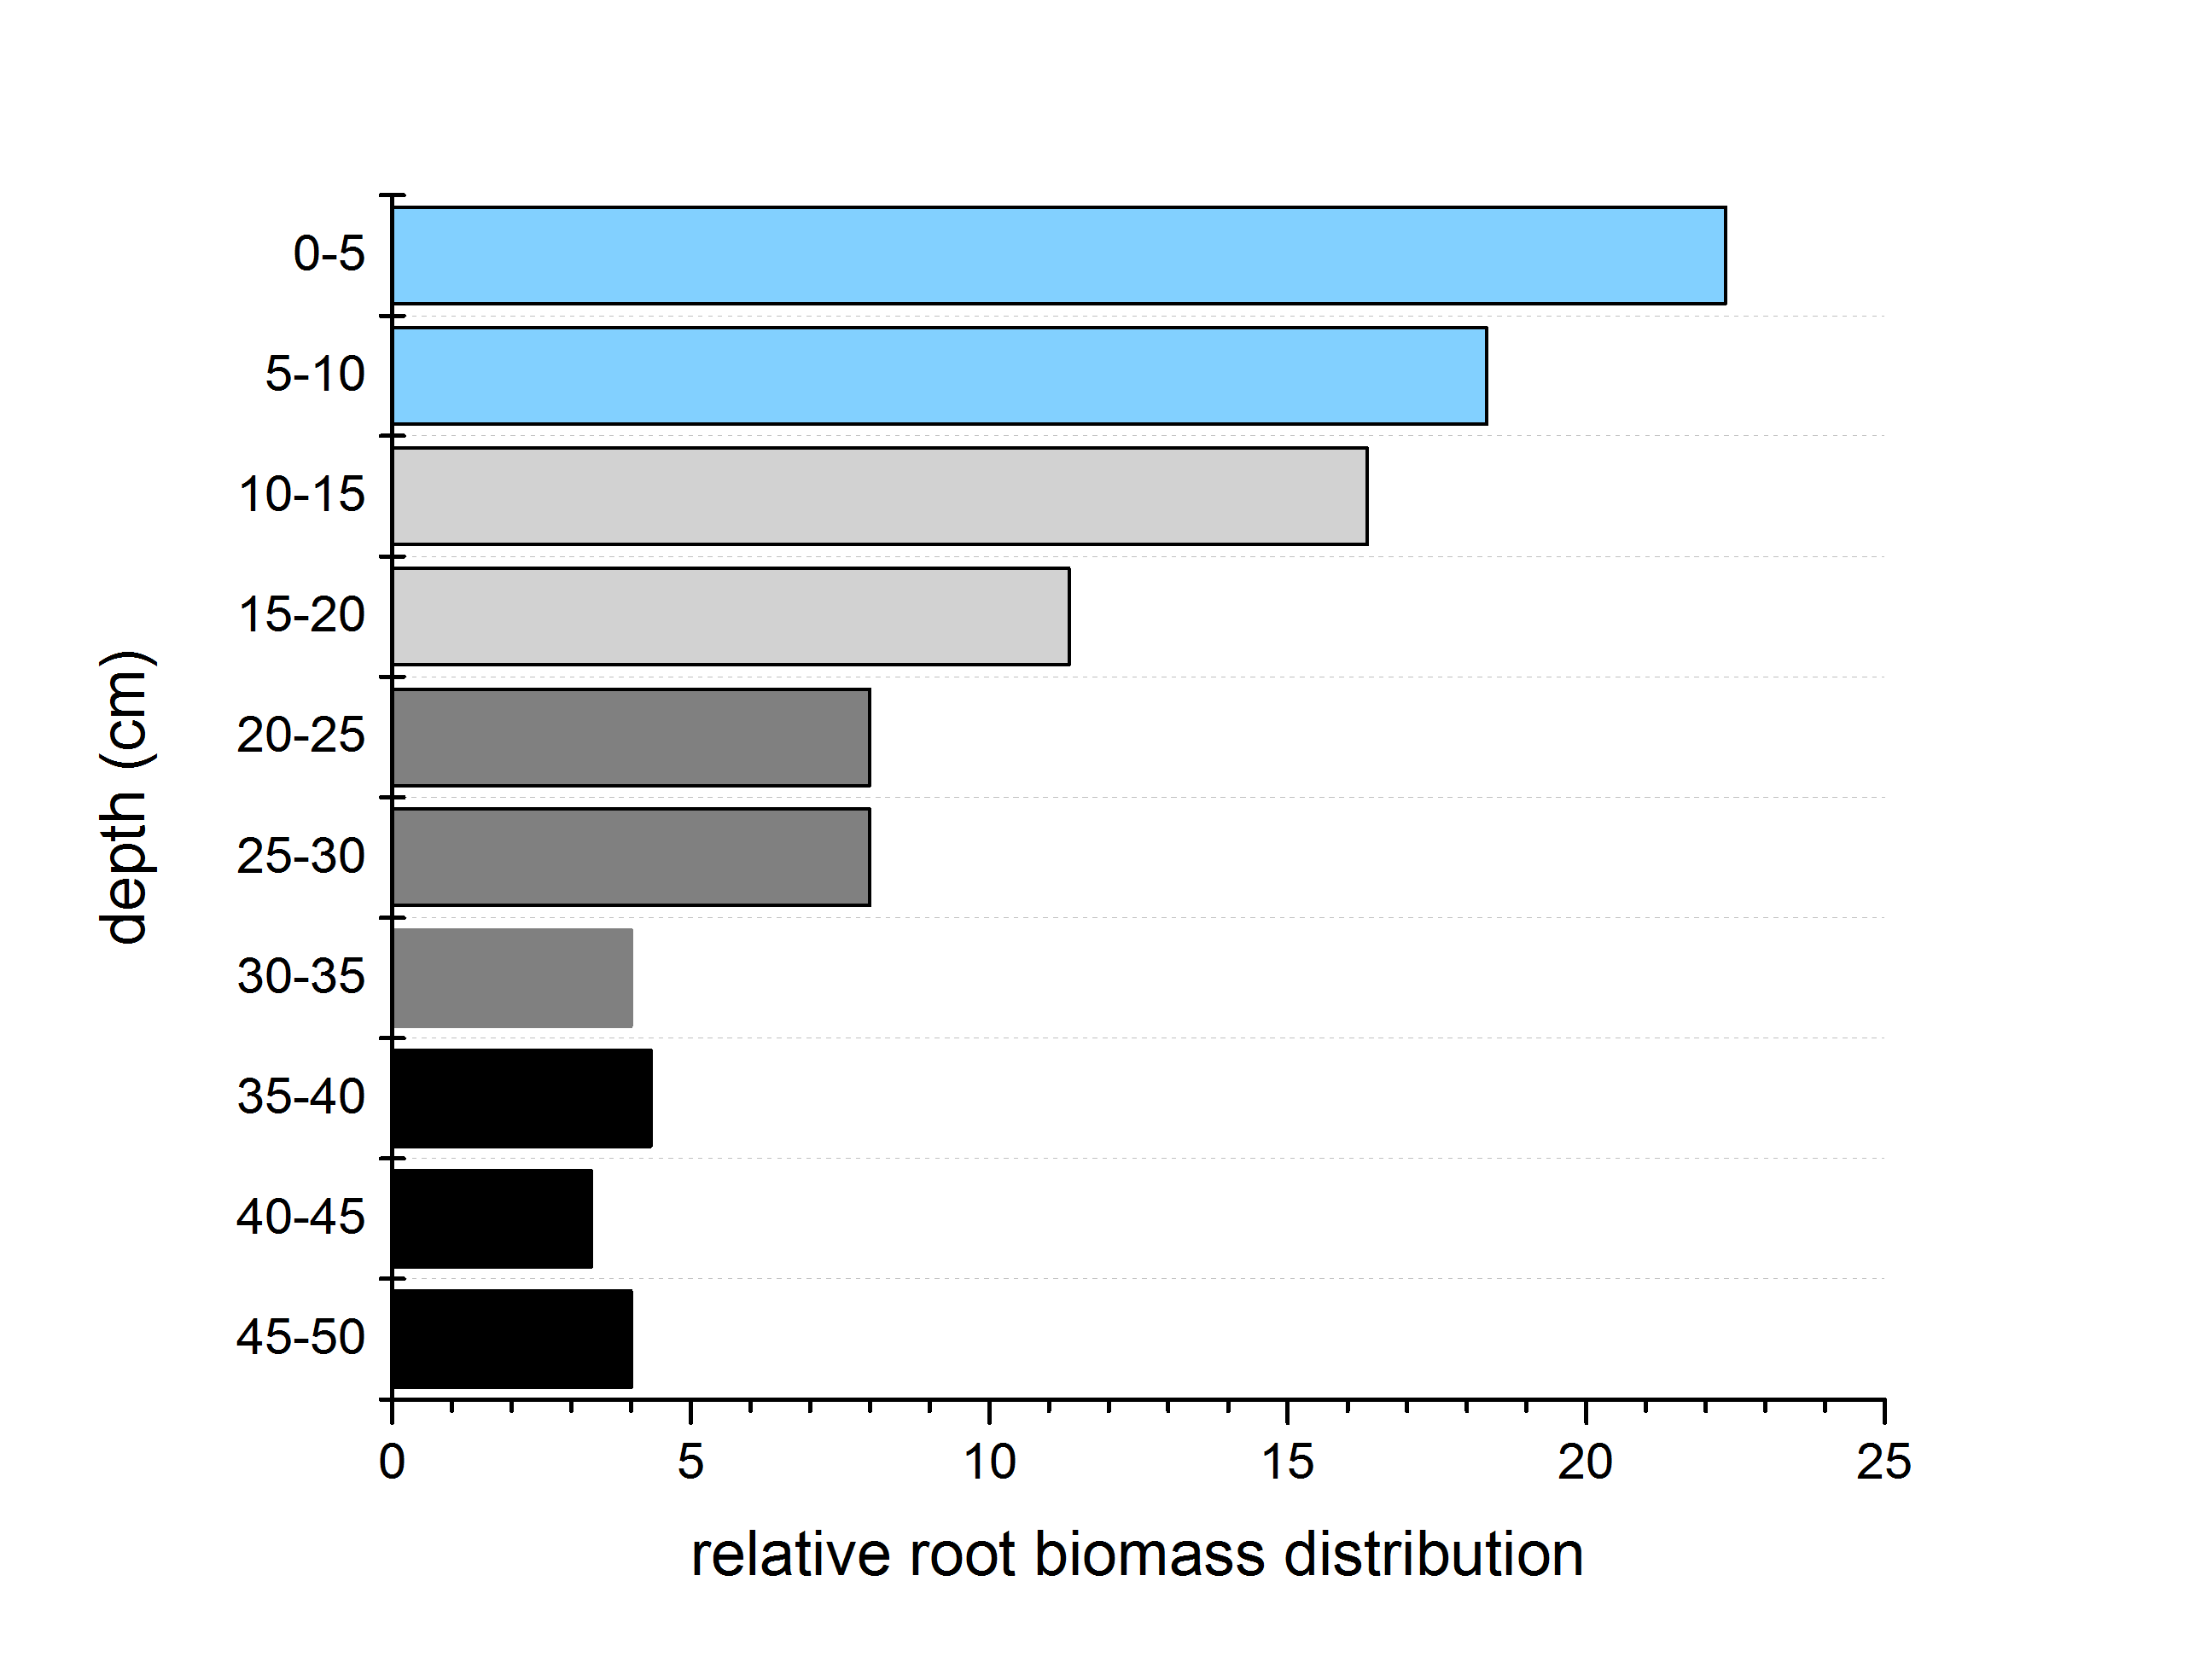
Relative contribution of water sources from different depths to total tree water use
Root biomass distribution over the soil horizon
Bayesian isotope mixing modeling (BIMM)

Slide 6
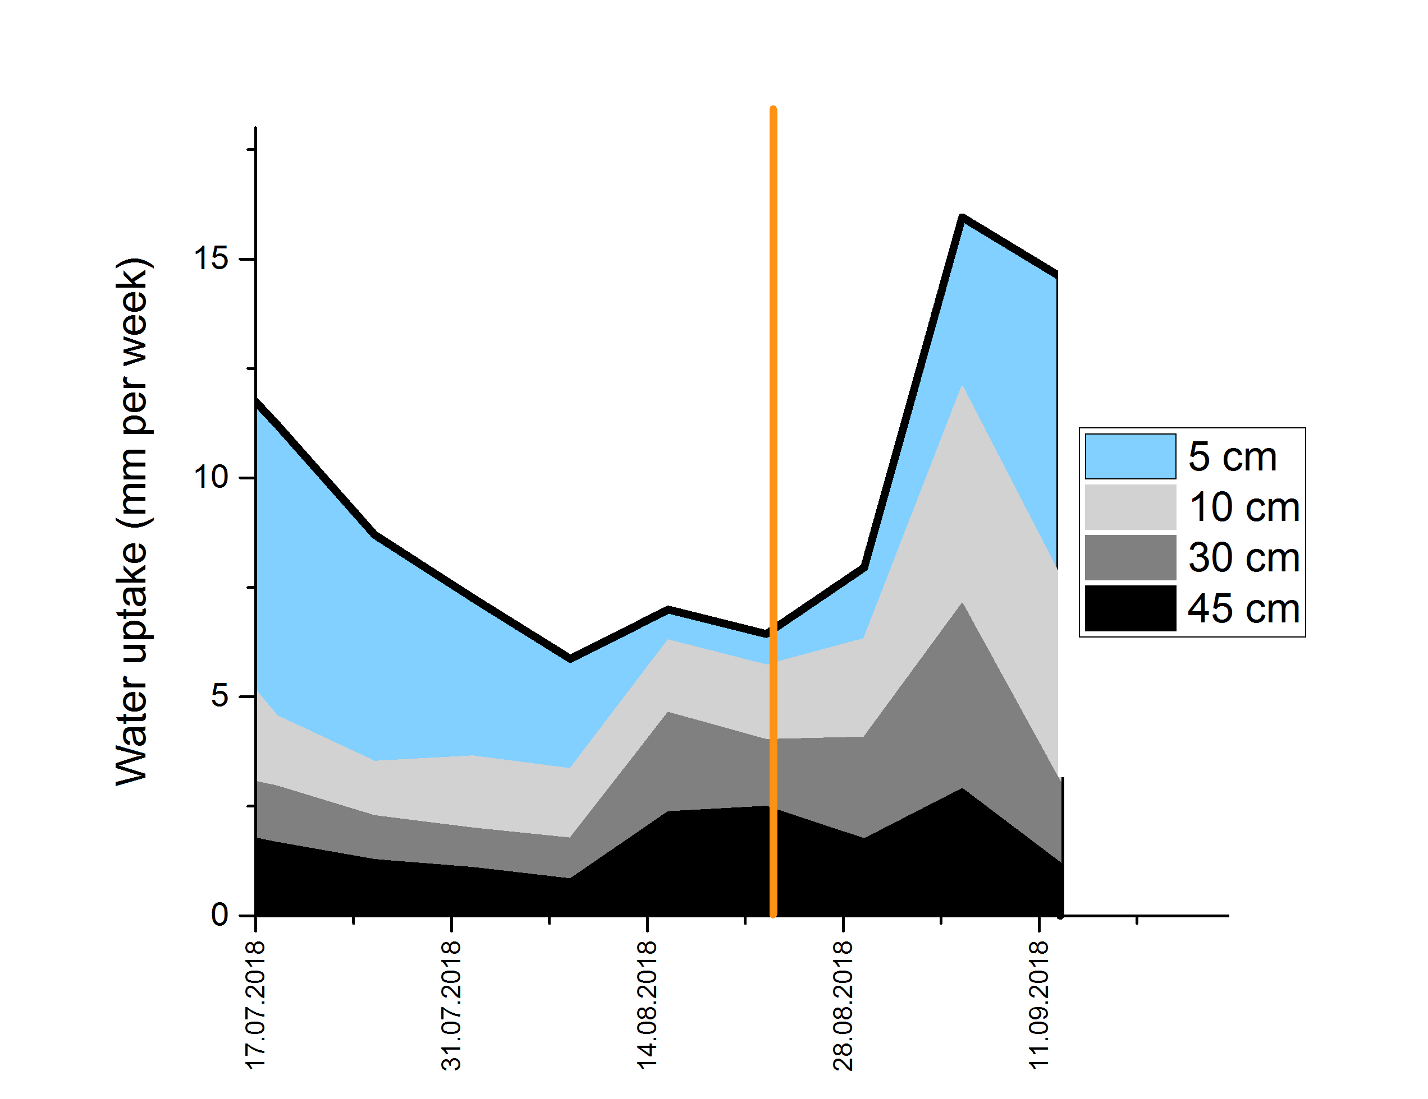
Absolute contribution of water sources from different depths to total tree water use

Slide 7
Conclusions
Beech trees are able to shift water uptake to deeper layers
That, however, can only partially compensate the lower availability in shallower layers (root distribution)
Fast recovery of water use and also shift to uptake from shallower layers after drought has ceased

