Slide 1
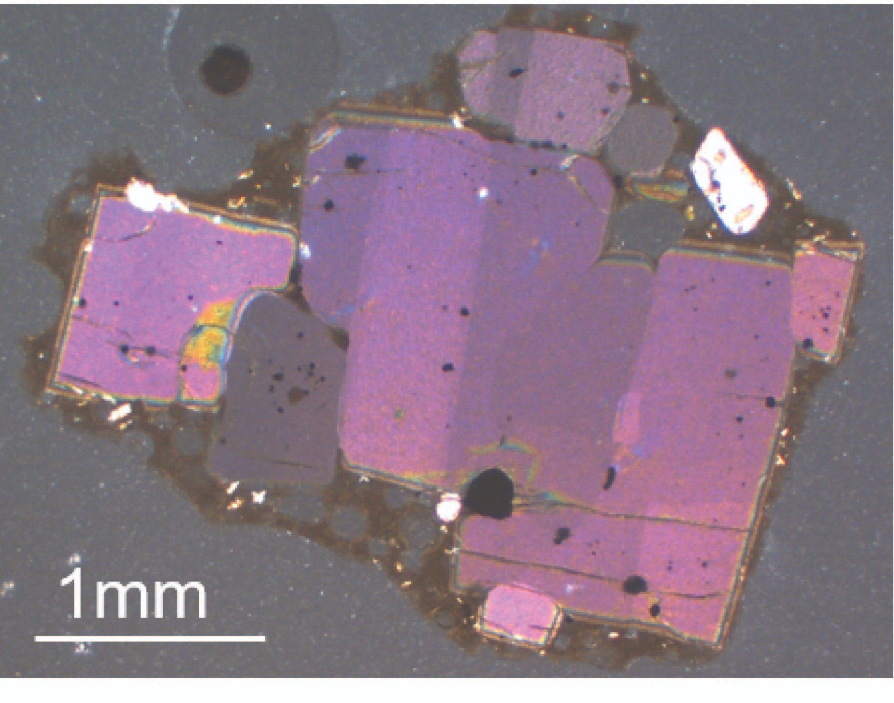

Microstructural Constraints on Magmatic Mushes Beneath Kīlauea Volcano
Penny Wieser^{*1}, Marie Edmonds ¹, John Maclennan¹, and John Wheeler²
¹University of Cambridge ²University of Liverpool
Motivation:
What igneous processes produce distorted olivine crystals at basaltic volcanoes?
What can these features tell us about the geometry of magmatic mush piles?
Findings:
EBSD allows quantitative assessment of different hypotheses.
Distorted olivines form during gravitation loading in mush piles with thicknesses of ~180-720 m.
For more info, flick through slides, or read the paper! https://www.nature.com/articles/s41467-019-13635-y
Penny_Wieser

Slide 2
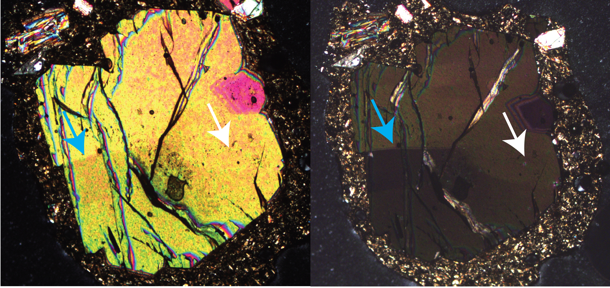
Distorted Olivine Crystals
This study investigates the origin of prominent “intracrystalline distortions” within olivine crystals at Kīlauea Volcano.
Distortions of the crystal lattice produce sharp changes in birefringence colours across linear “subgrain” boundaries under a polarizing microscope (blue and white arrows).

Slide 3
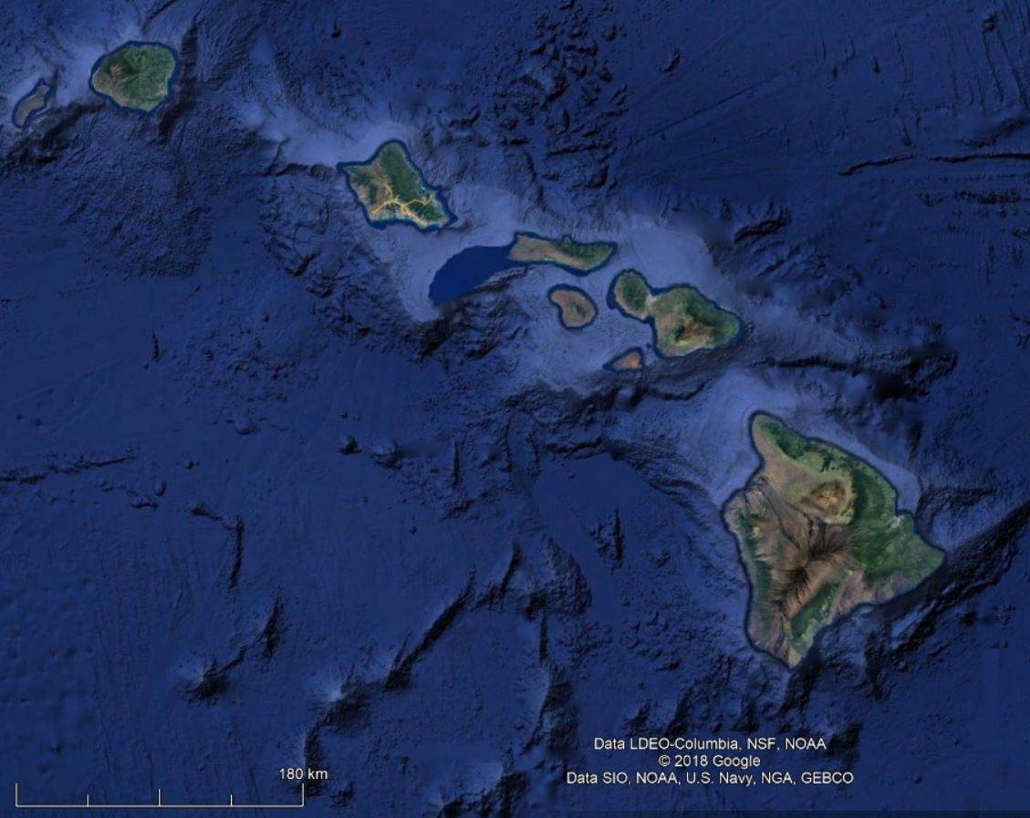
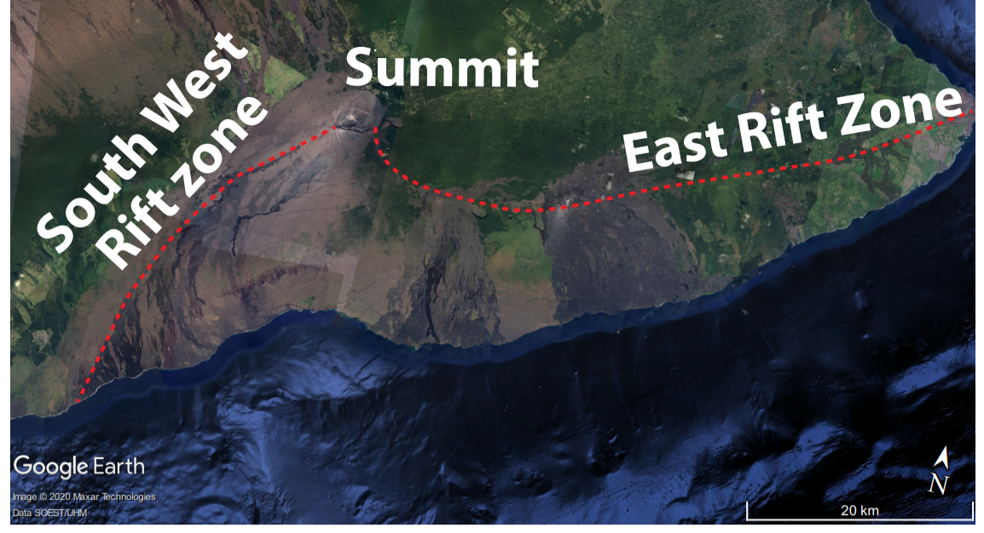
Kīlauea Volcano
a)
b)
We focus on Kīlauea - the youngest volcano on the island of Hawai’i (a, red triangle).
Eruptive activity is focused around the summit caldera, and on two prominent rift zones extending to the East and South West (b).

Slide 4
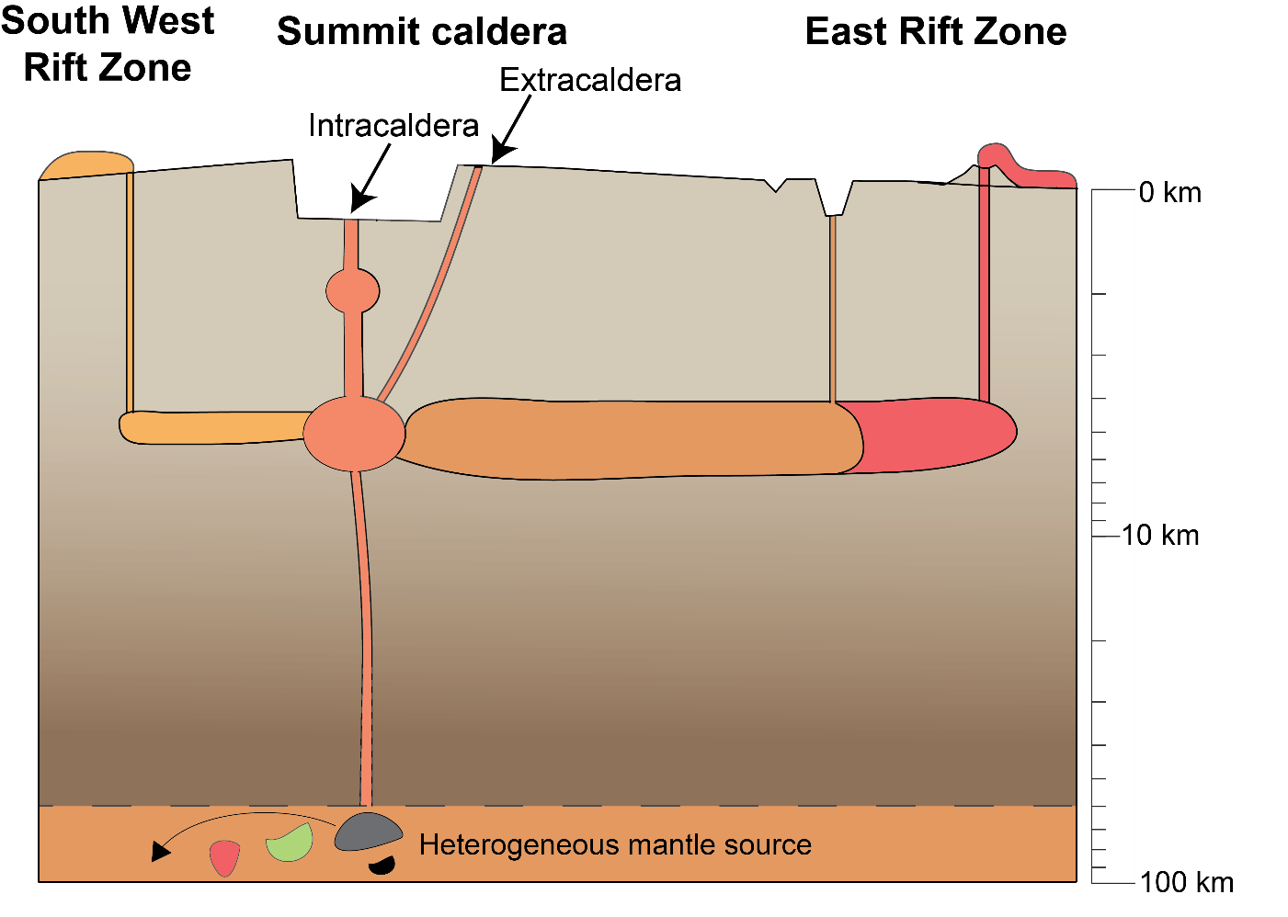
Volcanic Plumbing
Primary melts ascend from the Hawaiian mantle plume, and are stored within two main magma storage reservoirs (3-5 km and 1-2 km depth).
It is thought that melts travel laterally from the deeper reservoir (1.) into the rift zones.
2.
1.

Slide 5
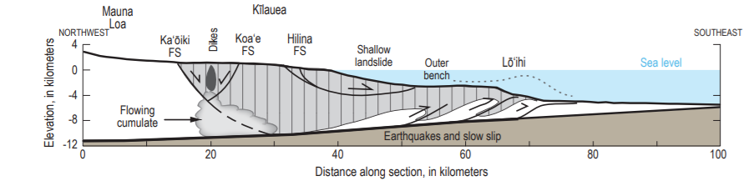
Hypothesis 1
Fig. from Denlinger and Morgan, 2014, see also Clague and Denlinger, 1994
M7.7 in 1975, M6.9 in 2018!
The south flank of Kīlauea has the structure of a large landslide slump, thrusting over the basal decollement (where the volcanic edifice rests on sea floor sediments) in large earthquake events.
It has been suggested that the creep of hot, ductile olivine cumulates within Kīlauea’s deep rift zones help to drive these collapse events.
Hypothesis 1: Olivine crystals are deformed within these creeping bodies. Magma transport paths through the deep rift zones carry these crystals to the surface.

Slide 6
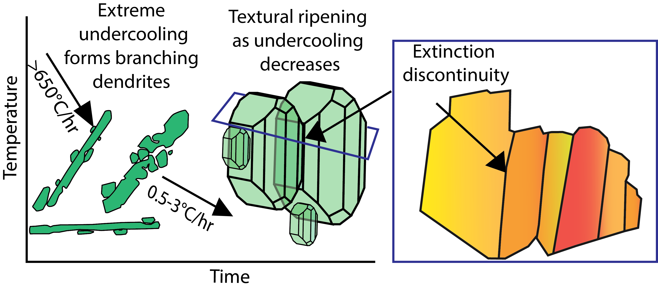
Hypothesis 2
a)
b)
c)
However, Welsch et al (2013) suggest that these textures form during rapid, dendritic growth.
Olivine dendrites form small “buds” which have a different orientation to the host crystal (a).
Following textural re-equilibration and the development of polyhedral crystal shapes during slower growth (b), merging of these buds with the host crystal produces planar “pseudodeformational” features (c).
Hypothesis 2: Rapid growth, not plastic deformation.

Slide 7
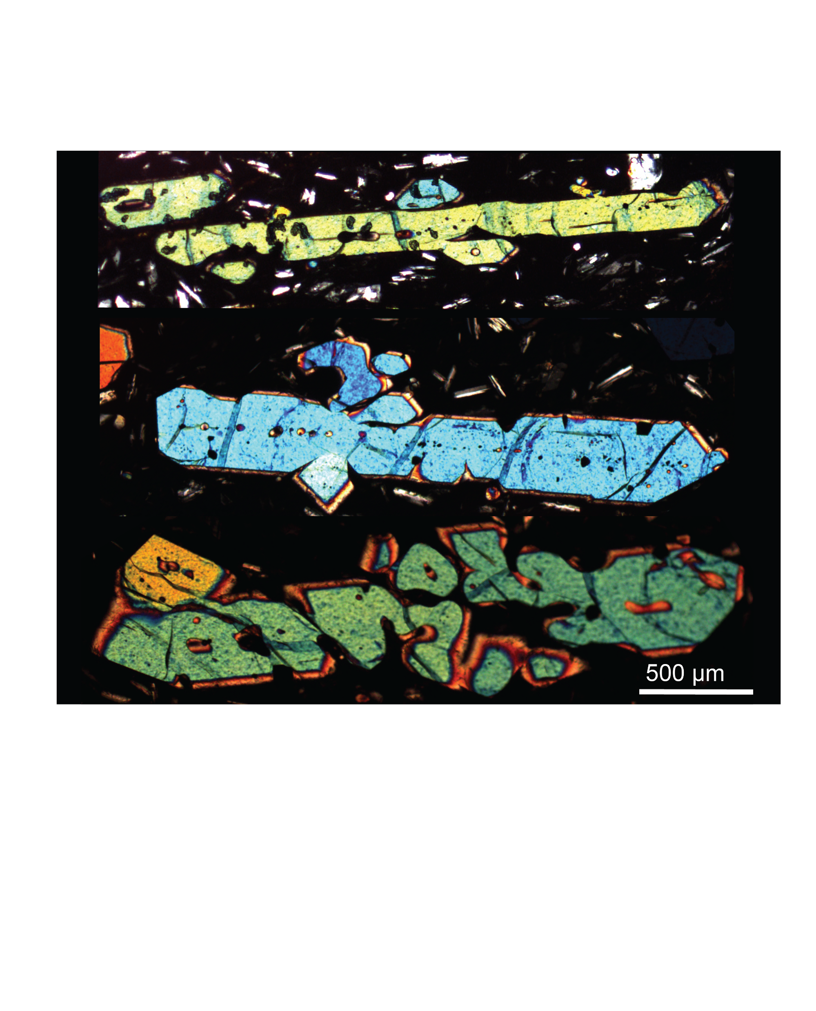
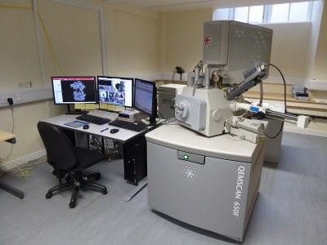
EBSD
Cambridge SEM with EBSD detector
Dendritic olivines from West Greenland
b)
a)
.
We use Electron Backscatter Diffraction (EBSD, a) to quantitatively assess the misorientation and Weighted Burgers Vector Directions (WBVDs) of subgrain boundaries within Kīlauean olivines and branching olivine dendrites from West Greenland (b).
If distorted Kīlauean olivines were formed by an early dendritic growth phase, their crystallographic signatures should match those of dendrites.

Slide 8
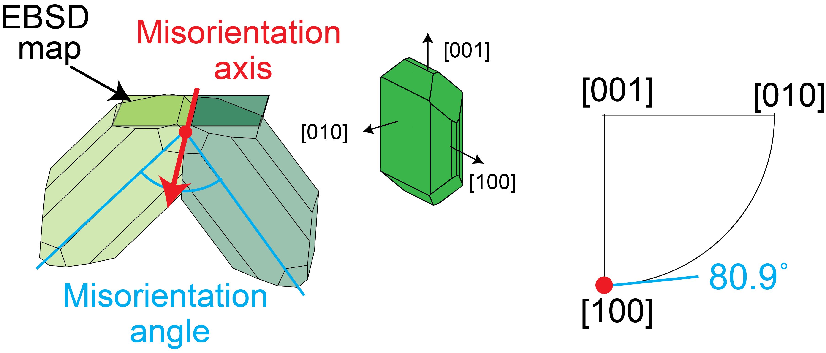
Misorientation
a)
c)
b)
.
EBSD allows the “misorientation” between two regions of a crystal to be quantified in terms of a crystallographic axis (a) and angle (b).
Misorientation axes are plotted on inverse pole figures (c)– The light and dark green crystals are misorientated about the [100] axis.

Slide 9
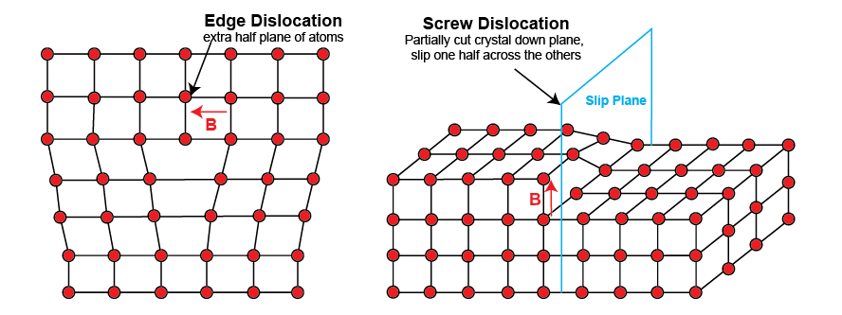
WBVD
The Burgers vector quantifies the magnitude and direction of the distortion of a lattice due to the presence of a dislocation (shown here as a red arrow for an edge and screw dislocation).
The crystallographic direction of the Burgers vector can be calculated from orientation gradients in EBSD maps (Weighted Burgers Vector Direction; WBVD; Wheeler et al., 2009).

Slide 10
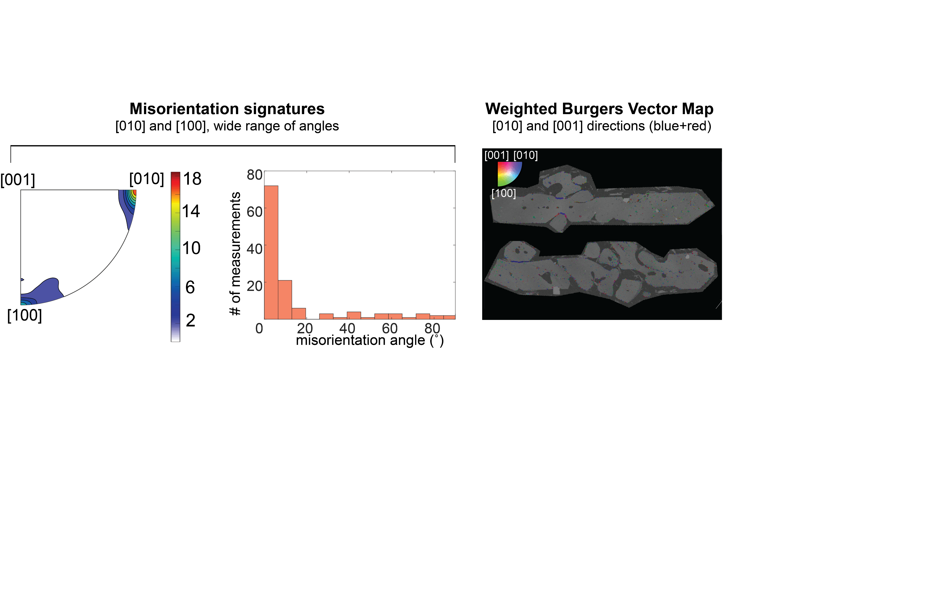
Dendritic Growth Signatures
Dendrite buds in West Greenland olivines are predominantly misorientated from the main crystal about the [010] axis, with a secondary maximum at [100].
Misorientation angles are mostly <10˚, but extend to significantly higher angles.

Slide 11
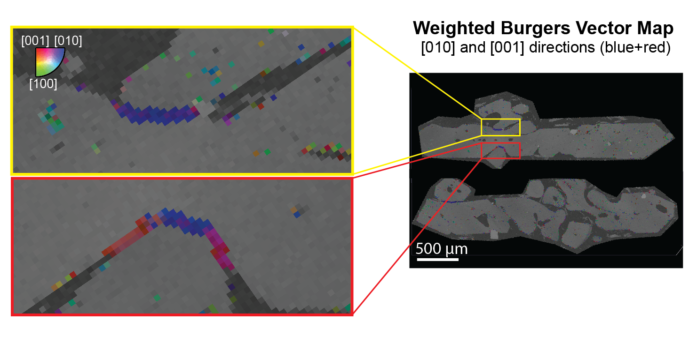
Dendritic Growth Signatures
Dendrite buds show predominantly [010] (blue) WBVDs, with secondary [010] (red) directions.

Slide 12
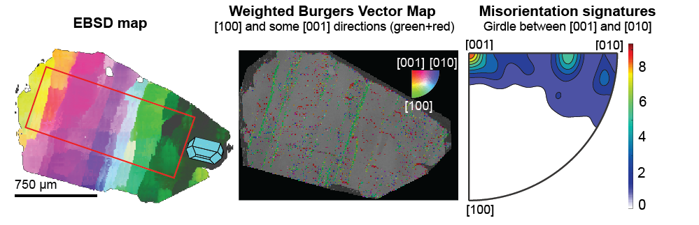
Kīlauean Olivines
Subgrain boundaries within Kīlauean olivines exhibit misorientation angles between 0.5-5˚, and misorientation axes distributed in a girdle between [001] and [010].
Predominantly [100] (green) WBVDs, with secondary [010] (red) directions.

Slide 13
Comparison
1. Misorientation
angles
2. Misorientation
axes
3. Weighted Burgers
Vector Directions
Dendrites
Peak at 3-10˚
tail between
10-90˚
[010]
some
[001]
[010], secondary [100]
Kīlauean Olivines
[100]
some
[001]
Mostly 0.5-1,
some up to 5˚
[010]-[001] girdle
For all 3 measures, dendrites and Kīlauean olivines have different signatures
This rules out the dendritic growth hypothesis, and suggests that Kīlauean olivines have experienced true deformation of the crystal lattice

Slide 14
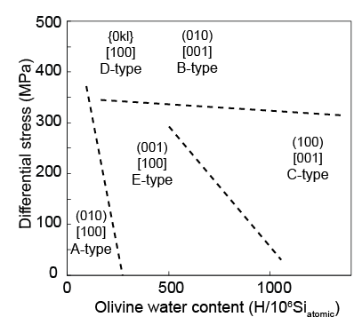
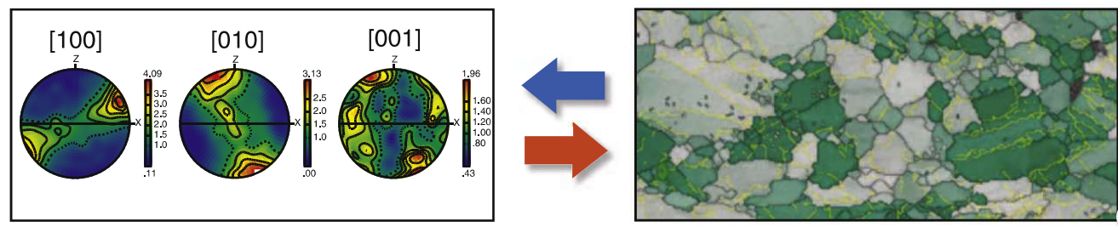
Olivine Microstructures
Traditional method – CPOs –
E.g., Skemer and Hansen, 2016
Jung et al., 2006
b)
a)
Extensive study of naturally and experimentally-deformed mantle peridotites has identified 5 olivine fabric types- these form at different stresses, temperatures, and water contents (a).
Thus, classification of fabric types allows inference of the conditions of deformation.
Fabric types are traditionally identified using crystallographically-preferred orientations
(CPOs, b).

Slide 15
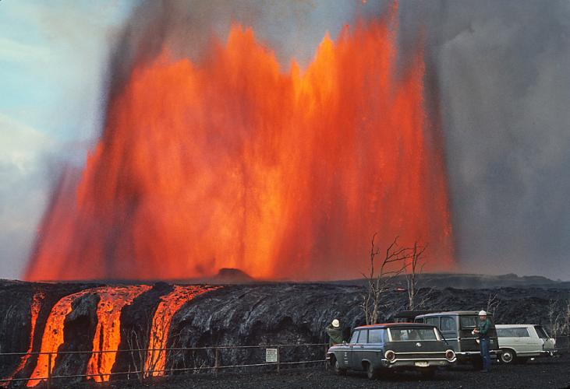
Olivine Microstructures
However, olivine crystals in volcanic products are suspended in the melt, rather than in close contact with each other.
Their orientations have been randomised by volcanological processing, sample collection etc.
Instead, we classify slip systems by examining individual subgrain boundaries, using well established links between slip systems and fabric types.
Mauna Ulu eruption: Photo credit USGS

Slide 16
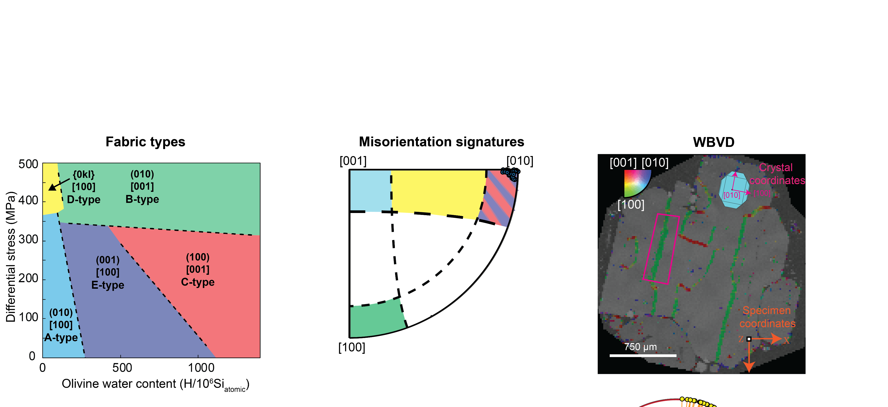

Slip System Identification
a)
b)
Our MTEX code utilizes misorientation axes (a), WBVDs (b), and the orientation of the boundary trace (c) to classify the most slip system operating on each subgrain boundary.
c)

Slide 17
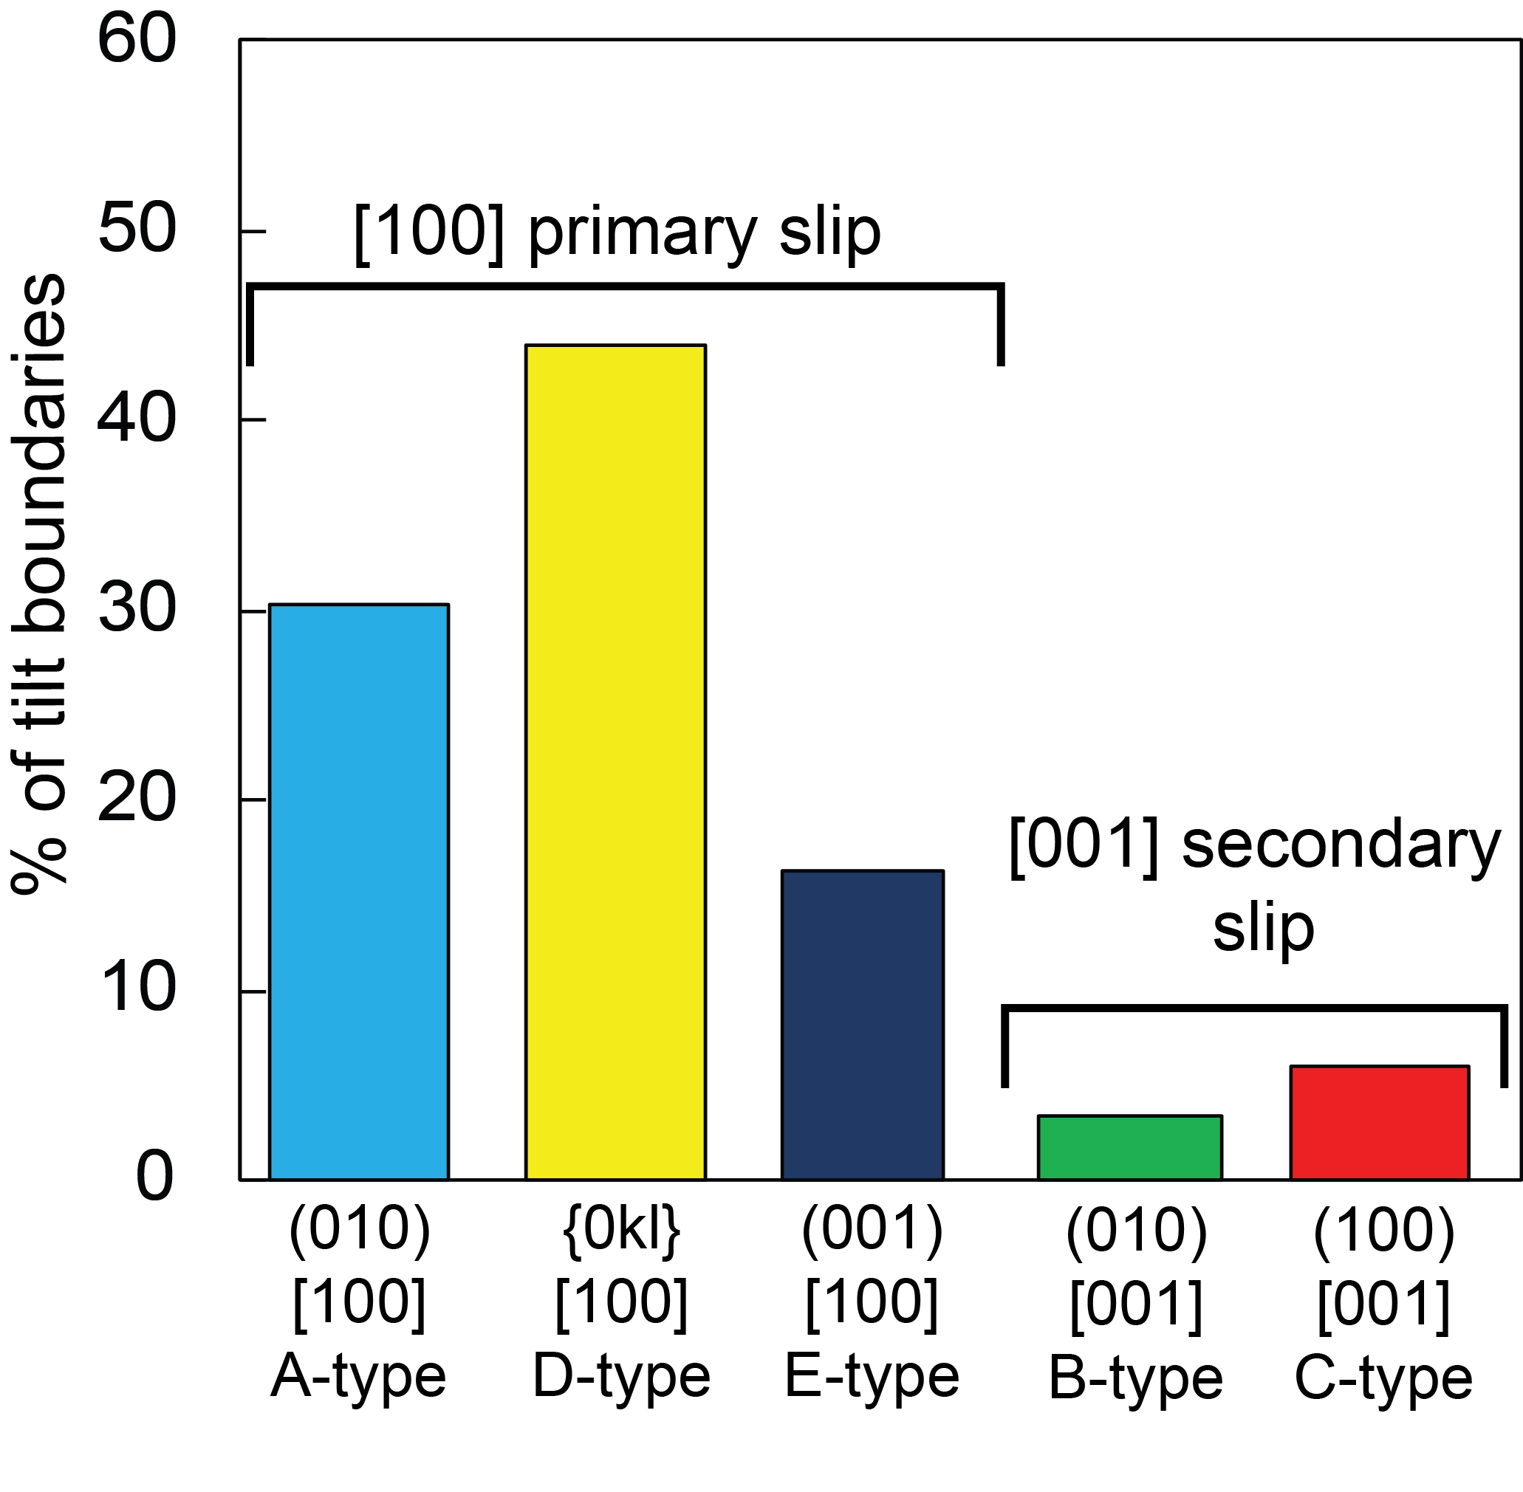
Slip system proportions
Kīlauean olivines predominantly show slip systems with [100] WBVDs, consistent with deformation at high temperatures (>1000˚C) and low water contents.
Independent constraints are needed to estimate stresses (as slip systems thought to form D-type fabrics may form at high stresses, or through the interaction of A and E-type dislocations on a single boundary)

Slide 18
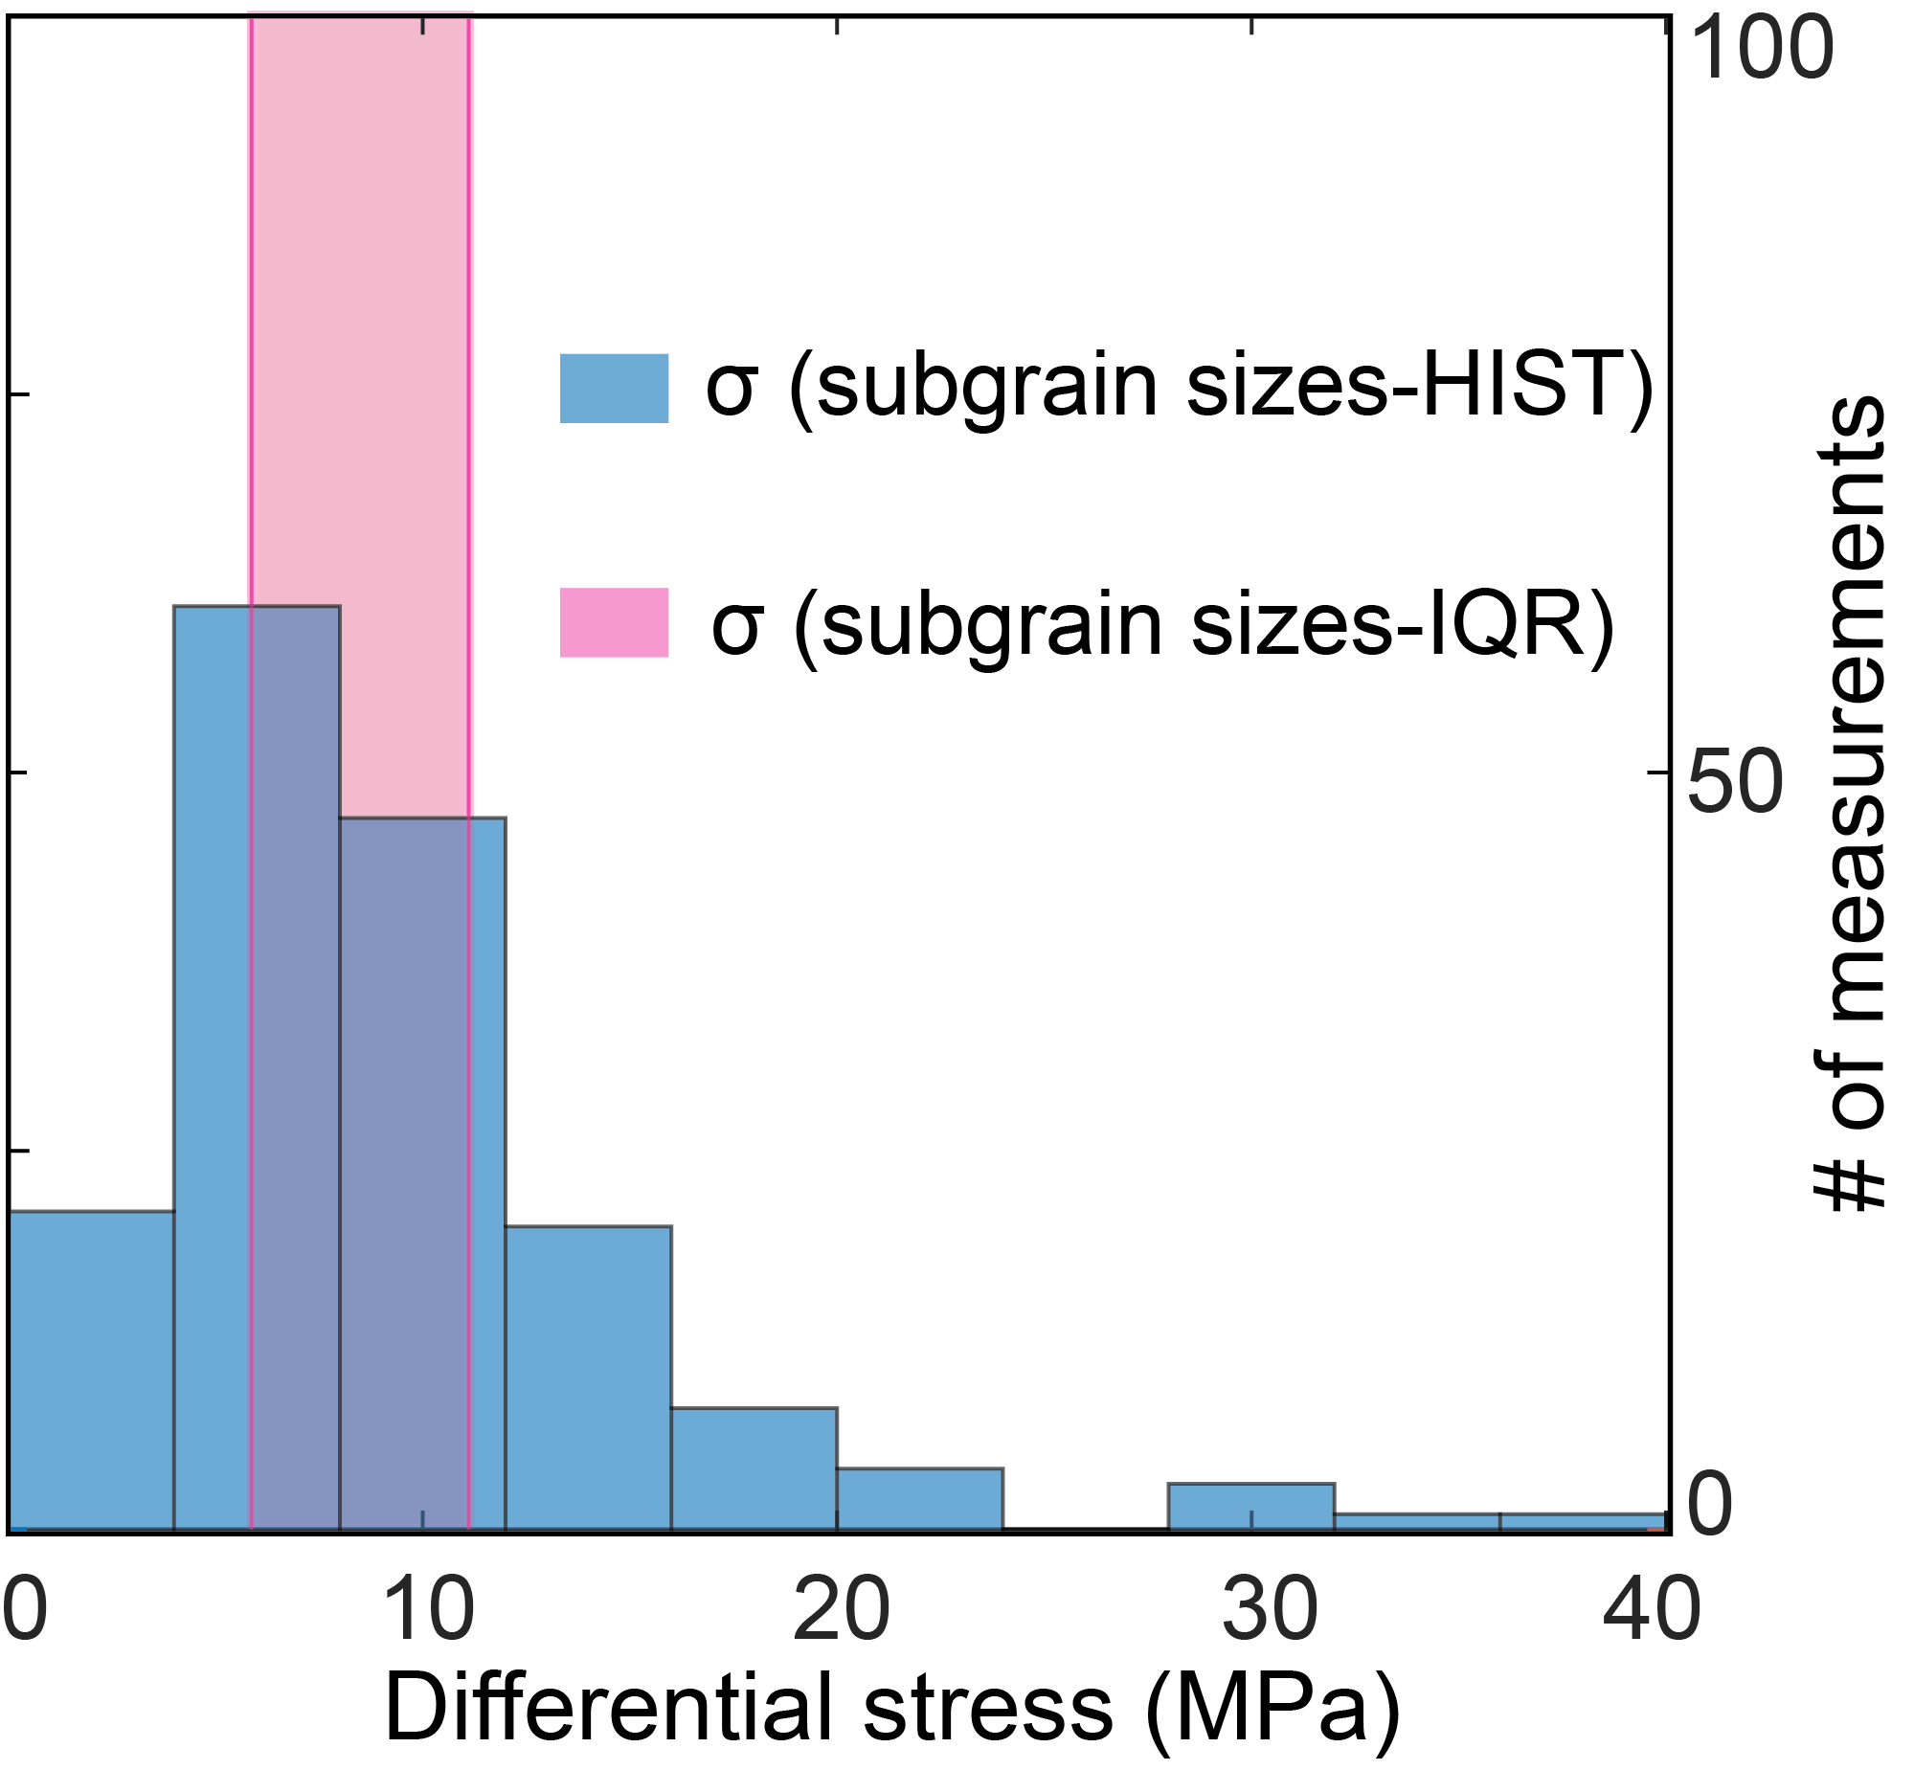
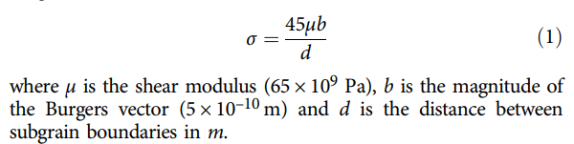
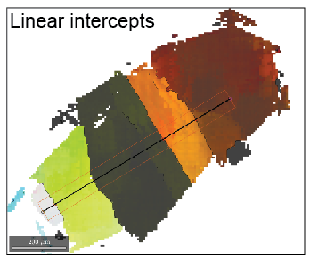
Subgrain Sizes
Toriumi et al., 1979 Subgrain piezometry
b)
Intercept distances (subgrain sizes, a) were converted into differential stresses (b) using the piezometer of Toriumi (1979
a)

Slide 19
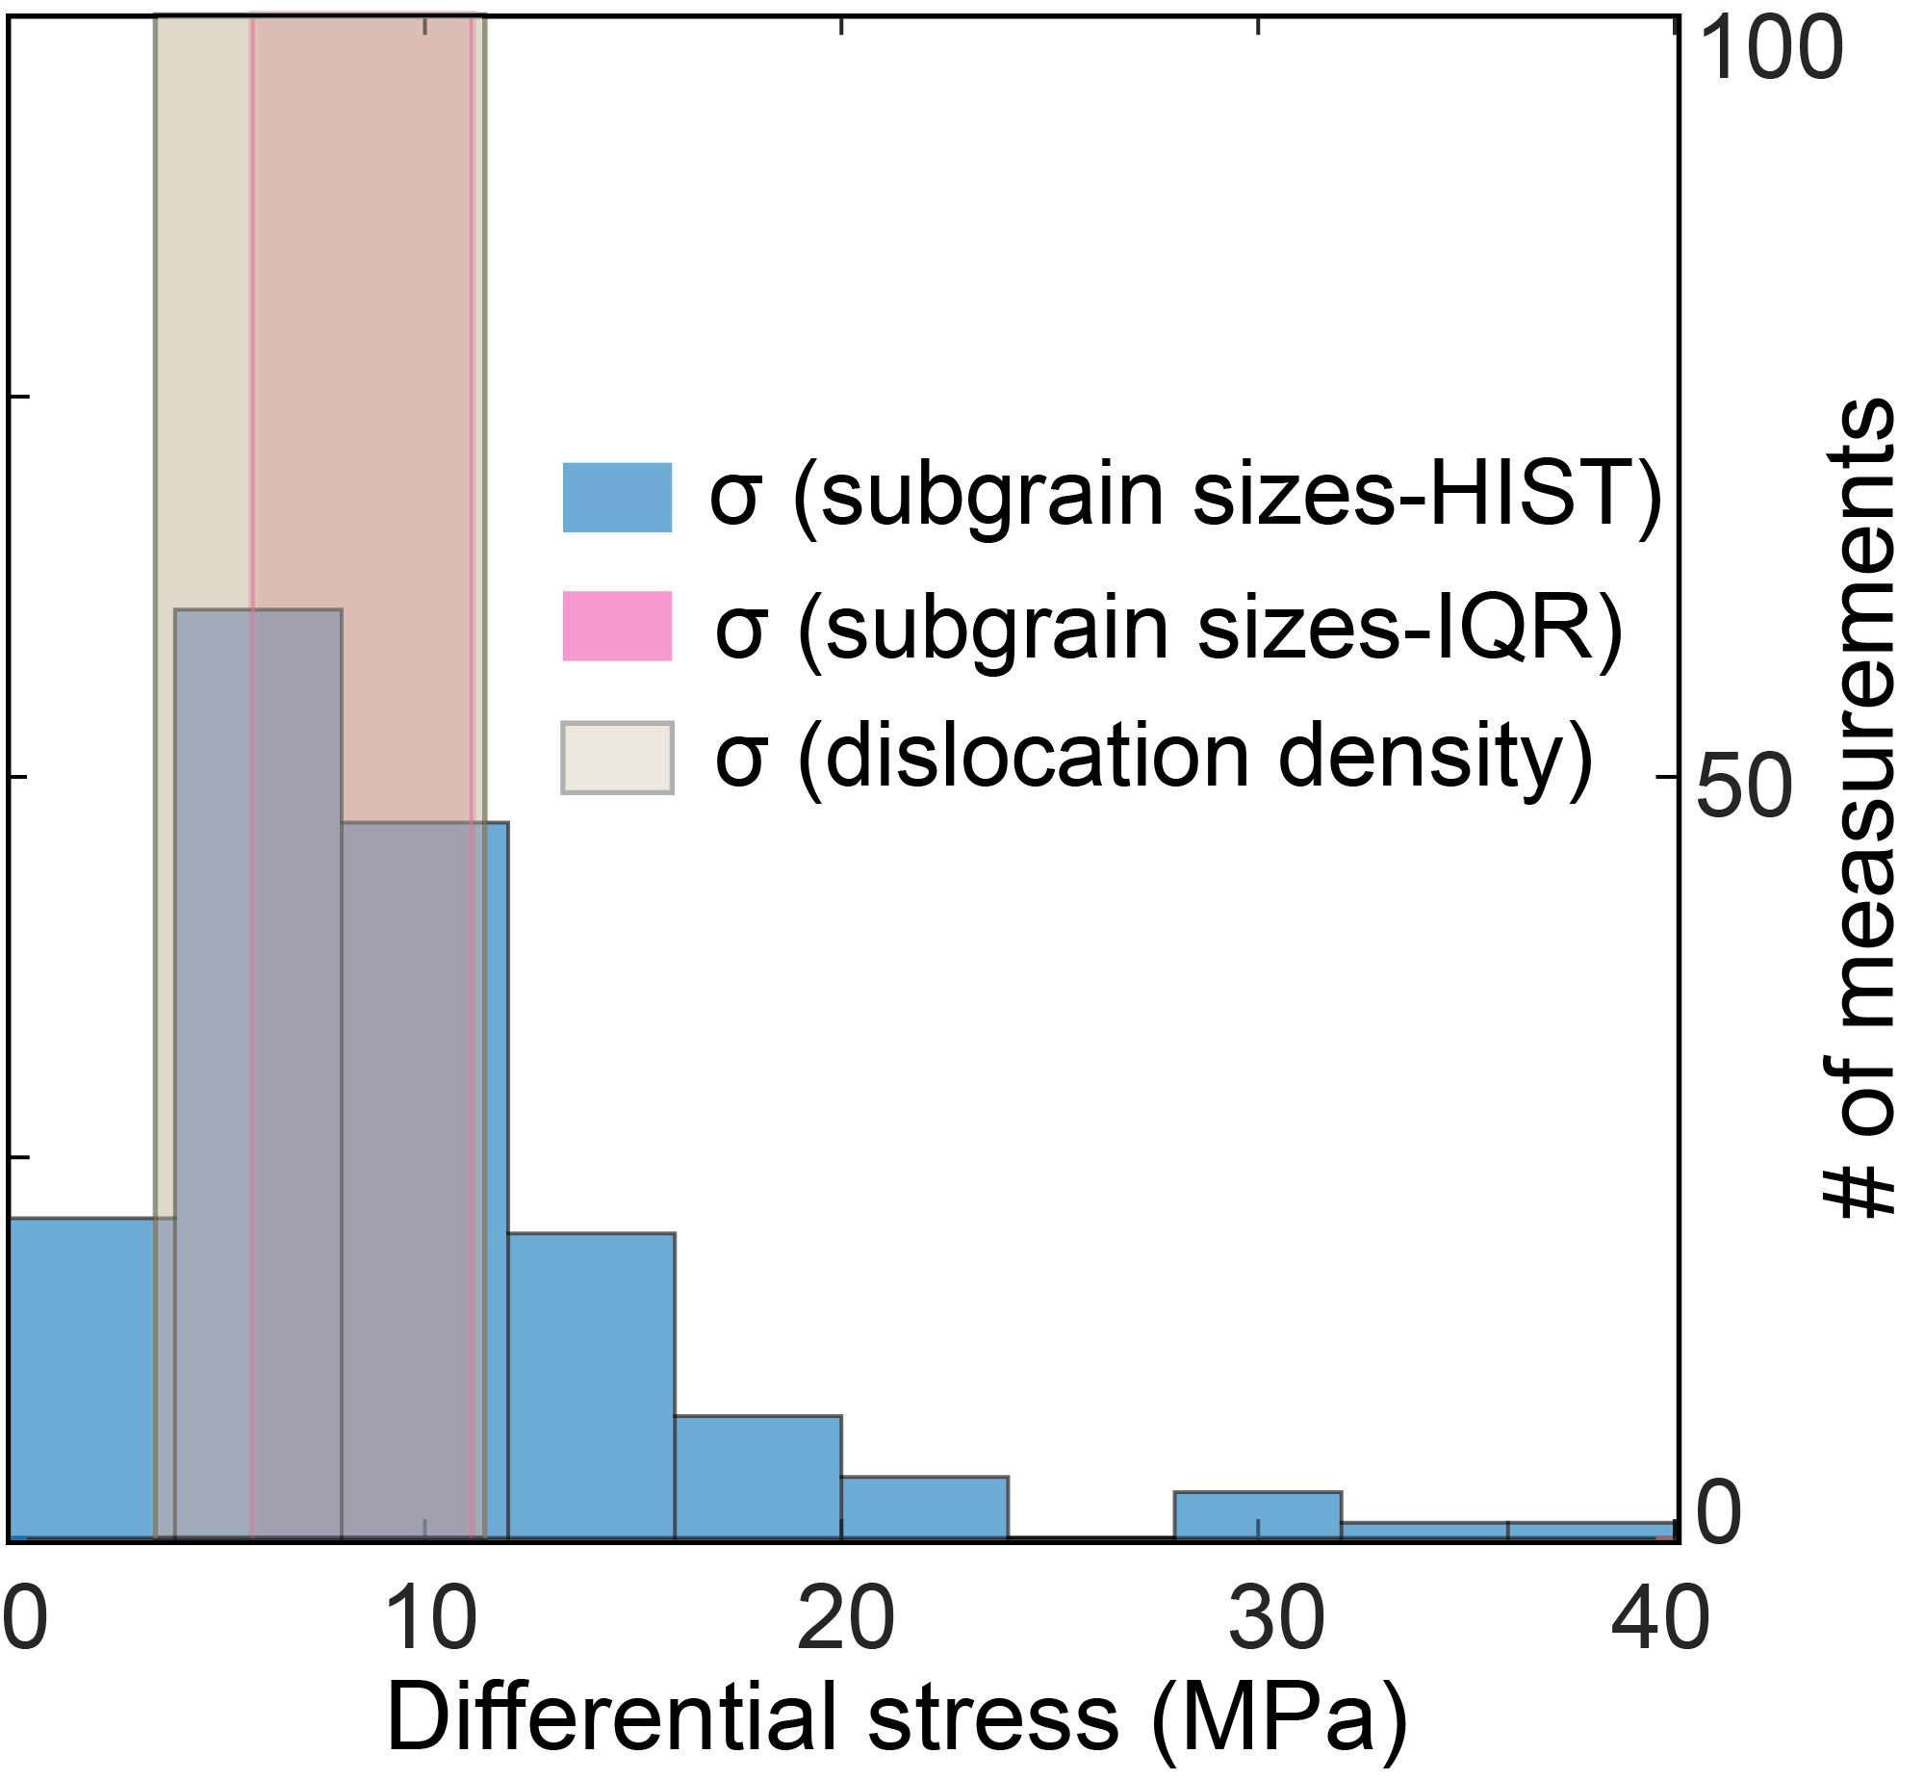
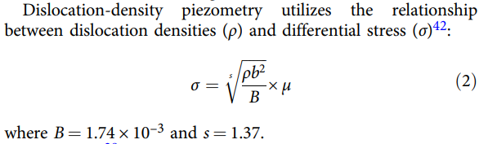
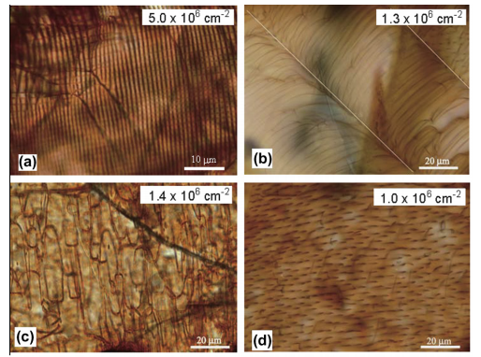
Dislocation Densities
b)
Bai and Kohlstedt, 1992
a)
Dislocation densities measured in Hawaiian olivines by Sakyi et al. (2012, a) yield differential stresses which overlap with those estimated from subgrain sizes (~3 –12 MPa, b).
Sakyi et al. 2012

Slide 20
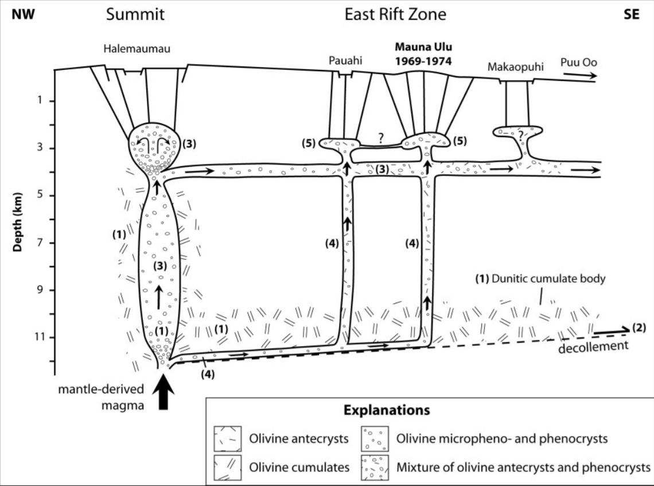
A Deep Rift Zone Source?
Suggestions that deformed olivines are derived from creeping bodies within Kīlauea’s deep rift zones require significant proportions of magma to be transported along the basal decollement to pick up these olivines (a), followed by vertical transport to the eruption site (b).
However, there is very limited geophysical evidence that magma supply bypasses the summit reservoir system in this way.
b)
a)
Fig. from Vinet and Higgins, 2010

Slide 21
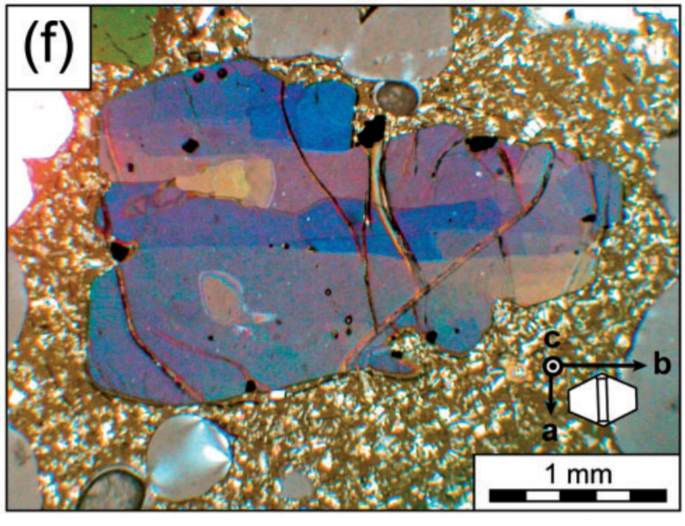
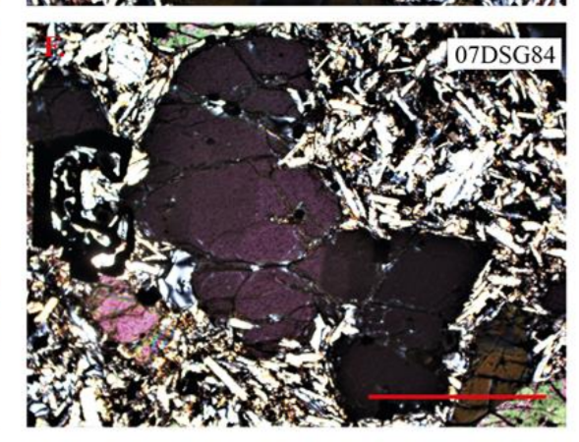
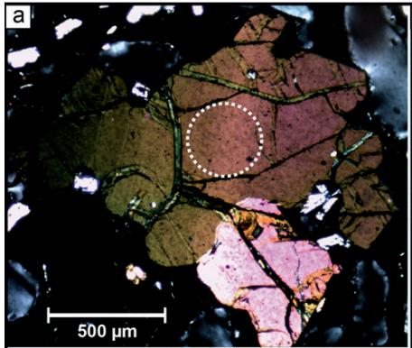
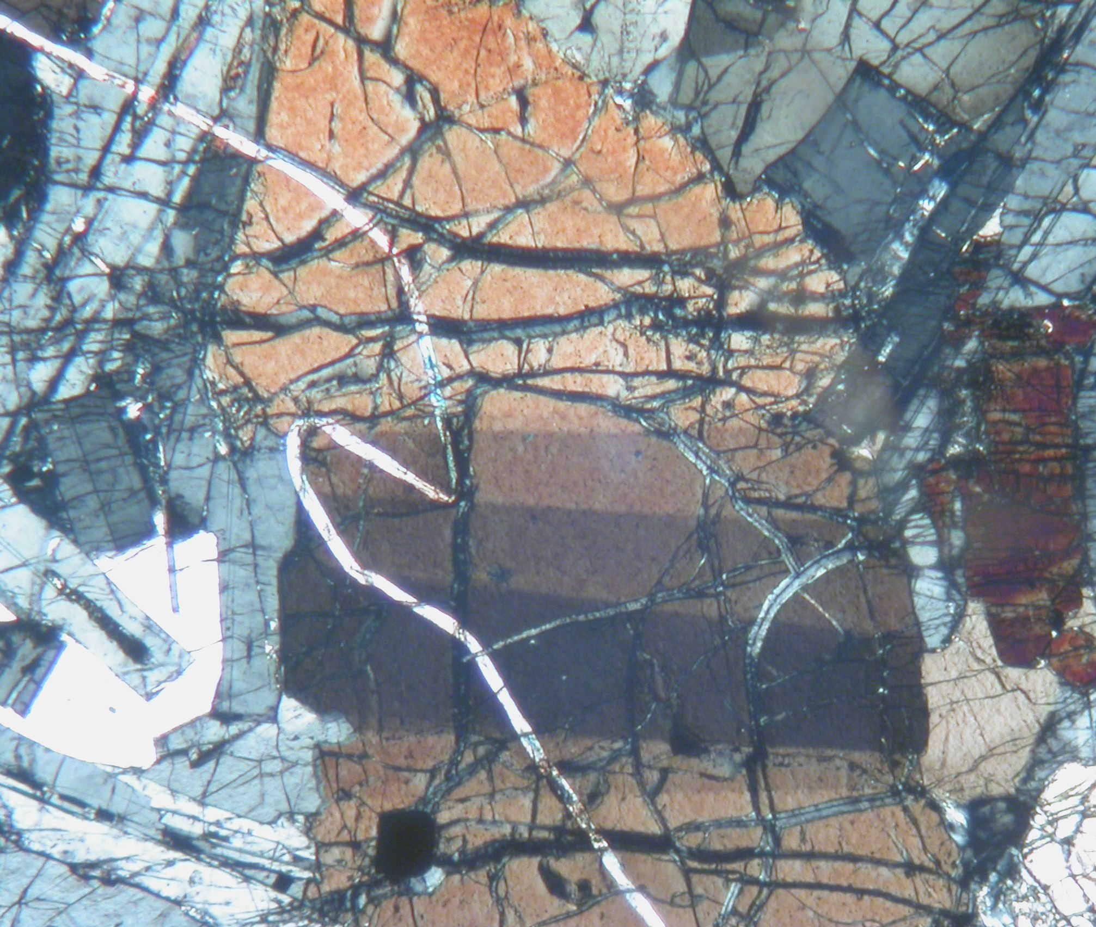
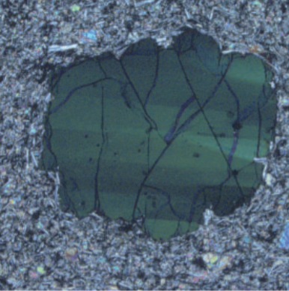
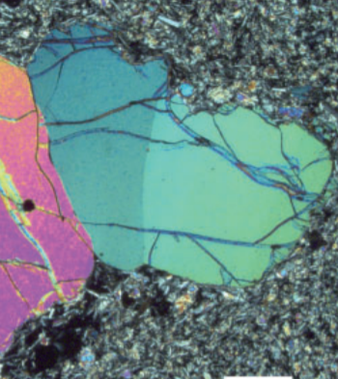
Global Occurrence
Additionally, deformed olivines are found in a variety of basaltic systems which do not have deep rift zones.
This indicates that olivines must be deformed by a mechanism which operates at many different basaltic volcanoes.
Reunion - Welsch et al. 2012
Isla Santiago - M Gleeson
Andean SVZ - Vinet et al. 2011
Mull, UK – J. Westland, thesis
Iceland– Thomson and Maclennan, 2012

Slide 22
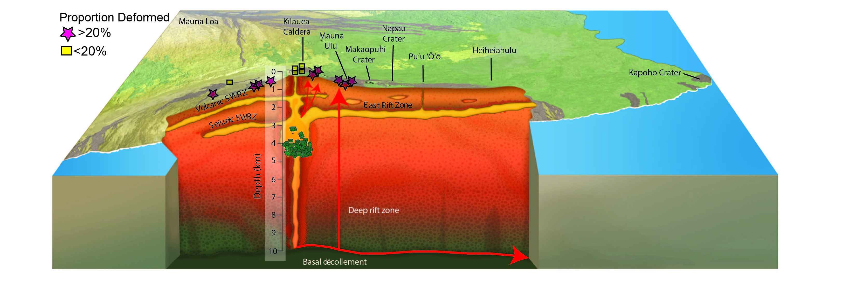
Spatial Distribution of Deformed Grains
Adapted from
Poland et al., 2014
We find that eruptions containing high proportions of deformed grains are located on Kīlauea’s rift zones and on the rim of the summit caldera.
It seems very unlikely these eruptions were all supplied by deep magma transport paths.
However, these eruptions derive their magma supply from the deeper reservoir at 3-5 km.
We suggest that olivines are deformed by processes operating within this reservoir.

Slide 23
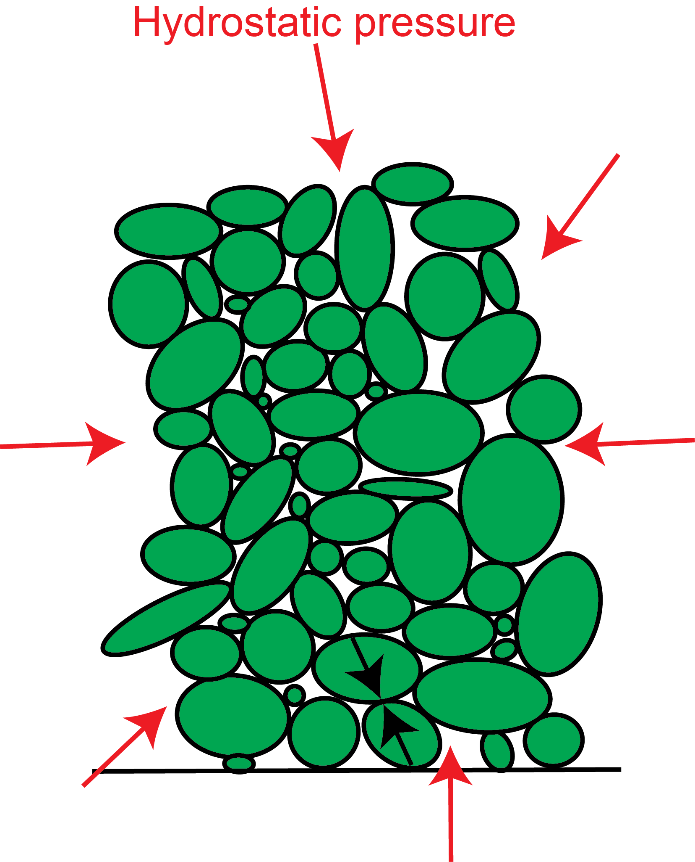
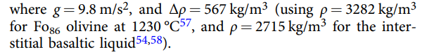

Gravitational Loading
Magmastatic pressure
$${\text{σ}}_{\text{D}}=\text{Δρ} × \text{g} × \text{H}$$
H ~ 540-2160 m
Due to their high densities, olivine crystals settle into mush piles at the base of magma storage reservoirs.
The differential stress exerted on these settled crystals scales as a function of the density difference between olivine and the melt, as well as the height of the mush pile.
Differential stresses of 3-12 MPa can be generated in mush piles with heights of 540-2160 m.

Slide 24
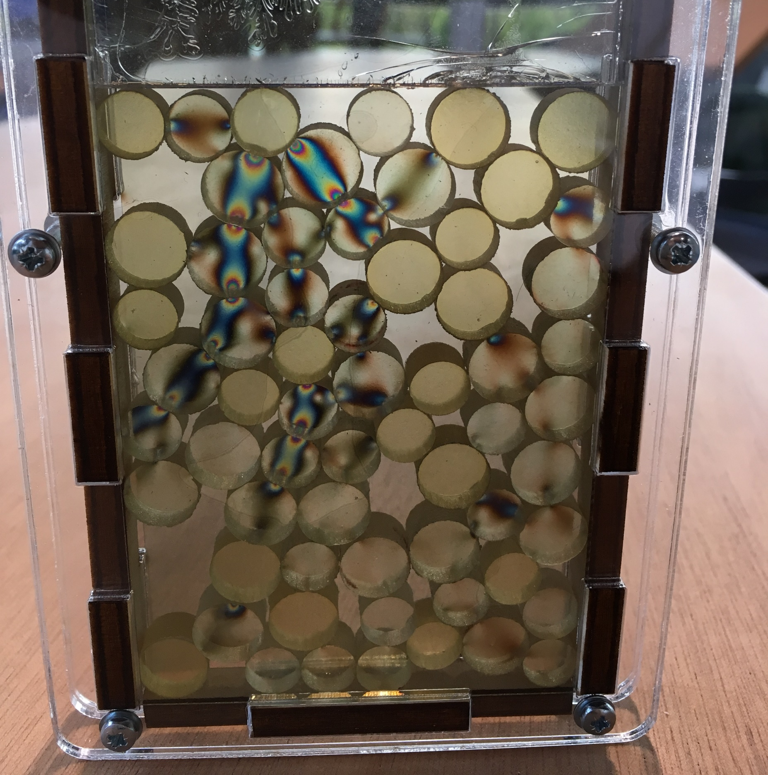
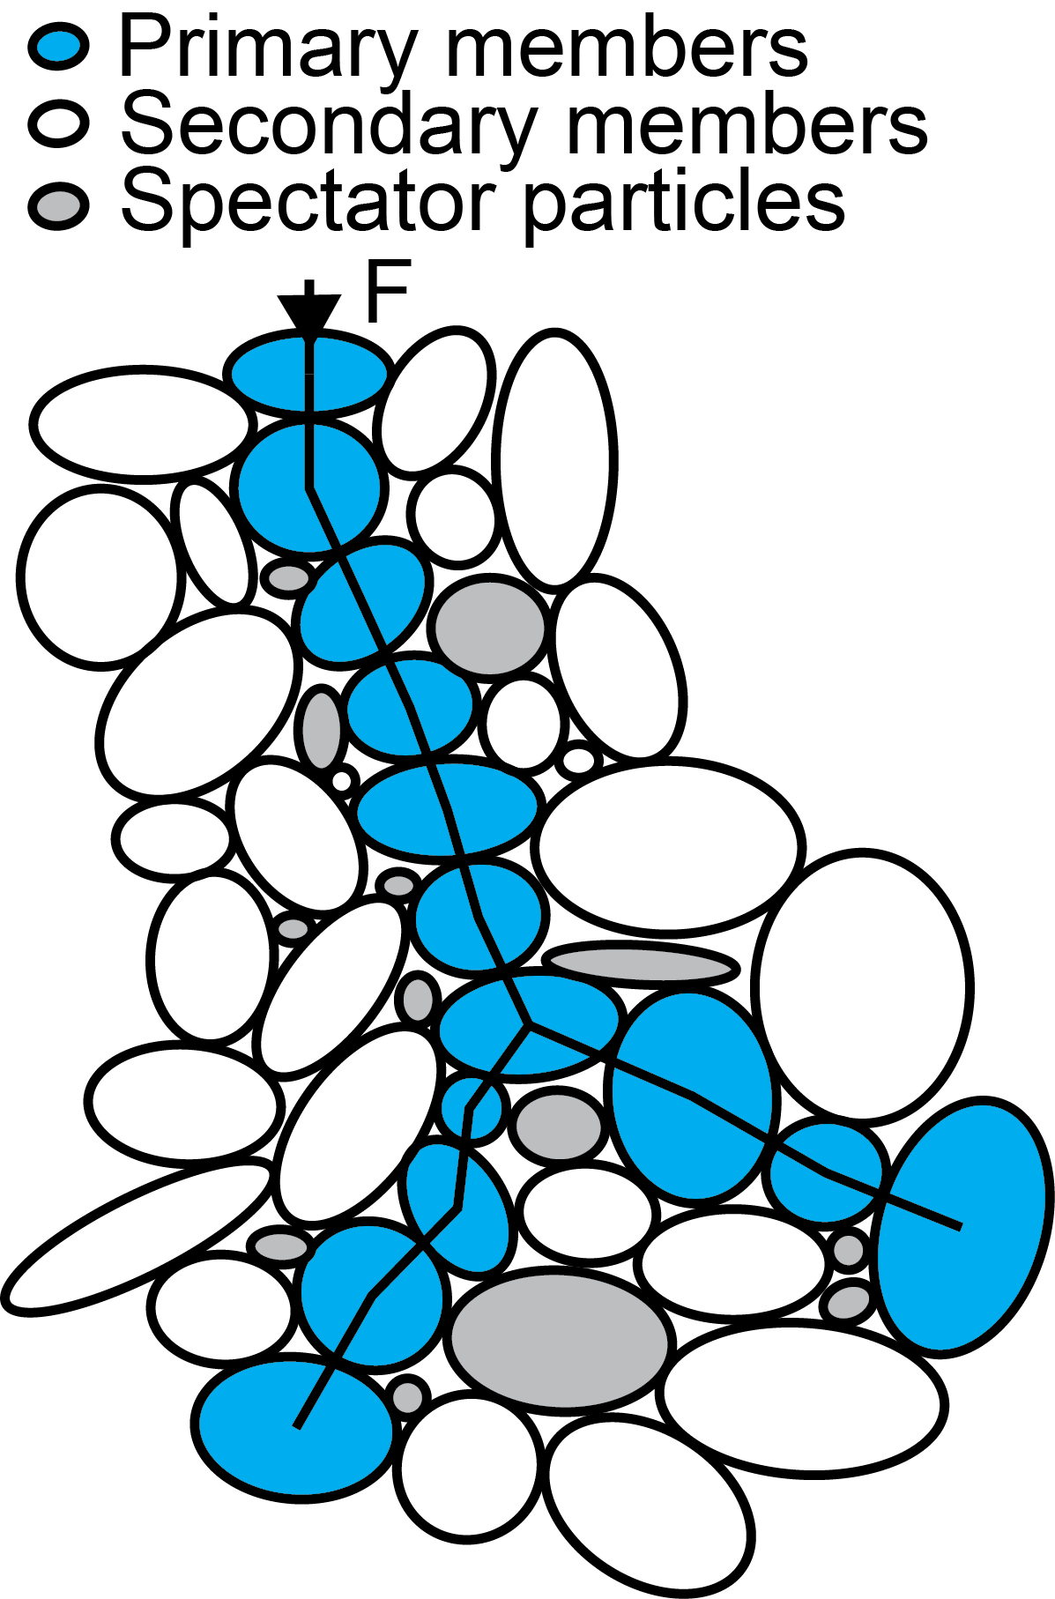
Force Chains
Mushes behave as granular mediums, so force chains are expected to form.
Certain grains will experience far more than the mean stress, while others will experience low-to-no stress. Magma injection, small seismic events and other processes will cause force chain migration.
Thus, large numbers of crystals experience ~3x the mean stress.
180-720 m
Disk Mikado Game –
https://motenay.wordpress.com/portfolio
/disk-mikado-mini-game/
Adapted from Bergantz et al., 2017

Slide 25
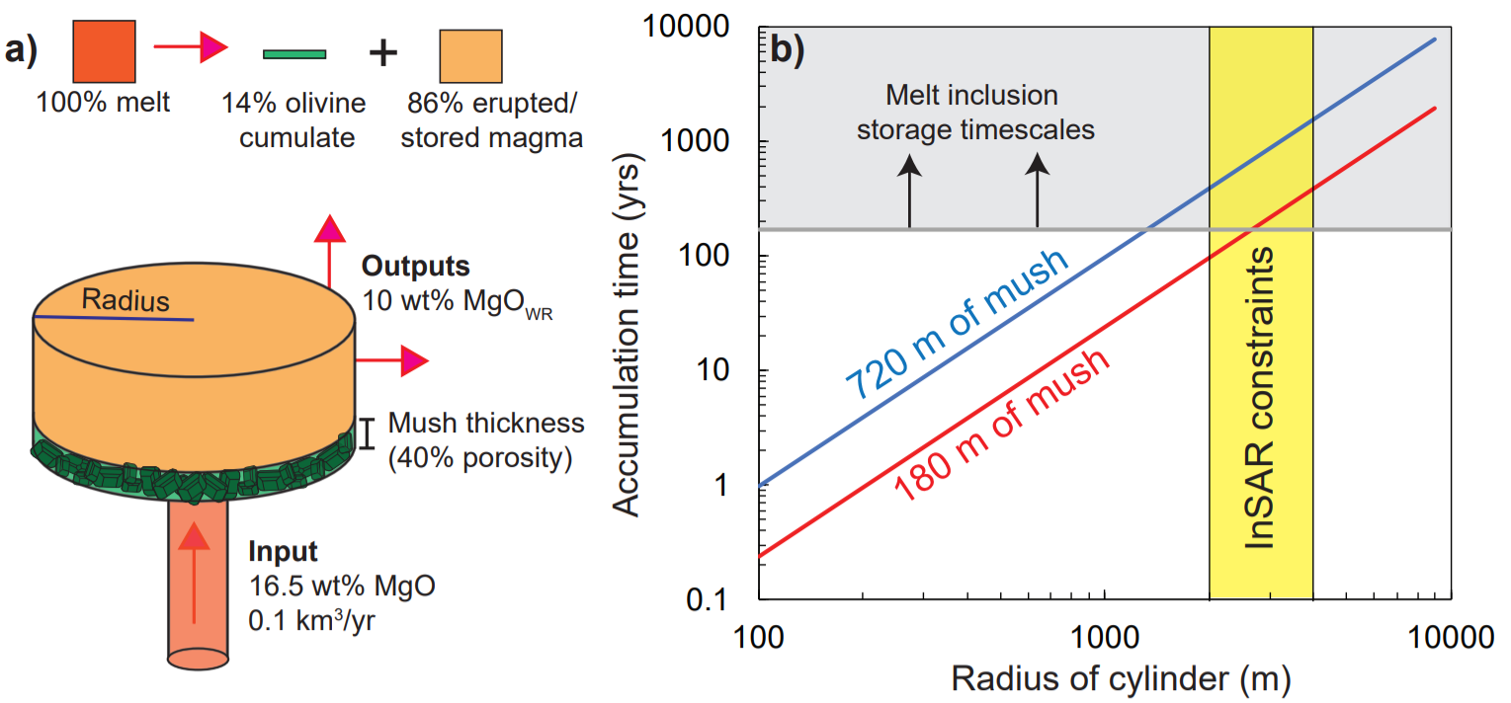
Exploring the Parameter Space
Stress amplification in force chains reduces the required mush thickness to ~180 – 720 m.
Using a simple box model of magma input rates at Kīlauea (a, with ~14 vol% of olivine fractionating from primary melts; Clague and Denlinger, 1994), these thicknesses can accumulate in a few centuries (b).
This is consistent with storage times from melt inclusion chemistry (Wieser et al., 2019).

Slide 26
Conclusions
Deformed olivine crystals show different crystallographic signatures from olivine dendrites – Rules out an origin from fast crystal growth
They are present in a variety of basaltic systems – Inconsistent with an origin from deep rift zone dunitic bodies, which are unique to Kīlauea.
Gravitational loading within mush piles– Accounts for the near-ubiquity of these textures in basaltic volcanoes worldwide, as well as their prevalence in Kīlauean eruptions which are thought to tap the deeper reservoir (where the vast majority of olivine fractionation takes place).
Piezometric techniques – Provide the first quantitative constraints on the geometry of mush piles within volcanic systems.

Slide 27
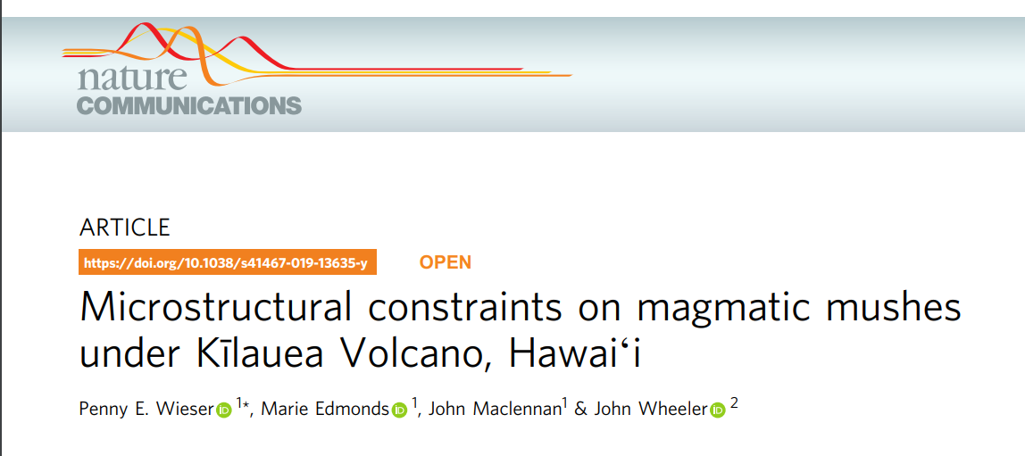
This paper
https://www.nature.com/articles/s41467-019-13635-y

Slide 28
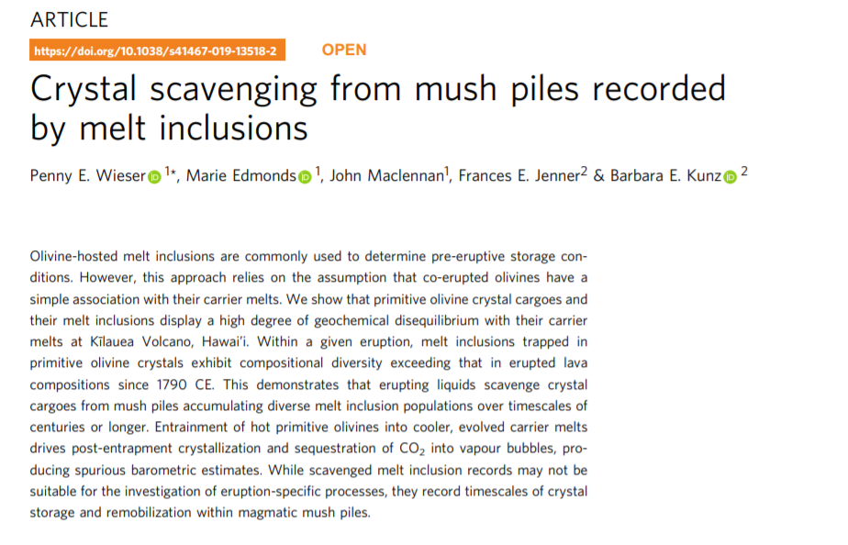
Companion paper – links to melt inclusion records
https://www.nature.com/articles/s41467-019-13518-2

Slide 29
References
Bai, Q. & Kohlstedt, D. L. High-temperature creep of olivine single crystals, 2. Dislocation structures. Tectonophysics 206, 1–29 (1992)
Bergantz, G. W., Schleicher, J. M. & Burgisser, A. On the kinematics and dynamics of crystal-rich systems: hydrogranular dynamics. J. Geophys. Res. 122, 6131–6159 (2017).
Clague, D. A. & Denlinger, R. P. Role of olivine cumulates in destabilizing the flanks of Hawaiian volcanoes. Bull. Volcanol. 56, 425–434 (1994)
Denlinger, R. P. & Morgan, J. K. Instability of Hawaiian volcanoes. Charact. Hawaii. Volcanoes 1801, 149–176 (2014).
Poland, M. P., Miklius, A. & Emily, M.-B. Magma supply, storage, and transport at shield-stage Hawaiian volcanoes. Charact. Hawaii. Volcanoes 1081, 179–234 (2014)
Sakyi, P. A., Tanaka, R., Kobayashi, K. & Nakamura, E. Inherited Pb isotopic records in olivine antecryst-hosted melt inclusions from Hawaiian lavas. Geochim. et Cosmochim. Acta 95, 169–195 (2012).
Skemer, P., and Hansen, L.N. Inferring upper-mantle flow from seismic anisotropy: An experimental perspective. Tectonophysics. 1-4, 2016.
Toriumi, M. Relation between dislocation density and subgrain size of naturally deformed olivine in peridotites. Contrib. Mineral. Petrol. 68, 181–186 (1979).
Thomson, A. & Maclennan, J. The distribution of olivine compositions in Icelandic basalts and picrites. J. Petrol. 54, 745–768 (2013).
Vinet, N. & Higgins, M. D. Magma solidification processes beneath Kīlauea Volcano, Hawaii: a quantitative textural and geochemical study of the 1969–1974 Mauna Ulu Lavas. J. Petrol. 51, 1297–1332 (2010)
Wieser, P. E., Edmonds, M., Maclennan, J., Jenner, F. E. & Kunz, B. E. Crystal scavenging from mush piles recorded by melt inclusions. Nat. Commun. (2019). https://doi.org/10.1038/s41467-019-13518-2. (2019).
MTEX - https://mtex-toolbox.github.io/

