Slide 1
Effects of Obstacle’s Curvature on Shock Waves in Gravity-Driven Experimental Flows Impacting a Circular Cylinder or a Wall
Zheng Chen^{1, 2}, Siming He¹, Dieter Rickenmann²
zheng.chen@wsl.ch
EGU2020 (May 2020)
¹Key Laboratory of Mountain Hazards and Surface Process, Institute of Mountain Hazards and Environment IMHE, CAS, 610041 Chengdu, China
²Mountain Hydrology and Mass Movements, Swiss Federal Research Institute WSL, 8903 Birmensdorf, Switzerland
© Authors. All rights reserved

Slide 2
Contents
Granular-flow experimental simulation system
Methods
Granular shock waves: geometric properties, impact pressures, and seismic signals
Conclusions

Slide 3
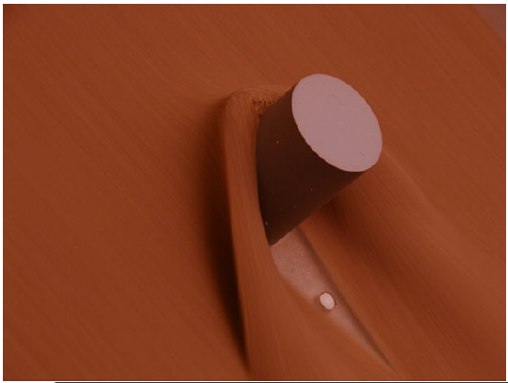
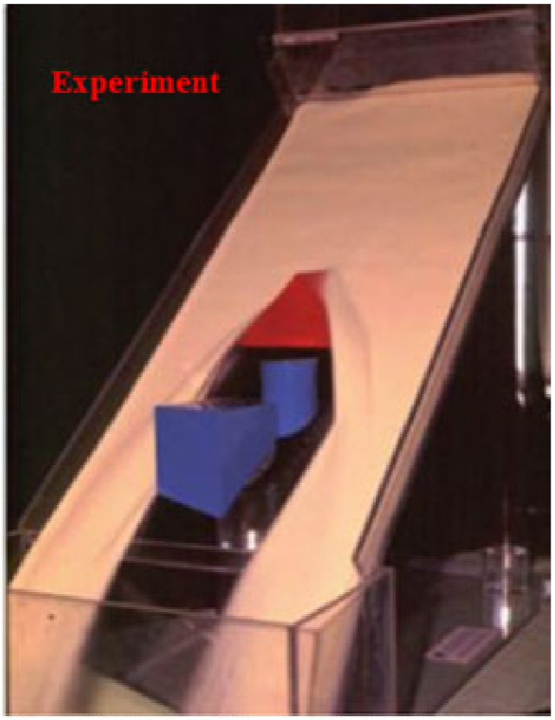
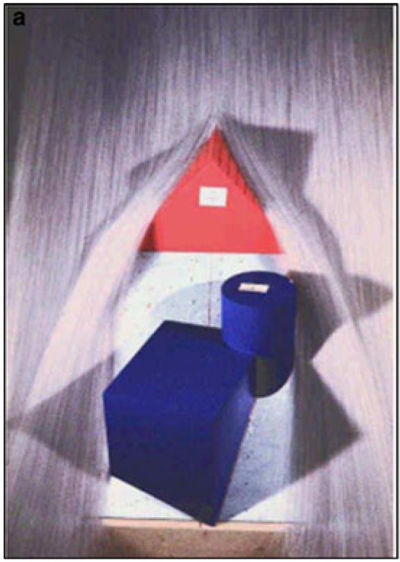
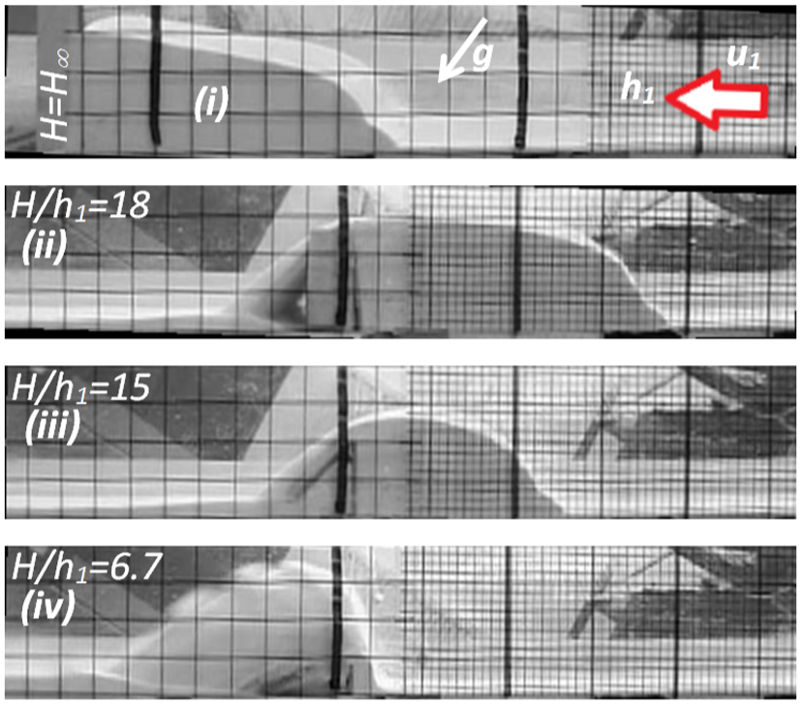
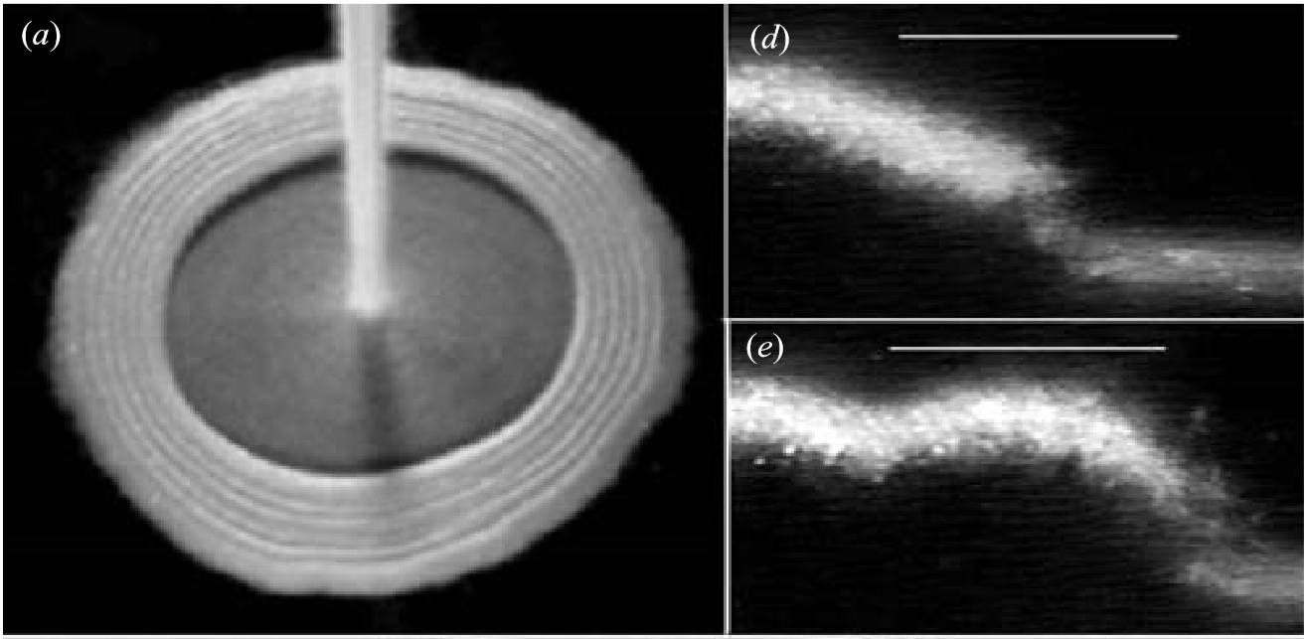
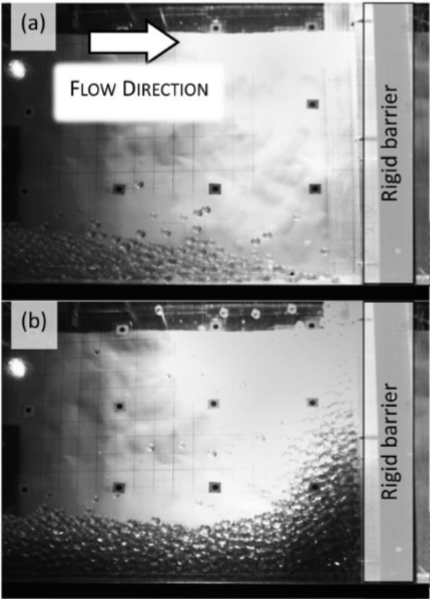
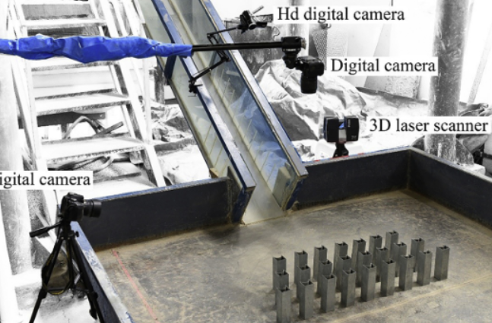
Cui and Gray (2013)
Tai et al. (1999 and 2001)
Color pictures can be found in Abdelrazek AM, Kimura I and Shimizu Y (2016)
Faug (2015)
Effects of obstacle shape?
Boudet et al. (2007)
Iverson et al. (2016)
Ng et al. (2019)
Wang et al. (2020)

Slide 4
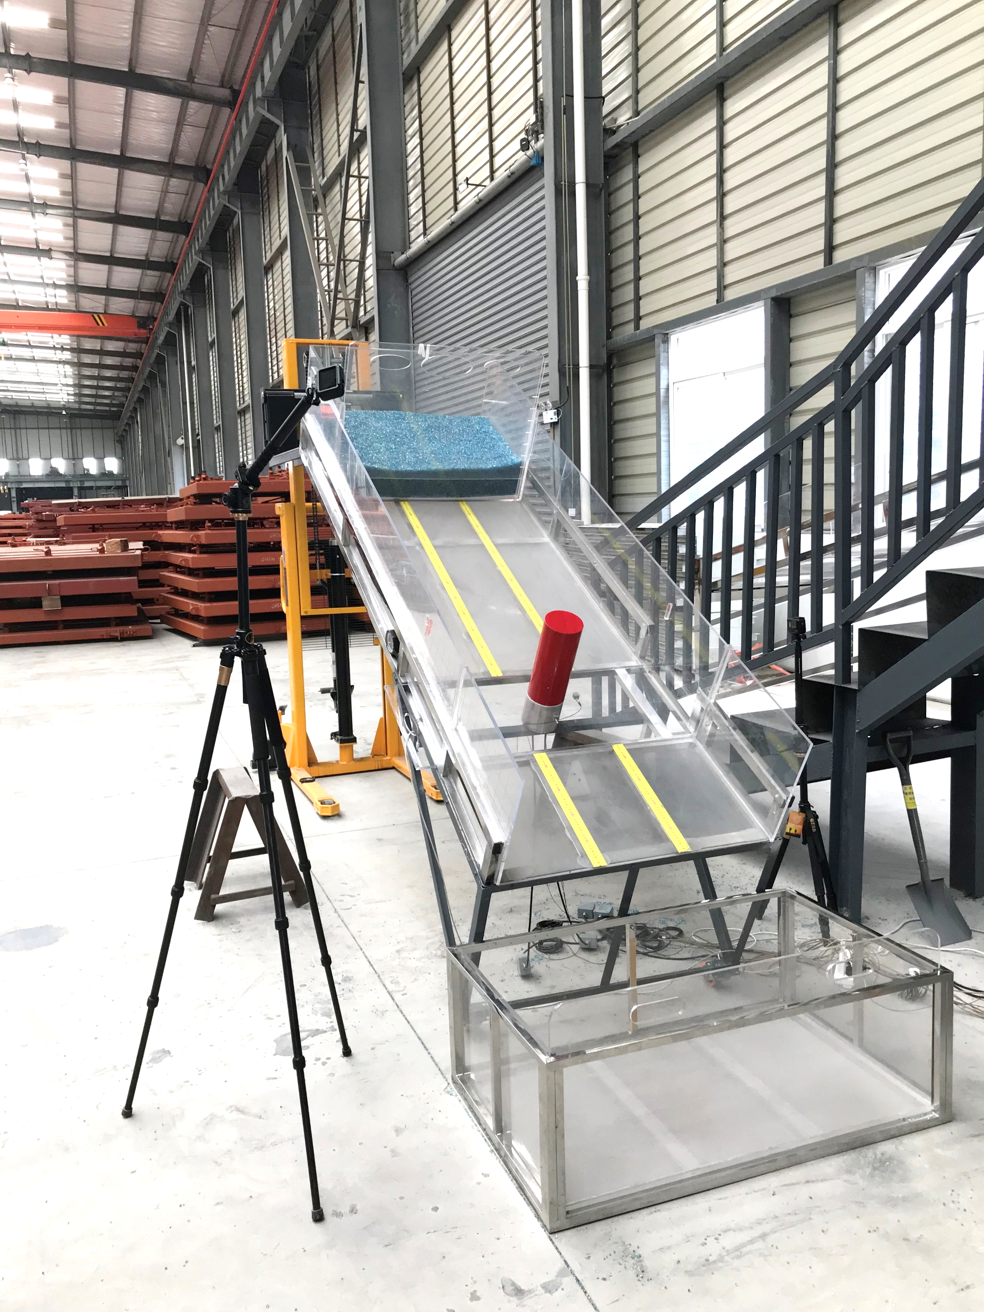
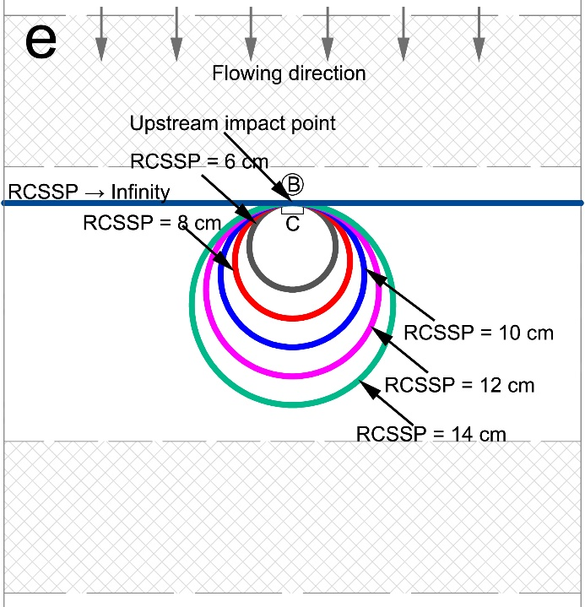
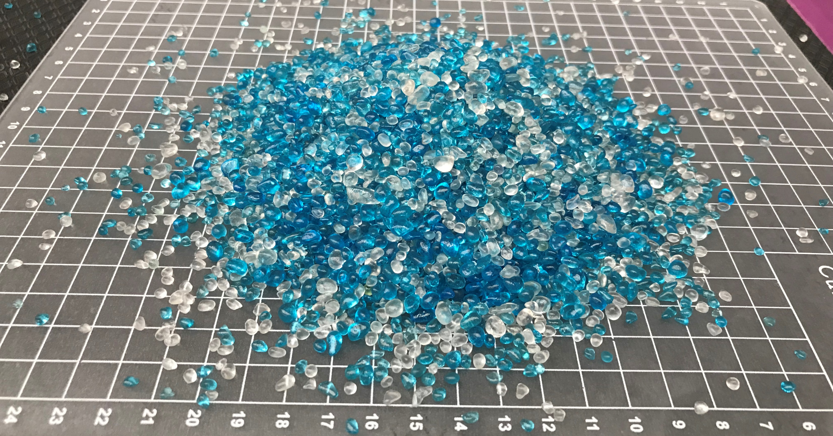
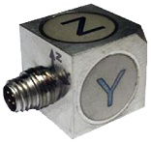
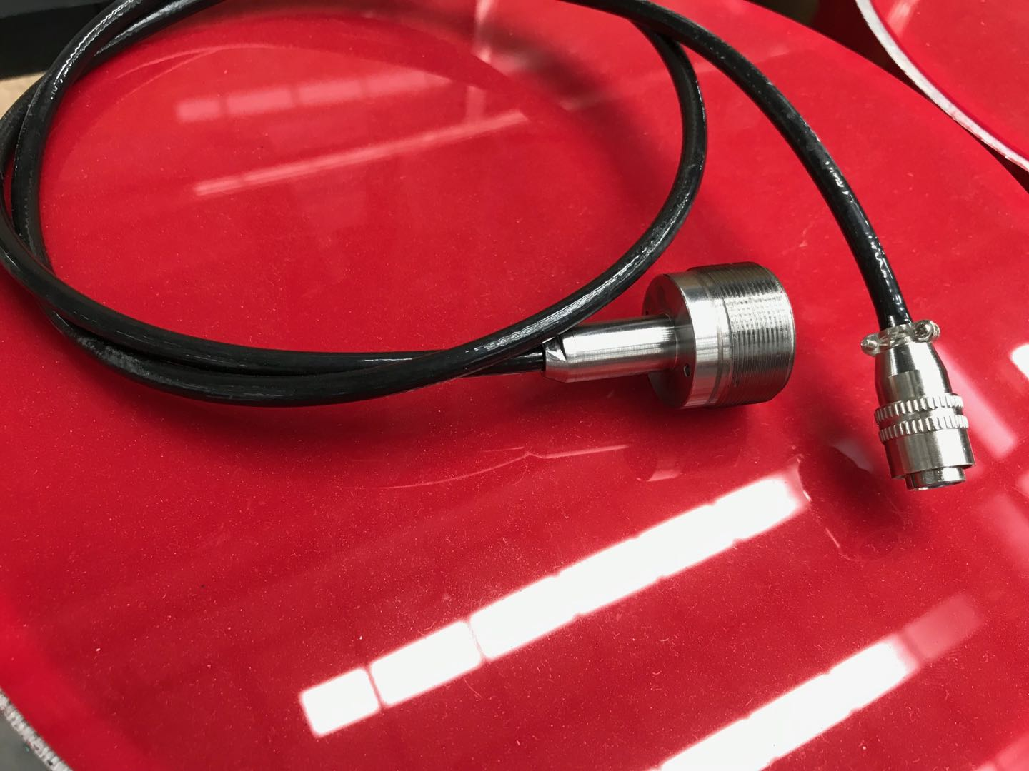
$1×1 {cm}^{2}$ grid
Hydraulic system
Glass-sand grains
Hopper
100 kg
Z
RCSSP =radius of curvature of the structure at the stagnation point (or upstream impact point)
Y
X
Accelerometers
2.5 m
0.35 m
0.8 m
C
Accelerometer
B
Collecting box
Pressure sensors
Pressure sensor

Slide 5
RCSSP = 8 cm, v = 2.19 m/s, Fr1 = 7.3

Slide 6
Granular shock waves: geometric properties and Fr₁
Standoff
$${DH}_{runup}=\frac{1}{2}\sqrt{1+8χ{Fr}_{1}^{2}}−1$$
$$χ=β\left(k−\frac{KL\left(tanθ−μ_{e}\right)}{h_{2}−h_{1}}\right)$$
Pinch-off
$${Fr}_{1}={u_{1}}/{\sqrt{gh_{1}\cos{θ}}}$$
Runup

Slide 7
Granular shock waves: empirical impact coefficient and Fr
$$α=\frac{IMP}{ρu_{1}^{2}}=a{Fr}^{b}$$
$$α_{peak_head,C}$$
$$α_{mean_head,C}$$
$$α_{mean_body,C}$$
$$α_{mean_all,C}$$

Slide 8
Granular shock waves: seismic signals
c
FFT transform
$f_{mean, A}$; $f_{mean, IMP}$
b

Slide 9
Conclusions
The standoff distance decreased nonlinearly with increasing Fr₁. The pinch-off distance and the runup height increased linearly with increasing Fr₁. The runup heights were generally higher than compared to a traditional hydraulic jump model valid for Newtonian fluids.
This empirical coefficient α generally decreased with increasing approach flow Froude number Fr. The larger values of α are caused by the smaller obstacle geometry. We found that increasing flow intensity weakens the effects of obstacle geometry on the impact pressure.
We observed that the flow-transversal vibrations were the weakest among three spatial components. Generally, the strongest vibrations were observed for the bed-normal direction. f_{mean,A} and f_{mean,IMP} show dependence of RCSSP. f_{mean,A} and f_{mean,IMP} show the opposite trend caused by RCSSP in the range of 6 cm to 12 cm.

Slide 10
Thanks for listening! Any questions?

