Slide 1
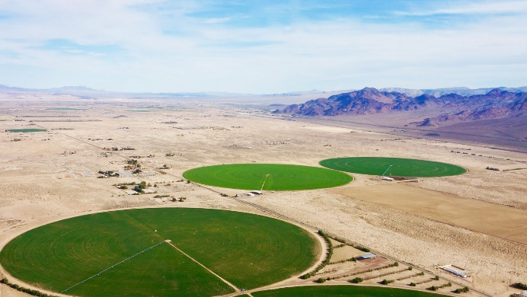
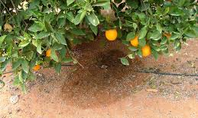
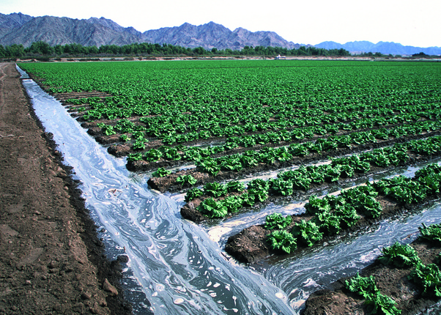
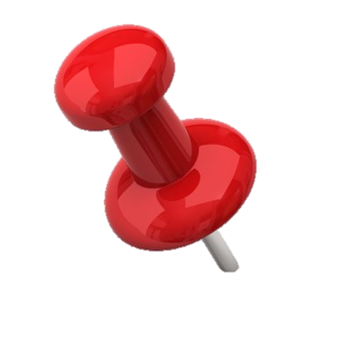
The detection of irrigation through remote sensing soil moisture and a land surface model: a case study in Spain
EGU General Assembly 2020, Online
Sharing Geoscience Online, 4-8 May, 2020
Jacopo Dari ⁽¹⁾, Pere Quintana-Seguí ⁽²⁾, Maria José Escorihuela ⁽³⁾, Luca Brocca ⁽⁴⁾, Renato Morbidelli ⁽¹⁾, and Vivien Stefan ⁽³⁾
⁽¹⁾ University of Perugia, Dept. Of Civil and Environmental Engineering, Perugia, Italy
⁽²⁾ Ebro Observatory, Ramon Llull University – CSIC, Roquetes, Spain
⁽³⁾ isardSAT, Parc Tecnòlogic Barcelona Activa, Barcelona, Spain
⁽⁴⁾ National Research Counchil, Research Institute for Geo-Hydrological Protection, Perugia, Italy
Session HS6.8 - Live chat on Thursday, 07 May 2020, 14:00 – 15:45

Slide 2
Key question:
Do we know where irrigation practices actually occur?
Please see the notes for further details and references
Abstract:
Irrigation practices introduce imbalances in the natural hydrological cycle at different spatial scales and put pressure on water resources, especially under climate changing and population increasing scenarios. Despite the implications of irrigation on food production and on the rational management of the available freshwater, detailed information about the areas where irrigation actually occurs is still lacking. For this reason, the comprehensive knowledge of the dynamics of the hydrological cycle over agricultural areas is often tricky.
The first aim of this study is to evaluate the capability of five remote sensing soil moisture data sets to detect the irrigation signal over an intensely irrigated area located within the Ebro river basin, in the North of Spain, during the biennium 2016-2017. As a second objective, a methodology to map the irrigated areas through the K-means clustering algorithm is proposed. The remotely sensed soil moisture products used in this study are: SMOS (Soil Moisture and Ocean Salinity) at 1 km, SMAP (Soil Moisture Active Passive) at 1 km and 9 km, Sentinel-1 at 1 km and ASCAT (Advanced SCATterometer) at 12.5 km. The 1 km versions of SMOS and SMAP are DISPATCH (DISaggregation based on Physical And Theoretical scale CHange) downscaled versions of the corresponding coarser resolution products. An additional data set of soil moisture simulated by the SURFEX-ISBA (Surface Externalisée - Interaction Sol Biosphère Atmosphère) land surface model is used as a support for the performed analyses.
The capability of soil moisture products to detect irrigation has been investigated by exploiting indices representing the spatial and temporal dynamics of soil moisture. The L-band passive microwave downscaled products, especially SMAP at 1 km, result the best performing ones in detecting the irrigation signal over the pilot area; on the basis of these data sets, the K-means algorithm has been employed to classify three kind of surfaces within the study area: the dryland, the forest or natural areas, and the actually irrigated areas. The resulting maps have been validated by exploiting maps of crops in Catalonia as ground truth data set. The percentage of irrigated areas well classified by the proposed method reaches the value of 78%; this result is obtained for the period May - September 2017. In addition, the method performs well in distinguishing the irrigated areas from rainfed agricultural areas, which are dry during summer, thus representing a useful tool to obtain explicit spatial information about where irrigation practices actually occurr over agricultural areas equipped for this purpose.
Recent updates:
Good preliminary results in quantitatively estimating irrigation volumes from remotely sensed surface soil moisture.
1/10

Slide 3
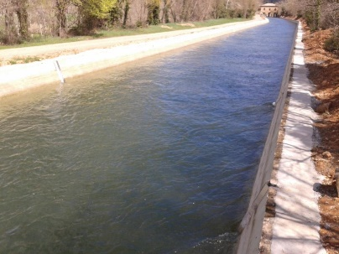
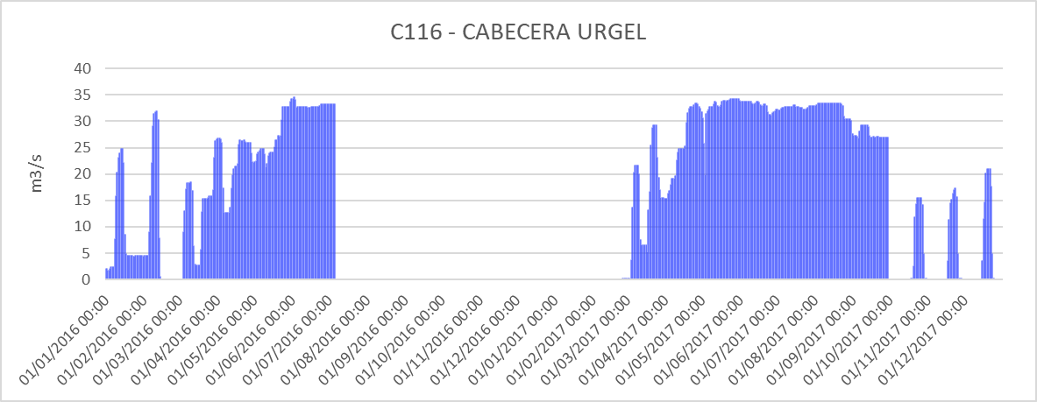
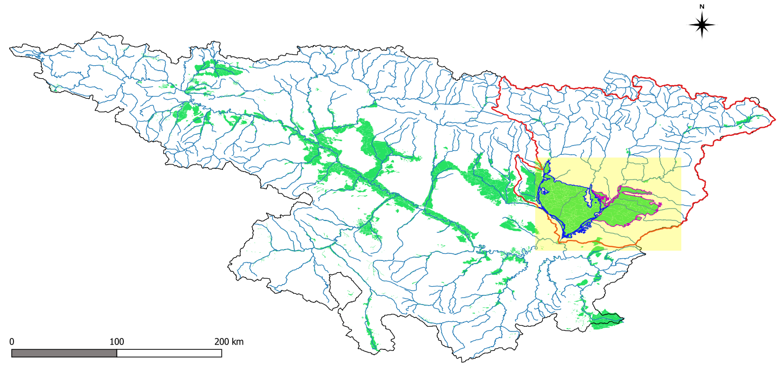
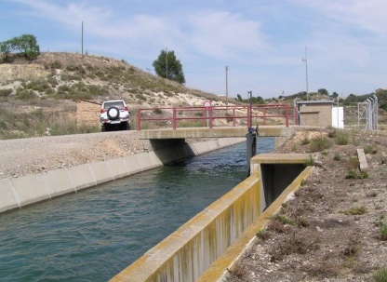
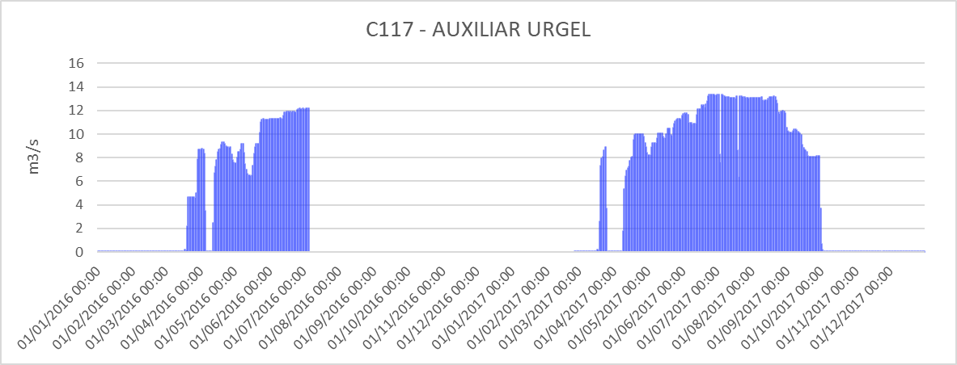
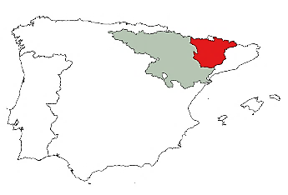
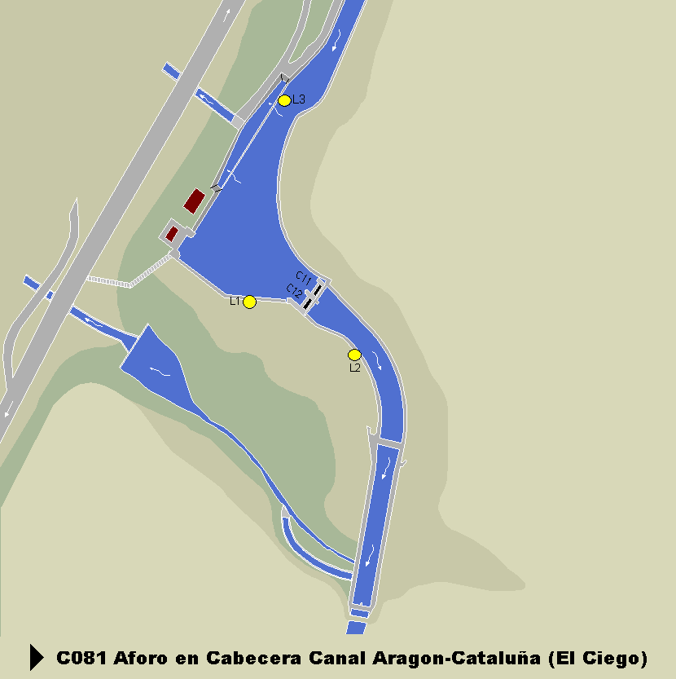
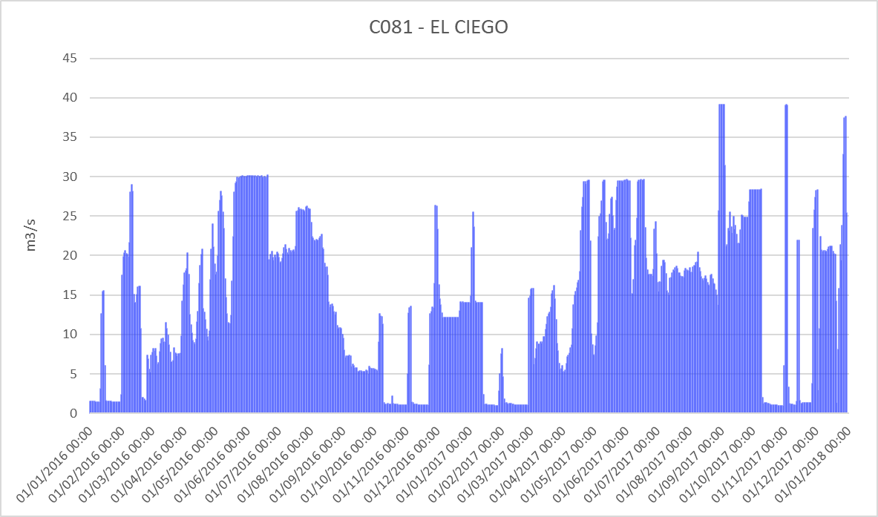
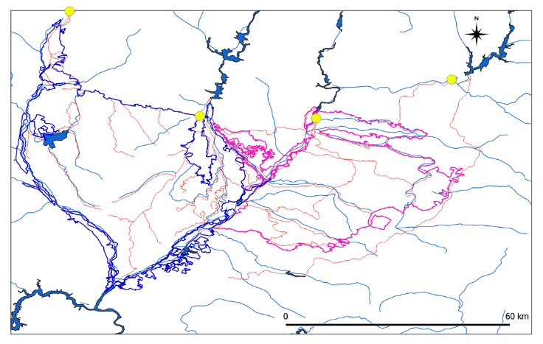
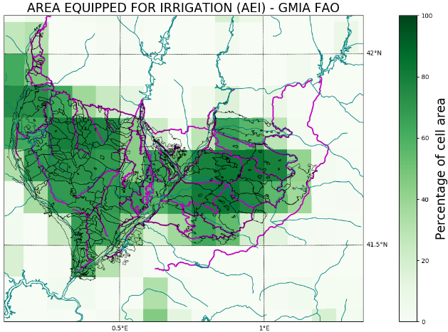
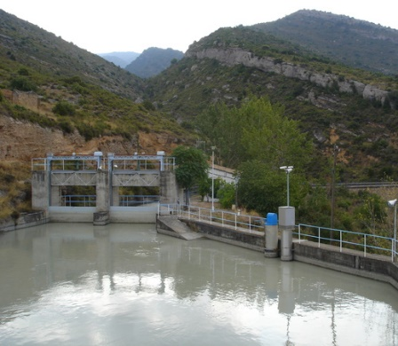
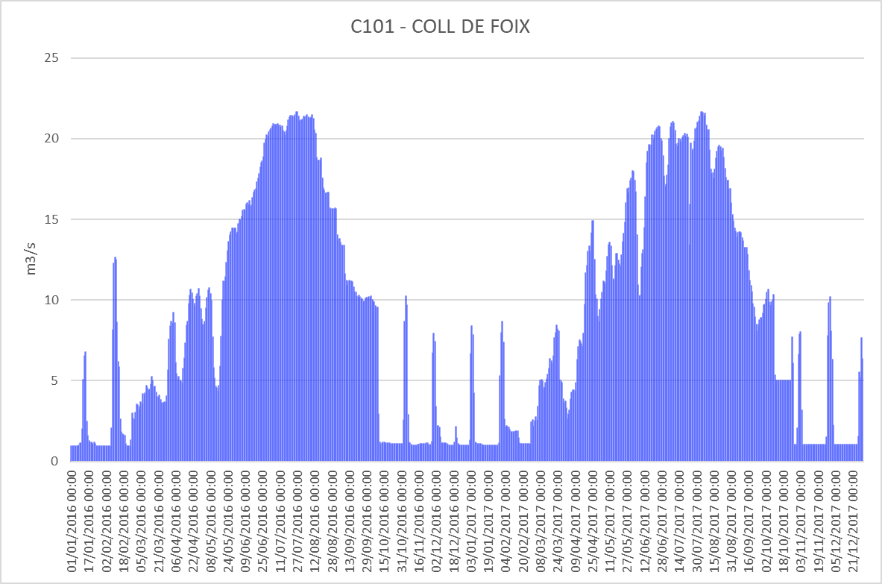
Study area:
We selected an intensely irrigated area within the Ebro river basin (North-East of Spain). It is a data rich area.
Irrigated areas
Sub-basin simulated with SURFEX LSM
Study area (focus)
C081
C101
C117
C116
From Siebert et al., 2013
2/10
Notes:
The data about the irrigation systems flow is delivered by the Automatic Hydrologic Information System of the Ebro river basin (SAIH Ebro), http://www.saihebro.com/saihebro/index.php?url=/datos/canals.
References:
Siebert, S., Henrich, V., Frenken, K., Burke, J., 2013. Global Map of Irrigation Areas version 5. Rheinische Friedrich-Wilhelms-University, Bonn, Germany / Food and Agriculture Organization of the United Nations, Rome, Italy.

Slide 4
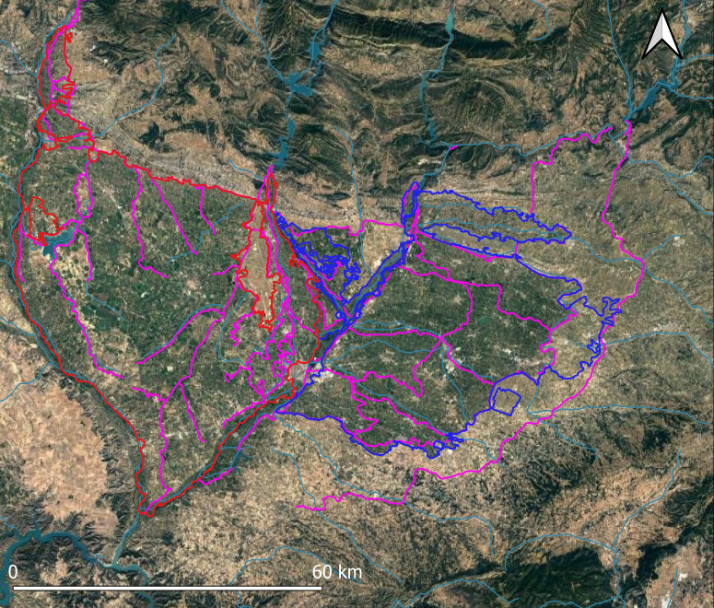
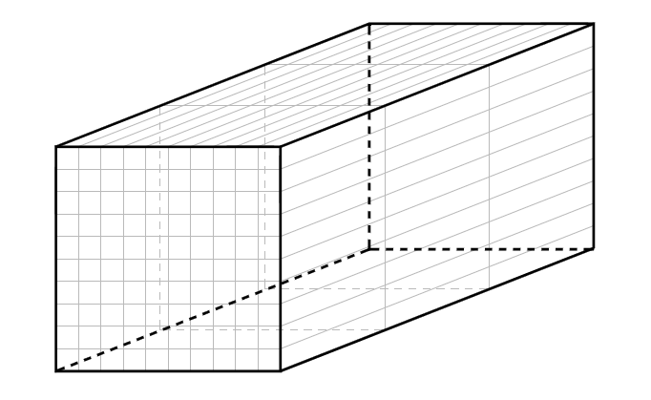
Detecting and mapping irrigated areas:
Catalan and Aragonese area
Evaluation of the capability to detect irrigation of five remote sensing soil moisture products:
SMOS (1 km)
SMAP (1 km, 9 km)
Sentinel-1 (1 km)
ASCAT (12.5 km)
SMOS and SMAP at 1 km are DISPATCH downscaled verions of the coarser resolution products. An additional data set of soil moisture at 1 km simulated by the SURFEX-ISBA LSM is used;
Irrigation mapping through the K-means clustering alghoritm.
Urgell area
Temporal stability derived indices
Temporal stability derived indices have been exploited. The mathematics of this well-established theory is used to derive indices representing the spatial and temporal dynamics of soil moisture.
$\overline{θ}$ _{t}
Spatial mean at day t
j
$\overline{θ}$ _{x}
Temporal mean
t
Relative differences:
$θ$ _{x, t}
δ _{x, t} = (θ_{x,t} - $\overline{θ}$ _{t)})/$\overline{θ}$ _{t}
Temporal anomalies:
A _{x, t} = (θ _{x, t} - $\overline{θ}$ _{x})/$\overline{θ}$_{x}
i
Vauchad et al., 1985
Ex. of data set
3/10
Notes:
References:
Vauchad, G., Passerat de Silans, A., Balabanis, P., Vauclin, M., 1985. Temporal stability of spatial measured soil water probability density function. Soil Sci. Soc. Am. J. 49, 822–828.

Slide 5
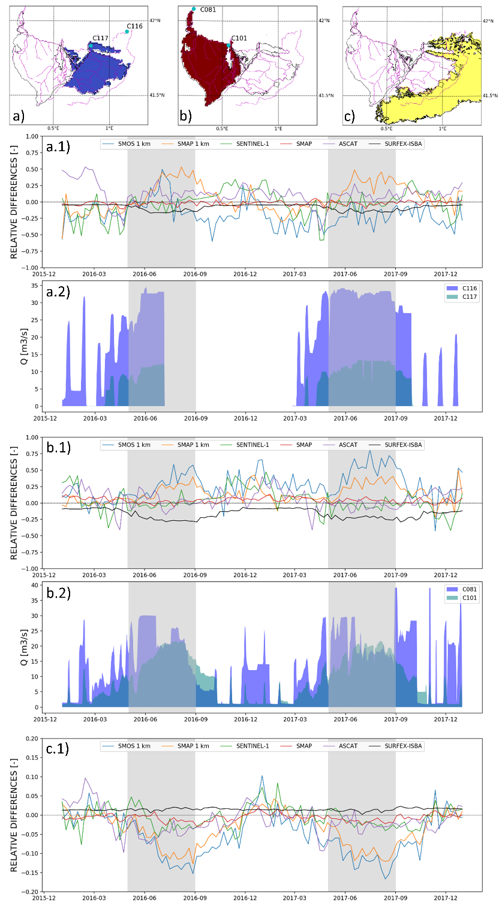
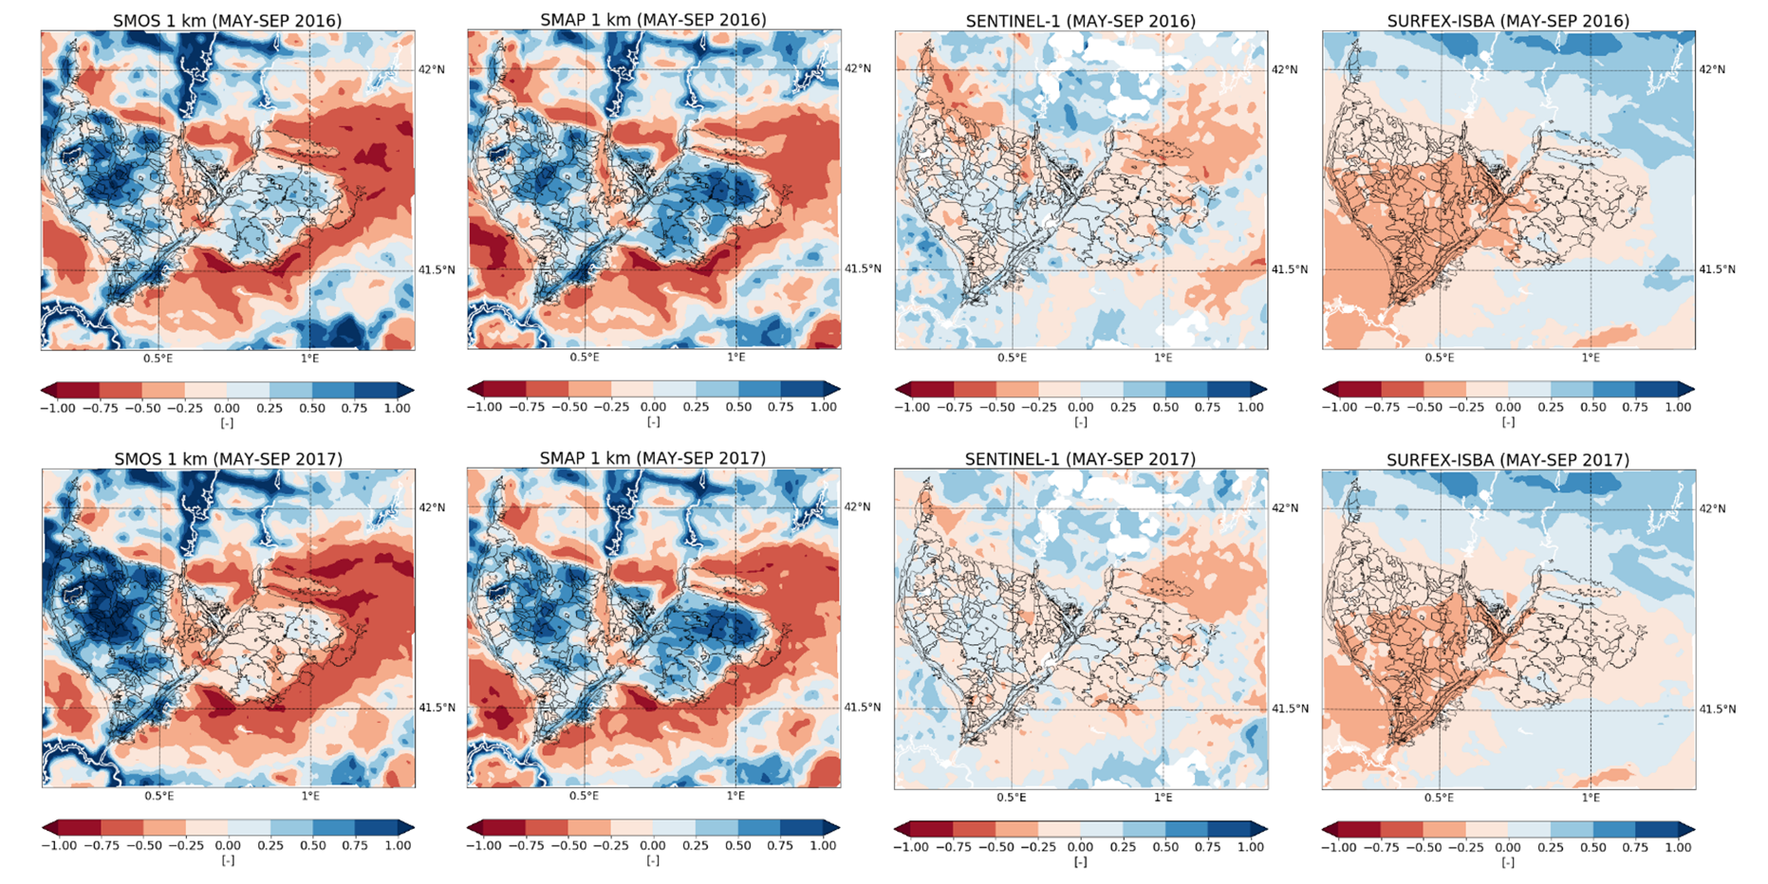
Spatial analysis:
Over the irrigable land, the spatial relative differences are expected to assume higher values (greater than zero) than over the surronding dryland.
Good performaces of the L-band passive microwave downscaled products (SMOS and SMAP at 1 km).
The model can be considered as a reference for a situation not taking into account of irrigation.
4/10
Notes:
On the left: the maps show the spatial distribution of the mean relative differences during the period May-September 2016 (upper panel) and 2017 (lower panel). Each column is referred to a different product. Please note that only the maps for the high resolution (1 km) products are shown.
On the right: panels a.1), b.1), and c.1) show the relative differences calculated for each data set and averaged over a) the Urgell area, b) the Cataland and Aragonese area, and c) the dryland surrounding the irrigated land. Panels a.2) and b.2) show the volumes of water flowing in the irrigation canals supplying the Urgell area and the Catalan and Aragonese area, respectively.

Slide 6
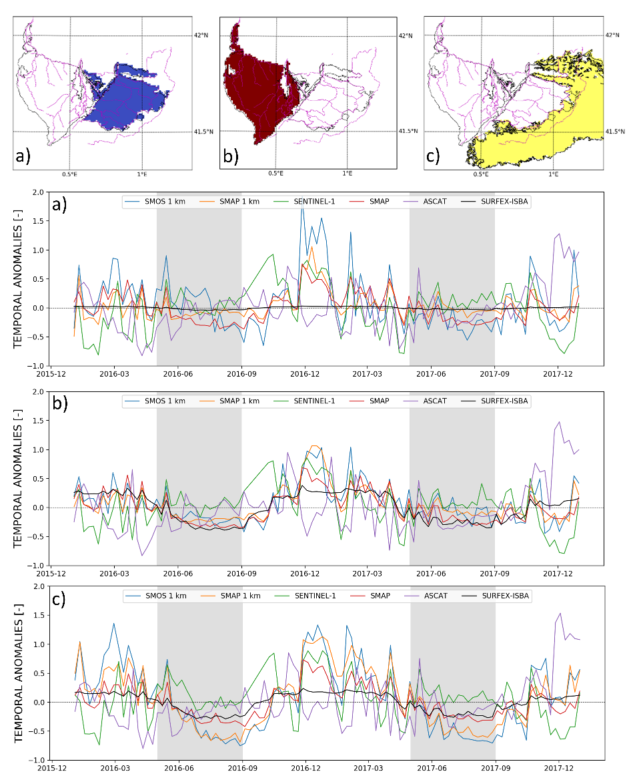
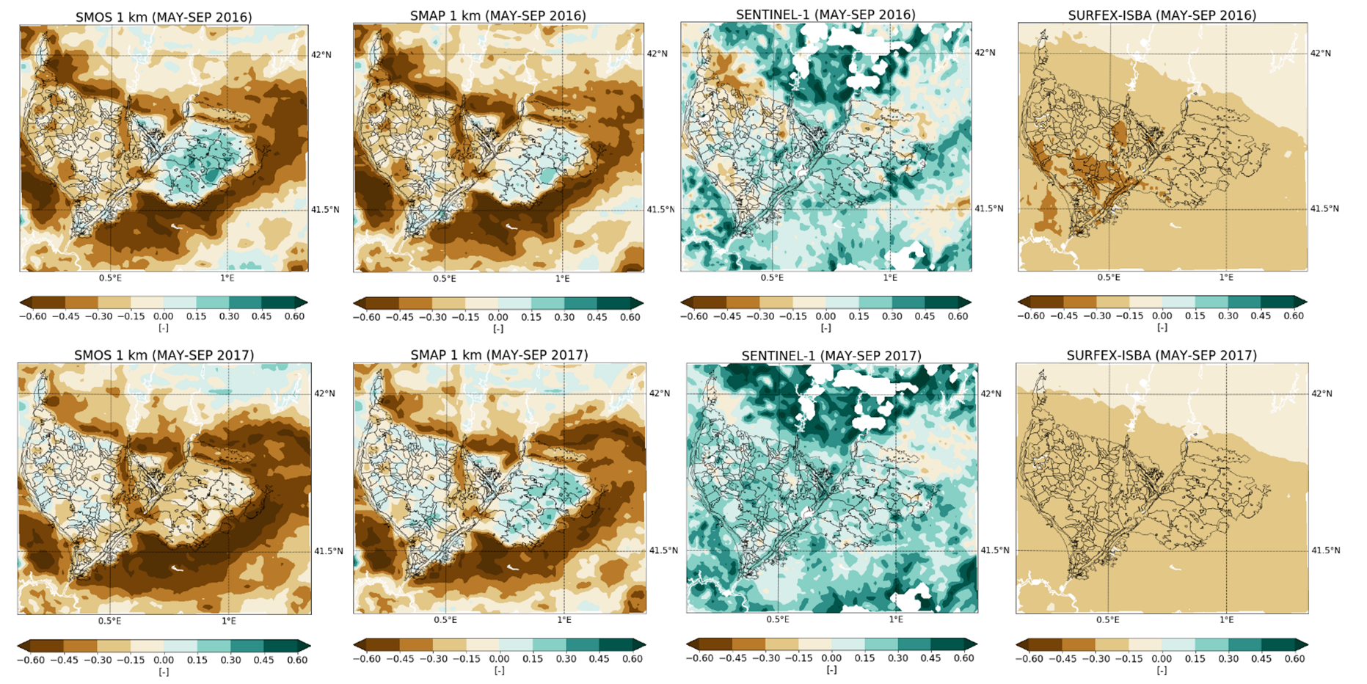
Temporal analysis:
Over the irrigable land, the temporal anomalies are expected to assume higher values (greater than or equal to zero) than over the surronding dryland.
Good performaces of the L-band passive microwave downscaled products (SMOS and SMAP at 1 km).
The model can be considered as a reference for a situation not taking into account of irrigation.
5/10
Notes:
On the left: the maps show the spatial distribution of the mean temporal anomalies during the period May-September 2016 (upper panel) and 2017 (lower panel). Each column is referred to a different product. Please note that only the maps for the high resolution (1 km) products are shown.
On the right: panels a), b), and c) show the temporal anomalies calculated for each data set and averaged over a) the Urgell area, b) the Cataland and Aragonese area, and c) the dryland surrounding the irrigated land.

Slide 7
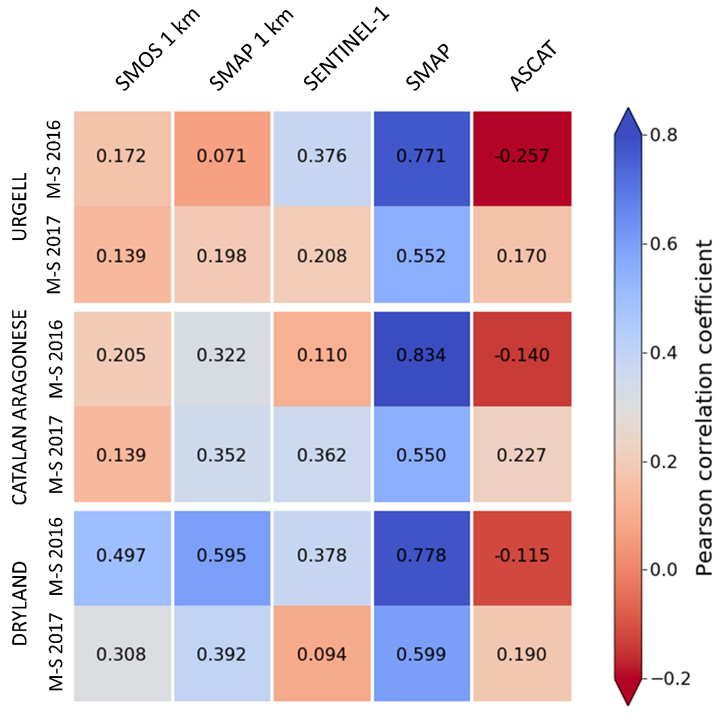
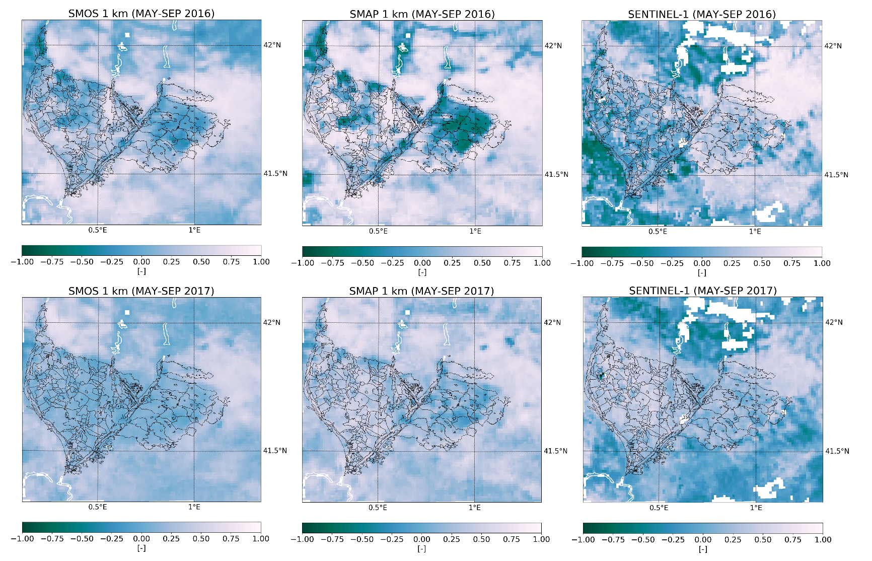
Correlation analysis:
The correlation between modeled and remotely sensed soil moisture has been calculated.
The satellite soil moisture products containining the irrigation signal are expected to show low (scarce correlation) or negative (inverse correlation) correlation coefficients over irrigated areas.
6/10
Notes:
On the left: heatmap representing the areal mean correlation between satellite and modeled soil moisture during the periods May-September 2016 and 2017 for the Urgell area, for the Catalan and Aragonese area and for the dryland.
On the right: maps of the correlation between satellite and modeled soil moisture for the periods May-September 2016 (upper panel) and May-September 2017 (lower panel). Please note that only the maps for the high resolution (1 km) products are shown.

Slide 8
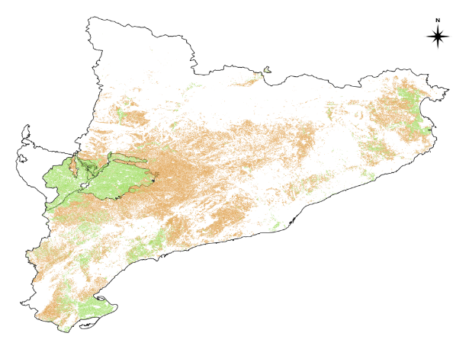
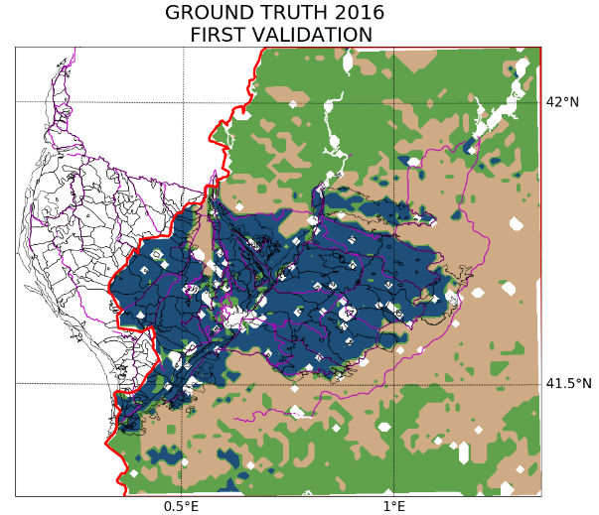
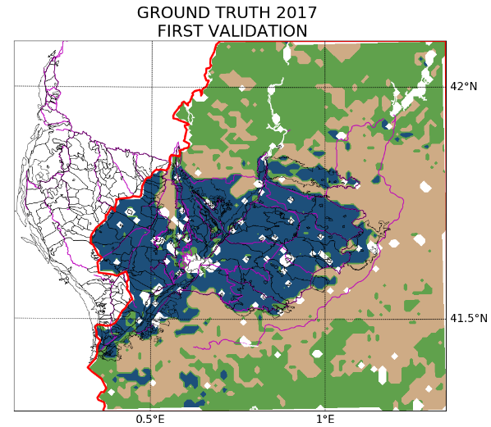
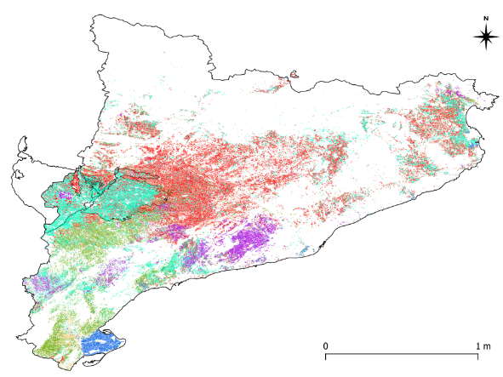
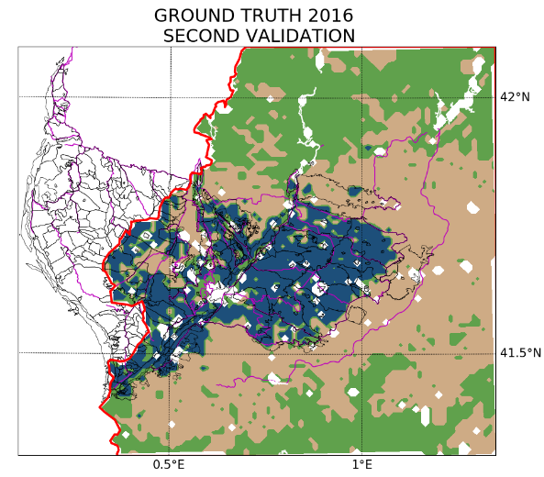
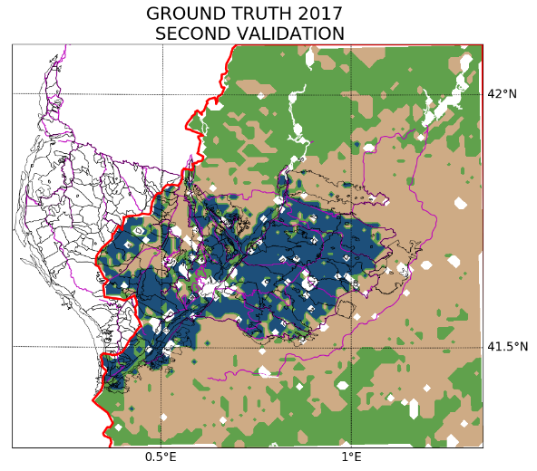
K-means clustering classification:
Over the study area, three main kinds of surfaces can be detected: the dryland (D), the forest or natural areas (F), and the actually irrigated areas (I).
The clustering has been carried out considering 16 different combinations of the input parameters; 8 of these exploit remote sensing data only and 8 merge remotely sensed and modeled soil moisture.
Validation:
Maps of crops in Catalonia from SIGPAC have been exploited as ground truth data set in two different ways.
First procedure
Exploits the irrigation information.
Second procedure
Exploits the information about the kind of crops.
7/10
Notes:
The maps of crops in Catalonia, which are produced in the same domain as the Geographic Information System for Agricultural Parcels (SIGPAC), are available at http://agricultura.gencat.cat/ca/serveis/cartografia-sig/aplicatius-tematics-geoinformacio/sigpac/mapa-cultius/.
In the first validation procedure, pixels with the irrigation information have been considered as irrigated (I), not irrigated pixel have been considered as dryland (D) and the not agricultural areas have been considered as forest or natural areas (F). The irrigation information means that the field can reach the irrigation infrastructure, but this does not imply that it has been actually irrigated, so we performed a second validation.
In the second validation procedure, pixels containing crops irrigated during the focus period (May – September) have been considered as irrigated land (I); these are: summer cereals, fruit trees and forage. Other agricultural areas have been considered as dryland (D) and the rest of the domain has been considered as forest or natural areas (F).

Slide 9
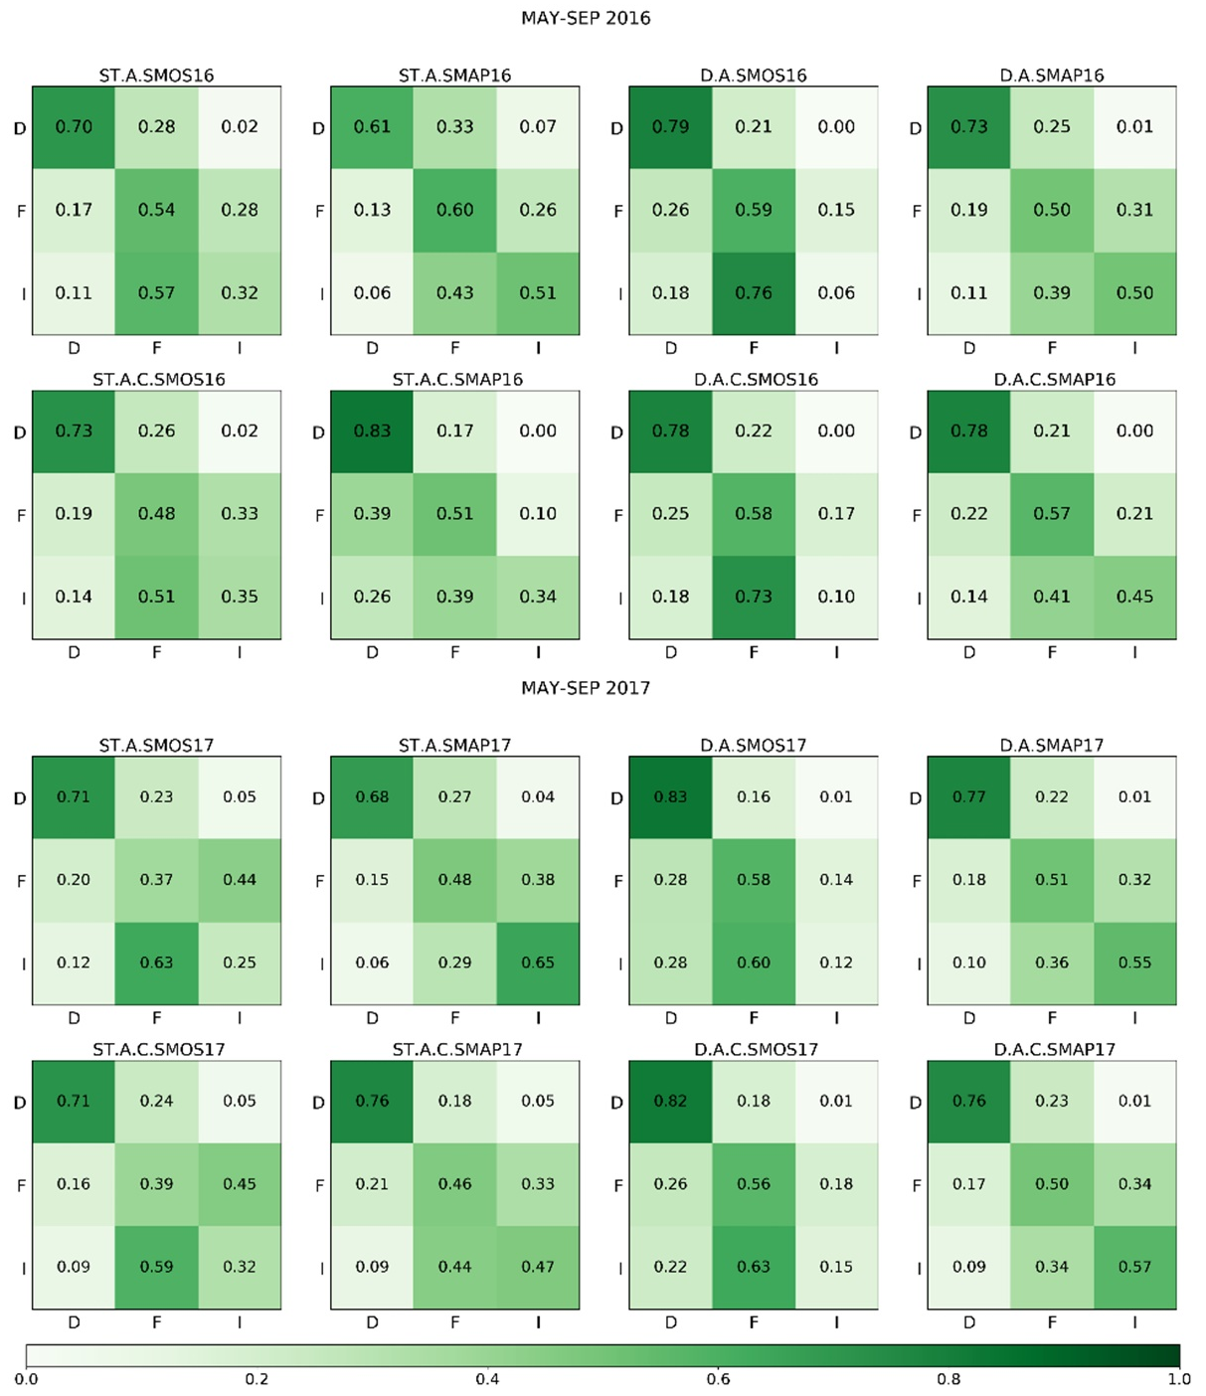
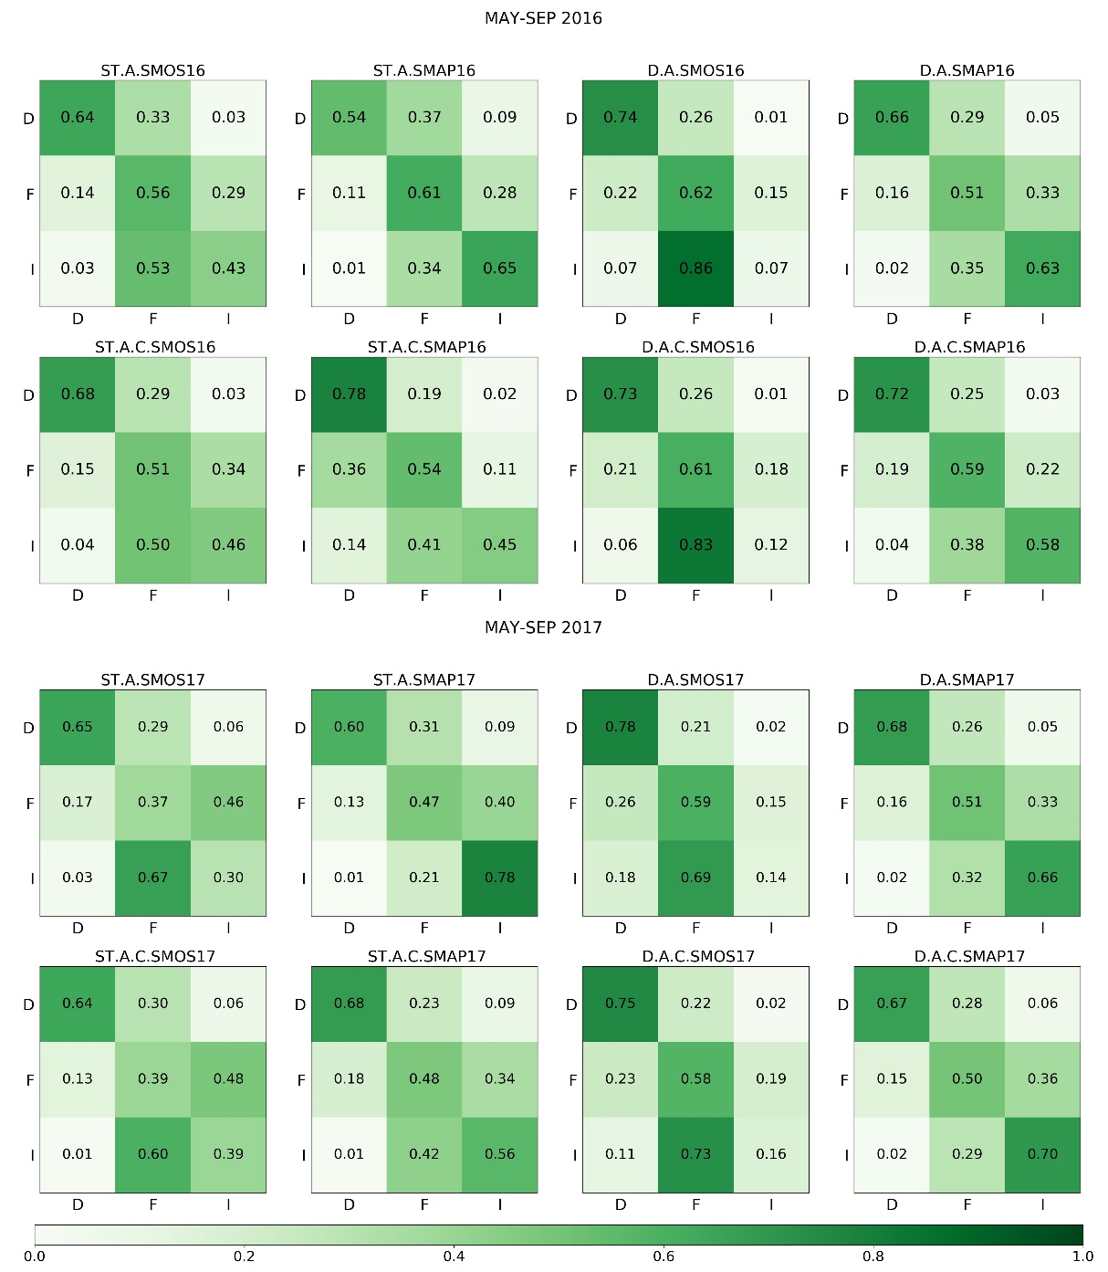
Validation results – confusion matrices:
First validation procedure:
Second validation procedure:
8/10
Notes:
Confusion matrices related to the first (on the left) and the second (on the right) validation of the classification of dryland (D), forest or natural areas (F), and irrigated land (I) for each combination of the input parameters during the periods May-September 2016 (upper panels) and 2017 (lower panels).

Slide 10
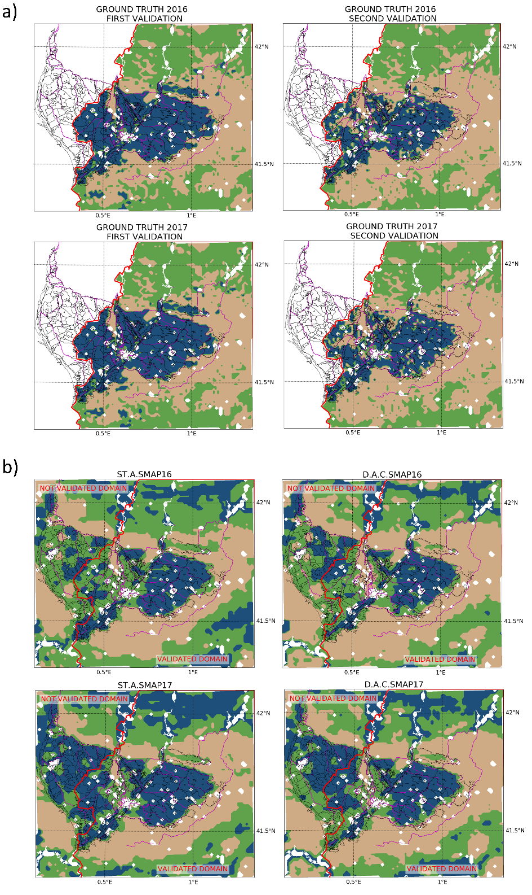
Validation results – best performing classifications:
Good performances in distinguishing between irrigated areas and rainfed agricultural areas.
For both the validation procedures, the best performing classifications are the same: STASMAP16 (51%, 65%) and STASMAP17 (65%, 78%) best represent the irrigated areas, DACSMAP16 and DACSMAP17 best represent all the three classes concurrently.
It is noteworthy that the model does not add information for the irrigation mapping. Conversely, it helps in enhancing the classification of the other classes.
In conclusion:
The L-band passive microwave downscaled products, especially SMAP at 1 km, are able to detect irrigation over the study area;
temporal stability derived indices are useful to evaluate the performances of remotely sensed data sets in detecting the irrigation signal;
the proposed method reaches good accuracy in mapping irrigated areas by exploiting remote sensing soil moisture only. Furthermore, the actually irrigated areas and the rainfed agricultural areas are well distinguished;
recursive confusion between irrigated areas and natural areas can be observed.
9/10
Notes:
On the left: round truth (a) and clustering derived (b) maps for the periods May-September 2016 and May-September 2017. The irrigated areas are represented in blue, the forest or natural areas in green and the dryland in brown.
The classification that best reproduces the irrigated areas exploits the standard deviation of the relative differences and the mean of temporal anomalies of soil moisture from SMAP at 1 km. The classification that best represents all the three classes concurrently exploits the same data set, but the input parameters are: the mean of relative differences, the mean of temporal anomalies and the correlation with the model.

Slide 11
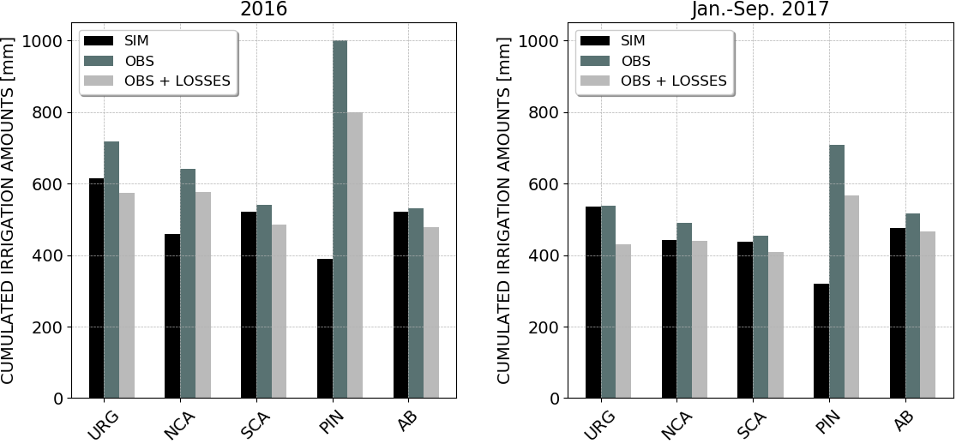
Future perspectives:
How much water is used for irrigation?
Estimation of irrigation volumes for each irrigation district.
Preliminary results show good agreement between estimated and observed irrigation amounts.
The irrigation volumes are estimated through an adapted version of the SM2RAIN algorithm (Brocca et al., 2018), in which the evapotranspiration term has been improved according to the FAO irrigation and drainage paper n. 56 (Allen et al., 1998). The results are obtained by exploiting soil moisture from the DISPATCH downscaled SMAP at 1 km data set.
Except for Pinyana district, the total irrigation volumes for the year 2016 and for the period January-September 2017 are well reproduced by our method.
For further information do not hesitate to contact:
Jacopo Dari
PhD Student
jacopo.dari@unifi.it
10/10
Notes:
On the bar chart: estimated and observed cumulated irrigation volumes during 2016 (on the left) and January-September 2017 (on the right) over the districts: Urgell (URG), North Catalan and Aragonese (NCA), South Catalan and Aragonese (SCA), Pinyana (PIN), and Algerri Balaguer (AB). The black bars show the estimated irrigation volumes, the dark gray bars represent the benchmark values and the light grey bars are the benchmark values adjusted considering losses due to irrigation efficiency.
References:
Allen, R.G., Pereira, L.S., Raes, D., Smith, M., 1998. Crop evapotranspiration – Guidelines for computing water requirements – FAO Irrigation and drainage paper 56. (Rome: Food and Agriculture Organization (FAO) of the United Nations).
Brocca, L., Tarpanelli, A., Filippucci, P., Dorigo, W., Zaussinger, F., Gruber, A., Fernández-Prieto, D., 2018. How much water is used for irrigation? A new approach exploiting coarse resolution satellite soil moisture products. Int. J. Earth Obs. Geoinformation, 73, 752-766.
Allen

