Slide 1
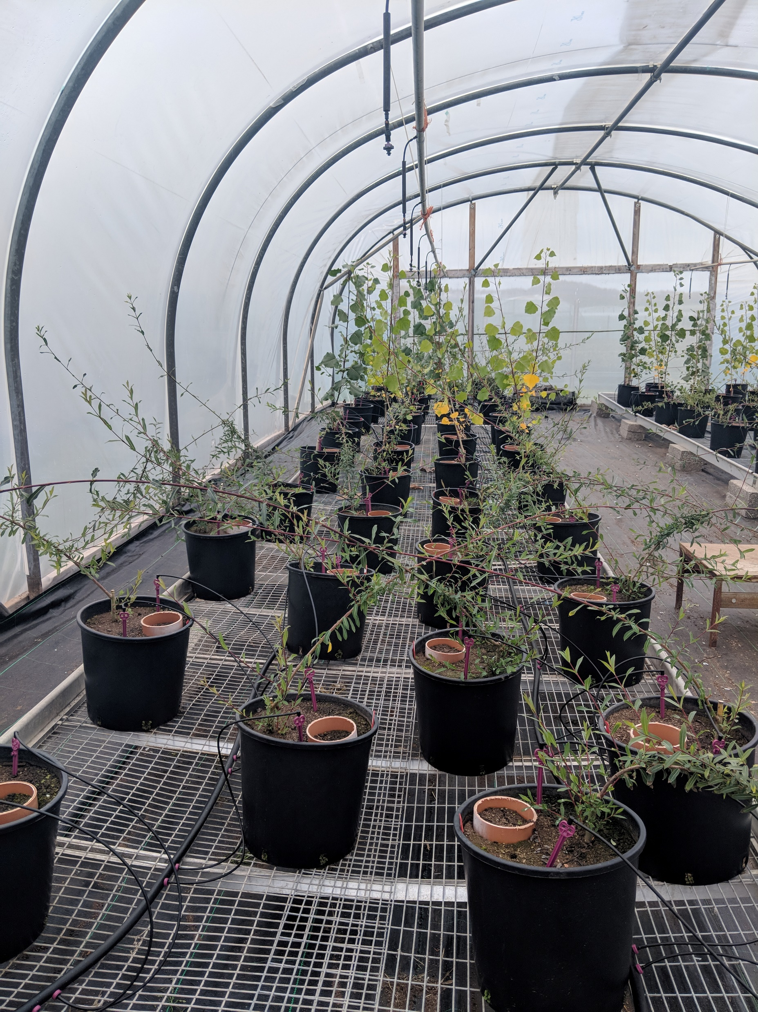
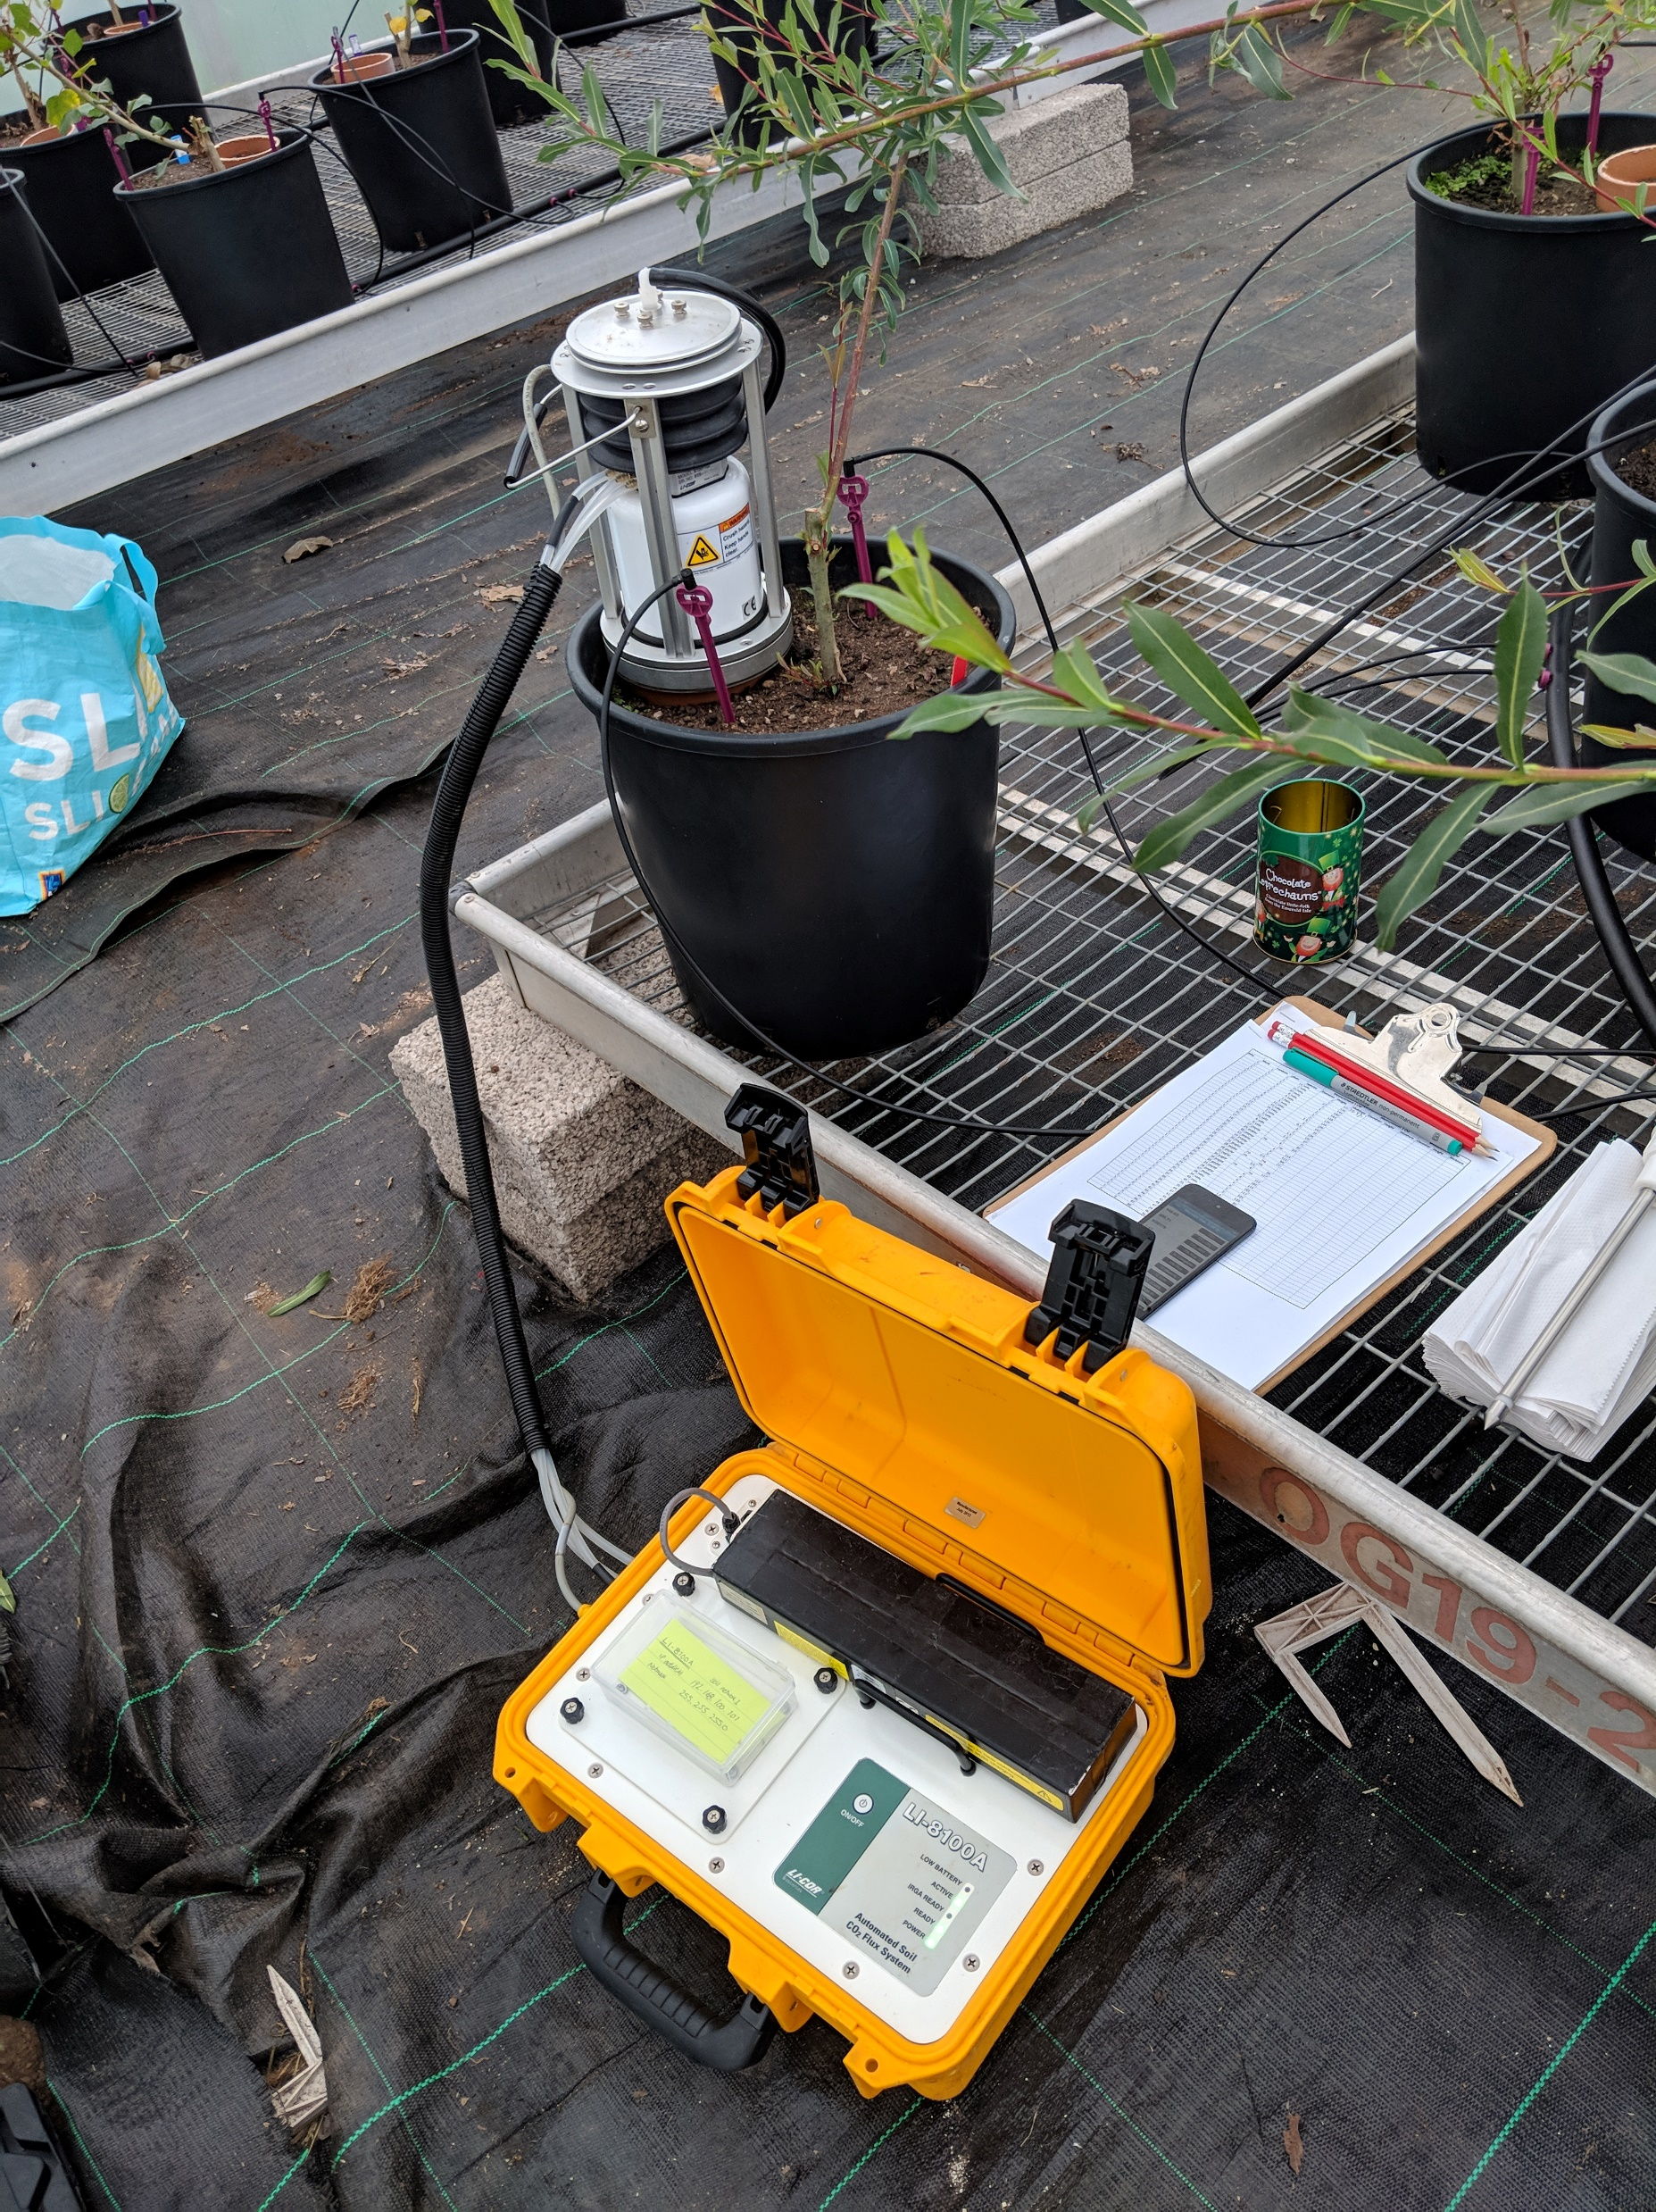
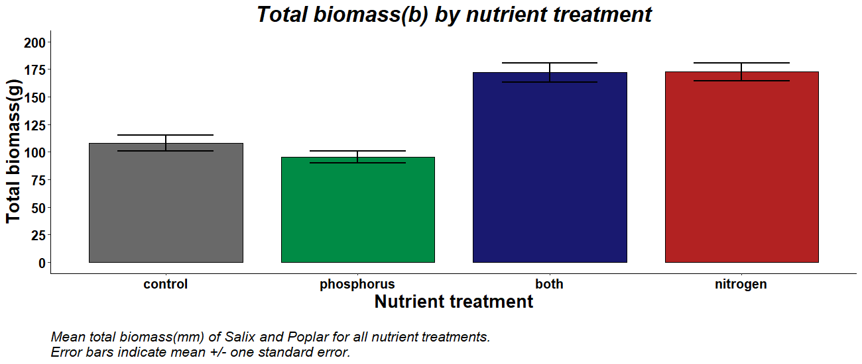
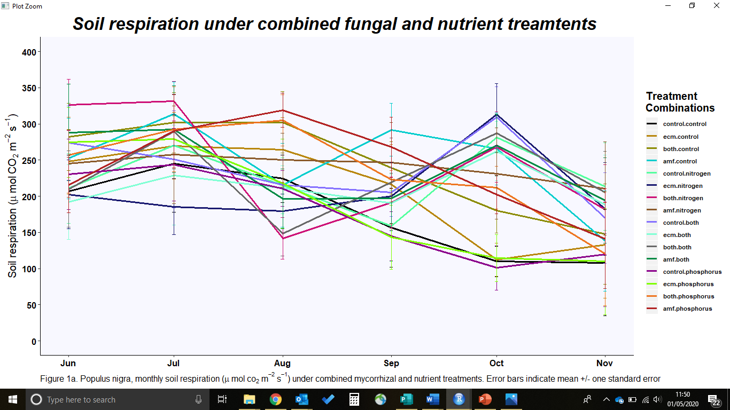
Greenhouse gas emissions and carbon storage by temperate tree bioenergy crops
LA. Kemp¹, A. Karley¹, A. Bennett², A. Taylor³, N. McNamara⁴, E.J Sayer⁵
How do soil fertility & mycorrhizal colonisation influence carbon cycling & storage in temperate tree bioenergy crops
Bioenergy trees grown in pots
Four mycorrhizal treatments
Four nutrient treatments
Monthly measurements taken
Short rotation coppice, often used as bioenergy crops
Providing a renewable energy source
Crops can form mycorrhizal associations, improving nutrient acquisition
Fertiliser additions increase carbon sink
But may also alter CO₂ emissions
Nitrogen addition significantly increased tree biomass
AM fungi & phosphorus combined
significantly increased soil respiration
Special thanks to : Duncan White, Lawrie Brown, Graham Pitkin, James Hutton Glasshouse staff
Icons from www.flaticon.com

Slide 2
Biomass may be considered advantageous over other renewable resources, it is a consistent source of energy and short rotation coppice (SRC) are viable for up-to 30 years before replanting is required providing both a regular income and sustainable supply.
Although biomass production supports less that 15% of global primary energy production and around 4% UK primary energy demand it is the largest renewable energy supplier to primary energy demand accounting for over 80% of the total UK renewables market.
However, increasing land set aside for bioenergy production creates competition with food production. Using marginal land and degraded areas would increase the area available while also improving soil quality and biodiversity and help meet future energy plans.
SRC require very little nutrient addition to soils. This is highly correlated with historic land use, if soil is heavily degraded agricultural soil significant fertiliser additions are required to maintain viable crop yield.
Mycorrhizal fungi play an important role in nutrient provision for host plants. It is estimated up to 90% of terrestrial plant species associate with Arbuscular mycorrhizal (AM) fungi and Ectomycorrhizal (ECM) fungi. AM fungi associate with ~80% of vascular plants while ECM fungi associate with ~10% of plants, most commonly top canopy woody species.
Mycorrhizal symbiosis is considered the most ancient widespread form of fungal symbiosis with plants dating back to colonisation of plants on land. Supplying nutrients such as phosphorus and nitrogen in return for carbon offering a possible solution to reduction nutrient additions to soil.
SRC have the potential to sequester and store large amounts of carbon from the atmosphere during photosynthesis and growth. In conjunction SRC have been shown to have high nitrogen uptake capacity again increasing carbon sequestration. Unsurprisingly aboveground shoots hold the largest carbon pool at harvest.
However plant – soil carbon cycling is often under estimated in carbon modelling. Studies have shown that nitrogen additions to crops can lead to an increase in CO₂ emissions. Conversely this has been shown to lead to a decrease in CO₂ emissions in woody crops such as SRC. Likely due to shifts in autotrophic and heterotrophic respiration under nitrogen addition regimes.
Overall knowledge on the effects of long term nutrient additions to crops such as SRC on soil carbon sinks is limited. Highlighting the need to increase knowledge and understanding of the role of soil fertility and mycorrhizal associations on GHG emissions such as CO₂ and carbon cycling of SRC used for bioenergy production.

Slide 3
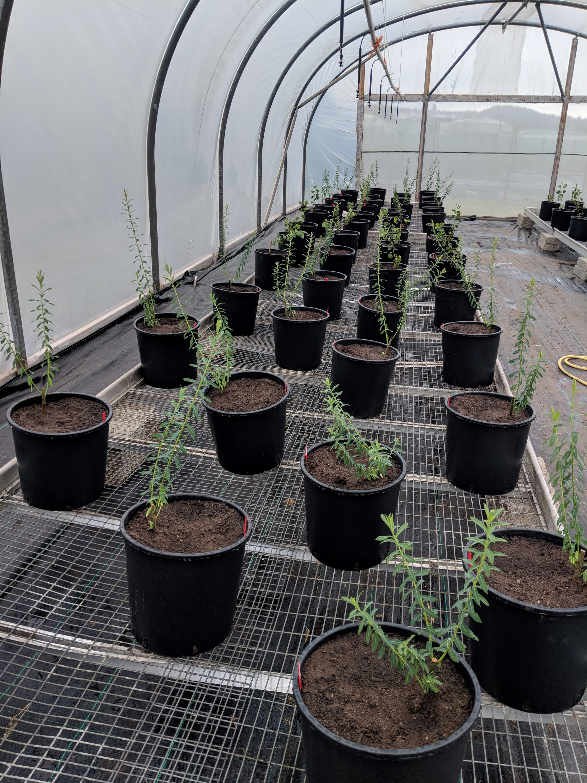
Salix and Populus are most commonly used as bioenergy crops.
As they have a high energy content, are fast growing and require little input once established.
Salix purpurea and Populus nigra where selected for this study.
As they are UK native species, associate with both AM & ECM fungi and have similar nutrient requirements.
A total of 192 trees (96 of each specie) were grown from 30cm cuttings sourced within the UK.
All cuttings were established in sterile soil for one month before transferring to individual 18l pots

Slide 4
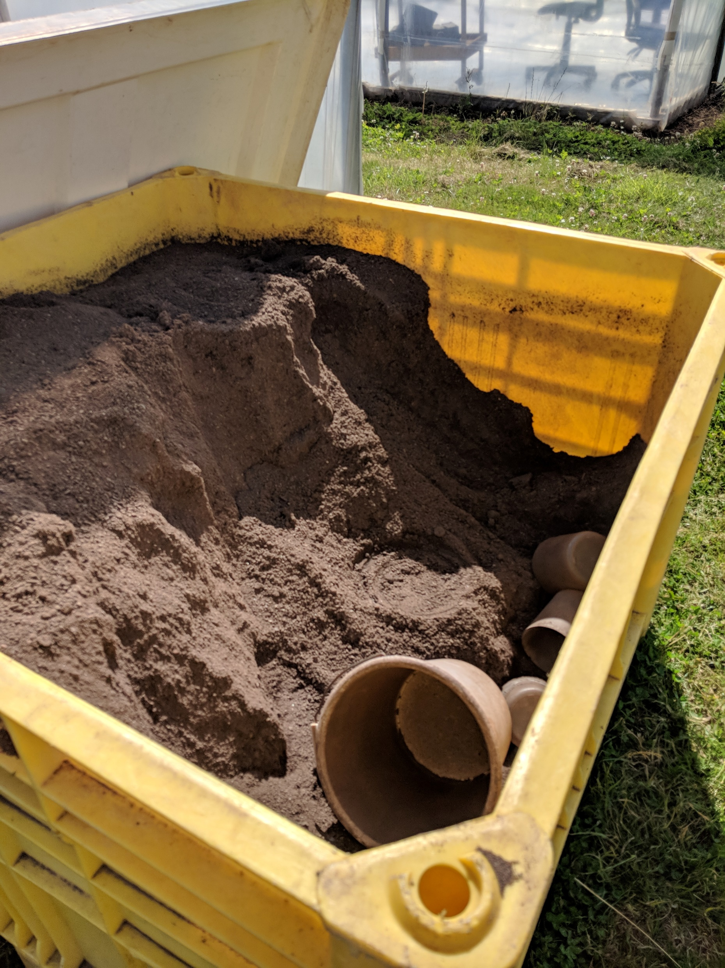
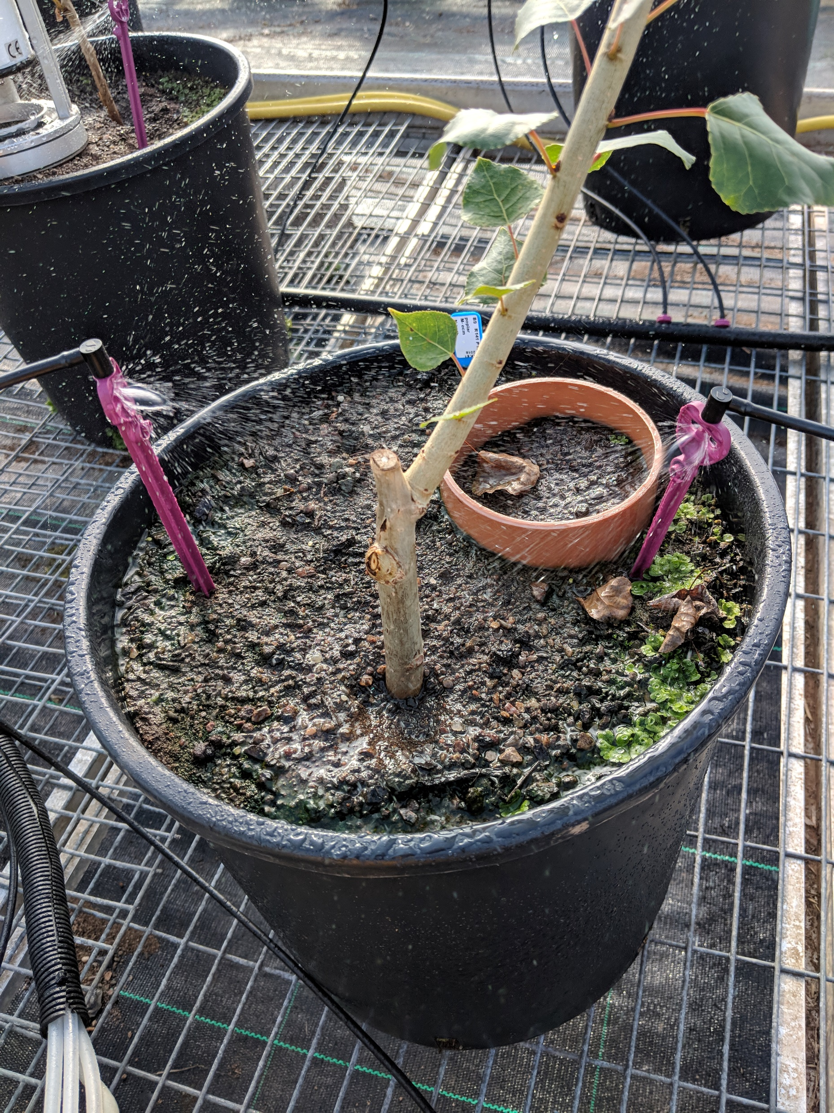
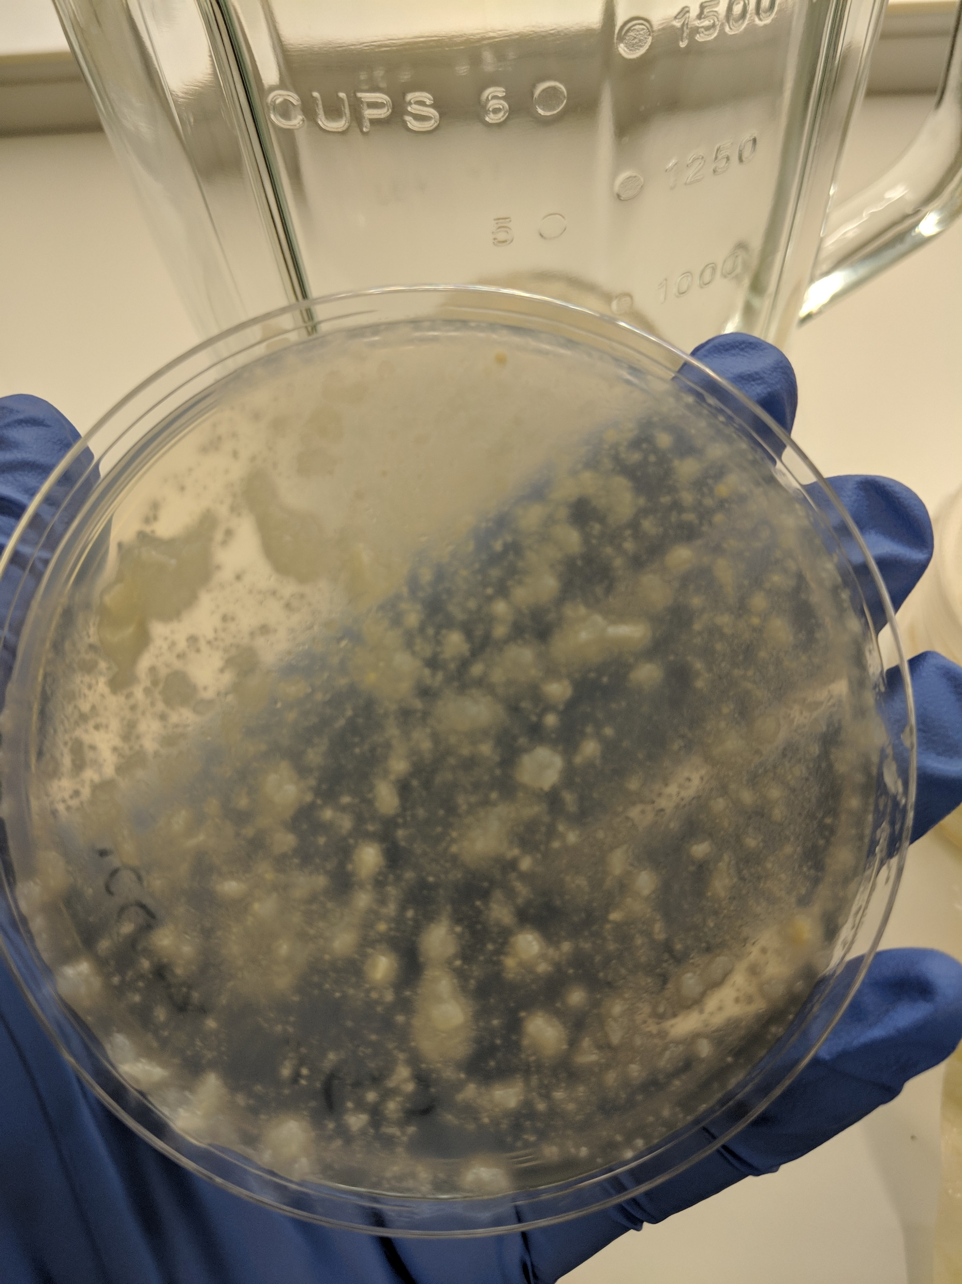
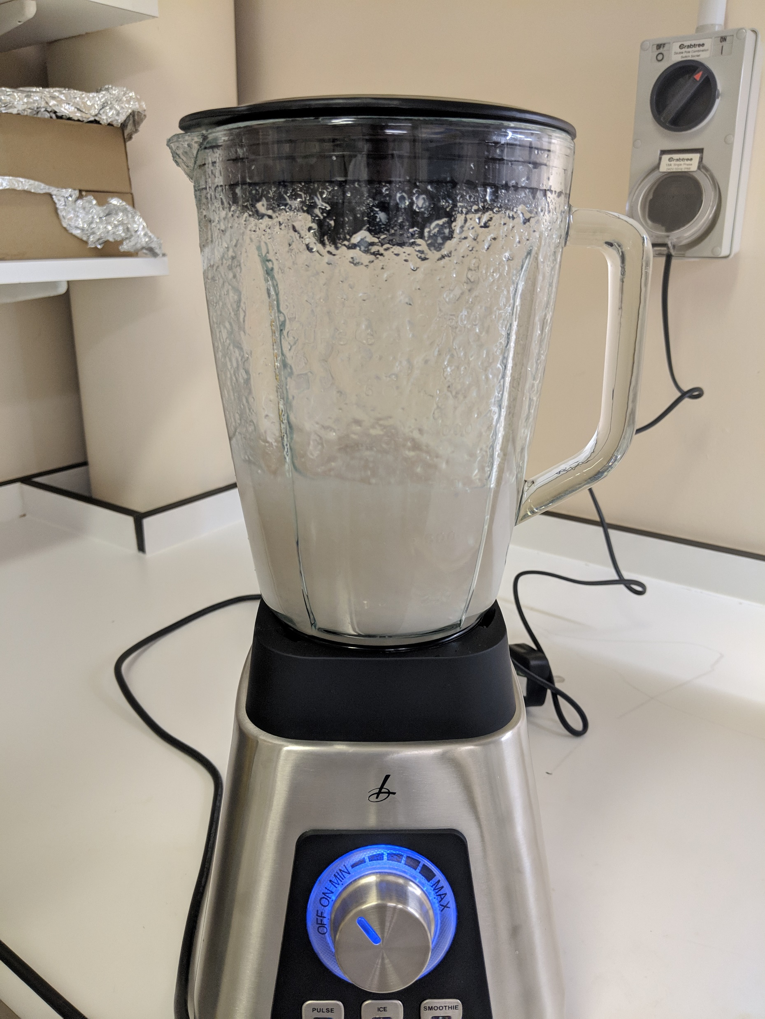
Four mycorrhizal treatments were implemented:
Control (no additions)
AM fungi
We implemented a three layer soil system. AM fungi granule inoculum sourced from Plantworks was mixed with sterile soil then applied between two sterile layers of soil.
ECM fungi
We chose five different species of ectomycorrhizal fungi considered aggressive colonisers. These were cultured in Melim Norkrans medium, blended with water to form a gelatinous consistency. We inoculated each tree with 50mls of slurry added at roots.
Both fungi
We added both fungi using above protocol.

Slide 5
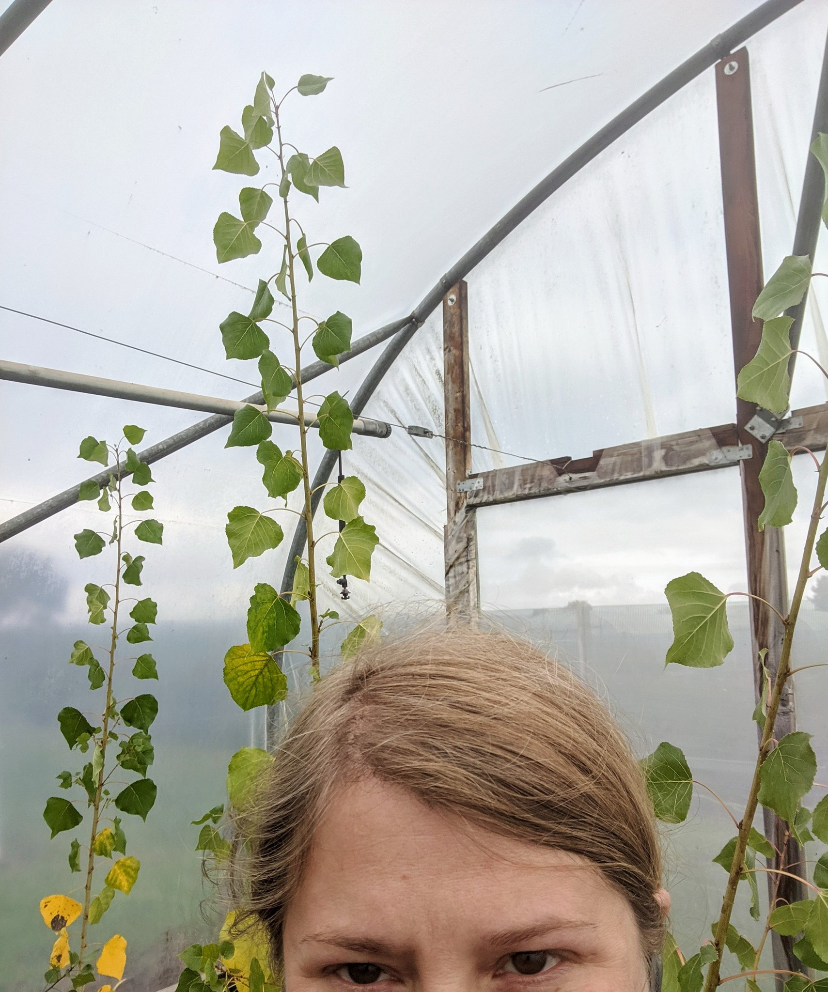
We added Four nutrient treatments between April and September
Control
We applied 40ml H₂O per treatment once every four weeks.
Nitrogen
We added 120mg/l of nitrogen per year spread over 6 treatments. This was applied at 40ml per treatment every four weeks.
Phosphorus
We added 80mg/l of phosphorus per year spread over 6 treatments. This was applied at 40ml per treatment every four weeks.
Both
We added 120mg/l of nitrogen per year and 80mg/l of phosphorus per year spread over 6 treatments. This was applied at 40ml per treatment every four weeks.
To ensure the same ratio of nitrogen, phosphorus and potassium are added per treatment we used different chemical compounds to create each fertilisation solution. The pH for each solution has been documented.

Slide 6
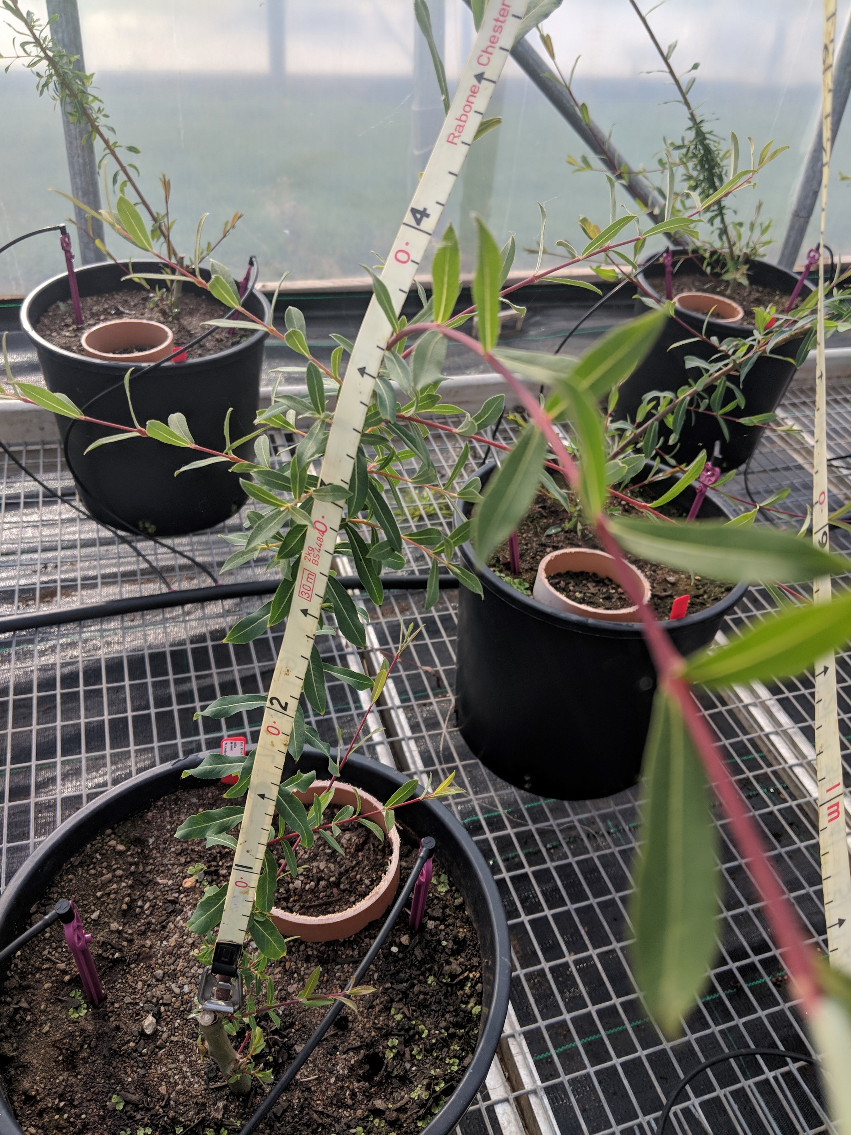
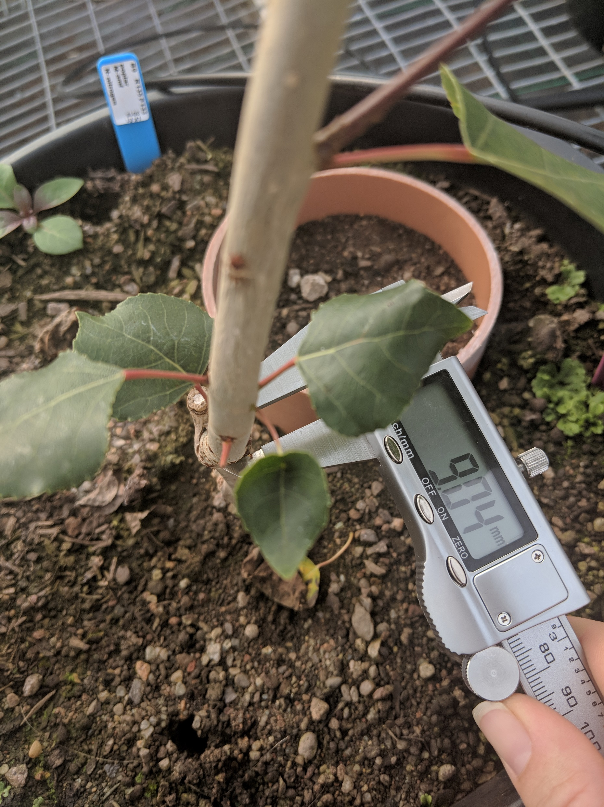
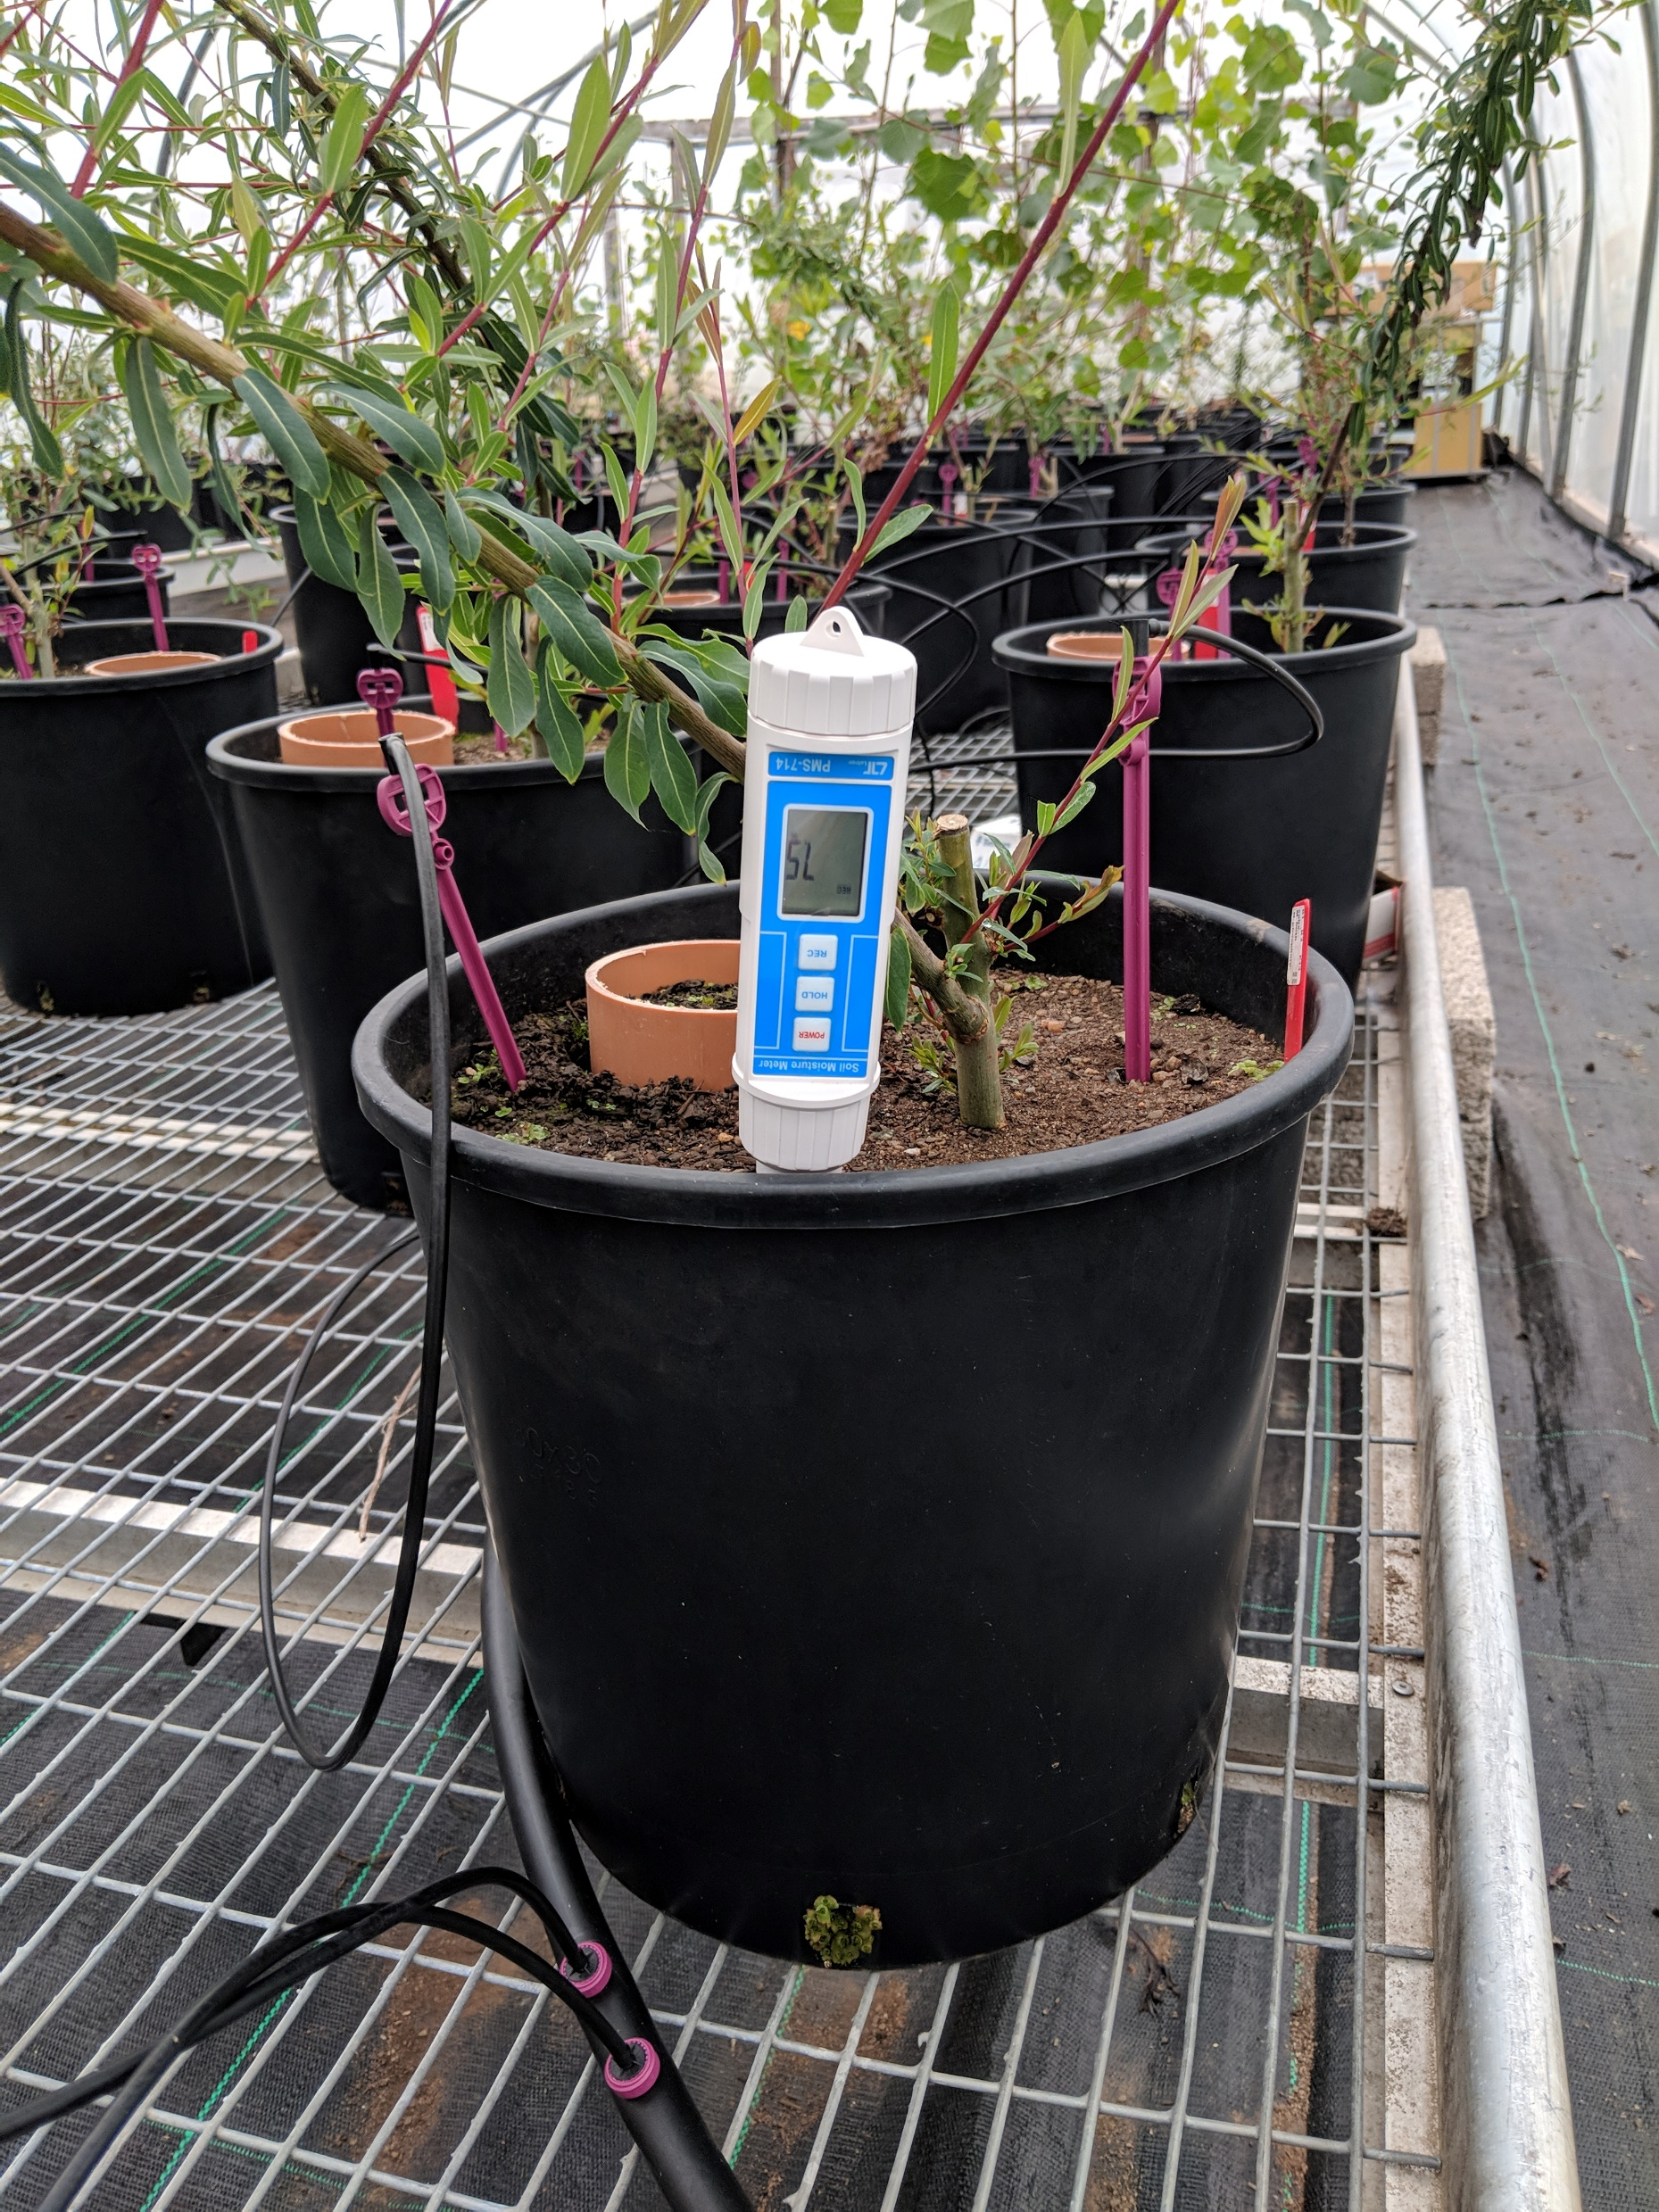
We carried out monthly data collection, recording the following measurements:
Tree height from stem base to tip.
Tree diameter at base of stem.
Soil moisture.
Soil respiration.
We measured soil respiration using LICOR li-8100a automated soil gas flux system to monitor co2 flux.
Measurements were taken using a 10cm survey chamber attached to the 10cm pipe inserted in each pot.
Each pot was measured for two minutes with a 15 second pre-purge and a 30 second dead band.

Slide 7
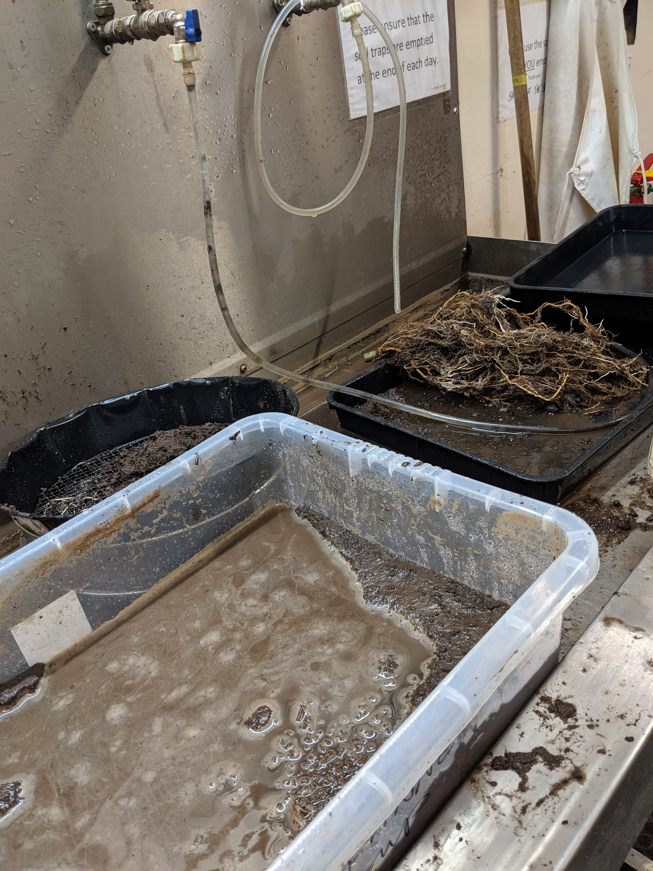
Completing a destructive harvest allowed us to:
Establish mycorrhizal colonisation of roots.
Record above and below-ground biomass.
Extract plant available nitrogen and phosphorous.
Extract carbon, nitrogen and phosphorus from leaves.
The only significant difference in total biomass was an increased growth under nitrogen addition
This is in agreement with many studies showing nitrogen addition increases biomass and crop yield. This can clearly been seen in the bar plot.
Nitrogen addition is shown as the red bar.
The bar plot shows that when both nitrogen and phosphorus are added total biomass again increases
It is less than when only nitrogen is added. Indicating on this occasion phosphorus addition limited tree growth.
Both additions are shown as the blue bar.
Phosphorus addition to soil limited plant growth leading to a reduction in total biomass compared with no additions.
Although this was not significant compared with control trees the difference between trees grown with nitrogen addition and trees with phosphorus addition was significantly different.
Phosphorus additions are shown as the green bar.

Slide 8
We analysed fresh and dry roots for root colonisation of mycorrhizal fungi.
We subsampled fresh roots and assessed for evidence of ECM fungi on root tips.
We took subsamples of the remaining oven dried roots, cleared the roots and stained with trypan blue then scored them to assess for AM fungi colonisation.
Colonisation was not found to be present. This requires further investigation but literature suggests this may indicate:
Inoculation was successful and soil respiration is increasing due to AM fungal turnover
Inoculation was unsuccessful and the increase in soil respiration is due to increased microbial activity as they feed on the AM fungi we added to the soil.
Inoculation as unsuccessful and the increase in soil respiration is due to increased microbial nitrogen mining activities in turning increasing soil respiration.
We found that AM fungi combined with phosphorus addition significantly increased soil respiration.
As the growing season progressed soil respiration increased.
This peaked in August before tailing off as tree dormancy occurred.
Highlighted with the dark blue circle on the line graph.
We found that nitrogen addition reduced soil respiration.
As the growing season progressed soil respiration decreased.
Soil respiration then increased as tree dormancy occurred.
While it was not significant, this agrees with current literature available and adds weight to the literature suggesting soil respiration has increased due to nitrogen mining.
Highlighted in the light blue circle on the line graph.

Slide 9
The James Hutton Institute, Errol Road, Dundee DD2 5DA.
The Ohio State University, Columbus, OH 43210, USA.
The James Hutton Institute, Craigiebuckler, Aberdeen AB15 8QH.
Centre for Ecology and Hydrology, Library Avenue, Lancaster Environment Centre, Lancaster, Bailrigg, LA1 4AP.
Lancaster University, Bailrigg, Lancaster LA1 4YW.
Leigh-Anne.Kemp@Hutton.ac.uk @LK_Soil_Carbon

