Slide 1
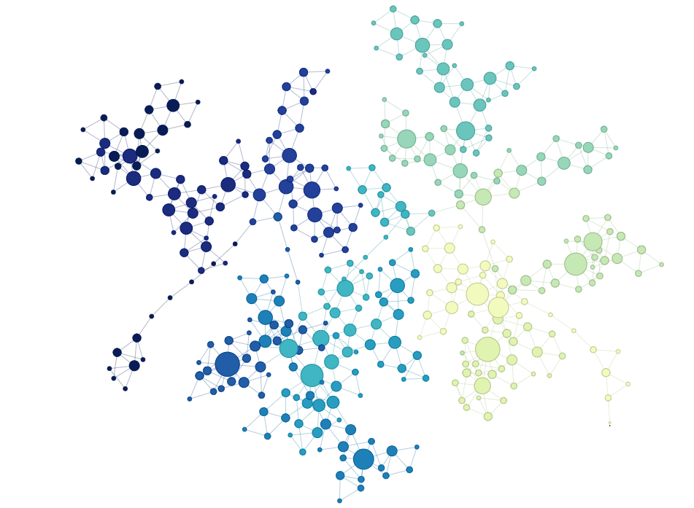
Inference On Streamflow Predictability Using Horizontal Visibility Graph Based Networks
Ganesh Ghimire, Navid Jadidoleslam, Witold F. Krajewski & Anastasios A. Tsonis
Notes:
We suggest browsing this presentation in the Slide Show view, however, we added comments in the Notes box below each slide.
The term “predictability” refers to the ability to be predicted. For both streamflow forecasting and water resources management point of view, finding the origin of predictability lies in our ability to distinguish between the dynamics of the process generating it i.e. randomly correlated/stochastic or chaotic.

Slide 2
Fourier Transform
Wavelet Transform
Machine Learning
Chaos Theory
Complex Networks
Use of HVG derived complex network for streamflow dynamics is relatively new
Horizontal visibility graph(HVG) based network
Notes:
View in Slide Show mode.
Over the years, several approaches such as Fourier transforms, Wavelet transforms, chaos theory, stochastic modeling are in use to study streamflow dynamics. Recently, complex network based approaches using the observed streamflow data are gaining more popularity due to their simplicity in conveying information about non-linear systems. Use of simple, yet attractive visibility graph derived network approaches (e.g. horizontal visibility graph(HVG)) to assess predictability of streamflow dynamics is still at infant stage in hydrologic community, which we explore here.

Slide 3
We pose few questions …
Is streamflow dynamics a stochastic or a chaotic process?
What is the role of spatial scale on the characteristics describing streamflow process?
Do timescale of streamflow time-series, and normalization of streamflow data impact inference from HVG based networks?
Do characteristics describing streamflow process show temporal trend?
Notes:
Streamflow (runoff) is directly related to rainfall at small scale. Rainfall is difficult to forecast accurately. At larger scale water transport in the river network play an increasingly significant role. River networks integrate water. Integration makes streamflow easier to forecast.

Slide 4
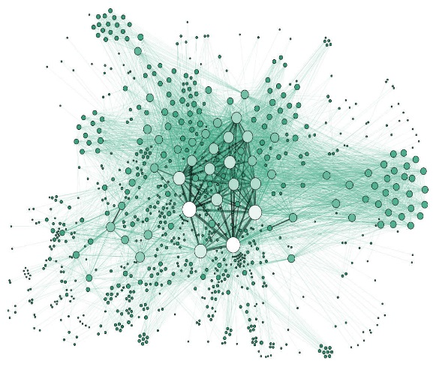
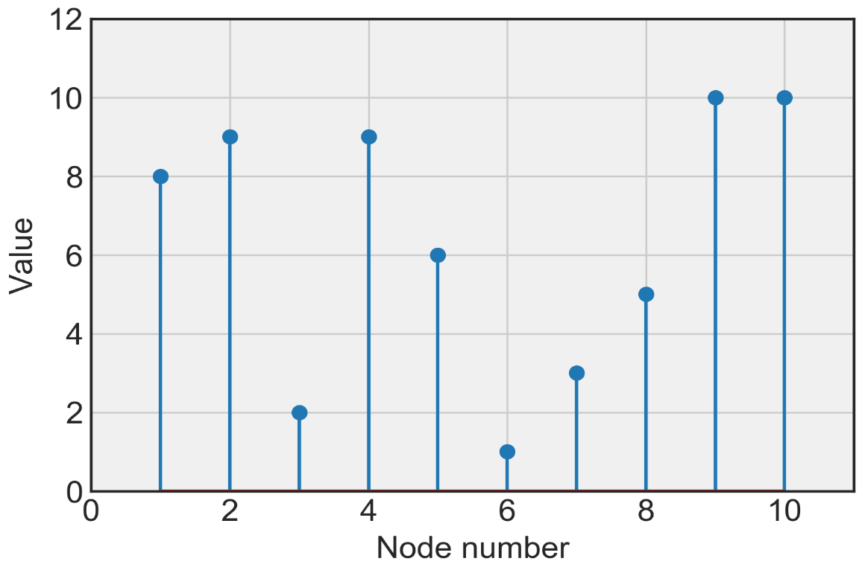
We use undirected pathways across nodes to construct HVG-based networks
1
3
2
4
5
6
9
7
10
8
Notes:
View in Slide Show mode.
Mapping of time-series into complex networks. Two characteristics of the resultant network (1) degree distribution (k); and (2) global clustering coefficient (GC).

Slide 5
Characteristic exponent (λ) and GC depict predictability measures of streamflow process
Degree Distribution
Global Clustering Coefficient (GC)
$$P\left(k\right)=e^{−λk}$$
Measure of the clustering of the network
Range = [0, 1]
k = number of connections of a node
λ= characteristic exponent
(Obtained from slope of linear model fit in a
log-linear space)
For random process, λ=0.41
$$GC=\frac{number of closed triplets(3×\#trianles)}{total number of triplets(open+closed)}$$

Slide 6
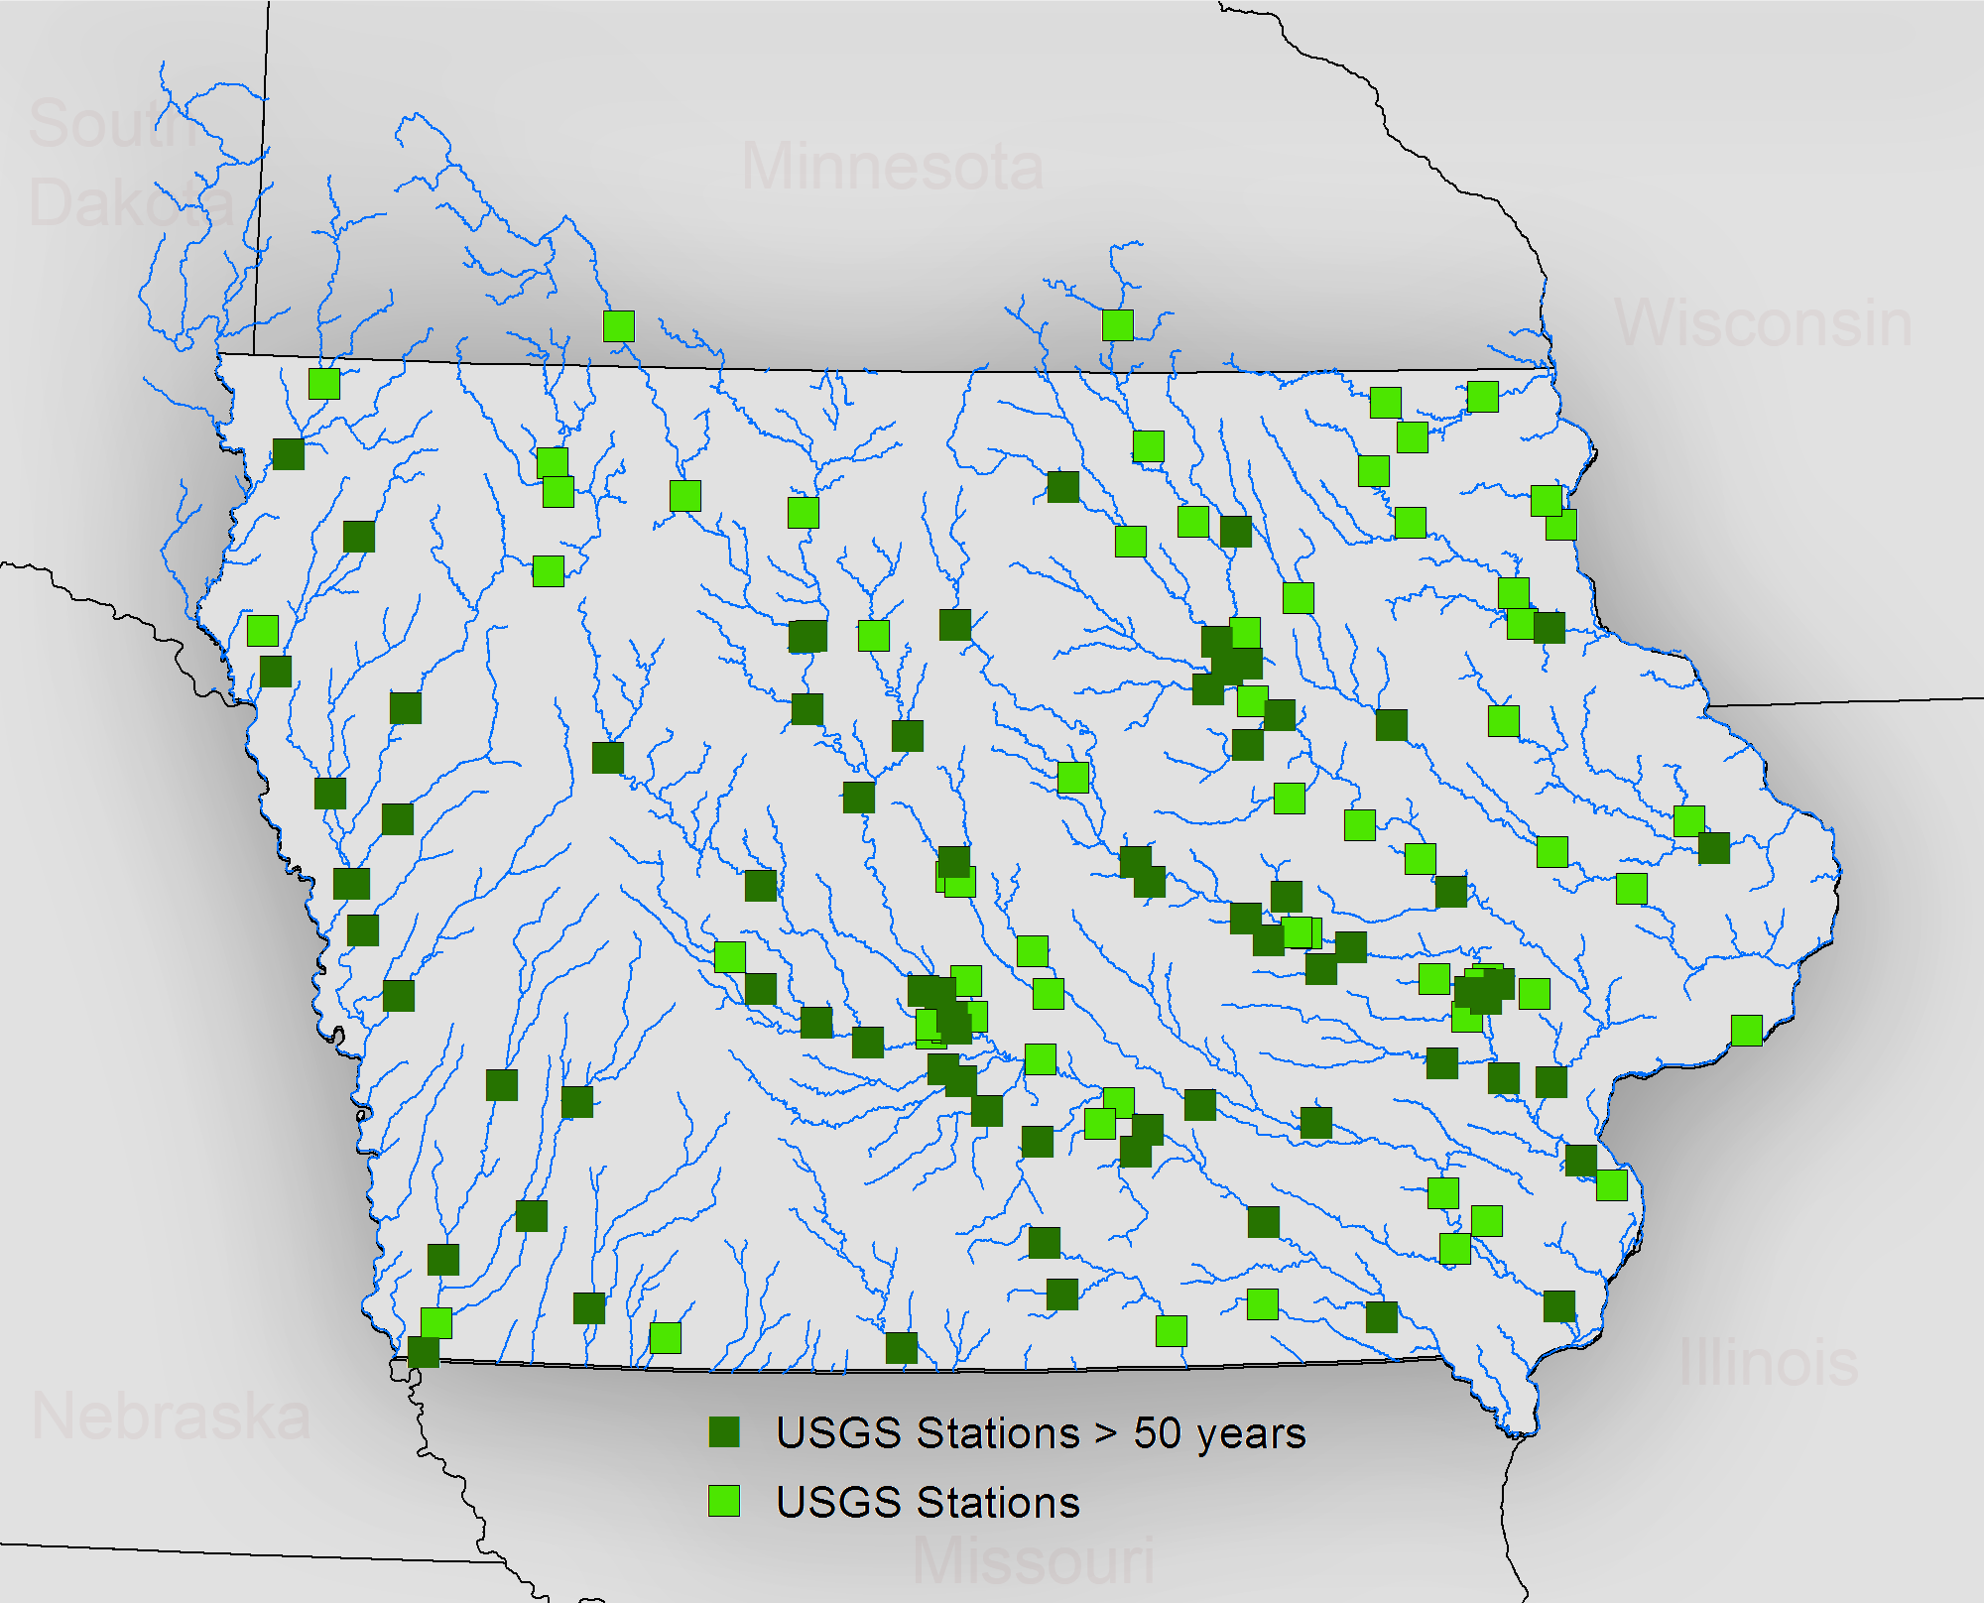
USGS monitors streamflow across wide range of basin scales in the state of Iowa
Notes:
We use the streamflow data at 140 stream gauge stations monitored by U.S. Geological Survey (USGS) in the state of Iowa, U.S. The dark green squares represent USGS stations with at least 50 years of daily streamflow records.

Slide 7
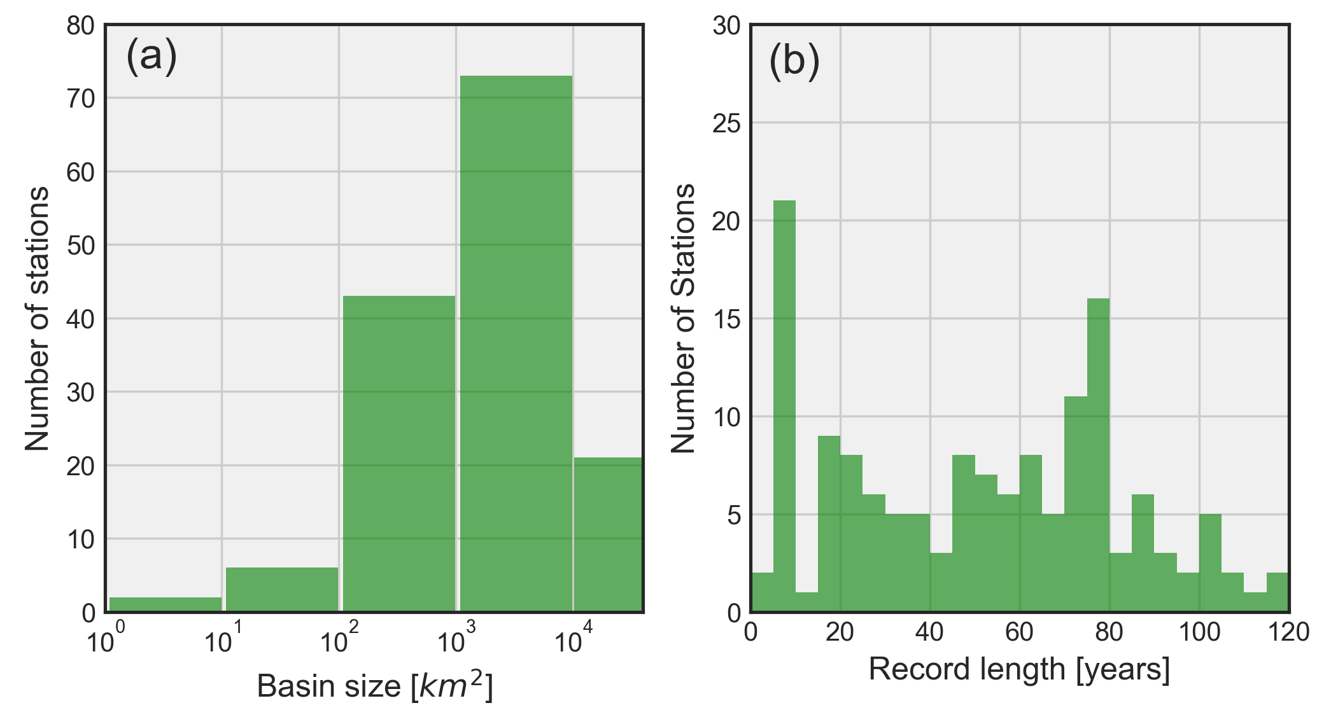
USGS typically monitors streamflow at larger basin scales
Notes:
(a) Distribution of monitored basin scales across the state of Iowa. (b) Distribution of streamflow record lengths.

Slide 8
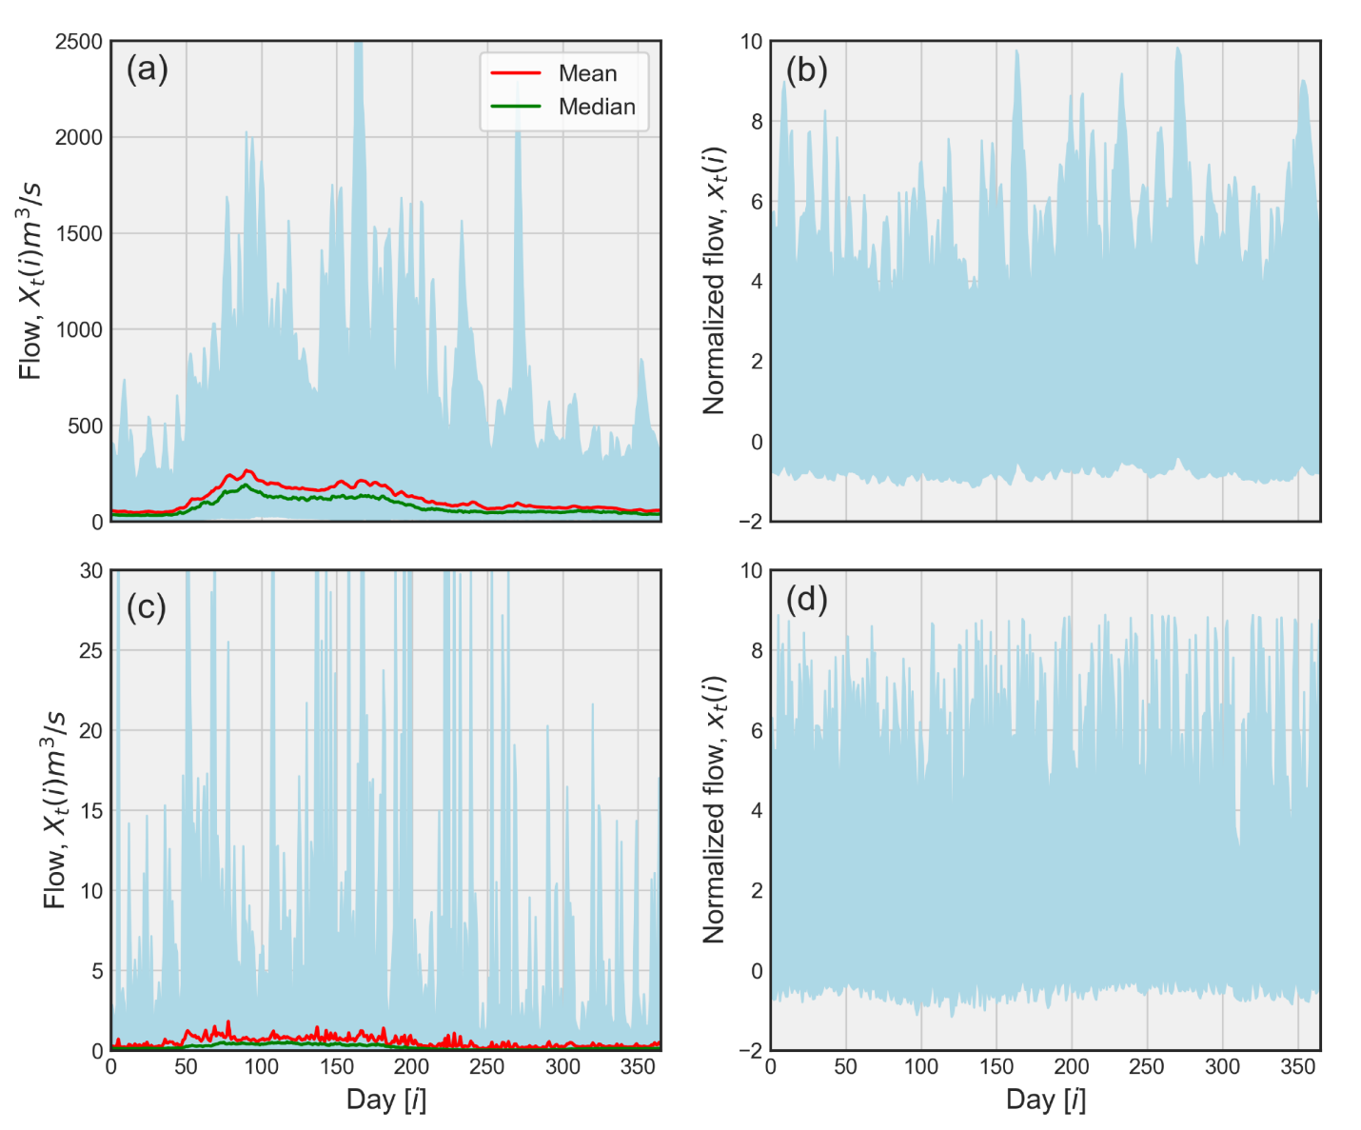
Streamflow variability is more prominent at smaller scales
Cedar River at Cedar Rapids
(A = 16800 km²)
Rapid Creek near Iowa City
(A = 70 km²)
Notes:
Here, we demonstrate the strategy of streamflow normalization across two basin scales. (a) Shaded envelope representing an ensemble of entire raw streamflow records, X_{t} (i), at a daily scale for the Cedar River at Cedar Rapids (16,800km²). The envelope shows the variability of streamflow, σ(i), while the red and green lines represent mean, μ(i), and median of flows, respectively. (b) Shaded envelope representing an ensemble of normalized streamflows, x_{t}(i), corresponding to (a). (c) Raw streamflow time series at Rapid Creek near Iowa City (70 km²) with same description as (a). (d) Normalized streamflow time series corresponding to (c).

Slide 9
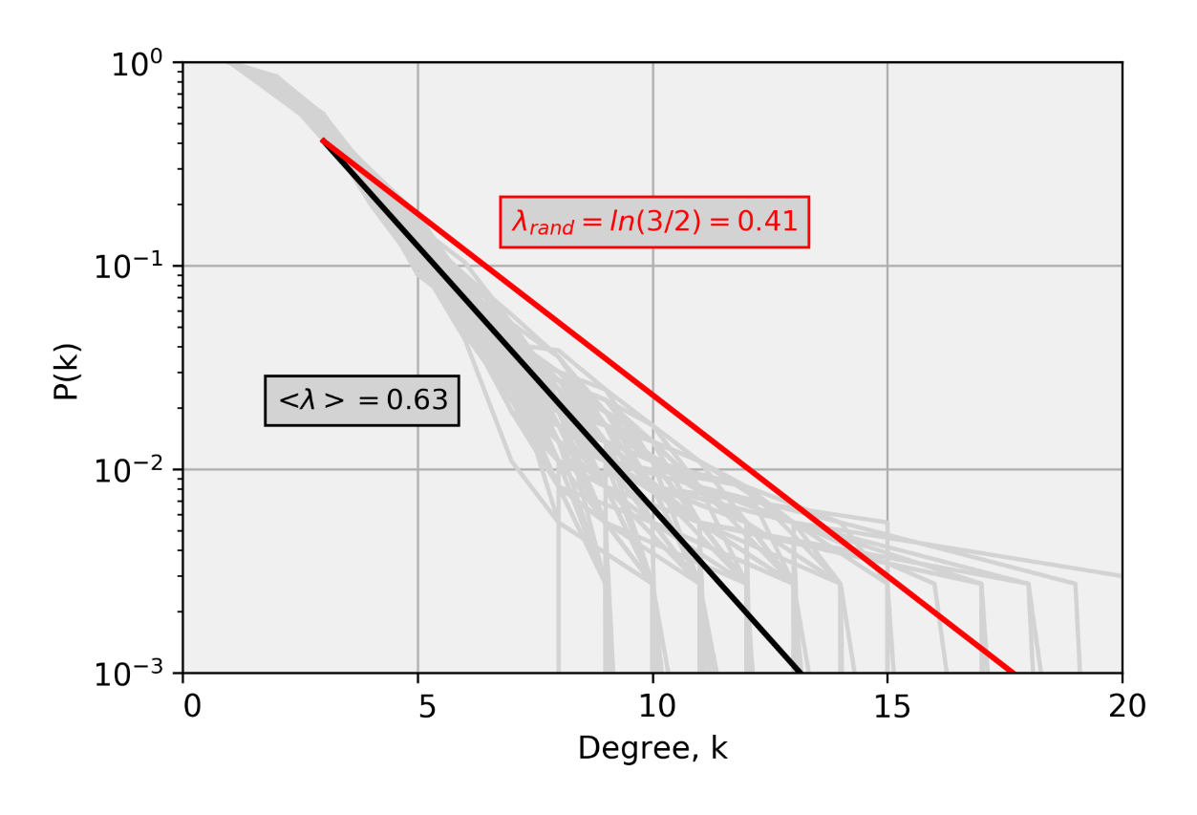
The process is characterized by higher values of λ than the purely random process
$$P\left(k\right)\sim e^{−λk}$$
Cedar River at Cedar Rapids
(A = 16800 km²)
Notes:
Grey lines represent degree distributions for each year, while solid black line represents the mean exponential fit. The solid red line corresponds to the degree distribution of the purely random process. Virtually the values of λ for all years are greater than that of purely random process (λ~0.41) indicating that the underlying streamflow dynamics corresponds to a stochastic process with temporal dependence.

Slide 10
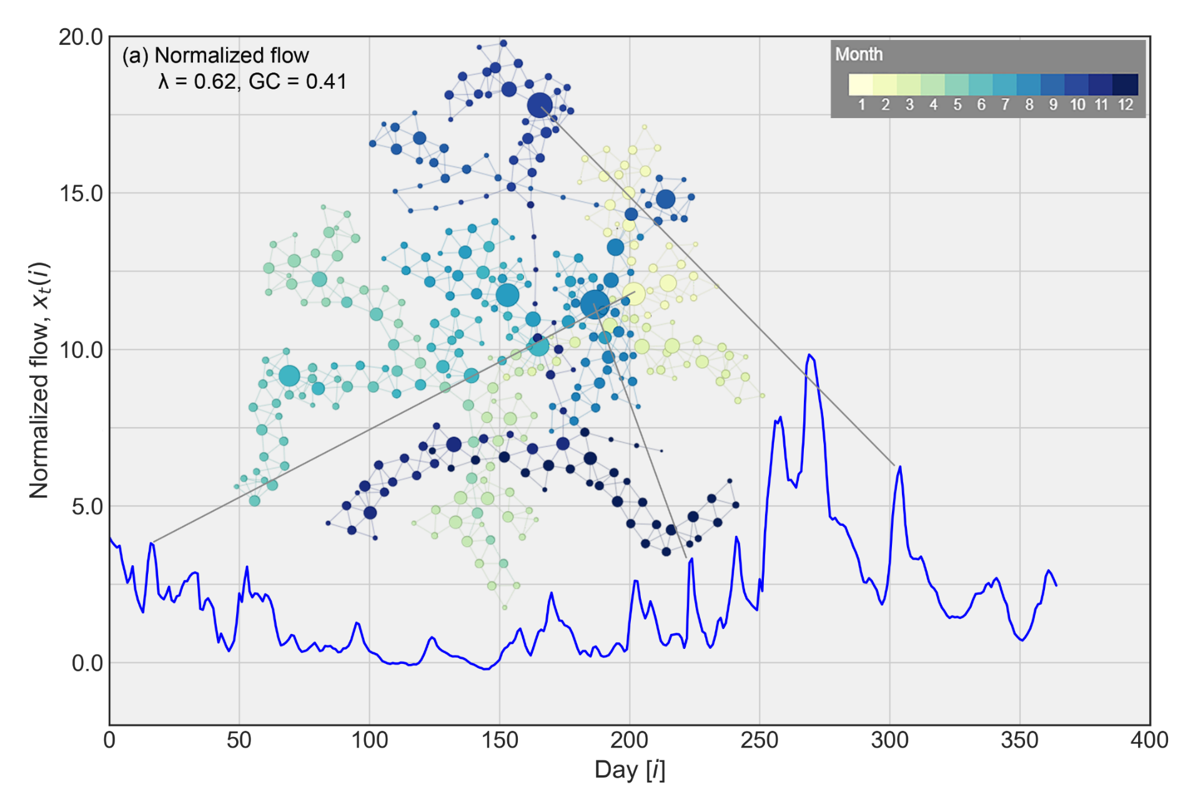
Dominance of more events makes the network complex and hence reduced predictability
Notes:
View in Slide Show mode.
To understand how networks transpire into predictability measures i.e. λ and GC, we present here HVG derived networks for Cedar River at Cedar Rapids. (a) represents network associated with normalized flow while (b) represents network associated with randomized streamflows from (a). Each color represents the corresponding month of a year where size of each node corresponds to the number of connections with its neighbors.

Slide 11
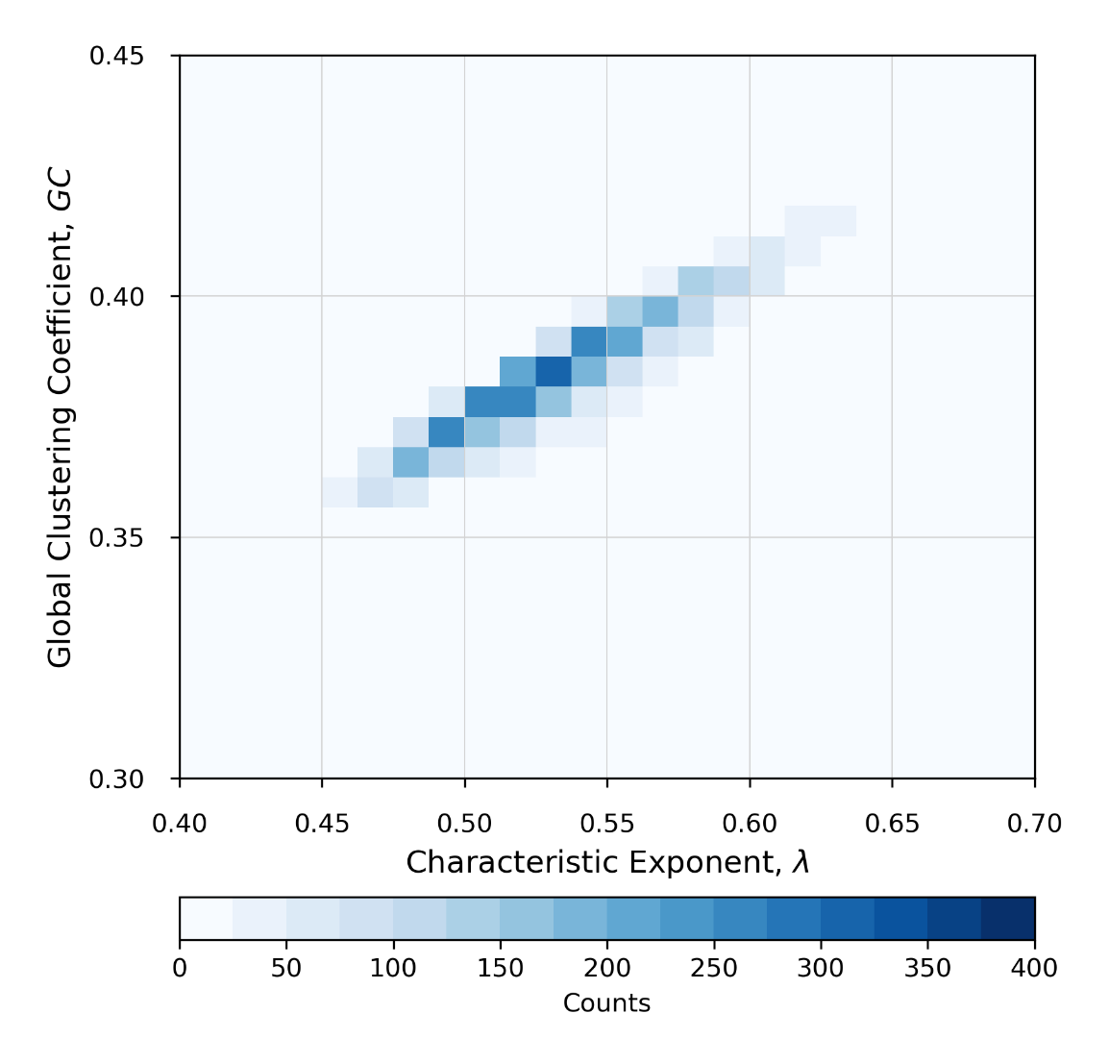
Streamflow process is stochastic (random) at daily time scale
Notes:
Our analysis of streamflow across all years and stations in Iowa shows a strong relationship between characteristic exponent and global clustering coefficient. The color code in this two dimensional histogram shows the number of data points in a bin of λ and GC. Note that, virtually all stations and years depict the corresponding values of λ and GC larger than ~0.41 and ~0.35 suggesting that the streamflow at the daily time scale is a stochastic (random) process.

Slide 12
GC is more sensitive than λ to the form of streamflow data used
Notes:
The two-dimensional histogram depicts the comparison between metrics for raw and normalized streamflow time-series data. The data are pooled from all stations for all historical records. (a)and (b) show the 1:1 comparison between normalized and raw streamflow data for λ and GC, respectively.

Slide 13
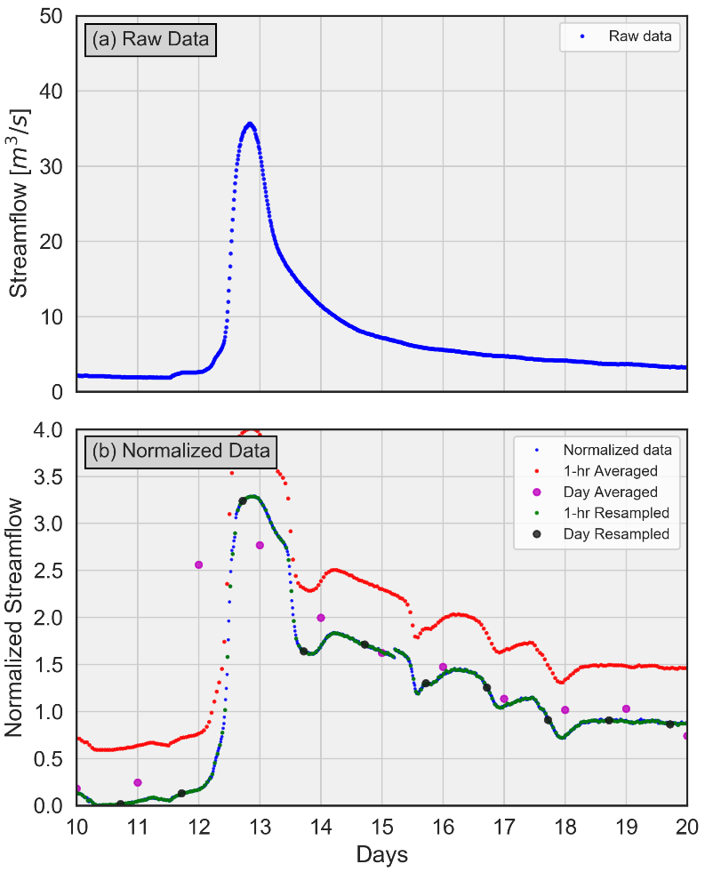
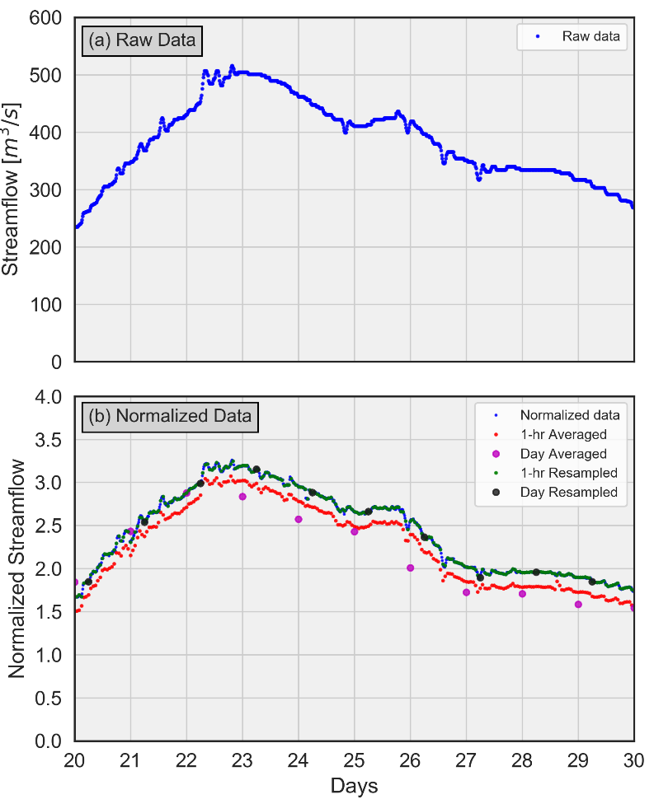
Does averaging timescale of streamflow time-series result in change in dynamics?
Area ≈ 500 km²
Area = 16800 km²
Notes:
Here, we demonstrate the averaging of highest resolution (15-minutes) time-series over hourly and daily time-scales across two basin scales. One could expect the impact of the averaging and resampling of streamflow across time-scales on the inference associated with the underlying streamflow dynamics.

Slide 14
The increase in averaging timescale shows the enhancement of the streamflow predictability
Notes:
View in Slide Show mode.
We present the predictability measures λ and GC in terms of violin plots across averaging time-scales. Violin plots are conceptually similar to the box plots. The solid white dot inside each violin represents median while the thicker solid line inside represents the interquartile range. The shape of the violins shows the point density distribution with kernel smoothing. It is apparent that as the time-scale increases, the values of λ and GC show systematic increase and hence the enhanced streamflow predictability.

Slide 15
Resampling approach shows similar behavior across timescales
Notes:
View in Slide Show mode.
We show here the results of our analysis across resampling time-scales from hourly to daily (as opposed to averaging shown previously). Apparently, the resampling time-scales show similar pattern as the averaging time-scales.

Slide 16
Characteristic exponent (λ) shows strong spatial dependence at daily timescale
Notes:
View in Slide Show mode.
The hydrologic community is more interested in exploring the dependence of predictability measures with basin scales. (a) shows the expected value of λ over the years across basin scales at daily time-scale. The solid dark line corresponds to the power-law model fit to the data. It is clear that the increasing basin size shows the increase in λ and hence the streamflow predictability or the ability to forecast streamflow. (b) shows the distribution of λ over the years considering pooled data from consecutive windows of basin scales. Apparently, the basin scale dependence of λ is preserved.

Slide 17
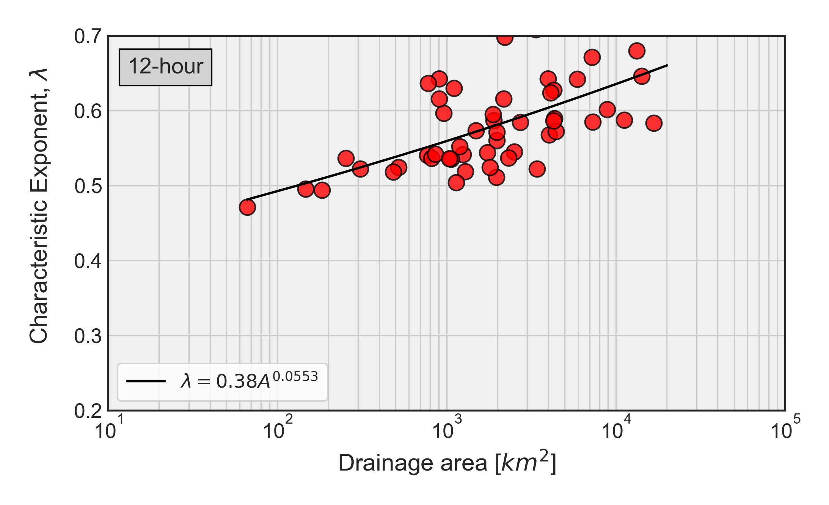
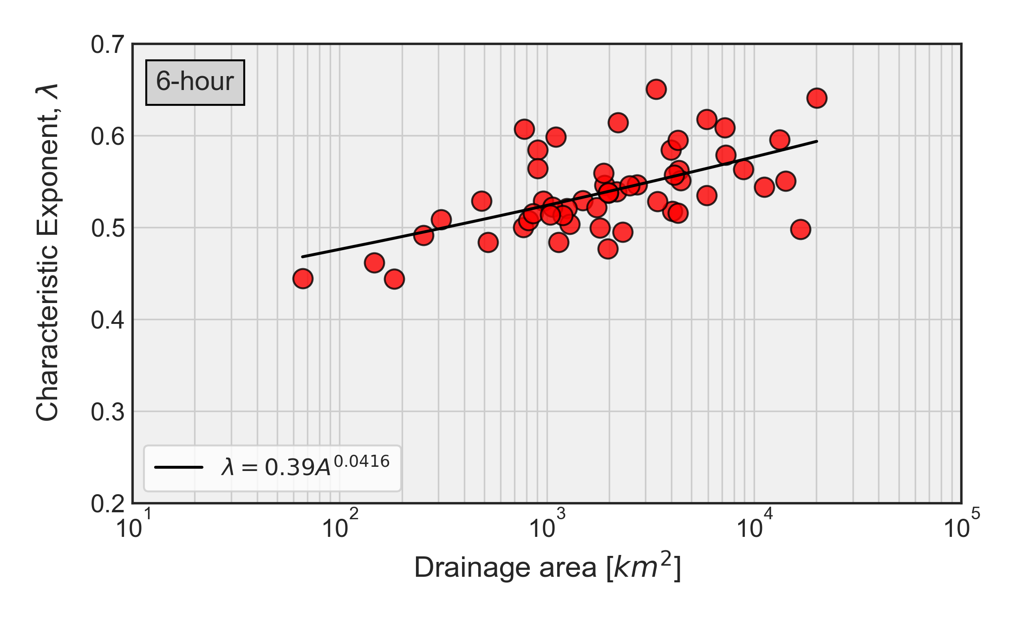
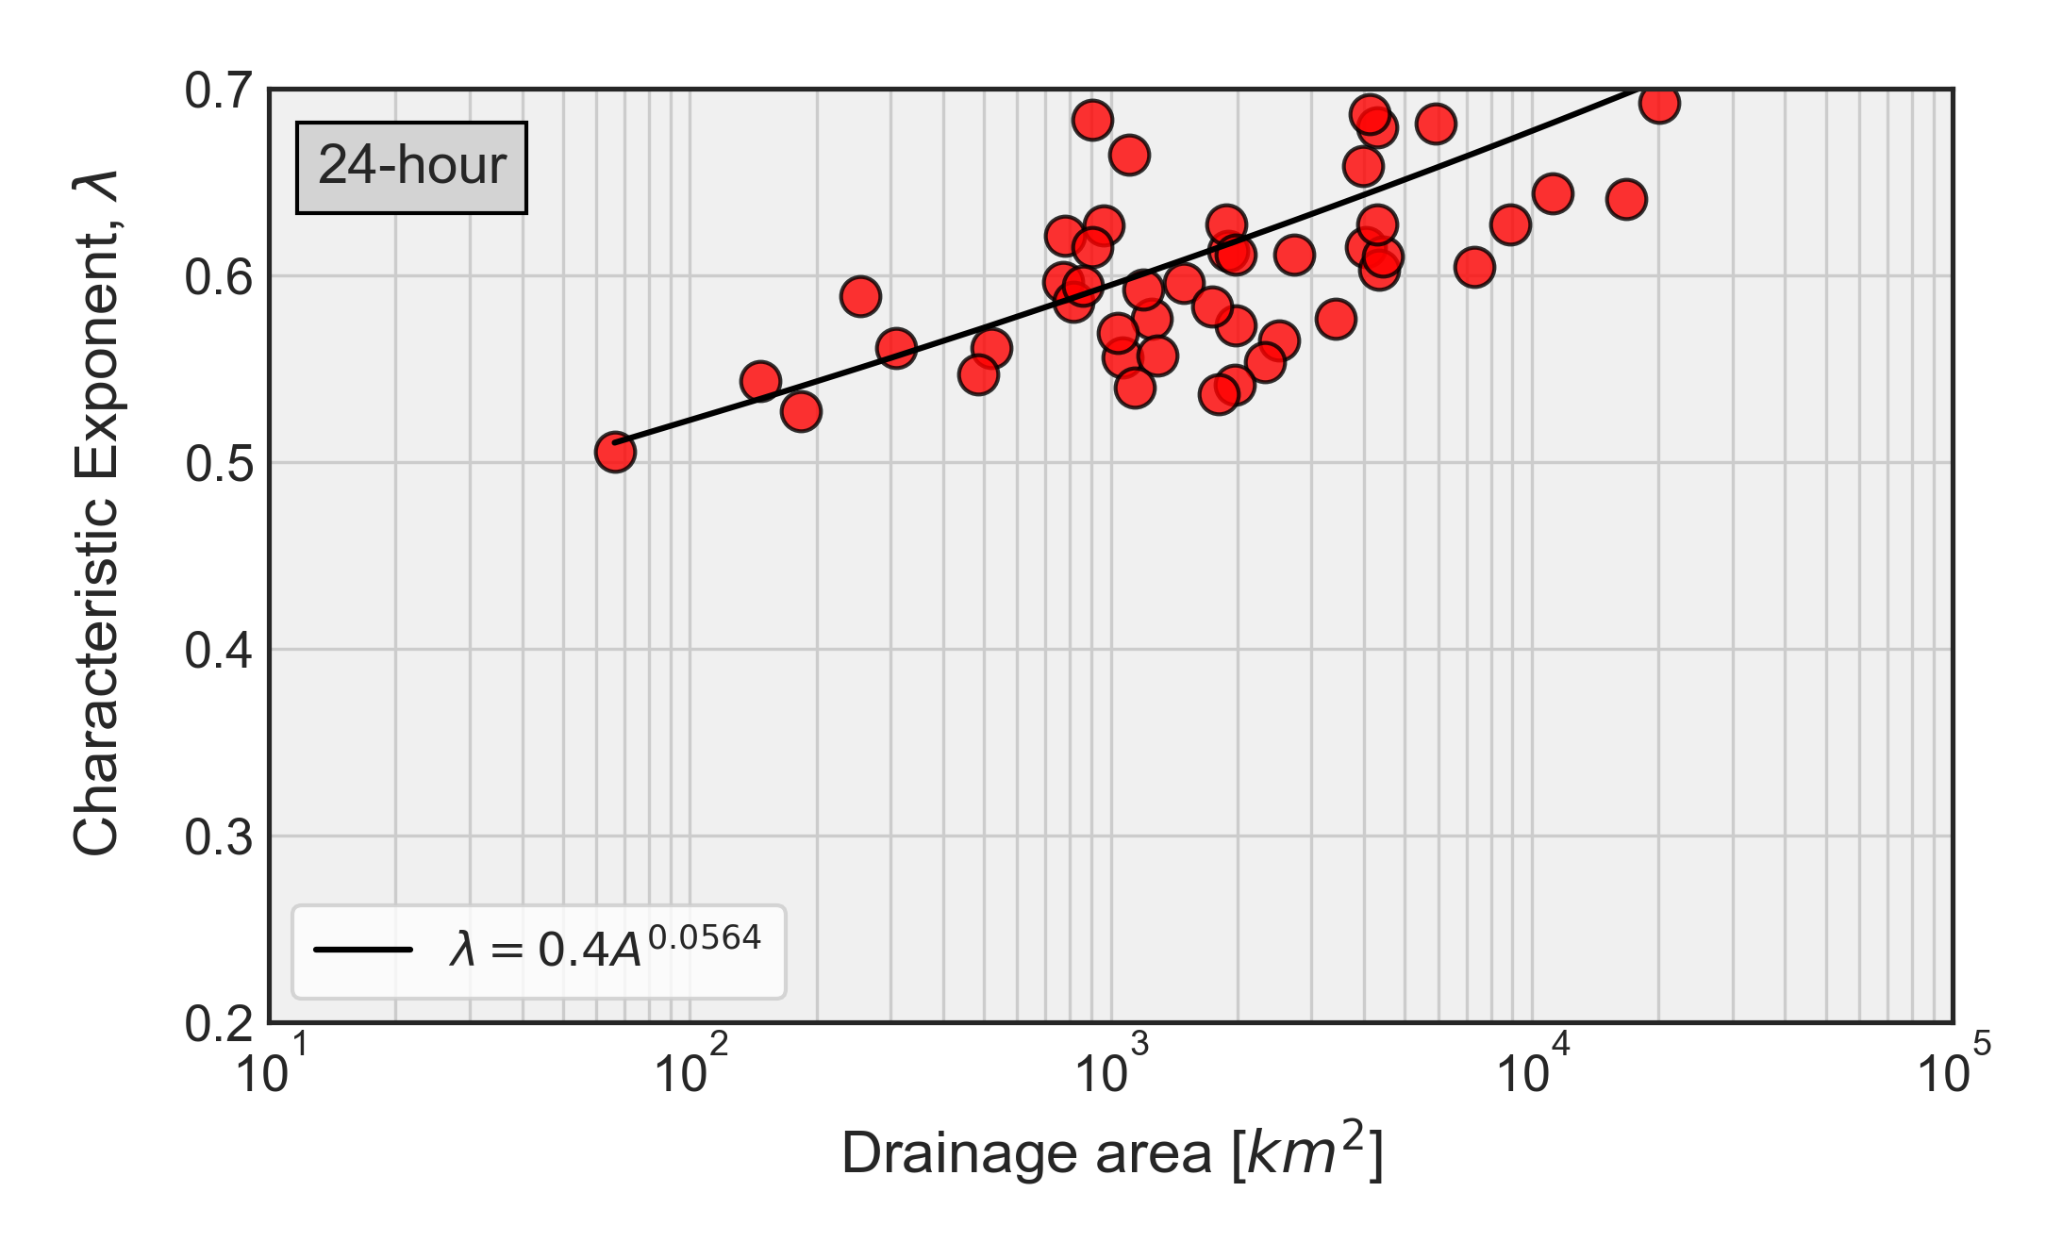
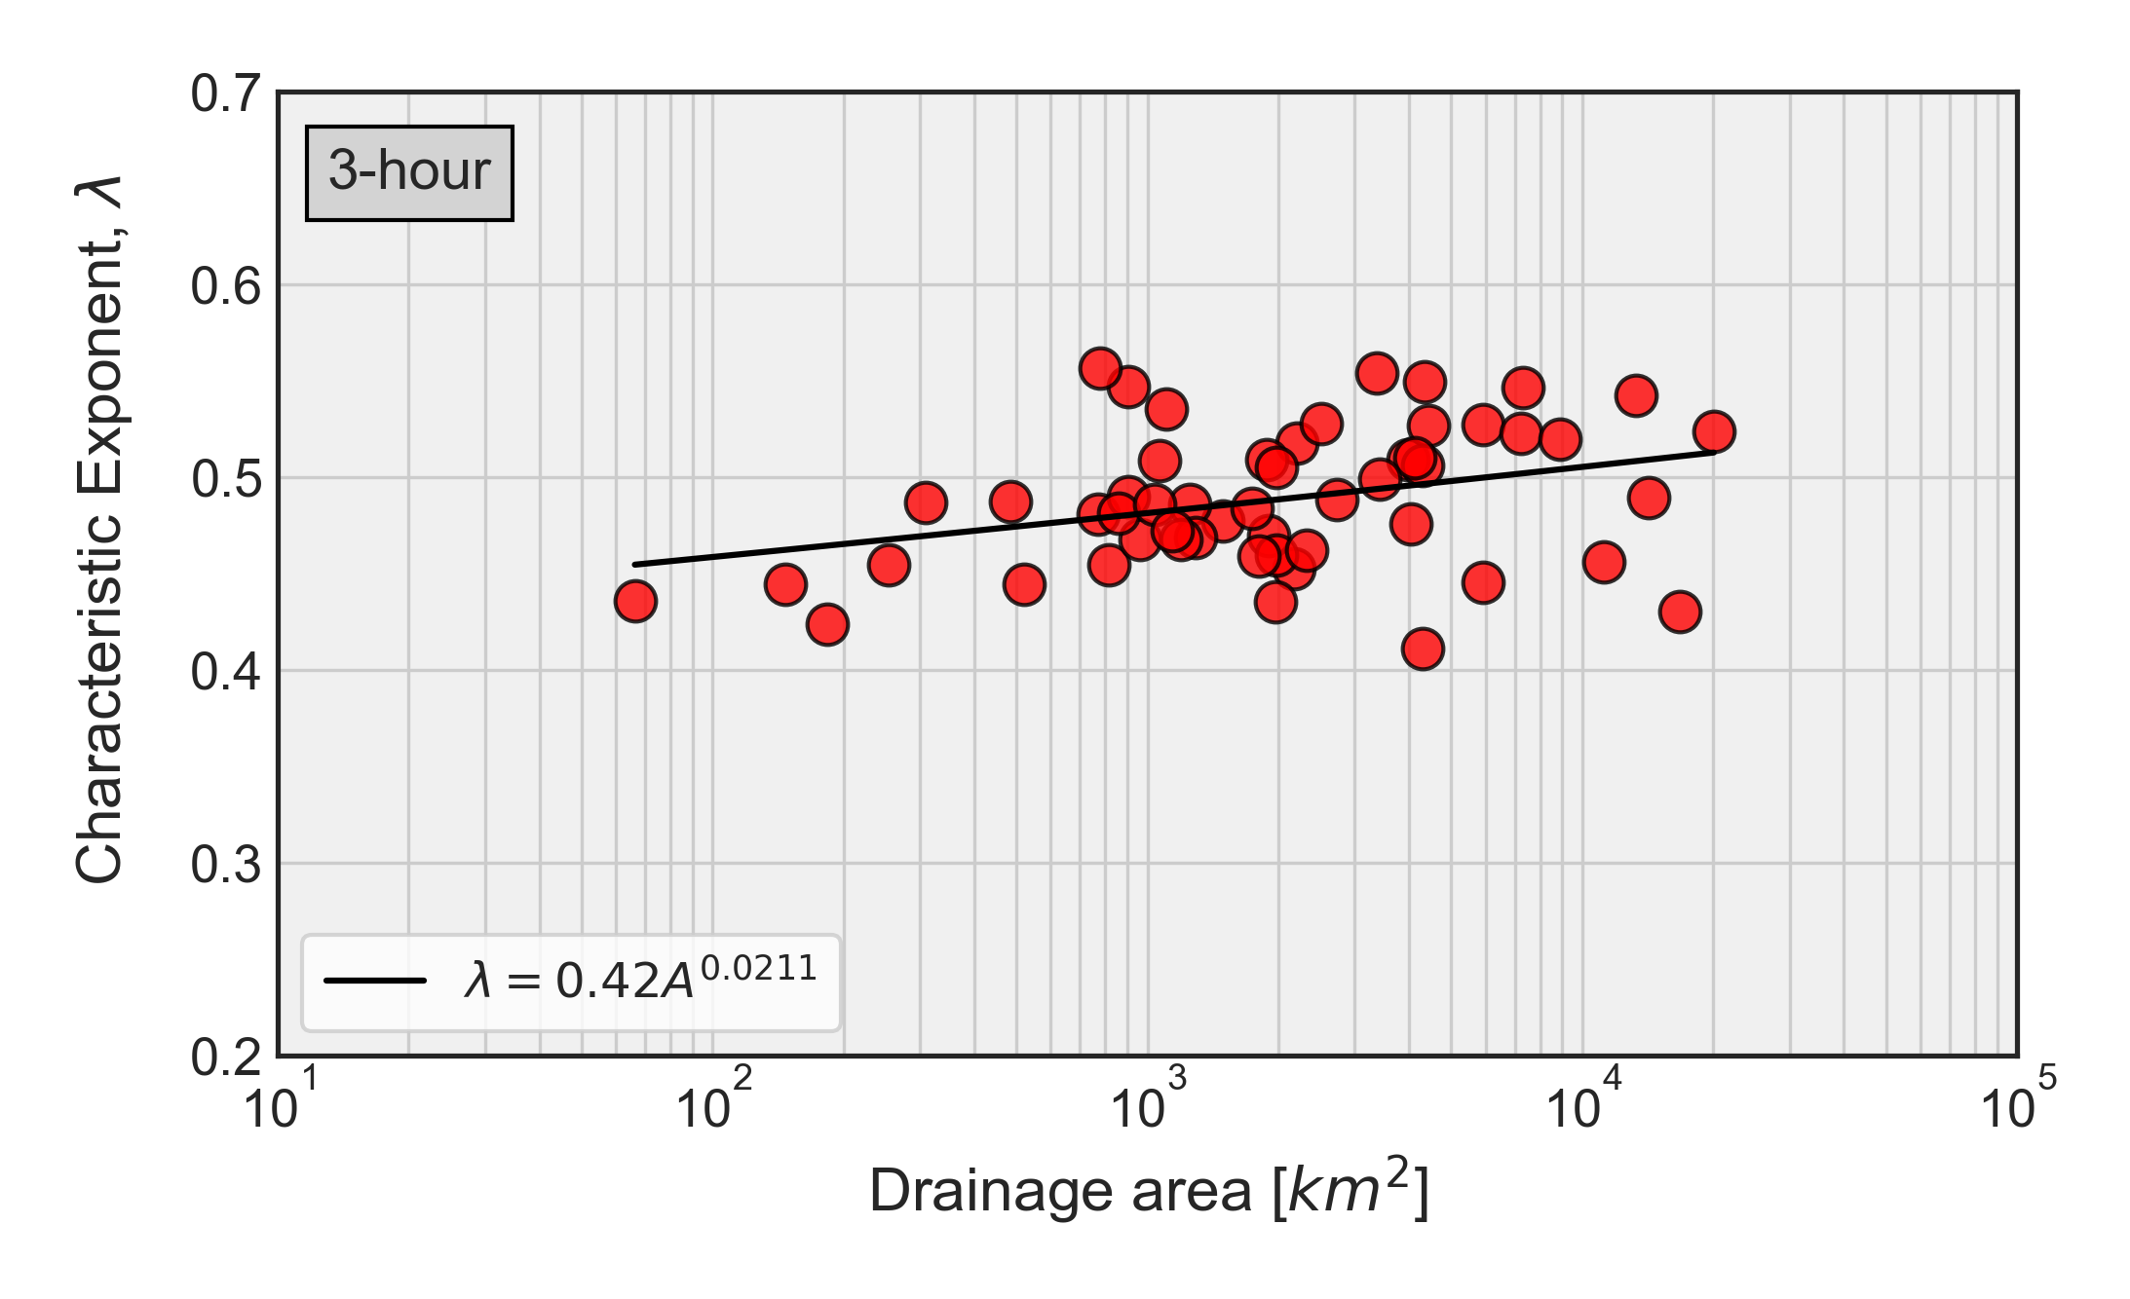
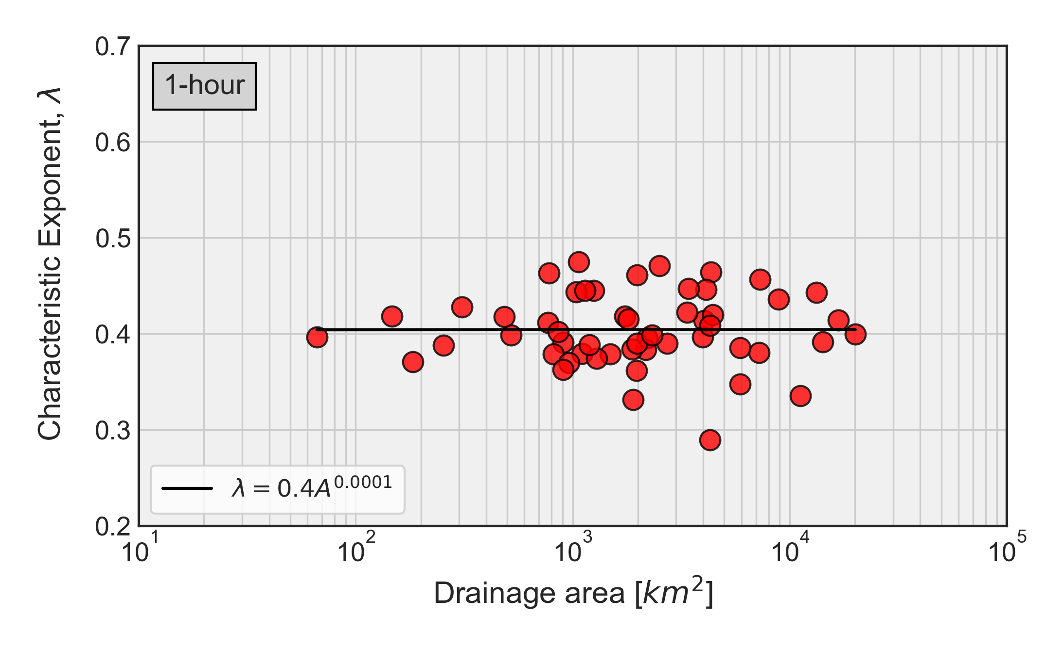
Spatial dependence is prominent with the increasing timescales
Notes:
View in Slide Show mode.
Here, we show the basin scale dependence of λ for streamflow time-series across time-scales. It is clear that the relationship between λ and basin size is prominent with the increasing time-scales. Note that the time-series with increasing time-scales has been created from the highest resolution 15-minutes streamflow data. Though the transition of dynamics between chaotic and stochastic processes is clear across timescales, the attribution of corresponding change in the spatial dependence is not clear at this point.

Slide 18
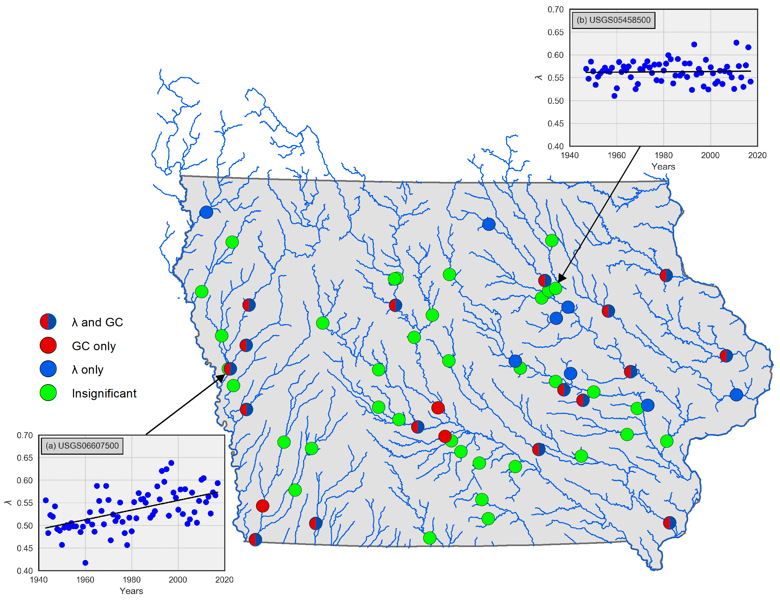
More than 40% of stations show significant temporal trend of predictability measures
Notes:
This plot illustrates the USGS sites with statistically significant temporal trends (at 95% confidence level) of λ and GC (measures of streamflow predictability). We compute the trend based on the simple linear model fit for each predictability measure. The color code corresponds to the trends for different measures. Insets (a) and (b) are examples of scatterplots with and without significant temporal trends, respectively. We observe that more than 40% of the stations analyzed in Iowa depict significant temporal trend, mostly increasing, over the years. At this point, we can attribute this trend to factors such as climate change, and land use change (tiling practice), which is a subject of further study.

Slide 19
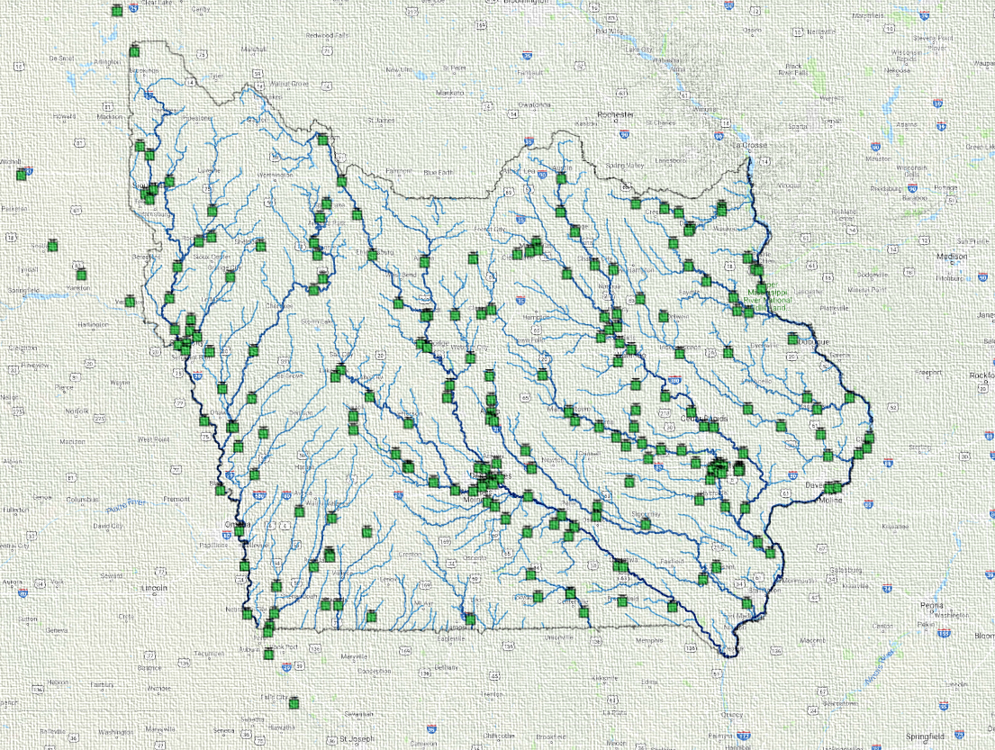
Key points…
Streamflow dynamics at daily time scale is correlated stochastic process.
GC is more sensitive than λ to the normalization of data.
Streamflow dynamics transition to chaotic process at sub-daily timescale.
Predictability measures show strong basin size dependence at daily time scale.
More than 40% of stations show statistically significant temporal trend of predictability measures.
Ghimire, G.R., N. Jadidoleslam., W.F. Krajewski., and A. A. Tsonis. 2020. “Insights on Streamflow Predictability across Scales using Horizontal Visibility Graph based Networks.” (in review Frontiers in Water)

