Slide 1
Energy Conversion in the Electron Stagnation Region of Magnetopause Reconnection
J. L. Burch¹, J. M. Webster², M. Hesse³, K. J. Genestreti¹, R. E. Denton⁴, H. Hasegawa⁵, P. A. Cassak⁶, R. B. Torbert^{7,1}, B. L. Giles⁸, R. E. Ergun⁹, C. T. Russell¹⁰, R. J. Strangeway¹⁰, O. Le Contel¹¹, K. R. Pritchard¹², A. T. Marshall², K.-J. Hwang¹, K. Dokgo¹, S. A. Fuselier^{1,12}, L.-J. Chen⁸, S. Wang¹³, M. R. Argall⁷, K. J. Trattner⁹, and M. Yamada¹⁴
¹Space Science and Engineering Division, Southwest Research Institute, San Antonio, TX USA
²Department of Physics and Astronomy, Rice University, Houston, TX, USA
³Department of Physics and Technology, University of Bergen, Norway
⁴Department of Physics and Astronomy, Dartmouth College, Hanover, NH, USA
⁵Institute of Space and Astronautical Science, Japan Aerospace Exploration Agency, Sagamihara, Japan
⁶Department of Physics and Astronomy, West Virginia University, Morgantown, West Virginia, USA
⁷Physics Department and Space Science Center, University of New Hampshire, Durham, New Hampshire, USA
⁸NASA, Goddard Space Flight Center, Greenbelt, MD, USA
⁹Laboratory for Atmospheric and Space Physics, University of Colorado, Boulder, CO, USA
¹⁰Department of Earth, Planetary, and Space Sciences, University of California, Los Angeles, CA, USA
¹¹Laboratoire de Physique des Plasmas, CNRS, Ecole Polytechnique, UPMC, Université Paris 06, University of Paris-Sud, Paris, France
¹²Department of Physics and Astronomy, University of Texas at San Antonio, TX, USA
¹³Astronomy Department, University of Maryland, College Park, MD, USA
¹⁴Princeton Plasma Physics Laboratory, Princeton University, Princeton, NJ, USA

Slide 2
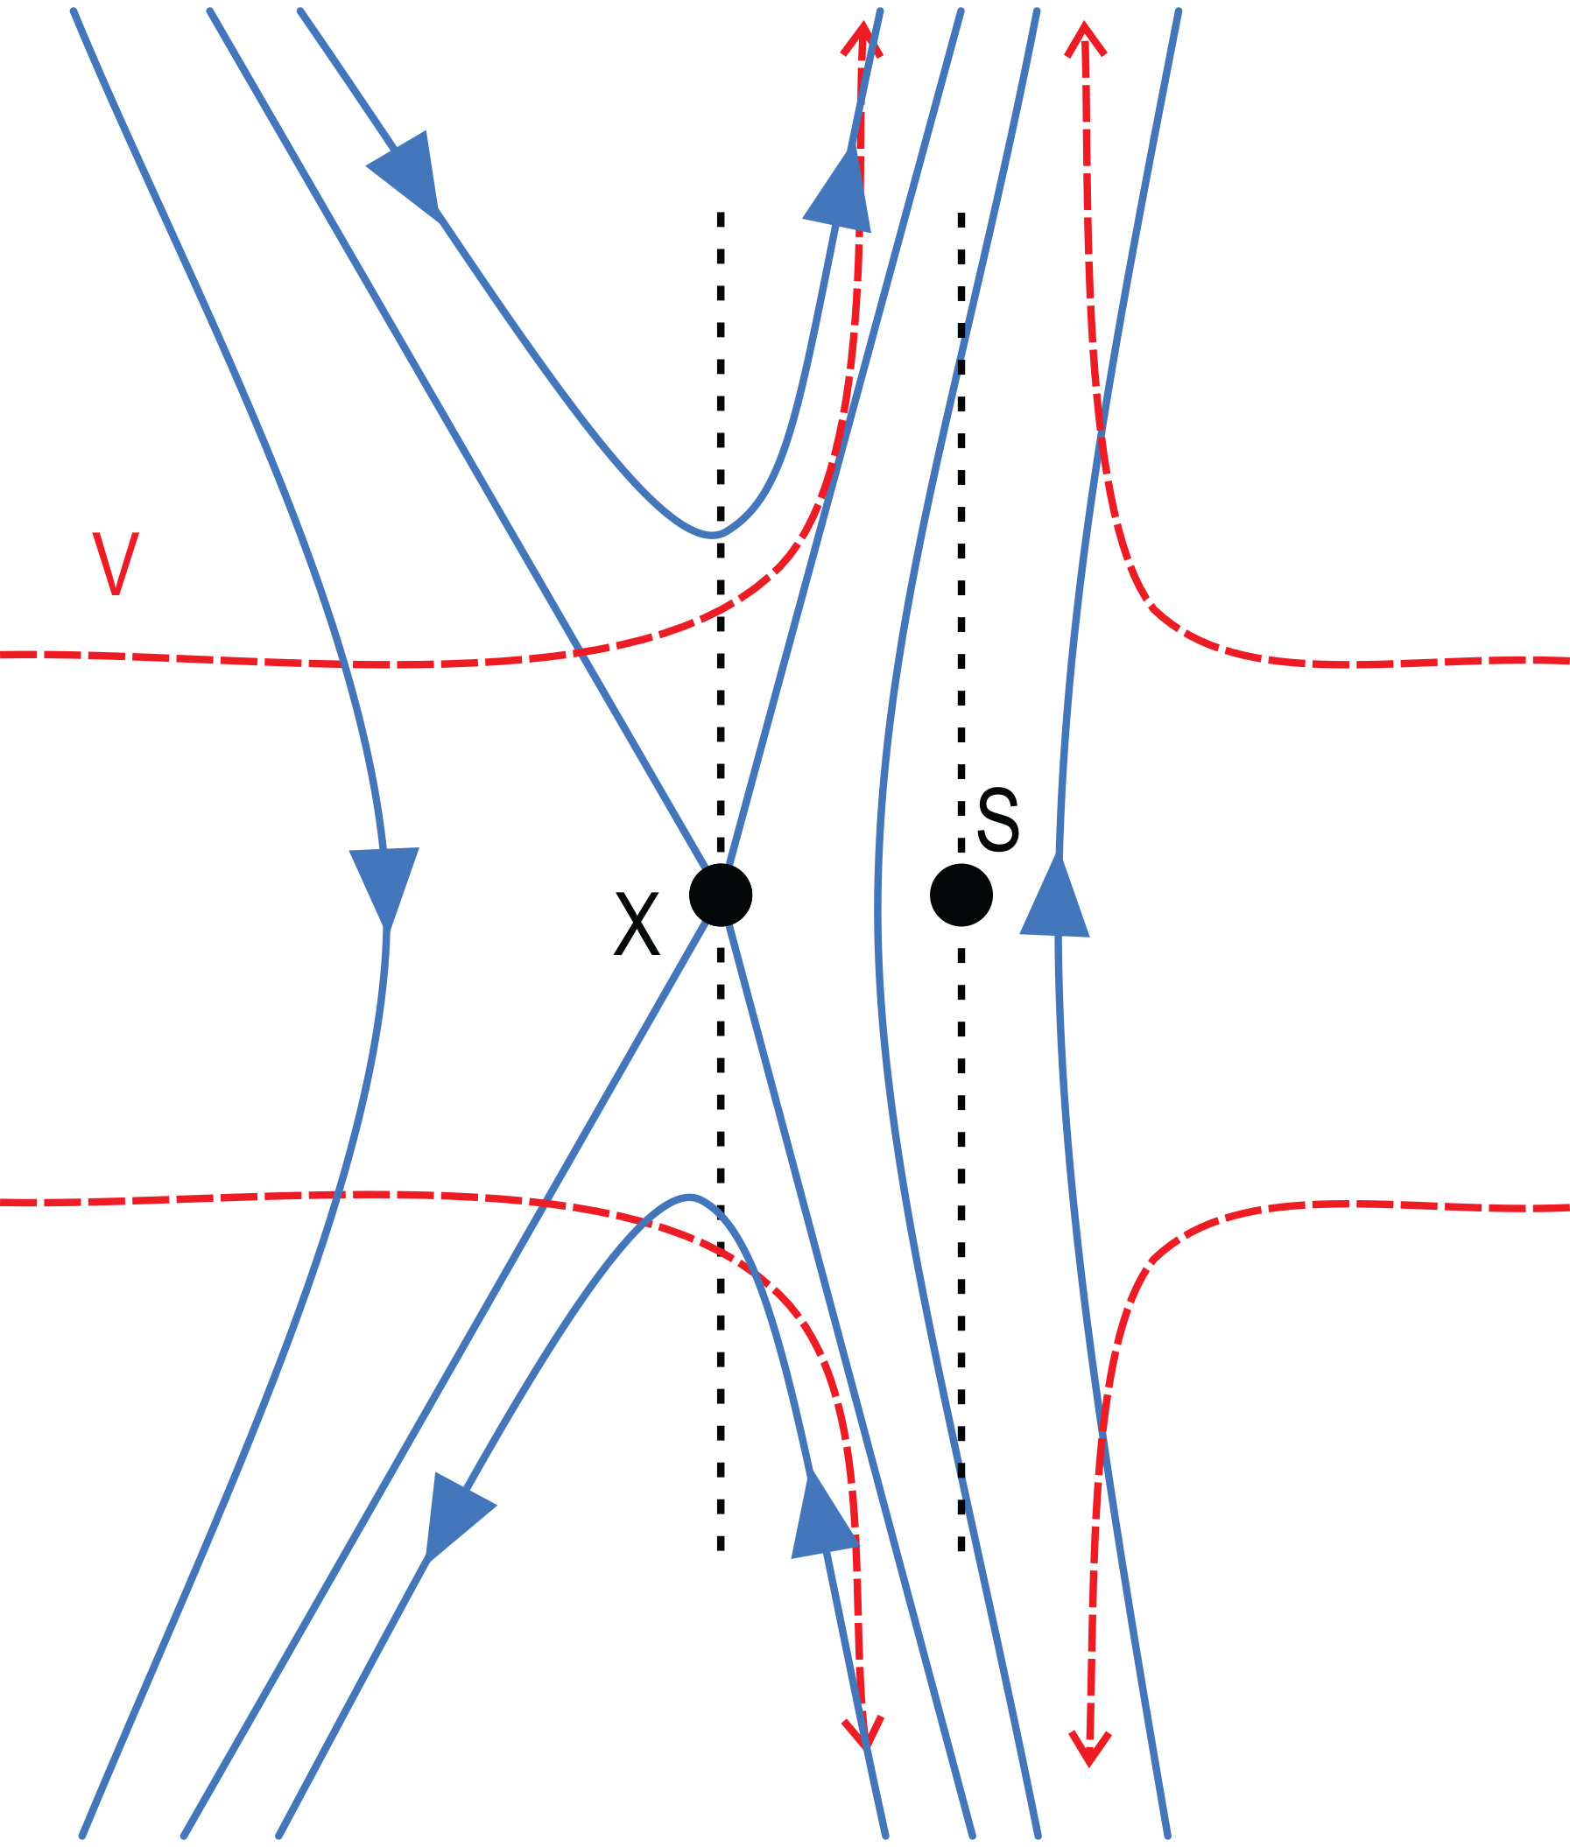
Asymmetric Reconnection at the Magnetopause
Since there is no magnetic flux across the X-line and there is no mass flux across the stagnation point, the X line (X) and the stagnation point (S) will only coincide for equal mass densities, inflow velocities and magnetic field strengths within each inflow region.
The much higher densities and velocities on the magnetosheath side overcome the somewhat higher magnetic field strength on the magnetosphere side to displace S toward the Earth from X.
At the kinetic scale there will be separate electron and ion stagnation points resulting from the larger gyroradii of ions.
Hess et al. (2014) predicted electron crescent distributions at the electron stagnation point, and these were observed by Burch et al. (2016).
This paper examines electron inflow and outflow at the stagnation point and draws conclusions about the electron-scale reconnection rate and the 3D nature of reconnection electron flows.
MHD Scale
Adapted from Cassak and Shay (2007)
by M. Argall

Slide 3
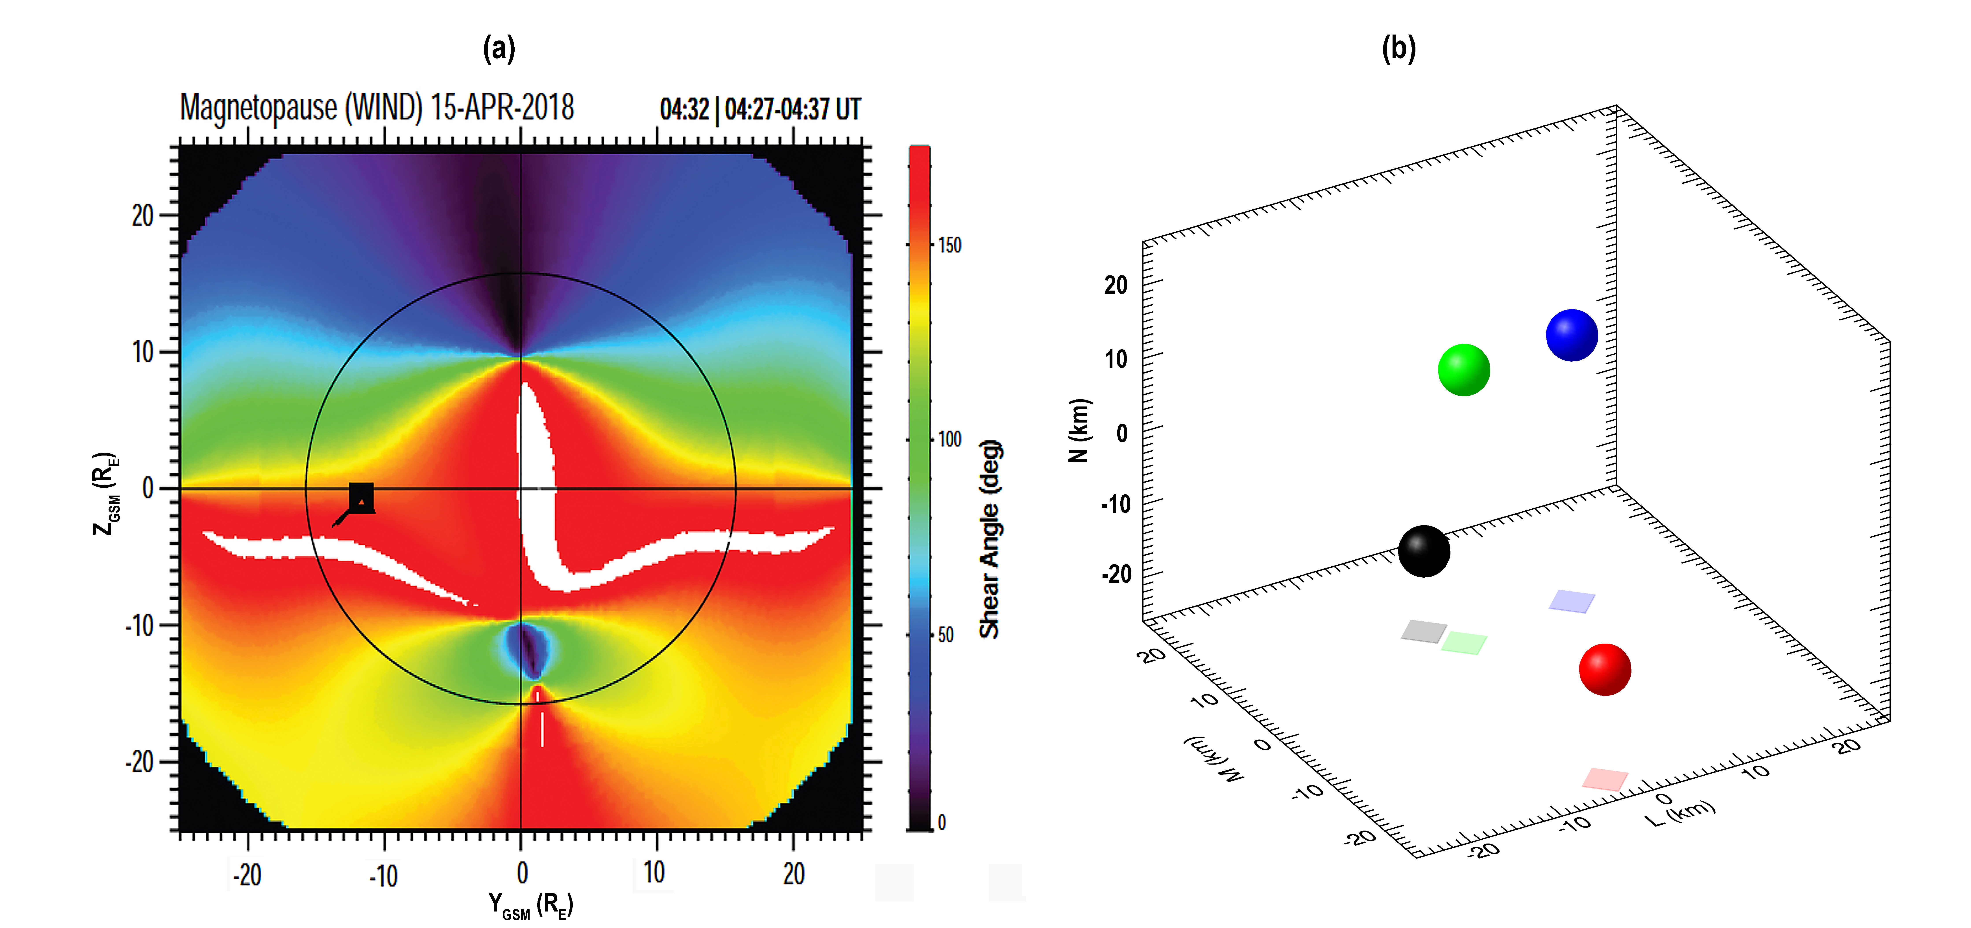
Reconnection Event on 15 April 2018
Shear between MS and MSP B fields
MMS at black box
Ion flow at line from box
MMS1 (black), 2 (red), 3 (green), 4 (blue)
Separations at ~15 km
LMN from joint variance analysis (Mozer and Retino, 2007; Genestreti et al., 2018)

Slide 4
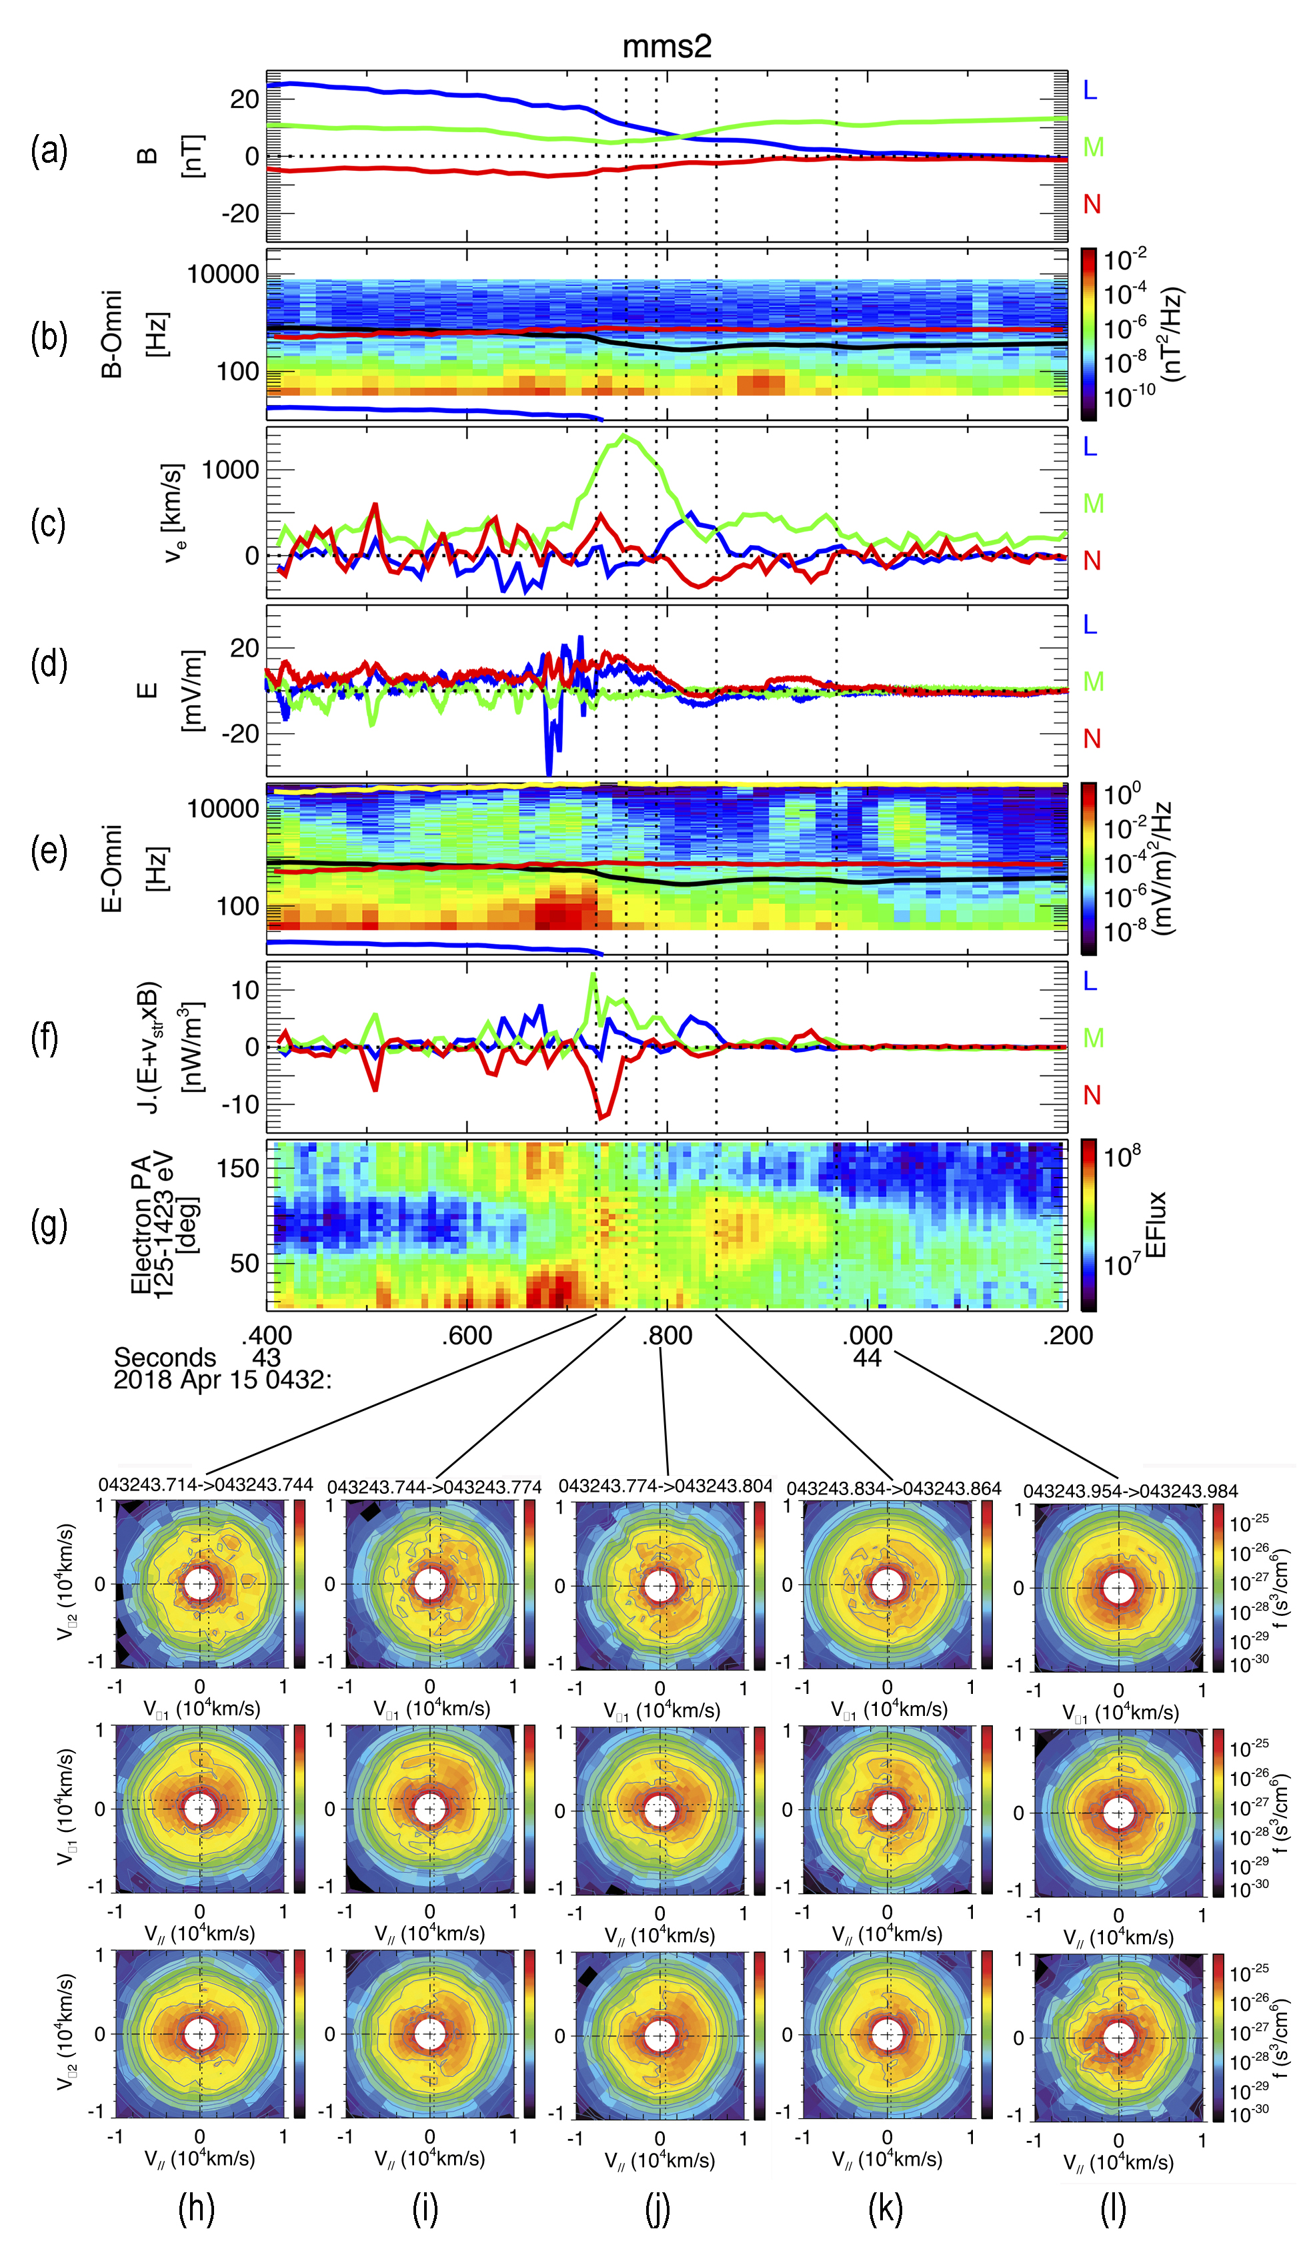
MMS2 Data on 15 April 2018
(a) MMS moved from MSP to MS with V_{N} ~ 23 km/s, V_{L} ~ 50 km/s, guide field ~0.4.
(b) Weak B waves except at lower hybrid (blue line).
(c) Electron velocity. Note inside red circle: strongest flow along M (out-of-plane current), bipolar flows in N (inflow velocity) and L (jet reversal)
(d) Turbulent E becomes laminar in EDR with highest values along N and L with weak E along -M (reconnection E field)
(e) Intense E waves above F_{ce} (black line) but mostly below F_{pe} (yellow line)--beam mode and Bernstein
(f) J⦁E in structure frame yields positive values along M (Torbert et al., 2020). Negative J⦁E along N and L
(g) Counterstreaming electrons (PA~0° and 180°) on the MSP side shift to trapped distributions (PA~90°) as the EDR is encountered except for a brief switch to mono-directional field-aligned electrons just after 43.8 s.
(h)-(l) The five vertical dotted lines denote times of the electron DFs in the bottom panel. Top row is in plane ⫠ to B while the bottom two rows are in plane containing B. Agyrotropies with perpendicular crescents occur at the five dotted lines with parallel crescents mixed in.

Slide 5
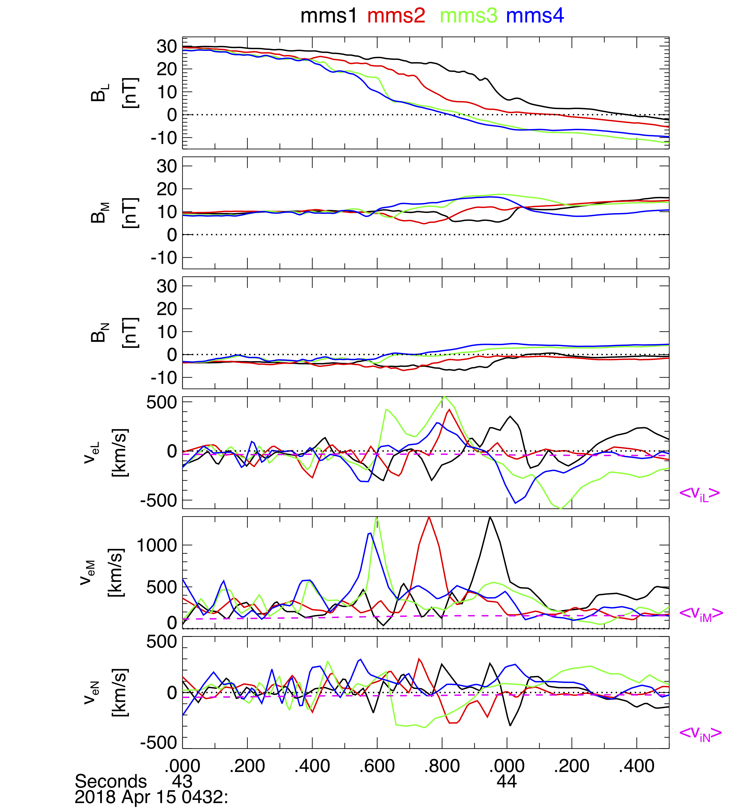
MMS1-4 Data on 15 April 2018
B and v_{e} for MMS1-4.
  Method of Schwartz (1998) used to determine flow velocity along N (~23 km/s) using peaks of v_{eM}.
  Note v_{eM} peak for MMS2 between red vertical lines and bipolar peaks in v_{eL} (jet reversals) and v_{eN} (converging inflows)
  Note similar patterns between vertical black lines for MMS1.
  Similar pattern can be seen for MMS3 but not for MMS4.
  Average ion velocities shown by magenta line with v_{iL} at ~ 50 km/s suggesting southward velocity of reconnection structure (Denton et al., 2016).

Slide 6
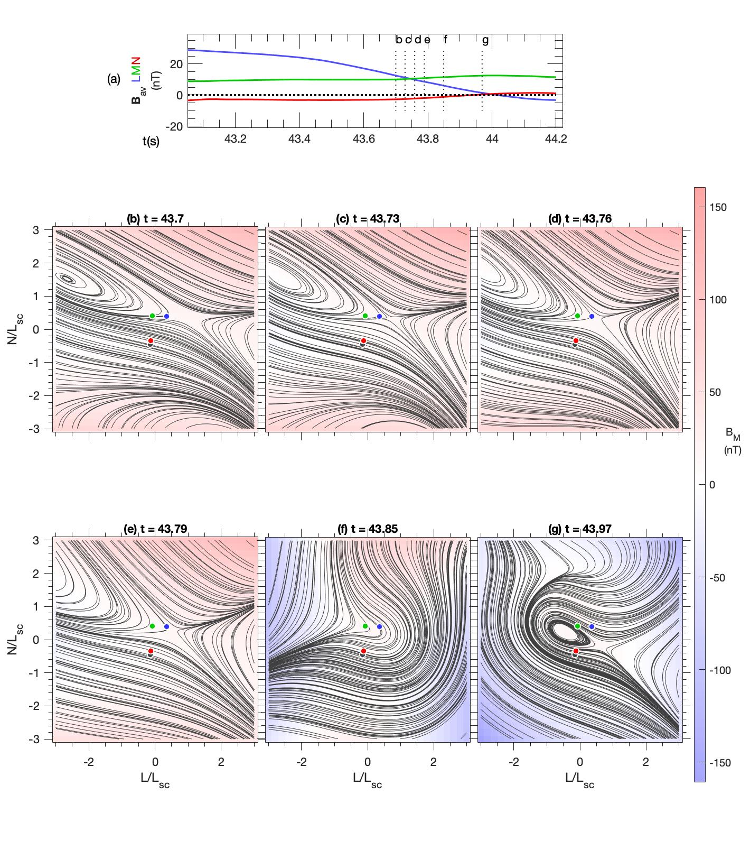
Reconstruction of 15 April 2018 Event
Reconstruction using polynomial method of Denton et al. (2020).
Color scale denotes B_{M}. Contours are magnetic field lines.
(a) Average B over MMS1-4. X line near 44.0 seconds.
(b) Reconstruction at 04:32:43.7 UT.
(c)-(g) Reconstruction at the five vertical dotted lines in the MMS2 data figure.
L_{SC} is average distance among the spacecraft, which is ~30 km.
Spacecraft start at southern edge of EDR and move toward its center.
MMS1 and 2 remain in the stagnation region, while MMS3 and 4 approach the X line.

Slide 7
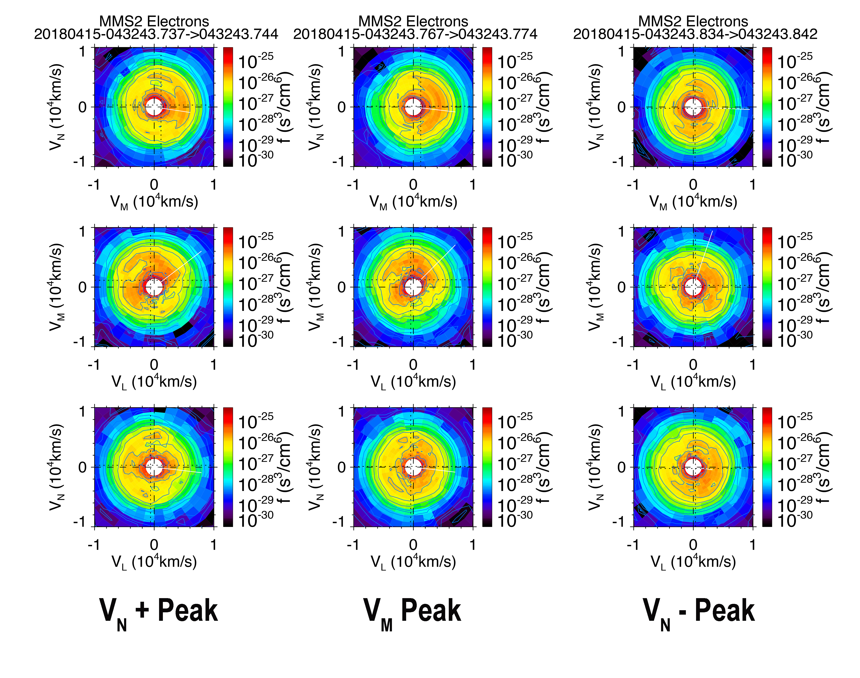
Electron Velocities and DFs for MMS2
(a)
(b)
(c)
(d)
(e)
(f)
7.5-ms DFs in LMN coordinates
Peaks in v_{eN} and v_{eM} are seen in DF plots, particularly in top row (perpendicular plane)
(a) B, (b) v_{eL} (c) v_{eM} (d) v_{eN} (e) v_{eA} (f) v_{eN}/ v_{eA}
Inflow velocity is ~ 0.05 - 0.1 times electron Alfvén speed

Slide 8
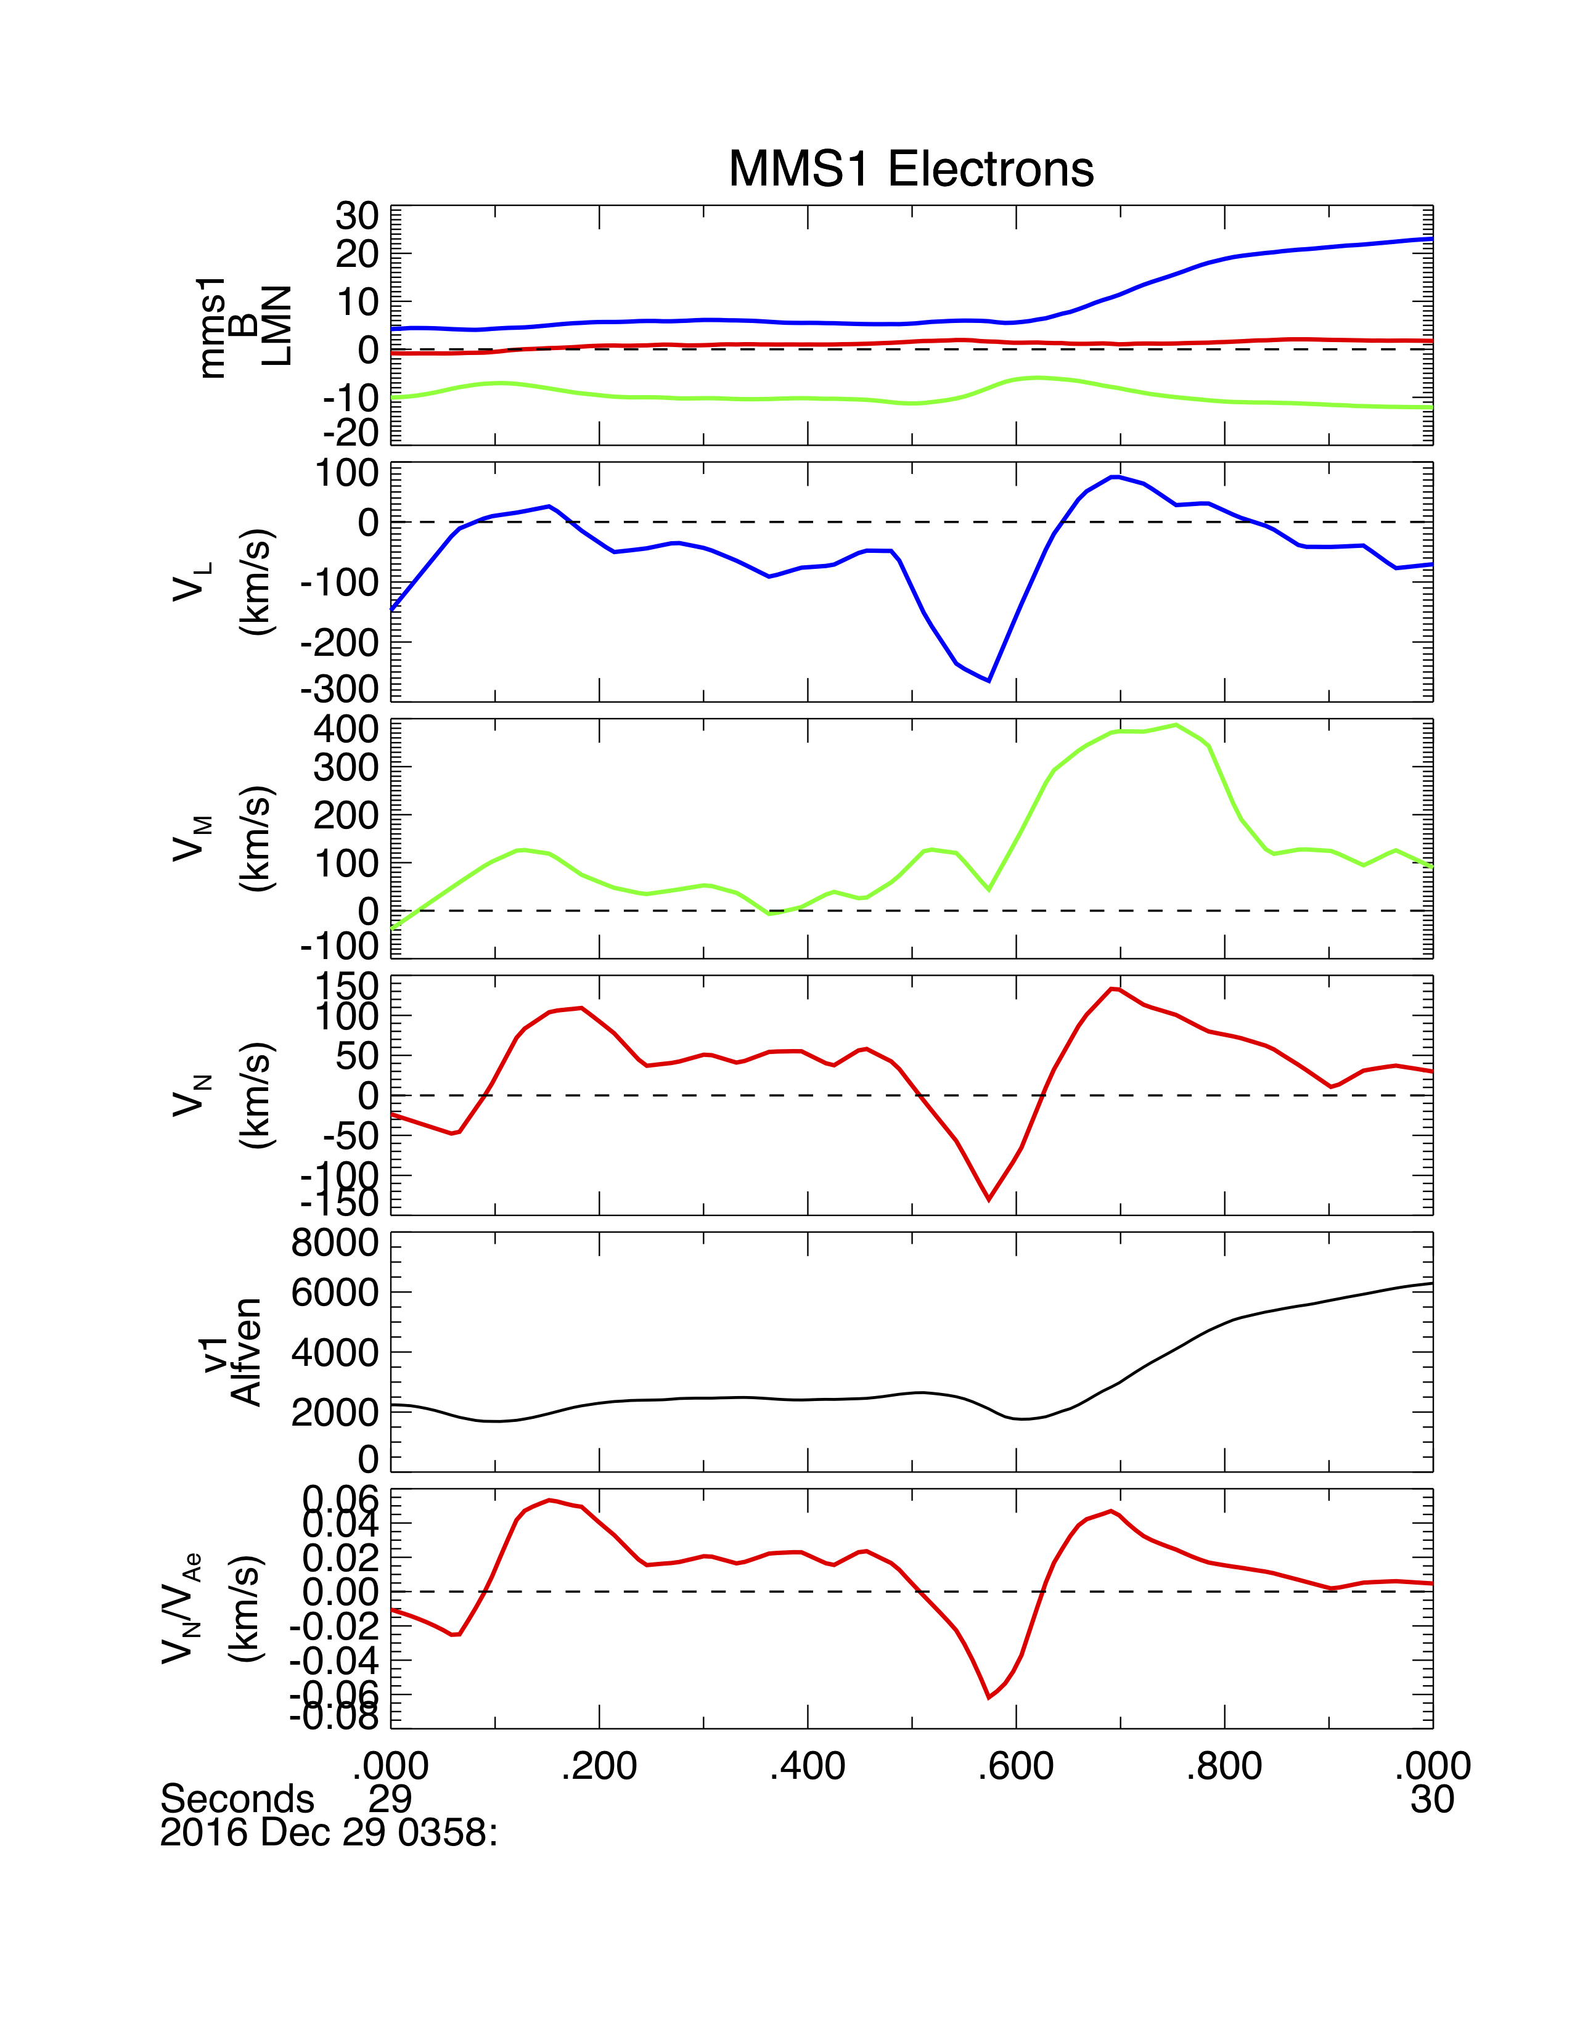
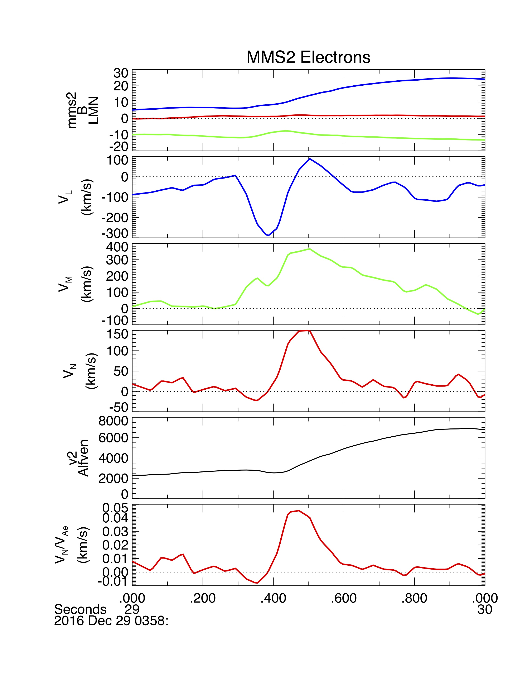
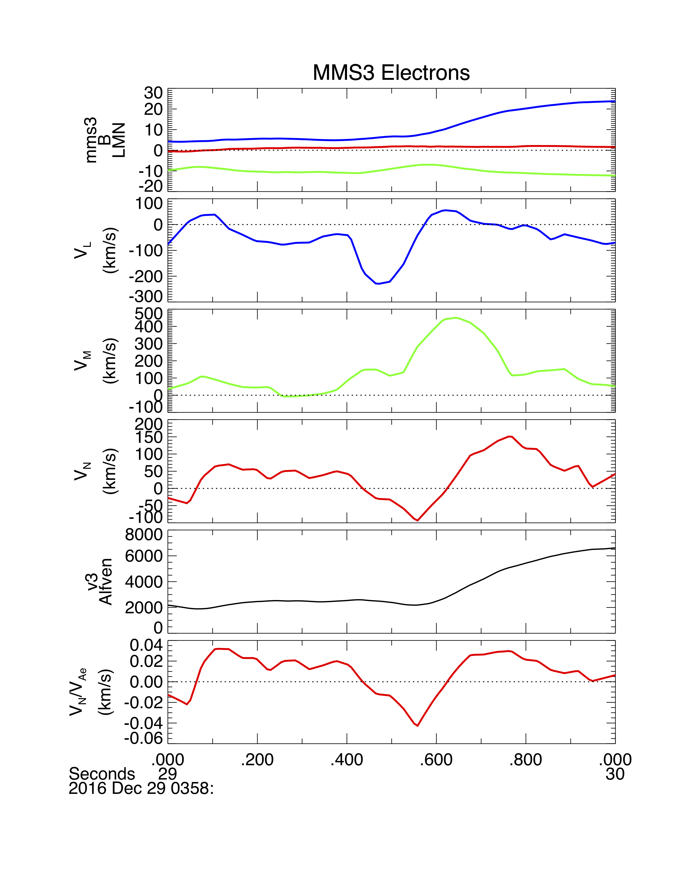
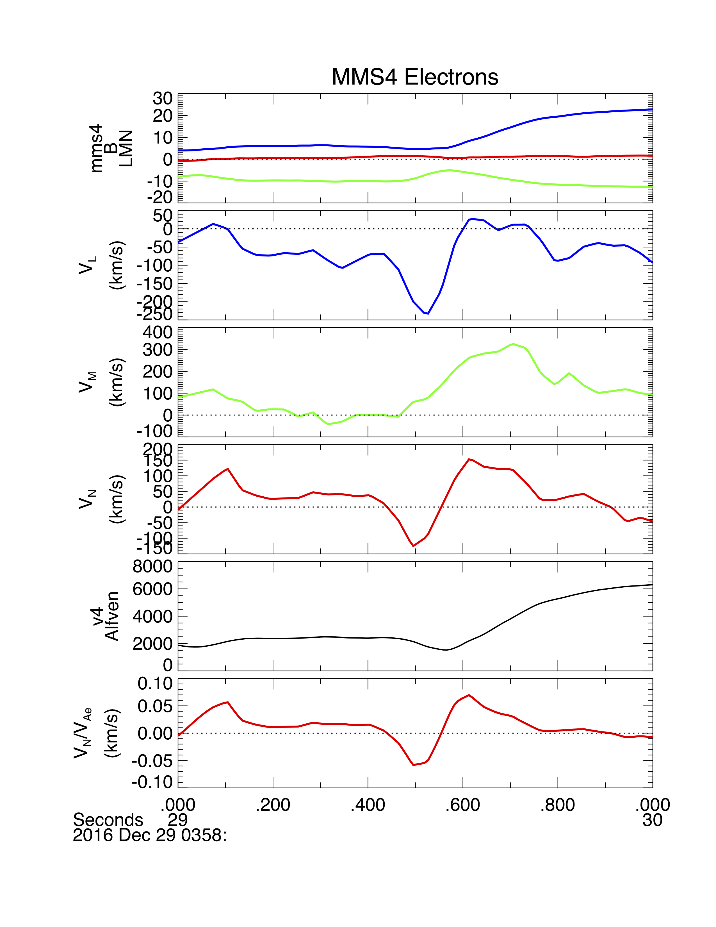
Electron Velocities for 29 December 2016
29 Dec. 2016 event with 7 km S/C separation (Pritchard et al., 2019). Inbound pass.
Electron jet reversal (2nd panel) with overlapping high v_{eM} (3rd panel) and v_{eN} inflows (4th panel).
Inflow velocity ~0.05 x electron Alfvén velocity.
v_{eM} > v_{eL} > v_{eN} as in 15 April 2018 event.

Slide 9
Summary and Conclusions
EDRs observed near electron stagnation point in numerous MMS events.
Electron flow velocities within the EDR follow a consistent pattern:
    Highest velocities are along M (out-of-plane reconnection current).
    Next highest velocities (~0.1 x electron Alfvén velocity, v_{eA}) are along L in jet reversals.
    Lowest velocities are along N (positive on Earthward side of EDR and negative on Sunward side of EDR. These are inflow velocities with magnitudes of ≤ 0.05 v_{eA}.
Conclusion is that multiple EDRs occur within electron stagnation region with reconnection rates ~0.05 and outflow velocities along L that are comparable to a few times the inflow velocities (still super-Alfvénic at ion speed).
At the electron scale reconnection is inherently 3D with outflows primarily along M.

