Slide 1




ACSIS
The North Atlantic Climate System Integrated Study
Alex Archibald
and the ACSIS aircraft team!
4th May 2020

Slide 2
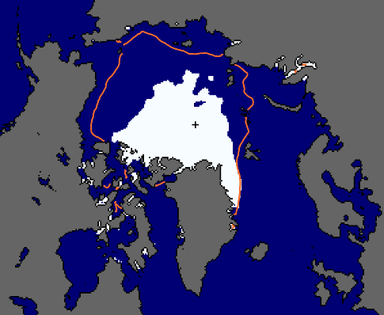
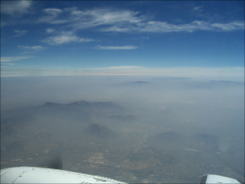
The North Atlantic Climate System: Integrated Studies: ACSIS
critical importance for the UK:
  weather and climate
  air quality
  shelf sea ecosystems & sea level
global impacts, e.g.:
  Arctic; sea level; monsoons
highly coupled:
  atmosphere-ocean-ice
  composition-climate
changing rapidly
JET
STREAM
Physical climate system
Atmospheric composition
Slides from Rowan Sutton
Notes:
Changes in NA directly affect the UK’s climate, weather, and air quality, with major economic impacts on agriculture, fisheries, water, energy, transport and health.
Example of remote impacts: changes in the NA affect African and Asian monsoons.
Link between ocean and atmosphere – warm, moist air tends to sit above warm water, cold, dry air sits over cold water – jet stream picture?
Greenland ice sheet is more to do with freshwater inputs -> ocean circulation and heat transport + regional sea level
Sea ice changes – need latest thoughts on Arctic – Atlantic teleconnections

Slide 3
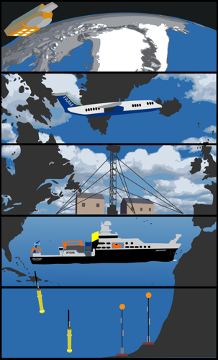
Sutton et al, BAMS, February 2018
Slides from Rowan Sutton

Slide 4

ACSIS Research Questions
How is the system changing?
  Quantifying multivariate changes
Why is the system changing?
  Atmospheric composition:
  emissions / chemistry / circulation
  Atmosphere-ocean-cryosphere physical system:
  natural variability & responses to anthropogenic forcings
How will it change in future?
  Will recent trends continue, accelerate or reverse?
  To what extent are changes predictable?
Focus on inter-annual to decadal timescales
Quantitative process-based attribution
Grand Challenge on Near-Term Prediction
Slides from Rowan Sutton
Notes:
How the system is changing - how are observed trends in different variables related?
Why the system is changing - what are the key drivers and how do they interact? Focus on coupled interactions.
Atmospheric composition: natural & anthropogenic emissions / chemistry / circulation
Atmosphere-ocean-cryosphere system: natural variability and responses to anthropogenic forcings
What changes should we expect in future - will recent trends be sustained, accelerate or slow, or might they reverse, temporarily or permanently?
N. Atlantic has been identified as the region with greatest potential for multi-year / decadal predictions
More specific questions that ACSIS will address include:
1. What effect have changes in emissions up-wind of the NA had on atmospheric composition?
2. What is the magnitude of recent changes in aerosol radiative forcing, and what factors have governed these changes?
3. What factors have governed trends in the North Atlantic Oscillation?
4. How and why are the NA MOC, heat content and SST changing on decadal timescales?
5. What has been the impact of trends in the NA atmosphere and ocean on Arctic sea ice and what could the impact be in future?

Slide 5
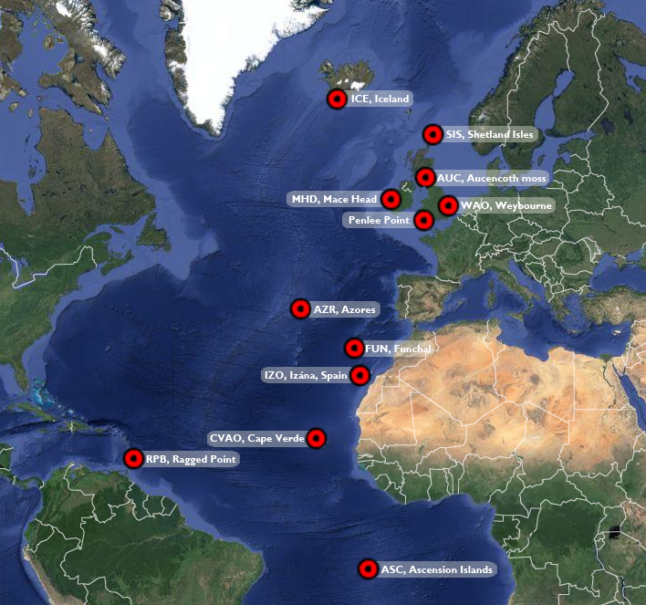
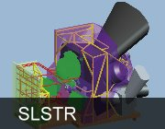
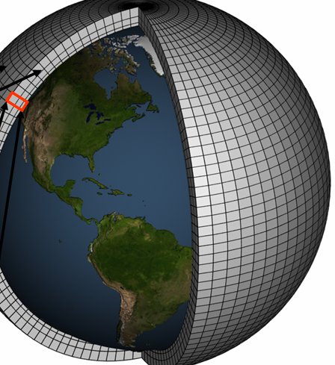
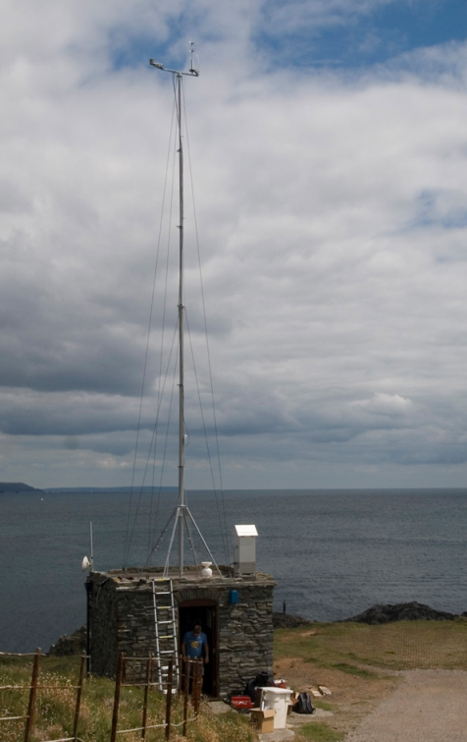
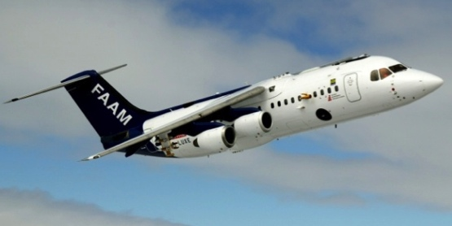
Objectives of composition theme
Through sustained observations, quantify how atmospheric composition and physics are changing in the NA basin.
Through bespoke model simulations, identify the causes of change in the NA basin.
Through engagement with the community, enable fundamental studies into atmospheric composition, climate and their interactions.
Satellite
Aircraft
Modelling
Ground based

Slide 6
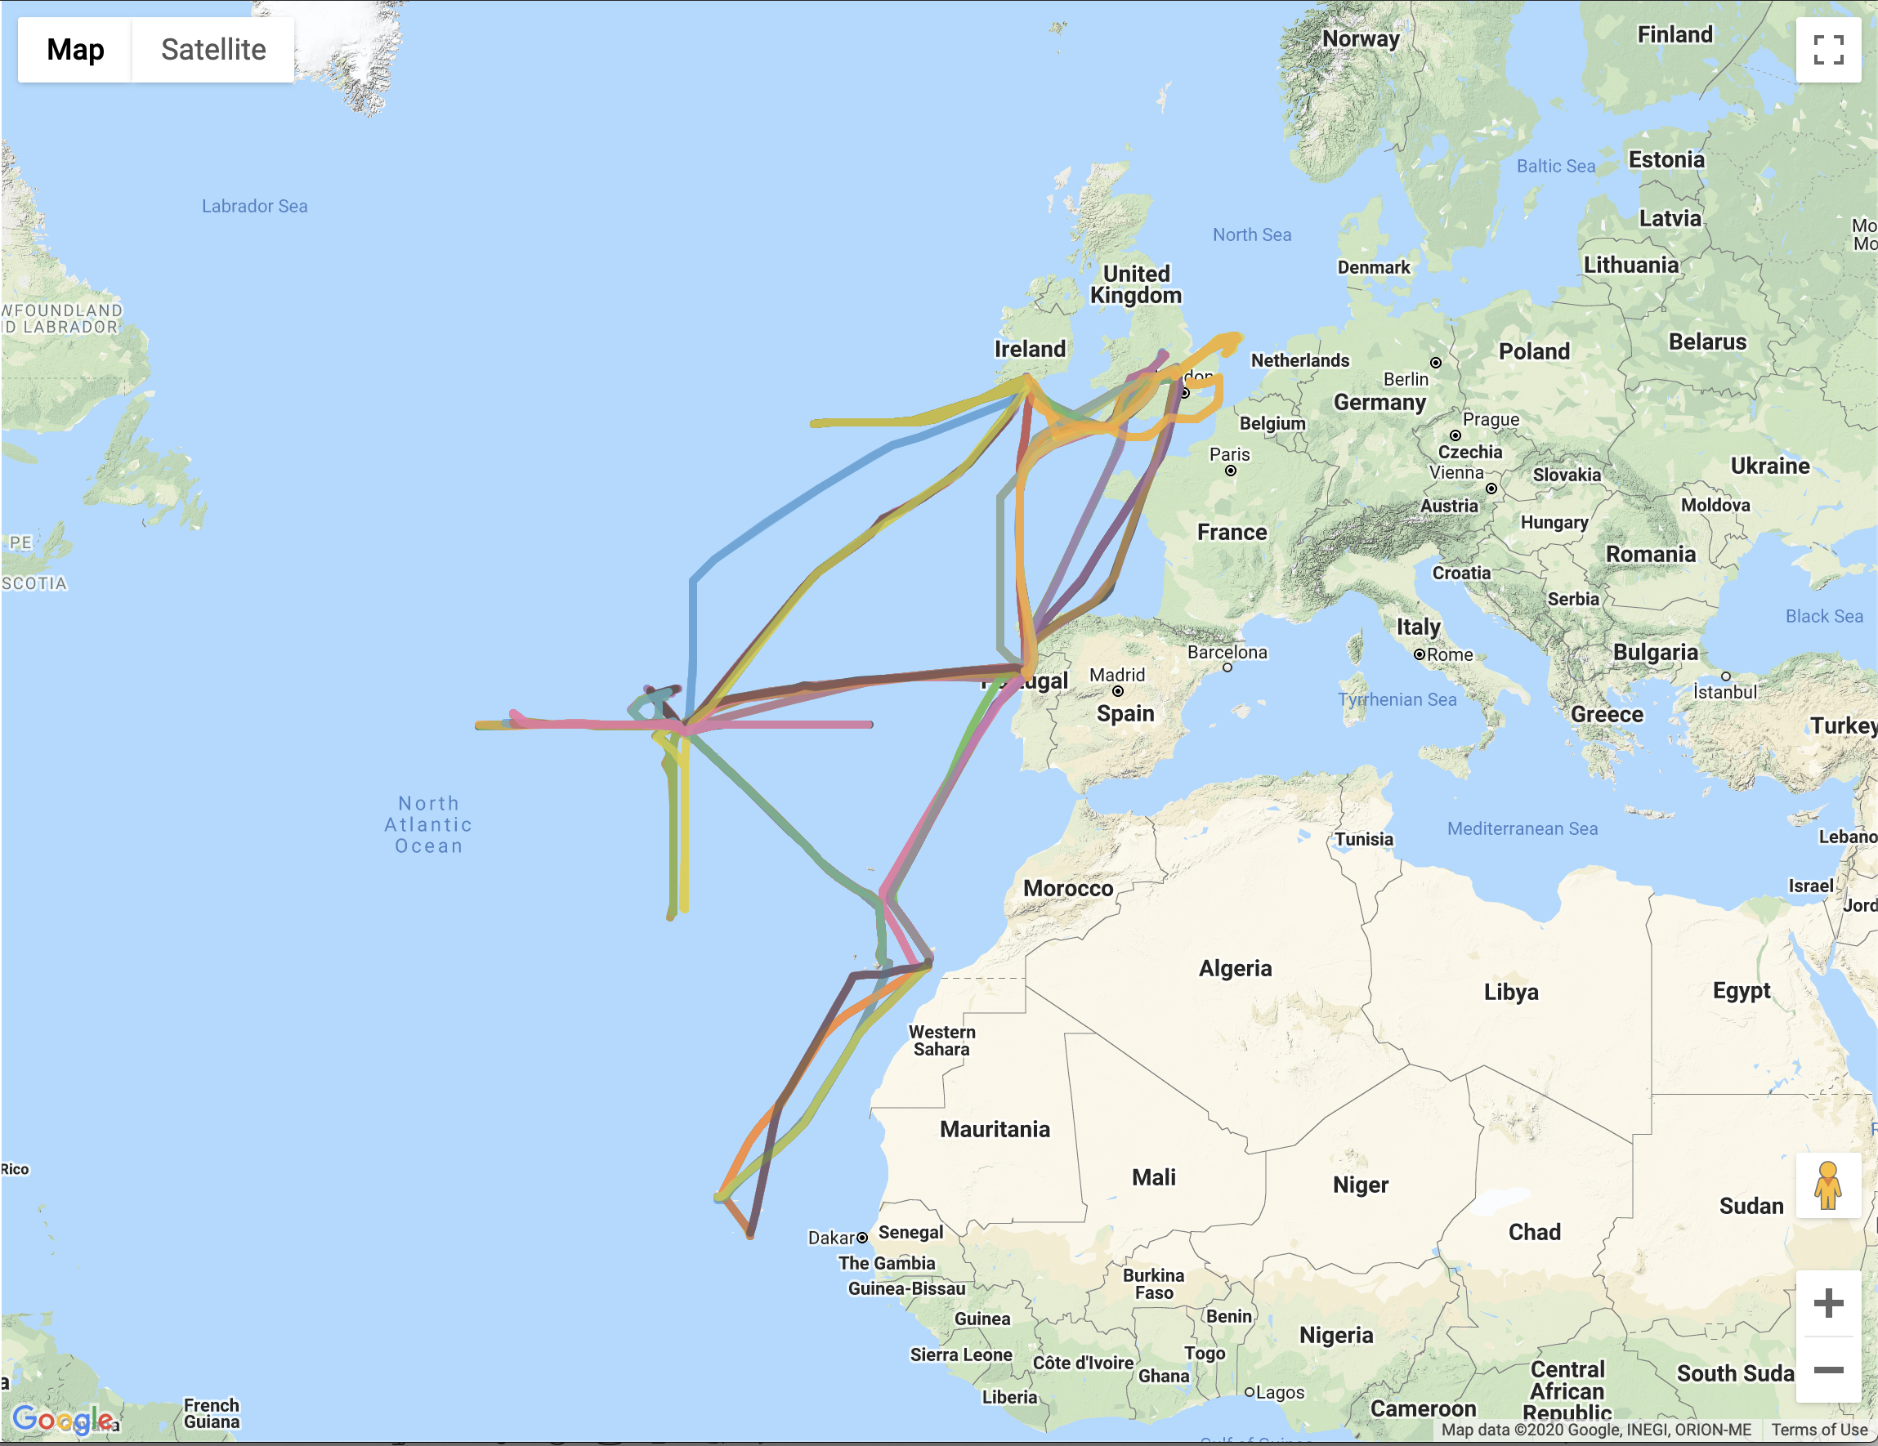
Aircraft missions overview:
Repeated sampling of the North Atlantic Region.
Main base of operation in Lajes (Azores).
Azores provide great opportunity for sampling background atmosphere.
US DOE site (ENA) provides core ground based measurements.

Slide 7
ACSIS Aircraft Missions Vertical profiles – examples from Cape Verde
Out
Back
10 mins
10 mins
10 mins
5000m
5 mins
5 mins
10 mins
5 mins
10 mins
10 mins
15 mins
3000m
Free Trop
5 mins
5 mins
10 mins
Boundary layer
15 mins
10 mins
1000m
5 mins
10 mins
5 mins
10 mins
200m
10 mins
10 mins
CVAO flypast
Ocean
Cape Verde

Slide 8
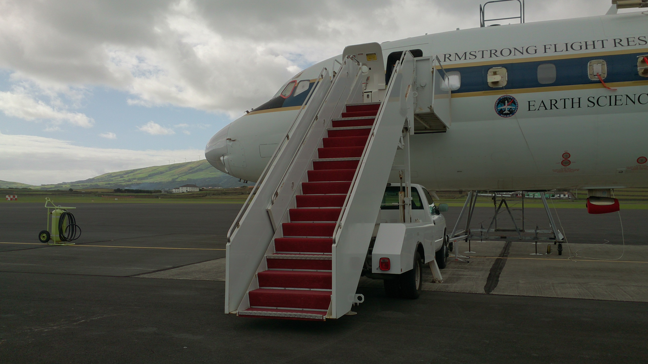
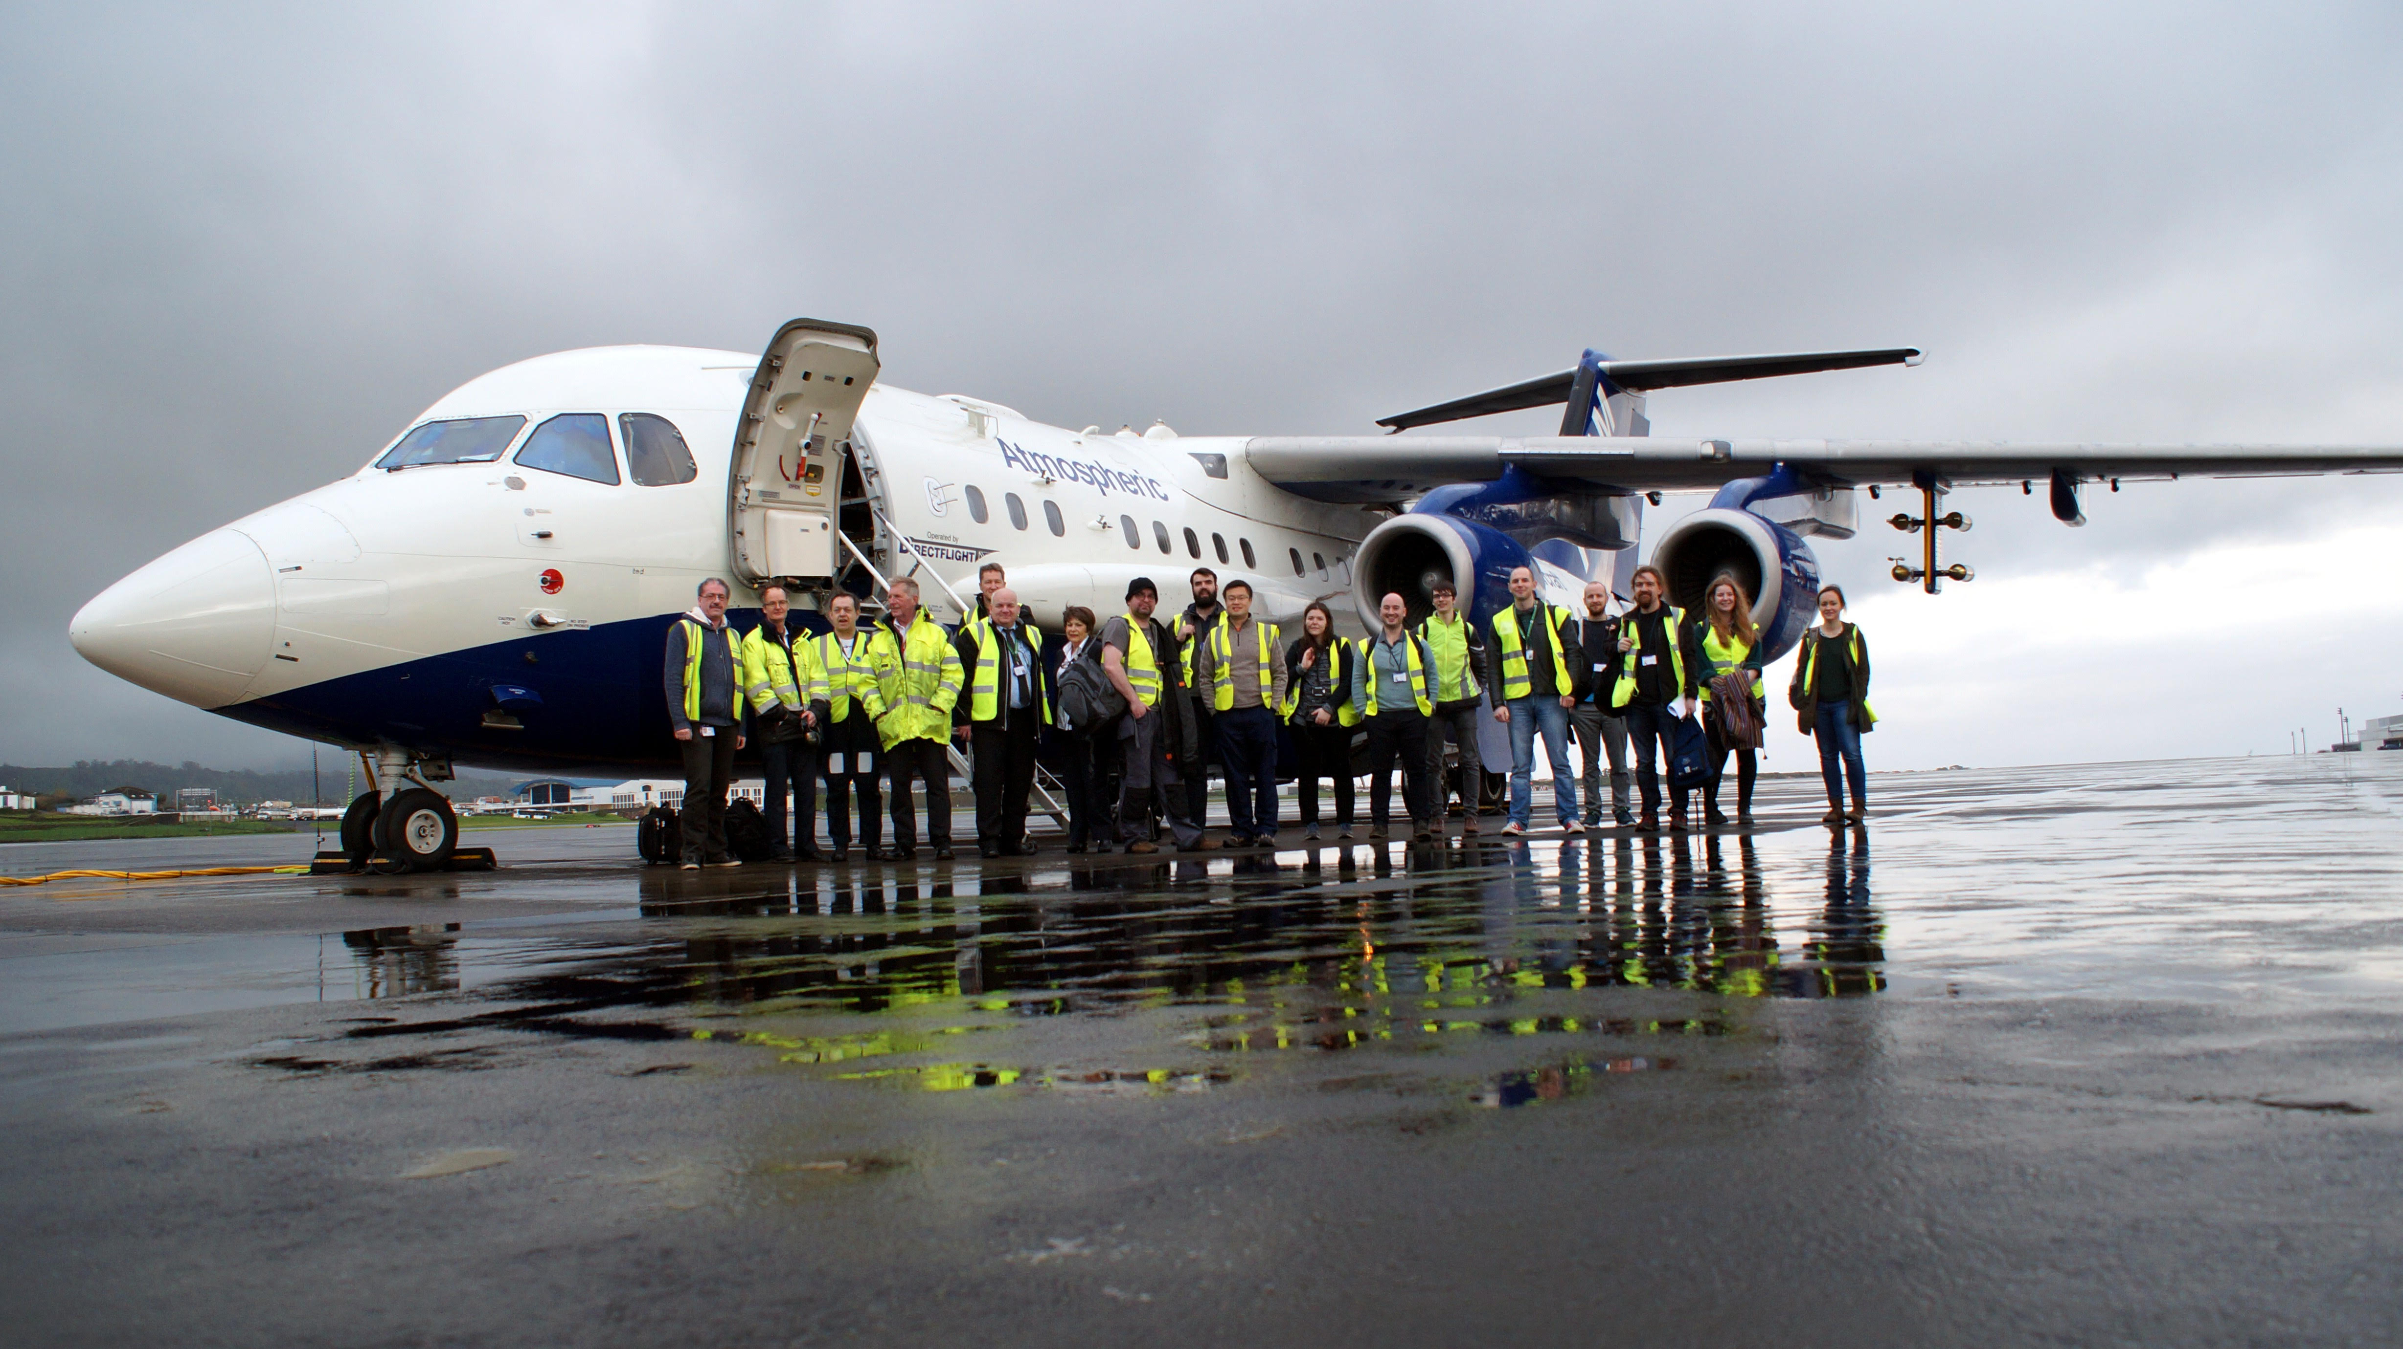
Aircraft missions: Feb 2017, Oct 2017, May 2018, Feb 2019, Aug 2019, Feb 2020, July 2020
We made three links with the NASA ATom campaign
NASA ATom DC-8
NERC ACSIS BAe-146

Slide 9
Example of comparison between ACSIS and ATom
Figures from Tom Ryerson – thanks!

Slide 10
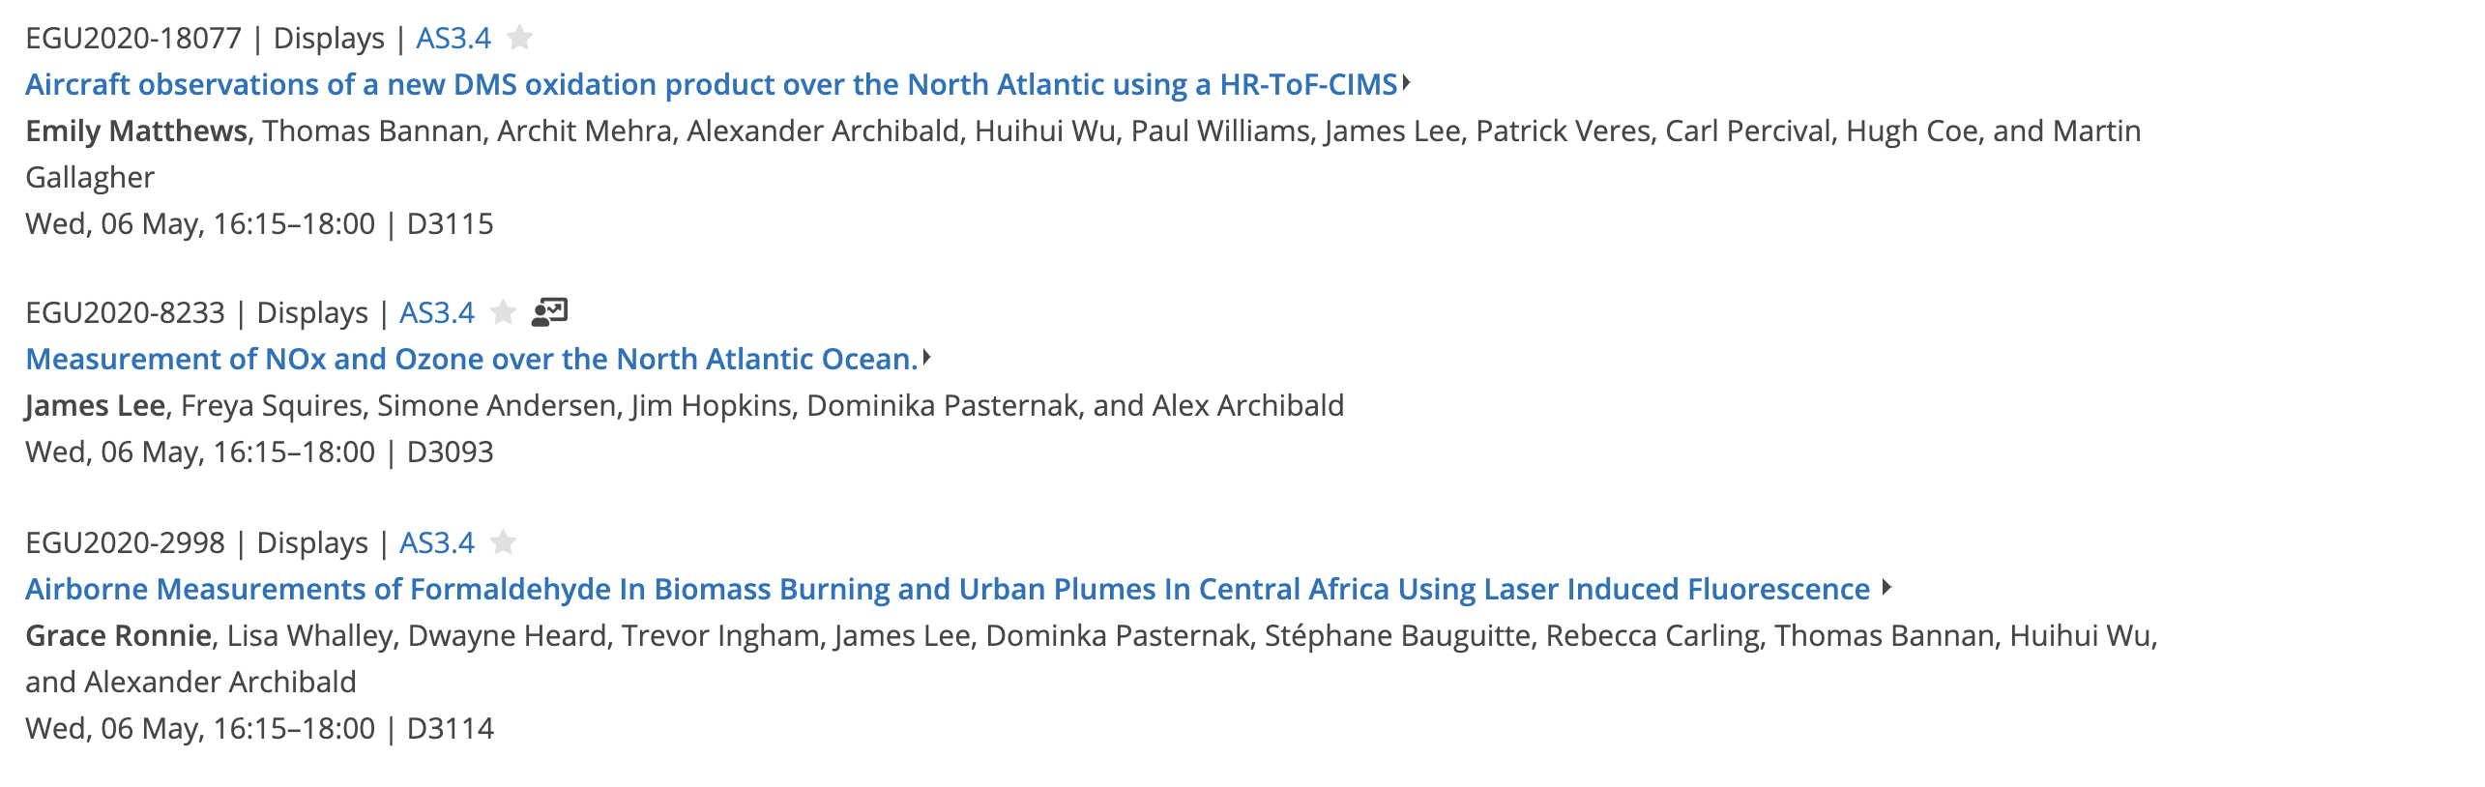
Next steps
Several analyses are under way and on display!
Hopefully we will be able to re-schedule cancelled flights.
Interested to partner with other aircraft campaigns and field campaigns in the NA region – get in touch!

