Slide 1
Evaluation and projection of long period return values of extreme daily precipitation in the CMIP5 and CMIP6 models
Michael F. Wehner
Lawrence Berkeley National Laboratory
Peter Gleckler, Jiwoo Lee
Lawrence Livermore National Laboratory
European Geophysical Union, May 5, 2020

Slide 2
US DOE Policy 411.2A
SUBJECT: SCIENTIFIC INTEGRITY
When expressing opinions on policy matters to the public and media, research personnel must make it clear when they are expressing their personal views, rather than those of the Department, the U.S. Government, or their respective institutions. Public representation of Government or DOE positions or policies must be cleared through their program management to include DOE headquarters.
In accordance with this policy, any material in this presentation should be considered the opinion of the speaker and not necessarily that of the US Dept. of Energy, the University of California or the Lawrence Berkeley National Laboratory.

Slide 3
Are there any differences in simulated extreme precipitation in CMIP6 compared to CMIP5?
CMIP6 horizontal resolution is not that different from CMIP5
In the mainstream “historical” models, most of the finest are near 100km. A very few at 50.
HighResMIP up to 20km.
Any differences would mostly be due to formulations.

Slide 4
Are there any differences in simulated extreme precipitation in CMIP6 compared to CMIP5?
Rx1day
Annual, boreal winter, boreal summer maximum daily precipitation rate
Mean
20 year return value from non-stationary GEV
ln CO2 as covariate (non-linear time)
1951-2004 reference period
REGEN-Rainfall Estimates on a Gridded Network (Contractor et al. 2011)
Gridded global land daily precipitation 1ºx1º
HadEX3: global land Rx1day 1.875ºx1.25º
The order of operations is different!

Slide 5
Annual Rx1day compared to REGEN

Slide 6
Annual Rx1day compared to REGEN
CMIP5
CMIP6
CMIP5 and CMIP6 models are intermixed

Slide 7
Boreal winter errors larger than annual

Slide 8
Boreal winter skill smaller than annual
CMIP5
CMIP6
Pattern correlation of return values is nil

Slide 9
Boreal summer errors smaller than winter but larger than annual

Slide 10
Boreal summer skill smaller than annual
CMIP5
CMIP6
Summer is less clustered than winter

Slide 11
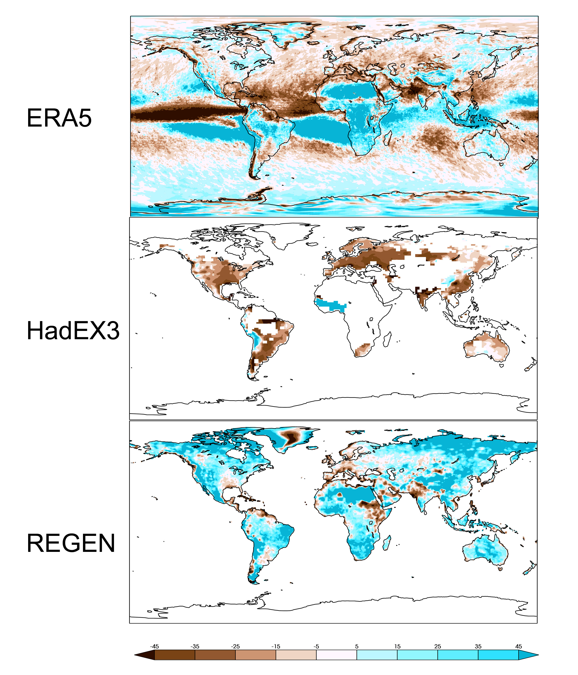
Large differences if HadEX3 is the reference
Annual Rx1day errors
This is not unexpected.
Extremes occur at different stations within a grid box on different days.
Averaging station Rx1day is larger than calculating Rx1day on cellular daily precipitation
This is inappropriate for model evaluation.
Gervais et al (2013)
REGEN: models too wet
HadEX3: models too dry.
ERA5: models are mixed.

Slide 12
Projections
IPCC AR6 WG1, chapter 11 will present future changes at “global warming targets”.
1.5, 2.0, 3.0, 4.0 above preindustrial GMT
Extracted from transient runs, not a stabilized target
CMIP5: RCP4.5, 6.0, 8.5
CMIP6: SSP245, SSP370, SSP585
Effectively removes transient climate sensitivity
Trades uncertainty in the magnitude for uncertainty in the timing

Slide 13
CMIP6 time to target
Model | 1.5 |  |  | 2 |  |  | 3 |  |  | 4
 | ssp245 | ssp370 | ssp585 | ssp245 | ssp370 | ssp585 | ssp245 | ssp370 | ssp585 | ssp245 | ssp370 | ssp585
BCC-CSM2-MR | 2035 | 2032 | 2030 | 2057 | 2046 | 2043 | - | 2074 | 2065 | - | - | -
BCC-ESM1 | x | 2041 | x | x | - | x | x | - | x | x | - | x
CESM2ª | 2026 | 2025 | 2024 | 2041 | 2041 | 2035 | 2081 | 2066 | 2053 | - | 2084 | 2069
CNRM-CM6-1 | 2030 | 2032 | 2028 | 2048 | 2045 | 2040 | 2084 | 2066 | 2058 | - | 2083 | 2072
CNRM-ESM2-1 | 2037 | 2036 | 2032 | 2055 | 2052 | 2045 | 2088 | 2072 | 2064 | - | 2089 | 2079
CanESM5 | 2013 | 2013 | 2012 | 2024 | 2023 | 2022 | 2049 | 2043 | 2040 | 2083 | 2059 | 2054
EC-Earth3 | 2022 | 2022 | 2024 | 2044 | 2038 | 2035 | 2085 | 2063 | 2057 | - | 2084 | 2073
EC-Earth3-Veg | 2010 | 2011 | 2011 | 2033 | 2032 | 2027 | 2067 | 2057 | 2050 | - | 2076 | 2067
GFDL-CM4 | 2031 | x | 2029 | 2049 | x | 2041 | - | x | 2059 | - | x | 2079
IPSL-CM6A-LR^{b} | 2018 | 2019 | 2018 | 2033 | 2034 | 2034 | 2065 | 2055 | 2050 | - | 2076 | 2066
MRI-ESM2-0^{c} | 2030 | 2031 | 2026 | 2049 | 2045 | 2038 | - | 2073 | 2064 | - | - | 2083
UKESM1-0-LL | 2023 | 2022 | 2023 | 2034 | 2031 | 2031 | 2059 | 2050 | 2046 | 2090 | 2069 | 2060
Courtesy of Matthias Hauser, ETH Zurich

Slide 14
Mean annual Rx1day change
Hatching: projected change less than cross model standard deviation
Less hatching than for a change at a specific time. That uncertainty is transferred to the time of the target.

Slide 15
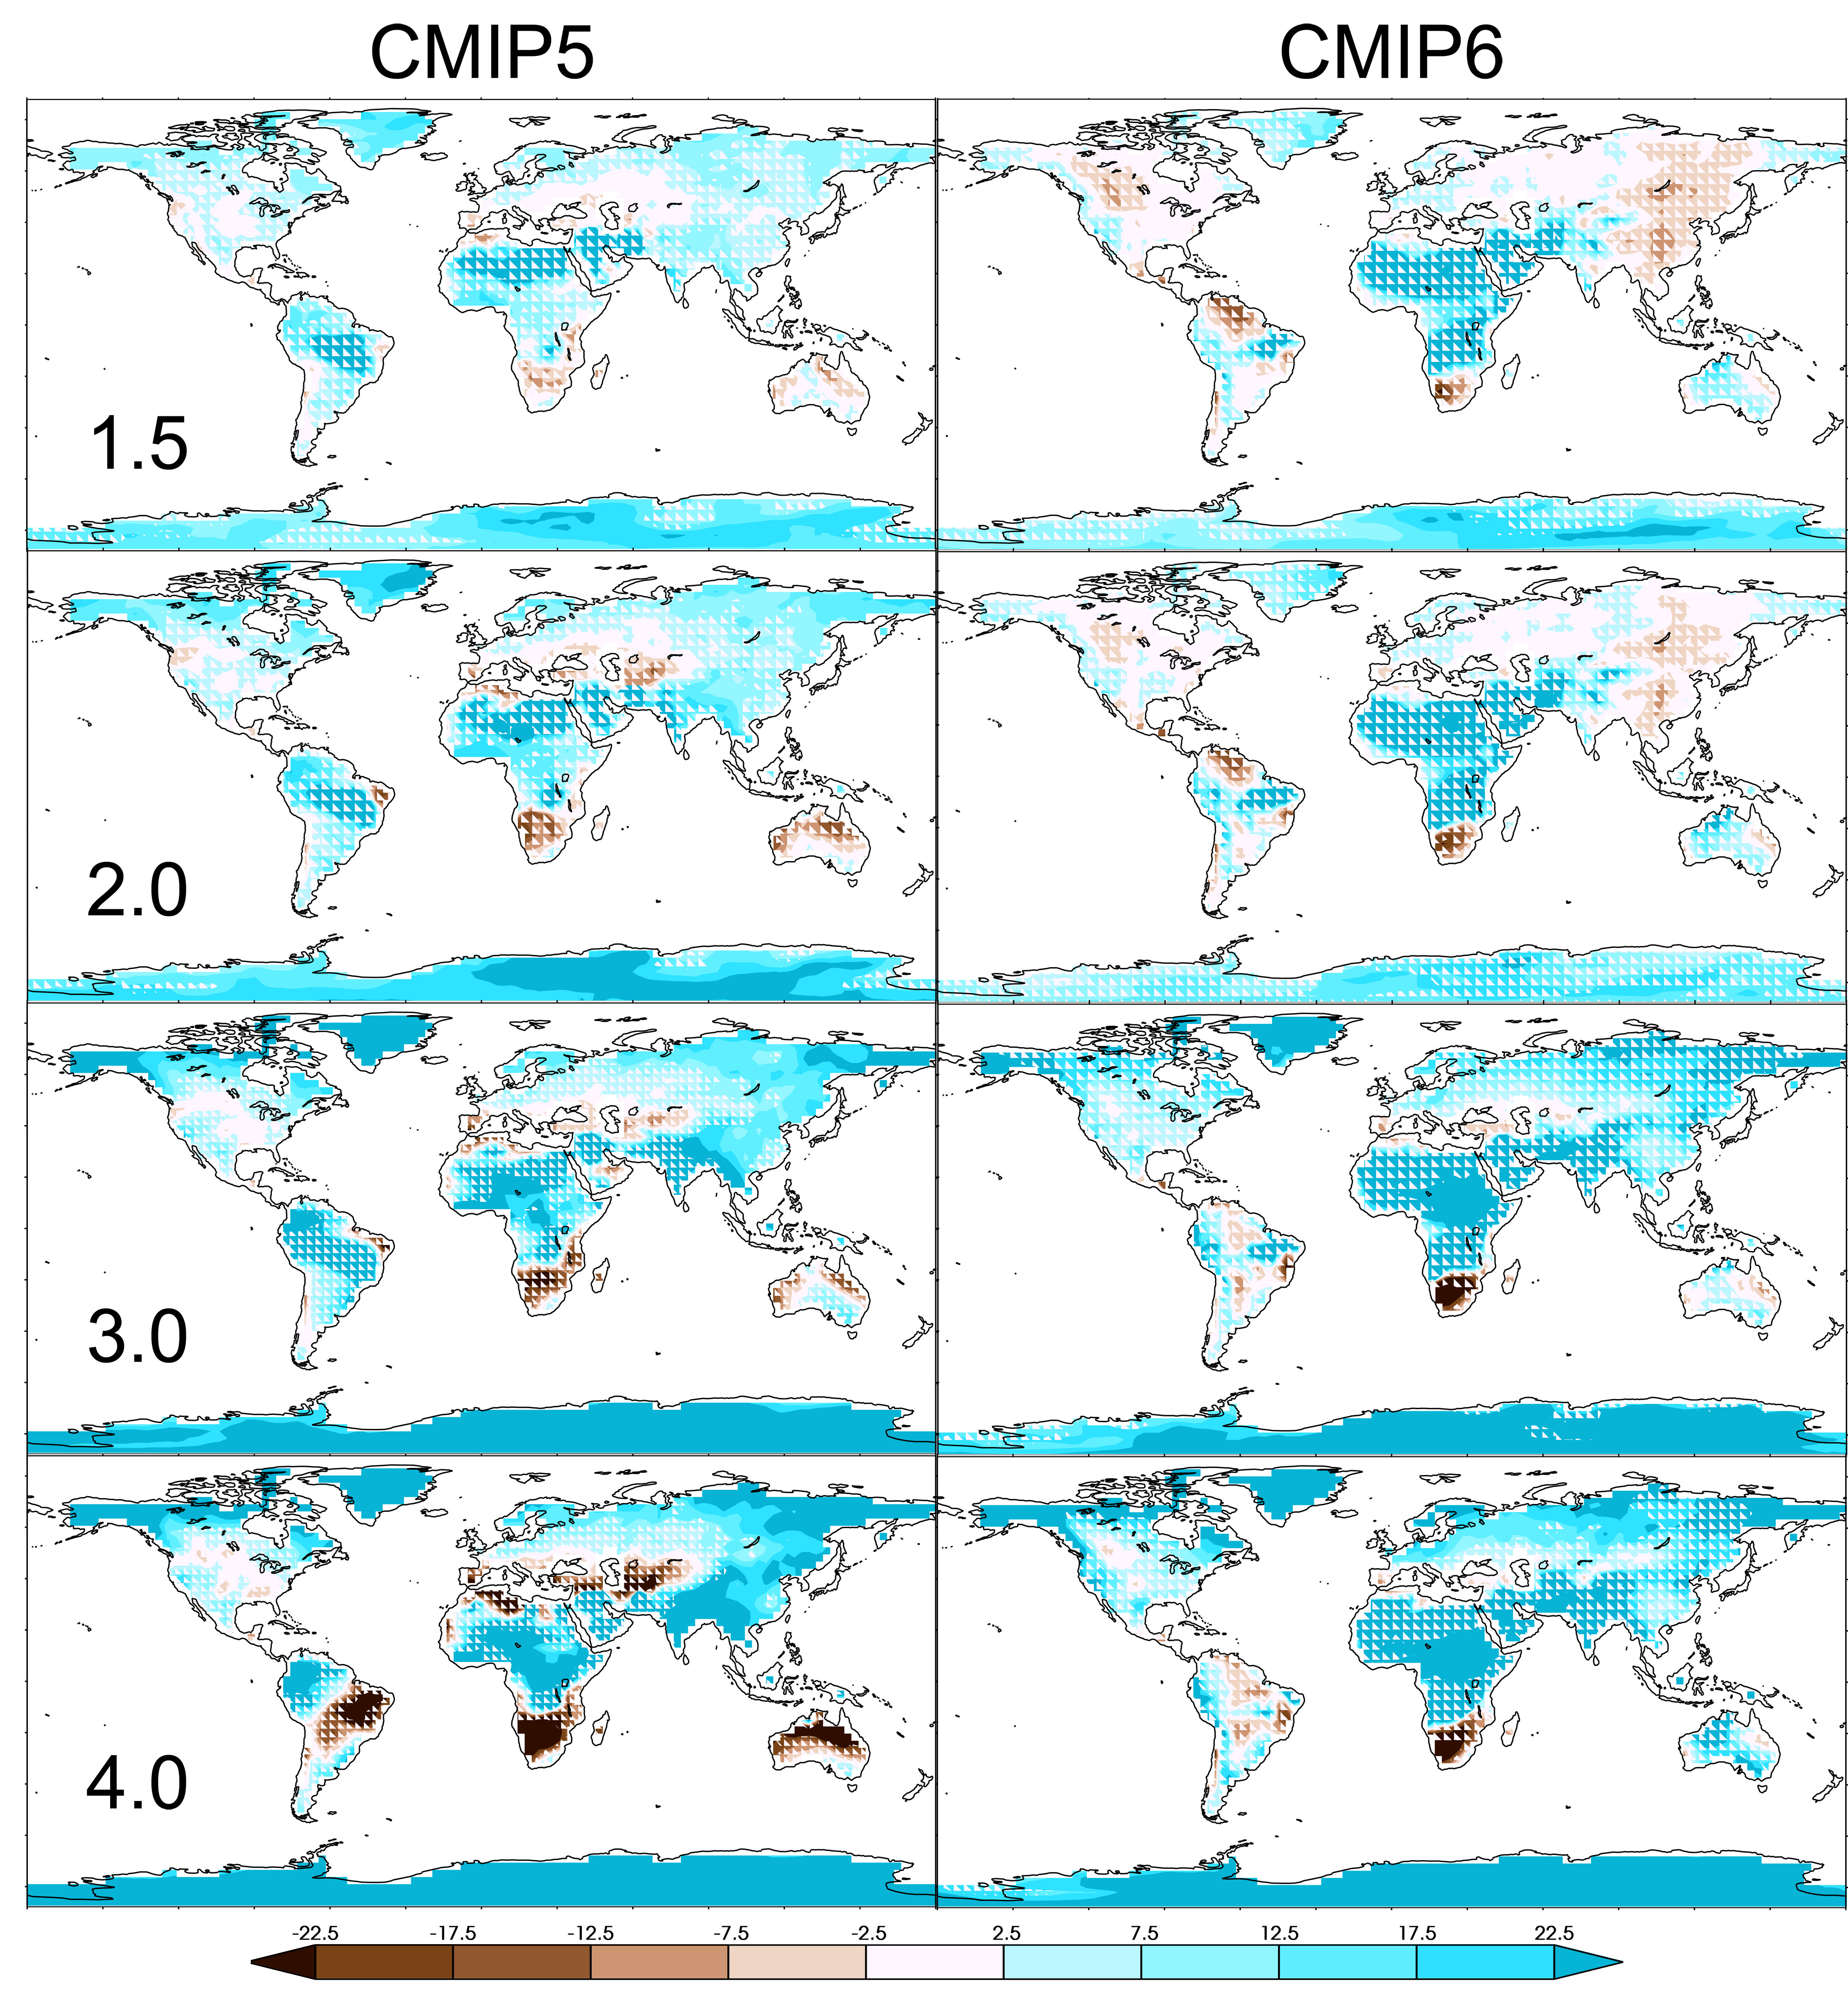
Seasonal mean Rx1day change
Winter Summer

Slide 16
Conclusions
Rx1day errors are correlated to mean precipitation errors.
Both annually and seasonally
Little skill in simulating 20 year daily precipitation return values.
CMIP5 and CMIP6 errors exhibit no real differences in skill.
Projections framed by (moving) global warming targets.
Roughly follows Clausius-Clapeyron at these grid sizes.
Winter % change larger than annual % change.
Summer % change smaller than annual % change.
No significant difference between CMIP5 and CMIP6.

Slide 17
The Bottom Line
Regarding extreme precipitation, after removal of climate sensitivity differences, the CMIP5 and CMIP6 ensembles are interchangeable in both skill and projected changes.

Slide 18
Thank you!
mfwehner@lbl.gov

