Slide 1
DETERMINATION OF HOMOGENOUS GRACE FOLLOW-ON MONTHLY DISPLACEMENTS BASED ON AVAILABLE SOLUTIONS
Artur Lenczuk, Anna Klos, Janusz Bogusz
Military University of Technology, Faculty of Civil Engineering and Geodesy, Warsaw, Poland
contact: artur.lenczuk@wat.edu.pl

Slide 2
MOTIVATION AND GOAL
Motivation:
wide using of GRACE/GRACE Follow-On observations,
data provided by different analysis centers,
assessment of noise left in various weighting schemes models,
assessment of signal content and signal variance,
possibilities of satellite gravimetry for Earth’s vertical displacements determination.
Research goal:
We focus on determining homogenous monthly vertical deformation fields with reduced systematic errors using 19 available monthly GRACE Follow-On observations provided by three different analysis centers.

Slide 3
DATA
GRACE-FO Level-2 products,
19 months of observations (June 2018 to February 2020),
release 6.0 spherical harmonics up to degree and order 96,
data analysis centers:
Center for Space Research (CSR) (Austin, USA),
Jet Propulsion Laboratory (JPL) (Maryland, USA),
German Research Centre for Geosciences (GFZ) (Potsdam, Germany).

Slide 4
METHODOLOGY: homogenous gravity field models
I. Weighting scheme
Input data: spherical harmonic coefficients from CSR, GFZ and JPL analysis centers
average spherical harmonic coefficients up to degree 96,
three various weighting schemes,
A. coefficient-wise
$$w_{n,m}^{i,t}={[{\left(X_{n,m}^{i,t}−{\overline{X}}_{n,m}^{i,t}\right)}^{2}]}^{−1}$$
C. variance component estimation
$$w^{i,t}={[\frac{\sum_{n=2}^{n_{max}}{\sum_{m=0}^{n}{{\left(X_{n,m}^{t}−{\overline{X}}_{n,m}^{t,(k−1)}\right)}^{2}}}}{N_{coeff}∙(1−\frac{w^{i,t,(k−1)}}{\sum_{i=1}^{N_{sol}}{w^{i,t,(k−1)}}})}]}^{−1}$$
B. field-wise
$$w^{i,t}={[\frac{1}{N_{coeff}}\sum_{n=2}^{n_{max}}{\sum_{m=0}^{n}{{\left(X_{n,m}^{t}−{\overline{X}}_{n,m}^{t}\right)}^{2}}}]}^{−1}$$
weighted monthly coefficients.
Output data: homogenous monthly spherical harmonic coefficients

Slide 5
METHODOLOGY: vertical deformations
II. Vertical displacements
Input data: spherical harmonic coefficients from CSR, GFZ, JPL analysis centers and weighted spherical harmonic coefficients from combined models
filter
Love numbers
$$def(θ,φ)=R\sum_{n=0}^{∞}{\sum_{m=0}^{n}{W_{n}P_{nm}(cosθ){(C}_{nm}cos⁡(mφ)+S_{nm}sin⁡(mφ))\frac{{h′}_{n}}{{1+k′}_{n}}}}$$
Deformations are calculated using:
Gaussian spatial smoothing,
viscoelastic model provided by Farrell (1972).
Output data: Earth’s crust vertical deformations computed for all analysis data centers and determined homogenous models

Slide 6
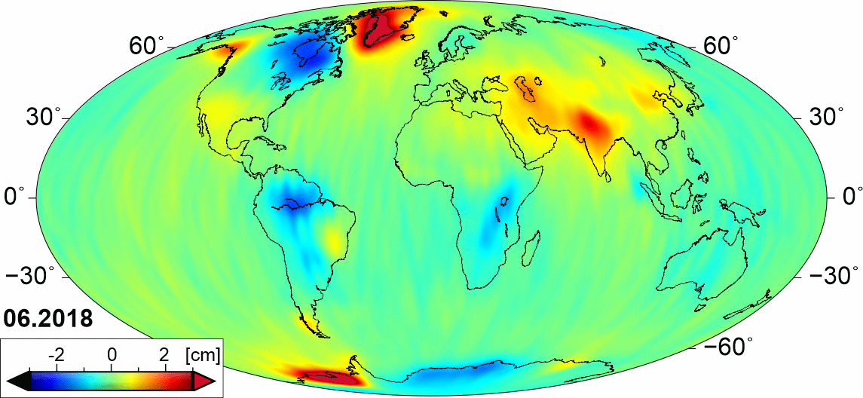
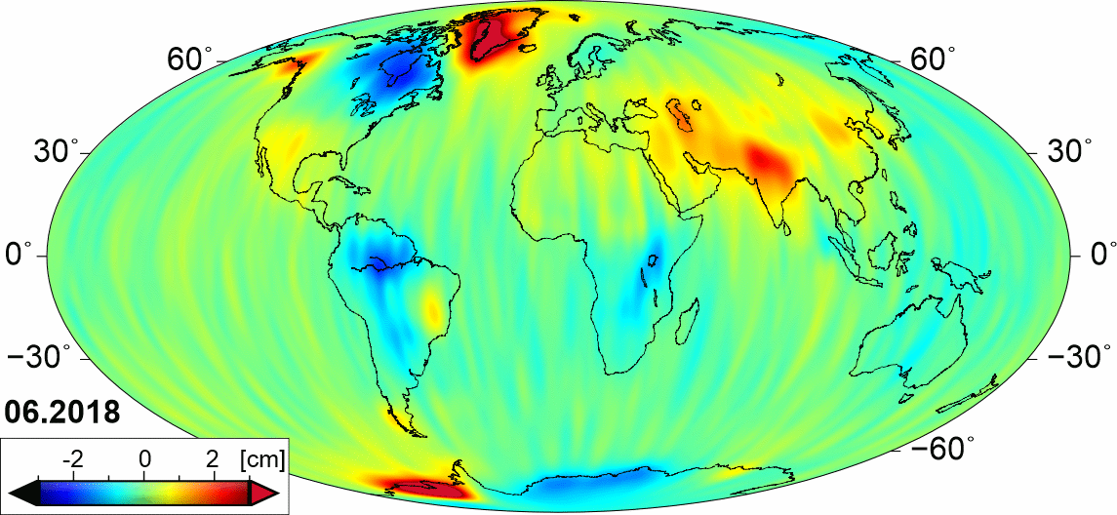
RESULTS: CSR, GFZ, JPL monthly vertical deformations
CSR
GFZ
JPL
Fig. 1. Monthly vertical displacements obtained from spherical harmonics provided by CSR, GFZ and JPL GRACE-FO data centres

Slide 7
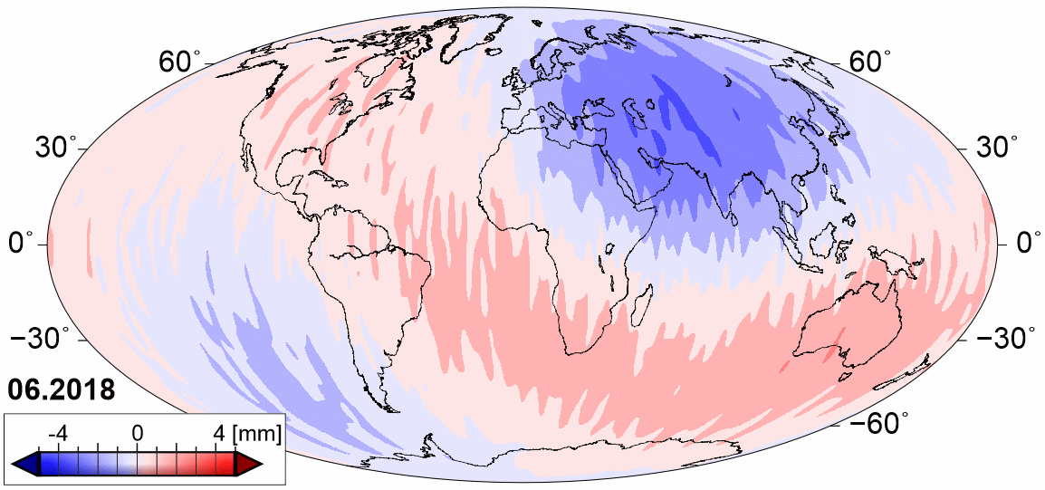
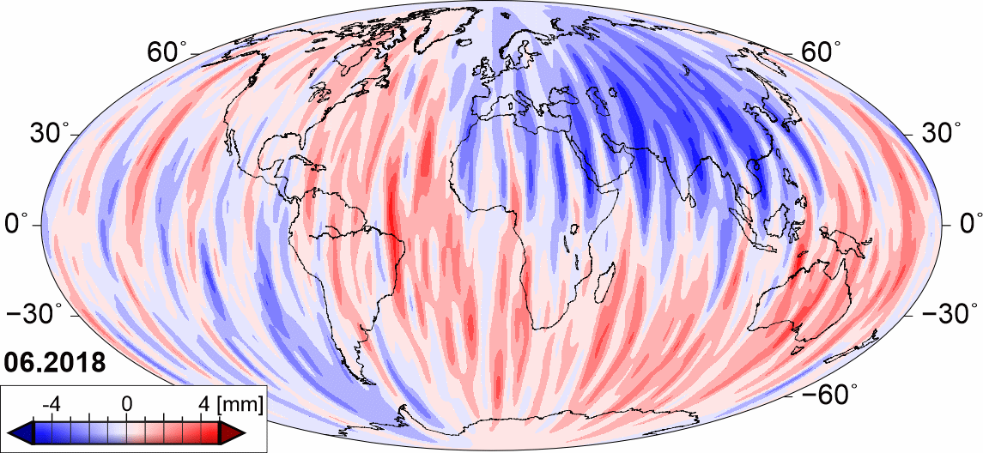
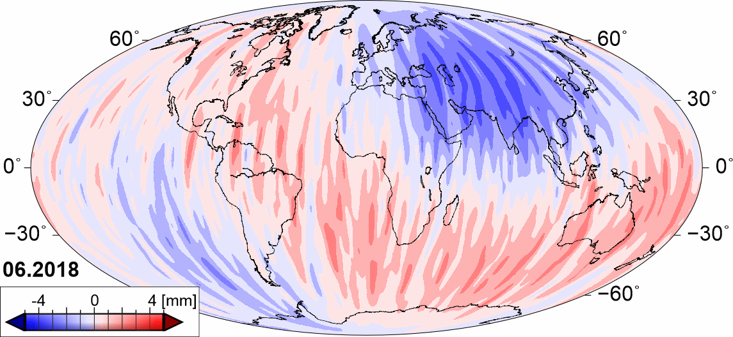
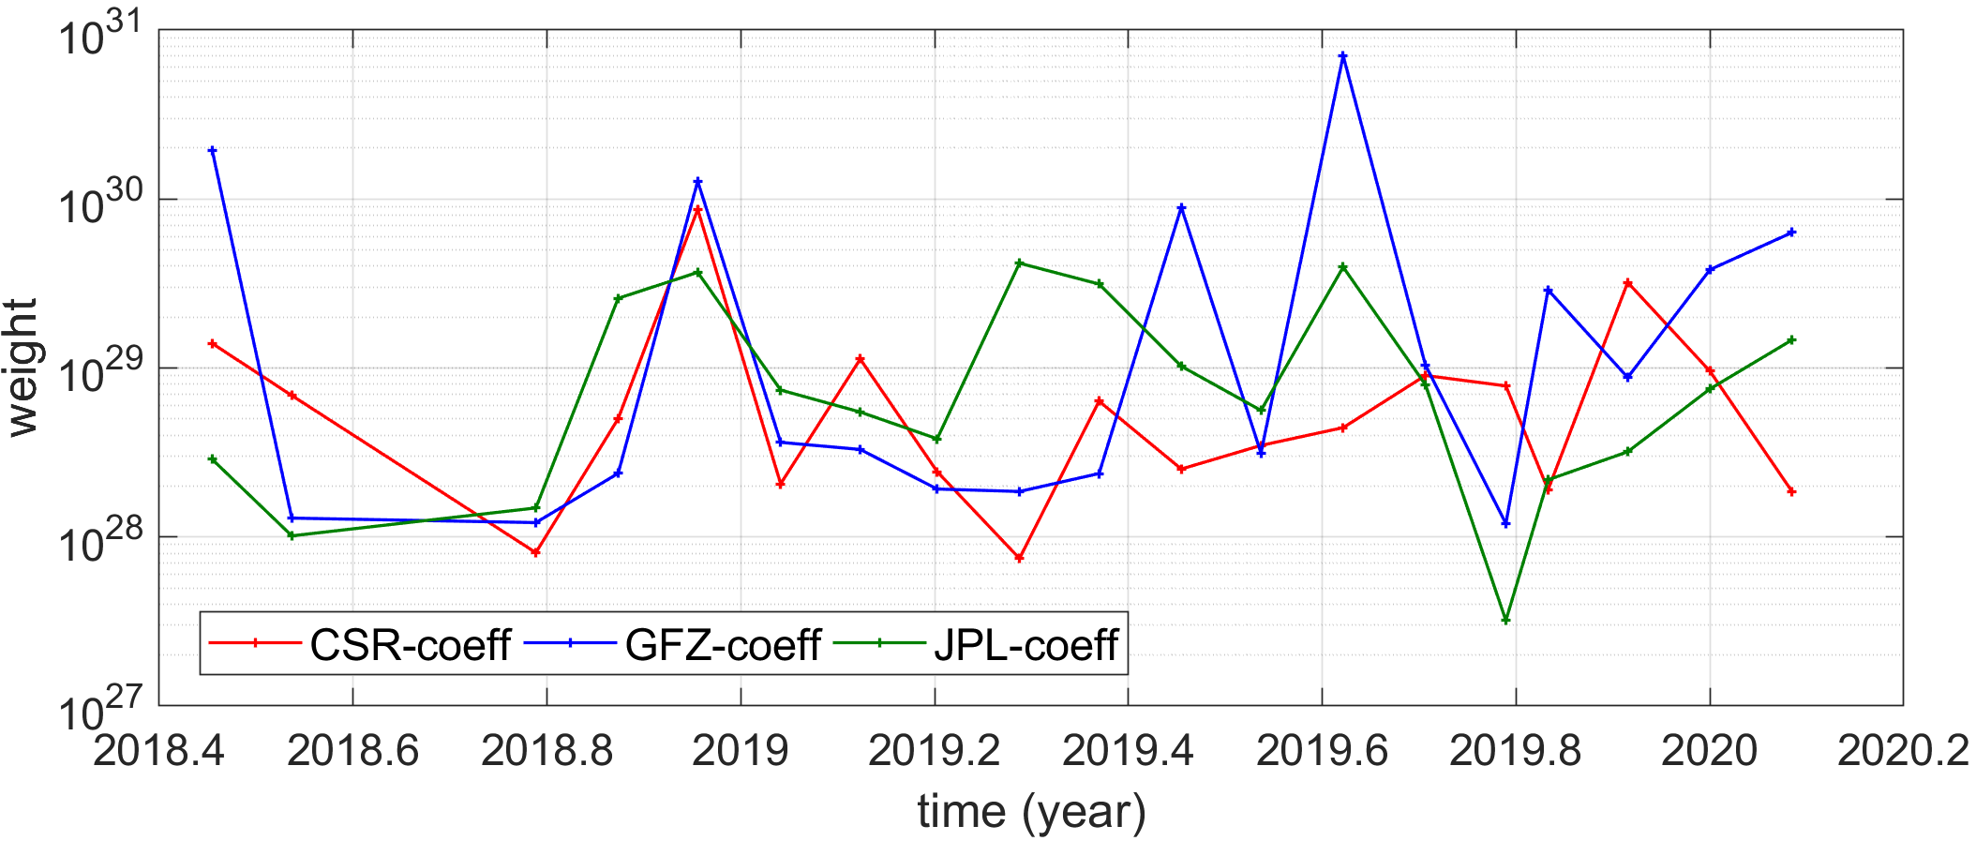
RESULTS: coefficient-wise weighting (COEFF) combined model
CSR
GFZ
JPL
± 2 mm errors for COEFF model monthly deformations (north-south patterns)
Fig. 2. Differences of monthly vertical displacements from coefficient-wise weighting model and CSR, GFZ, JPL GRACE-FO values

Slide 8
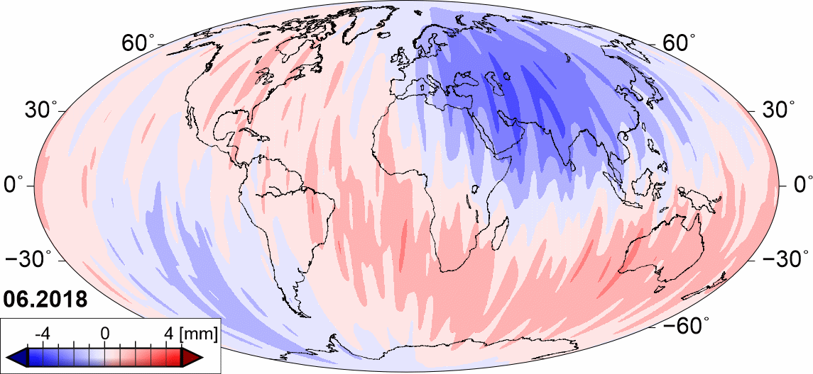
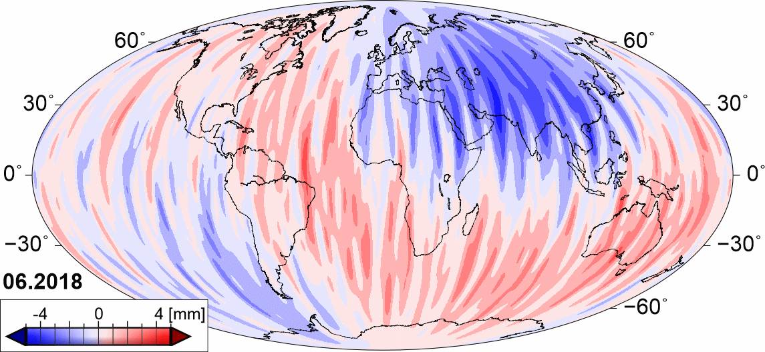
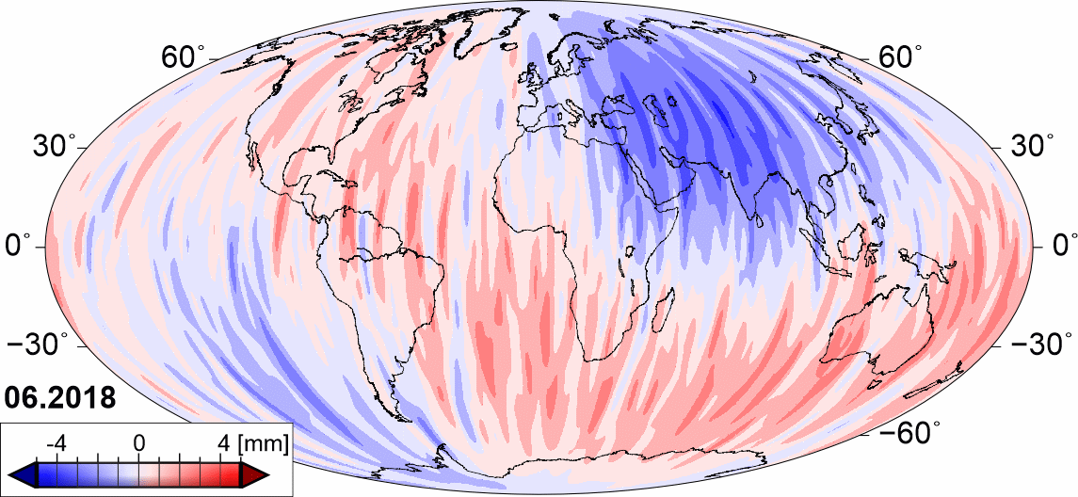
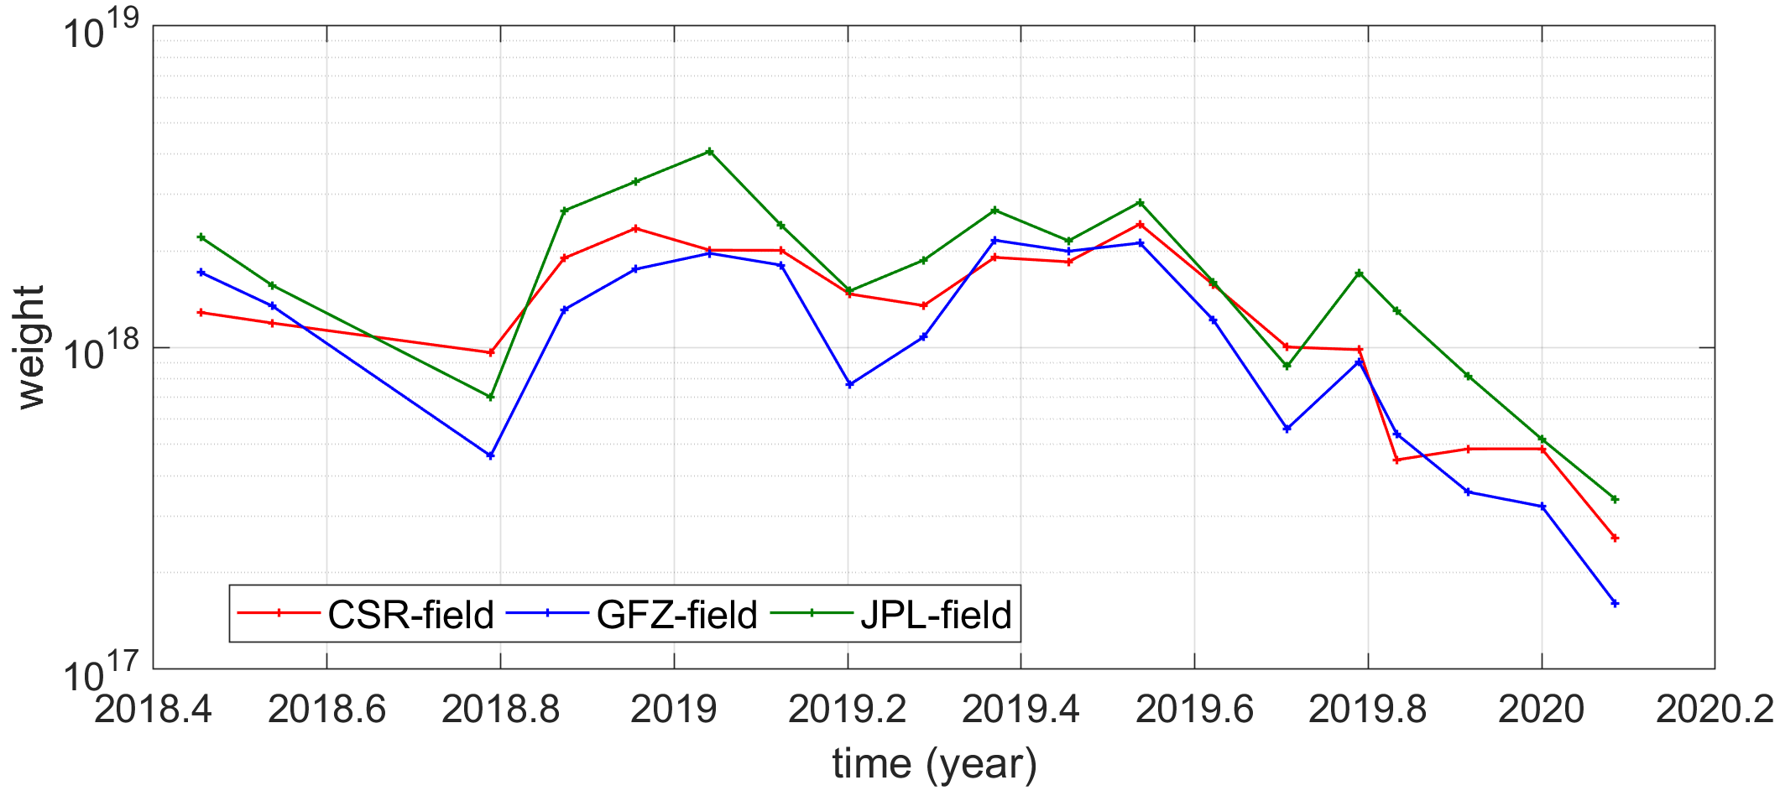
RESULTS: field-wise weighting (FIELD) combined model
CSR
GFZ
JPL
± 2 mm errors for FIELD model monthly deformations (north-south patterns)
Fig. 3. Differences of monthly vertical displacements from field-wise weighting model and CSR, GFZ, JPL GRACE-FO values

Slide 9
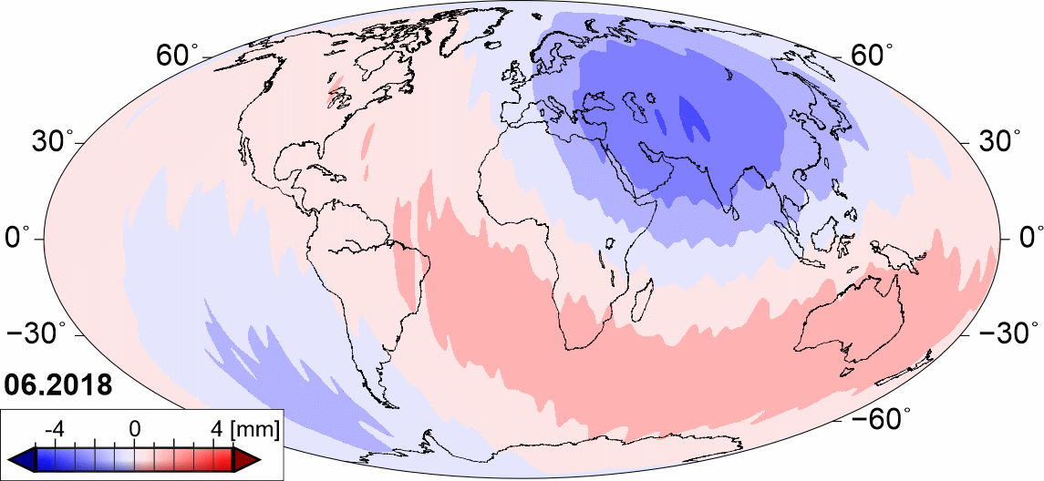
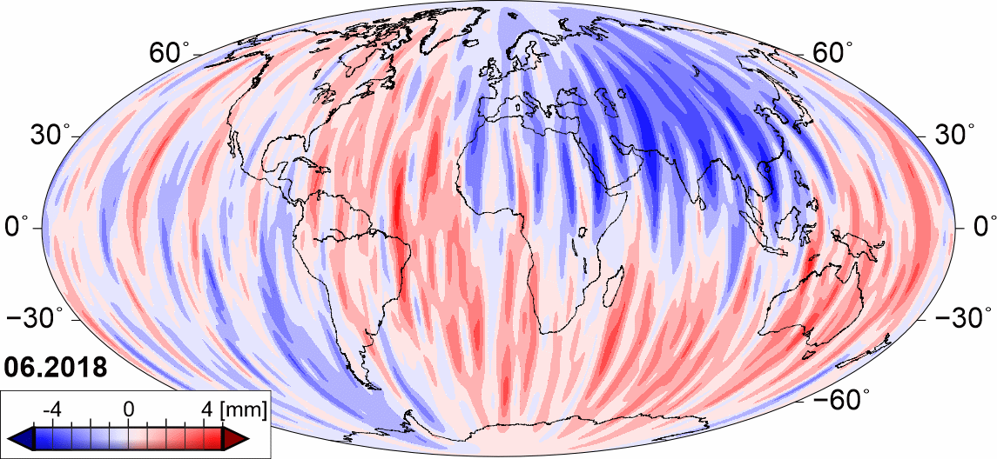
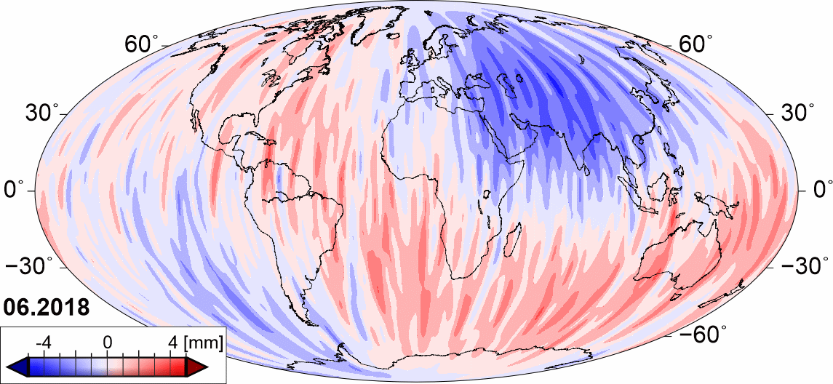
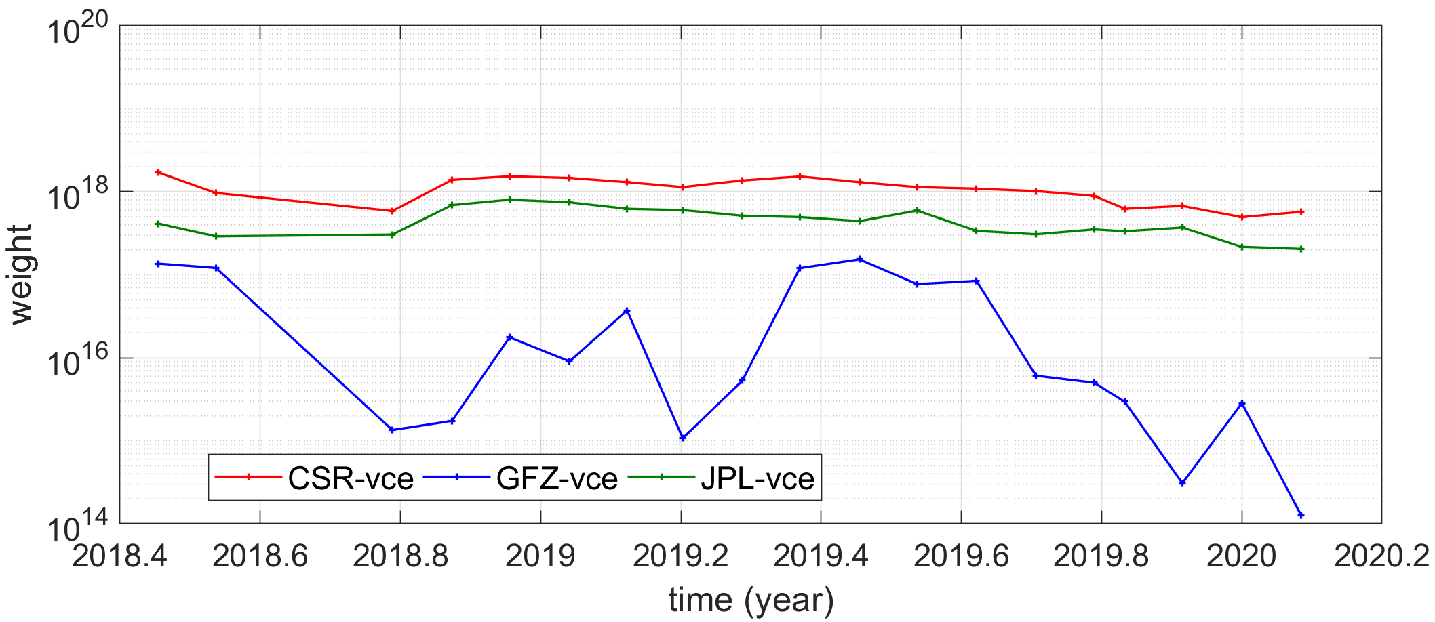
RESULTS: variance component estimation weighting (VCE) combined model
CSR
GFZ
JPL
± 2 mm errors for VCE model monthly deformations (north-south patterns)
Fig. 4. Differences of monthly vertical displacements from VCE-wise weighting model and CSR, GFZ, JPL GRACE-FO values

Slide 10
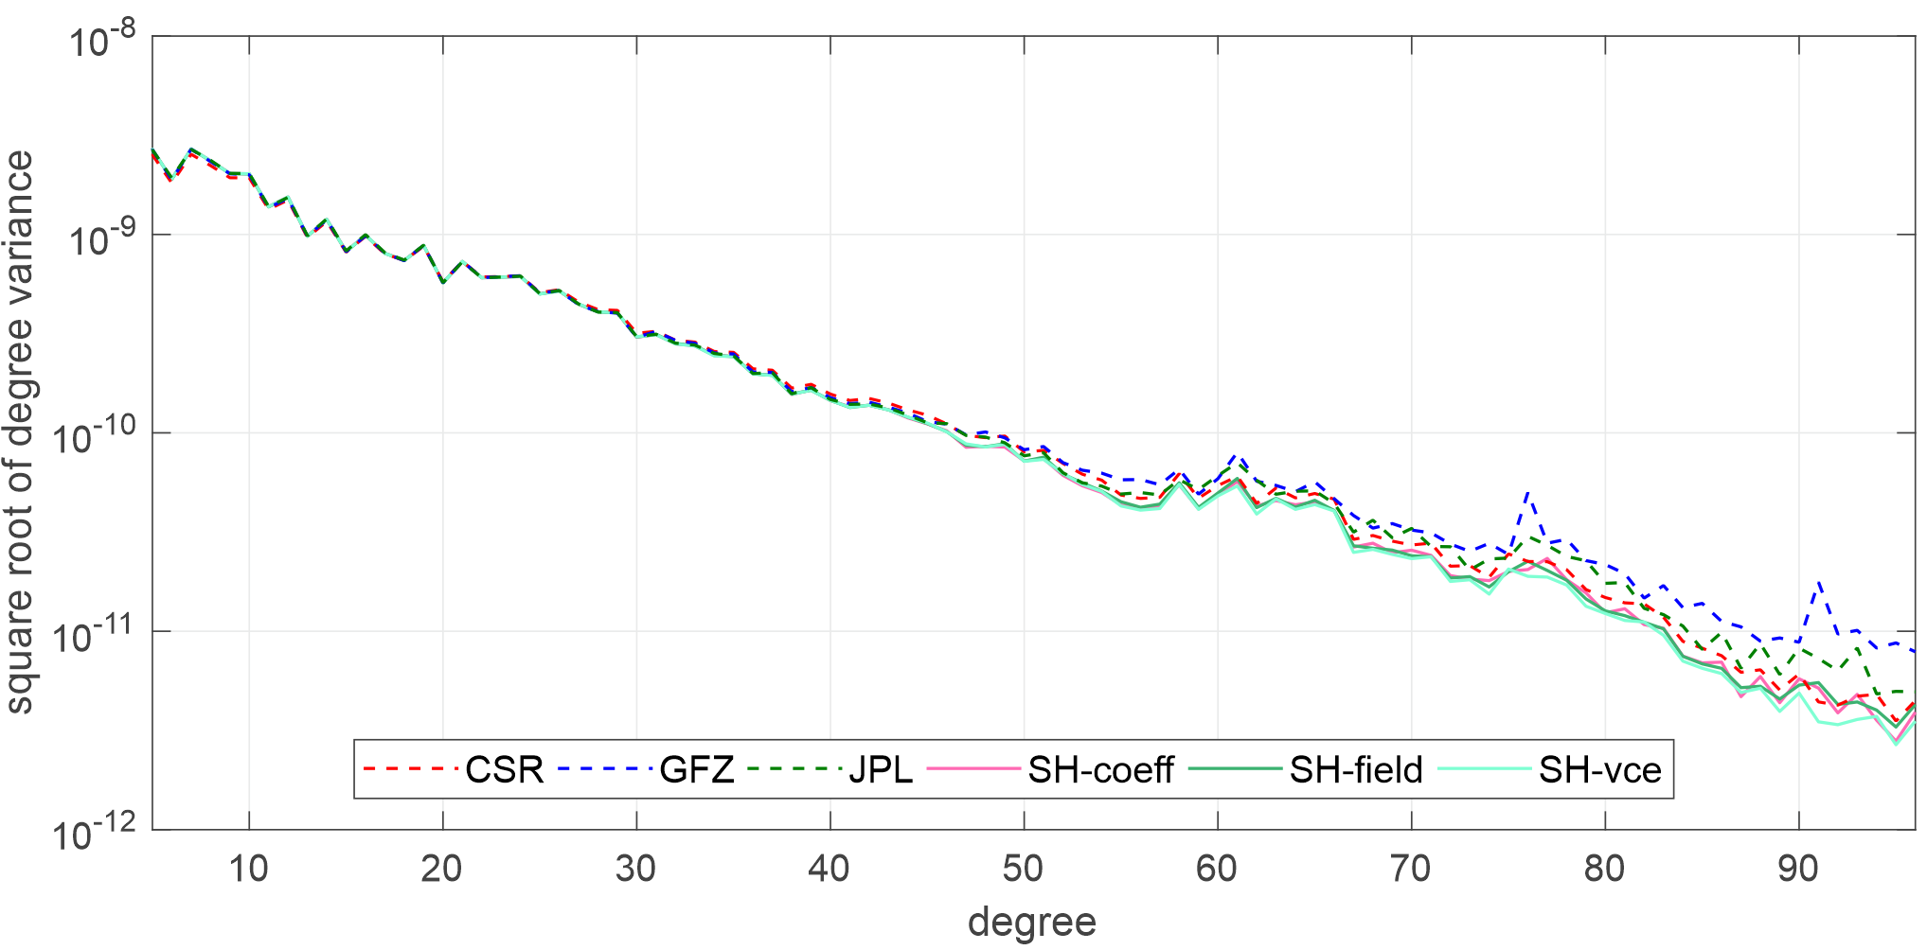
RESULTS: square root of degree variance
Fig. 5. Signal variance for degree up to 96 estimated for homogenous models and CSR, GFZ, JPL GRACE-FO observations

Slide 11
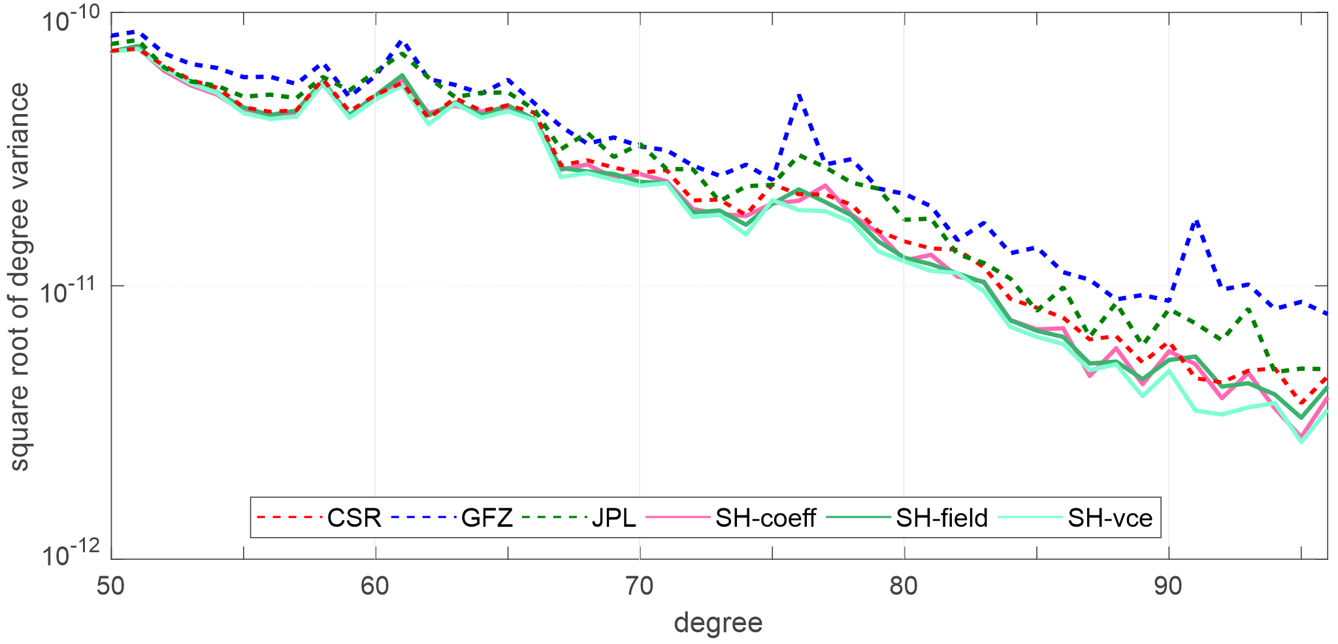
RESULTS: square root of degree variance
Fig. 6. Signal variance for degree above 50 estimated for homogenous models and CSR, GFZ, JPL GRACE-FO observations

Slide 12
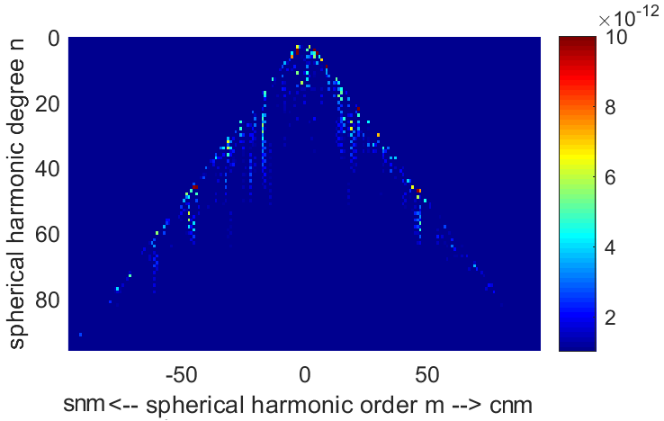
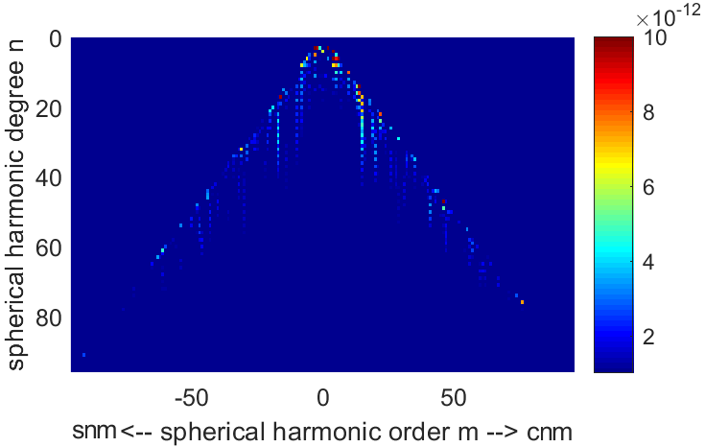
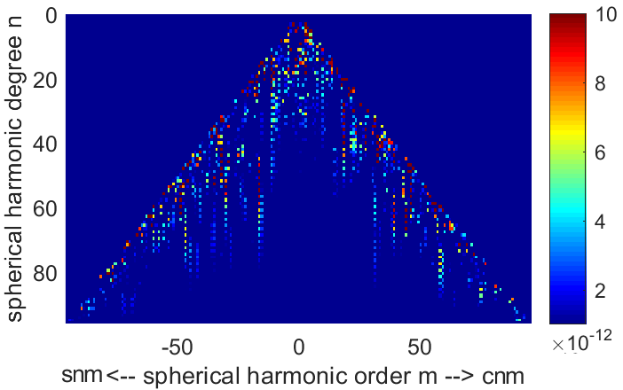
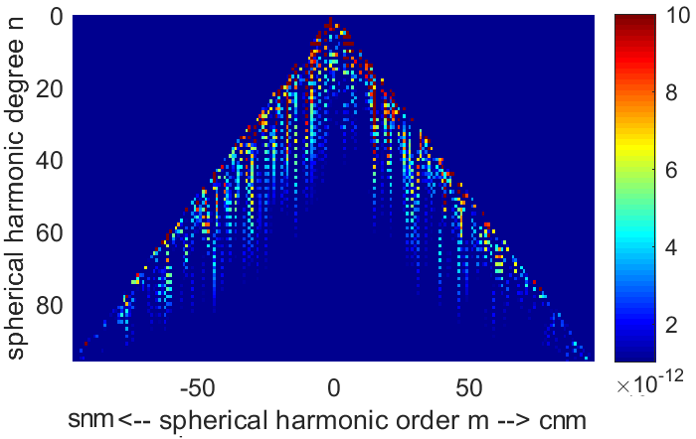
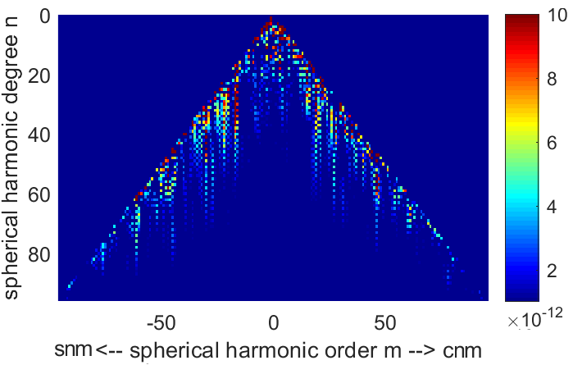
RESULTS: comparation of spherical harmonic coefficients
COEFFICIENT-WISE
FIELD-WISE
CSR
GFZ
JPL
Fig. 7. Differences of spherical harmonics between VCE-wise and coefficent-wise, field-wise, CSR, GFZ, JPL coefficients

Slide 13
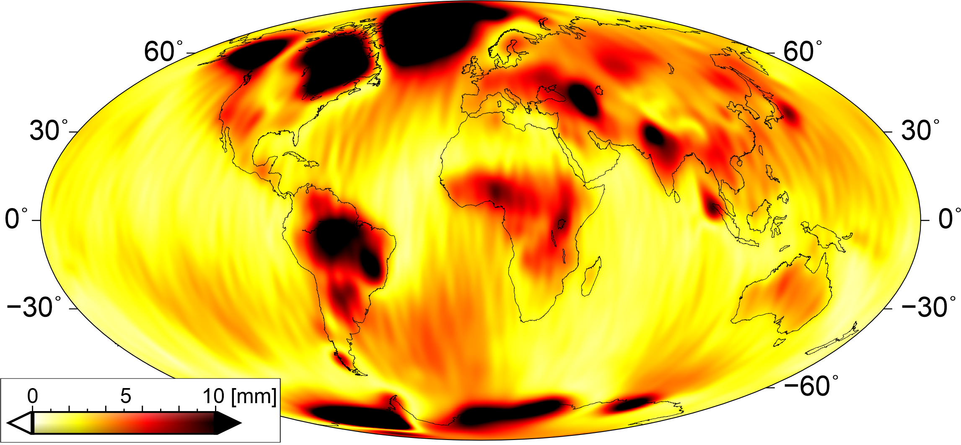
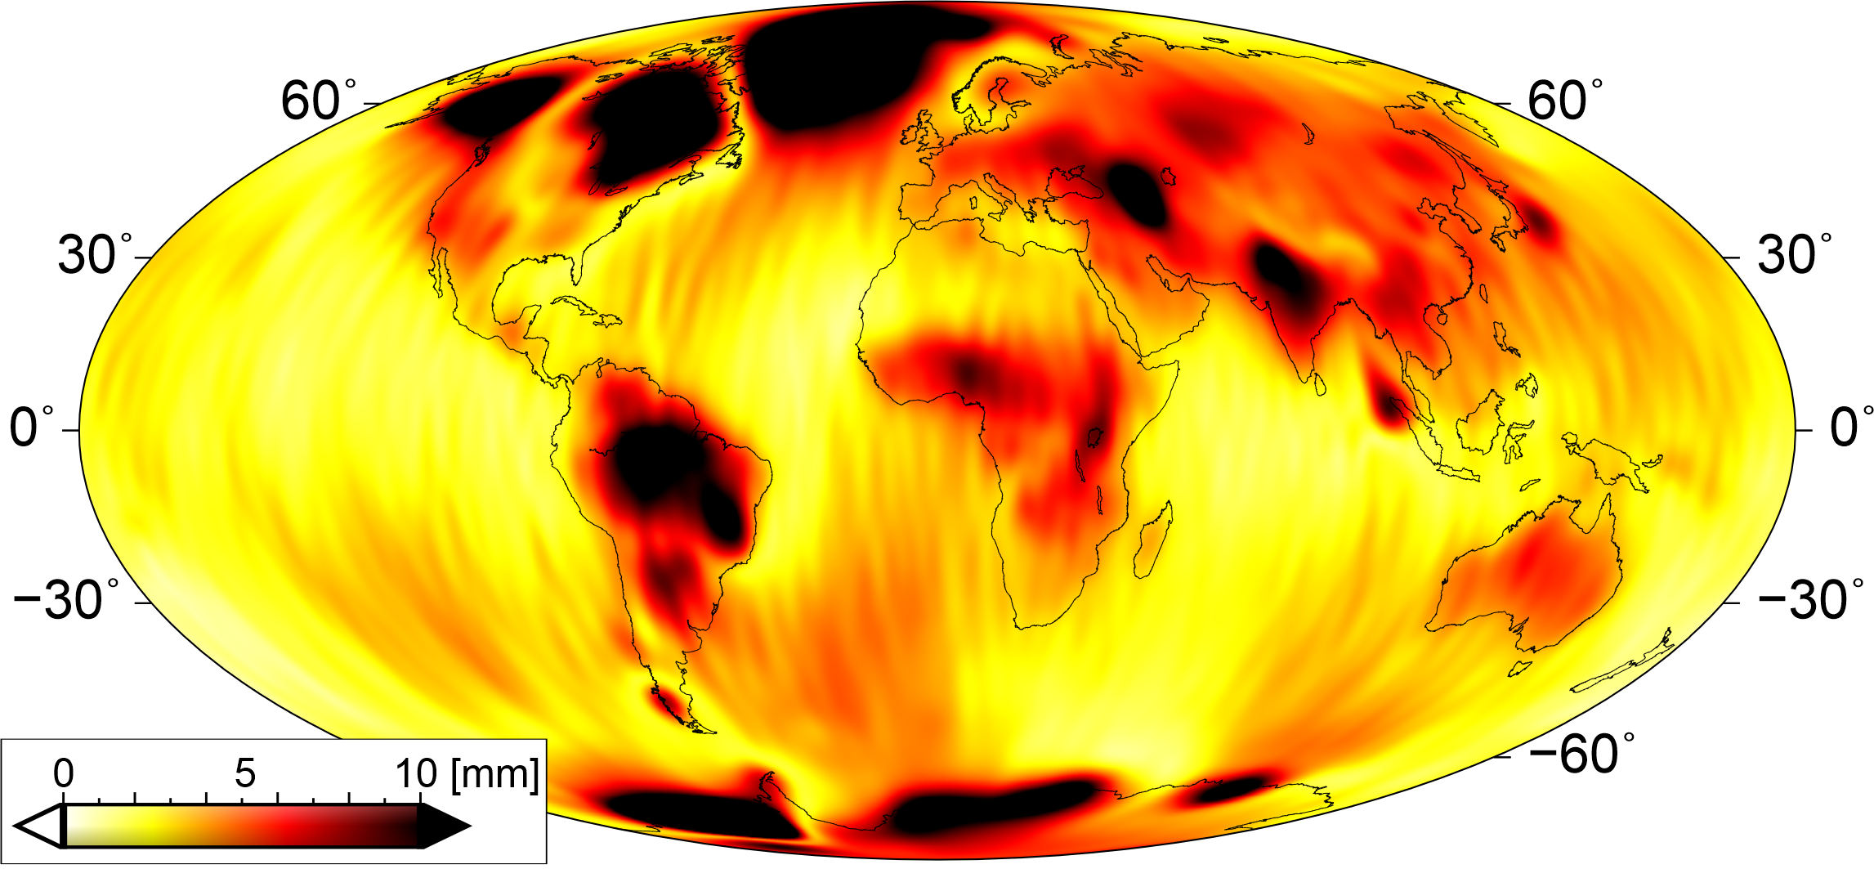
RESULTS: root mean square values
COEFFICIENT-WISE
FIELD-WISE
VCE
CSR
Fig. 8. RMS values of vertical displacements calculated for homogenous models and CSR GRACE-FO values

Slide 14
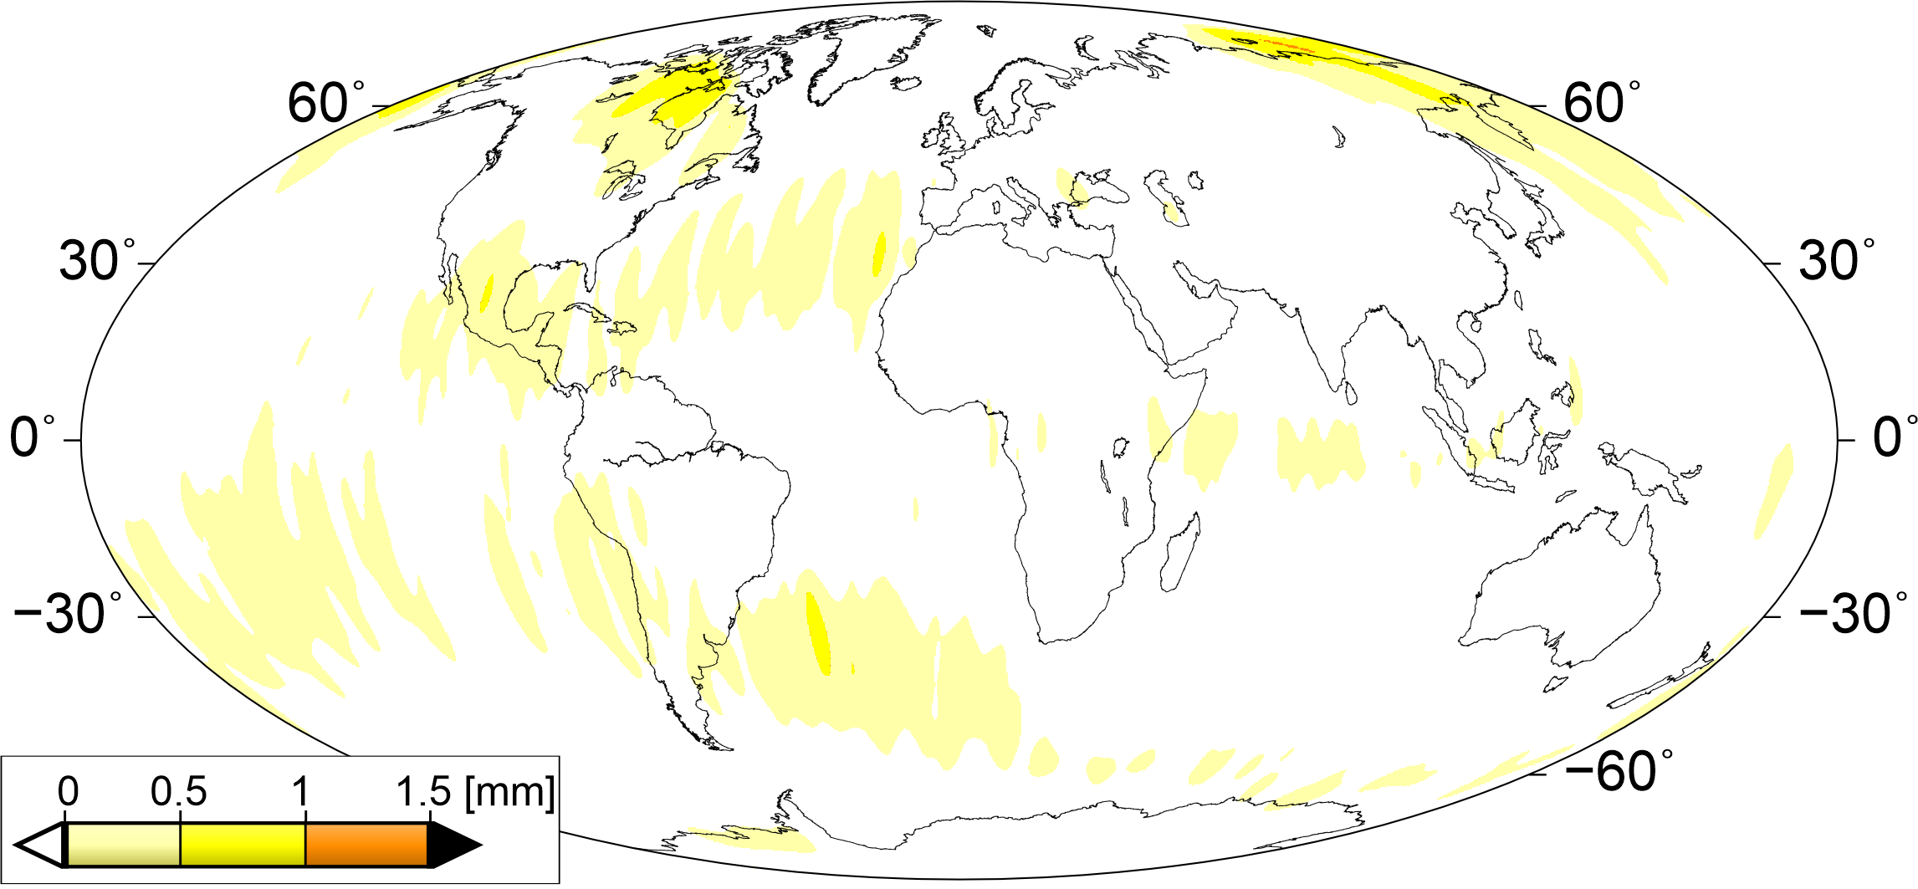
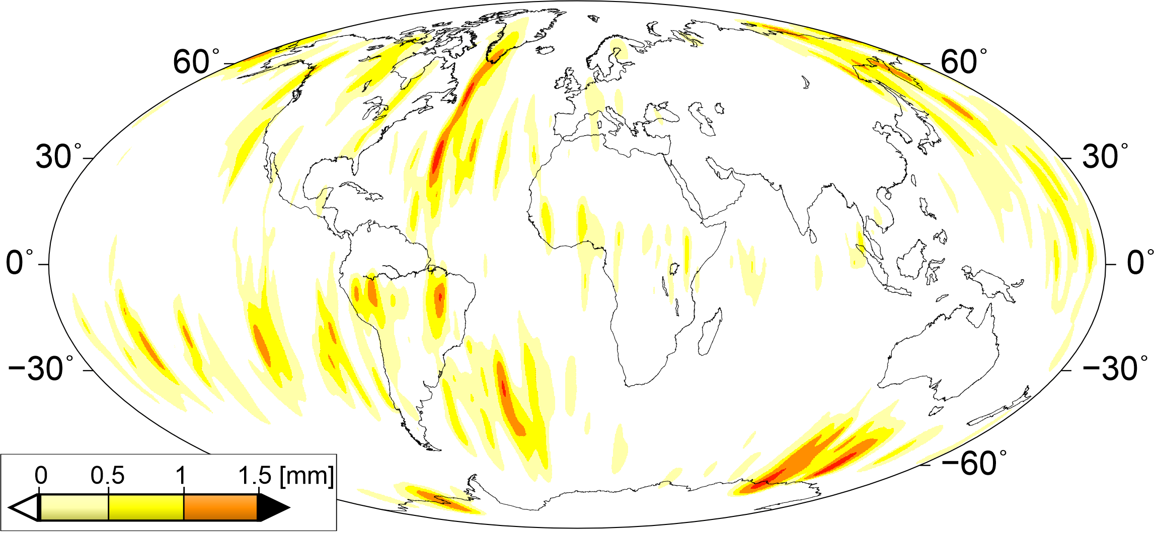
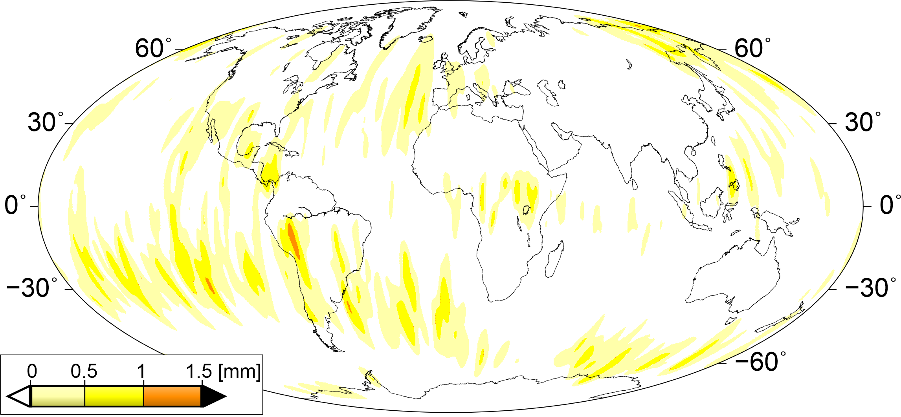
RESULTS: differences of RMS values
CSR
GFZ
COEFFICIENT-WISE
JPL
Fig. 9. Differences of RMS values of vertical displacements between coefficients-wise model and CSR, GFZ, JPL GRACE-FO values

Slide 15
CONCLUSIONS
Monthly displacements are of ±5 mm depending on the data center: CSR, GFZ or JPL.
Data provided by GFZ centre are noisier (north-south patterns) than CSR and JPL centers.
The coefficients-wise model is characterized by different weights for each centres with the smallest weights for GFZ data.
Monthly vertical deformations for 19 months observations for each combined models are characterized by similar north-south stripe errors equal ±2 mm.
Degree variance of CSR spherical harmonics are less constrained than GFZ and JPL - values similar to combined models.
The homogenous models contain higher signal than data provided by CSR, GFZ, JPL analysis centres.
The highest variances in the signal are obtained for sectoral harmonics up to the maximum degree.
The used weighting methods reduce RMS scatter of monthly deformations by nearly 5% for continental areas and by 10-15% changes for the oceans.
Thank you!

