Slide 1
The nighttime poleward wind responses to SAPS simulated by TIEGCM: a universal time effect
Kedeng Zhang¹ (Ninghe_zkd@whu.edu.cn^{),} Hui Wang¹, Wenbin Wang², Jing Liu², Shunrong Zhang³, Cheng Sheng⁴
1, Department of Space Physics, School of Electronic Information, Wuhan University, Wuhan, China
2, High Altitude Observatory, National Center for Atmospheric Research, Boulder, Colorado, USA
3, Haystack Observatory, Massachusetts Institute of Technology, Westford, Massachusetts, USA
4, Department of Physics, University of Texas at Arlington, Arlington, Texas, USA
Online display, EGU2020

Slide 2
TIEGCM-SAPS
TIEGCM-SAPS:
An empirical SAPS model is imposed in the F layer at subauroral region in TIEGCM, with the location and magnitude determined by the Kp index (Wang et al., 2012).
The larger the Kp is, the lower the MLat and the faster of the ion velocity of SAPS are.
SAPS have been included in SAPS-TIEGCM at four different UT times of 00, 06, 12, and 18 UT, respectively.
Wang, W., Talaat, E. R., Burns, A. G., Emery, B., Hsieh, S. Y., Lei, J., & Xu, J. (2012). Thermosphere and ionosphere response to subauroral polarization streams (SAPS): Model simulations. Journal of Geophysical Research: Space Physics, 117(A7).

Slide 3
Results
Data-Model comparison
00 UT on 18 March, 2015
18 March, 2015
TIEGCM-SAPS
TIEGCM
Fabry-Perot interferometers (FPI)
DMSP
SAPS
Positive denotes eastward
Positive stands for poleward wind
DMSP observed ion velocity is westward at ~60º MLat and 19.5 MLT with a speed of ~1500 m/s.
The modeled zonal ion velocity is strongly westward in the SAPS channel (~60º MLat and 14-22 MLT), with a speed of ~1200 m/s.
The modeled nighttime poleward wind induced by SAPS amounts to ~30% of the observed poleward winds.

Slide 4
UT variations?
00UT
06UT
12UT
18UT

Slide 5
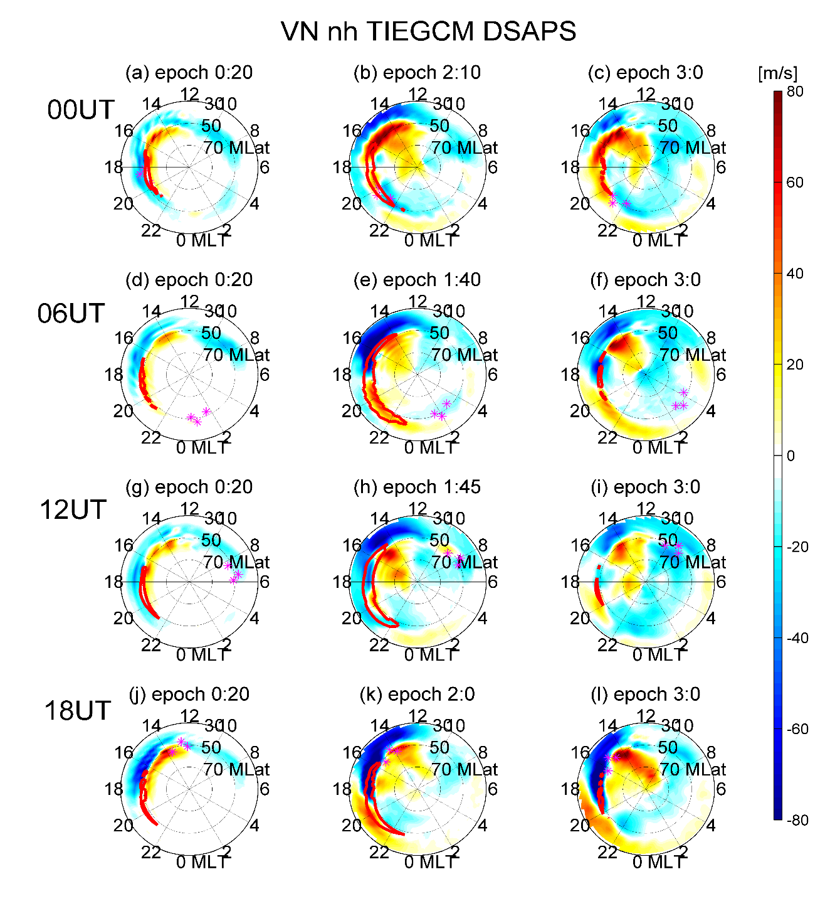
FOCUS: The meridional winds due to SAPS at 19-22 MLT and 30º~50º MLat
The largest poleward winds by SAPS have a magnitude of ~25 m/s
The peak speed of the poleward wind changes occurs at epoch time 01:40 and ~21 MLT, with a magnitude of ~56 m/s.
The largest poleward winds :~28 m/s
The largest poleward winds :~44 m/s
Peak poleward winds
SAPS onset
SAPS closed

Slide 6
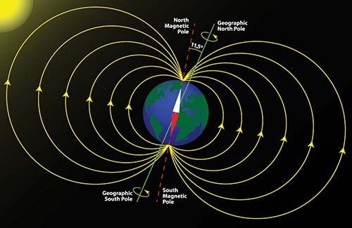
Ion Drag (One of forces)
The ion drag by SAPS is westward in the magnetic coordinates.
When it is projected or viewed in the geographic coordinates, it has two components: one is geographic westward to drive westward winds and the other is the geographic northward to contribute to poleward wind changes (06 and 18UT).

Slide 7
Summary
The nighttime poleward wind changes induced by SAPS exhibit remarkable UT variations, with a maximum at 06 UT and a minimum at 00 UT.
The ion drag effects on the poleward wind changes result from the displacement between the geomagnetic and geographic poles.

