Slide 1
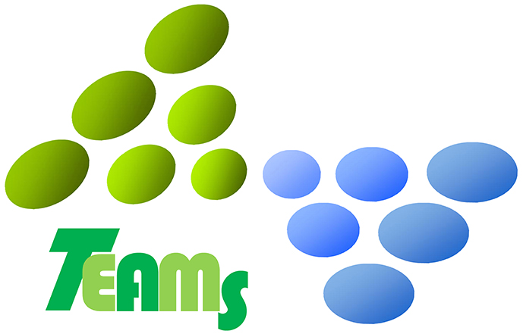
Habitat map plays an active role for coastal eco-DRR by multi-stakeholders
Hiroshi KITAZATO¹, Yuri OKI¹, Soichiro YASUKAWA²
(1: Tokyo University of Marine Science and Technology, Japan; 2: Section on Earth Sciences and Geohazards Risk Reduction, UNESCO, Paris, France)

Slide 2
abstract
Coastal land- and sea-scape is composed of diverse habitats such as reed bed, salt marsh, tidal-flats, sea grass fields, seaweed grounds, sandy and rocky-shores. Coastal habitats harbor both biodiversity and abundance of coastal lives. These complex coastal ecosystems are sustained by the function of land-sea linked material cycles. Coastal ecosystems provide wide ranges of ecosystem services and processes among natural environments, fisheries, and human livelihoods. Protecting coastal ecosystems secure material cycle, which is fundamental for sustainable human livelihood in coastal communities prone to disasters. In addition, bio-diverse coastal species such as sea grasses, function as nursery areas for commercially important seafood species such as fishes, clams, shrimps, and others. On the other side, coastal ecosystems provide natural infrastructure for both prevention and reduction from hazardous events, known as ecosystem-based disaster risk reduction (eco-DRR). For establishing concept of eco-DRR, we need to prepare precise coastal biological, geological and other data including human and social activities. Habitat map projection is effective way to pile multi-disciplinary data on same GIS grid. Habitat map, thus, provides common data sets to multiple stakeholders, such as scientists, fishermen, local fish markets and local and federal governments for planning coastal management systems.
Earthquakes and Tsunamis should give heavy damages on coastal lives and ecosystems in global scale. Because, more than half of world populations concentrate into vulnerable coastal areas. Together with the conventional hard-infrastructure measures, we have witnessed in previous disasters, that eco-DRR is both affordable and sustainable solution. Eco-DRR should be further promoted, not only in the preparedness and mitigation, but also for the better reconstruction from the disasters so to "Build Back Better". We plan to show a couple of best practices in terms of Eco-DRR activities from March 11, 2011 Earthquake and Tsunamis.

Slide 3
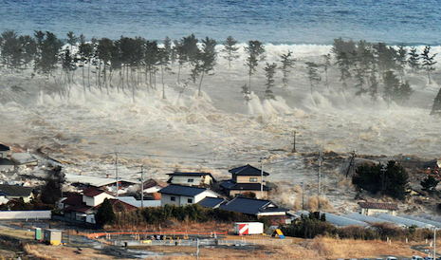
Great East Japan Earthquake and Tsunamis
White Tsunami
Both Black and white Tsunamis washed out coastal villages and infrastructures. More than 20K peoples are dead. More than 2/3 fishing boats and aquaculture systems were lost.
Black Tsunami
March 11, 2011, 15:56
（Kyodo News）
http://www.boston.com/bigpicture/2011/03/massive_earthquake_hits_japan.html
Tsunami inundation heights sometimes reaches at more than 40m high in altitude and destroyed coastal infrastructures and wash everything out.
They also strongly disturbed coastal to offshore ecosystems of the Northeast Japan.
(Jiji News)

Slide 4
How can we restore and construct coastal ecosystems for keeping sustainable use of marine resources and for keeping safe and healthy lives along coasts ?

Slide 5
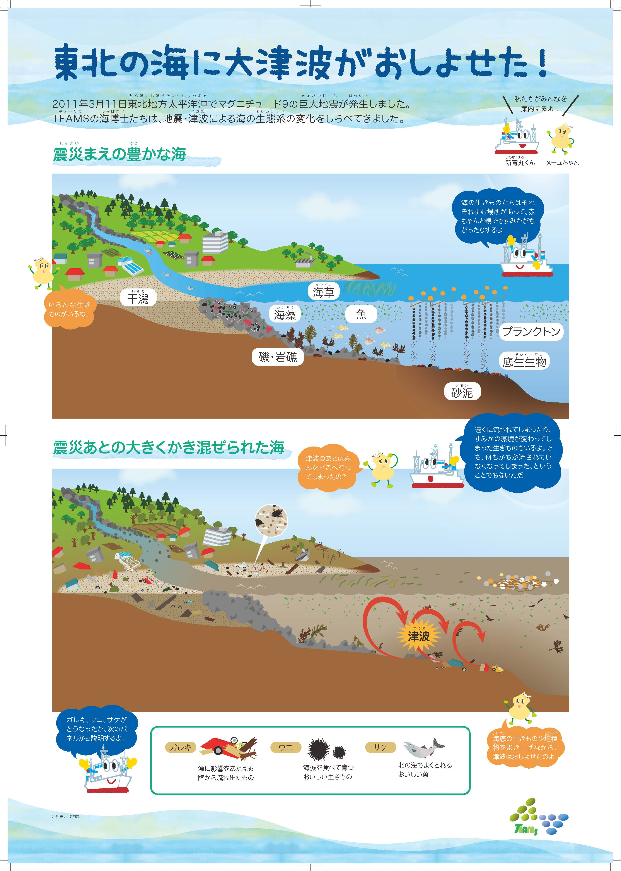
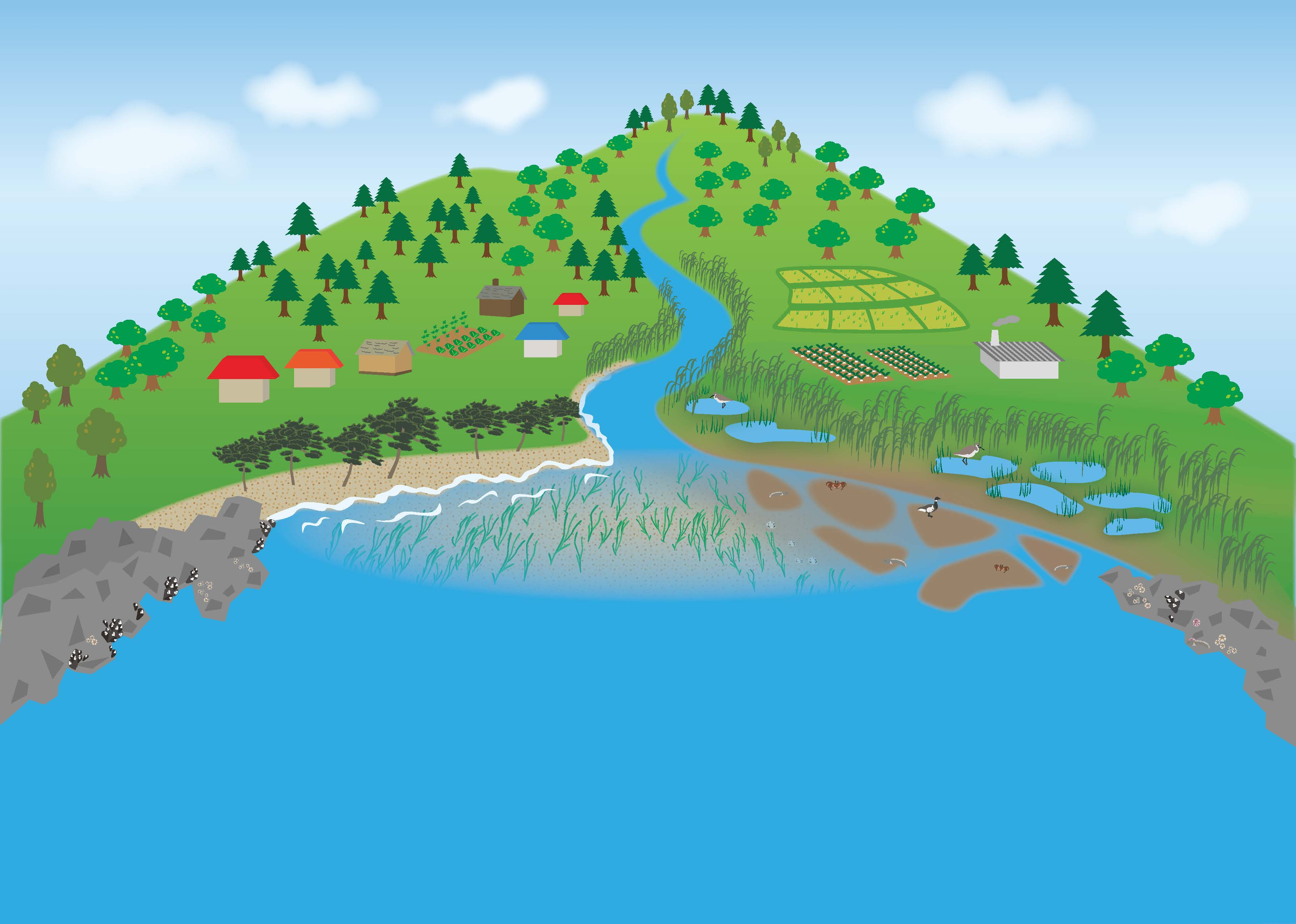
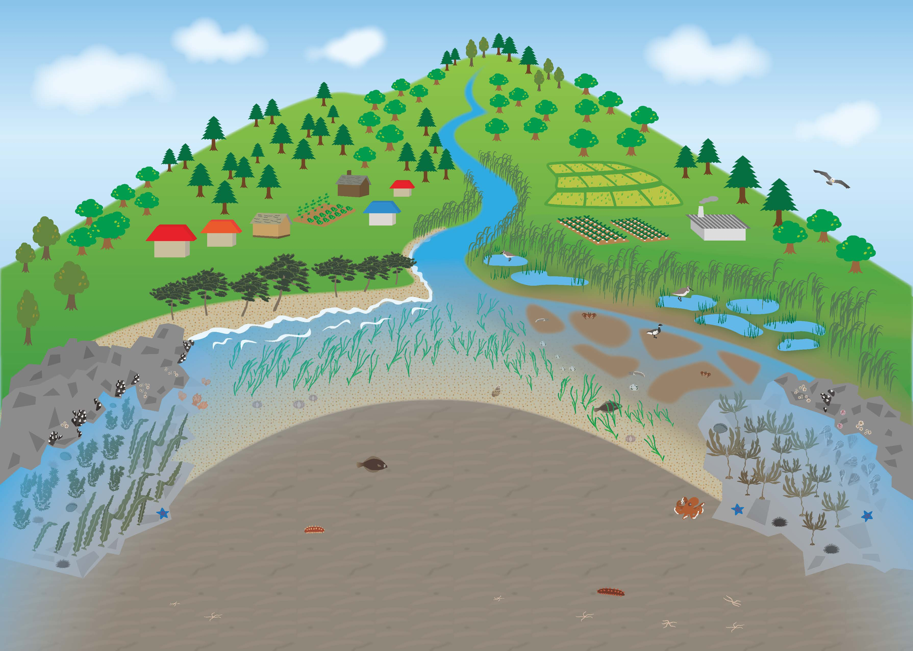
Upper panel shows a cartoon of coastal landscapes from sea to land. Lower panel shows coastal distribution of ecotone, series of ecosystems in the coastal sea.
Big Tsunamis washed Tohoku area !
Rich coastal seas
Everything swept away by Tsunamis

Slide 6
Extensional view of land-sea linkage of ecosysgtems
- Japanese Commons in the coastal areas -
“ Satoyama ”
Land ecosystems
forestry, agriculture, river systems
Material cycles
both biogeochemical
and sediment transportation
help to keep biodiversity and abundances
Of coastal areas
“ Satoumi ”
Natural coastal ecosystems
coastal fisheries
and aquaculture
Coastal Village
Ecosystem links between land and sea
Combined restorations of “Satoyama ” and “ Satoumi ” is more effective to build back coastal ecosystems and human lives better than before Tsunami disasters

Slide 7
Information flow of Risk Managements (Prevention, Reduction, Mitigation and Restoration)
Inter-disciplinarity
Citizens and local governments
(stakeholders)
Data &
Observation
Modeling &
synthesis
Information
products
(habitat maps)
Delivery
Action
Scientists
Trans-disciplinarity
Social Application of Scientific results
（ex. Coastal ecosystem managements, socio-ecological restoration、advanced fisheries and others)
＊ Application of TEAMS results for restoration of damaged fisheries and coastal societies need knowledge of either liberal arts or social sciences. We have started series of dialogue among TEAMS, social science community and regional stakeholders.

Slide 8
DIKW pyramid
Wisdom allows to predict the future correctly, not only by detecting and understanding patterns but also deeply comprehending the “Why” behind the patterns. Wisdom is about the future: it relies on Knowledge and pattern models, but it can help to shape your “gut feeling” and intuition. Knowledge ages quickly because of how fast reality changes, but wisdom remains more rigid. For now, this is a pure human skill, but AI is catching up fast. When AI wisdom becomes better than human wisdom, the outcomes will be unpredictable.
Knowledge requires learning. Take the data, categorize and process it generating Information, then organize all the Information in a way that it can be useful. Whereas Information can help us to understand relationships, Knowledge allows us to detect patterns. It is the foundation that will let us build predictive models and generate real insights.
Information is data with meaning. It is when you start to make data useful. Through organizing/classifying data, we can transform into Information. “What”, “When” and “Who” question are often answer. The “meaning” of information can be useful, but is not always useful.
Data is only a set of numbers/figures.
It is unorganized, unprocessed, and inert.
If we don’t know what it means, it is useless.
https://towardsdatascience.com/rootstrap-dikw-model-32cef9ae6dfb

Slide 9
DIKW pyramid
Local
knowledge
Scientific
knowledge

Slide 10
Scientists meet citizen, fishermen, local government and other stakeholders at coastal region
Scientific knowledge
Local knowledge
Habitat Mapping (Marine GIS) procedures and data set provide common platform to multi-stakeholders (citizens, local governments, scientists and others) for understanding and creating new view points to live besides seas with sustainably.

Slide 11
How do multi-stakeholders, citizen, fishermen, local government, change thoughts for keeping sustainable coastal lives ?
Learn and Understand ambient systems and patterns of human lives
（natural, social systems, material cycles, structures and functions ）
Think and Predict, sustainable use of natural resources
(quantity, production and waste rates, and their connections to human economy)
Sharpen own sensors and prepare properly when biased disastrous events, such as heavy rains, earthquakes and tsunamis, take place.
（archive and read history of human lives and natural environments at areas)

Slide 12
New conceptual view for establishing sustainable coastal environments and ecosystems
Ecosystem-based disaster risk reduction (Eco-DRR) is the sustainable management, conservation and restoration of ecosystems to reduce disaster risk, with the aim to achieve sustainable and resilient development.
Well-managed ecosystems, such as wetlands, forests and coastal systems, act as natural infrastructures, reducing physical and biological exposures to many hazards and increasing socio-economic resilience of people and communities by sustaining local livelihoods and providing essential natural resources such as food, water and building materials. (referred from IUCN website)

Slide 13
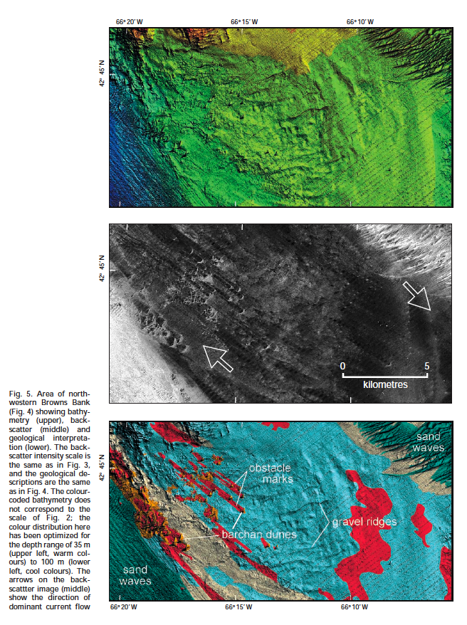
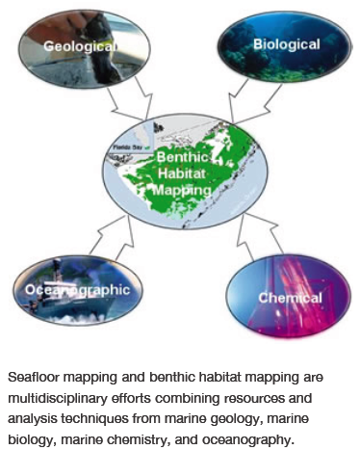
Habitat mapping (Multi-layered data accumulations and expressions) → Habitat map helps to make sustainable strategic plan for keeping coastal management
Precise Submarine
topography by MBES
↓
Backscattering
images
and sediment characters
↓
Geo- and eco-logical interpretation
↓
Determination of benthic habitats
for ecosystem managements

Slide 14
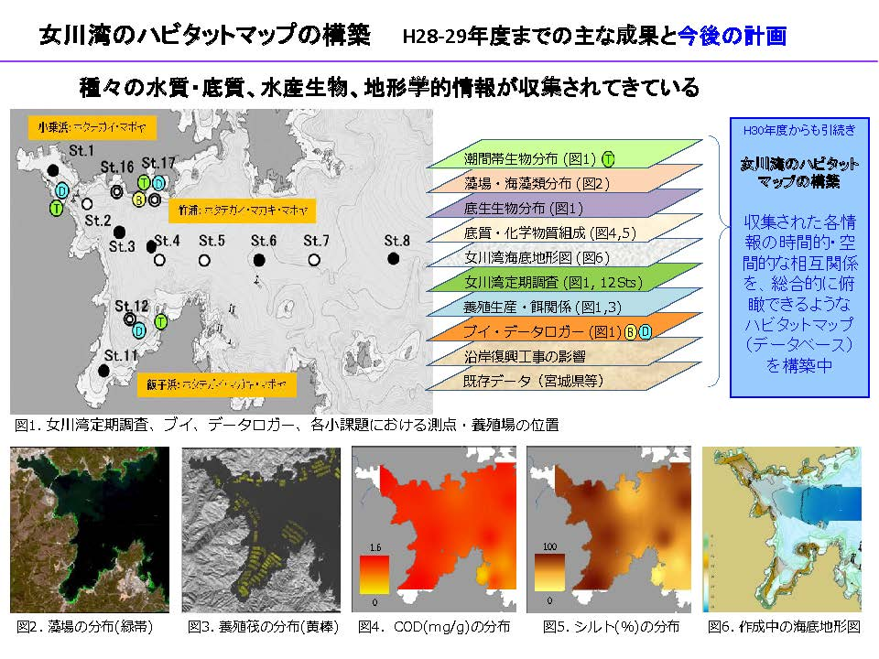
Habitat mapping data at Onagawa Bay (by Dr. T. Fujii, Tohoku Univ.)
→ multiple layered habitat mapping including both natural and societal data → It can use effective characterization of bay environment and ecosystems (ex. “Terroir” in the sea)
Data base
Habitat maps
(Restoration of coastal lives and fisheries)
(coastal management)
(eco-DRR)
(Marine Geo- and Eco-parks)
.
.
monitoring stations
Sea weed / grass
Benthos community
Sediment characters
Submarine topography
Oceanographic data
Aquaculture cages & shelter
Buoy & data logger
Coastal infrastructures
Past data
Sea grass / weed
Distributions
Aquaculture cages
COD (mg/g)
Silt / sand
Submarine topography

Slide 15
Best Practice case studies

Slide 16
Case 1: Multi-Stakeholder Engagement for eco-DRR
Recovery from Tsunami by Great East Japan Earthquake
Different stakeholder engagement on science for DRR
With the discussion of stakeholders:
The techniques to recover fishery (e.g. oyster farm) has been identified and implemented (in Miyagi Prefecture, Togura in Shizugawa Bay)
The location of the sea wall was identified to best protect the marine ecosystem and fishery industry (in Iwate Prefecture, Okirai Bay)
Example of the Sea-wall in Okirai Bay
Some researchers had been monitoring coastal ecosystem of Okirai Bay before the Great East Japan Earthquake occurred
They found that the sea-wall that the municipality was planning to ‘BBB’ after the earthquake, might destroy the coastal ecosystem on the course of recovery
They shared this information with the local fishery industry and proposed to set the sea-wall back inside from coast line
Scientists
Monitoring/Studying
<Scientific Knowledge>
Fishery industry
Implementing fishery
<Local Knowledge>
<Knowledge sharing/Discussion>
Municipalities
Rehabilitating Infrastructure
Set back sea-wall 200m inside from coast line
Sea-wall of Okirai Bay, Iwate prefecture, Japan

Slide 17
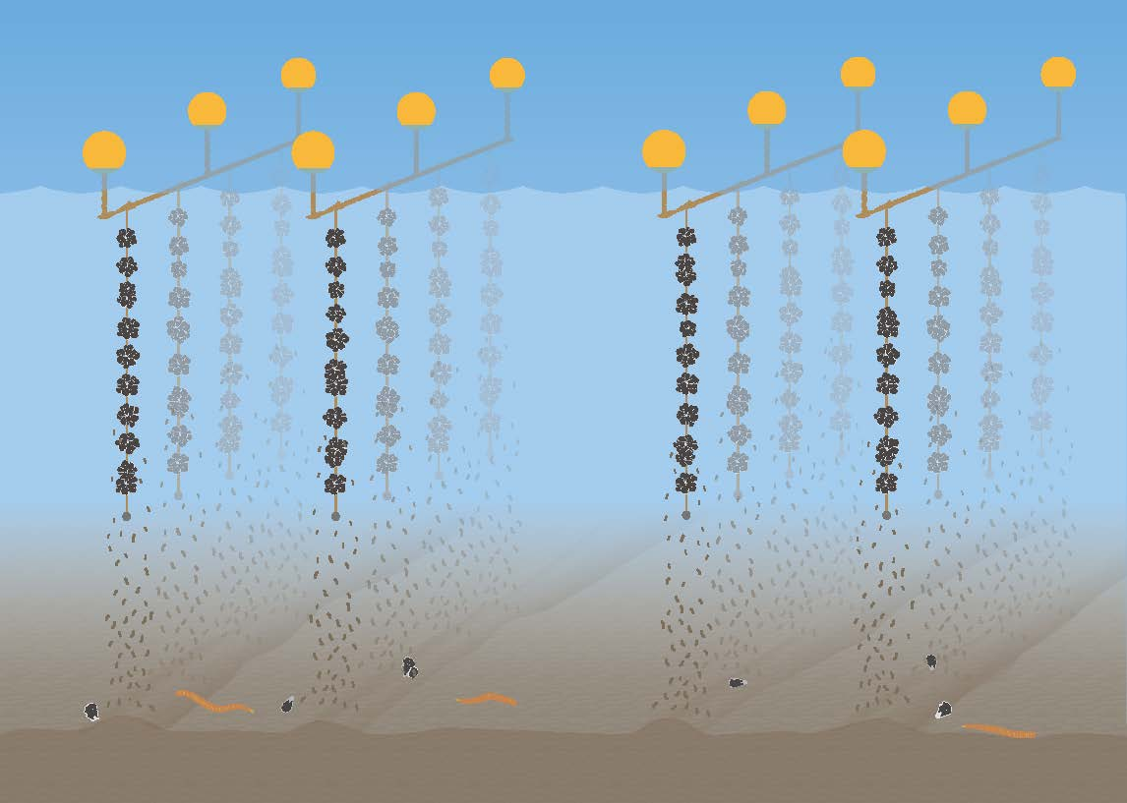
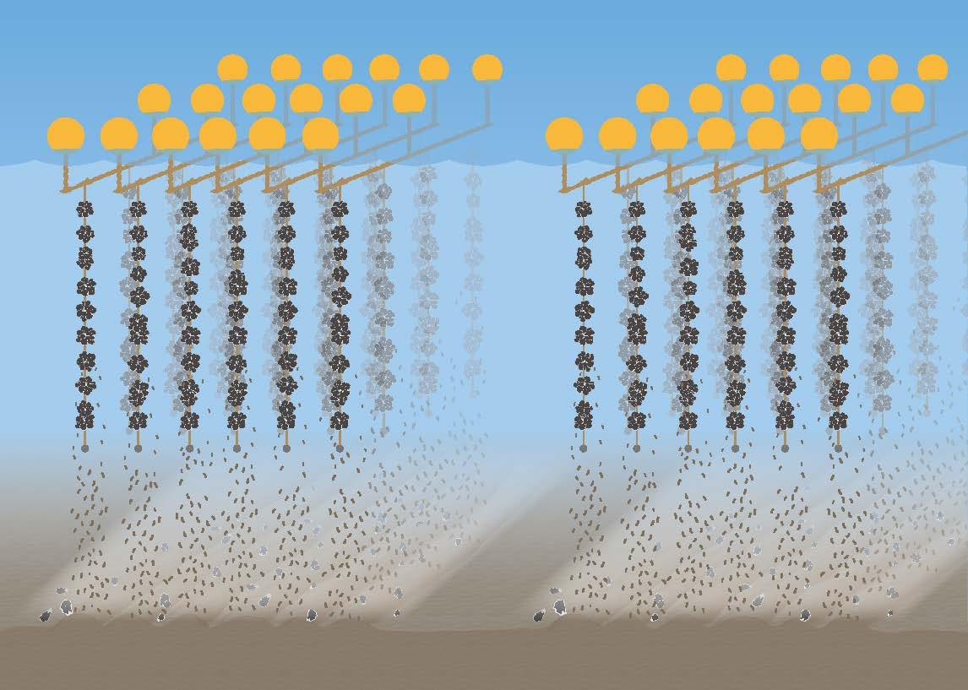
Case 2: Miracles of Oyster Farming @ Togura, Minami Sanriku (ASC certificate received oyster)
Oyster farming with adequate density after Tsunamis
Oyster farming with dense culture before Tsunami
Before Tsunami, the area was famous for low quality aquaculture, as dense farming oysters have not grown faster due to lack of foods. However, it grows faster when fishermen changed culture methods after Tsunamis. It becomes to grow three times more than dense culture. Recently, Oyster from Togura received ASC certification. Now they become famous for qualified oyster culture in the world.

Slide 18
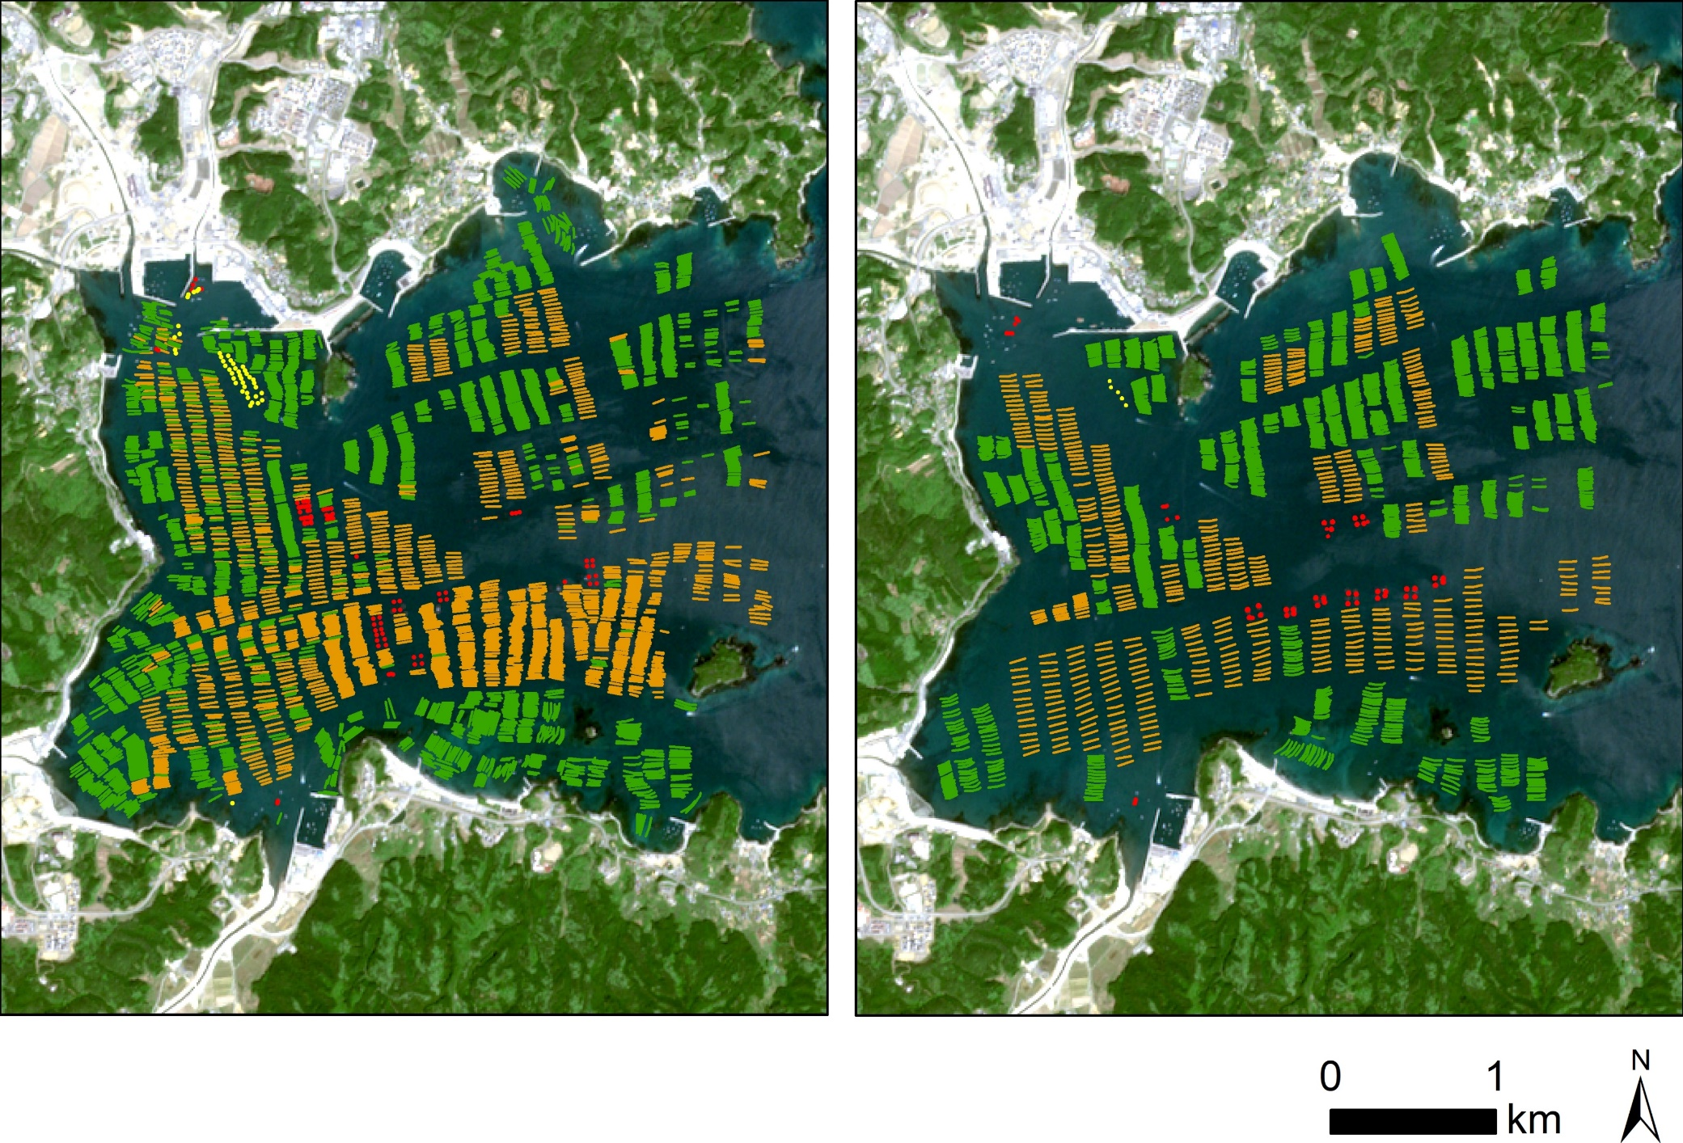
Togura aquaculture systems from satellite (red circle area)
Feb. 2009 (before Tsunami)
Feb. 2017 (after Tsunami)
Oyster farm
Laminaria farm
Fish pond

Slide 19
Take home messages
Earthquake and Tsunami disaster broke every coastal lives and infrastructures.
During restoration of coastal lives, reconstruction of infrastructure tends to start earlier.
It sometimes cut coastal material cycles between land and sea.
We need to keep viewpoints from ecosystem-based disaster risk reduction (eco-DRR).
It is important to work together with multi-stakeholders, scientists, citizens and local governments.
Habitat mapping provides an excellent platform for multi-stakehilders to construct restoration plan, evacuation from disasters, and sustainable use of coastal resources.

