Slide 1











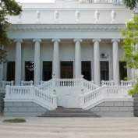

X-ray absorption analysis of Zn and Cu speciation in soils around the sediment ponds of chemical plants
Tatiana Minkina, Dina Nevidomskaya, Victoria Shuvaeva, Tatiana Bauer, and Marina Burachevskaya
Southern Federal University, Rostov-on-Don, Russia
tminkina@mail.ru

Slide 2

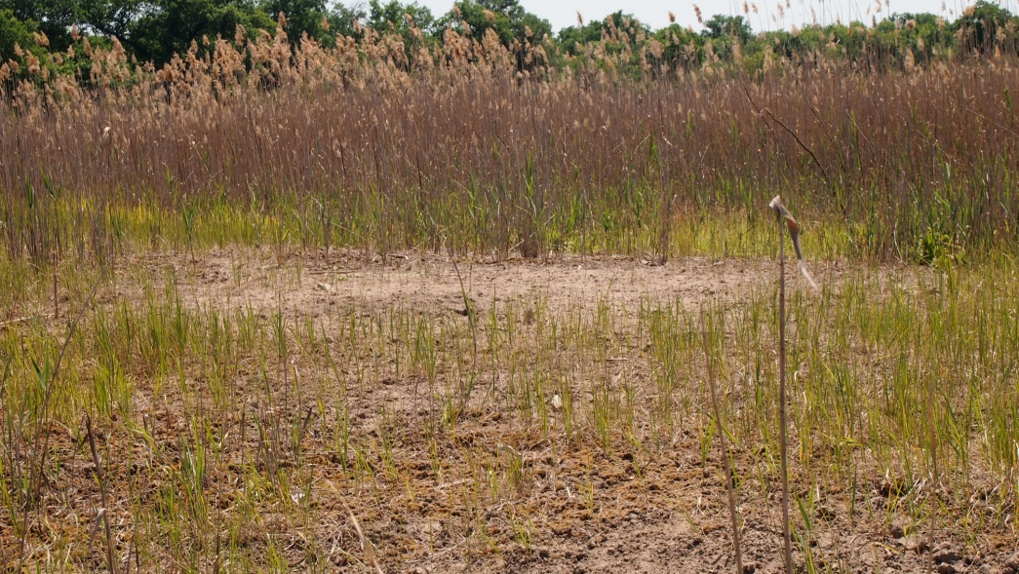
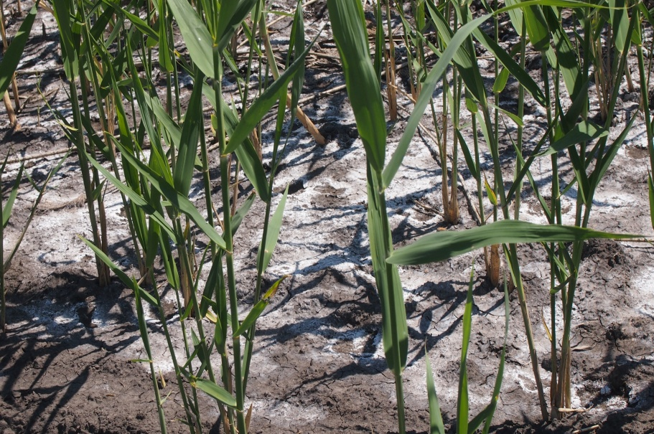
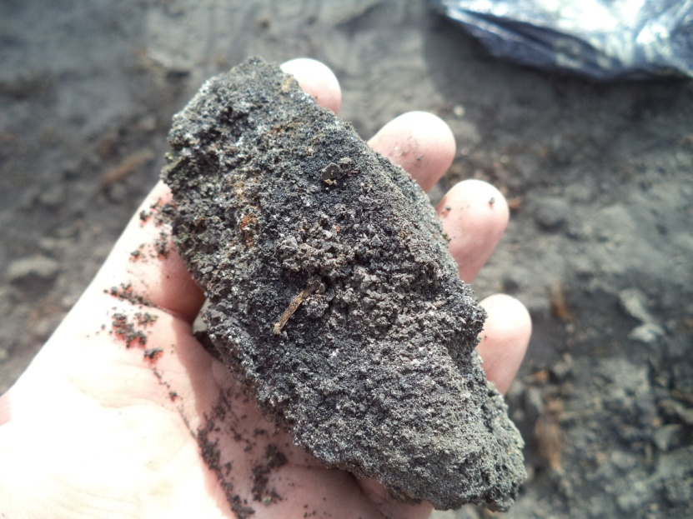
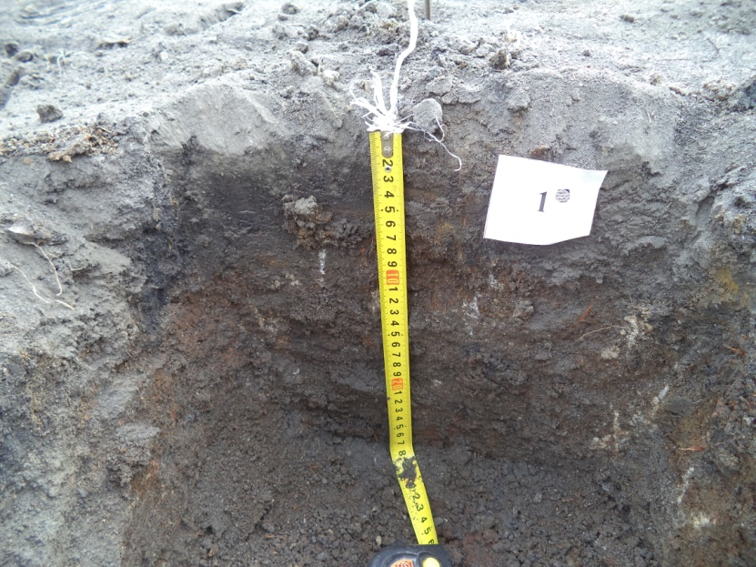
D1
Object of study
D4
The territory around the sediment ponds of chemical plants in the Severskii Donets floodplain in Rostov oblast, South of Russia

Slide 3
Physical and chemical properties Fluvisol (background soil D0) and Technosols (D4) of the investigated monitoring plots
Sample/Parameter | D0 (Control) | D4
C_{org},% | 3.4±0.1 | 4.4±0.2
pH_{water} | 7. 3±0.2 | 7.7±0.3
СаСО₃, % | 1.3±0.02 | 5.3±0.3
Exchangeable Ca²⁺, cmol(+)/kg | 31.0±2.4 | 35.2±1.7
Exchangeable Mg²⁺, cmol(+)/kg | 4.5±0.3 | 5.0±0.2
SO₃, % | 0.8±0.02 | 7.3±0.1
Fe₂O₃,% | 7±0.2 | 6.0±0.1
Silt fractions (0.01-0.001 mm), % | 53.1±2.7 | 52.1±3.8
Clay fraction (<0.001 mm), % | 32.4±2.1 | 33.0±2.6
Pb (16*) | 20.1±1.7 | 1591.2±129.3
Cr (83) | 97.9±7.3 | 154.1±12.5
Ni (58) | 40.9±2.6 | 80.5±10.0
Mn (1000) | 230.4±66.9 | 426.1±51.0
Cu (47) | 43.7±3.2 | 146.9±10.4
Zn (83) | 90,0±7,6 | 66000±5903
Cd (0.13) | 0.2±0.003 | 10.6±1.0
(*) lithosphere clark (Vinogradov, 1957); excesses over the clarks are highlighted in bold

Slide 4
Mineralogy composition Fluvisol (background soil D0) and Technosols (D4) of the investigated monitoring plots, %
Sample | Terrigenic minerals |  |  |  |  |  |  |  |  | Autigenic minerals
 | Stable |  |  |  |  | Unstable
 | Rutil | Zircon | lmenite | Kyanit | Staurolite | Amphibole | Muscovite, biotite | Magnetite, hematite | Pyroxene | Iron hydroxides | Pyrite, marcasite | Carbonates | Sulfates
D0 (Control) | 4.0 | 8.0 | 5.0 | tr* | 4.0 | nd** | н/о | 57.0 | 3.0 | 13.0 | 1.0 | tr | 5.0
D4 | tr | tr | 12.0 | tr | nd | nd | nd | tr | nd | 20.0 | 8.0 | tr | 60.0
*(tr) traces
**(nd) not detected

Slide 5
Method of Sequential extraction
Extraction stage and heavy metal fractions | Extracts
First: Water soluble, exchangeable and carbonate bound fraction | extraction with 0.11 mol/dm3 of acetic acid for 16 h at 22 ± 5 °C with constant stirring
Second: Reducible fraction (Iron/manganese oxyhydroxides) | extraction with 0.1 mol/dm³ Na₂OH·HCl during 16 h with continuous stirring at pH = 2 (with the HNO₃ input)
Third: Oxidizable fraction (Organic matter and sulfides) | 1) 2 h in water bath at temperature 85±2 ºC, dispersion H₂O₂ at pH = 2 2) 16 h in water bath at temperature 22 ± 2 oC, continuous stirring, dispersion 1.0 mol/dm³ NH₄OAc(CH₃COOHNH₄) at pH = 2 (with the HNO3 input)
Residual: residual fraction (soluble in oxidative acids) | includes dispersed metals with a mixture of concentrated hot acids HNO₃ and HCl
BCR three-stage sequential extraction scheme

Slide 6
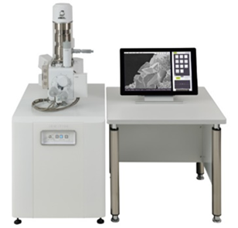
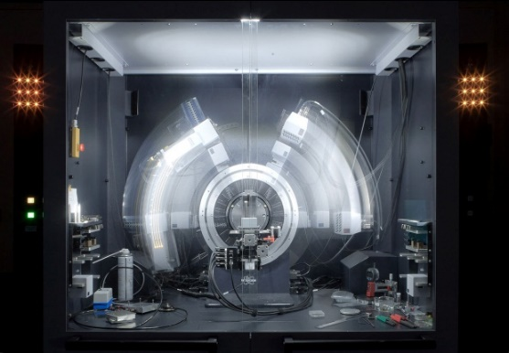
Methods of study
X-ray Absorption Spectroscopy
(XANES and EXAFS)
X-ray Diffraction (XRD)
Fragment of a large ring of the Kurchatov synchrotron
Scanning Electron Microscopy (SEM) and energy-dispersive X-ray (EDX) spectroscopy
SEM – CarlZeiss EVO-40
X-ray diffraction
The accumulation and speciation of Zn and Cu technogenically man-transformed soils within the anomaly zone were studied using a direct
nondestructive physical methods

Slide 7
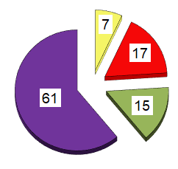
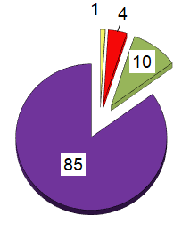
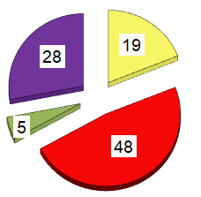
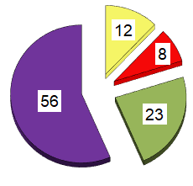
Fraction composition of Zn and Cu compounds (mg/kg) in
Fluvisol (background soil D0) and Technosol (D4)
Zn
Cu
Background soil (D0)
Monitoring plot | Fraction
 | acid-soluble | reducible | oxidisable | residual
Zn
D0 | 6.0±0.04 | 15.0±1.2 | 13.8±0.7 | 55.2±7.2
D4 | 1172 ±1069 | 29954±2356 | 2794±146 | 17559±1491
Cu
D0 | 0.6±0.1 | 1.6±0.1 | 4.4±0.6 | 37.1±2.8
D4 | 18.0±0.9 | 12.0 ±1.0 | 34.1±3.7 | 82.8±9.1
Background soil (D0)
Technosol (D4)
Technosol (D4)
Fractionation of Zn in the Technosol unraveled a high degree of metal fixation with Fe–Mn (hydr)oxides and silicates. Cu is characterised by accumulation in the residual and oxidisable fractions.

Slide 8
Synchrotron X-ray diffraction (XRD) of Technosol samples after the BCR selective sequential extraction
The XRD analysis unraveled the presence of authigenic S-containing minerals: sphalerite (cubic ZnS), würtzite (hexagonal ZnS), covellite (CuS) and bornite (Cu₅FeS₄).

Slide 9
Diagnostics of Zn speciation in chemical fractions of the Technosol using synchrotron methods (XANES and EXAFS)
Results of the modeling of experimental Zn K-edge XANES spectra of Technosol samples after different stages of the sequential fractionation and linear combinations of the spectra of reference compounds, % of the share of compounds in sample
Fractions | ZnSO₄ | ZnO | ZnS
_{First stage} _{(Exchangeable)} | 65 | 0 | 35
_{Second stage} _{(Reducible)} | 0 | 50 | 50
_{Third stage} _{(Oxidizable)} | 25 | 18 | 57
Zn K-edge XANES spectra of
fractions extracted
k²-weighted EXAFS oscillations in the Zn K-edge absorption spectra
Best fits of the Fourier transform
of Zn EXAFS spectra
After the removal of exchange Zn compounds from Technosol (First stage), the soil is enriched in a great diversity of metal compounds, primarily with Zn–S and Zn–O bonds. In the fraction associated with phyllosilicates, the Zn–О bond is the main component (50%). After extracting the first and second fractions, the Zn–S bond prevails as würtzite (hexagonal ZnS) that makes up more than 50%, in agreement with predominance of the Zn–O bond in the first shell based on the EXAFS data.
9

Slide 10
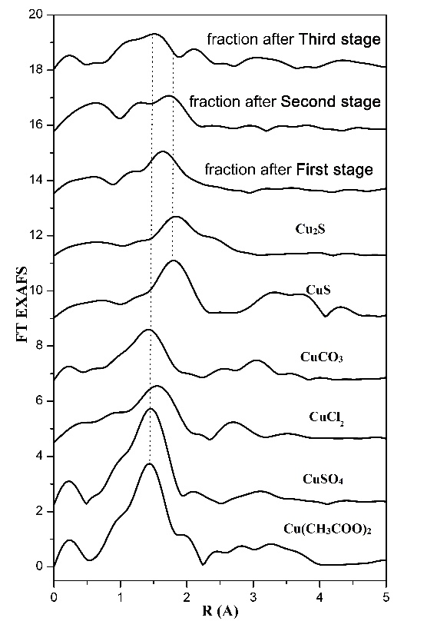
Diagnostics of Cu speciation in chemical fractions of the Technosols using synchrotron methods (XANES and EXAFS)
Results of the modeling of experimental Cu K-edge XANES spectra of Technosol samples after different stages of the sequential fractionation with the linear combination of reference compound spectra, % of the share of compounds in sample
Fractions | CuSO₄ | CuCO₃ | Cu₂S | CuS | CuCl₂
_{First stage} _{(Exchangeable)} | 4 | 0 | 86 | 0 | 10
_{Second stage} _{(Reducible)} | 0 | 0 | 100 | 0 | 0
_{Third stage} _{(Oxidizable)} | 12 | 50 | 33 | 0 | 0
Cu K-edge XANES spectra of
fractions extracted
k²-weighted EXAFS oscillations in the Cu K-edge absorption spectra
Best fits of the Fourier transform
of Cu EXAFS spectra
The results show that samples after the First stage are typically dominated by Cu₂S and CuCO₃. Spectra of soil samples after the Second stage match the Cu₂S spectra with a high degree of accuracy, suggesting the prevalence of chalcocite in the given fraction. The soil sample after the third stage is characterised by a high content of CuCO₃ (50% of all Cu compounds) and Cu₂S (30% of all Cu compounds).
10

Slide 11
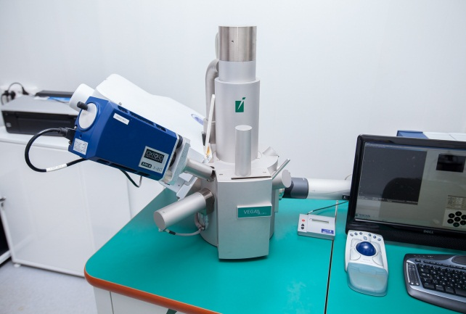
SEM images of the newly formed minerals of Zn and Cu along with EDX spectra
The EDX spectra of Technonol's microaggregats. wt %
О | Al | Si | S | Ca | Fe | Zn
14.3 | 0.5 | 0.8 | 23.1 | 3.3 | 1.7 | 43.3
Zinc speciation occurs as ‘crusts’, aggregates with calcite and gypsum
The EDX spectra revealed that metal concentrations are higher than the detection limit of ~0.05 wt %. The main concentrator of Zn phase is represented by the aqueous sulphate, goslarite (ZnSO₄•7H₂O) produced after the oxidation of zinc sulphate, and würtzite (ZnS). It has been established that Zn can make up both eigenphases and bonds with clay minerals or carbonates. The latters tend to adsorb actively Zn and fix it on the surface. High Cu concentration (> 0.05 wt %) was recorded only in the bond with clay aggregates.

Slide 12
CONCLUSION
Zn and Cu speciation in the highly contaminated Technosol was studied based on the XAFS, XRD and SEM methods after each stage of the sequential extraction procedure.
• Phyllosilicates and Fe-Mn (hydr)oxides are the main stabilizers of Zn mobility. Cu is characterised by accumulation in the residual and oxidisable fractions.
• The number of compounds with a higher solubility decreases at the subsequent stages of extraction.
•After first stage, the residual soil is enriched of with Me–S and Me–O bonds. In the residual soil left after extracting first and second fractions, the Zn–S bond prevails as würtzite (ZnS), while the Cu–S bond is represented only by chalcocite (Cu₂S).
.

Slide 13

Thanks
The reported study was funded by Russian Foundation for Basic Research, projects no. 19-34-60041 and 19-05-50097

