Slide 1
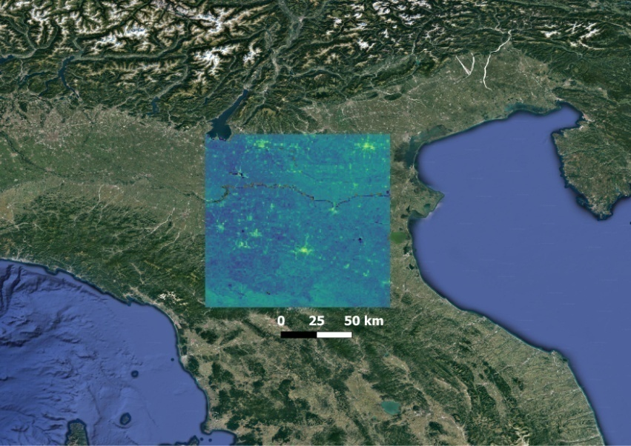
2020 EUROPEAN GENERAL ASSEMBLY,
4-8 May 2020
Irrigation detection with Sentinel-1 radar backscatter observations over an agricultural area in the Po River Valley (Italy)
Sara Modanesi^{1,2,4}, Gabriëlle J. M. De Lannoy², Alexander Gruber², Christian Massari¹, Luca Brocca¹, Hans Lievens², Renato Morbidelli³
¹ Research Institute for Geo-hydrological Protection, National Research Council, Via Madonna Alta 126, 06128 Perugia, Italy
² Department of Earth and Environmental Sciences, KU Leuven, Heverlee, Belgium.
³ Dept. of Civil and Environmental Engineering of Perugia, via G. Duranti 93, 06125 Perugia, Italy
⁴ DICEA Dept. of Civil and Environmental Engineering, University of Florence, Via di S. Marta 3, 50139 Firenze, Italy
sara.modanesi@irpi.cnr.it

Slide 2
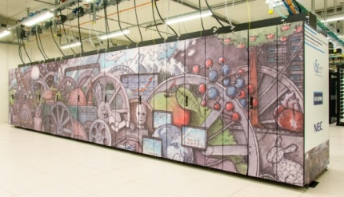
OBJECTIVE
*
Land Surface Model (LSM)
Simplified or absent anthropogenic activities
DATA ASSIMILATION
Detection of irrigation and improvement of LSM water fluxes
Sentinel-1 backscatter
σ⁰_{VV} and σ⁰_{VH}
1km spatial resolution
Noah MP
Noah MP With/without irrigation module turned on (Ozdogan et al., 2010)
+
Water Cloud Model
(Attema and Ulaby,1978)
(product by Lievens, H.)
DOI: 10.1175/JHM-D-14-0104.1
Notes:
The research focuses on the detection of irrigation using a Land Surface Model (LSM). Noah MP LSM has been selected for its ability to dynamically simulate the vegetation. It runs within the NASA’s Land Information System (LIS) and the framework is performed through the Flanders Vlaams Supercomputer Centrum (VSC). LSMs are generally characterized by simplified or absent description of anthropogenic activities. Therefore, data assimilation of satellite remote sensing observations seems to be the best way to overcome this issue. In particular, Sentinel-1 mission backscatter observations in both VV and VH polarizations have been used for this research considering their ability to look at the Earth surface in a more realistic way and to theoretically detect irrigation. The main idea is to assimilate radar observations into the Noah MP, running with or without an irrigation module turned on and coupled with a Water Cloud Model (WCM), which simulates the backscatter.

Slide 3
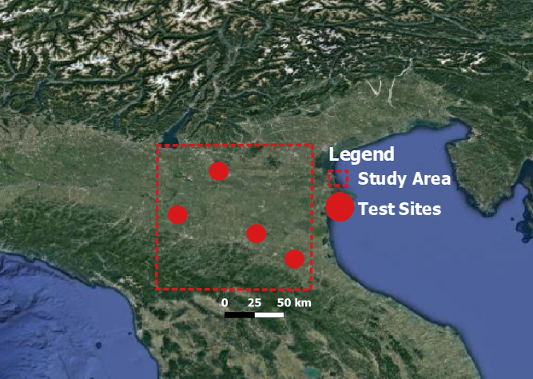
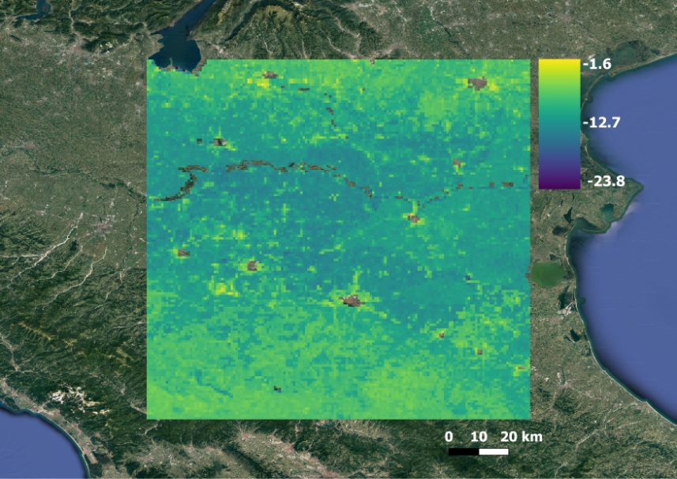
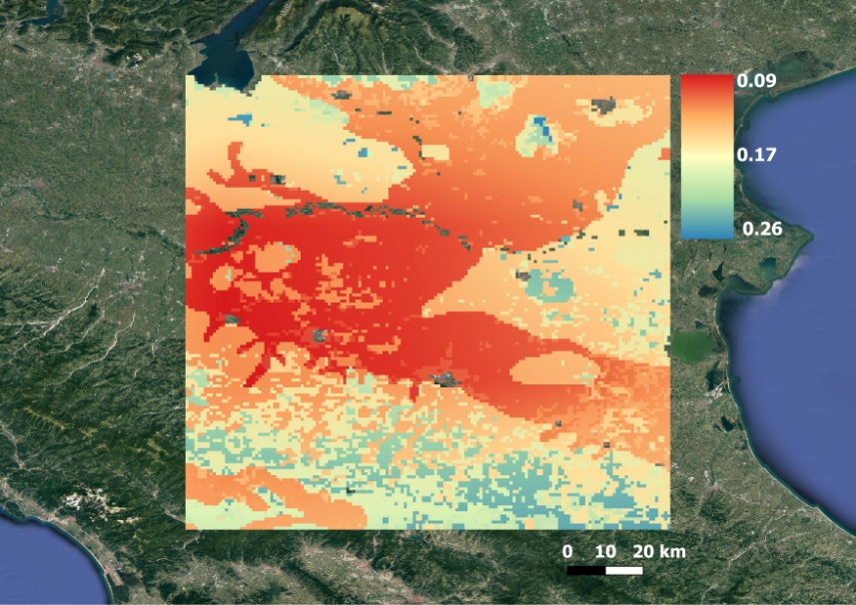
MODELLED DATA & SENTINEL-1
Study area
Po River Valley
important agricultural area
Four test sites
Irrigation data
Sentinel-1
Noah MP
Noah MP +WCM
σ⁰_{VV} (dB)
2016-07-22
Soil moisture (m³/ m³)
2016-07-22
σ⁰_{VV} (dB)
2016-07-22
Notes:
Part of the Po River Valley (Italy) has been selected as study area considering its importance for agricultural practices. Irrigation data for four test sites are additionally available to validate all the process. Sentinel-1 backscatter data were collected from the period 2015-2018, both in VV and VH polarization. The product is characterized by a spatial resolution of 1km (EASEv2 grid) and it has been generated through Google Earth Engine using both images from Sentinel-1A and Sentinel-1B. Noah MP has been running for the study period (2015-2018), every six hours and successively it was coupled with a calibrated WCM in LIS. Indeed, the WCM takes input from the state variables of Noah MP to simulate the backscatter. Adding a WCM in LIS was the first step to generate a data assimilation system able to assimilate radar backscatter observations.

Slide 4
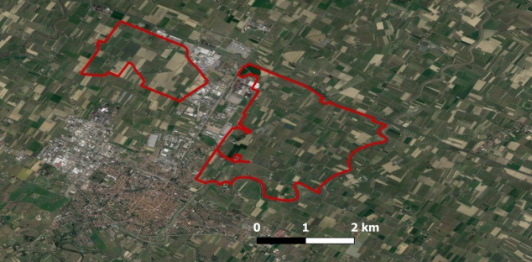
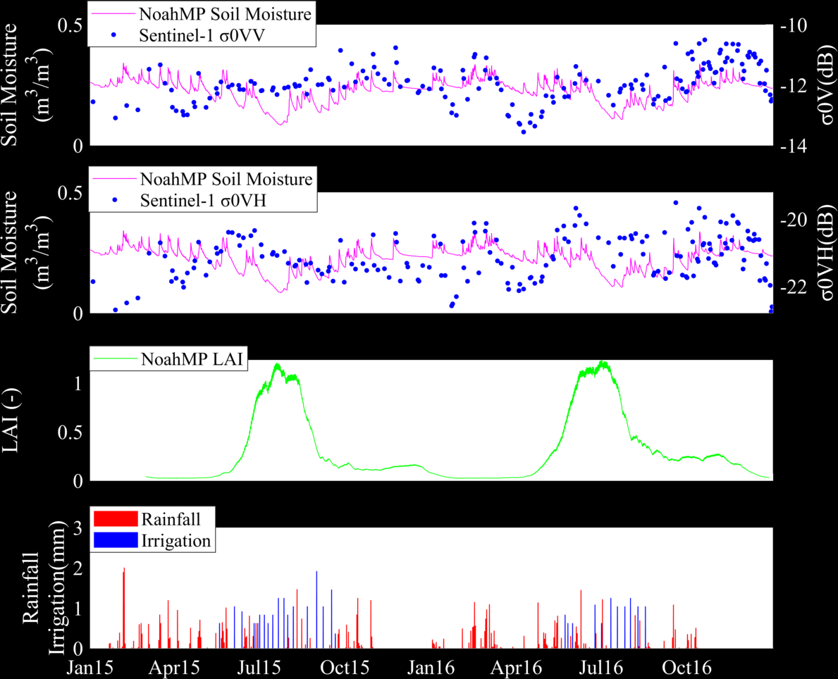
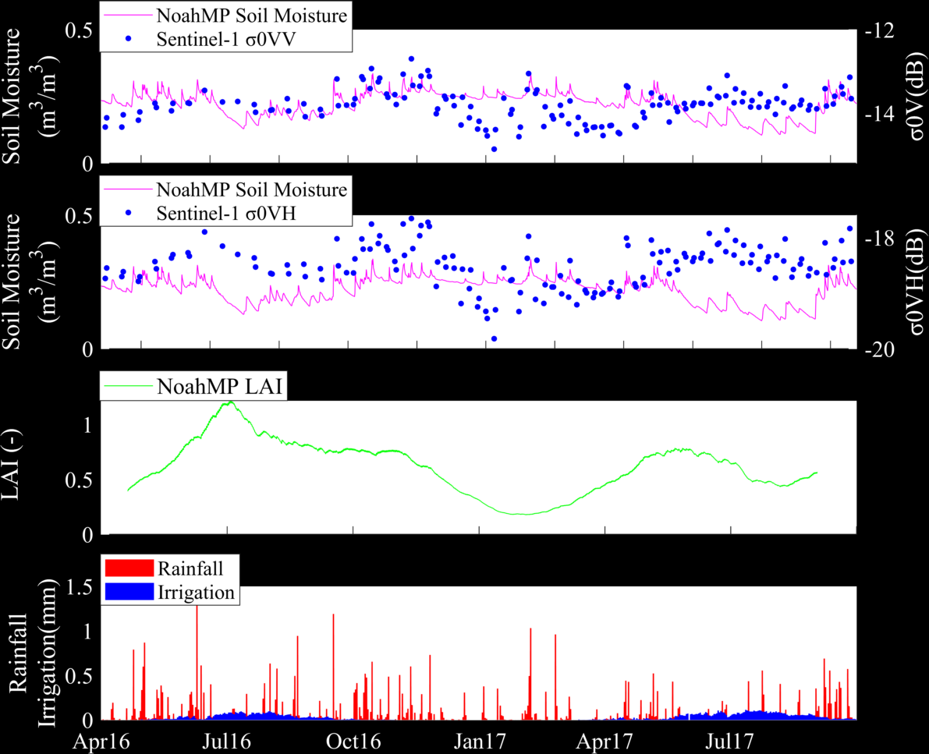
SENTINEL-1 & IRRIGATION
Budrio
Test site
Faenza
Test site
Notes:
As a preliminary step we compared irrigation data from the four test sites to soil moisture and LAI from Noah MP, and backscatter in VV and VH polarization from Sentinel-1. Here are two examples from two test sites, Budrio and Faenza. For each test site, the upper plot displays soil moisture and σ⁰_{VV}, while in the second plot soil moisture is overlapped to σ⁰_{VH} . The VV polarization seems to be more related to soil moisture as compared to the σ⁰_{VH} , which on the opposite follows a pattern more related to the vegetation climatology. Obviously, soil moisture and LAI are prone to model errors . As an example soil moisture from Noah MP drop down during irrigated periods while σ⁰_{VV} has a steady pattern and stays higher. On the other side, the LAI climatology need to be corrected using satellite observations. The main objective is then to create a data assimilation system which will allow to update both soil moisture and vegetation using σ⁰_{VV} and σ⁰_{VH}.

Slide 5
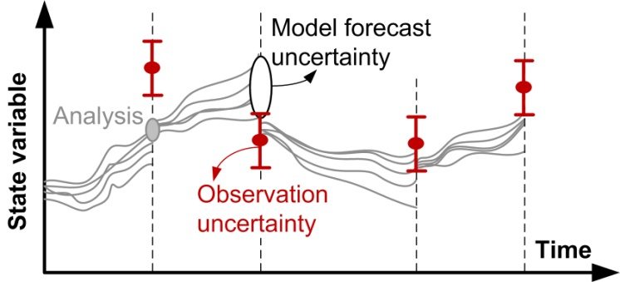
FUTURE STEPS
Data Assimilation system: Irrigation can be derived from the misfits between sequentially updated model forecasts and satellite observations
Update vector
soil moisture and vegetation
Optimization
Which DA technique?
Work in progress!
Notes:
Future steps include to create a data assimilation systems in which the irrigation can be derived from the misfits between sequentially updated model forecasts and satellite observations. In order to update both soil moisture and vegetation we will need to the optimal data assimilation technique to be selected. This is still work in progress.

