Slide 1
First Results of the 2019 Algerian Magnetic Repeat Station Network A.LEMGHARBI ⁽¹⁾, A.ABTOUT ⁽¹⁾, M.HAMMOUDI ⁽²⁾, A.BENDDEKEN ⁽¹⁾, A.MANSOURI ⁽¹⁾, A.HEMMI ⁽¹⁾, F.ANNAD⁽¹⁾, M.ALLIL⁽¹⁾, E.AGANOU⁽¹⁾, A.MAZARI⁽¹⁾
(1): CRAAG (Centre de Recherche en Astronomie, Astrophysique et Géophysique)
(2): USTHB (Université des sciences et de la technologie Houari Boumediene -Alger)
Email: lemgharbi.geomag@gmail.com , a.lemgharbi@craag.dz

Slide 2
Abstract:
The second part of the history of the Algerian magnetic repeat station network goes back to 1989 when the new one was started with 37 stations. It was then followed by three other networks in 1993, 1997 and 2005. The first part of this history started at the beginning of the XXth and ended ca 1956.
After a 14-year break, we launched a new repeat stations network in February 2019. The number of carried out stations was increased to 51 to try to cover all the territory.
Each repeat station network consists of stations of periodically, say 5-6 years, measured of three components of the Earth's magnetic field. to try to derive the spatial distribution of the geomagnetic field of Algeria and it's secular variation. This periodicity is also very important for the need to update local as well as global geomagnetic field models such as the International Geomagnetic Reference Field (IGRF).
In this work we describe the new 2019 Algerian repeat station network. Then we will discuss the steps of the absolute measurements using two methods. The first one is called the ‘method of zero’ and the second one ‘method of residuals’. The accuracy and resolution of the instruments and data reduction used and their effect on the final results will as well be discussed. We derive the spatial distribution of the geomagnetic field, and its secular variation. Finally, we will show how local, for instance regional polynomial modeling, is the key issue.

Slide 3
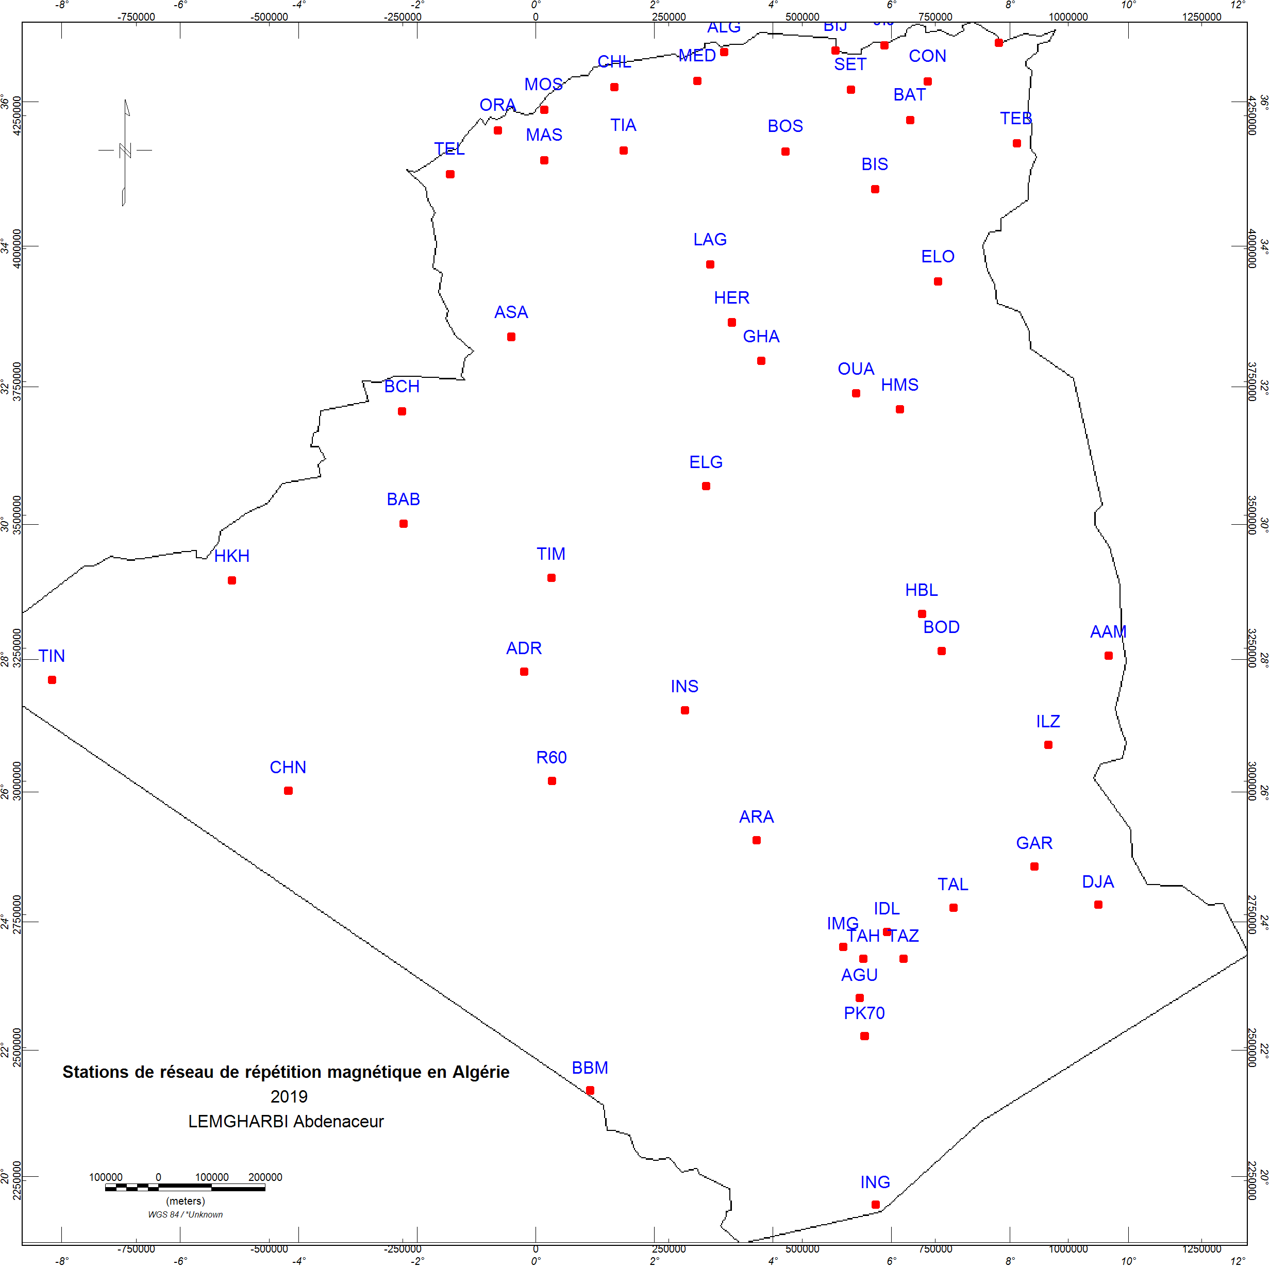
Stations of Network

Slide 4
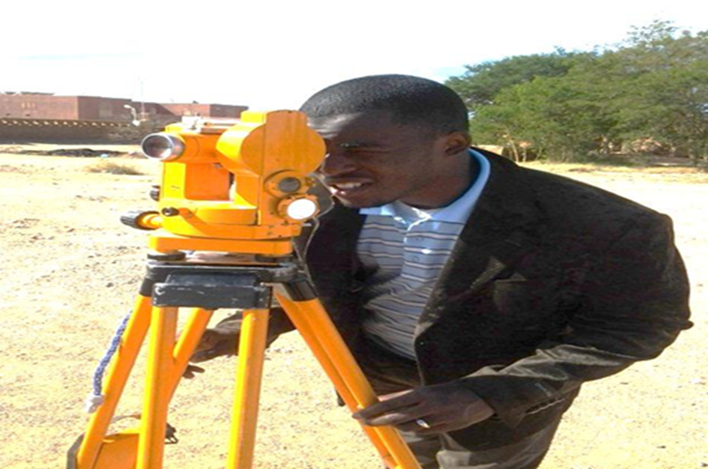
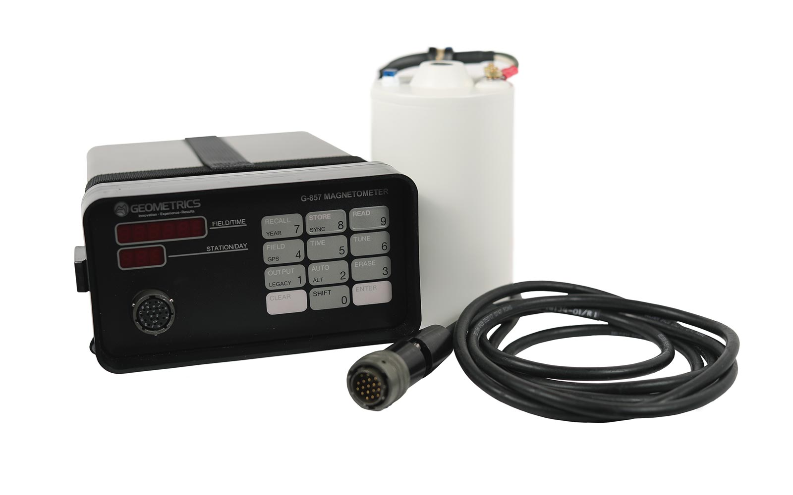
Equipment

Slide 5
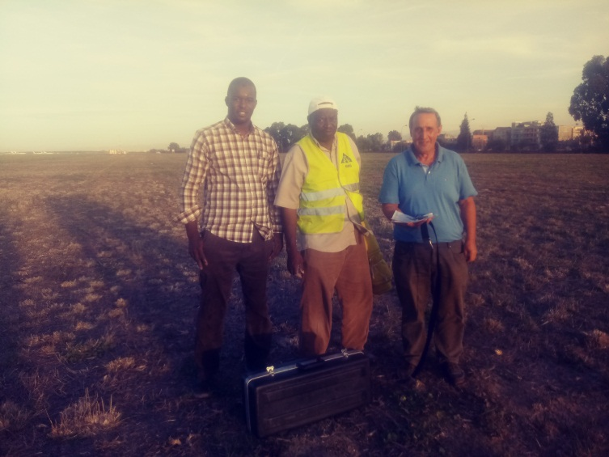
Field crew

Slide 6
Data processing
All data collected has been processed with a customized program that includes all stages of processing , based on this following main relations:
AZIMUTH MARKER: ${ AZ}_{B}={AZ}_{A}+V_{B}−V_{A}$
The declination: $D=\frac{1}{4}\sum_{i=1}^{4}{L_{i}−\frac{1}{2}\sum_{i=1}^{2}{V_{i}+{AZ}_{B}}}±90$
The inclination : $I=\frac{1}{4}\left(\sum_{i=1}^{2}{L_{i}}−\sum_{i=3}^{4}{L_{i}}\right)+90$

Slide 7
Data reduction
All data collected has been reduced to the Tamanrasset Observatory by using on the following relation:
$$E_{s}(t)−E_{s}=E_{o}(t)−E_{0}$$
where :
$E_{s}(t)$ is the observed value of element E at the repeat station at epoch t.
$E_{s}$ is the corresponding value at the station reduced to either a quiet night-time value or to an annual mean.
$E_{o}(t)$ is the value of the element E at the observatory at epoch t.
$E_{0}$ is either the value of the element E at the observatory for a quiet night-time interval or an annual mean value of E at the observatory.

Slide 8
Inclination (I) of Magnetic Field obtained from processed data

Slide 9
Intensity of Magnetic Field obtained from processed data

Slide 10
declination (D) of Magnetic Field obtained from processed data

Slide 11
Polynomial Model
The following surface polynomial was used:
$$B\left(φ,λ\right)=\sum_{n=0}^{N}{\sum_{m=0}^{N}{K_{mn}{\left(φ−φ_{o}\right)}^{n}{\left(λ−λ_{o}\right)}^{m}}}$$
where B is the magnitude of the main field for each element
at the point with geographic coordinates $φ$ (latitude) and $λ$ (longitude), kmn is a numerical coefficient and $φ_{o}$ and $λ_{o}$ are the coordinates of the center of the modelled area: $φ_{o}$ = 30 ◦S and $λ_{o}$ = 2.80 E. The degree
of the polynomial is determined by the value of integer N
(N = 1, 2, 3, 4, 5, . . .).

Slide 12
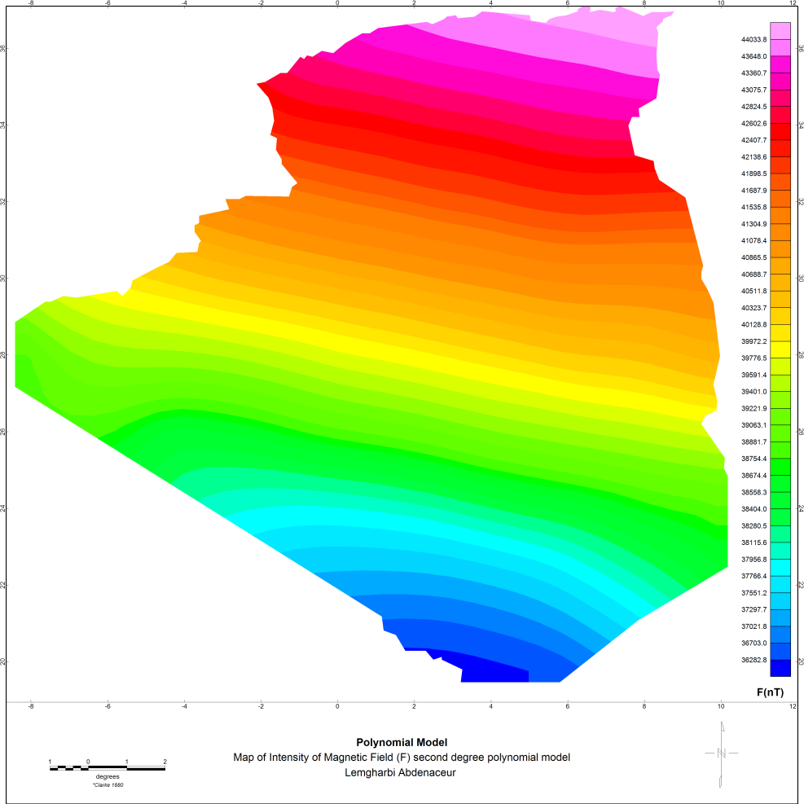
first and second degree of polynomial model Intensity of EMF

Slide 13
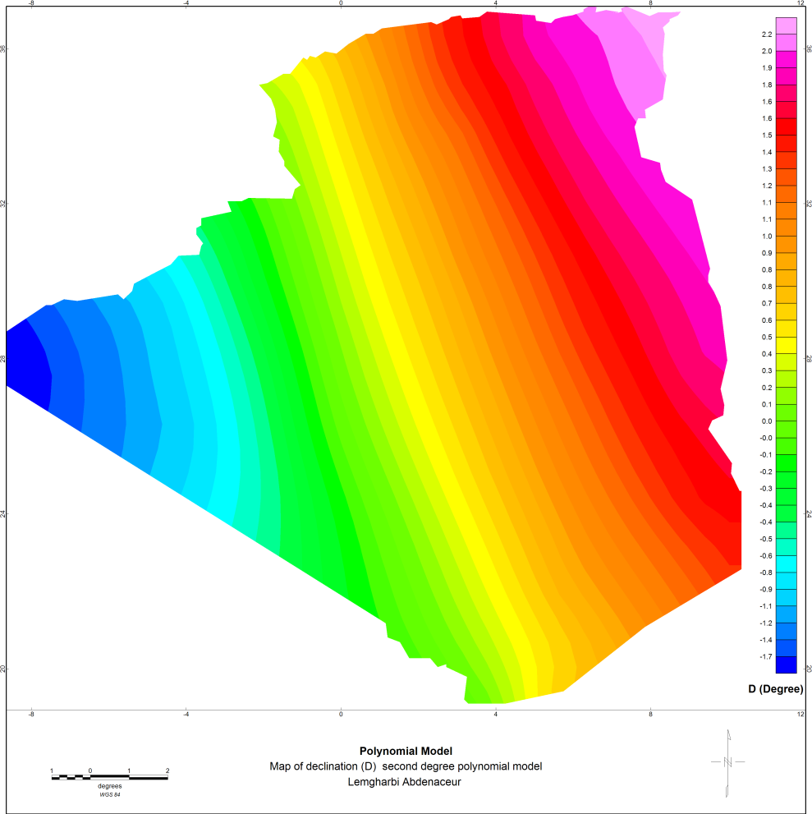
first and second degree of polynomial model declination (D) of EMF

Slide 14
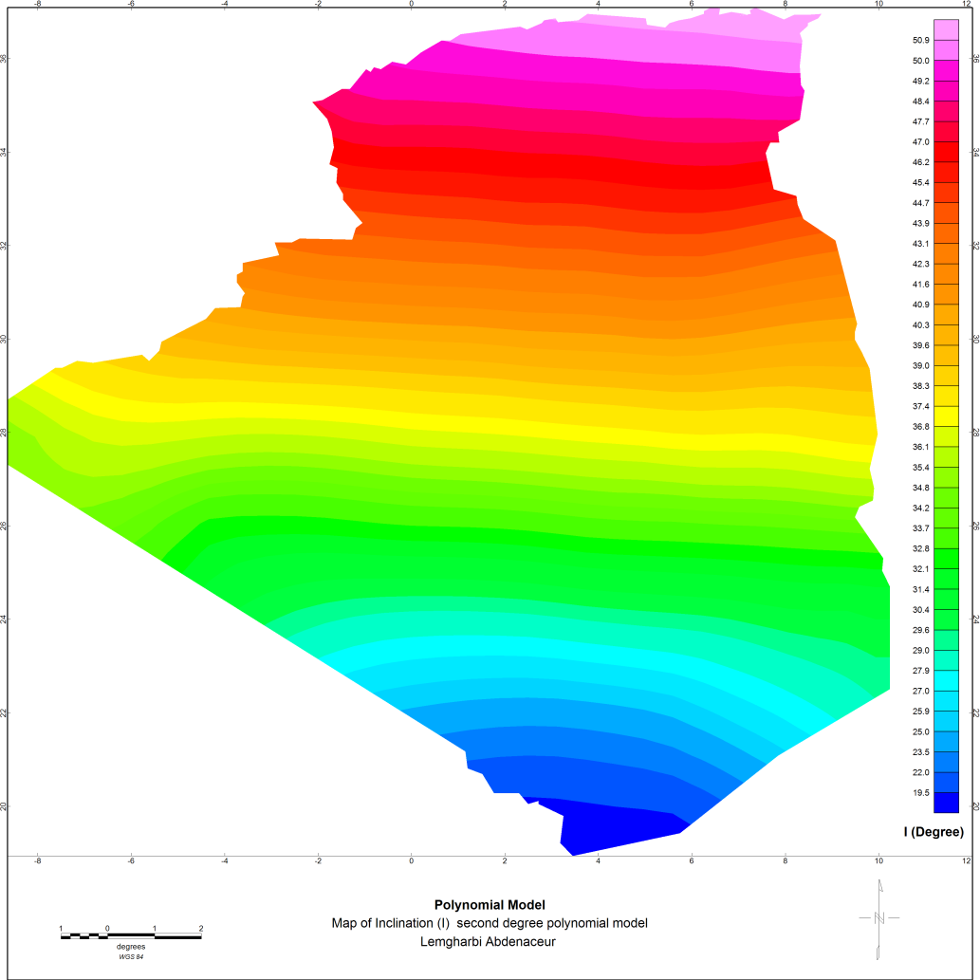
first and second degree of polynomial model Inclination (I) of EMF

