Slide 1
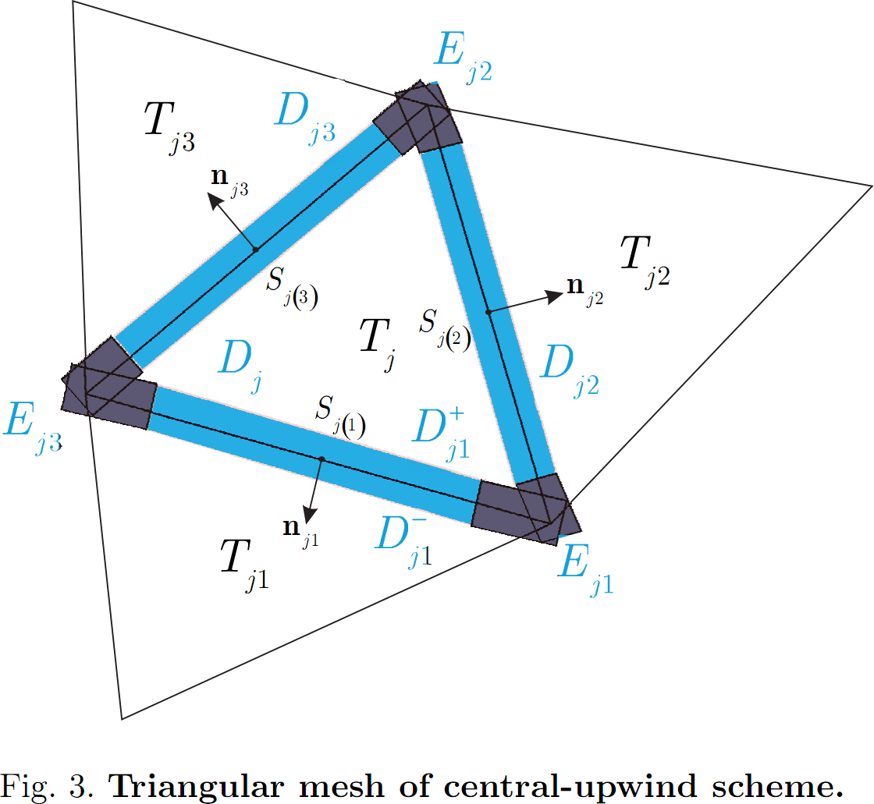
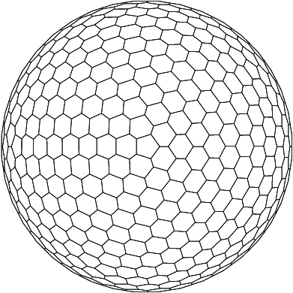
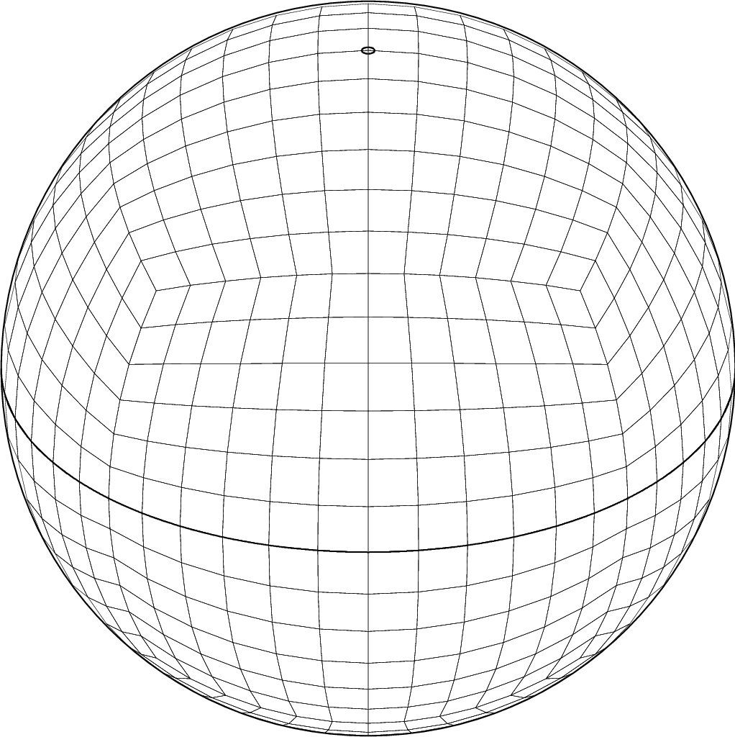
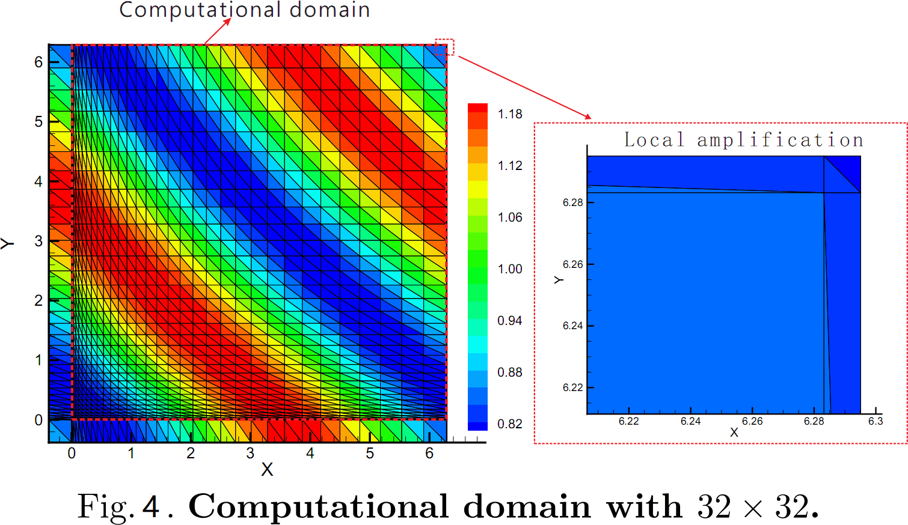
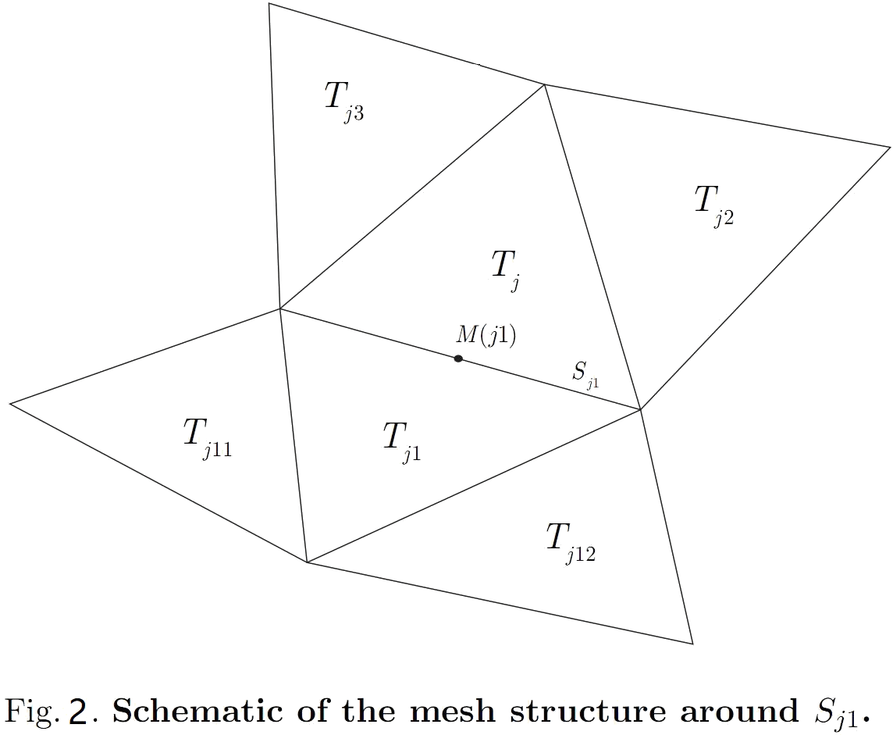
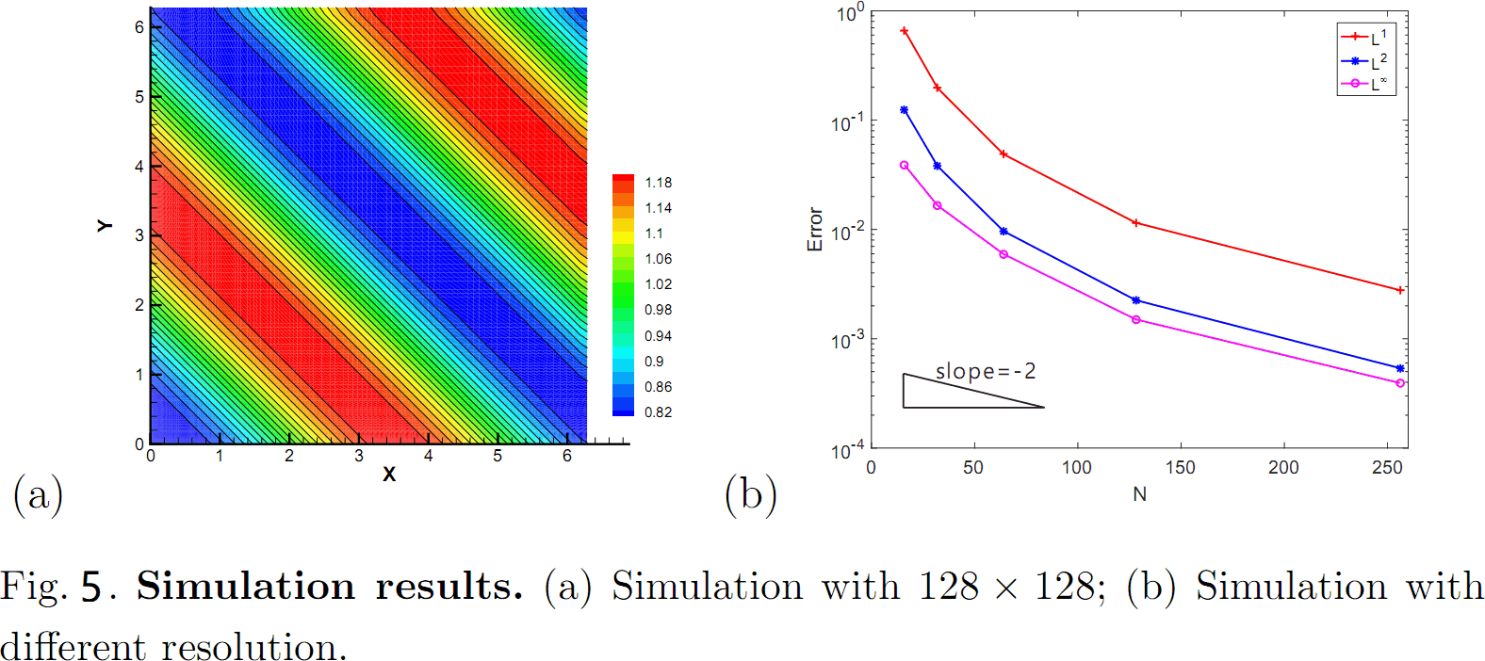
MPDATA method for non–uniform mesh
Xinpeng Yuan
State Key Laboratory of Severe Weather, Chinese Academy of Meteorological Sciences,China
Meteorological Administration, Beijing 100081, China
Introduction
MPDATA method (multidimensional positive definite convection transmission algorithm) is used to efficiently solve the advection transport problem of non-negative thermodynamic variables (such as liquid water or water vapor) in atmospheric dynamics model.
（1）
Three kinds of positive treatment schemes ：
1. Introduce constraint conditions and manually erase discontinuity .
2. Let's bring in a small quantity, and make a negative positive.
Disadvantages: destroy precision, destroy conservation.
3. The convective equation is solved by using a numerical algorithm with guaranteed positive definite, such as MPDATA method, which requires the convective equation to be solved in the premise of guaranteed positive accuracy and conservation, so as to ensure that the numerical solution is always in the invariant set.
Two-dimensional MPDATA for non–uniform grid:
（2）
（3）
On the other hand, there is currently no uniform grid distribution on the sphere.
where：
The theoretical results ：
Theorem: For the compact set (2), when the numerical format (3) is used to solve (1), if , then if and only if
Fig. 1. Spherical unstructured mesh.
where
Methods and theoretical results
For non-uniform grid, the traditional MPDATA method should be improved in two aspects ：
1. The calculation of the derivative at the boundary should be applied to the non-uniform grid
Simulation results
The initial value of
the test:
Improvement: will be expanded at .
Computational domain：
Computation time ：
T=2.0.
Then we have
2. The numerical format itself must be compatible with the non-uniform grid
the convection equation and the discontinuity of convection velocity are fully considered. The finite volume method is applied to block the computational domain .

