Slide 1
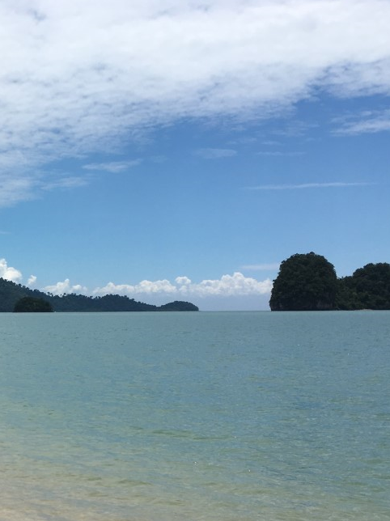
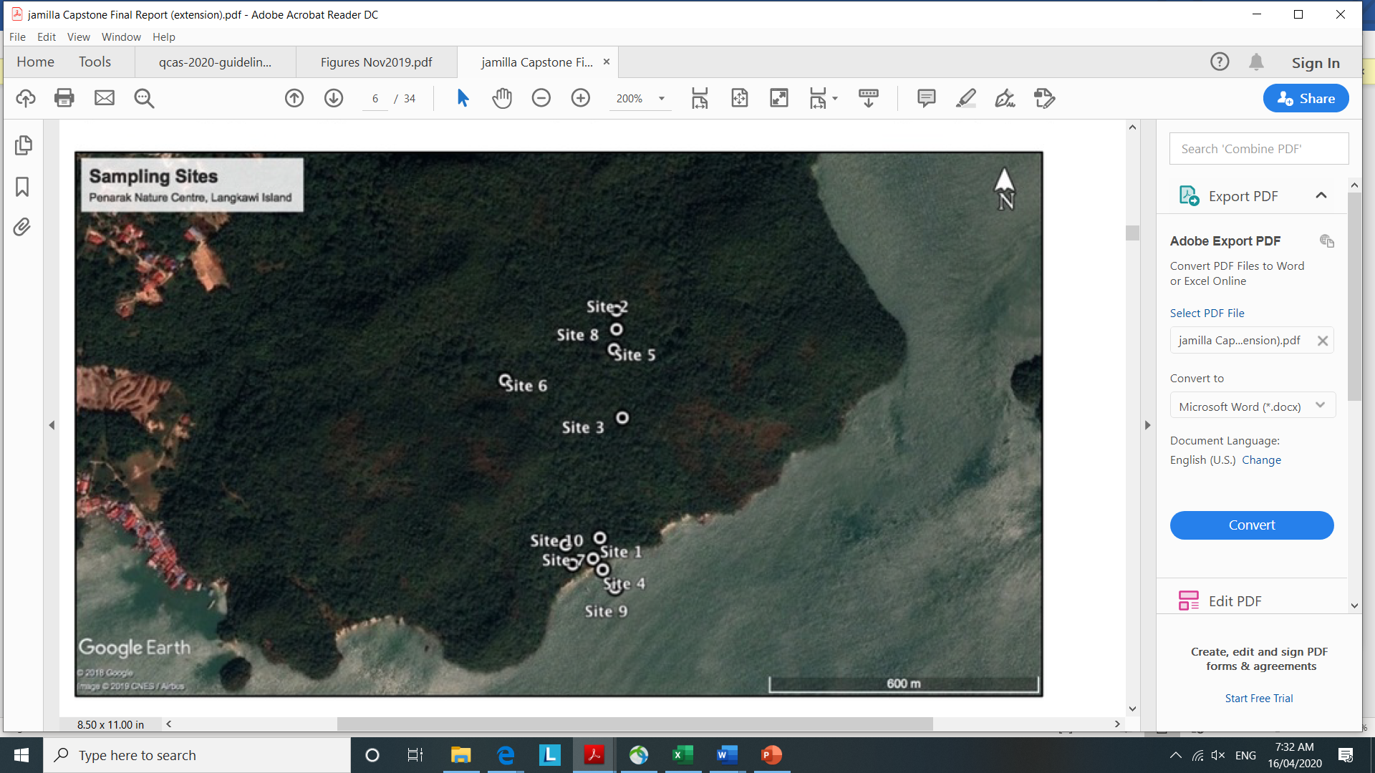

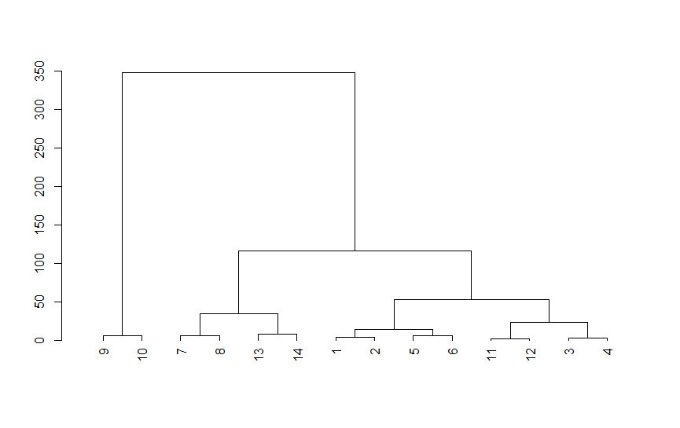

At the Penarak Nature Centre on Langkawi Island, water sampling and analyses were carried out, with a team of undergraduate science students, to characterise the baseline surface water and groundwater chemistry. Samples were collected from 10 locations at the limestone forest site. As no groundwater monitoring bores were available at the site, samples were instead collected from 4 identified groundwater seepage sites, in addition to 5 surface water sites and 1 seawater site. Field measurements of pH, EC, redox potential, dissolved oxygen and temperature were obtained. Samples from each site were also analysed for δ18O, δ2H and major ions.
An assessment of groundwater and surface water geochemistry in a limestone forest, Langkawi Island, Malaysia Lucy Reading (Lucy.Reading@qut.edu.au)
Sampling Sites
Through a combination of geochemical plots and multivariate data analysis (Principal Components Analysis and Cluster Analysis), relationships between the water composition from different sites were identified. The water type for all of the groundwater seepage and surface water sites was Ca-HCO₃, indicating a high degree of groundwater-surface water interaction and rock dissolution.
groundwater seepage and surface water samples
seawater samples
Cluster Analysis
The multivariate data analysis results showed a slight difference in chemical composition for one of the seepage sites, within a construction area, and provided an indication that groundwater sites located less than 300 meters apart may be flowing through separate karst conduits.
construction site
western sites
eastern sites
Site 5a
Site 3b
Site 3a
Site 8b
Site 8a
Site 6b
Site 5b
Site 6a
Site 9a
Site 7b
Site 9b
Site 7a
Site 2
Site 1
This study has been able to provide some baseline geochemical data and preliminary insights into groundwater and surface water interactions in a limestone forest at Langkawi Island. Recommendations for further research include a program of geophysical/hydrogeological mapping of the karst system and the establishment of a water monitoring network within the limestone forest.
Acknowledgments: Queensland University of Technology (QUT), 2018 and 2019 QUT “capstone” students,
Dr Siti Suriawati Isa, Husba Isa, Professor Jenn Firn, New Colombo Plan funding

