Slide 1
Magnetic reconnection induced by the Kelvin-Helmholtz vortex at the Earth’s magnetopause during southward IMF
EGU2020-4027
Takuma (T.K.M.) Nakamura
Space Research Institute (IWF)/Austrian Academy of Sciences (OeAW)
Collaborators:
F. Plaschke (IWF), H. Hasegawa (ISAS), Y.-H. Liu (Dartmouth College), K.-J. Hwang (SwRI), K. A. Blasl (IWF), R. Nakamura (IWF).
Computers:
MareNostrum 4 (PRACE-BSC), Leo1 (IWF)

Slide 2
KH waves for southward IMF
KH waves are observed much less frequently. [e.g., Kavosi & Raeder, 2015]
Reported structure of the observed non-linear KH vortex was irregular and temporally intermittent [Hwang+, 2011].
Cluster observations of KH vortices for southward IMF
KHWs observation rate
[Kavosi & Raeder, 2015]
[Hwang+, 2011]

Slide 3
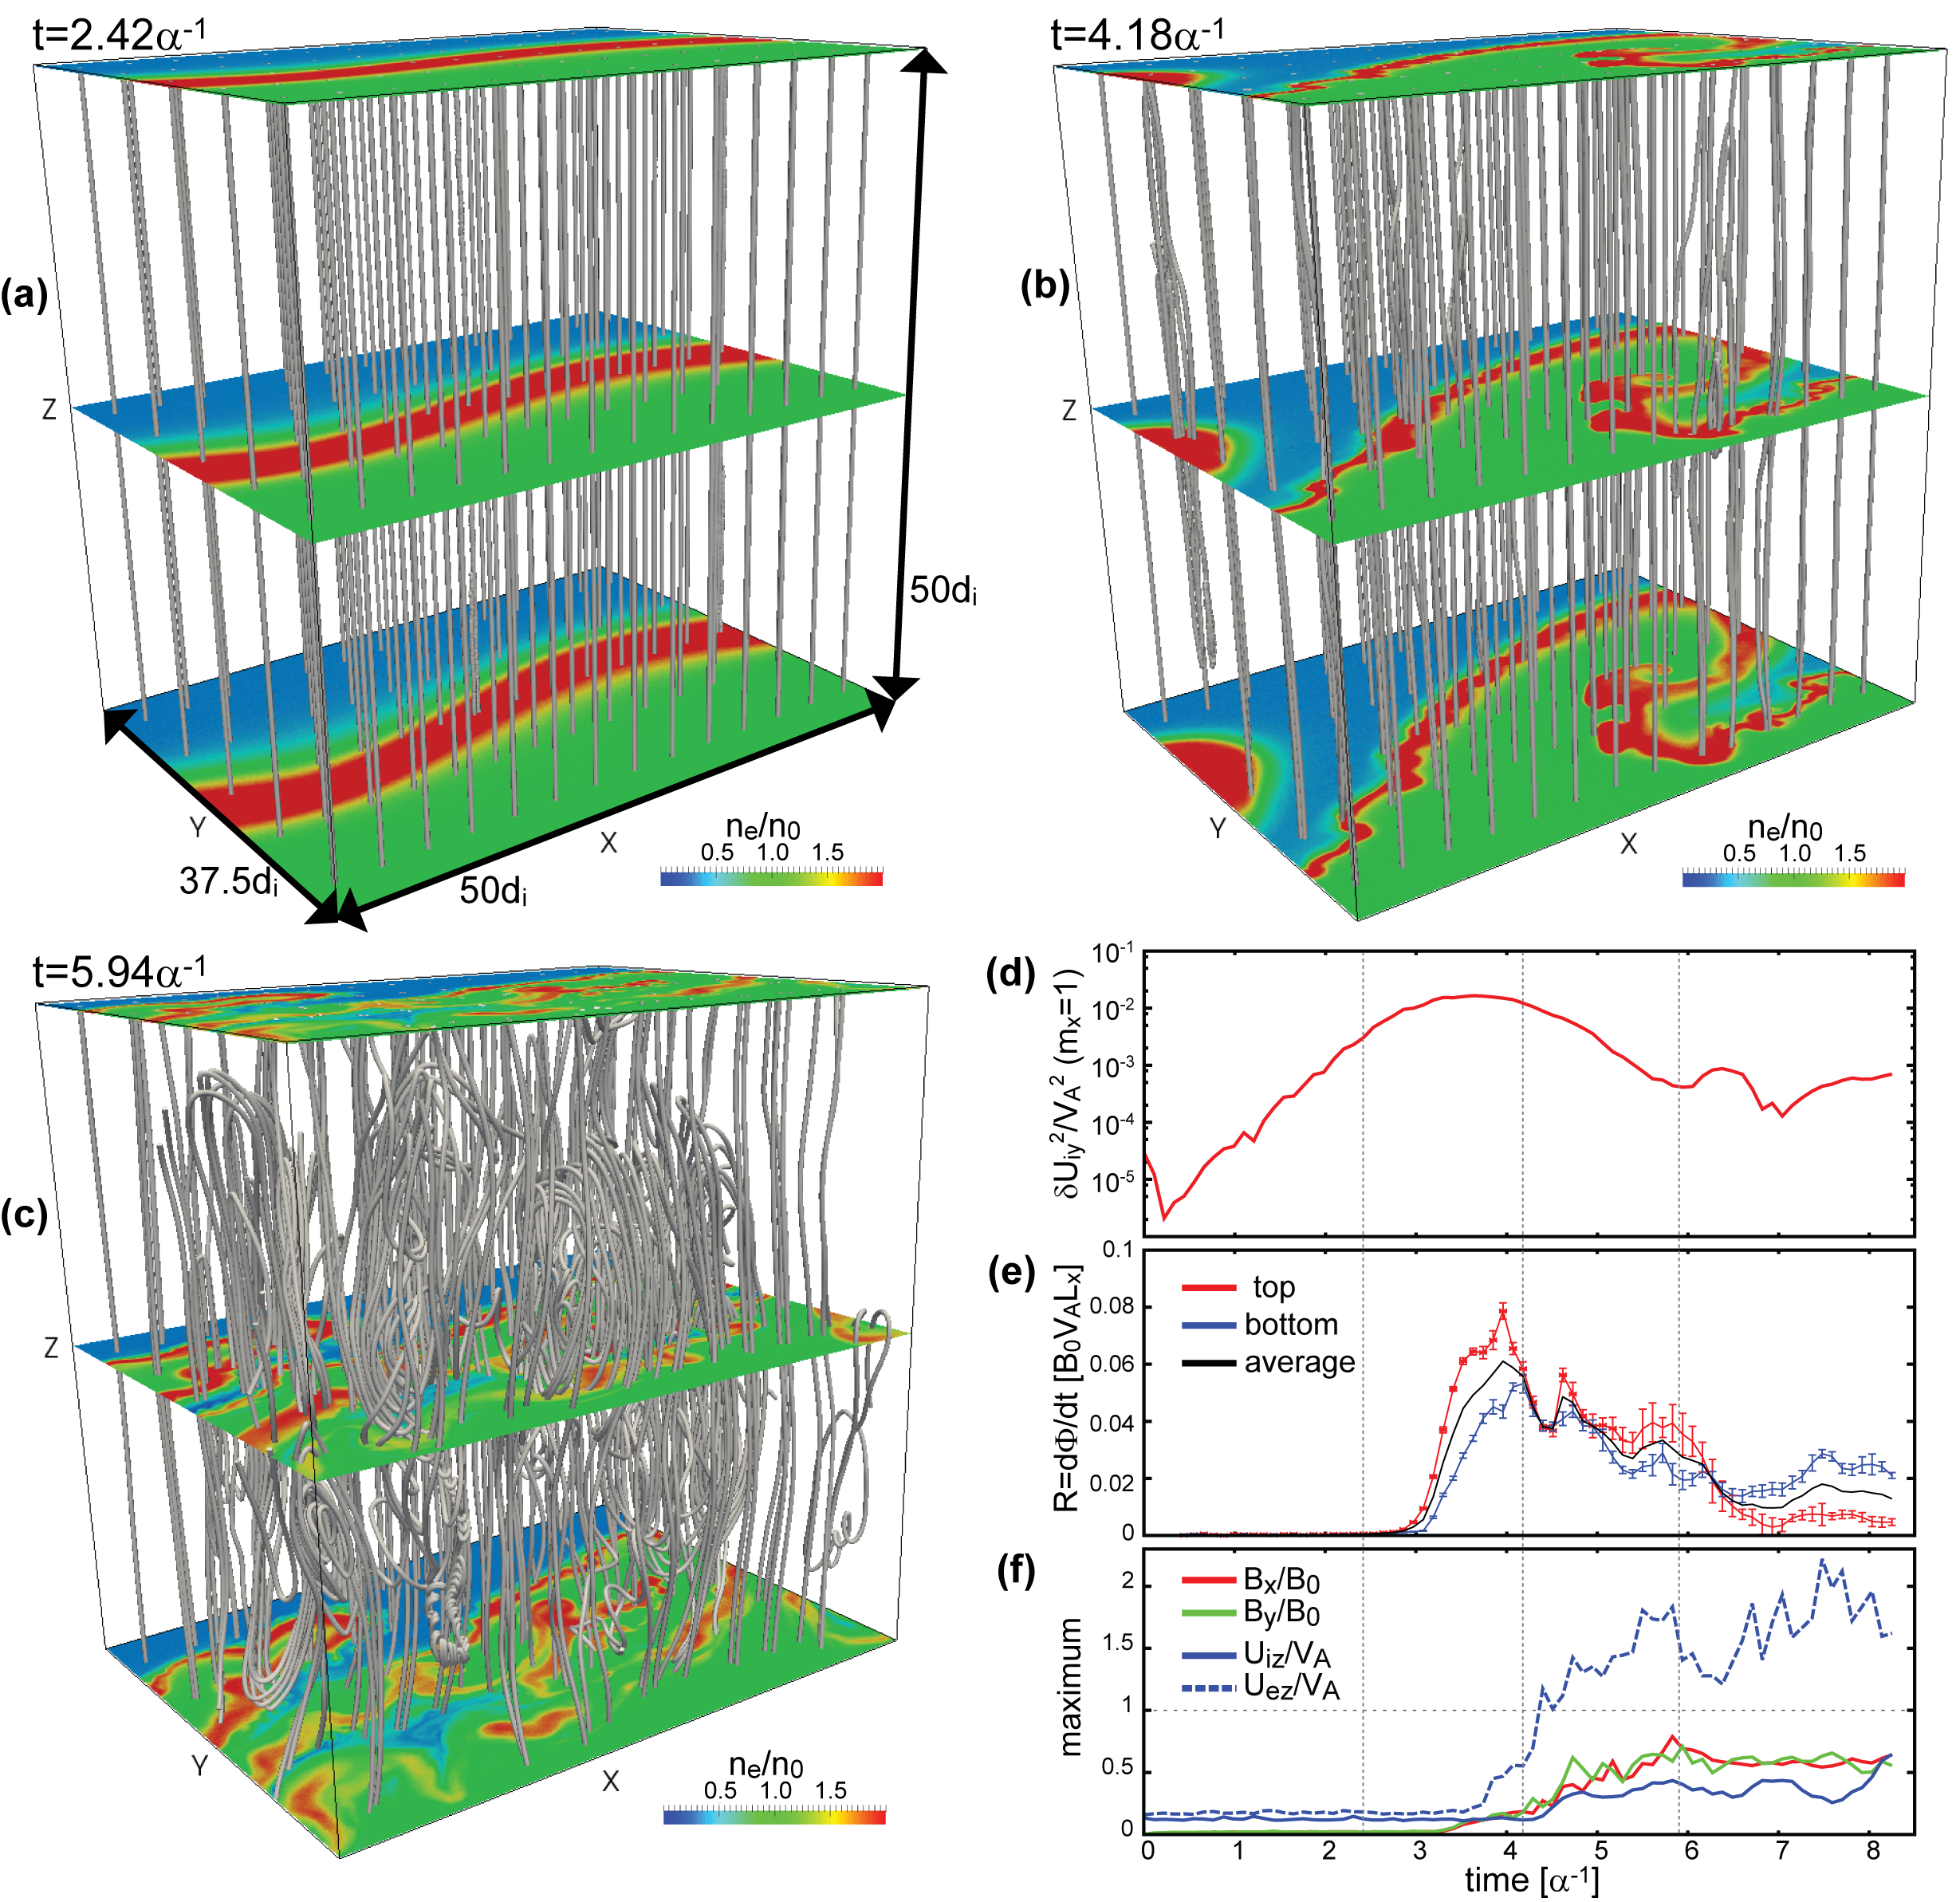
Simulation overview
Simulation code:
Fully kinetic PIC code, VPIC [Bowers+, 2008]
Adjusted setting of the simulation for MMS northward IMF KH event on 8 Sep. 2015 [Nakamura+, 2017a,b] to a pure southward IMF condition
  n₁/n₂=3
  V_{x}=V₀*tanh(y/D₀) with D₀=3.3d_{i}
  B_{z}=B₀*tanh(y/D₀)
  m_{i}/m_{e} = 25, ω_{pe}/Ω_{e}=1.0
System size:
Lx x Ly x Lz = 50 x 50 x 50 d_{i}³
=1024³ cells
with 2.2 x 10¹¹ total particles

Slide 4
Simulation overview
Reconnection is driven along the thin layer compressed by the non-linear vortex flow.
After the reconnection onset, the field line structure gets rather complex (bended, twisted and tangled).
→leading to a quick decay of the vortex structure.

Slide 5
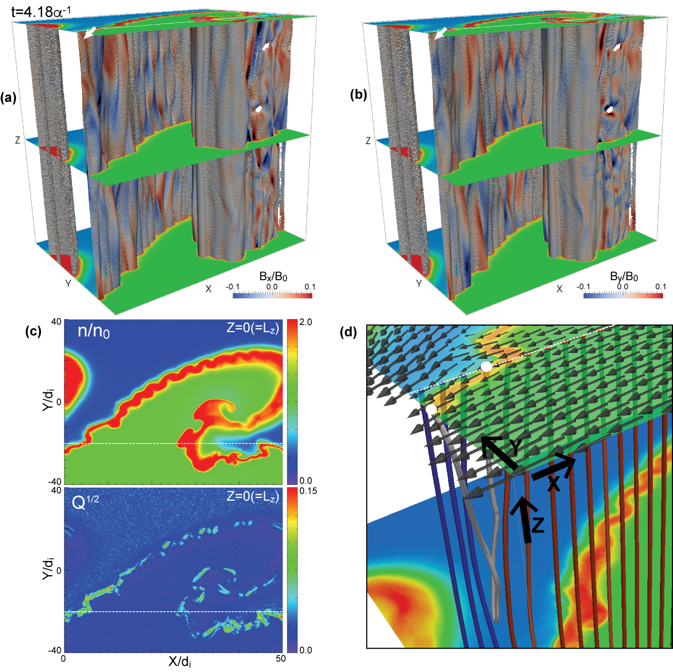
Reconnection structure
Reconnection begins from the compressed current layer.
Reconnection produces both B_{x} (along the flow) and B_{y} (normal) variations related to reconnected field lines being twisted by the local shearing flow [e.g., Liu et al., 2018].

Slide 6
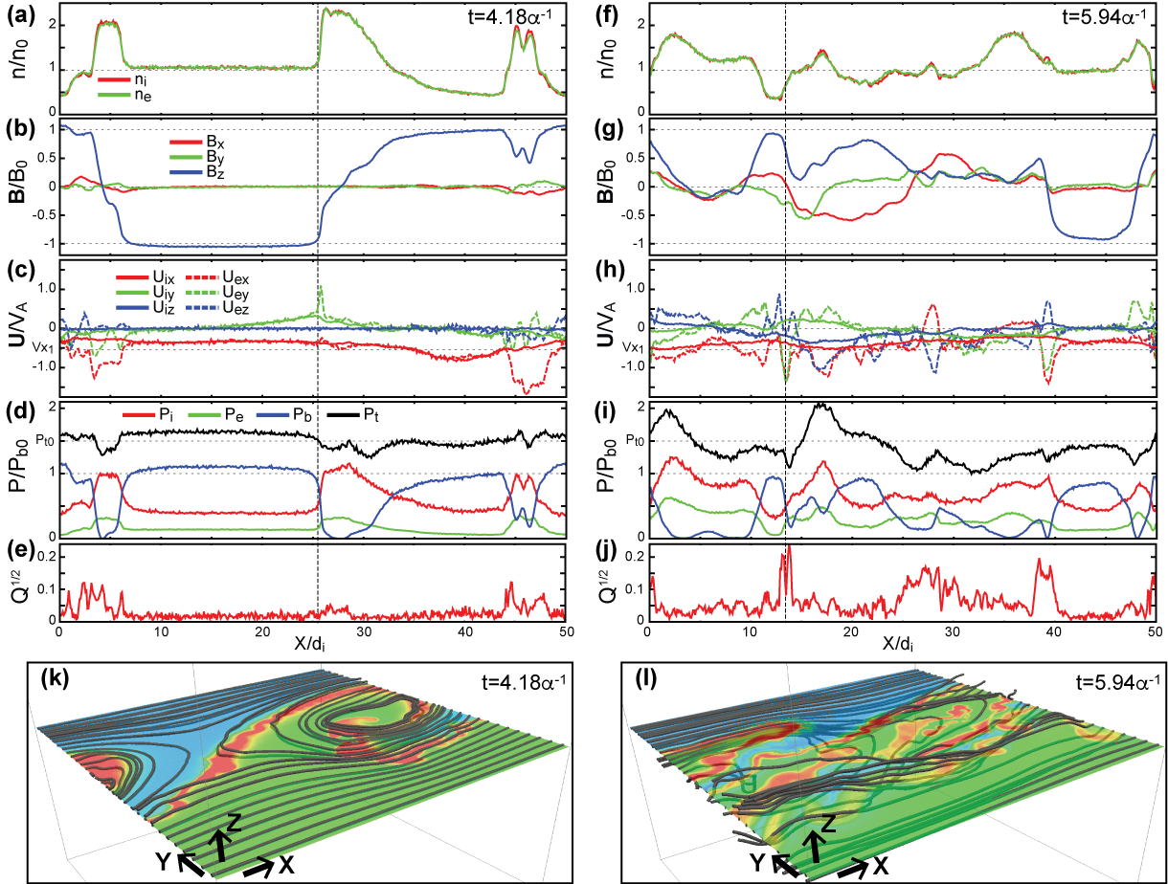
Decay of vortex
At t=4.18α⁻¹ (early non-linear phase), both the KH wave/vortex signatures like periodic U_{iy} & P_{tot} variations and reconnection signatures like local B_{x} & B_{y} and U_{ez} variations at the vortex edges are observed.
Just after that, wave/vortex structures are significantly disturbed with much stronger B_{x}, B_{y} and U_{i,ez} variations.

Slide 7
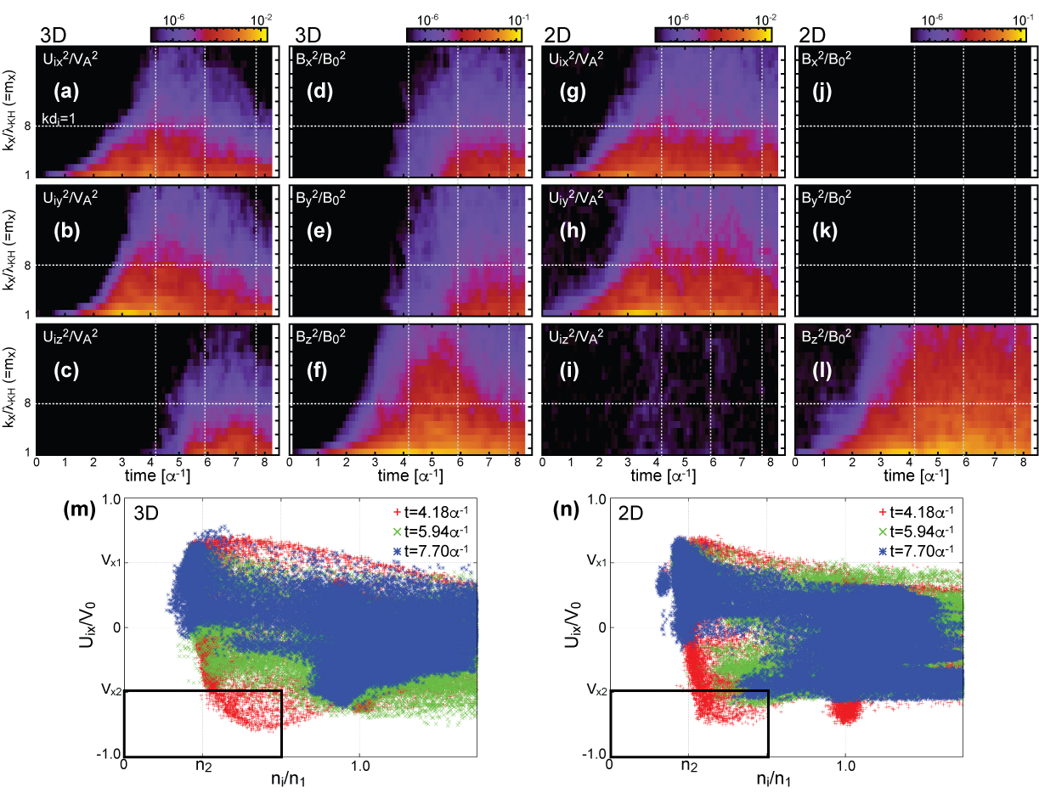
Disappearance of wave/vortex signatures
In 3-D, after the onset of reconnection, U_{iy} modes get weaker as U_{iz} modes get stronger.
In addition, low-density-faster-than-sheath ions (non-linear vortex signatures) quickly disappear.
These indicate that during southward IMF, clear KH wave signatures are expected to be observed only during a very limited growth phase of the KHI
consistent with past observations
[e.g., Hasegawa+, 2006; Hwang+, 2011; Kavosi & Raeder, 2015]

Slide 8
Summary
[Nakamura+, submitted]
Performed 3-D fully kinetic (VPIC) simulation of the KH vortex at the Earth’s magnetopause during pure southward IMF
  i.e., pure southward (-Z) & northward (+Z) field in the M’sheath and M’sphere and velocity shear in the X-Y plane
Reconnection is induced at multiple sites along the vortex edge in an early non-liner growth phase of the KHI.
Reconnection produces reconnected field lines being twisted by the shearing/vortex flow and resulting complex field line structures.
leading to a quick decay of wave/vortex structures
Clear KH wave/vortex structures are expected to be observed only in a limited times during southward IMF. → consistent with observations [e.g., Hwang+, 2011; Kavosi & Raeder, 2015]

Slide 9
References
Bowers, K. J., B. J. Albright, L. Yin, B. Bergen, and T. J. T. Kwan (2008), Ultrahigh performance three-dimensional electromagnetic relativistic kinetic plasma simulation, Phys. Plasmas 15, 055703.
Hasegawa, H., M. Fujimoto, K. Takagi, Y. Saito, T. Mukai, and H. Reme (2006), Single-spacecraft detection of rolled-up Kelvin-Helmholtz vortices at the flank magnetopause, J. Geophys. Res., 111, A09203, doi:10.1029/2006JA011728.
Hwang, K.‐J., M. M. Kuznetsova, F. Sahraoui, M. L. Goldstein, E. Lee, and G. K. Parks (2011), Kelvin‐Helmholtzwaves under southward interplanetary magnetic field, J. Geophys. Res., 116, A08210, doi:10.1029/2011JA016596.
Kavosi, S. and J. Raeder (2015), Ubiquity of Kelvin–Helmholtz waves at Earth’s magnetopause. Nat. Commun. 6:7019 doi: 10.1038/ncomms8019.
Liu, Y.-H., M. Hesse, F. Guo, H. Li, and T.K.M. Nakamura (2018), Strongly localized magnetic reconnection by the super Alfvenic shear flow, Phys. Plasmas 25, 080701.
Nakamura, T. K. M., H. Hasegawa, W. Daughton, S. Eriksson, W. Y. Li, and R. Nakamura (2017a), Turbulent mass transfer caused by vortex-induced reconnection in collisionless magnetospheric plasmas, Nat. Commun. , 8, 1582.
Nakamura, T. K. M., Eriksson, S., Hasegawa, H., Zenitani, S., Li, W. Y., Genestreti, K. J., et al. (2017b). Mass and energy transfer across the Earth’s magnetopause caused by vortex-induced reconnection. J. Geophys. Res., 122, 11,505–11,522. https://doi.org/10.1002/2017JA024346

