Slide 1
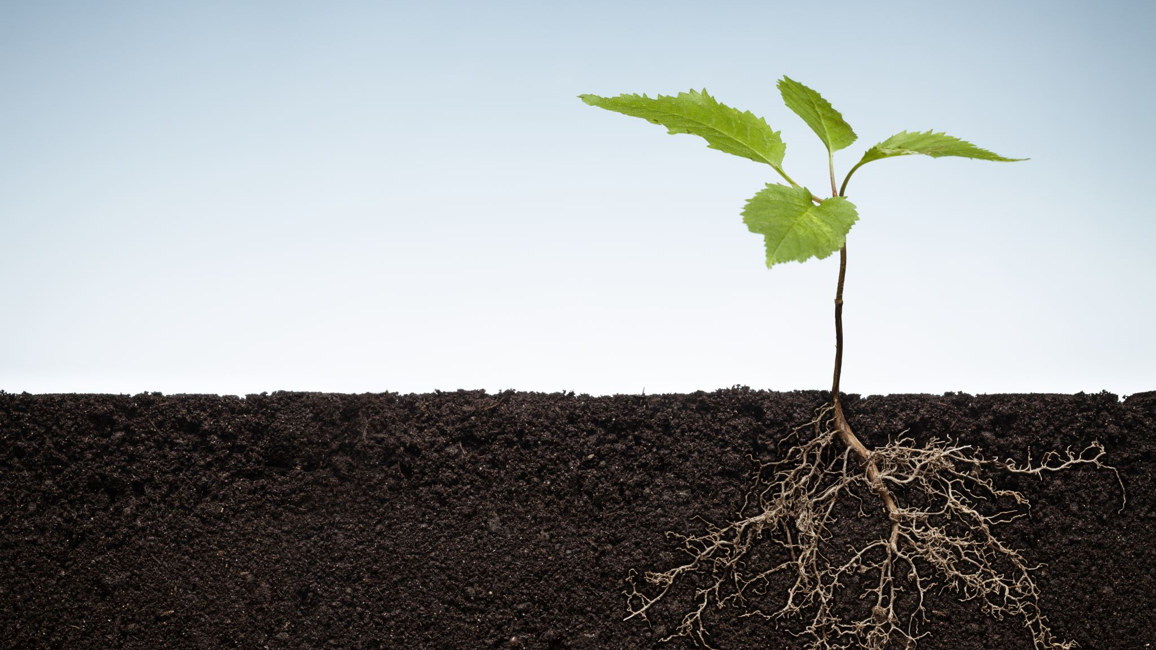
Highlighting the importance of topsoil in human life through a soil education program
Aiki Masuda,Sakushin Gakuin High School, Tochigi, Japan
Emi Yokoo, Utsunomiya Girls’ High School, Tochigi, Japan
Hideaki Hirai, School of Agriculture, Utsunomiya University, Japan
Akiko Deguchi, School of Education, Utsunomiya University, Japan

Slide 2
Aim
This study aims to highlight the importance of topsoil in human life from the viewpoint of daily rice consumption in Japan.

Slide 3
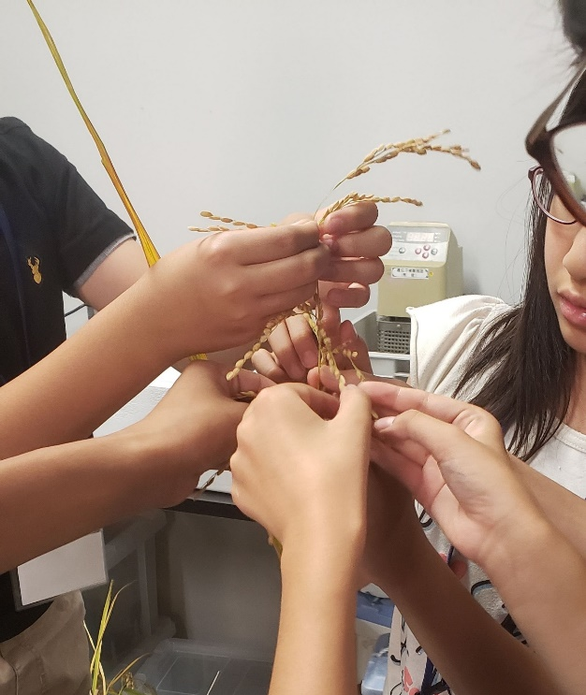
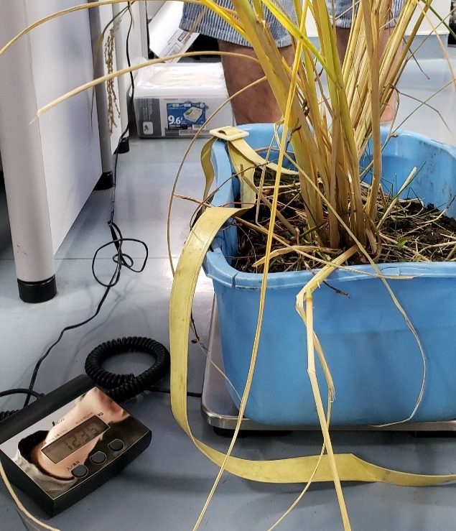
Educational program for elementary (5th to 6th grade) to Junior high school students (1st to 3nd grade). The number of the participants is 19.
The weight and the area of the topsoil per rice hill were measured after calculation on how many rice hills are necessary for 150 g rice grain was done.
In order to find out how many rice grains were in 1 cup of rice(150 g), the number of rice in 5 g rice was first counted and multiplied by 30 times.
Finally, the children touched fertilizer-free soil, composted soil, and soil with continuous chemical fertilizer application.
We asked the children to touch the panicle of a rice plant and check the following.
① How many panicles are there in one hill of a rice plant ?
② How many rice grains are there in one panicle ？
③ Calculate the number of grains of the rice plant per hill with ①×②
After this activity, a lecture from a professor of soil science was delivered.

Slide 4
The results of the questionnaire survey on soil, showing the difference before and after the education program for elementary to junior high school students (N=19).
Before
After
5
15
13
16
10
18

Slide 5
Thank you very much
for your Interest
Contact: Aiki Masuda
fancyaiki1121@gmail.com

