Slide 1
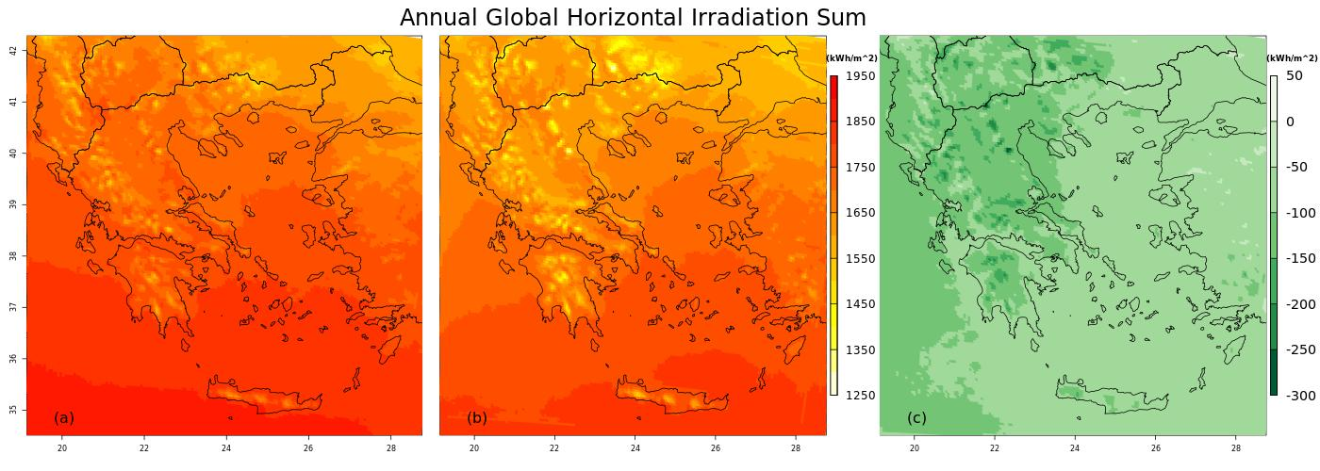
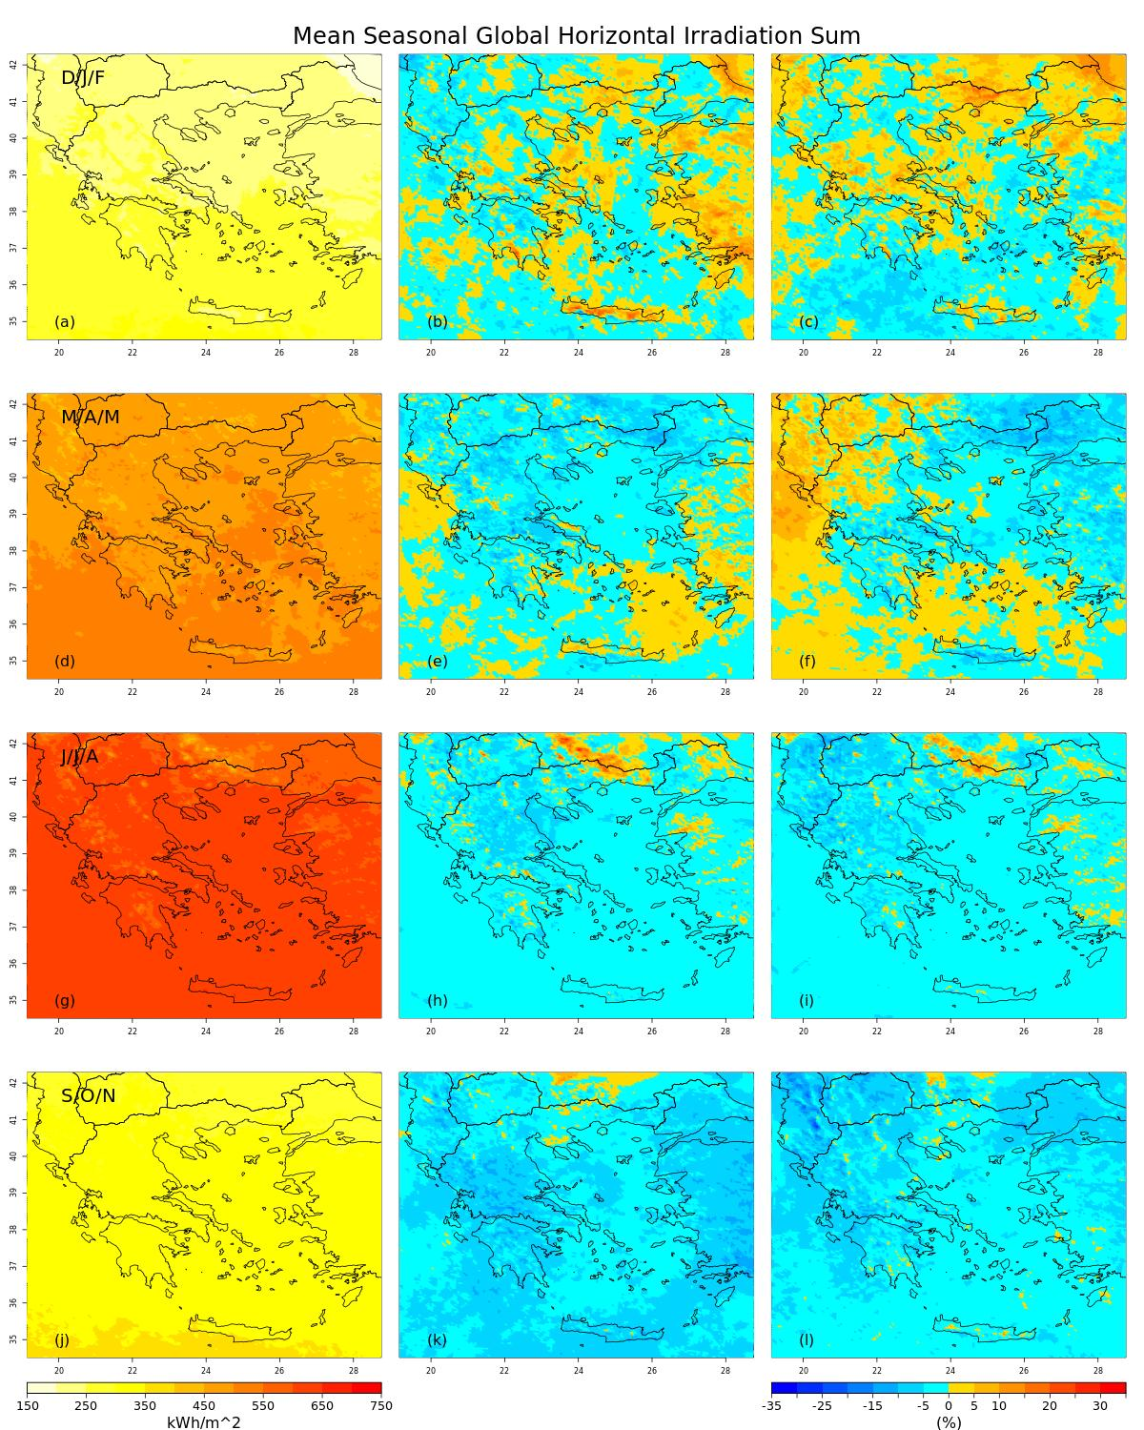
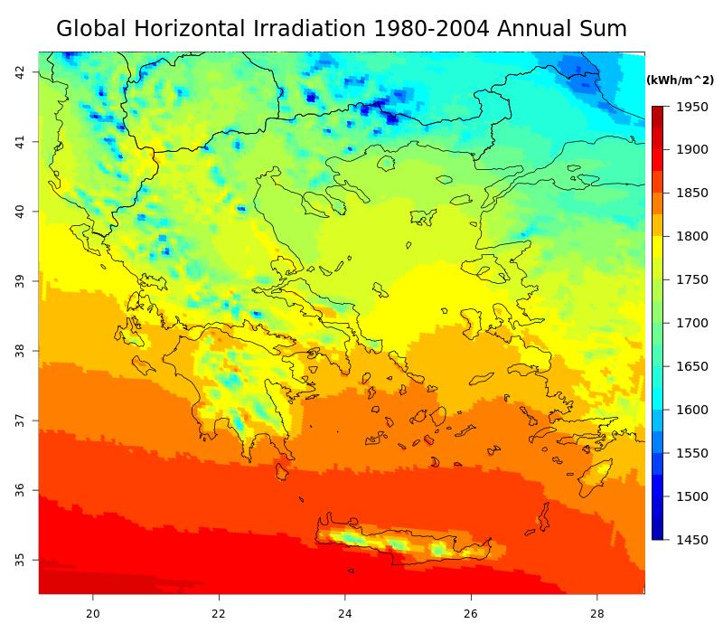
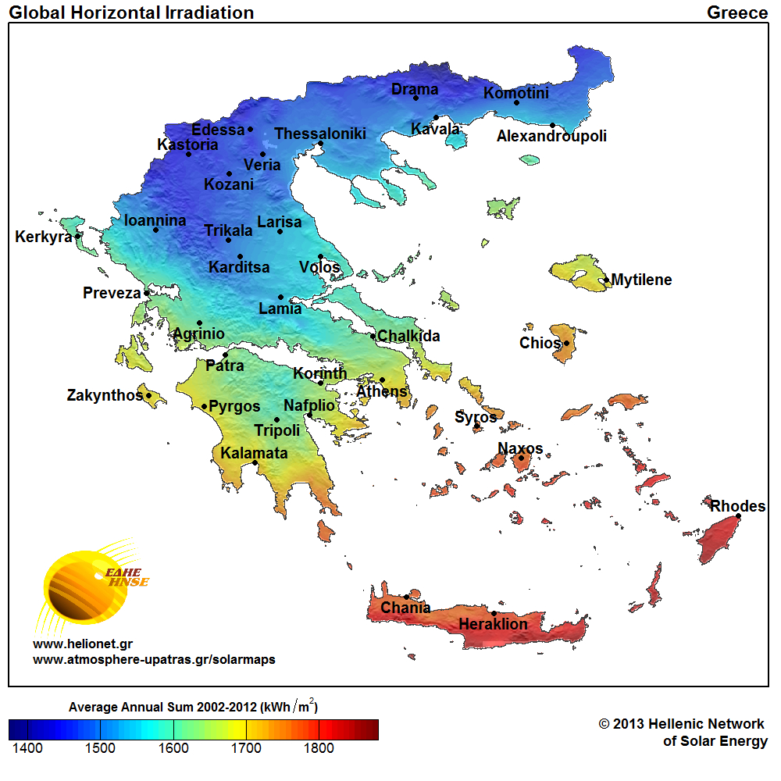
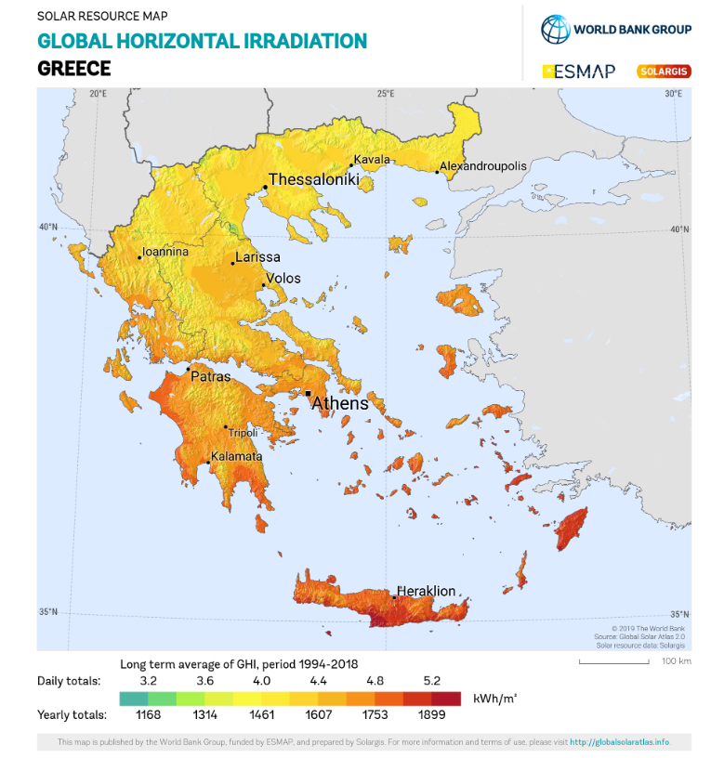
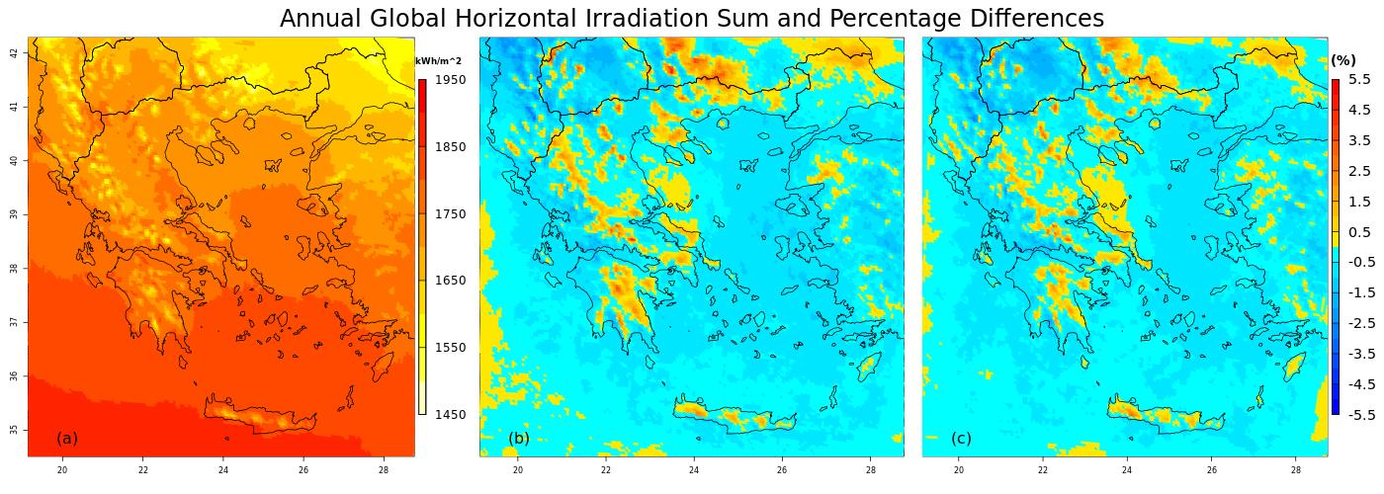
High resolution solar atlas for Greece under climate change Iason Markantonis, Nadia Politi, Diamando Vlachogiannis, Nikolaos Gounaris, Stylianos Karozis, and Athanasios Sfetsos NCSR 'Demokritos', INRASTES, Agia Paraskevi, Greece (jasonm@ipta.demokritos.gr)
Abstract
Renewable energy (RE) is considered as the most attractive and climate friendly source of energy to mitigate GHG effects. Due to the inherent, “non stationary” nature of climate, it is of paramount importance to be able make risk-informed decisions considering also the future conditions when installing / operating RES in Greece. As the amount of solar energy falling on the earth’s surface is highly influenced by local and large scale atmospheric movement conditions, high resolution simulations should be used to calculate it. The aim of this research is to generate a climatology atlas of mean yearly and seasonal values for the GHI for the “historic time period” 1980-2009 and compare it against future values in 2020-2050. The current study employs high resolution downscaled climate model data to generate future solar radiation atlases for Greece based on RCP4.5 and RCP8.5 scenarios. Greece is a country with high potential in renewable solar energy. Several studies have mentioned the high amount of sunshine hours in most parts of the country, (e.g. Matzarakis & Katsoulis, 2006¹, HNMS²). The data for both historic and future period analyses are produced from WRF 5km downscaled model output with temporal resolution of 6 hours, using as input ERA-INTERIM and EC-EARTH input data, respectively. The study that has produced the atmospheric model dataset is described in Politi, et al. (2018)³. We explore spatio-temporal changes of the GHI climatology and identify those areas which will exhibit considerable changes in the future.
Objectives-area of study
Methods-models
The objective of this study is to compare
solar energy estimates of the NCSRD high resolution climate model and existing works
the difference between WRF(EC-EARTH) and WRF(ERA-Interim) forcing models for the historic period 1980-2004.
1. We obtain the data from the dynamical downscaling of WRF model (Politi, et al. 2018) at 6 hour temporal resolution and 5km grid space.
2. We transform output into seasonal and annual GHI values in kWh/m2.
3. We project annual and seasonal GHI in the historic (1980-2004) and future (2020-2044) under RCP 4.5 and RCP 8.5 scenarios.
Results
EC-Earth and ERA-Interim Comparison for the period 1980-2004
WRF(EC-Earth) annual GHI sum.
WRF(ERA-Interim) annual GHI sum.
WRF(ERAInterim )– WRF(Ecearth) difference.
Comparison of Annual GHI sum with other works
Left: NSCR “Demokritos” results using EC-Earth for the period 1980-2004
Centre: Results from Laboratory of Atmosphere Physics of University of Patras for the period 2002-2012
https://www.atmosphere-upatras.gr/solarmaps
Right: Results from SOLARGIS for the period 1994-2018
https://solargis.com/maps-and-gis-data/download/greece
Conclusions
• Our high resolution climate solar atlas gives comparable results to other studies (U of Patras and JRC) although each covers a different temporal period.
• High-resolution WRF forced by EC-Earth tends to overestimate annual GHI in comparison to the ERA-Interim forced model
•There are no big differences (under 6%) between the past period and future scenarios concerning the annual GHI.
•There are noticeable differences (over 20%) for the seasonal GHI sum. Positive in future in (DJF) for both scenarios. Positive in future in (MAM) for scenario RCP 8.5 and negative for both future scenarios in (SON).
EC-Earth past and future annual GHI comparison
WRF(EC-Earth) 1980-2004 annual GHI sum.
Percentage difference between future period 2020-2044 scenario RCP 4.5 and the past period 1980-2004
Percentage difference between future period 2020-2044 scenario RCP 8.5 and the past period 1980-2004
EC-Earth past and future seasonal GHI comparison
Left column : WRF(EC-Earth) 1980-2004 seasonal GHI sum (a) DJF, (d) MAM ,(g) JJA ,(j) SON.
Central column : Percentage difference between future period 2020-2044 scenario RCP 4.5 and the past period 1980-2004 (b) DJF, (e) MAM ,(h) JJA ,(k) SON.
Right column : Percentage difference between future period 2020-2044 scenario RCP 8.5 and the past period 1980-2004 (c) DJF, (f) MAM ,(i) JJA ,(l) SON.
References
1.(Matzarakis & Katsoulis, 2006), ‘Sunshine duration hours over the Greek region’. Theoritical and Applied Climatology.
2.HNMS, ‘Greece Climate Atlas’. http://climatlas.hnms.gr/sdi/
3.(Politi, N. et al. 2018) ‘Evaluation of the AWR-WRF model configuration at high resolution over the domain of Greece’. Atmospheric Research Volume 208, 1 August 2018, Pages 229-245.
Acknowledgments: .This work was supported by computational time granted from the Greek Research & Technology Network (GRNET) in the National HPC facility - ARIS - under project ID HRCOG.
European Geosciences Union General Assembly 2020– Vienna, Austria – 4-8 May, 2020

