Slide 1



Dating shearing: W Alps, Naxos, Garhwal
I.M. Villa^{1,2}
1 – Dip. Scienze Ambiente e Terra, Milano Bicocca, Italy
2 – Inst. für Geologie, Bern, Switzerland

Slide 2
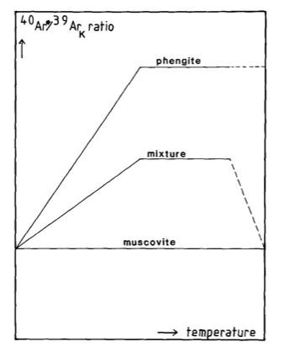
Wijbrans & McDougall 1986: Ar-Ar
hump shape = mix
M1 (HP) = 50 Ma
M2 (HT) = 15-20 Ma
T ≈ 530 °C

Slide 3
Modelling Ar-Ar alone
Duration of metamorphism from D_{lab}
shorter than thermal inertia!

Slide 4
What went wrong?
Field observations: high-T inheritance of ⁴⁰Ar
conflict with lab diffusivity experiments

Slide 5
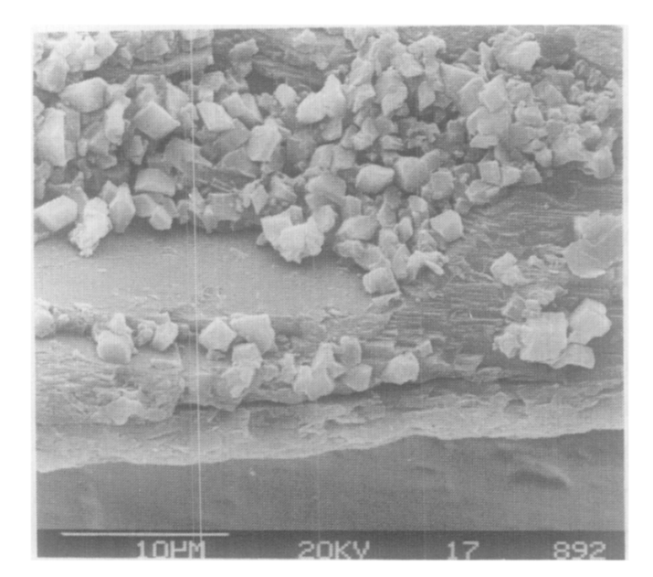
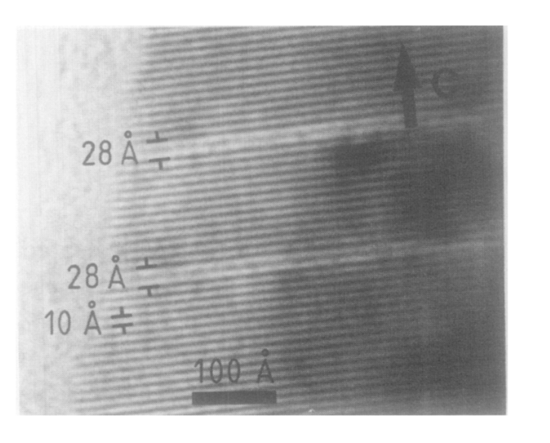
Hydrothermal lab experiments
Observation: Micas dissolve (both µm and nm!)
What is measured is not diffusion rate but dissolution
Hess et al., 1987

Slide 6
How to date shearing
1. Forget about lab-based closure T estimates
2. Strive for „redundant“ overdetermination

Slide 7
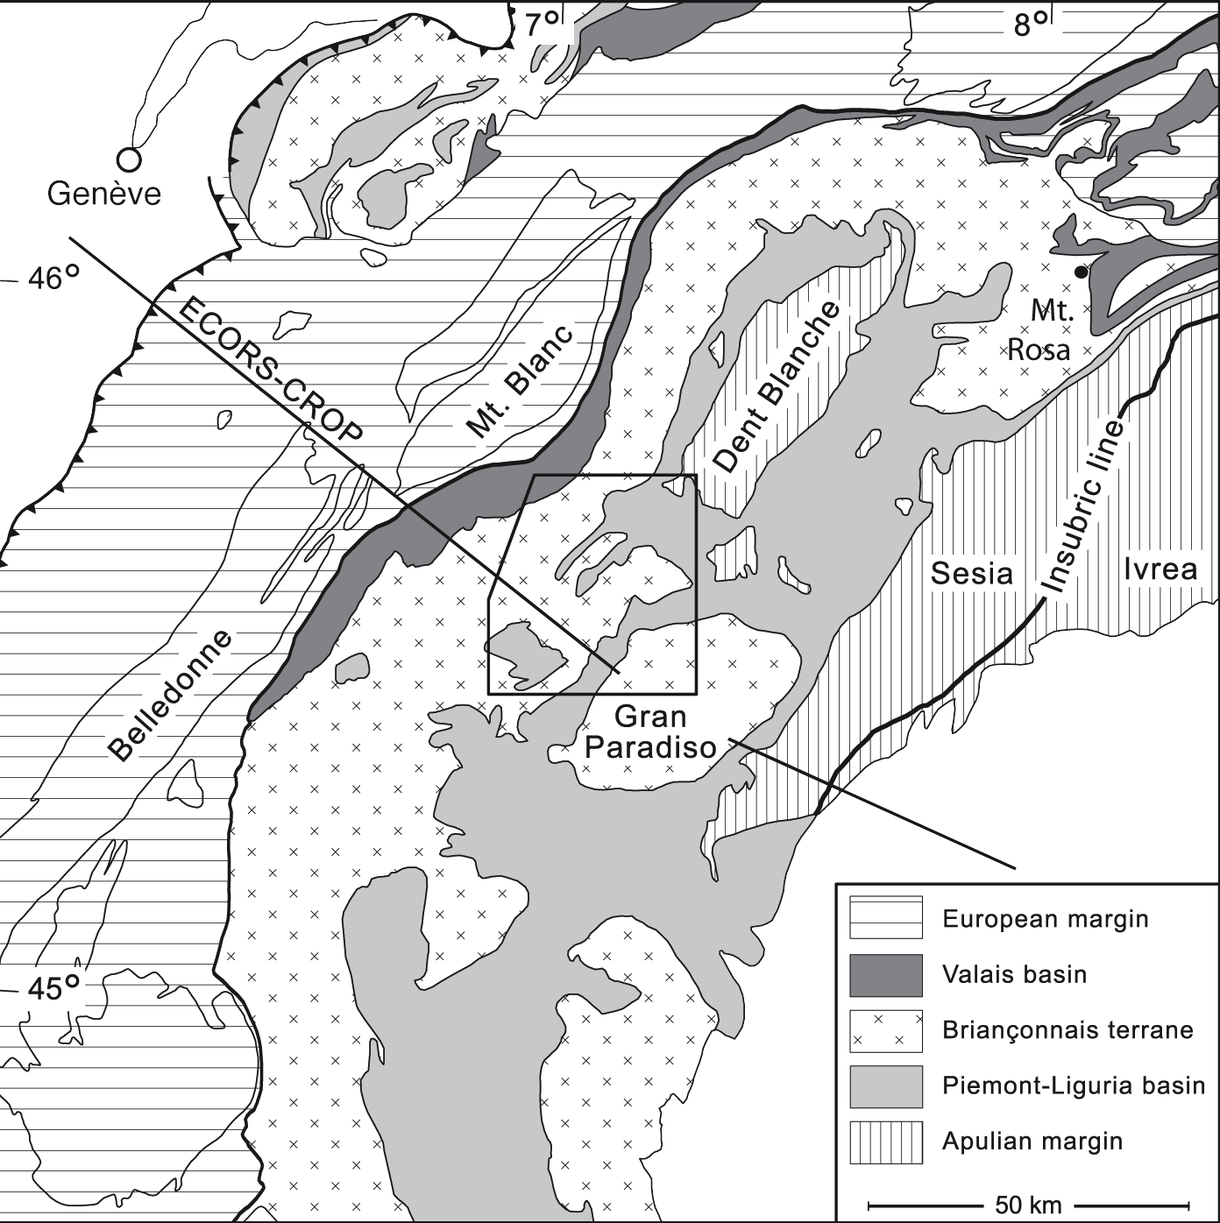
W Alps Eclogites

Slide 8
Ages in metamorphic terrane: T ~ distance
If T is the main control: smooth trend of t vs T
t
protolith age
cooling ages
T

Slide 9
Ar lost < 300 °C AND Ar retained > 500°C
Grt Lu-Hf
Villa et al 2014 J Petrol

Slide 10
Ar retained > 550 °C (hump shape)
Monte Rosa ≈ 580 °C: Vaughan-Hammon et al, this meeting

Slide 11
Good news: Western Alps
Shearing dated by new phengite rextl
Lu-Hf (Grt) = Ar-Ar phengite
Phengites retain Ar >550°C if they retain Si
They lose Ar @ 250°C if retrogressed to Ms
This is not a unique function of T

Slide 12
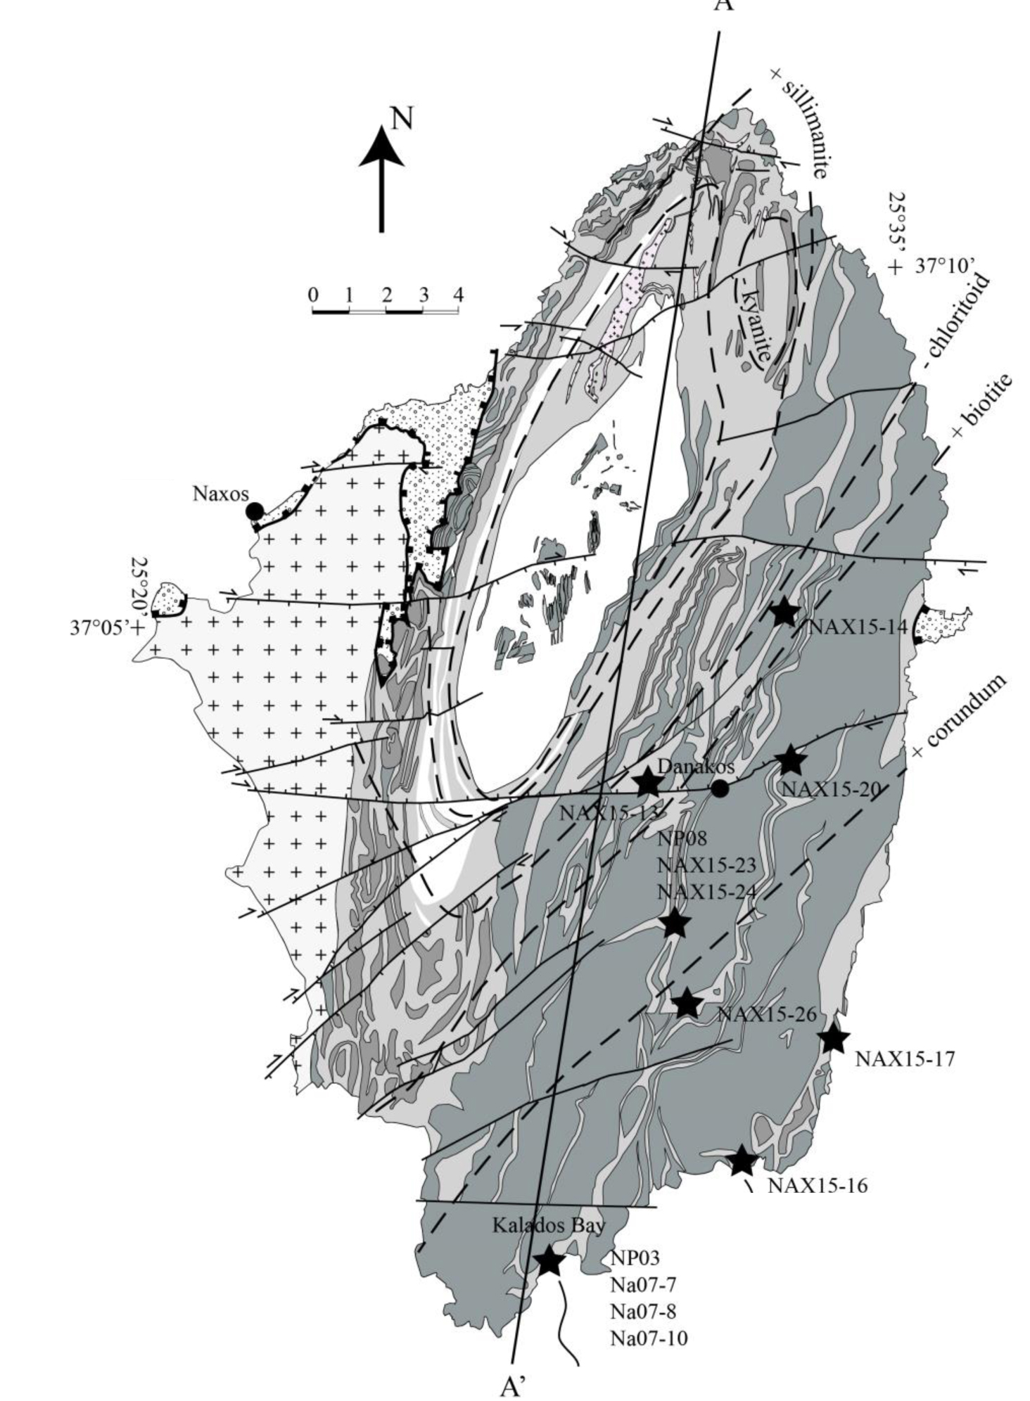
T ≈ 550 °C
colder than M. Rosa
hump-shaped Ar-Ar

Slide 13
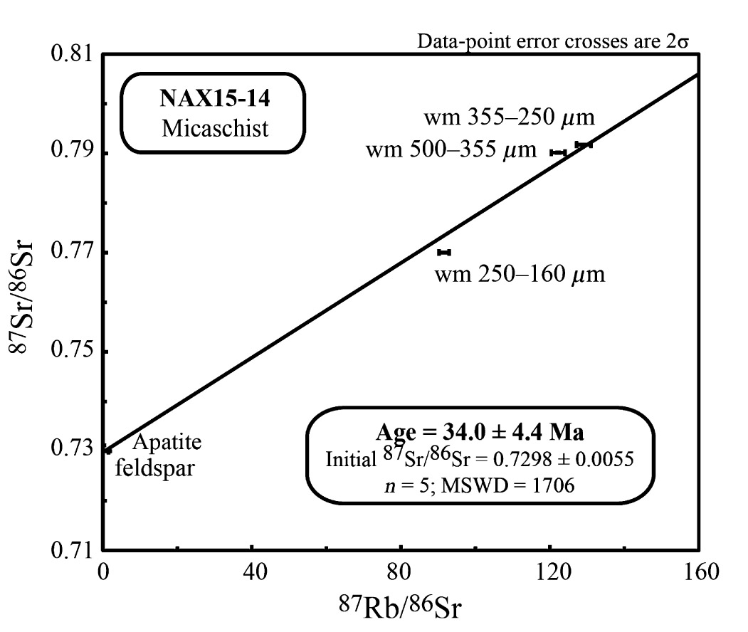
Peillod et al 2017: Rb-Sr
M0 (blueschist) = 38 Ma
M1 (greenschist) = 30-33 Ma
high MSWD: unravel mixtures?

Slide 14
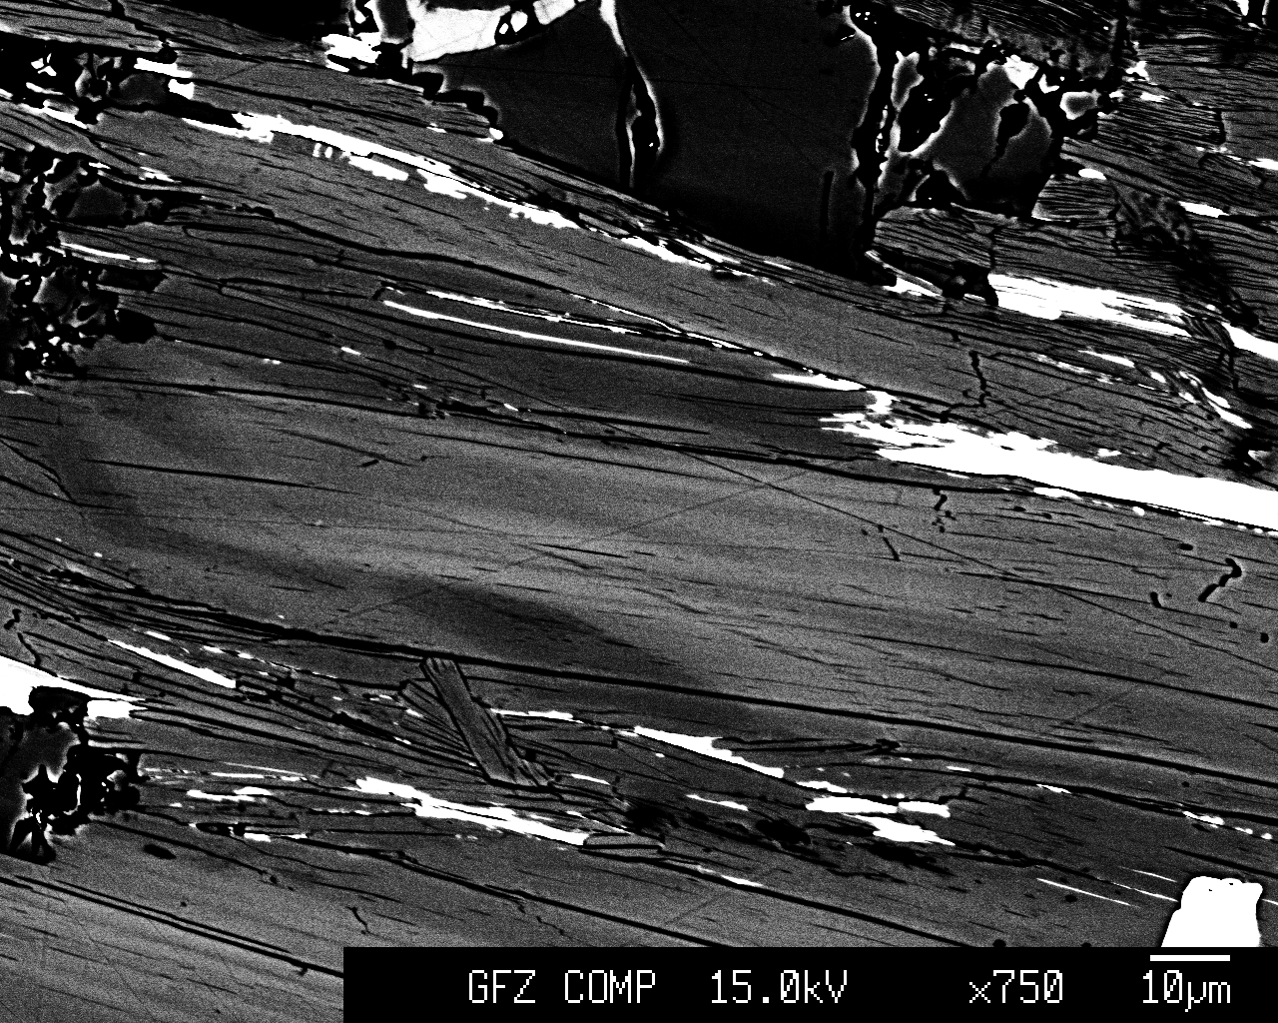
EPMA (Nax15-13)

Slide 15
“Clays” (leached layers: Hellman; Putnis)

Slide 16
Laserprobe??

Slide 17
Age spectra: hump-shaped

Slide 18
Compositions: Coarse ≠ fine!

Slide 19
Age vs Cl/K
37
wm1 trend
Age
33
29
retrograde
Cl-rich wm2
25
21
0
0.0004
0.0008
0.0012
Cl/K

Slide 20
Naxos: Petrochronology of white mica
Neither Sr nor Ar diffusive reequilibration
Both Sr and Ar date formation
Shearing datable if mica entirely recrystallized

Slide 21
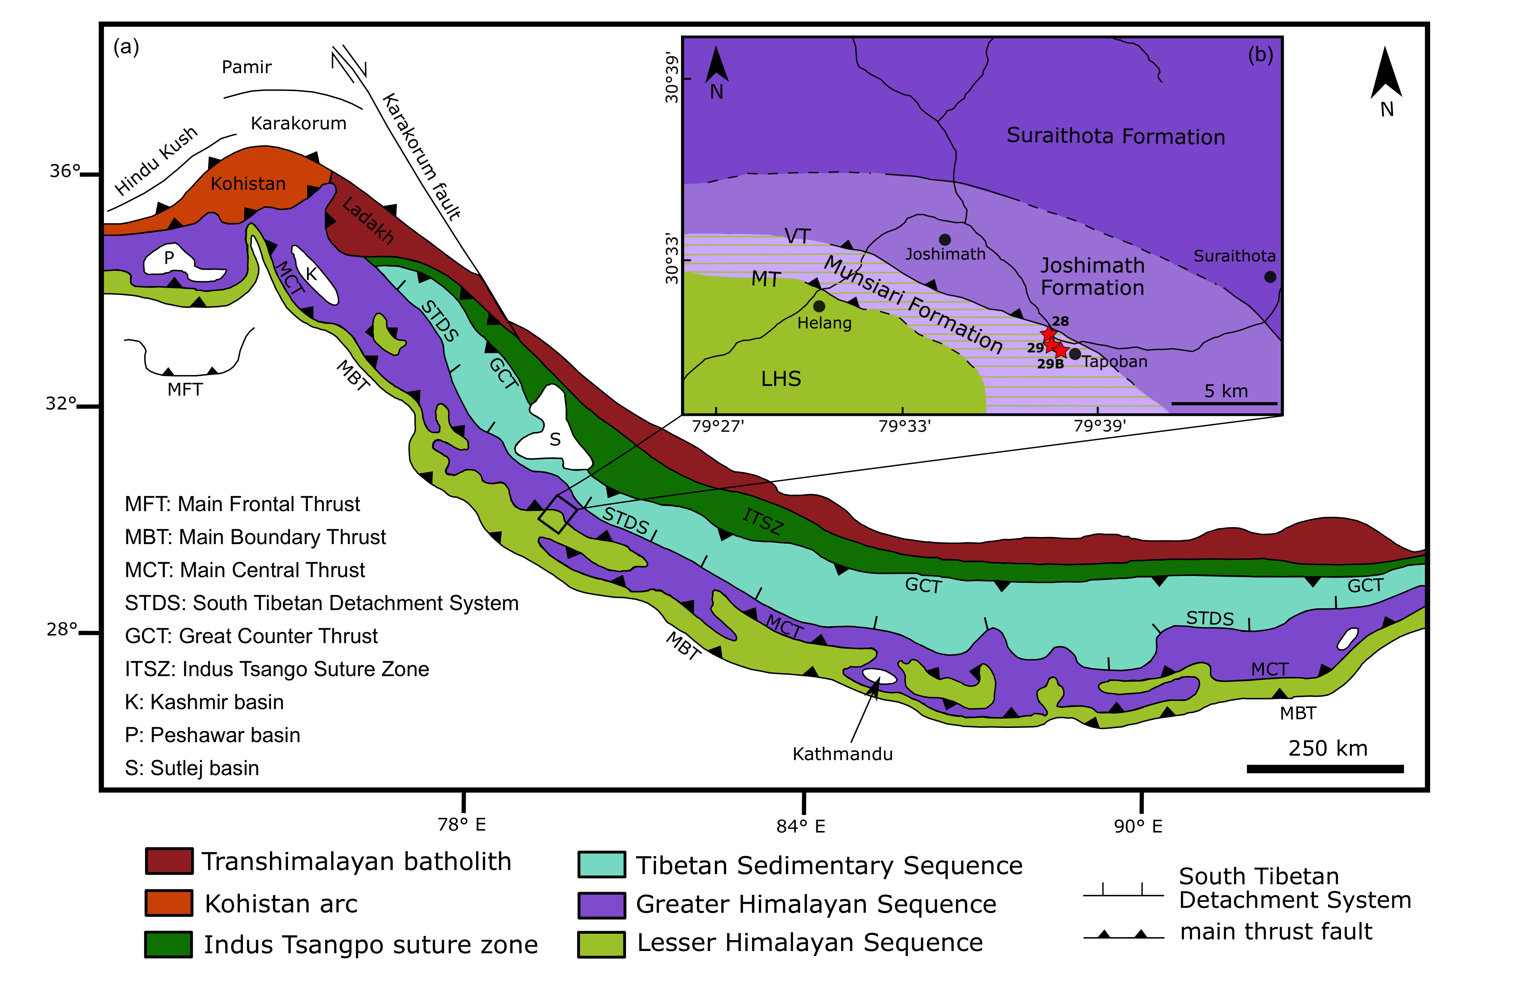
Main Central Thrust

Slide 22
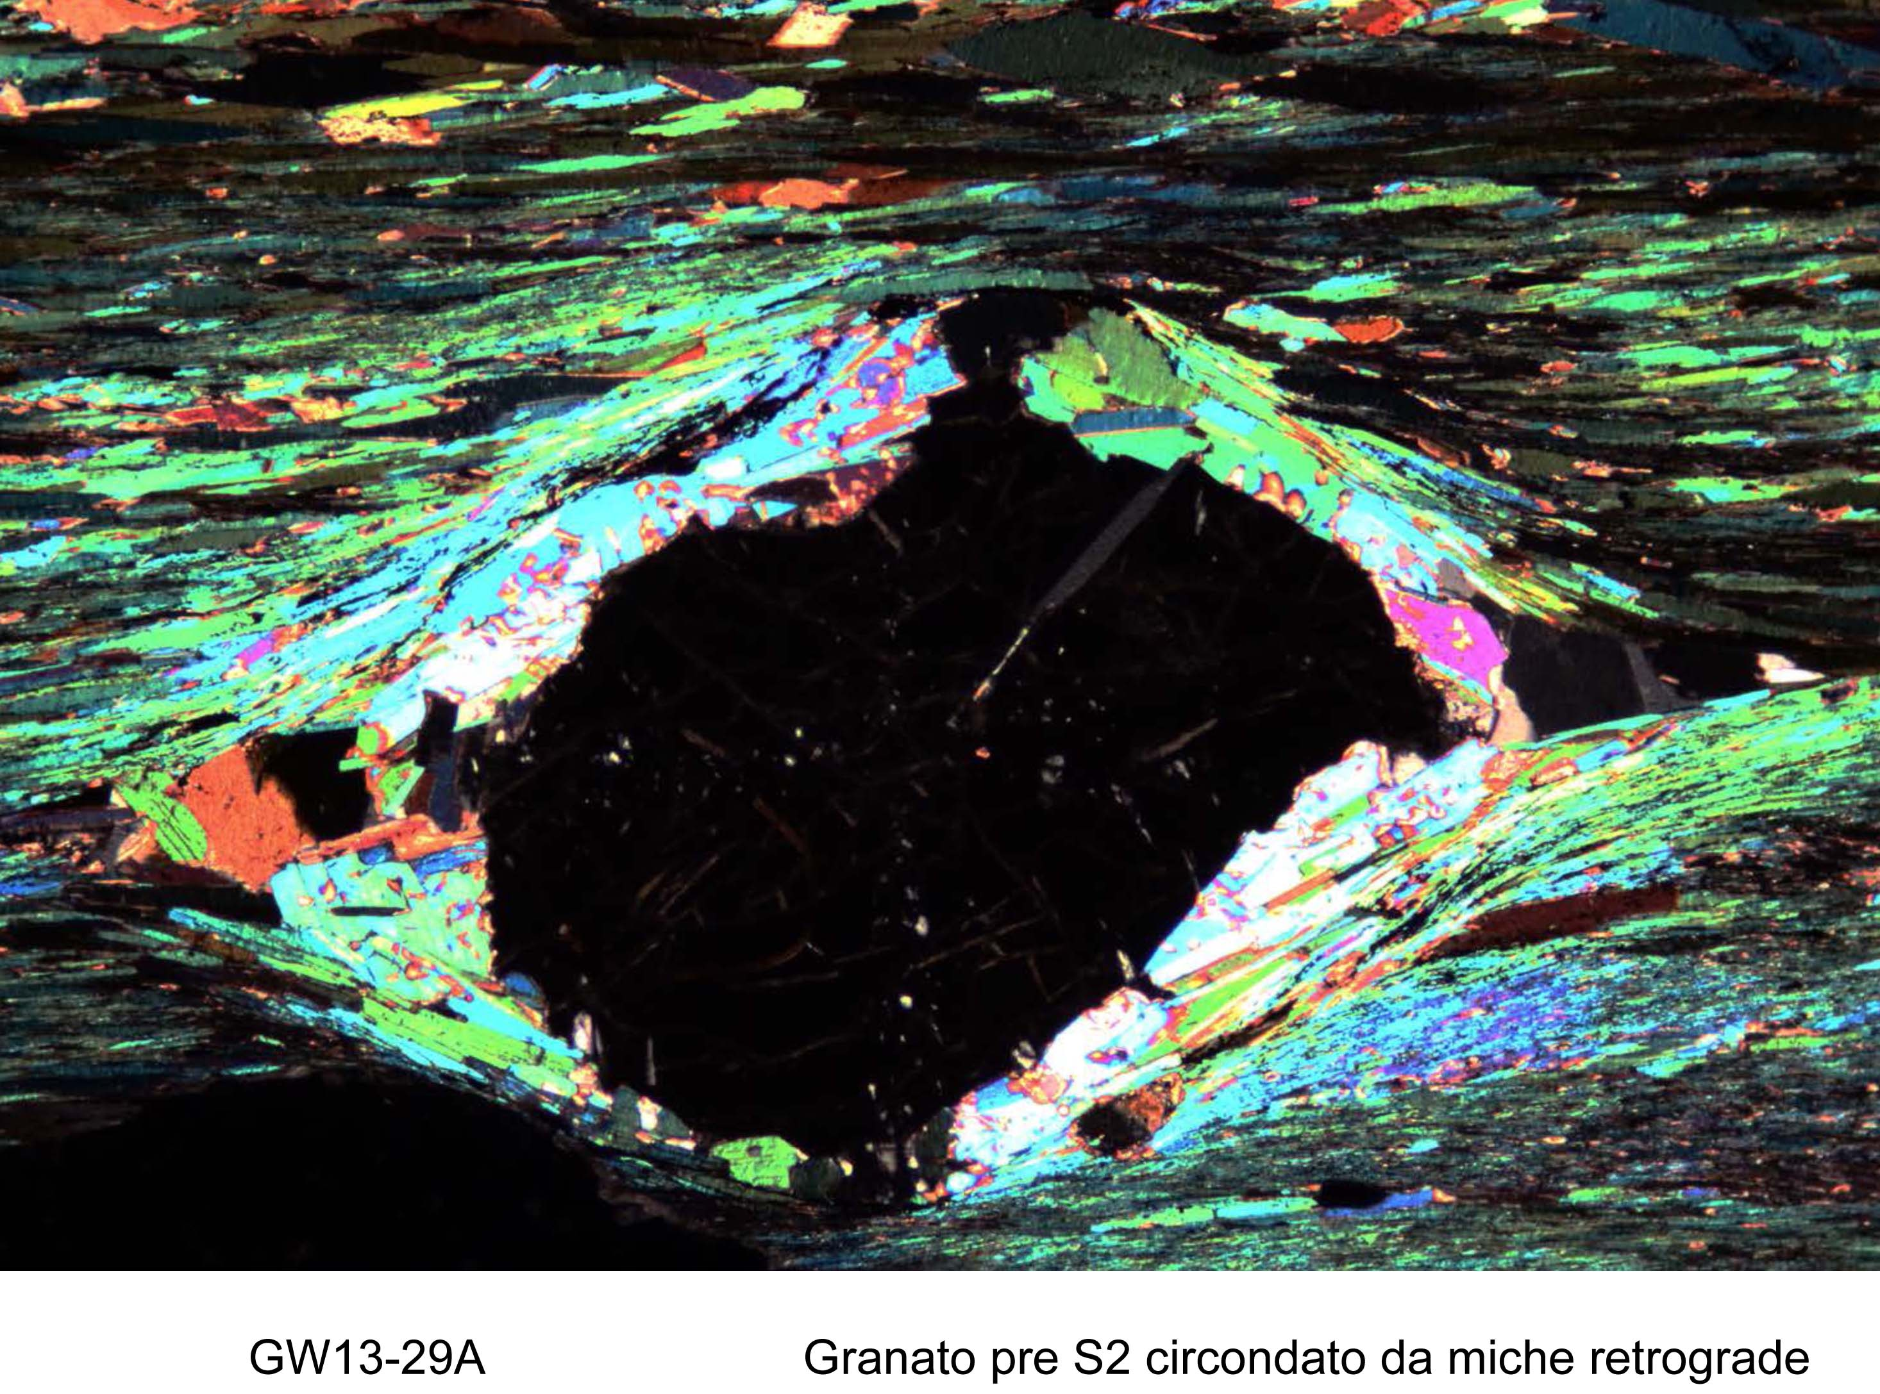
main S2:
Bt, Ms
retrograde
coronite: Ms
Grt
S1?

Slide 23
Inconsistent ages → wrong tectonics
Monazite > 3-4 chemically distinct
Mica-1 (Bt) relict foliation (~S1 in Grt)
Mica-2 (Bt, Ms) fine-grained, along S2
Mica-2a,b: heterogeneous Ti, Mg, Fe
Mica-3 (Ms) coarser, coronite, Grt brkdn

Slide 24
Garhwal Bt microchemistry

Slide 25
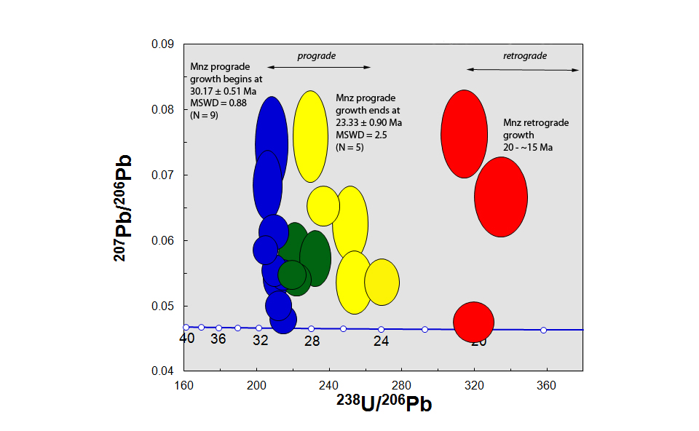
Monazite generations

Slide 26
Garhwal biotite ages

Slide 27
Garhwal muscovite ages

Slide 28
Garhwal: U-Pb + Ar-Ar
Prograde phase (Mnz cores) ≈ 20-30 Ma
Peak (high-Y Mnz rims) ≈ 15-20 Ma
Biotite S1: 18 Ma
Biotite S2: 9 Ma
Long-lasting deformation
Coronitic Muscovite: 6 Ma
Thrusting had stopped, Grt consumed
Three mica generations, three ages
At most 1 „cooling“ age, two formation ages

Slide 29
Recipe for reducing gross mistakes
Microtextures
Electron Microprobe!!
Petrogenesis of multiple generations
Never just age spectra, use all five Ar isotopes
Multichronometry

