Slide 1
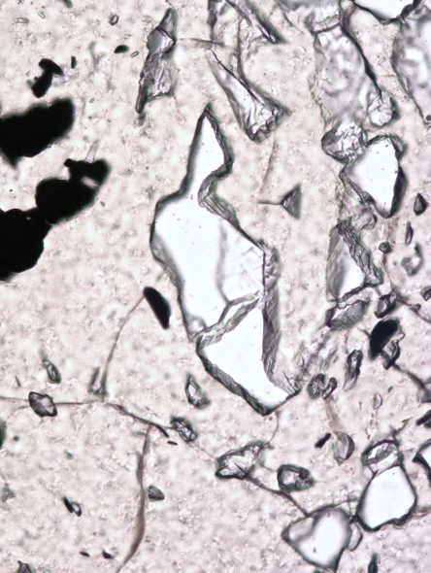
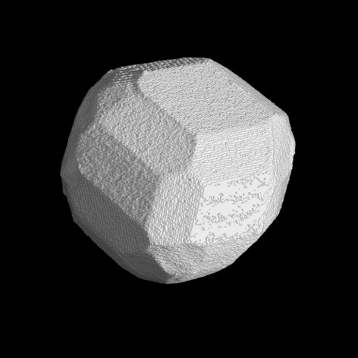
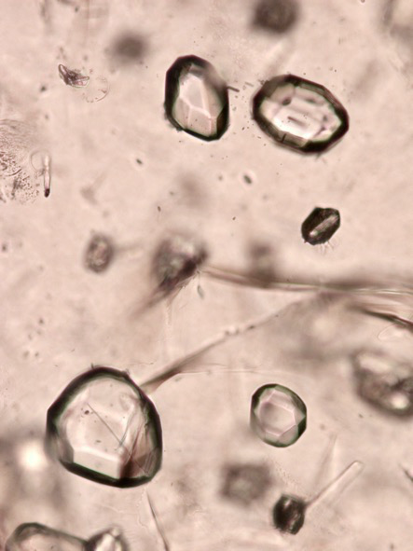
Quartz inclusions in garnet from HT metamorphic rocks change their shape
Bernardo Cesare, Matteo Parisatto, Lucia Mancini, Luca Peruzzo, Marco Franceschi, Tommaso Tacchetto, Steven M. Reddy, Richard Spiess, and Federica Marone

Slide 2
Abstract
Sheltered inside crystals, mineral inclusions preserve crucial information on the geological history of our planet. Inclusions allow estimation of the pressure and temperature trajectories of metamorphic rocks, but also can tell about rock mineralogy and provenance, and geodynamic and petrogenetic processes. This information is recovered under the axiom that the inclusions have remained immutable objects that do not deform.
Here we analyse the shape and orientation of quartz inclusions within garnet, a common metamorphic mineral, and show that they undergo a change from irregularly-shaped forms in rocks formed at T<550 °C, to combined dodecahedron and icositetrahedron geometries imposed by the host garnet in granulites equilibrated at T>750 ºC. Lack of fluid at the quartz-garnet boundary indicates that inclusion shape change occurs by thermally-induced grain boundary diffusion, driven by the minimization of the surface energy of the host-inclusion system.
Since inclusions acquire a negative crystal shape after entrapment, our discovery redefines the conceptual framework for the application of elastic thermobarometry and motivates a reevaluation of the criteria for mineral inclusion syngenesis in metamorphic rocks.

Slide 3
Disclaimer
This material is still unpublished, therefore
©
Cesare, Parisatto, Mancini, Peruzzo, Franceschi,
Tacchetto, Reddy, Spiess, and Marone
All rights reserved
Do not use it before publication

Slide 4
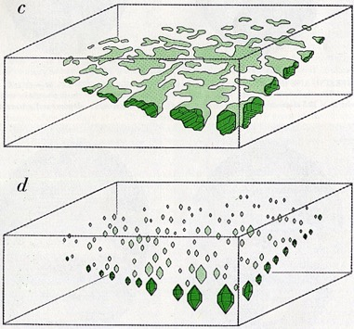
Do mineral inclusions change shape?
It has been long known that after being trapped fluid/melt inclusions change shape with T and t toward a faceted, «negative crystal» shape imposed by the host. This is called «shape maturation»
Roedder (1962)
For mineral (solid) inclusions, shape change has not been considered, except for rare works which propose inclusions to tend to rounded shapes
Vernon (2004)
Basically, mineral inclusions are considered
immutable objects

Slide 5
Do mineral inclusions change shape?
It has been long known that after being trapped fluid/melt inclusions change shape with T and t toward a faceted, «negative crystal» shape imposed by the host. This is called «shape maturation»
Roedder (1962)
For mineral (solid) inclusions, shape change has not been considered, except for rare works which propose inclusions to tend to rounded shapes
Vernon (2004)
Basically, mineral inclusions are considered
immutable objects
We show it is not like that

Slide 6
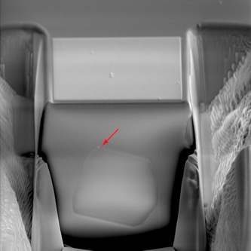
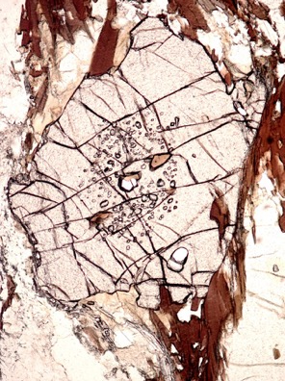
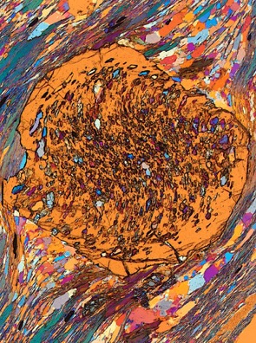
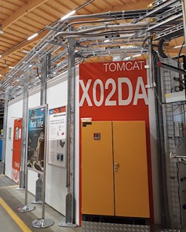
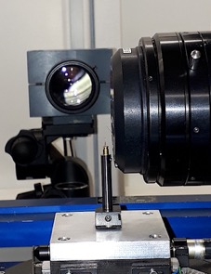
FIB-SEM serial slicing
Samples and Methods
5 Granulites (750 to 1000 ºC)
2 Metapelites (450 & 550 ºC)
Cores of Grt with Qz inclusions
Optical microscopy, BSEM, SRXTM and 3D volume reconstruction, XRD, EBSD, micro-Raman, FIB-SEM slicing
Granulite, Namibia
Schist, Tauern window
The TOMCAT beamline at SLS Synchrotron, PSI, Villigen (CH), and one sample ready for SRXTM

Slide 7
Results: shape of high-T inclusions
In the granulites quartz inclusions are systematically polyhedral (click to run video)
Combination of dodecahedron and icositetrahedron
Common orientation of facets in inclusions of same garnet

Slide 8
Crystallographic orientation of high-T inclusions
The quartz inclusions in the garnet have random crystallographic orientation (c axes on left)
BUT
The shape of quartz inclusions has symmetry axes coinciding with the crystallographic axes of host garnet (right)
Garnet imposes morphology:
NEGATIVE CRYSTALS

Slide 9
Results: shape of low-T inclusions
In the schists, inclusions are highly irregular, with «scalloped» boundaries
Their surface/volume ratio is much greater (yellow) than in the high-T samples (red)

Slide 10
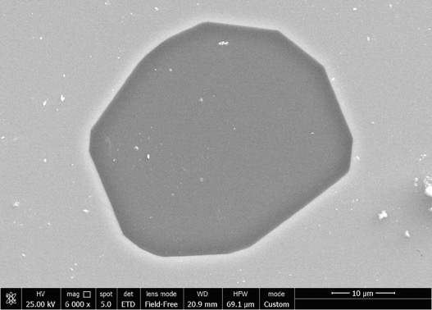
Necking down and fluid at boundary
Qz-Grt boundaries are generally sharp and clean. Possible fluid observed, but exception, not rule
Spectacular examples of frozen necking in granulite samples

Slide 11
Inferences
Qz inclusions in Grt show T-assisted shape maturation that is compatible with diffusion along interphase boundaries, not requiring fluid. Similarly to fluid and melt, Qz inclusions are not rounded but polyhedral negative crystals, whose shape is controlled by the crystallographic structure of the host Grt

Slide 12
Implications
Shape maturation – an irreversible strain – will probably reset the internal pressure of the host/inclusion system, that is at the basis of elastic barometry. Care should be taken in interpretation of high-T rocks
Grt (500 µm) in Dia
Qz (30 µm) in Grt
As negative crystal shape can be attained after entrapment, the main criterion for inclusion syngenesis with host (e.g., inclusions in diamond) is flawed
Koorneef et al. (2017)

Slide 13
Quartz inclusions in garnet from HT metamorphic rocks change their shape
stay tuned
Bernardo Cesare, Matteo Parisatto, Lucia Mancini, Luca Peruzzo, Matteo Franceschi, Tommaso Tacchetto, Steven M. Reddy, Richard Spiess, and Federica Marone

