Slide 1
Interpretation of a Network-scale Tracer Experiment in Fractured Rock
Matthew Howroyd
Kent Novakowski
Department of Civil Engineering Queens University, Kingston, Ontario, Canada
© Howroyd and Novakowski 2020. All rights reserved

Slide 2
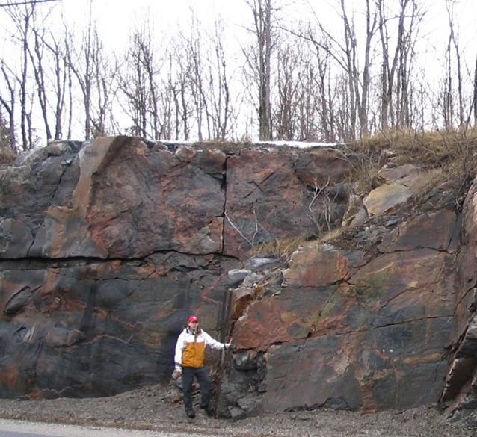
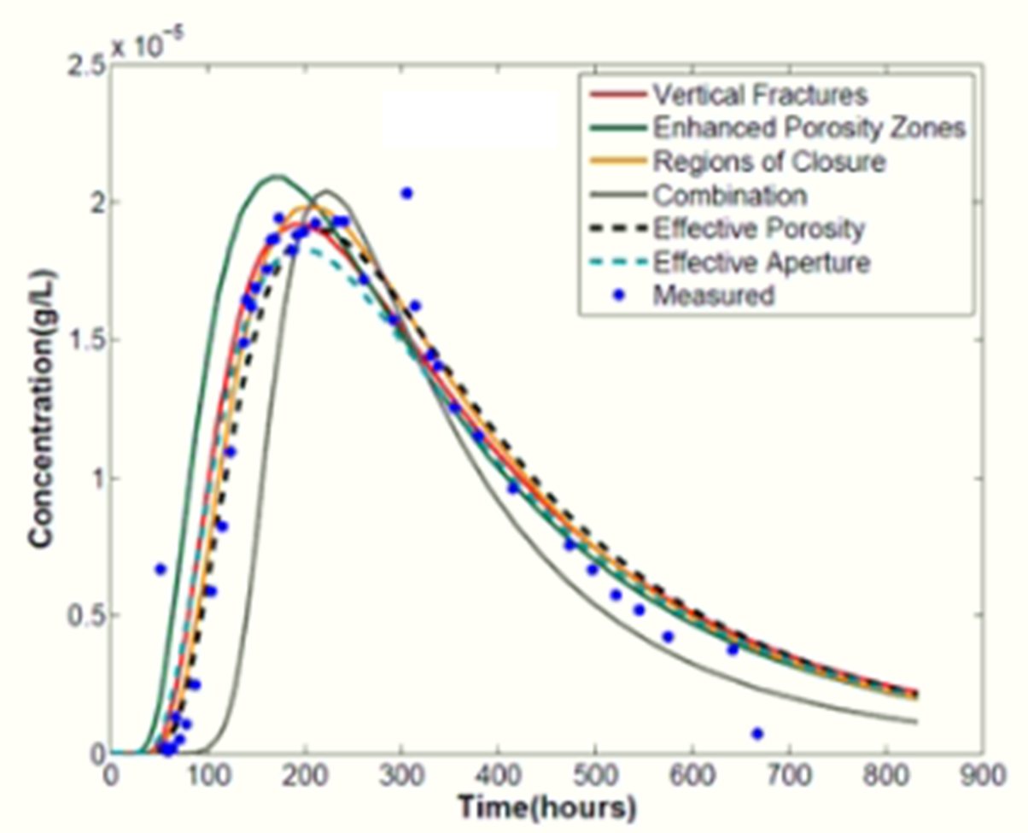
Introduction
Fractures which commonly pervade bedrock result in complex flow and transport patterns
Convoluted pathways which are difficult to predict
Matrix diffusion allowing for long residence times for contaminants
Transport processes still not fully understood at large scales (>50m)
Use of extra fitting parameters
Non-uniqueness in conceptual models
Difficulties at site in Smithville, Ontario

Slide 3
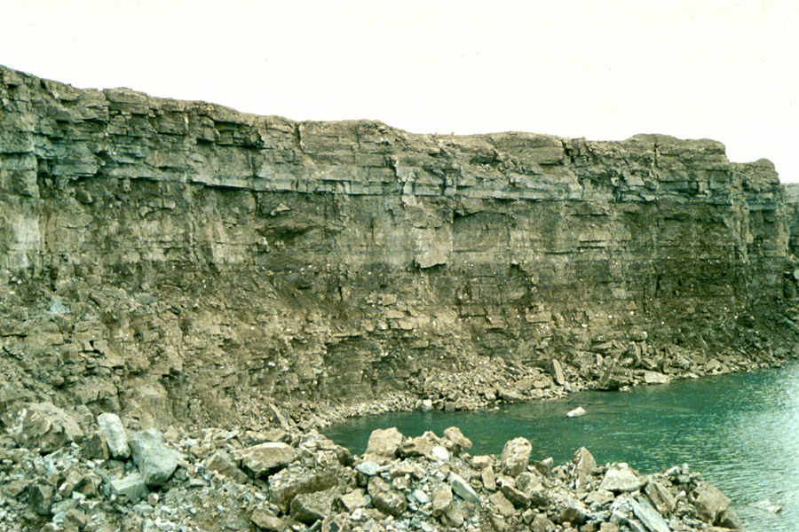
Introduction
Despite the need, there still exists a scarcity of tracer studies at large scales
Experimental difficulty
Cost - especially that of multi-level wells
Open wells are cheaper, but what can we learn about in-formation concentrations from experiments in such wells?

Slide 4
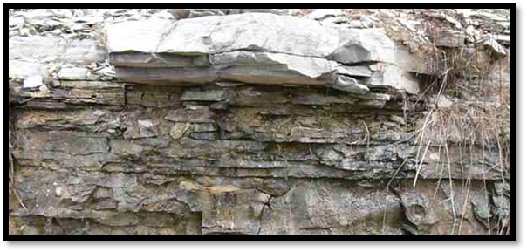
Objectives
Determine if a tracer experiment conducted in a fracture network using open boreholes can provide useful information regarding discrete fracture properties
Improve understanding of transport processes in fractures at a large scale

Slide 5
Methodology
Used the results of a large-scale tracer experiment conducted previously at the Smithville site where open observation wells were employed
Developed a finite-difference model to simulate an open observation well and net fluxes of solutes through the well
No consideration of processes taking place outside the observation well, just the resulting fluxes into or out of the well
Then expanded to a larger, control-volume finite element model of whole system with physical properties based on those measured in the field

Slide 6
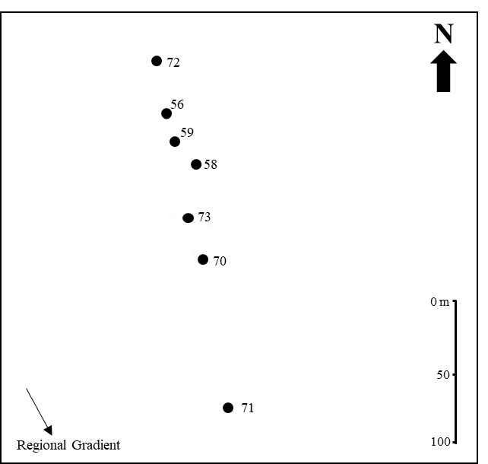
Previous Work: Tracer Experiment
Geology
Till cover (10 m in thickness)
Lockport formation Dolostone
Upper Eramosa Member (~15 m thickness)
Hydrogeology
Constant head test transmissivity measurements
3-4 horizontal fractures identified in experiment domain
Presence of vertical fractures identified using inclined wells
Tracer Experiment
Divergent flow setup with flow rate at 92 L/min
Lissamine FF dye
Isolated 10.4m section of BH72 (Upper Eramosa) as source
Steady state flow conditions maintained
Six open observation wells
Focus currently on BH56
Measurements obtained with downhole fluorometer

Slide 7
Results of Tracer Experiment in BH56
Each profile line represents a continuous series of concentration measurements as a fluorometer was lowered or raised in the well.
Descending Measurement Profile
Ascending Measurement Profile
Similar profile shapes also seen in other wells and in other experiments conducted at the same site

Slide 8
Finite Difference Model: Development
Implicit 1-D finite difference model for flow and transport in well.
Forward difference in time, central difference spatially
Steady-state flow with transient transport solution
Governing equations
Flow: $π{rs}^{2 }Kw\frac{∂2h}{∂l2}±q|n=0$
Transport: $π{rs}^{2 }(\frac{∂Cw}{∂t}−Dw\frac{∂2Cw}{∂l2}+qw\frac{∂Cw}{∂l})±Γ|n=0$
Flow and conservative transport in porous media with extra terms representing fluxes perpendicular to the well at each node ($q|n$ and $Γ|n$)
See Lacombe et al. (1995) for additional detail
Discretization
15m domain
0.1m element sizes and 20s timesteps
Tested using analytical solution for 1-D flow and transport in a well
Equation parameters
r_{s} – well radius
K_{w} – hydraulic conductivity of well. $\frac{rs2ρg}{8μ}$
ρ – fluid density
g – gravitational acceleration constant
μ – fluid viscosity
$l$ – position along well
q|_{n} – nodal water flux normal to the well
D_{w} – hydrodynamic dispersion coefficient. $\frac{rs2qw2}{48D0}+D0$
D₀ – free-water diffusion coefficient
C_{w} – concentration of the solute (Lissamine)
q_{w} – water velocity along well. -$Kw\frac{∂h}{∂l}$
$Γ|n$ – nodal solute flux normal to the well
Citation: Lacombe, S., Sudicky, E.A., Frape, S.K., & Unger, A.J.A. 1995. Influence of Leaky Boreholes on Cross‐Formational Groundwater Flow and Contaminant Transport. Groundwater, 31, 1871-1882.

Slide 9
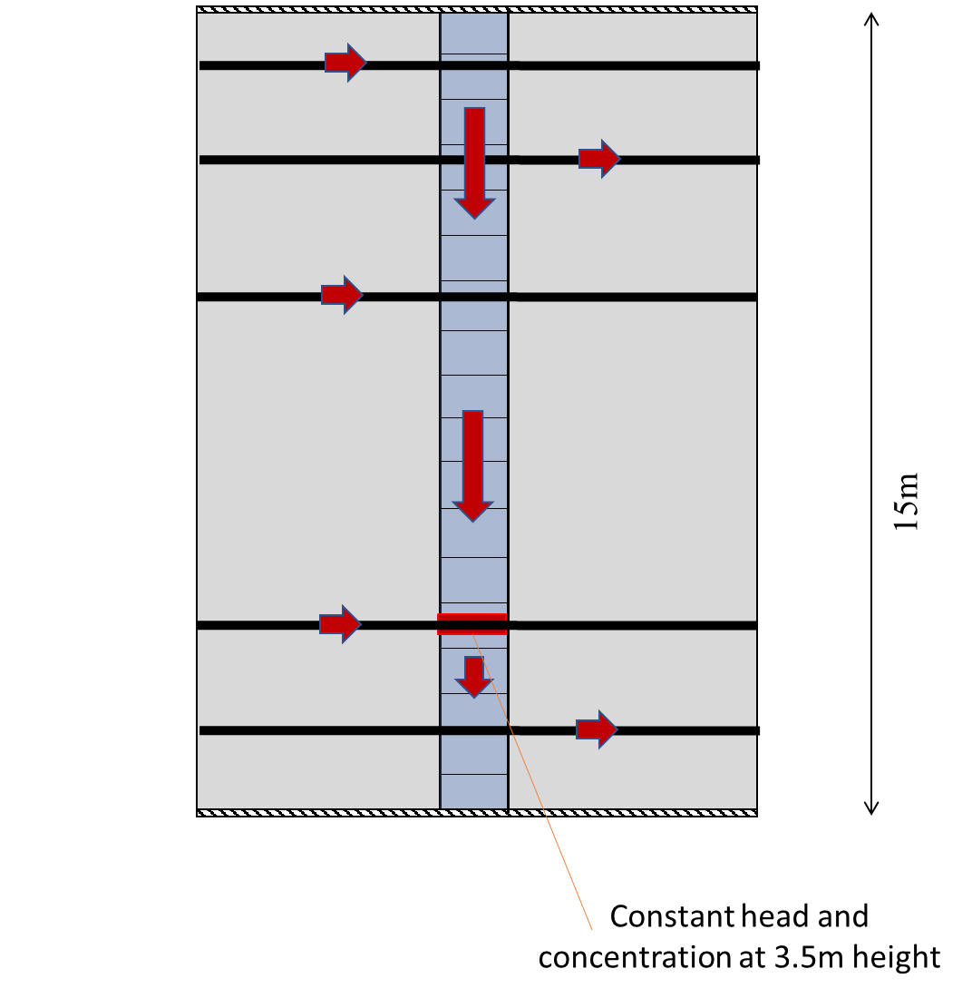
Finite Difference Model: Development
Boundary conditions
Single node chosen at 3.5m height to be constant head and concentration boundary
Node initially selected at height where measurements indicated the presence of high conductivity fracture which could be correlated between the injection well and observation well.
Top and bottom of domain set as type 2 boundaries
Other relevant parameters (i.e. well radius, diffusion coefficient) based on measurements
Values of nodal flux terms then varied to achieve fits to profile shapes
Various conceptual models tested

Slide 10
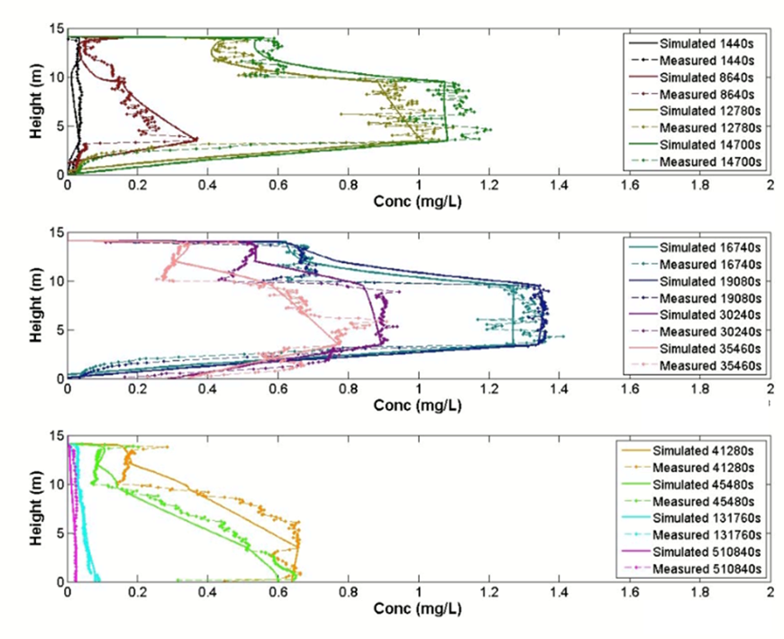
Finite Difference Model: Fits to Data
Testing of different conceptual models resulted in a fit
Each fit to a line in the 3 diagrams shown was achieved with the same model, with just the source condition at 3.5m height changing with time to reflect the measured breakthrough concentration.
Non-uniqueness was observed in the number of fractures and the magnitude and direction of water velocity through the well that could result in a fit
Therefore, it is potentially possible to find another fit, but likely not one that is distinctively different
Parameters of fit
5-6 connecting fractures controlling flow and transport. Fractures were added at heights of approximately 0m, 1.5m, 9.5m, and 14m
Comparisons to the measured transmissivity data supports the positioning of the fractures at 9.5m and 14m. Furthermore, there is evidence of a fracture very close to the lower boundary of the domain.
Velocity through the well of 10⁻⁴ – 10⁻³ m/s in central section of domain (~3m – 10m) and 1-2 orders of magnitude lower on edges
Fractures at 9.5m and 14m height had net positive solute fluxes, with the majority being added from the 9.5m fracture (fluxes 10x larger than any other fracture)
Conversely, fractures at 0m and 1.5m had net negative fluxes for both flow and solute in all fits to the measured data.

Slide 11
Observations from Modeling
Possible to identify the number and approximate positions of the 5 most important fracture features for transport in the experiment domain
The fracture at 9.5m height was the largest contributor of tracer to the well of the added fractures.
The differences in direction and magnitude of solute fluxes from fractures of similar hydraulic aperture, indicate a lack of strong vertical connection in the domain.
While the open borehole tracer experiment combined with a simple finite difference model can provide us mostly qualitative information regarding the transport properties of the Upper Eramosa, it does not supply any detail on absolute concentrations in the formation, or provide specifics on the transport parameters of individual fractures.
Next step to look at a model of the larger system.

Slide 12
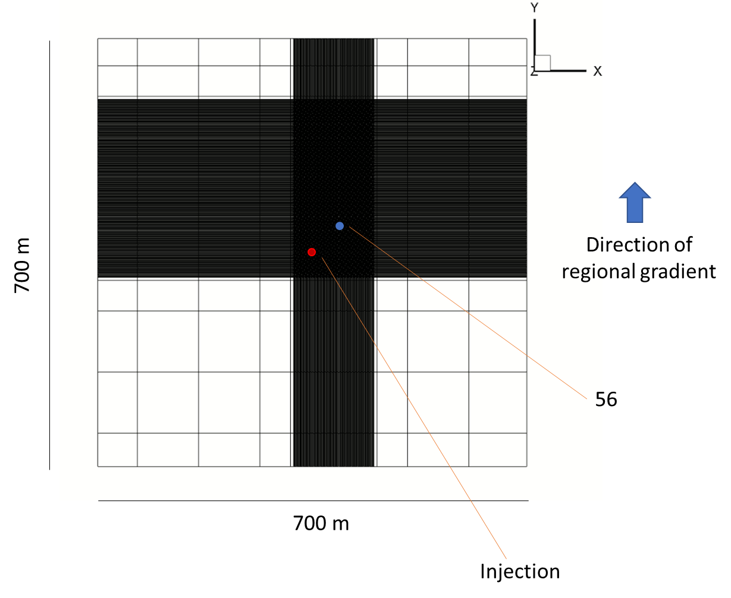
Expanded Model: Initial Simulation
Used HydroGeoSphere, a 3-D control volume finite element model
Steady state flow solution with transient transport
Domain
700 x 700 x 17 m
Injection well in middle of domain
Observation wells represented as physical features
Fractures initially fully continuous in domain and placed in positions indicated by constant head tests.
Initial estimates of porosity, fracture apertures, and regional hydraulic gradient taken from field measurements
Discretization
Chosen by shrinking the block sizes until the transport solution no longer varied
Fine around fractures and the injection well with lengths of 1mm vertically and 1cm horizontally. Coarsened outwards to 1 x 1 x 0.5 m blocks

Slide 13
Expanded Model: Attempts to Fit Measured Profile
Wide variety of parameters tested to attempt to fit measured concentration profile in open wells
Heterogenous matrix porosities and fracture apertures
Variable fracture lengths
Presence of regions of closure or channelization
Vertical fractures to connect horizontal fractures
Additional horizontal fractures, both connected and unconnected to the injection and observation wells
Vertical gradients
A decay parameter to represent non-reversible adsorption or loss of solute from the domain
Mixing effects in well
Many various combinations of the above models
Fit to entire profile could not be attained with this modelling approach
Unable to achieve sufficient mixing of solute through advective or diffusive means. Mixing due to measurement method considered unlikely due to similarity between the measured profiles in down and up directions

Slide 14
Expanded Model: Effects of Observation Wells
While a fit to concentration profile was not achieved, the effect of the presence of an observation well on concentration measurements could be examined
This was done by fitting a single point on the profile over time (i.e. a breakthrough curve at a fracture discharging solute) and then removing the observation well to observe changes
Fits for a single position could be achieved in two ways
Introducing aperture heterogeneity in the form of decreasing the aperture on the far side of the observation well (i.e. decreasing aperture with distance)
Creating a 100 m wide “channel” of increased aperture between the injection and observation wells.
Previous modelling of other tracer experiments in the same area indicated that matrix porosity or vertical interconnection could also explain some of the observed tortuosity in transport pathways. However, in this case, aperture heterogeneity was the only important factor identified.

Slide 15
Conclusions
Used two numerical models to analyze the results of a unique, network scale tracer experiment conducted in a dolostone unit
From a finite difference model for an open well, information regarding the positions of the discrete features controlling transport, as well as their relative importance could be identified
The use of a more complex finite element model could not achieve a fit to the observed tracer profile in the open well
Therefore, it was not possible to determine network geometry or specific mechanisms controlling transport at the site
Overall, this study indicates that tracer experiments conducted in open boreholes with the use of a downhole fluorometer can provide useful information for large-scale transport.

