Slide 1
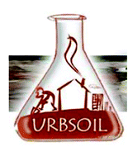
European Geophysical Union
General Assembly 2020
4–8 May 2020, Vienna, Austria
LOMONOSOV MOSCOW STATE UNIVERSITY
POLLUTION OF MOSCOW SOILS WITH POTENTIALLY TOXIC ELEMENTS: ANALYSIS OF LONG-TERM MONITORING DATA
N.E. Kosheleva, A.G. Tsykhman

Slide 2
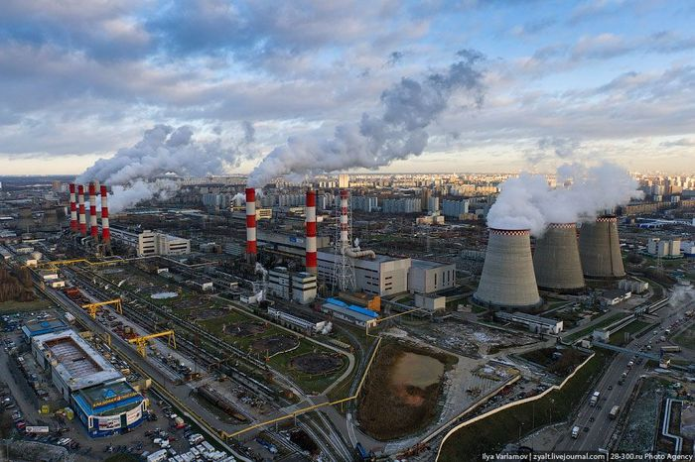
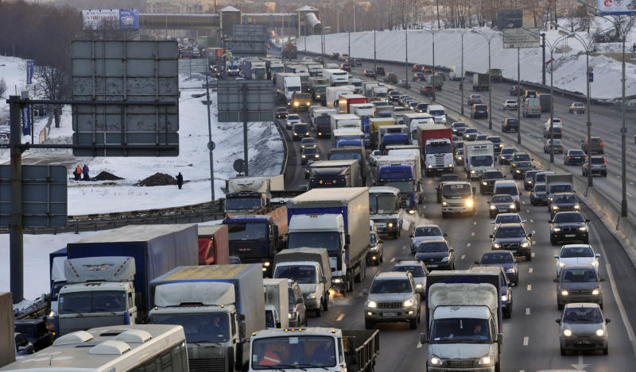
Moscow
The largest city not only in Russia, but also in Europe;
On its territory there are more than 340 thousand industrial enterprises, 39 thousand residential buildings, 10 thermal power plants, 53 thermal stations;
There are 3 waste incineration plants in the city, another 6 are planned to be built in the vicinity;
Industrial zones occupy > 17% of the city’s area (Bityukova, Saulskaya, 2017);
There is a constant population growth – now 12.4 million people and
growth in the number of cars – 5.6 million (according to the traffic police for 2017).
Modern views of Moscow

Slide 3
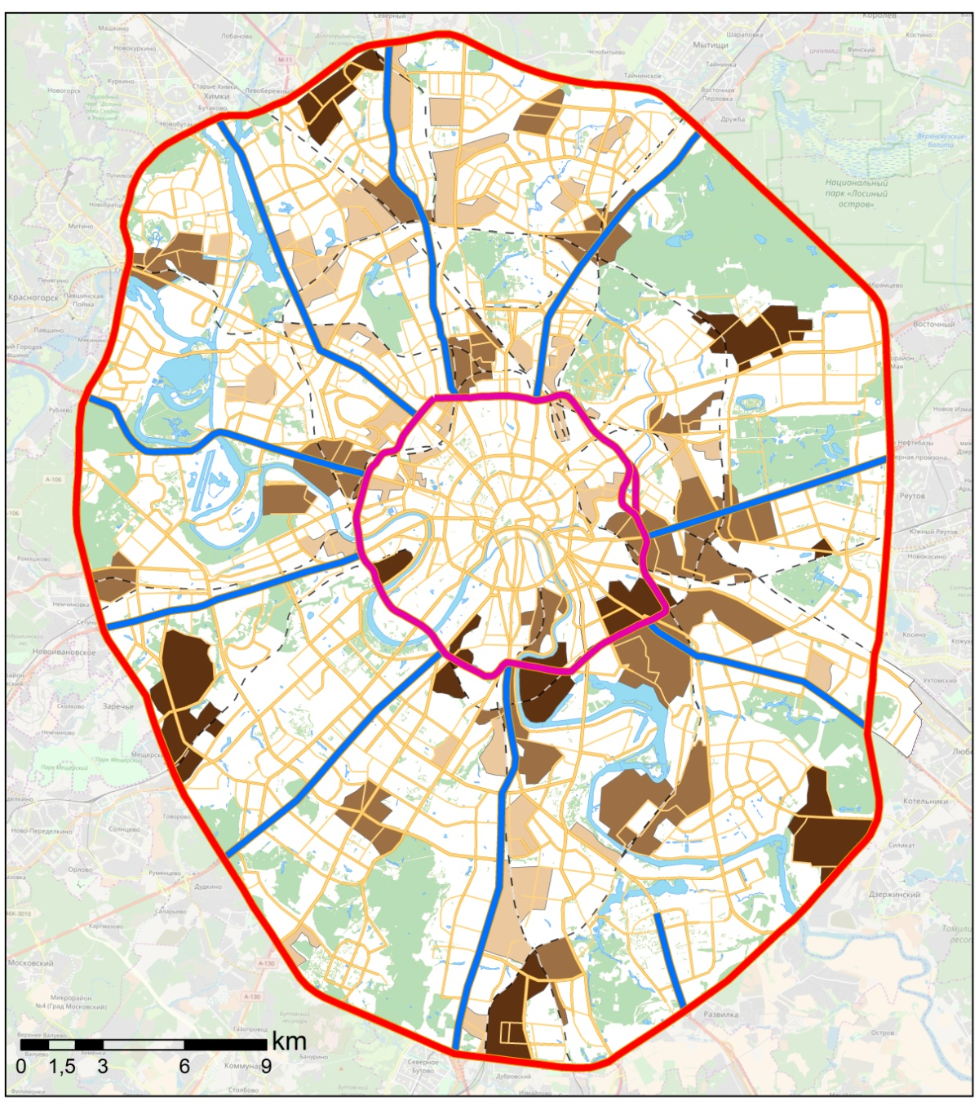
Anthropogenic impact on the soils of Moscow
Roads and industrial areas of Moscow
(Kasimov_et al., 2018; Bityukova, Saulskaya, 2017)

Slide 4
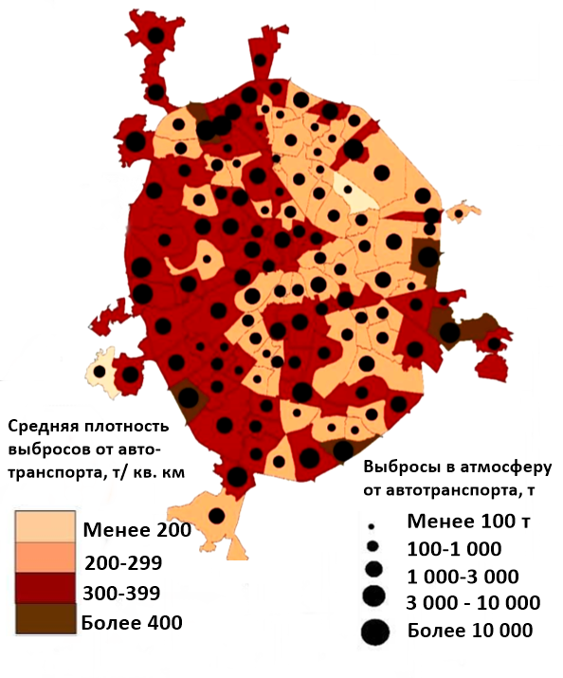
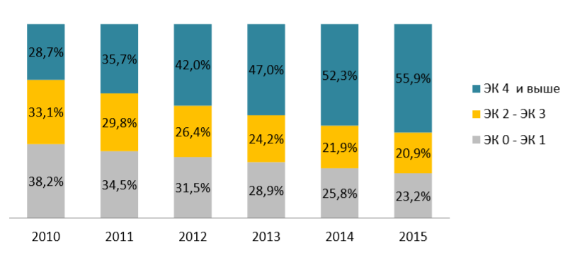
Impact of motor transport
Atmospheric emissions from mobile sources and the average density of atmospheric emissions in municipal districts of Moscow in 2016
(according to Geocenter Consulting data)
Annual emissions to the atmoshpere:
930 thousand tons - transport;
63 thousand tons - industry, including
70% - TPPs, oil refinery plant,
three incinerators
Dynamics of fleet renewal the city of Moscow
Environmental class 4 and higher
Environmental class 4 and higher
Environmental class 2 - 3
Environmental class 0 -1
Average density of emissions from vehicles, tons per sq. km
Emissions from motor vehicles, t
less than 200 200-299 300-399 more than 400
less than 100 100-1000 1000-3000 3000-10000 more than 10000
(Report "On the state of the environment in the city of Moscow“, 2017)
(Saulskaya, 2018)

Slide 5
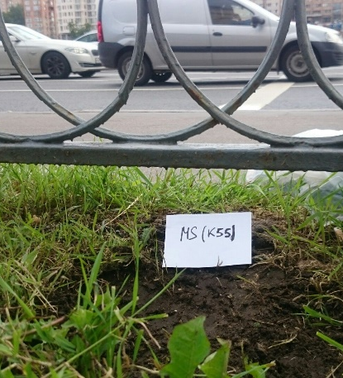
The aim of this study:
to analyze the long-term dynamics of soil pollution in Moscow with potentially toxic elements (PTEs) within the Moscow Ring Road according to the data of geochemical soil monitoring for 2007-2016.
The specific objectives of the study were:
To analyze the data of long-term (2007-2016) soil monitoring on the content of PTEs in the soil cover of Moscow;
To reveal spatial and temporal patterns in changes in PTE content in surface (0-10 cm) soil horizons in the administrative districts of the megacity within the Moscow Ring Road (MRR);
To give an ecological and geochemical assessment for the status of urban soils.

Slide 6
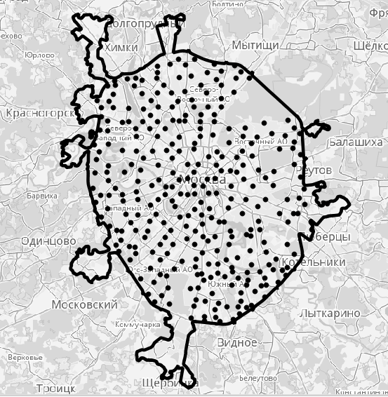
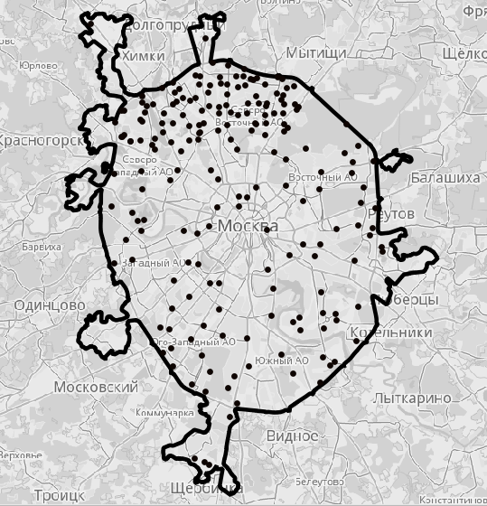
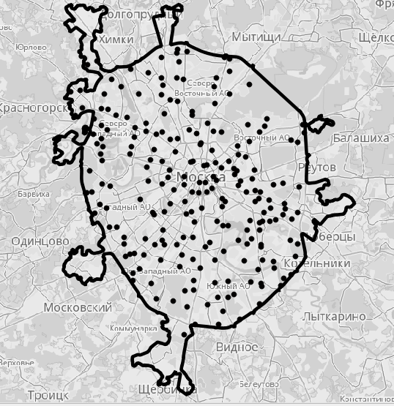
Materials and methods: laboratory research
Monitoring data of the State Environmental Institution “Mosekomonitoring” were used: materials of observing the state of topsoils within the MRR over a 10-year period (from 2007 to 2016) at 2238 points.
Location of sampling points in different years of research
2007 2010 2016
The content of As, Cd, Hg, Pb, Zn (they belong to the first class of hazard according State Standard 17.4.1.02-83),Cu, Ni, Co (II class), Mn (III class) was determined by spectrometry with inductively coupled plasma on a Varian 720-ES device at the Analytical Laboratory of the State Environmental Institution “Mosekomonitoring”.

Slide 7
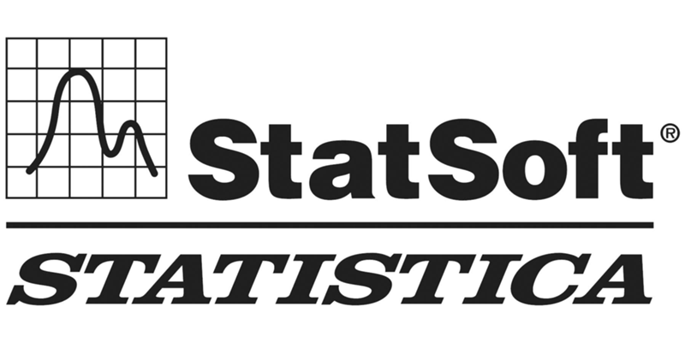
Materials and methods: processing of soil-geochemical data
Methods of descriptive statistics (calculation of average values, min–max range,
standard deviations Ϭ, variation coefficients Cv, etc.) in the STATISTICA 10.0 package.
Multivariate statistical analysis using the regression tree method in the S-PLUS package.
Natural factors: C org, pH, particle-size distribution of soils;
Anthropogenic factors: land-use zone (LU-Z) and administrative district (AD).
The soil-geochemical map was compiled in the QGIS 2.18.0 and ArсGIS 10.3.1
packages; the interpolation method is IDW.
Land-use zoning of sampling points was carried out using the Google Maps service.
Geochemical coefficients and indices:
– PTE concentration coefficient: Кс = Сi / Сref, where Сi, Сref – PTE content in urban and background soils at the i-th sampling point, mg/kg.
– Total pollution index Zс = ∑Kс – (n – 1) characterizes the general geochemical load on the soil, where n is the number of chemical elements with Kc > 1.0. Zс shows the accumulation levels in soils and environmental hazards of a group of PTEs coming from technogenic sources: <16 - non-hazardous, 16-32 - moderately dangerous, 32-64 - dangerous, 64–128 - very dangerous,> 128 - extremely dangerous.
– Environmental hazard coefficient: Ko = Сi / MPCi, where MPCi – maximum permissible concentration.

Slide 8
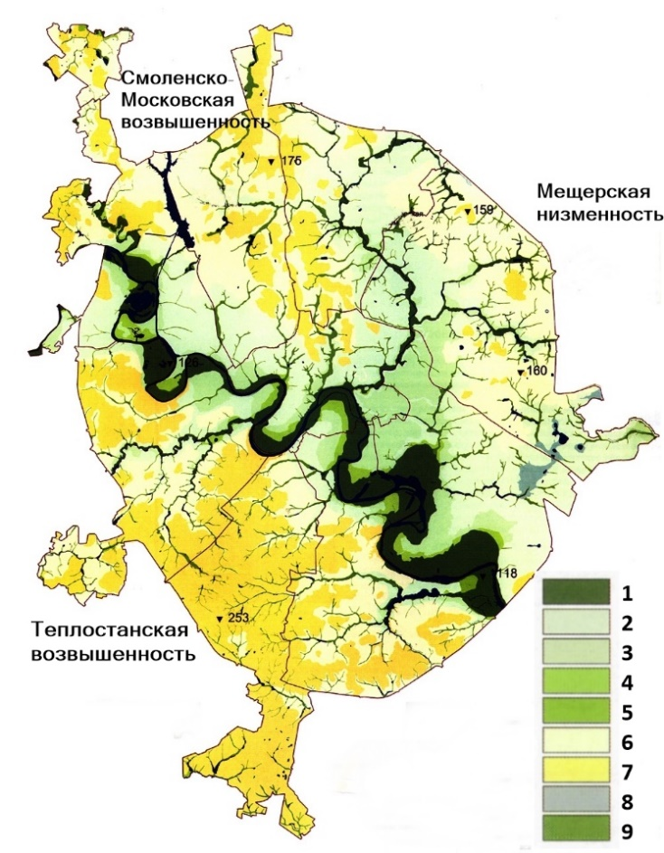
RESULTS AND DISCUSSION
Geochemical background*
Geomorphological map of Moscow
Physiogeographic Province | Meshcherskaya | Moscow | Moskvoretsko-Okskaya
Cu | 20,4 | 13,7 | 15,8
Zn | 37 | 66,3 | 65,6
Ni | 10,8 | 20,7 | 20,1
Pb | 14,2 | 23,6 | 22,2
Cd | 0,210 | 0,469 | 0,233
As | 1,960 | 2,972 | 4,686
Mn | 357 | 2862 | 1543
Co | 4,3 | 11,3 | 9,4
Hg | 0,06*
Moscow
Upland
Meshcherskaya
lowland
Moskvoretsko-Okskaya Upland
1 - floodplain, 2 - the first floodplain, 3 - the 2nd floodplain, 4 - the 3rd floodplain, 5 - the undivided complex of floodplain terraces; 6 - fluvioglacial plain; 7 - moraine plain; 8 - lake plain; 9 - bottoms of valleys of small rivers, gullies, hollows
(Ecological Atlas of Moscow, 2000)
* (Vlasov, 2015)
** (Bessonov, Yanin, 2006)

Slide 9
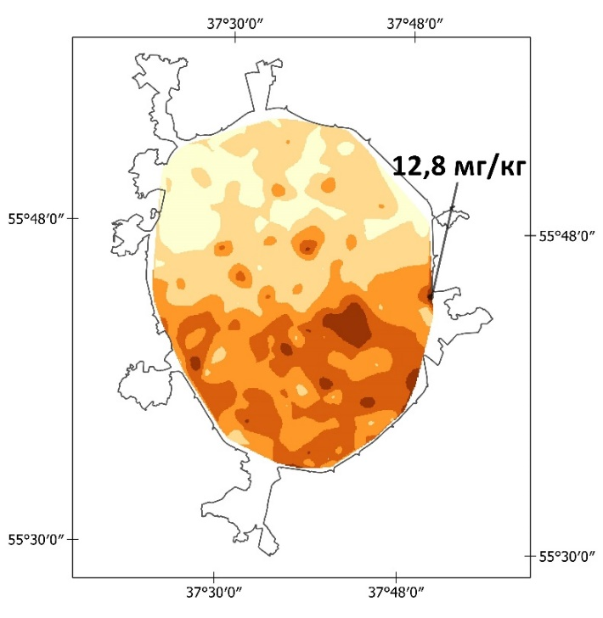
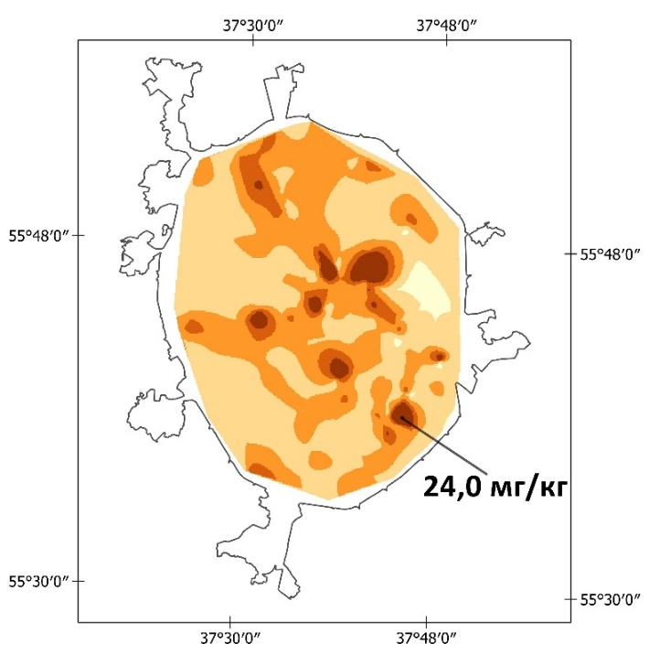
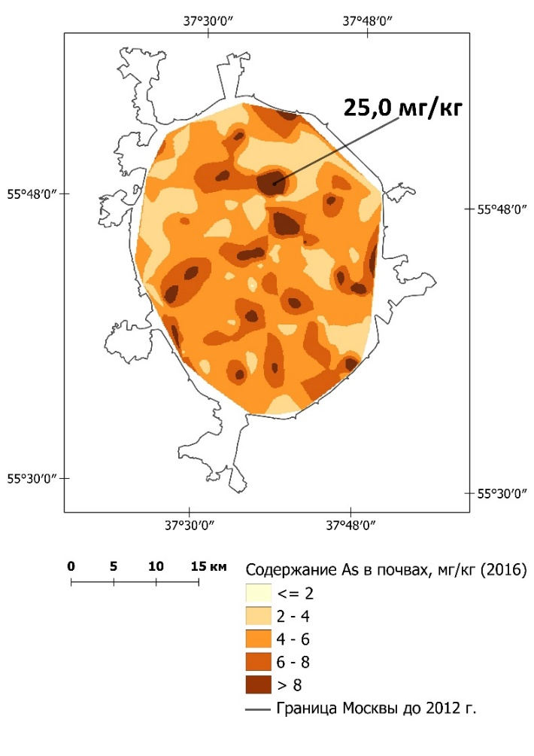
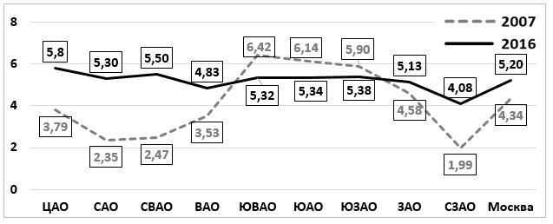
RESULTS AND DISCUSSION
Dynamics of the content of As (I class of hazard) in the soils of Moscow
2007 2012 2016
mg/kg
mg/kg
The values on the map are local anomalies of As
mg/kg
As content in the soils, mg/kg
MPC = 10 mg/kg
Spatial-temporal changes in the mean As content in the soils of Administra- tive Districts (ADs) of Moscow (in mg/kg)
Boundaries of Moscow until 2012
ADs: Central Northern N-Eastern Eastern S-Eastern Southern S-Western Western N-Western City

Slide 10
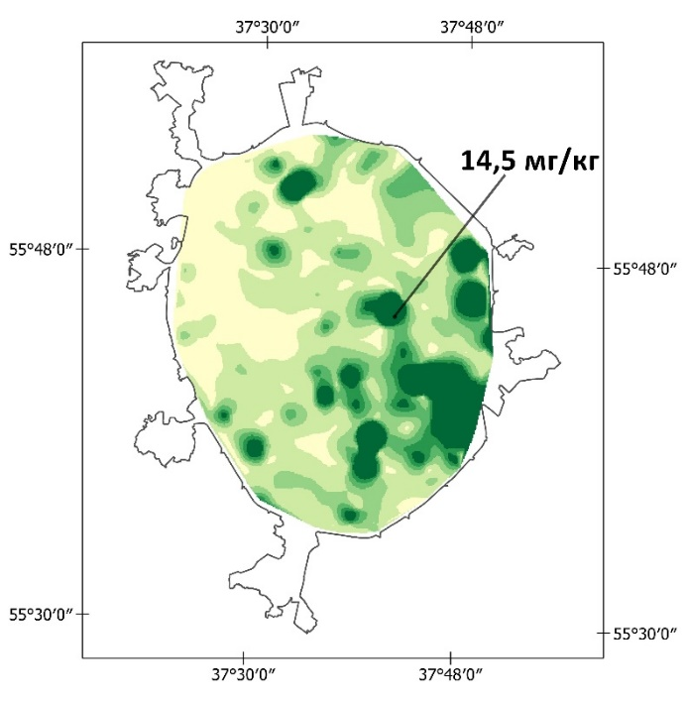
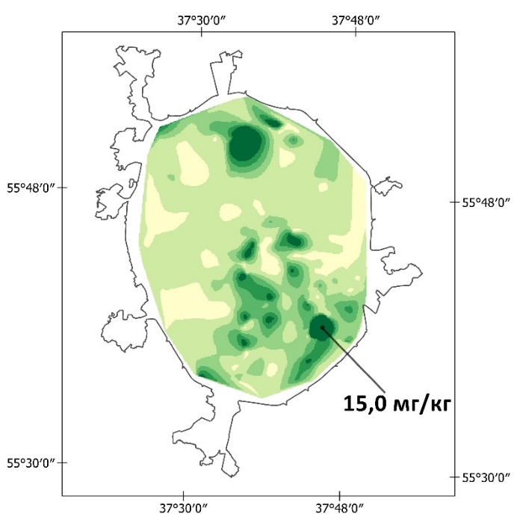
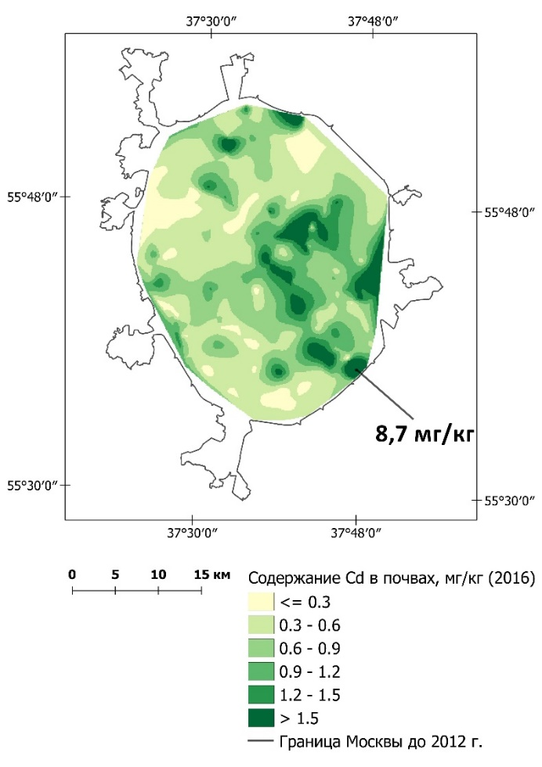
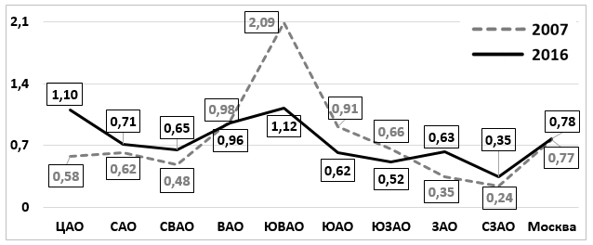
RESULTS AND DISCUSSION
Dynamics of the content of Cd (I class of hazard) in the soils of Moscow
2007 2012 2016
mg/kg
The values on the map are local anomalies of Cd
mg/kg
mg/kg
Cd content in the soils, mg/kg
MPC = 2 mg/kg
Spatial-temporal changes in the mean Cd content in the soils of Administra- tive Districts (ADs) of Moscow (in mg/kg)
Boundaries of Moscow until 2012
ADs: Central Northern N-Eastern Eastern S-Eastern Southern S-Western Western N-Western City

Slide 11
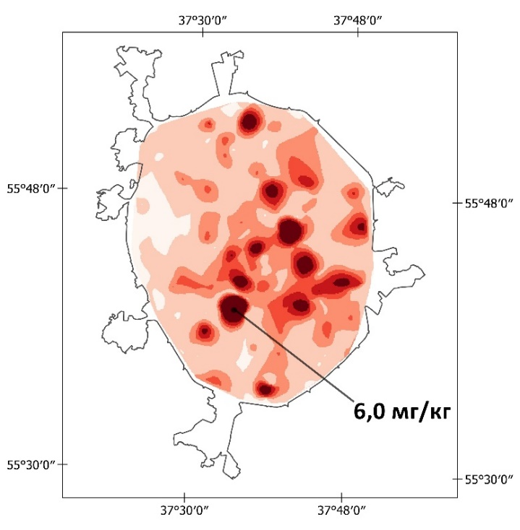
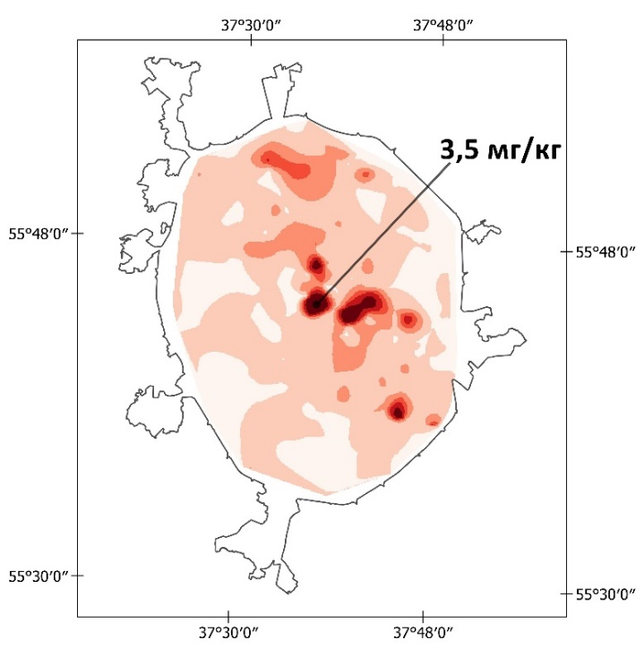
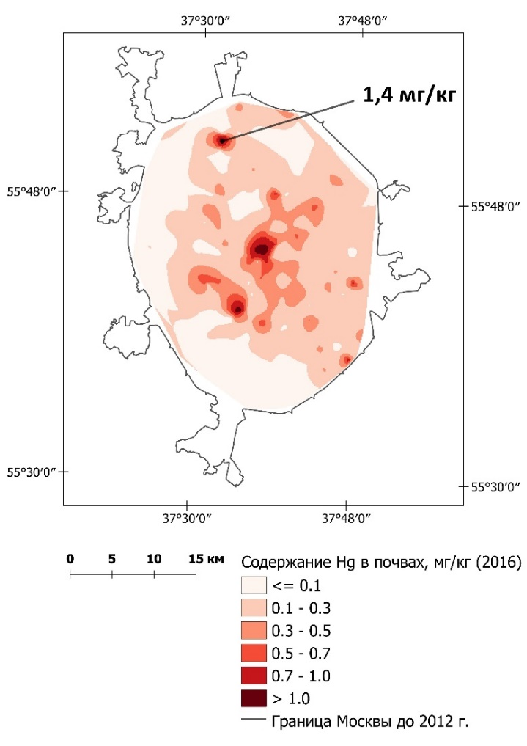
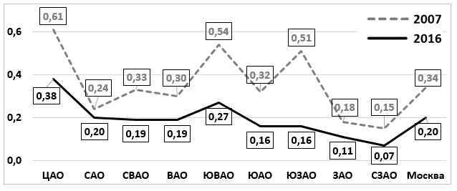
RESULTS AND DISCUSSION
Dynamics of the content of Hg (I class of hazard) in the soils of Moscow
2007 2012 2016
mg/kg
mg/kg
The values on the map are local anomalies of Hg
mg/kg
Hg content in the soils, mg/kg
MPC = 2,1 mg/kg
Spatial-temporal changes in the mean Hg content in the soils of Administra- tive Districts (ADs) of Moscow (in mg/kg)
Boundaries of Moscow until 2012
ADs: Central Northern N-Eastern Eastern S-Eastern Southern S-Western Western N-Western City

Slide 12
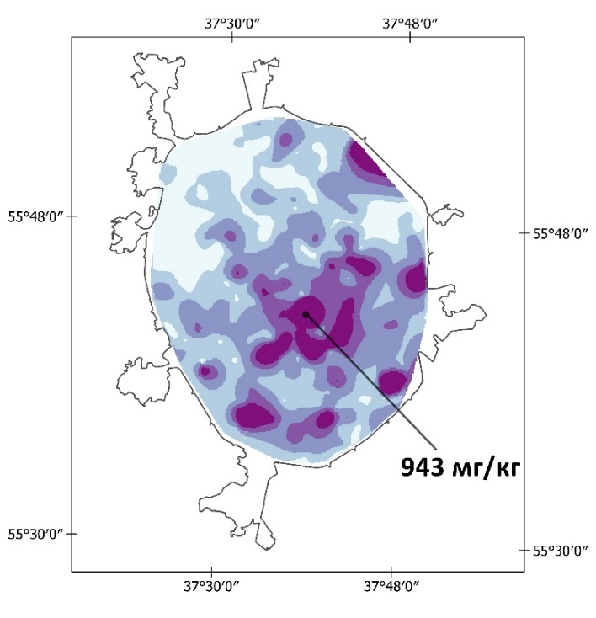
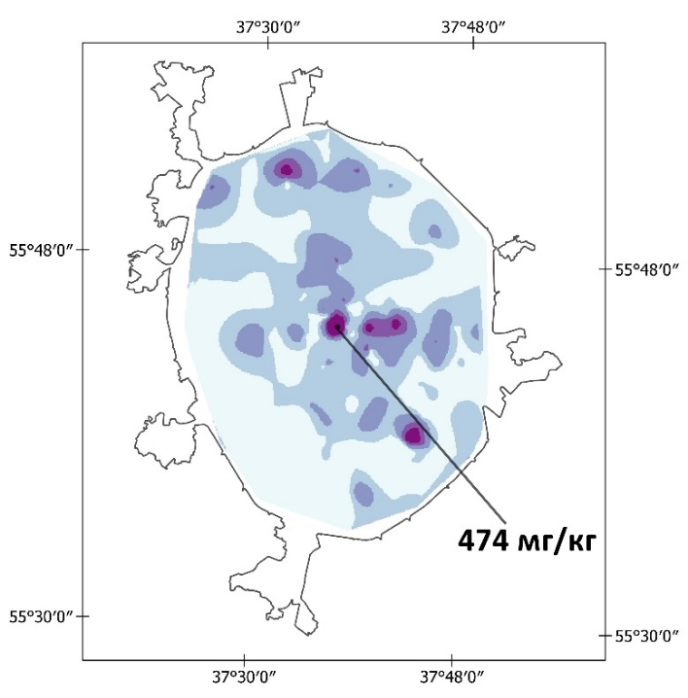
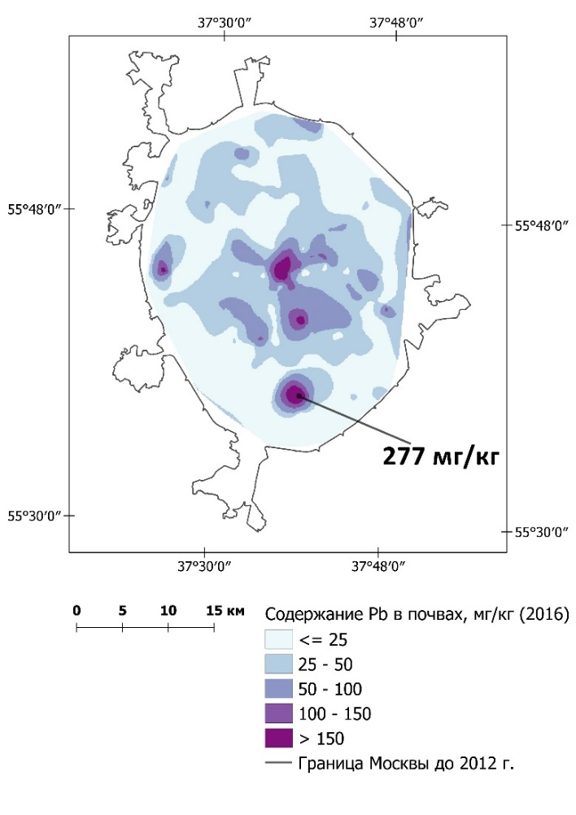
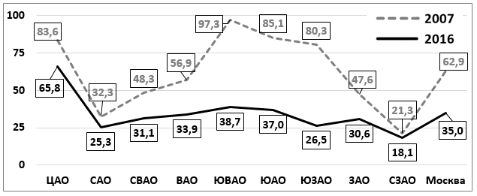
RESULTS AND DISCUSSION
Dynamics of the content of Pb (I class of hazard) in the soils of Moscow
2007 2012 2016
The values on the map are local anomalies of Pb
mg/kg
mg/kg
mg/kg
Pb content in the soils, mg/kg
MPC = 32 mg/kg
Spatial-temporal changes in the mean Pb content in the soils of Administra- tive Districts (ADs) of Moscow (in mg/kg)
Boundaries of Moscow until 2012
ADs: Central Northern N-Eastern Eastern S-Eastern Southern S-Western Western N-Western City

Slide 13
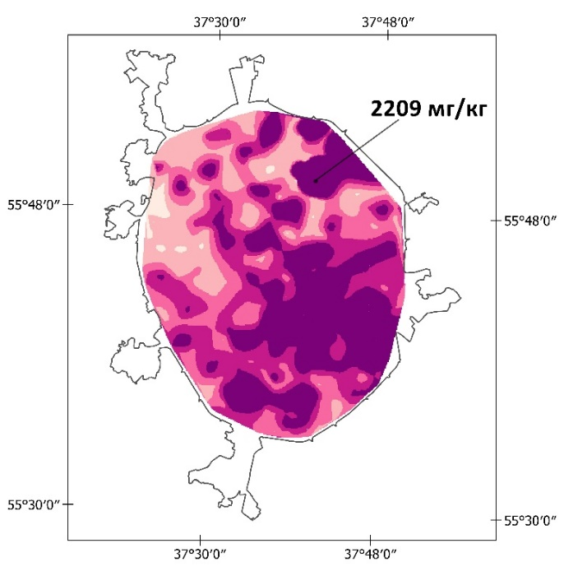
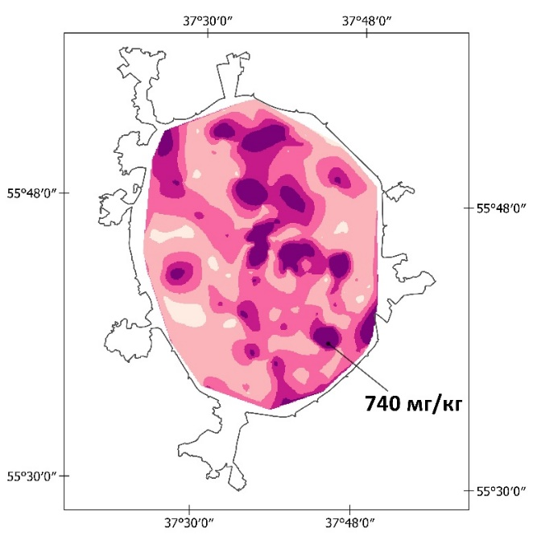
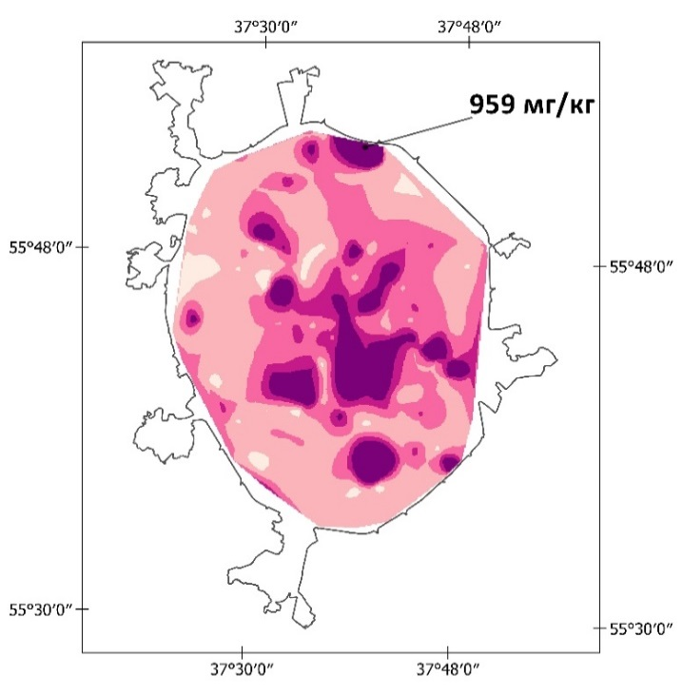
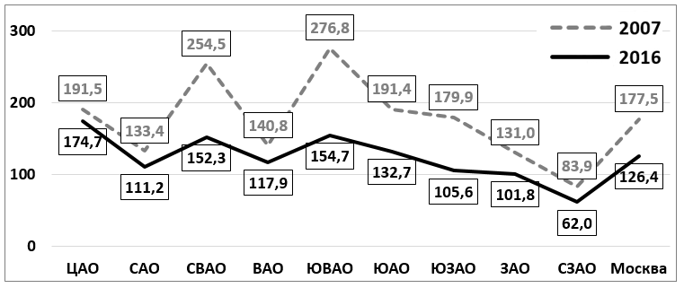
RESULTS AND DISCUSSION
Dynamics of the content of Zn (I class of hazard) in the soils of Moscow
2007 2012 2016
mg/kg
mg/kg
The values on the map are local anomalies of Zn
Zn content in the soils, mg/kg
MPC = 100 mg/kg
Spatial-temporal changes in the mean Zn content in the soils of Administra- tive Districts (ADs) of Moscow (in mg/kg)
Boundaries of Moscow until 2012
ADs: Central Northern N-Eastern Eastern S-Eastern Southern S-Western Western N-Western City

Slide 14
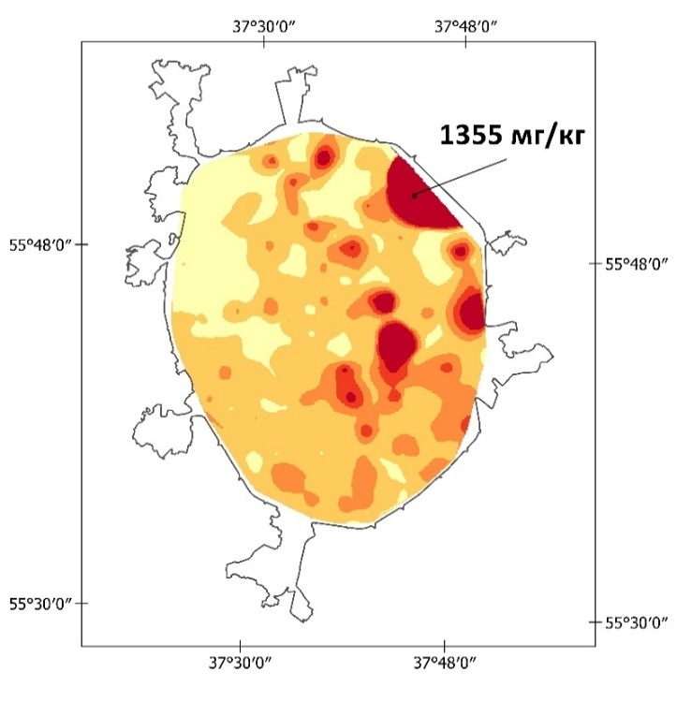
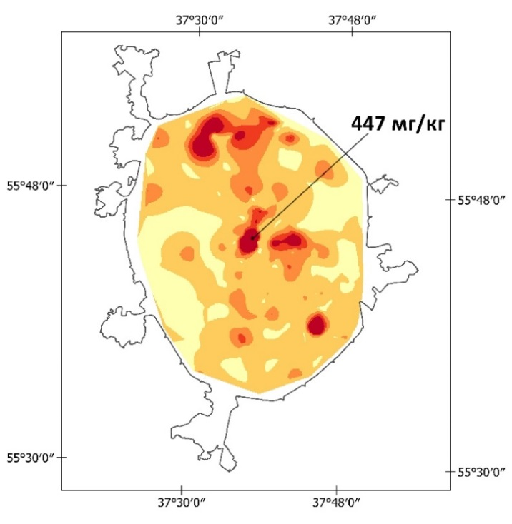
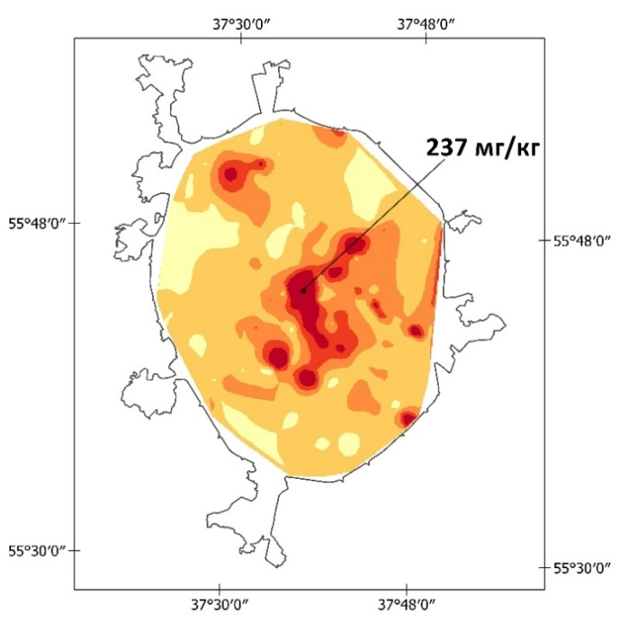
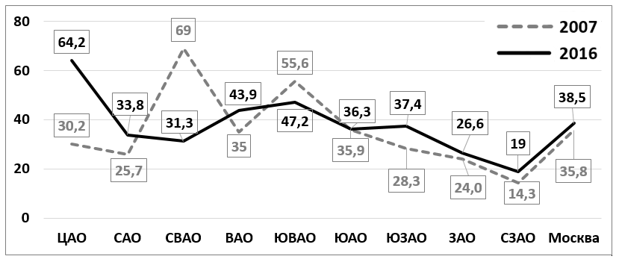
RESULTS AND DISCUSSION
Dynamics of the content of Cu (II class of hazard) in the soils of Moscow
2007 2012 2016
mg/kg
mg/kg
mg/kg
The values on the map are local anomalies of Cu
Cu content in the soils, mg/kg
MPC = 55 mg/kg
Spatial-temporal changes in the mean Cu content in the soils of Administra- tive Districts (ADs) of Moscow (in mg/kg)
Boundaries of Moscow until 2012
ADs: Central Northern N-Eastern Eastern S-Eastern Southern S-Western Western N-Western City

Slide 15
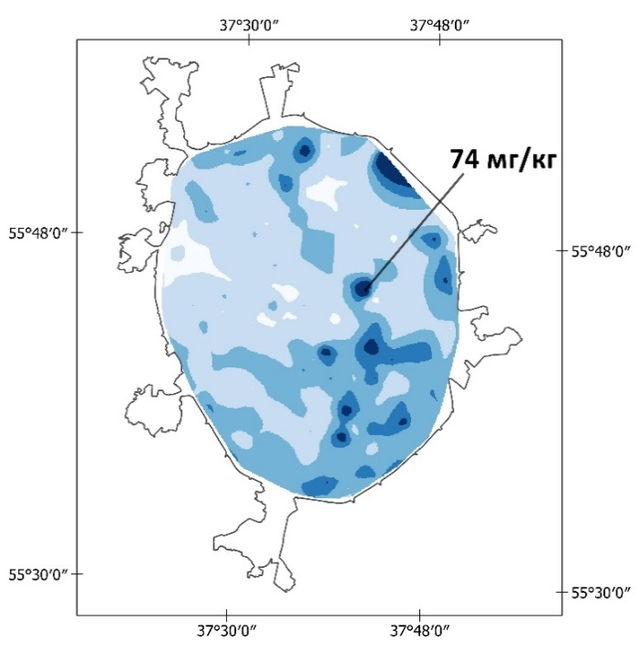
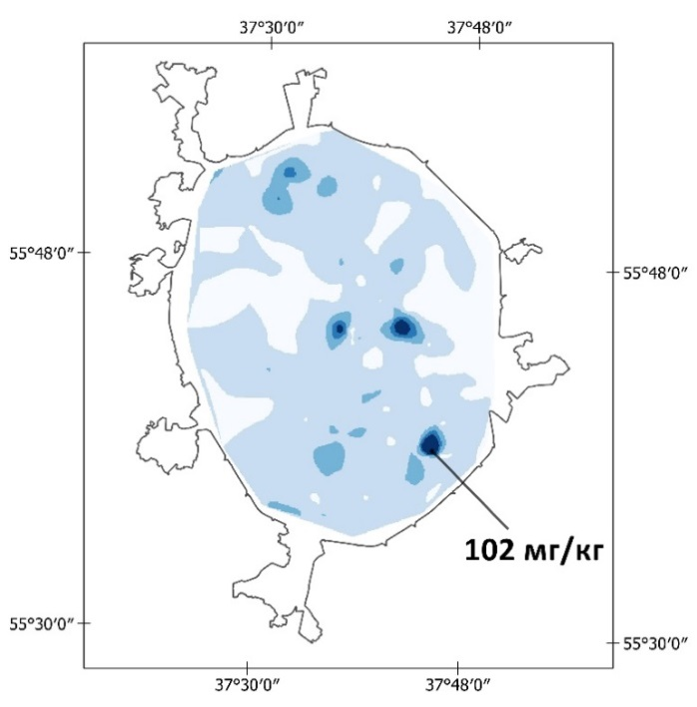
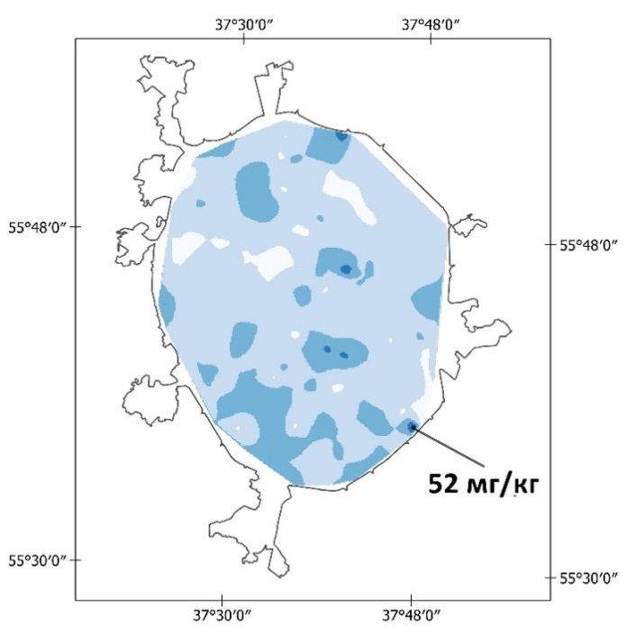
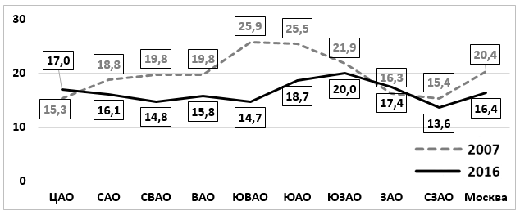
RESULTS AND DISCUSSION
Dynamics of the content of Ni (II class of hazard) in the soils of Moscow
2007 2012 2016
mg/kg
The values on the map are local anomalies of Ni
mg/kg
mg/kg
Ni content in the soils, mg/kg
MPC = 85 mg/kg
Spatial-temporal changes in the mean Ni content in the soils of Administra- tive Districts (ADs) of Moscow (in mg/kg)
Boundaries of Moscow until 2012
ADs: Central Northern N-Eastern Eastern S-Eastern Southern S-Western Western N-Western City

Slide 16
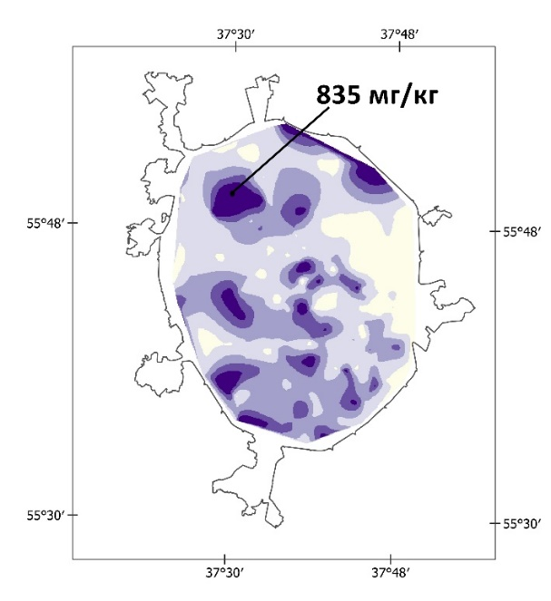
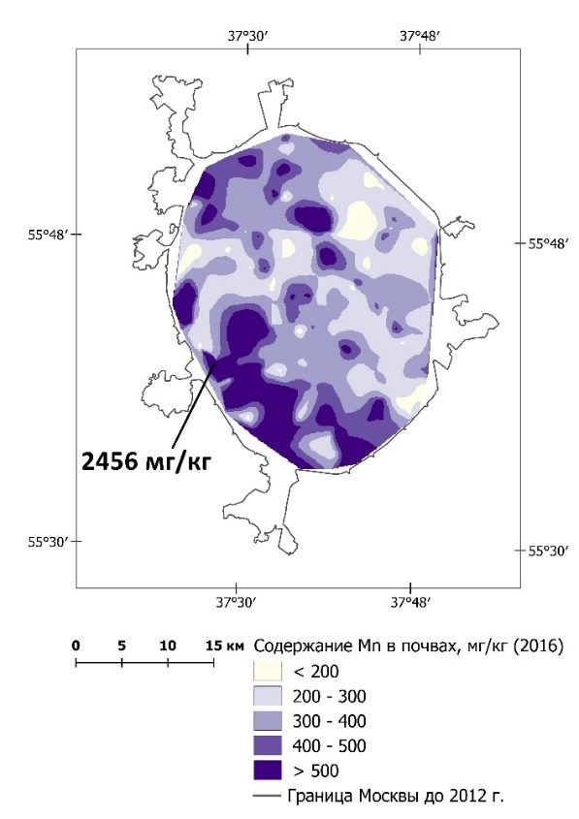
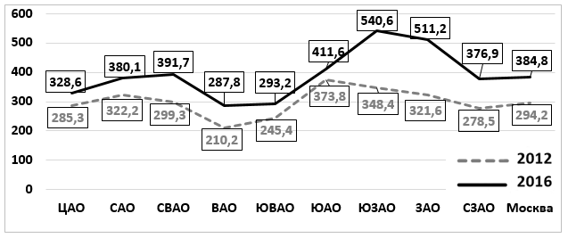
RESULTS AND DISCUSSION
Dynamics of the content of Mn (III class of hazard) in the soils of Moscow
2012 2016
mg/kg
The values on the map are local anomalies of Mn
mg/kg
Mn content in the soils, mg/kg
MPC = 1500 mg/kg
Spatial-temporal changes in the mean Mn content in the soils of Administra- tive Districts (ADs) of Moscow (in mg/kg)
Boundaries of Moscow until 2012
ADs: Central Northern N-Eastern Eastern S-Eastern Southern S-Western Western N-Western City

Slide 17
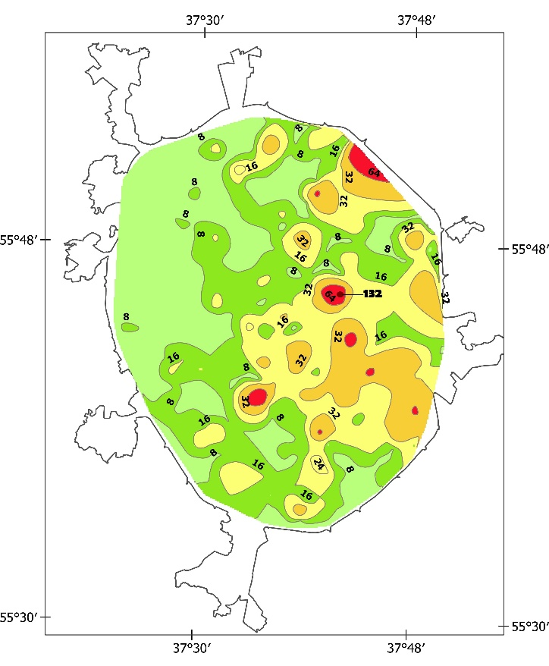
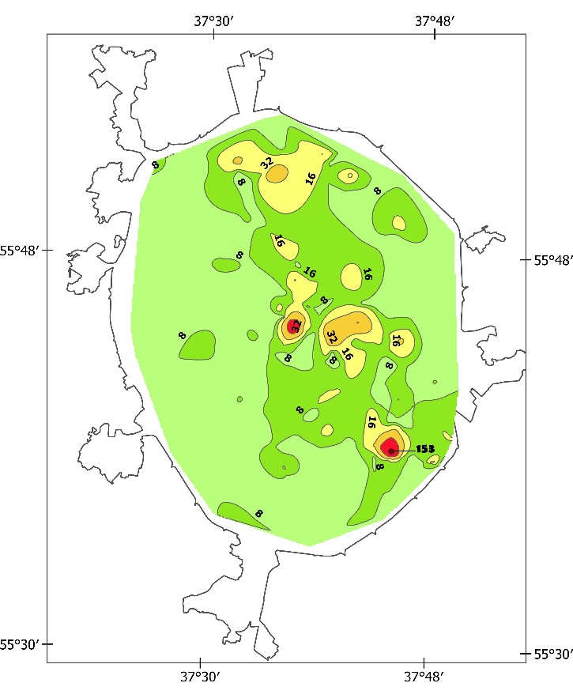
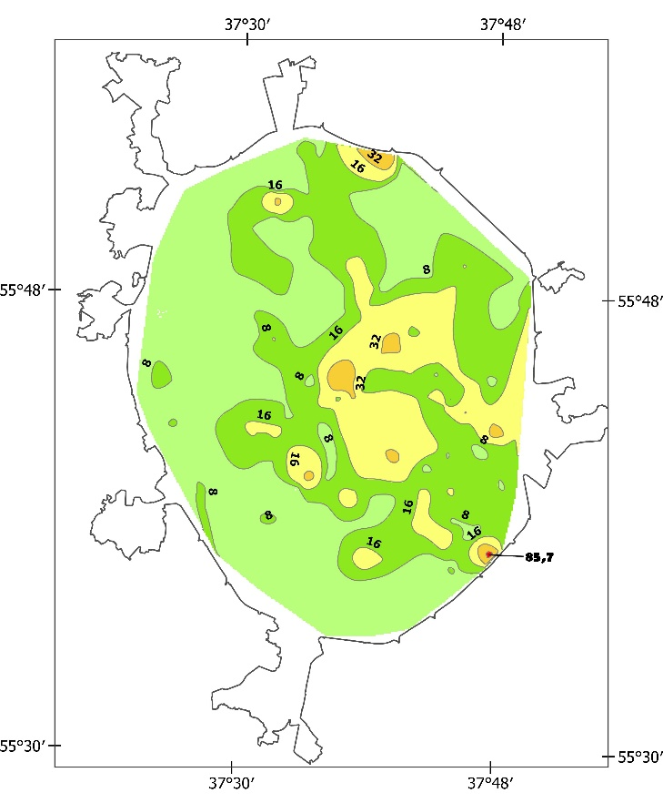
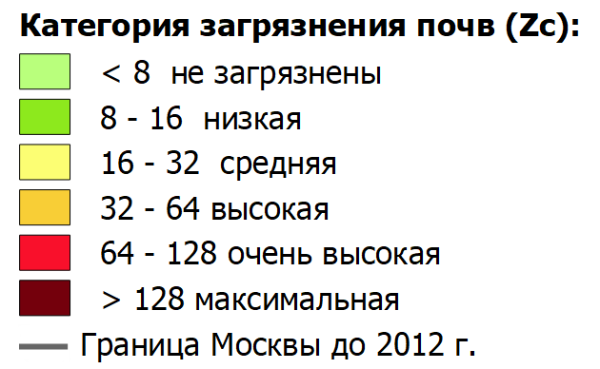
RESULTS AND DISCUSSION
Long-term dynamics of total pollution with PTEs in urban soils
2007 2012 2016
Categories of total soil pollution Zc
<8 clean 8-16 low 16-32 average 32-64 high 64-128 very high > 128 maximum
Boundaries of Moscow until 2012

Slide 18
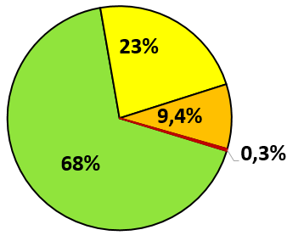
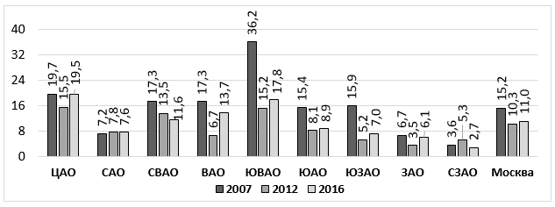
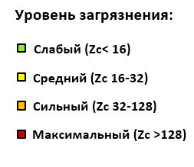
RESULTS AND DISCUSSION
Long-term dynamics of total pollution with PTEs in urban soils
Distribution of city areas by the level of total soil pollution index Zc in 2007 and 2015
Average values of the coefficient of total soil pollution Zc in different districts of the city
Zc
2007 2015
Level of pollution Zc
< 16 low 16-32 average 32-128 high > 128 maximum
ADs: Central Northern N-Eastern Eastern S-Eastern Southern S-Western Western N-Western City

Slide 19
RESULTS AND DISCUSSION
Comparison of geochemical data with sanitary standards
Average and maximum values for the coefficient of environmental hazard Ko for Pb in urban soils
Average and maximum values for the coefficient of environmental hazard Ko for Zn in urban soils
Ko
Ko max
Ko
Ko max
ADs: Central Northern N-Eastern Eastern S-Eastern Southern S-Western Western N-Western City
ADs: Central Northern N-Eastern Eastern S-EasternSouthern S-WesternWesternN-Western City
mean
mean
mean
mean

Slide 20
Conclusion
In the soil cover of Moscow, a tendency toward a decrease in Zn, Pb, and Hg content determined during the annual monitoring was revealed. The reduction in pollution is due to a decrease in emissions of vehicles, a reduction in industrial production and the removal of harmful enterprises in the suburbs. However, it is premature to talk about improving the environmental situation in Moscow, since such dangerous PTEs as Sb, Mo, W, Cr, Bi are not detected during the soil-geochemical monitoring.
The spatial distribution of HMMs in the soils of Moscow is determined primarily by the number and geochemical specialization of pollution sources, which vary greatly in administrative districts. Central, Eastern, Southeastern districts are leading in terms of pollution of Cu and Pb. The Central and Southeastern districts are distinguished by Hg pollution. The Central, Northeastern, Southeastern, and Southern districts are most polluted with Zn and Cd. Soils in the South-East, South and Southwestern districts are most enriched in Ni.
The geochemical state of the urban soils over a ten-year period is characterized by a significant decrease in the frequency and frequency of exceeding the MPC of individual pollutants, as well as a decrease in the mean level of multi-elemental soil pollution Zc – from 15,2 to 11. The Eastern part of the city is the most polluted, the average Zc in Southeastern district varied from 36,2 in 2007 to 17,8 in 2016.
In Moscow, the area of the city with exceeding the MPC standards increases, but their excess ratio becomes lower, and the differences between the land-use zones are erased due to the prevalence of traffic. Over the past decade, the maximum values of the coefficients of environmental hazard Ko for individual PTEs decreased to 12-13, i.e. more than 100 times.

Slide 21
Thank you for attention!
Kosheleva Natalia
natalk@mail.ru

