Slide 1


Beyond Cloud Microphysics: Representing Subgrid-Scale Processes in Lagrangian Cloud Models
Fabian Hoffmann
CIRES, University of Colorado / NOAA Chemical Sciences Laboratory
Boulder, Colorado, USA
EGU General Assembly 2020, Session AS5.9, 04.05.2020

Slide 2
Representing Subgrid-Scale Processes in Lagrangian Cloud Models
Lagrangian cloud models (LCMs) have become the state-of-the-art approach for the detailed representation of cloud microphysics
However, they also offer a unique opportunity to parameterize the effects of small-scale dynamics, in particular supersaturation fluctuations, and their effects on cloud microphysics
These fluctuations are deemed to be an important process in the broadening of droplet size distributions; and LCMs offer a concise (and probably the only) way to consider these small-scale effects in dynamical models such as LES
Gustavo Abade developed an approach to represent fluctuations of the vertical velocity based on solving a stochastic differential equation (upcoming talk D3632)
I will introduce a different subgrid-scale approach that is able to mimic the separation of cloudy and cloud-free air down to scales as small as a couple of decimeters, allowing to represent inhomogeneous mixing processes accurately

Slide 3
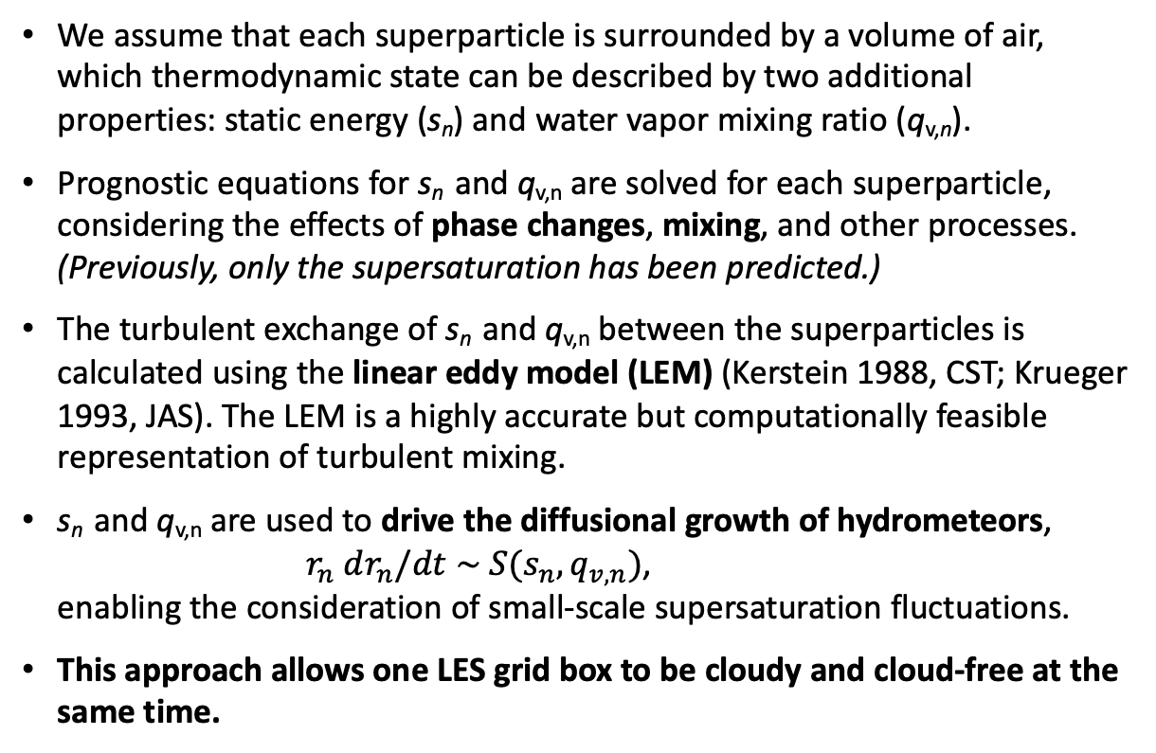
The Basic Concept
LES grid box
We assume that each superparticle is surrounded by a volume of air, which thermodynamic state can be described by two additional properties: static energy (s_{n}) and water vapor mixing ratio (q_{v,n}).
Prognostic equations for s_{n} and q_{v,n} are solved for each superparticle, considering the effects of phase changes, mixing, and other processes. (Previously, only the supersaturation has been predicted.)
The turbulent exchange of s_{n} and q_{v,n} between the superparticles is calculated using the linear eddy model (LEM) (Kerstein 1988, CST; Krueger 1993, JAS). The LEM is a highly accurate but computationally feasible representation of turbulent mixing.
s_{n} and q_{v,n} are used to drive the diffusional growth of hydrometeors, $r_{n} dr_{n}/dt \sim S(s_{n},q_{v,n})$, enabling the consideration of small-scale supersaturation fluctuations.
This approach allows one LES grid box to be cloudy and cloud-free at the same time.
Lagrangian particle

Slide 4
Small-Scale Mixing: Homogeneous or
Inhomogeneous?
homogenous mixing
n(r)
After entrainment, microphysics react in distinct ways to the subsaturated air (Baker and Latham 1979, JAS)
Depending on the speed of turbulence and microphysical response, mixing can be:
  homogeneous: fast turbulence, slow evaporation => maintains droplet number, but decreases mean radius
  inhomogeneous: slow turbulence, fast evaporation => reduces droplet number, but maintains mean droplet radius
r
(extreme) inhomogeneous mixing
n(r)
r

Slide 5
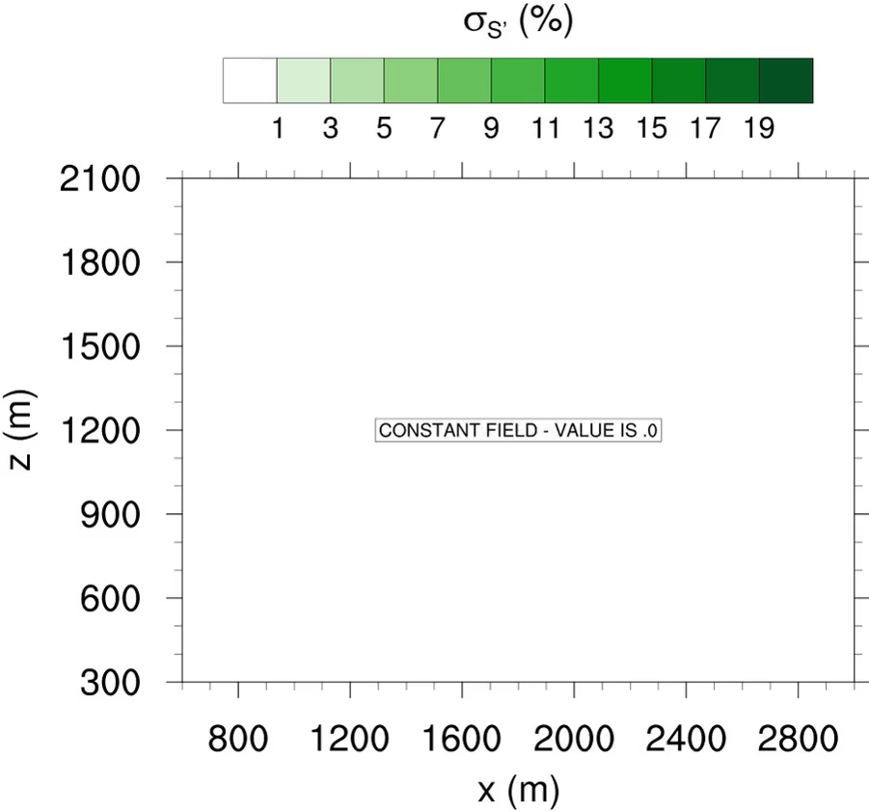
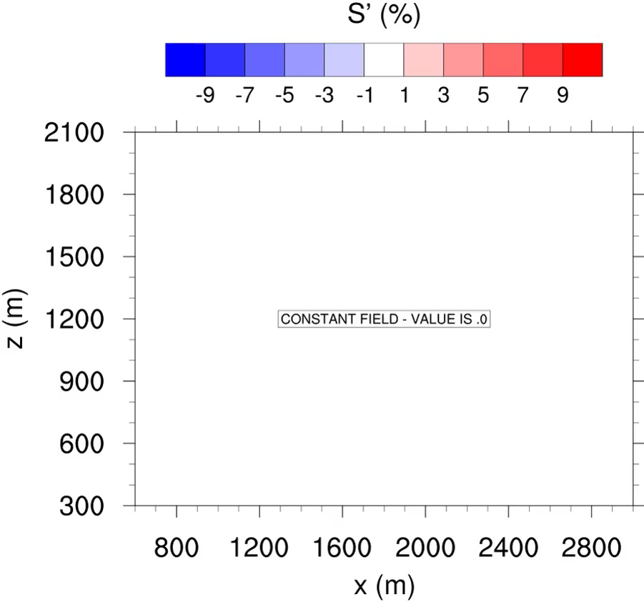
Bubble Cloud: Effects on Supersaturation
µ_{S’} (%)
Results from Hoffmann et al. (2019, JAS) and Hoffmann and Feingold (2019, JAS)
Standard deviation and mean of the supersaturation perturbation of all superdroplets inside a grid box
Maximum of the standard deviation at the cloud edge where cloudy filaments reach out into the cloud-free air, and blobs of cloud-free air are entrained into the cloud
Commensurately, the mean of the supersaturation perturbation is increased outside the cloud, and decreased inside

Slide 6
Bubble Cloud: Microphysics
standard LCM: homogenous
LCM with LEM: “inhomogeneous”
Cloud droplet number concentration is reduced in some regions of the cloud
Some droplets experience significant growth
Also, evaporation is decelerated by allowing droplets to stay in cloudy filaments
Note: Only some droplets benefit from inhomogeneous mixing

Slide 7
Mixed-Phase Microphysics
. ice crystal
. ice nuclei
In an idealized study, the LEM is applied as a stand-alone model to simulate an entrainment event with subsequent mixing in a mixed-phase cloud (Hoffmann 2020, JAS)
The Lagrangian cloud model has been enhanced by ice microphysics (Ervens et al. 2011, JGR)
We will focus on the effects between instantaneous (homogeneous) mixing and the correctly represented (potentially inhomogeneous) mixing processes by the LEM on scales smaller than 100 m
Special focus on changes in the Wegener-Bergeron-Findeisen (WBF) process, i.e., the accelerated growth of ice crystals on the expense of liquid droplets
Two main inhomogeneous processes will be identified:
  voids in the field of ice crystals / liquid droplets
  delayed freezing of entrained ice nuclei

Slide 8
Mixed-Phase Microphysics
LEM simulations exhibit less ice and more liquid water compared to the homogeneous simulations: WBF is reduced
Ice water content is reduced because of the decelerated nucleation of entrained IN:
  IN stay longer in the entrained air that is less favorable for nucleation.
  Reduced integral uptake of water vapor by ice crystals.
Liquid water content is increased:
  Voids in the ice crystal / liquid droplet field reduce WBF locally by decelerating the transport of water vapor from the liquid to the ice phase.
  These voids only have an effect at high IN concentrations when the deposition process is so fast that it can be affected by changes in the turbulent transport of water vapor between the void and the rest of the cloud.

Slide 9

Mixed-Phase Microphysics
Average distance between an ice crystal and
the closest liquid droplet (mm)
Changes in the average distance between an ice crystal and the closest liquid droplet indicates what delays WBF:
  Initially, entrainment causes voids in the ice crystal field
  Later, WBF evaporates all liquid droplets in the vicinity of an ice crystal
Both processes lead to reduced uptake of water vapor by the ice phase, which slows down WBF
$$\left|z_{i}−z_{l}\right| (mm)$$

Slide 10
Summary and Conclusions
Besides a highly accurate representation of cloud microphysics, Lagrangian cloud models (LCMs) enable the unique opportunity to represent subgrid-scale processes such as supersaturation fluctuations in larger-scale dynamical models
Accordingly, LCMs may be the only model to investigate inhomogeneous mixing processes in dynamically evolving cloud systems adequately
In agreement with theory, we showed that inhomogeneous mixing accelerates droplets growth in warm-phase cumuliform clouds
In mixed-phase clouds, small scale inhomogeneous processes delay the nucleation of entrained ice nuclei and reduce the Wegener-Bergeron-Findeisen process by decelerating the transport of water vapor from the liquid to the ice phase

