Slide 1
EGU 2020 Session ST1.7 - Zoom Meeting 09:00 CEST 6 May 2020
Solar and Interplanetary Turbulence: Lagrangian Coherent Structures
Abraham Chian
U. Adelaide, Australia; ISEE, Nagoya U., Japan; INPE, Brazil
&
Luis R. Bellot Rubio, Heng Q. Feng, Tiago F. P. Gomes, Milan Gosic, Daniela Grasso, Qiang Hu, Kanya Kusano,
Rodrigo A. Miranda, Pablo R. Munoz, Erico L. Rempel, David Ruffolo, Suzana S. A. Silva, and De J. Wu
abraham.chian@gmail.com

Slide 2
Outline
Coherent structures & intermittent turbulence in solar-interplanetary plasmas
LCS in active-region plage & quiet-Sun supergranulations
Shock-sheath of an erupting coronal flux rope
Shock-sheath of an interplanetary coronal mass ejection
Interplanetary rope-rope magnetic reconnection

Slide 3
Coherent structures & intermittent turbulence
in solar-interplanetary plasmas

Slide 4
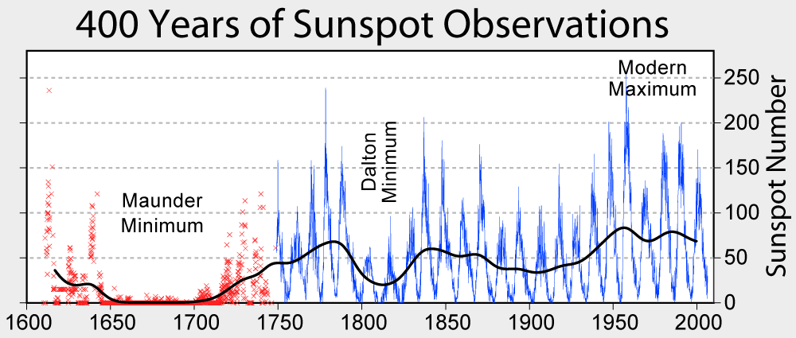
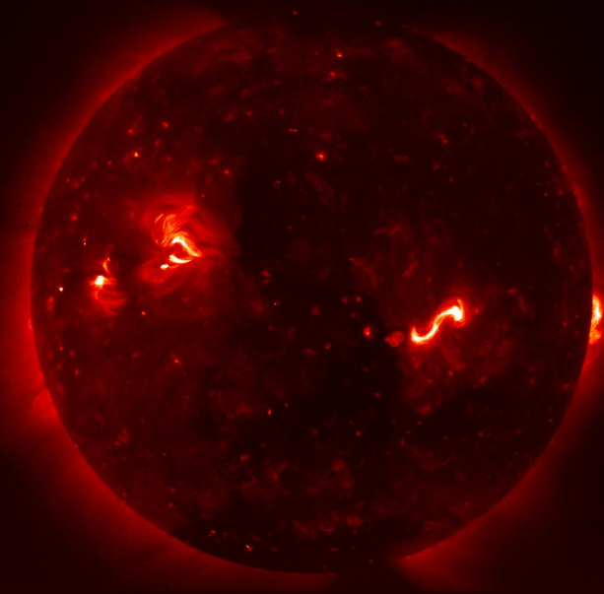
Coherent structures & intermittent turbulence
Sunspot cycles: Intermittent turbulence
Hinode XRT image: Coherent structures
Time series displays random regime switching between laminar periods of small-amplitude fluctuations and bursty periods of large-amplitude fluctuations
Probability density function (PDF) displays a non-Gaussian shape (fat-tails and sharp peak) due to an excess of large- and small-amplitude fluctuations at small scales
Power spectrum displays a power-law behavior indicative of multiscale interactions in energy cascade
Image displays localized regions of clustering related to coherent structures
Kamide & Chian, Handbook of the Solar-Terrestrial Enviornment, Springer (2007)

Slide 5
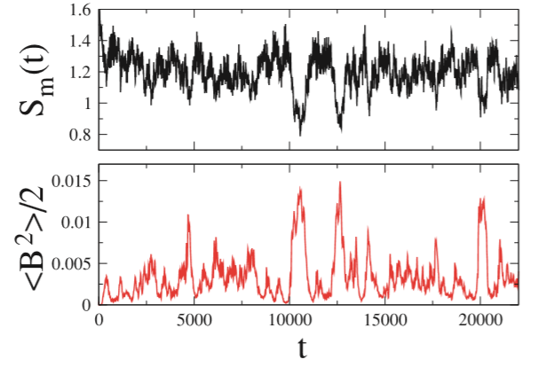
Intermittent turbulence in MHD simulation of turbulent dynamo: Solar cycles
Power spectral Shannon entropy & magnetic energy => Magnetic coherent structures
Rempel, Proctor & Chian MNRAS 2009: On-off intermittency in a turbulent dynamo
Chian+ PRL 2010: Amplitude-phase synchronization => On-off intermittency in fluids & plasmas

Slide 6
LCS in active-region plage & quiet-Sun supergranulations

Slide 7
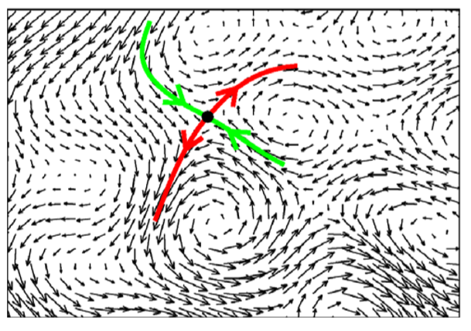
Lagrangian coherent structures
LCS are material lines/surfaces in the velocity field that act as transport barriers. They trace flow patterns better than their Eulerian (snapshot) counterparts since they measure transport along particle trajectories
Example: Velocity field with a saddle point (Black circle) in a dynamical flow
Hyperbolic LCS (Finite-Time Lyapunov Exponents)
Forward-time FTLE/SM (Green) => Repelling LCS
Backward-time FTLE/UM (Red) => Attracting LCS
Elliptic LCS => Objective vortices
Haller ARFM 2015
Rempel+ ApJL 2011
Yeates+ A&A 2012
Chian+ ApJ 2014
Rempel+ MNRAS 2017
Silva+ ApJL 2018
Chian+ MNRAS 2019

Slide 8
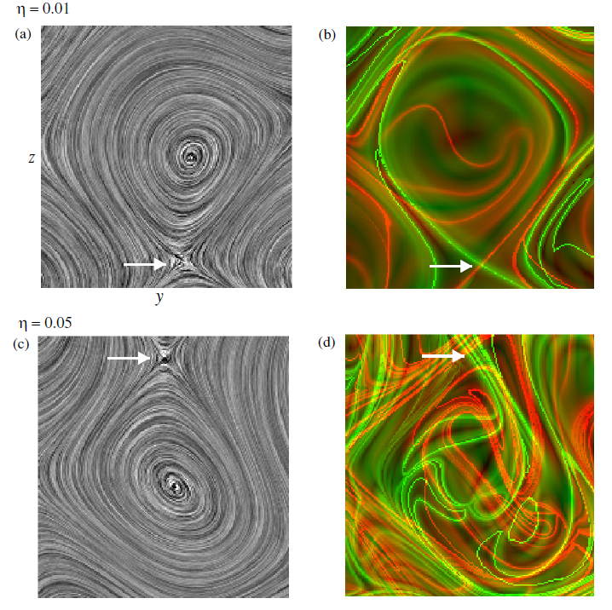
Kinematic vortex in a turbulent dynamo
Eulerian coherent structures Lagrangian coherent structures
V streamlines
Repelling LCS: Green
Attracting LCS: Red
Rempel, Chian & Brandenburg ApJL 2011: 3D MHD simulation of turbulent ABC dynamo, Eta=B diffusivity

Slide 9
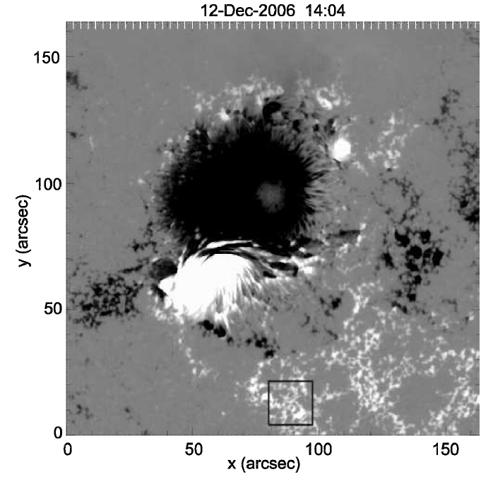
LCS in active-region plage: Hinode/SOT image of AR 10930
Plage (12.4 Mm x 12.4 Mm)

Slide 10
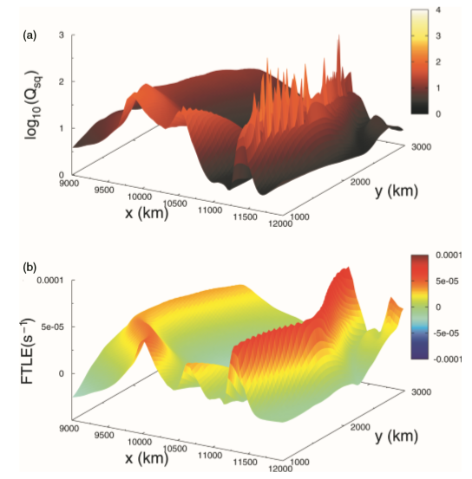
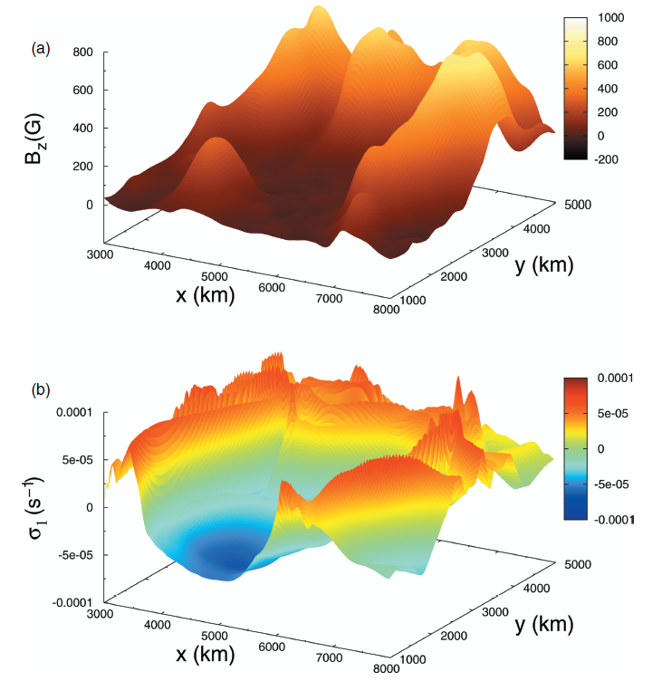
Hinode/SOT observation of rLCS & aLCS in AR 10930 plage
Repelling LCS: Ridges of large f-FTLE => Locally strongest repelling material lines
Attracting LCS: Ridges of large b-FTLE => Locally strongest attracting material lines
Horizontal V-field computed by LCT from LOS-B of Hinode/SOT for t = + (-) 12 h
Repelling LCS
Attracting LCS
Yeates+ A&A 2012: Network of quasi-separatrix layers (QSL, Q-factor) ⬄ rLCS => Magnetic reconnection
Chian+ ApJ 2014: Network of magnetic flux concentration in intergranular lanes ⬄ aLCS => Downflow

Slide 11
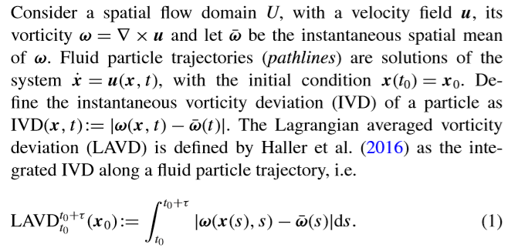
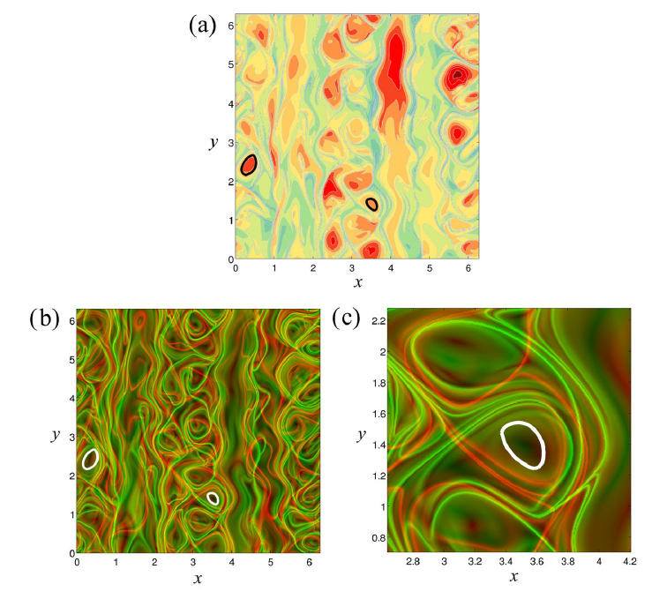
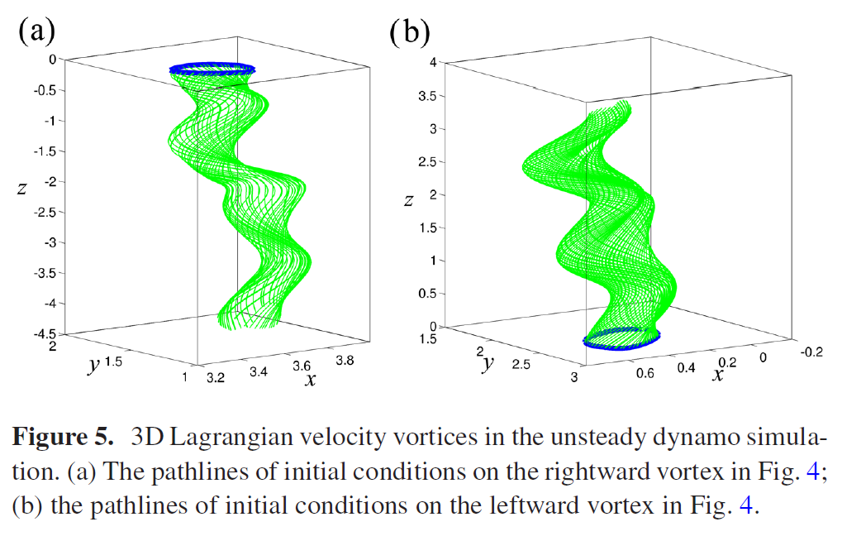
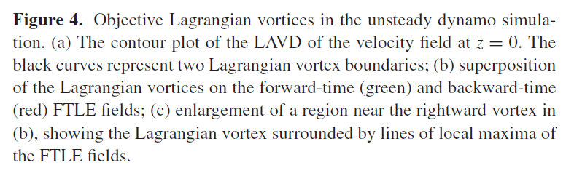
Objective kinematic vortex
Tubular level surfaces of Lagrangian Averaged Vorticity Deviation
Turbulent dynamo
Rempel+ MNRAS 2017: 3D MHD simulation of turbulent ABC dynamo; Silva+ ApJL 2018: Hinode observation

Slide 12
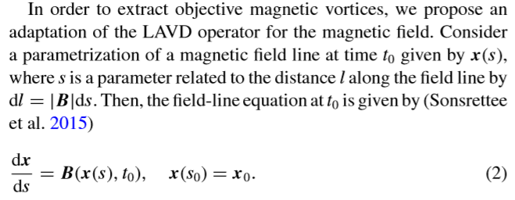
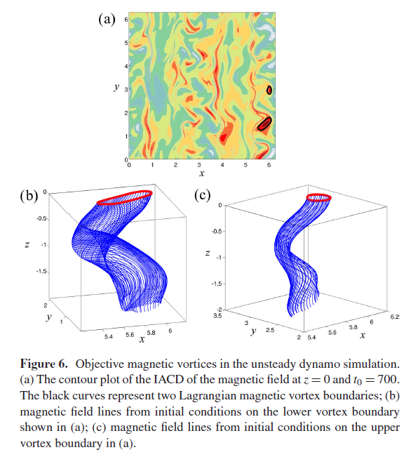
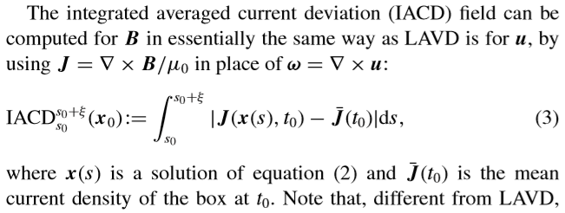
Objective magnetic vortex
Tubular level surfaces of Integrated Averaged Current Deviation
Turbulent dynamo
Rempel+ MNRAS 2017, PRE 2019: 3D MHD simulation of turbulent ABC dynamo

Slide 13
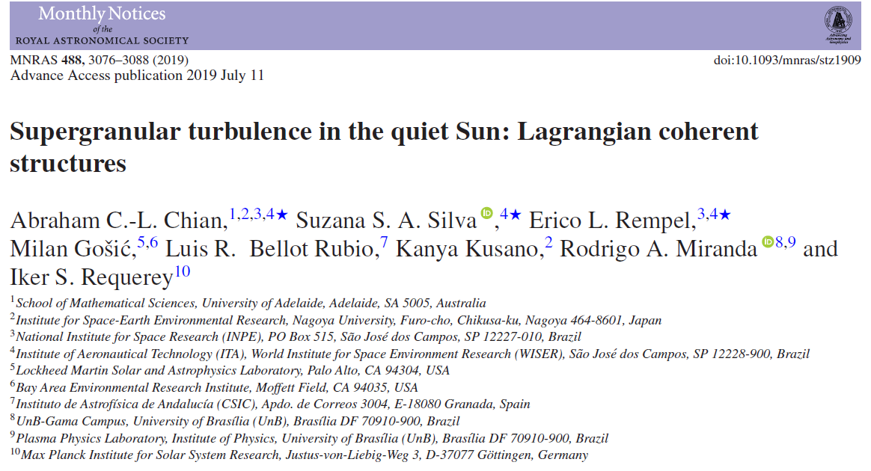
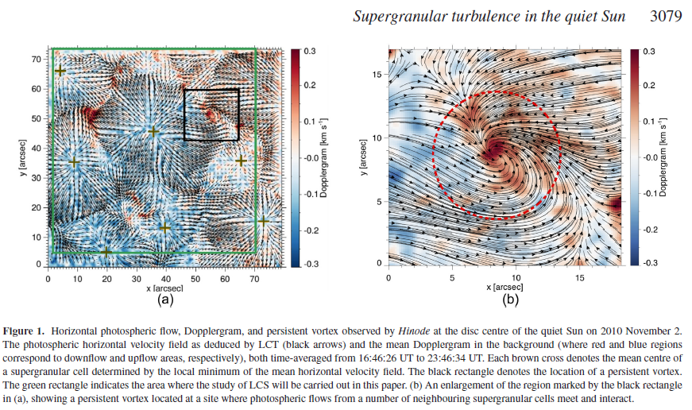
Hinode/NFI 2010 Nov 2: From 16:46:26 UT to 23:46:43 UT (7 hr)

Slide 14
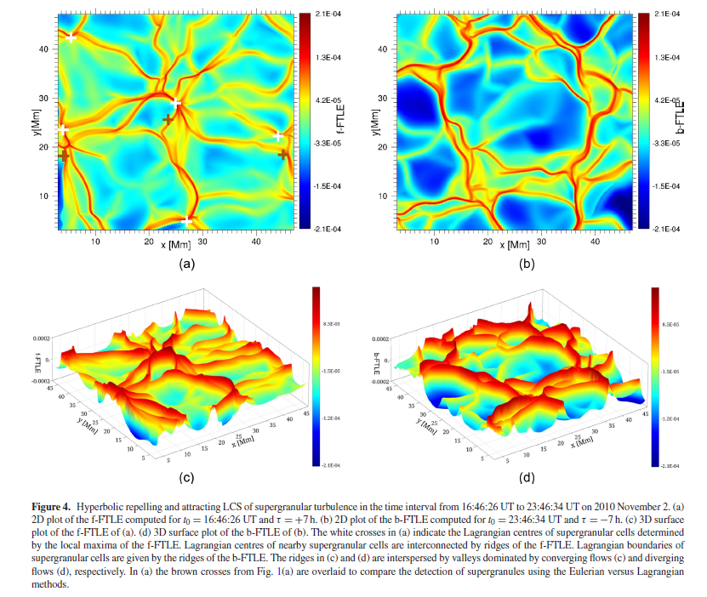
Repelling & attracting Lagrangian coherent structures: Ridges of f-FTLE & b-FTLE
Chian+ MNRAS 2019 => Lagrangian centers of SG cells linked by repelling LCS
=> Lagrangian boundaries of SG cells given by attracting LCS

Slide 15
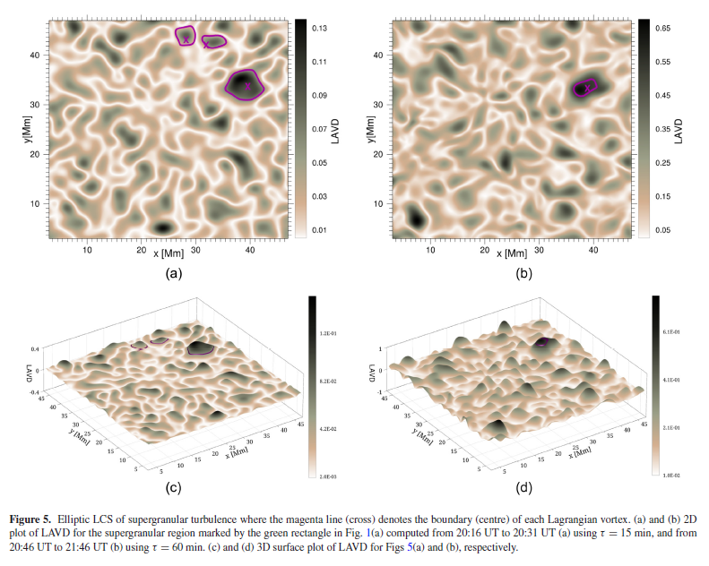
Objective kinematic vortex: Lagrangian averaged vorticity deviation (LAVD)
Chian+ MNRAS 2019: Objective kinematic vortex centers/contours (tau= 15 min/60 min)

Slide 16
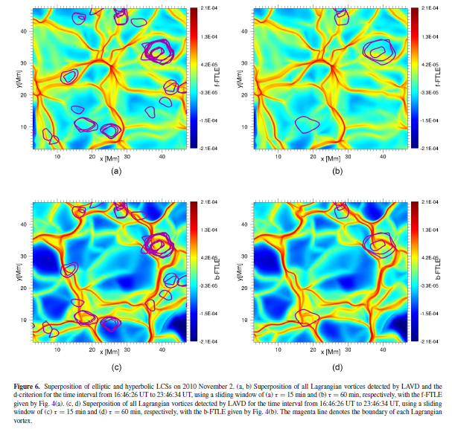
Objective kinematic vortex contours & repelling-attracting Lagrangian coherent structures
Chian+ MNRAS 2019

Slide 17
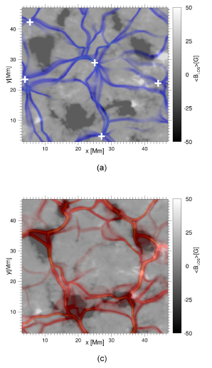
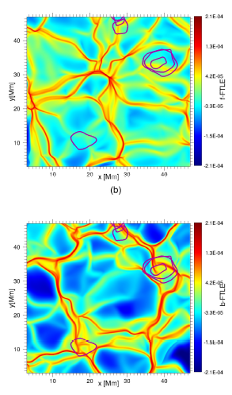
Lagrangian coherent structures in supergranular turbulence: Hinode/NFI 2010 Nov 2
Objective vortices (LAVD) & Repelling/attracting LCS (f-FTLE/b-FTLE)
Chian+ MNRAS 2019

Slide 18
Shock-sheath of an erupting coronal flux rope

Slide 19
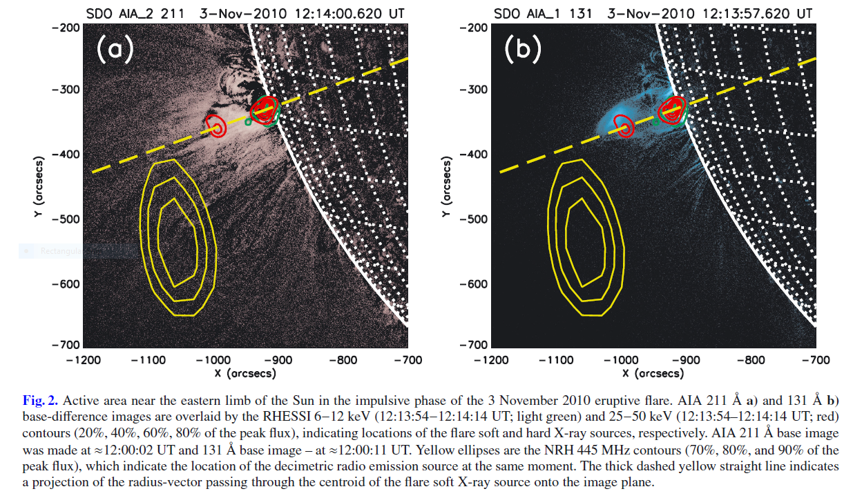
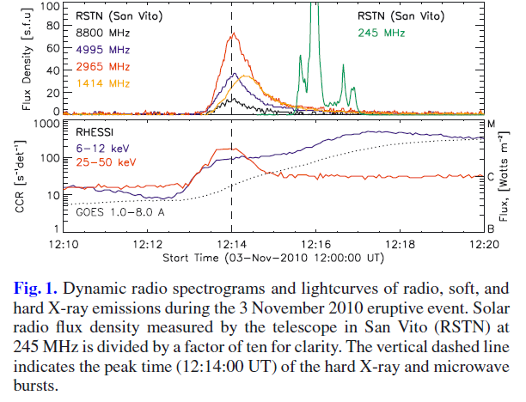
Solar flare & coronal mass ejection: Radio, EUV & X-ray emissions
AR 11121 - 2010 Nov 3
Zimovets+ A&A 2012: Nancay Radioheliograph, RHESSI & SDO/AIA

Slide 20
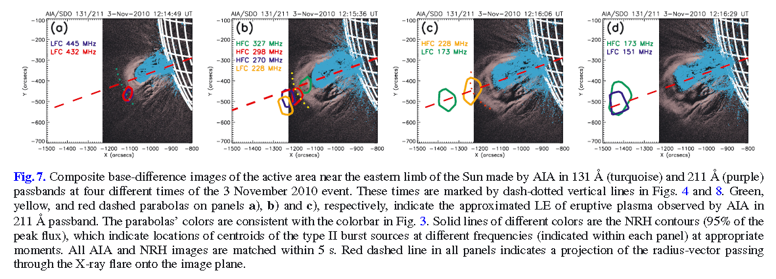
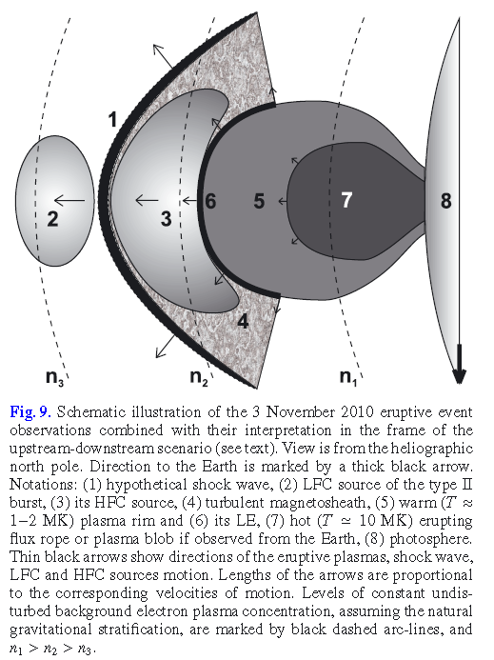
Type-II radio bursts emitted from Erupting Coronal Flux Rope: AR 11121
Radio waves emitted from upstream (LF) & downstream (HF) of shock
Genesis of coronal turbulence by magnetic reconnection: Shock-sheath
Zimovets+ A&A 2012:: SDO/AIA & Nancay Radioheliograph

Slide 21
Shock-sheath of an interplanetary coronal mass ejection

Slide 22
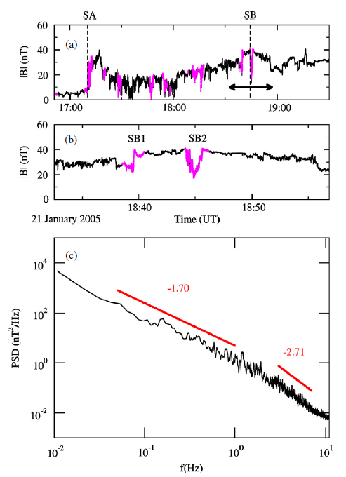
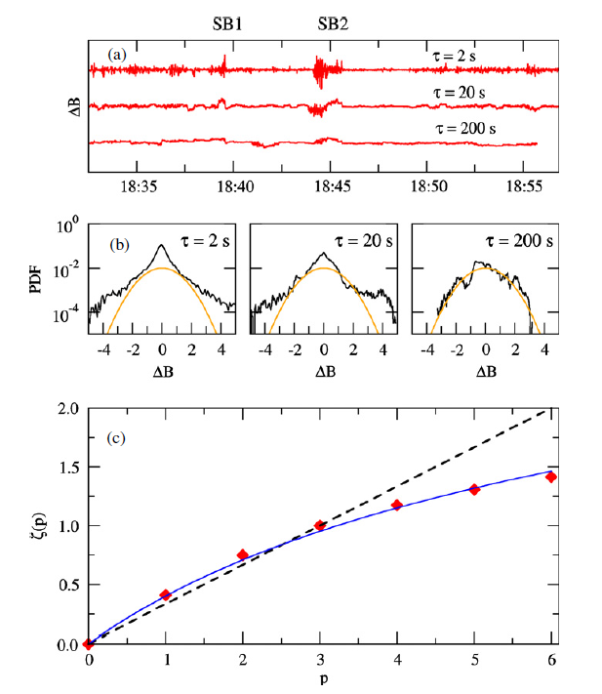
Genesis of interplanetary intermittent turbulence
Magnetic reconnection at turbulent shock-sheath: ICME of 2005 January 21
Chian & Munoz ApJL 2011: Cluster observation

Slide 23
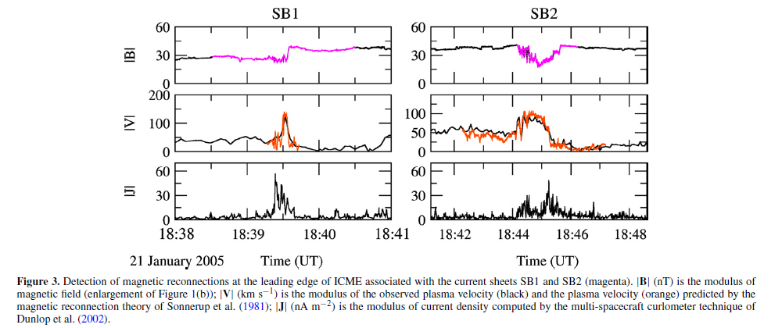
Magnetic reconnection
Magnetic cavities, jets, current sheets, counterstreaming Alfven waves
Chian & Munoz ApJL 2011: Cluster observation

Slide 24
Interplanetary rope-rope magnetic reconnection

Slide 25
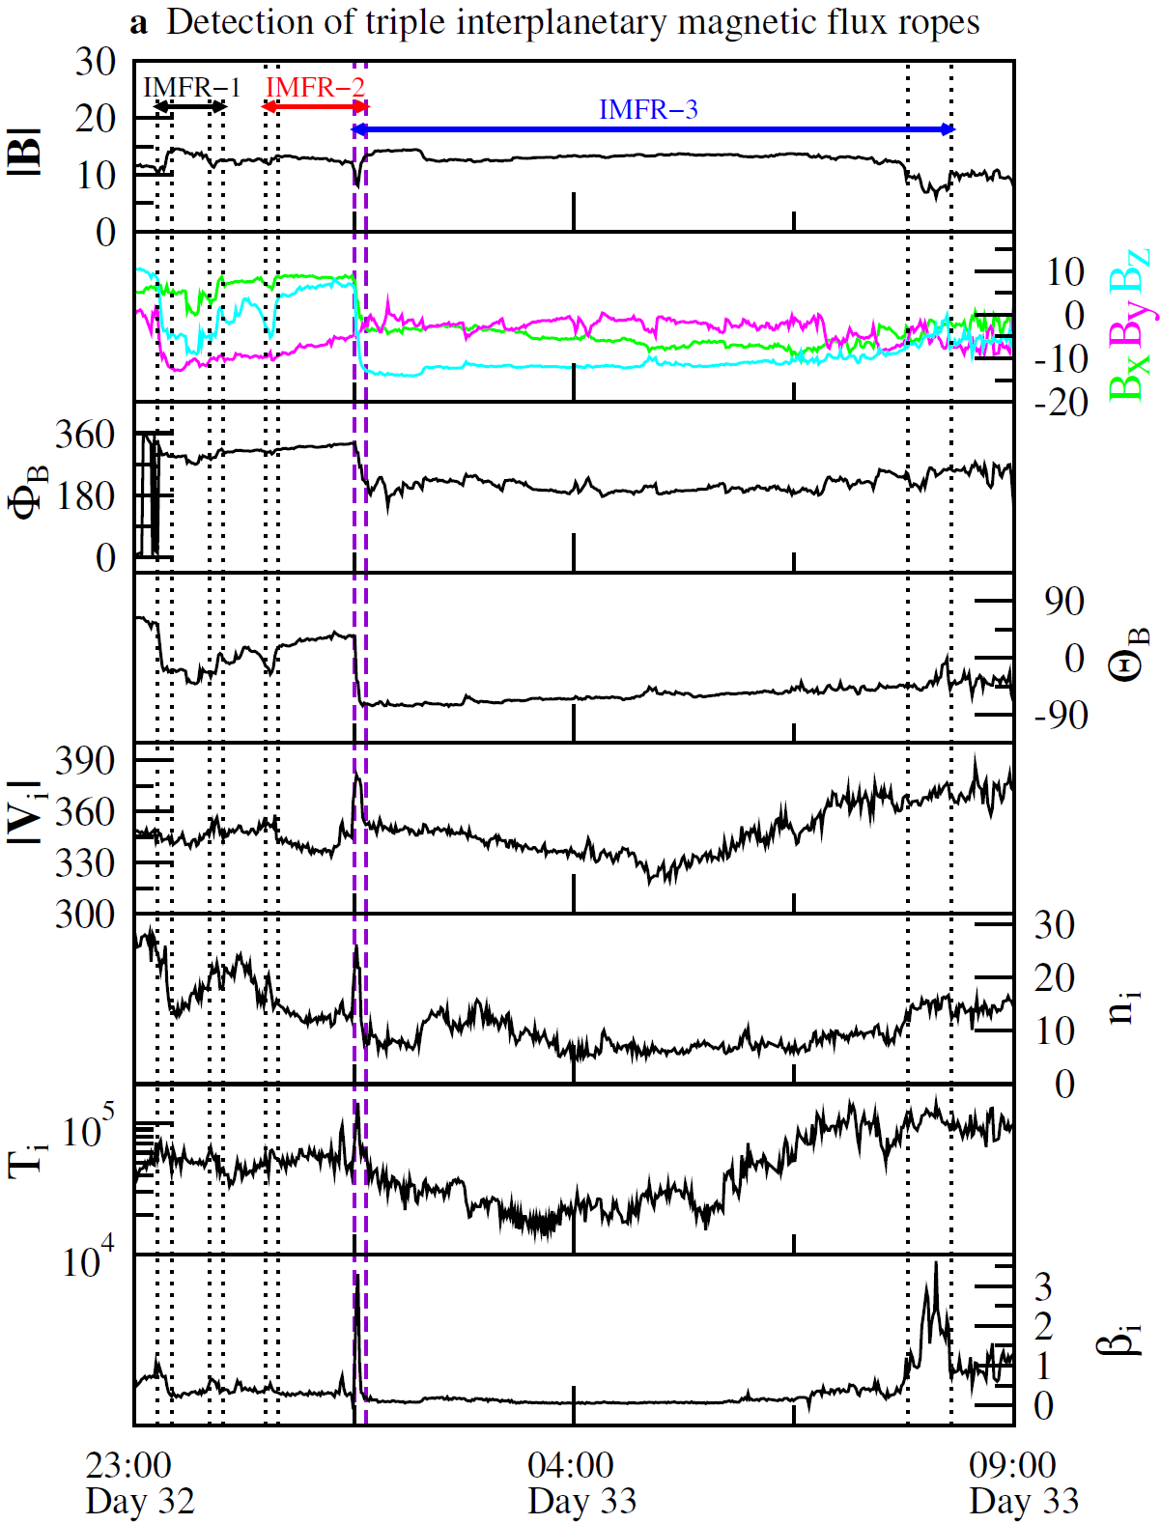
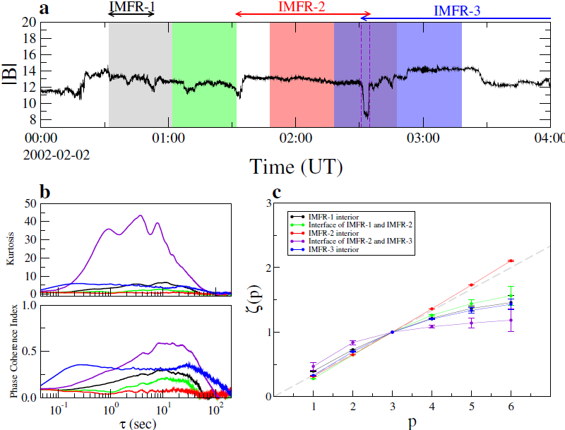
Genesis of interplanetary intermittent turbulence
Triple magnetic flux ropes observed by ACE-WIND-Cluster: ICME of 2002 Feb 12
Chian+ ApJ 2016

Slide 26
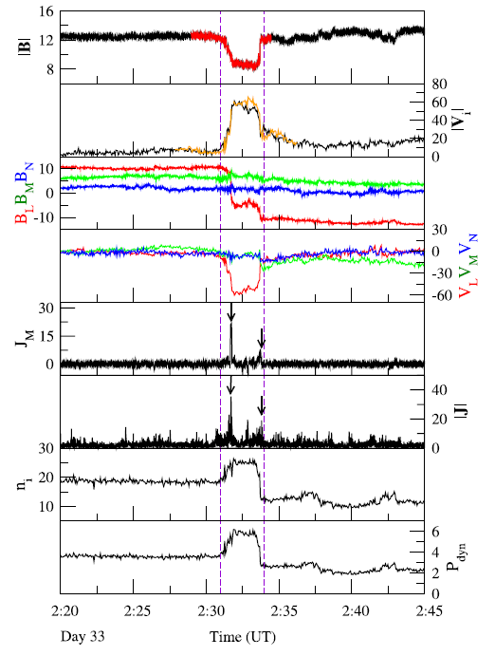
Cluster observation of interplanetary rope-rope magnetic reconnection
Magnetic cavity, jet, Alfven waves, current sheets, dynamic pressure pulse
Chian+ ApJ 2016

Slide 27
Conclusion
Solar-interplanetary plasmas are governed by nonlinear dynamical processes, e.g.,
coherent structures (vortex tubes & MFRs), magnetic reconnection & intermittent turbulence
2. Lagrangian coherent structures provide a powerful tool to detect transport barriers, e.g.,
objective kinematic & magnetic vortex tubes, quasi-separatrix layers & convection cell junctions
3. Sun & heliosphere serves as a unique laboratory for studying flares & coronal mass ejections
in astrophysical systems, e.g., Galactic Center and exoplanets

Slide 28
Thank you !

