Slide 1
ASSESSMENT OF WATER FOOTPRINT FOR KOSHI RIVER BASIN (KRB), NEPAL
HS5.2.6: Water Security Frameworks, Assessment Tools and Indicators to inform Water Governance
R.D. Singh, Kumar Ghimire, and Ashish Pandey¹
¹Department of water Resources Development & Management
Indian Institute of Technology Roorkee, India

Slide 2
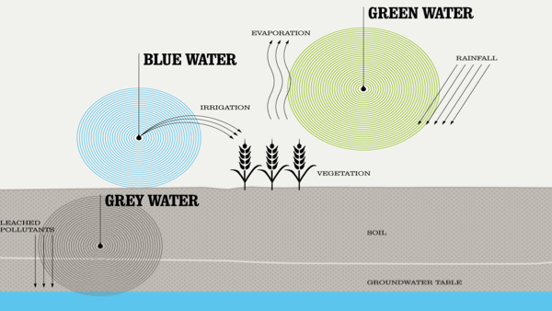
Water footprint
Volume of fresh water used to produce a particular product measured at the production point.
Blue water footprint: Volume of surface or ground water evaporated or incorporated into product.
Green water footprint: Volume of rain water evaporated or incorporated into product.
Grey water footprint: Volume of the fresh water polluted in the production process .
Components of agricultural water footprint: green, blue and grey

Slide 3
Objectives of the Study
Assessment of monsoon variability and water stress in Koshi river basin.
Assessing green and blue water footprint of crops production at basin level with a bottom-up approach.
Exploring spatial and temporal variation of water footprint of crops production within basin.

Slide 4
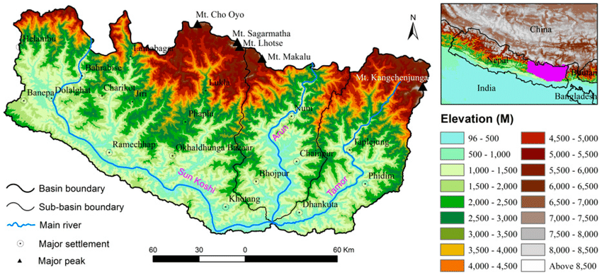
Study Area
Study Area: - Koshi River Basin (KRB) in Nepal.
largest river basin in Nepal
located at the upstream of Chatara in the mountainous region of eastern Nepal and southern border of China (between latitudes 26⁰51′ and 29⁰59′ N, and longitudes 85⁰24 and 88⁰57′E)
Consists of three major sub-basins (Sunkoshi, Arun, Tamor) covering about 25936 km² of 16 districts.
comprises 22% agricultural land of which 94% is rainfed and 6% is irrigated.
Passes through the Himalayas to agricultural lowland of Terai plains.
The average annual temperature are 20°C in hill and 16 °C in mountain

Slide 5
Data Availability
Meteorological Data
Daily Rainfall Data
36 yrs daily rainfall data (1980-2015) of 16 stations
Data Source: DHM, Nepal
Daily Climatic Data
10 yrs daily observed data (2005-2014) of 16 stations on T_{min} & T_{max}, Rh_{min} & RH_{max}, sunshine hours and wind speed
Data Source: DHM, Nepal
Agricultural Data
Crop types, crops production and crop harvested area of the period (2005-2014) : Accessed from CBS, RAD, and DADO,Nepal
Crop coefficients: Derived from FAO

Slide 6
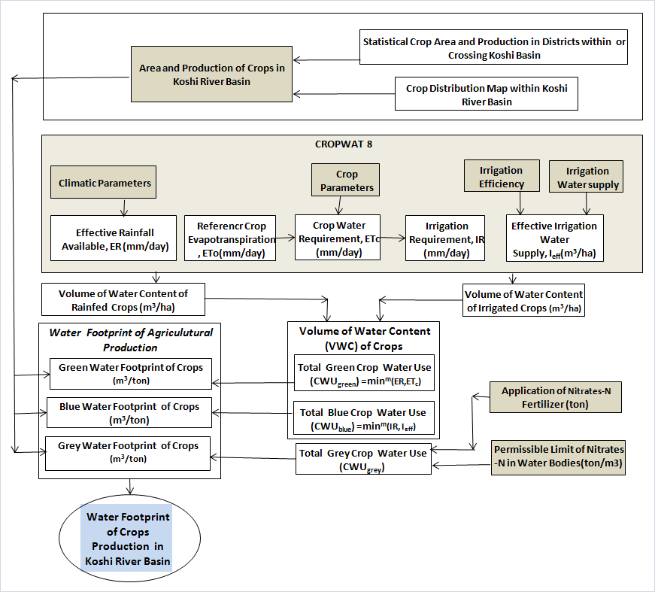
Methodology

Slide 7
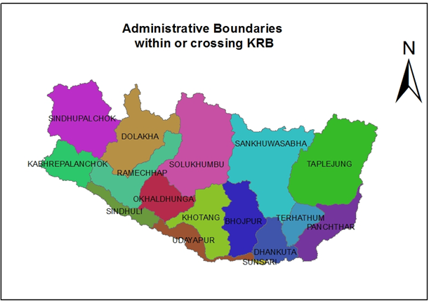
Methodology…
Data processing for area and production of crops in KRB:
Study area has been defined using DEM and administrative map of the country in ArcGIS environment.
Land shared by each district within or crossing KRB are evaluated and proportionately crop harvested area for each crop in each district are taken to estimate KRB’s crop harvested area. Similar approach is used to estimate crop production within KRB.

Slide 8
Methodology…
Estimated Crop Harvested Area within KRB during the period 2005-2014:
Crops/years | Harvested Area (ha)
 | Barley | Maize | Millet | Potato | Rice | Sugarcane | Wheat
2005/06 | 2778 | 215673 | 92668 | 37151 | 128574 | 312 | 56791
2006/07 | 2840 | 216573 | 91580 | 37388 | 119946 | 301 | 57092
2007/08 | 2795 | 218689 | 92556 | 38488 | 129985 | 301 | 57268
2008/09 | 2662 | 220445 | 92392 | 50539 | 131467 | 301 | 56069
2009/10 | 2662 | 217907 | 92877 | 54062 | 123872 | 272 | 56157
2010/11 | 2918 | 219988 | 94993 | 54078 | 133362 | 293 | 46760
2011/12 | 2835 | 227954 | 99320 | 57065 | 138107 | 303 | 51698
2012/13 | 2751 | 220604 | 99269 | 55816 | 129960 | 307 | 52475
2013/14 | 2602 | 251875 | 96797 | 55816 | 131937 | 247 | 47058
2014/15 | 2493 | 240888 | 96431 | 53441 | 117602 | 279 | 48931
Avg. | 2734 | 225060 | 94888 | 49384 | 128481 | 292 | 53030

Slide 9
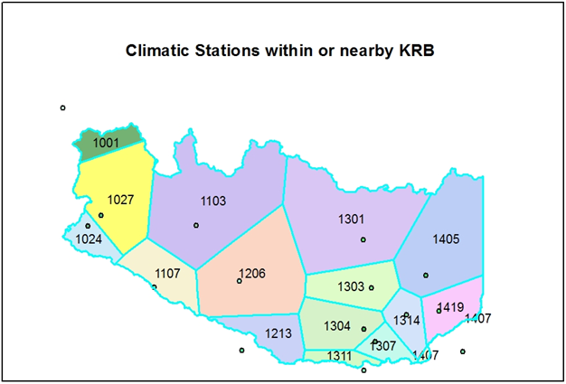
Methodology…
Influencing area of each climatic station over KRB is identified by superimposing Thiessen polygons over the basin.
Portions of the harvested area of each district within KRB that falls under stations polygon are identified.
WF_{prod} for each crop of the influence portion in the district is calculated by considering influencing climatic station. Taking weighted averages of WF_{prod} of crops of each portion in the districts, WF_{prod} of crops of that district have been evaluated.

Slide 10
Methodology…
Crops | Ecological Belt | Irrigation | Date of Planting/Harvesting |  | Crop Periods
 |  |  | PL | H
Maize | Hill | Irrigated /Rainfed | 27-Feb | 1-Jul | 125 days
Paddy |  |  | 29-Jun | 26-Oct | 150 days
Wheat |  |  | 3-Nov | 12-Mar | 130 days
Barley |  |  | 3-Nov | 2-Mar | 120 days
Millet |  |  | 15-Aug | 27-Nov | 105 days
Potato |  |  | 1-Dec | 9-Apr | 130 days
Sugarcane |  |  | 3-Dec | 2-Dec | 365 days
Adopted ecological belt and date of crop planting/harvesting for study

Slide 11
Results and Discussions
1. Monsoon Variability Assessment and Water Stress:
Daily rainfall data of periods 1980-2015 (36 years) of 16 climatic stations within or near by the Koshi basin have been analyzed for monsoon days considering daily, decade, monthly and monsoon season.
About 76% of the total rainfall within the basin has occurred during monsoon season (June to September)

Slide 12
Green and blue water footprint of crops production:
Crops | WFprod,green (m³/ton) |  |  |  |  |  |  |  |  |  | Avg. Annual WFprod,green (m³/ton)
 | 2005 | 2006 | 2007 | 2008 | 2009 | 2010 | 2011 | 2012 | 2013 | 2014
Barley | 1627 | 1613 | 1486 | 1469 | 1988 | 1640 | 1549 | 1405 | 1482 | 1424 | 1568
Maize | 1974 | 1751 | 1696 | 1662 | 1982 | 1770 | 1517 | 1681 | 1597 | 1691 | 1732
Millet | 1802 | 1847 | 1743 | 1677 | 1819 | 1825 | 1666 | 1752 | 1674 | 1640 | 1744
Potato | 180 | 160 | 173 | 160 | 151 | 145 | 152 | 152 | 176 | 160 | 161
Rice | 1919 | 2114 | 1889 | 1871 | 2092 | 1924 | 1760 | 1748 | 1629 | 1715 | 1866
Sugarcane | 717 | 812 | 642 | 631 | 708 | 765 | 344 | 349 | 372 | 402 | 574
Wheat | 899 | 1027 | 879 | 1118 | 1514 | 948 | 1038 | 912 | 972 | 945 | 1025
Avg. WFprod,green of all crops in KRB (WFc-green ) | 1302 | 1332 | 1215 | 1227 | 1465 | 1288 | 1147 | 1143 | 1129 | 1140 | 1239
Crops | WFprod,blue (m³/ton) |  |  |  |  |  |  |  |  |  | Avg. Annual WFprod,blue (m³/ton)
 | 2005 | 2006 | 2007 | 2008 | 2009 | 2010 | 2011 | 2012 | 2013 | 2014
Barley | 0 | 0 | 0 | 0 | 11 | 0 | 0 | 0 | 0 | 0 | 1
Maize | 1 | 0 | 1 | 1 | 41 | 8 | 0 | 10 | 1 | 12 | 7
Millet | 0 | 0 | 0 | 0 | 0 | 0 | 0 | 0 | 0 | 0 | 0
Potato | 24 | 54 | 30 | 29 | 89 | 57 | 44 | 54 | 34 | 47 | 46
Rice | 3 | 5 | 0 | 0 | 18 | 6 | 7 | 5 | 6 | 3 | 5
Sugarcane | 0 | 1 | 1 | 1 | 24 | 17 | 1 | 2 | 0 | 7 | 5
Wheat | 0 | 0 | 0 | 0 | 10 | 0 | 0 | 0 | 0 | 0 | 1
Avg. WFprod,blue of all crops in KRB (WFc-blue ) | 4 | 9 | 5 | 4 | 28 | 13 | 7 | 10 | 6 | 10 | 10

Slide 13
Water footprint of crop production during 2005-2014
Crops | WFprod (m³/ton) |  |  |  |  |  |  |  |  |  | Mean WFprod (m³/ton) | SD | CV (%)
 | 2005 | 2006 | 2007 | 2008 | 2009 | 2010 | 2011 | 2012 | 2013 | 2014
Barley | 1627 | 1613 | 1486 | 1469 | 2000 | 1640 | 1549 | 1405 | 1483 | 1424 | 1569 | 173 | 11
Maize | 1974 | 1751 | 1698 | 1662 | 2022 | 1778 | 1517 | 1691 | 1598 | 1704 | 1739 | 156 | 9
Millet | 1802 | 1847 | 1743 | 1677 | 1819 | 1825 | 1666 | 1752 | 1674 | 1640 | 1744 | 76 | 4
Potato | 204 | 214 | 203 | 189 | 240 | 202 | 196 | 205 | 209 | 207 | 207 | 13 | 7
Rice | 1922 | 2119 | 1889 | 1871 | 2111 | 1929 | 1768 | 1753 | 1635 | 1719 | 1872 | 159 | 9
Sugarcane | 718 | 812 | 642 | 631 | 733 | 782 | 346 | 351 | 372 | 409 | 580 | 190 | 33
Wheat | 899 | 1027 | 879 | 1118 | 1524 | 948 | 1038 | 912 | 972 | 945 | 1026 | 190 | 18
Avg. WFprod all crops in KRB (WFc_prod ) | 1307 | 1340 | 1220 | 1231 | 1493 | 1301 | 1154 | 1153 | 1135 | 1149 | 1248 | 114 | 9

Slide 14
Spatiotemporal variation of water footprint of crop production in KRB
Avg. annual WFc production is higher for Ramechhap and Shankhuwasabha districts whereas it is lower for Sunsari, Dhankuta and Khotang districts.
CV of WFc production is also lower for khotang, okhaldhunga and sunsari districts. Sindhuli and ramechhap districts have higher CV of WFc.

Slide 15
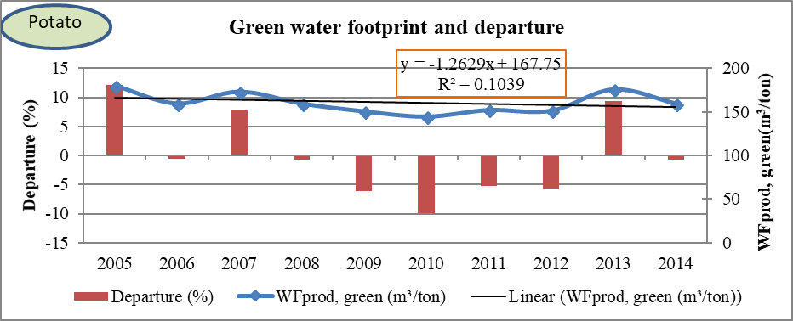
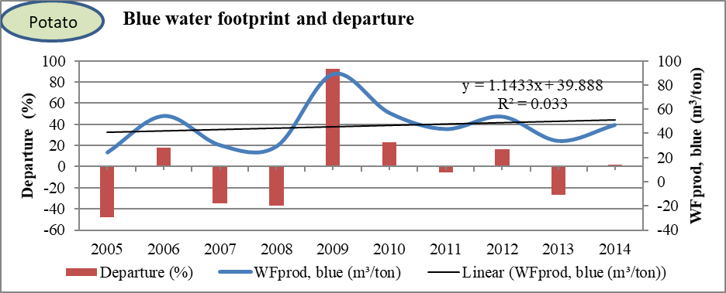
Inter-annual variability of WF of crops production
in KRB:
WFprod,green of potato has significant +ve co-relation with effective rainfall (0.74) and significant -ve co-relation with Sunshine (0.7) & Solar radiation(.71)
WFprod,blue of potato has significant +ve co-relation with Tavg. (0.72) with ETo (0.93)and ETb (1)

Slide 16
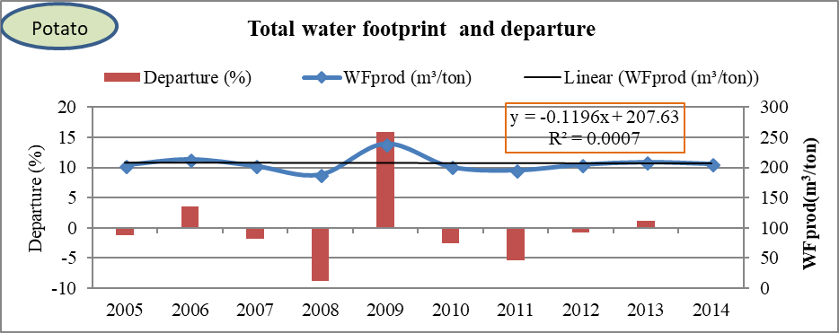
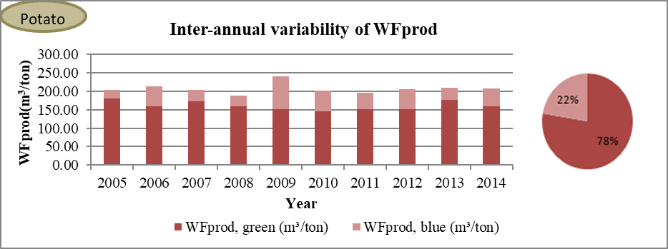

Slide 17
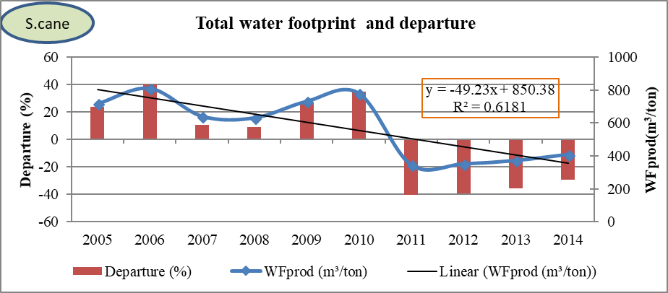
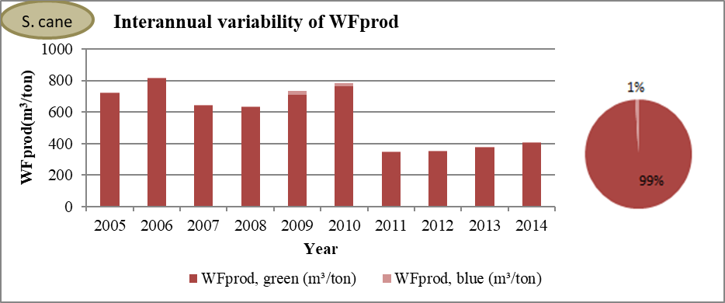

Slide 18
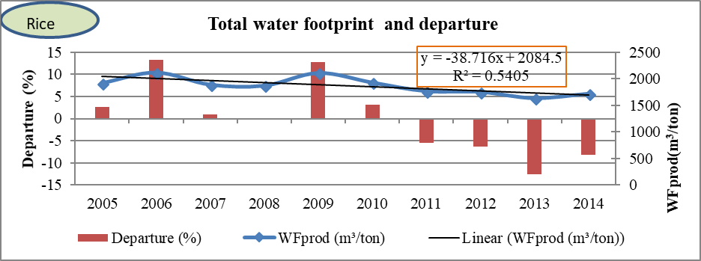
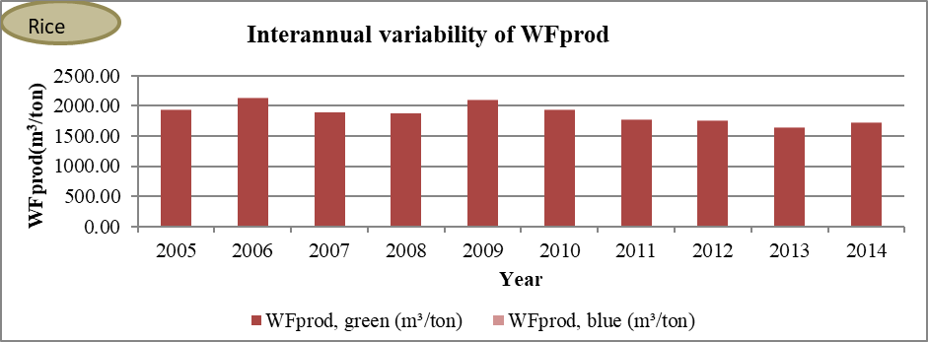

Slide 19
Conclusions…
About 76% of the total rainfall within the KRB occurs during monsoon (June-September) during which average rainfall in the KRB varies from 1425mm (in 2009) to 2044mm (in 1989).
The average annual water footprint of crop production in KRB is 1248m³/ton with the variation of 9% during the period 2005-2014 and associates average blue water proportion of 0.76% indicating mostly rainfed agriculture.
In the basin, rice has highest average annual water footprint (1872m³/ton) followed by millet (1744m3/ton), maize (1739m3/ton), barley (1569m3/ton), Sugarcane (580 m³/ton) and Potato (207m3/ton) respectively.
Co-efficient of variation of water footprint of crop production is lowest for millet (4%) whereas it is highest for sugarcane (33%). Maize and rice have 9% co-efficient of variation in water footprint production at KRB.

Slide 20
Conclusions
About 98% of total water use (Mm³/year) in crop production at KRB during 2005-2014 is due to green water use (received from rainfall) whereas only 2 % is due to blue water use.
Maize, rice and millet have major contribution on total water use of crops production in KRB; 46%, 31% and 10% respectively.
Water footprint for most of the crops in the year 2009 (the monsoon rainfall deficient year) is highest. Blue water use in that year is also highest.
After the year 2010, there is large improvement in the reduction of total water footprint of sugarcane production due to introduction of higher yielding/diseases resistant variety of sugarcane.
The average water footprint of crop production of the year 2005-2014 represents the situation of water footprint of crop production of that period in basin level. This water footprint of crop production accounts only the green and blue component of water footprint of the crop.

Slide 21
Thank You!

