Slide 1
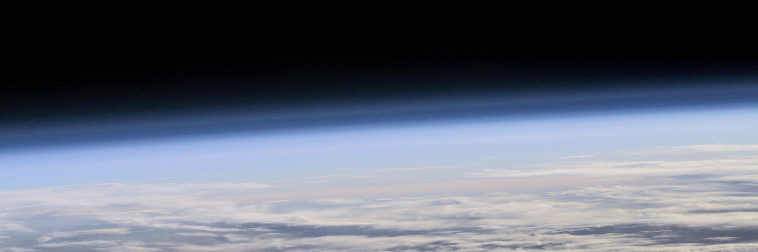


EGU 2020-4409 GI3.1/PS6
Open session on planetary and space instrumentation
Thermal behaviour of ram-facing instruments during deep dives into a planetary atmosphere:
The case of Daedalus/CWS
J. De Keyser¹, M. Echim¹, S. Ranvier¹, Th. Chambon², B. Ordoubadian³, A. Lecuyot⁴
¹ Royal Belgian Institute for Space Aeronomy (BIRA-IASB), Brussels, Belgium
² Thales Alenia Space (TAS), Cannes, France
³ OHB System AG, Gilching, Germany
⁴ European Space Agency, ESTEC, The Netherlands
ROYAL BELGIAN INSTITUTE FOR SPACE AERONOMY

Slide 2

Introduction
Spacecraft that aim to study the atmosphere of a planetary object through in situ sampling face the problem of strong atmospheric drag. In order not to compromise mission lifetime, the orbit can be designed so that repeated deep dives into the upper atmosphere are performed to sample atmospheric density, pressure, and composition down to relatively low altitudes. During such deep dives into the atmosphere, ram-facing instruments (such as ion and neutral wind instruments) in particular are exposed to a severe heating flux.
The present contribution focuses on the particular case of the neutral cross-wind sensor CWS under study for the Daedalus mission, which will sample the Earth’s upper atmosphere during its perigee passes at an altitude currently planned to be in the 110 to 140 km range. Thermal simulations are presented that show the transient heat loads on the CWS instrument. It is shown that, with an appropriate materials choice, these heat loads can be dealt with in a satisfactory manner.

Slide 3
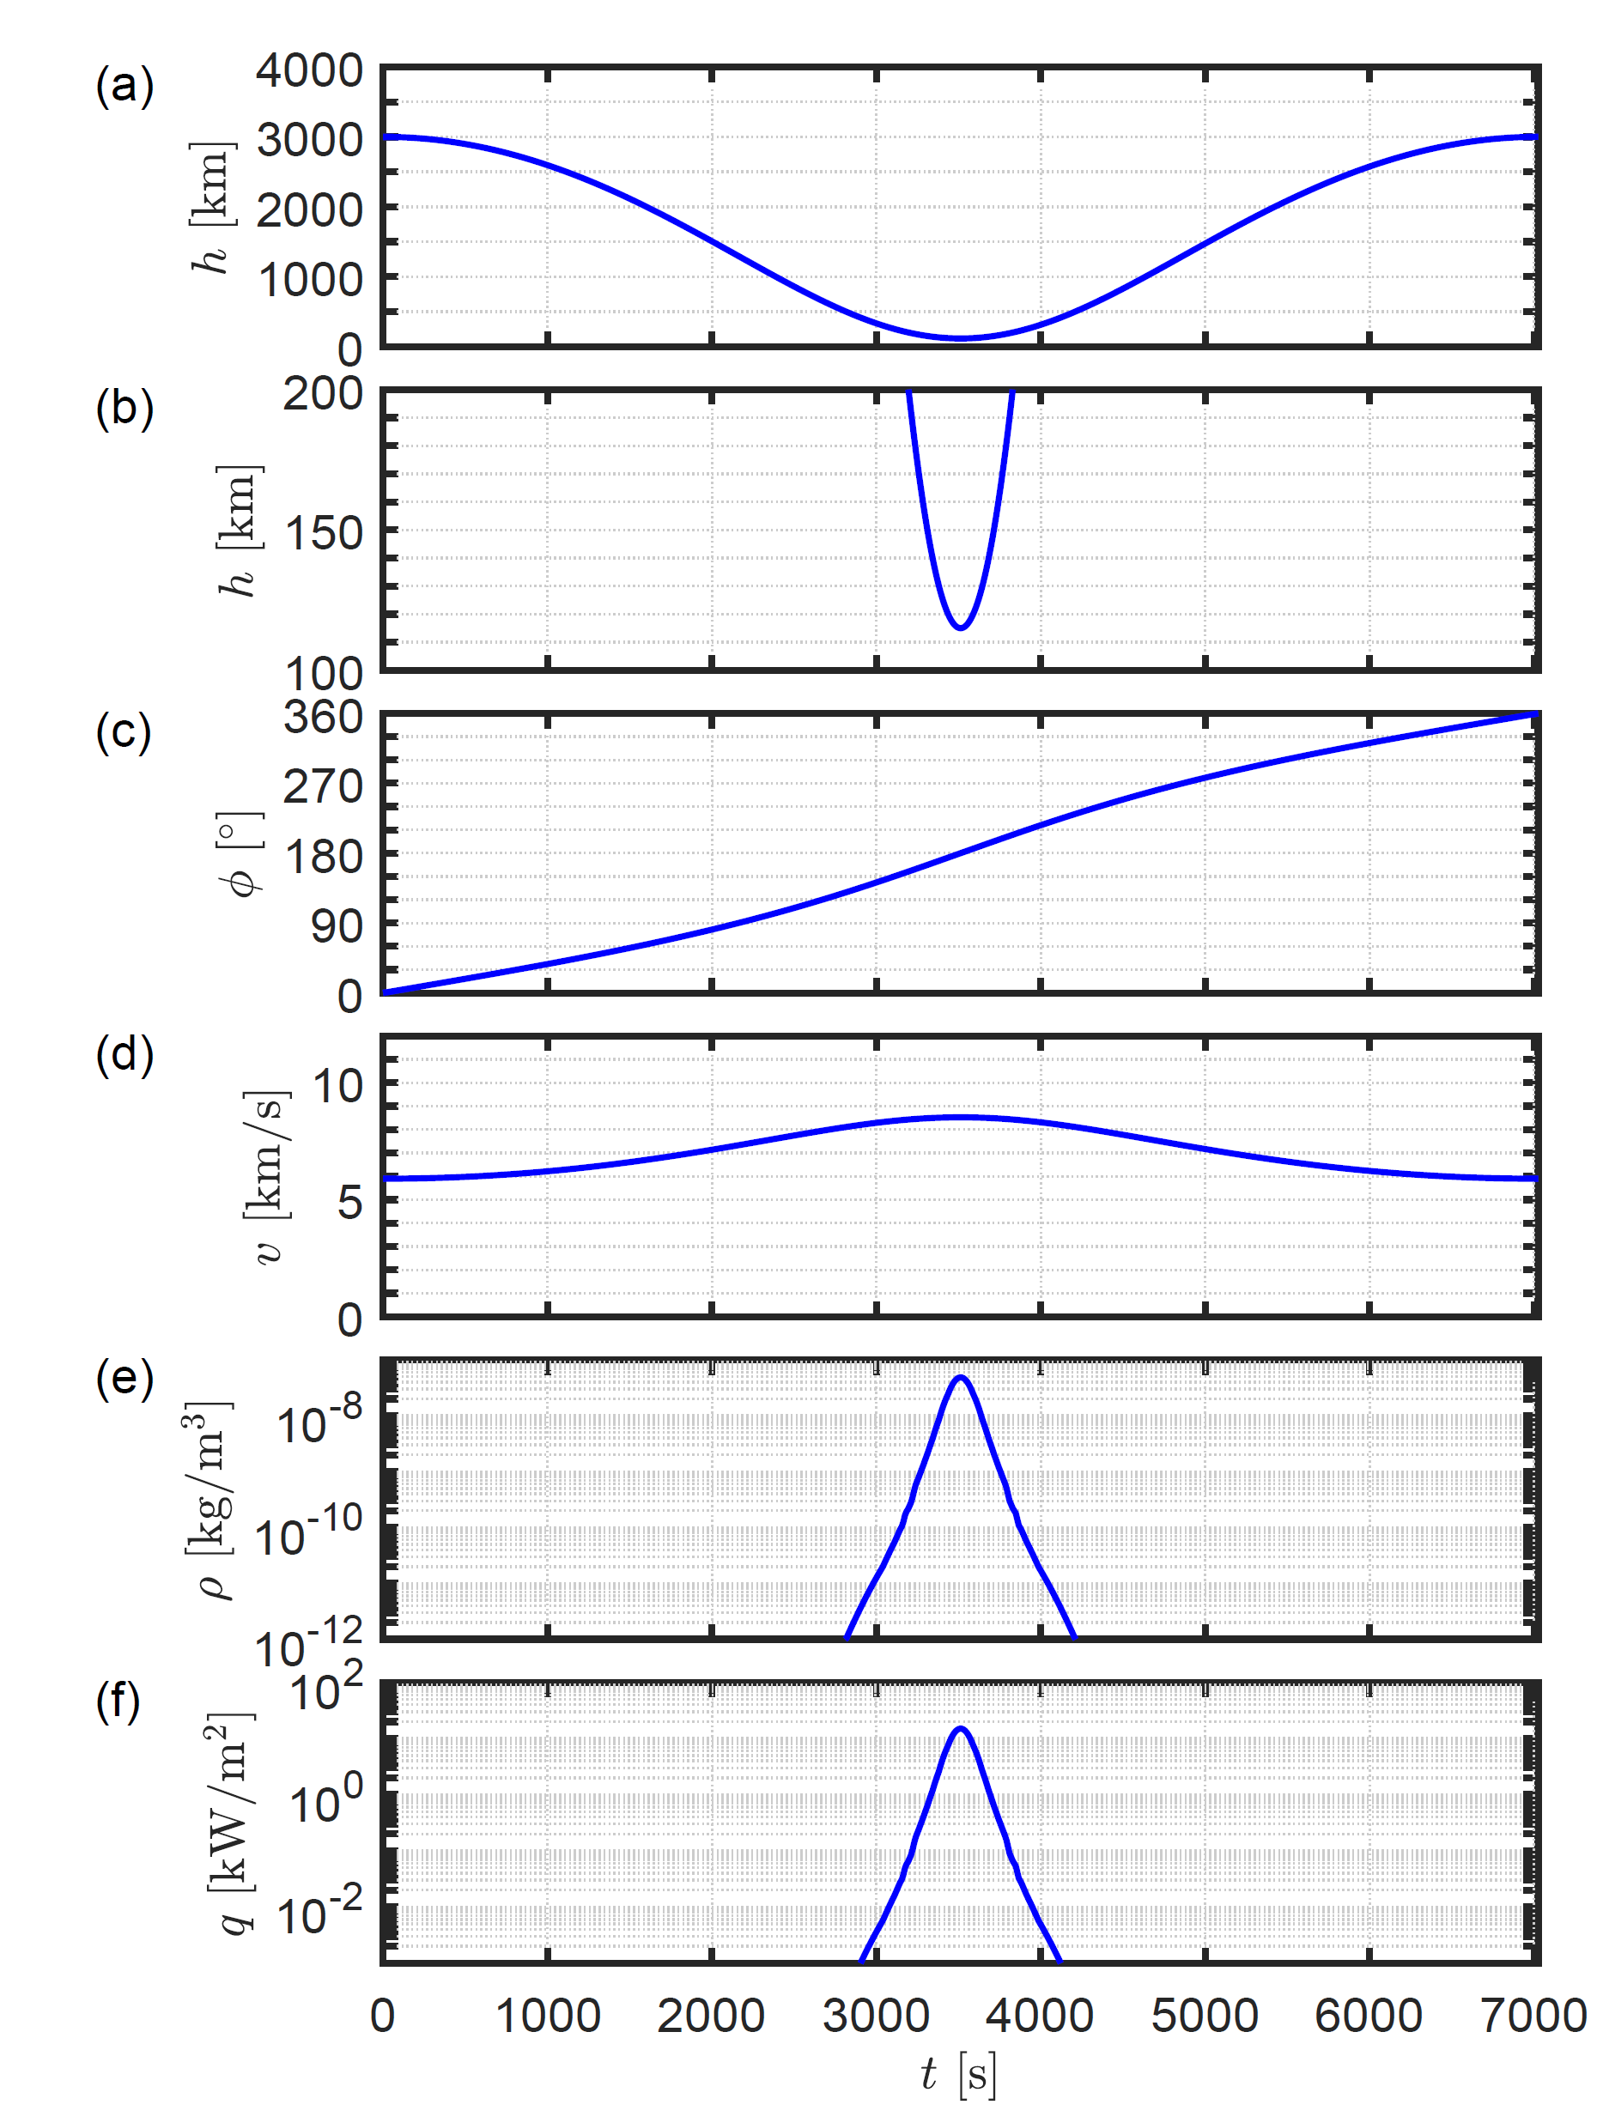
Atmospheric incursions
Spacecraft orbit around a spherical Earth with an apogee at 3000 km altitude and perigee at 115 km (period 7025 s).
Altitude
Altitude zoom
Phase
Orbital speed, 8.5 km/s at perigee
Atmospheric mass density
Heat flux due to drag
High speed at perigee
High atmospheric density

Slide 4
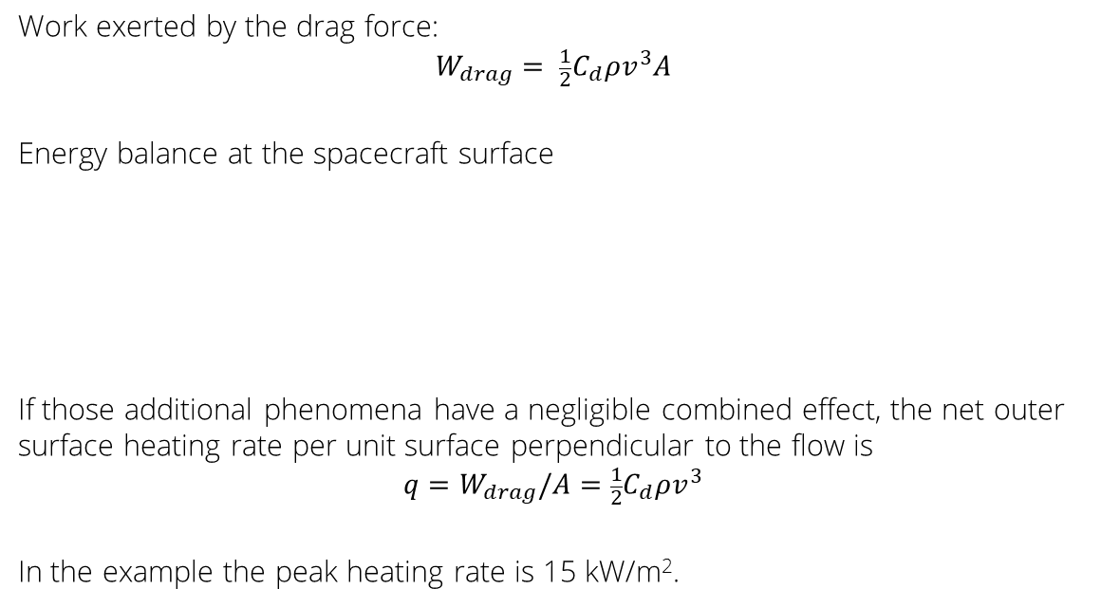
Frictional heating
Work exerted by the drag force:
$$W_{drag}= \frac{1}{2}C_{d}{ρv}^{3}A$$
Energy balance at the spacecraft surface
If those additional phenomena have a negligible combined effect, the net outer surface heating rate per unit surface perpendicular to the flow is
$${q=W}_{drag}/A=\frac{1}{2}C_{d}{ρv}^{3}$$
In the example the peak heating rate is 15 kW/m².
+ | -
frictional heating due to drag | heat conduction from sc to gas
(radiative transfer from shocked fluid to sc) | radiative energy loss from the spacecraft

Slide 5
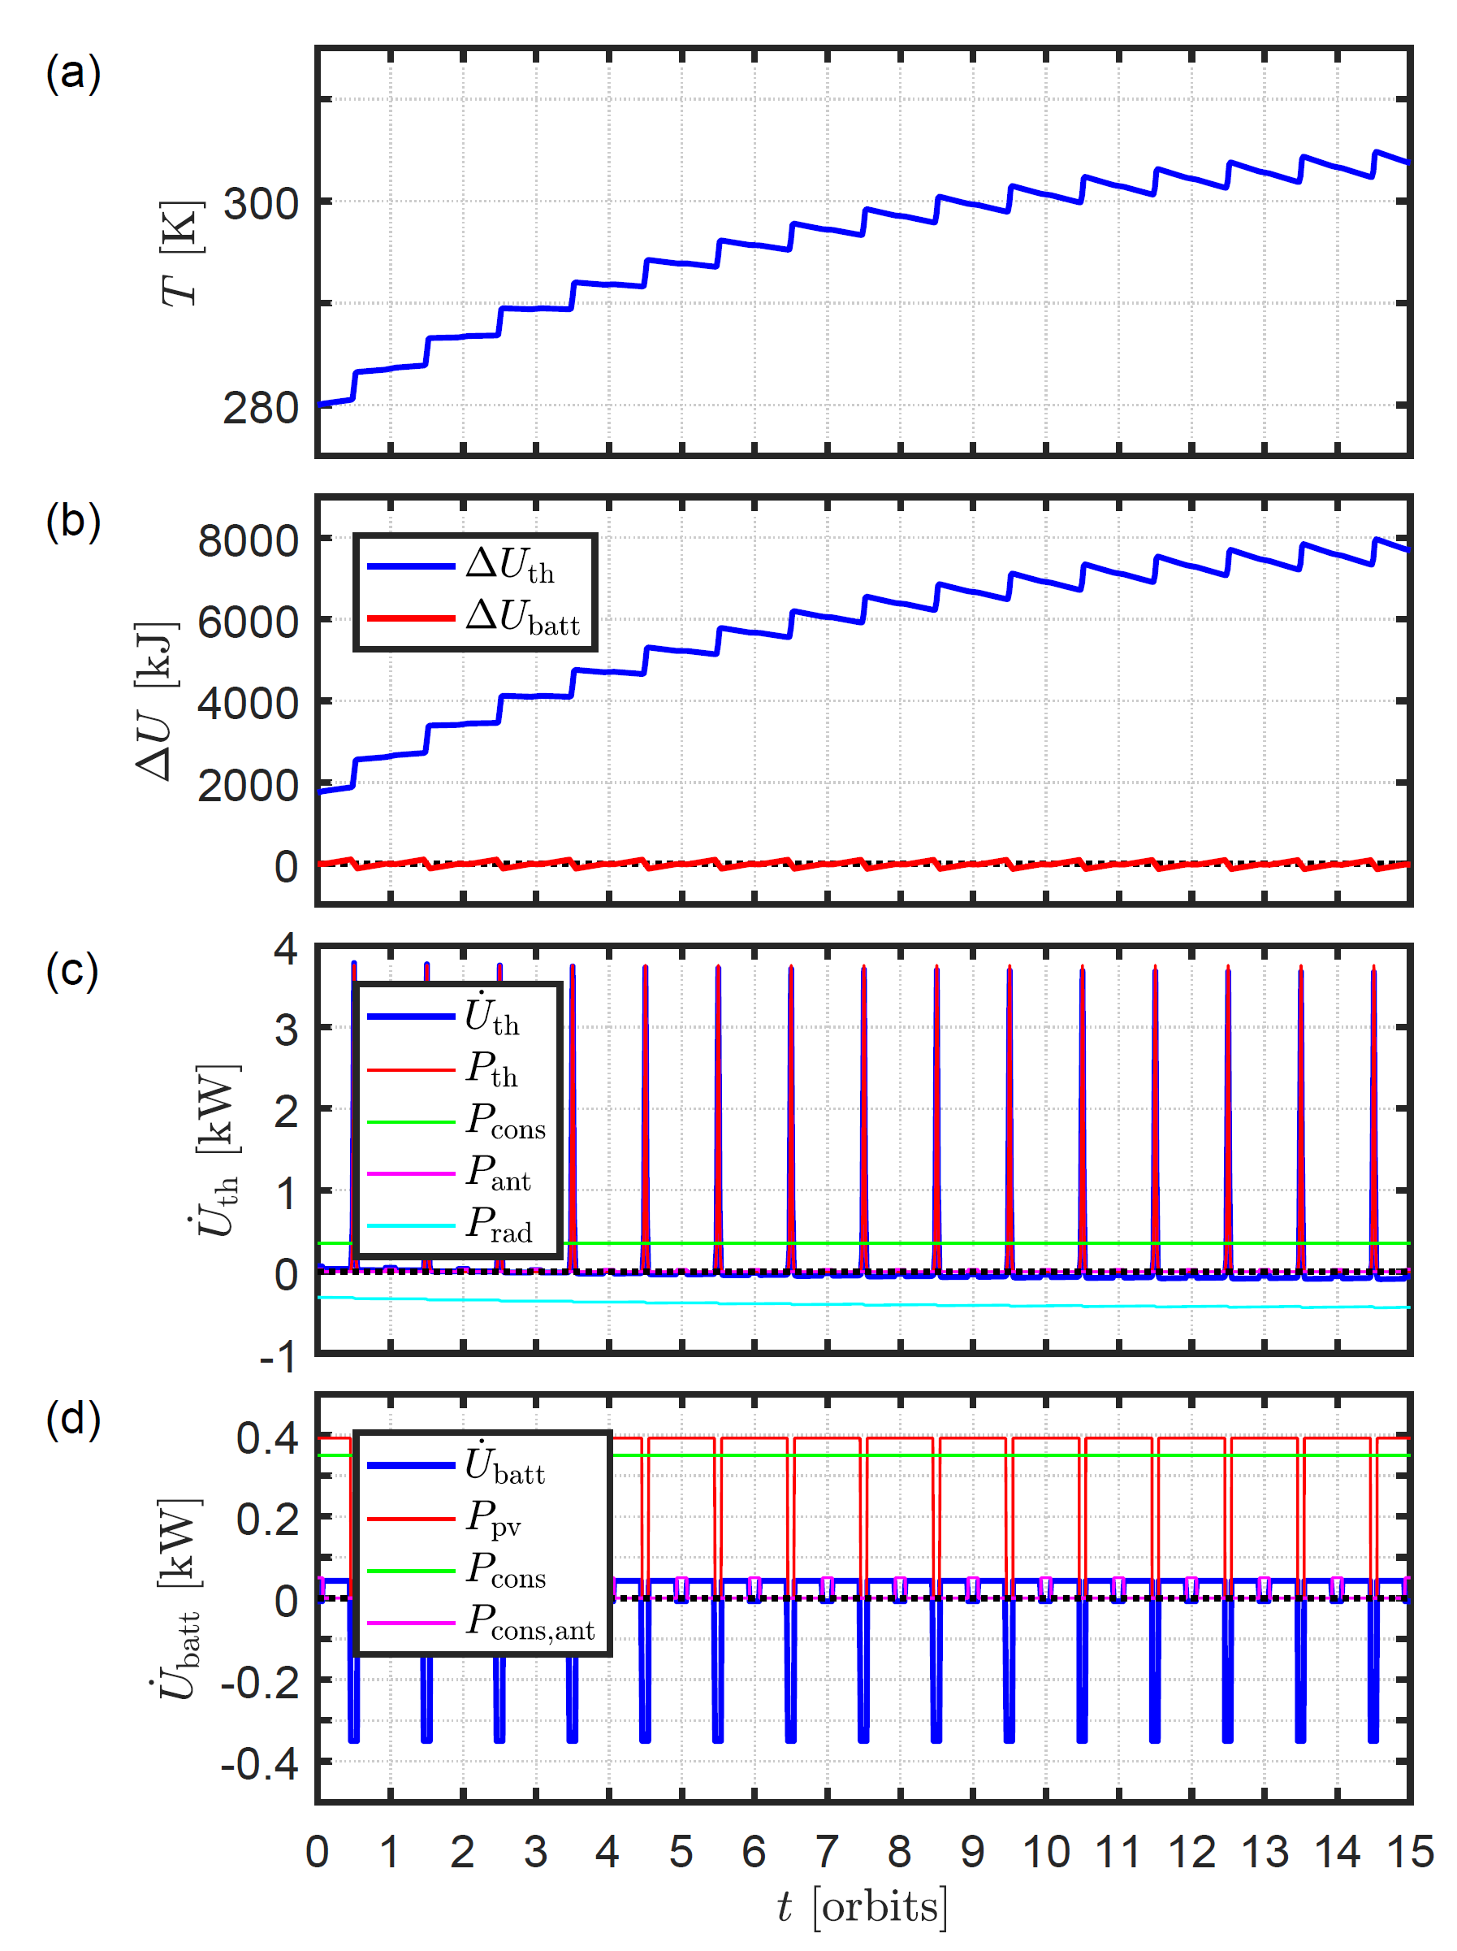
Spacecraft thermal balance
Consider a spacecraft in the (terminator) orbit discussed before (no eclipses). Assume a single spacecraft temperature T.
Energy sources
solar panels, except near perigee to avoid drag
frictional heating near perigee
Energy losses
dissipation in s/c systems, e.g. antenna use at apogee
radiated antenna power
thermal radiation
Battery load/unload cycle

Slide 6
Spacecraft thermal balance - conclusions
T adapts to match radiative loss to power budget, leading to cyclic T variations.
T sensitive to (variable) frictional heating
    Atmospheric density changes with geomagnetic activity.
    Especially if the orbit is modified to include incursions at variable depth.
S/C active temperature control needed
    Regulating solar power that is generated (changing solar panel attitude)
    Regulating spacecraft radiator area
T must be low: instruments use S/C as heat sink.

Slide 7
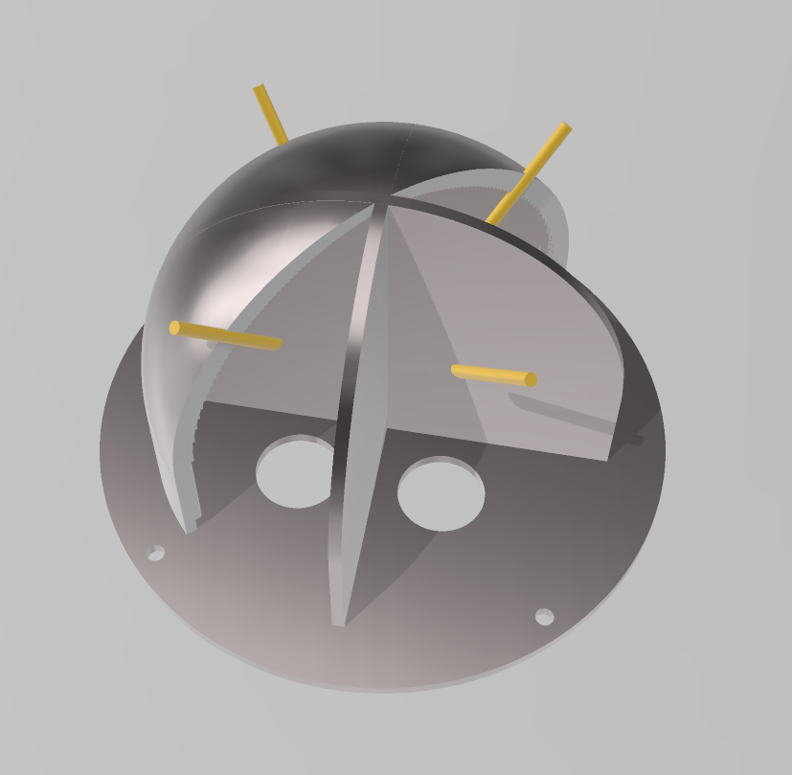
CWS instrument : collection volumes
CWS is the neutral cross-wind sensor under study for the Daedalus mission [Sarris et al., 2019, https://doi.org/10.5194/gi-2019-3], which is similar in concept as the Cross Track Sensor in CINDI on C/NOFS.
The sensor unit consists of four detection volumes with an opening, exposed to the flow. Particles enter a detection volume through the opening, thermalize through collisions with the volume walls, and leave the volume again through the opening. Residence time depends on the relative size of the volumes and the openings. Pressure inside the volume is higher than outside since ram pressure is converted to static pressure.
CWS detection volumes
(yellow bars indicate the instrument openings)

Slide 8
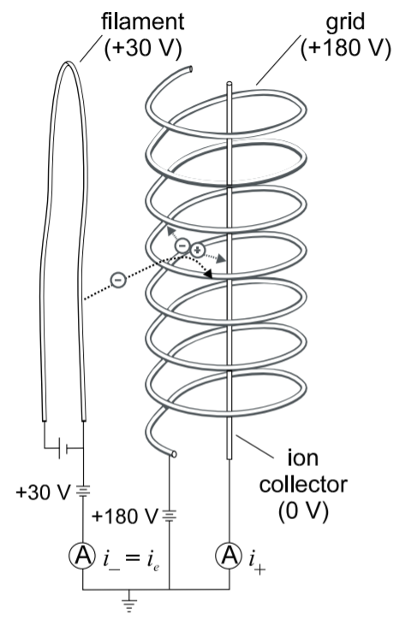
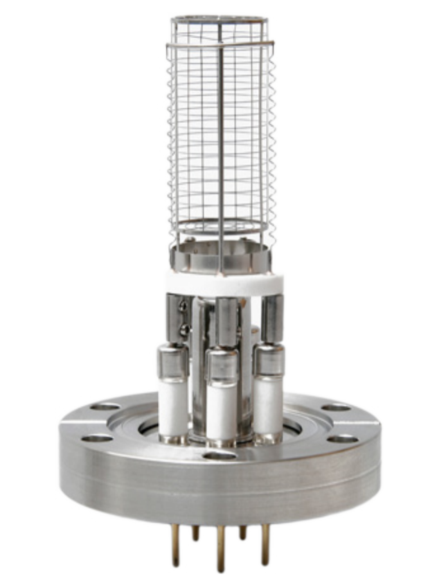
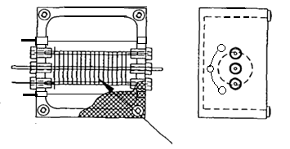
CWS instrument : ionization gauge
An ionization gauge inside each volume measures the pressure there. A filament emits electrons, which are accelerated through a potential difference. They ionize the ambient neutral gas, and the current is collected. The current is proportional to the pressure in the collection volume.
From the pressures in the four volumes the neutral wind direction can be established.
Filaments
Collector
Grid
Commercial gauge
First prototype of the modified gauge to be used for CWS

Slide 9
1D thermal modelling
The sensor unit’s outer surface is exposed to strong frictional heating. This heat is conducted through the outer shell and the inner dividing walls toward the instrument base, which is mounted to the spacecraft, which acts as a heat sink during the perigee pass.
If the ram direction is along the instrument axis, the flow and the resulting frictional heating are cylindrically symmetric. In a first approximation the temperature distribution in the instrument’s outer shell can then be considered to be cylindrically symmetric as well. Assuming thin outer shell and divider walls, temperature T(z, t) is a function of the vertical instrument coordinate z and of time t only. The structure is considered to be made of aluminium.

Slide 10
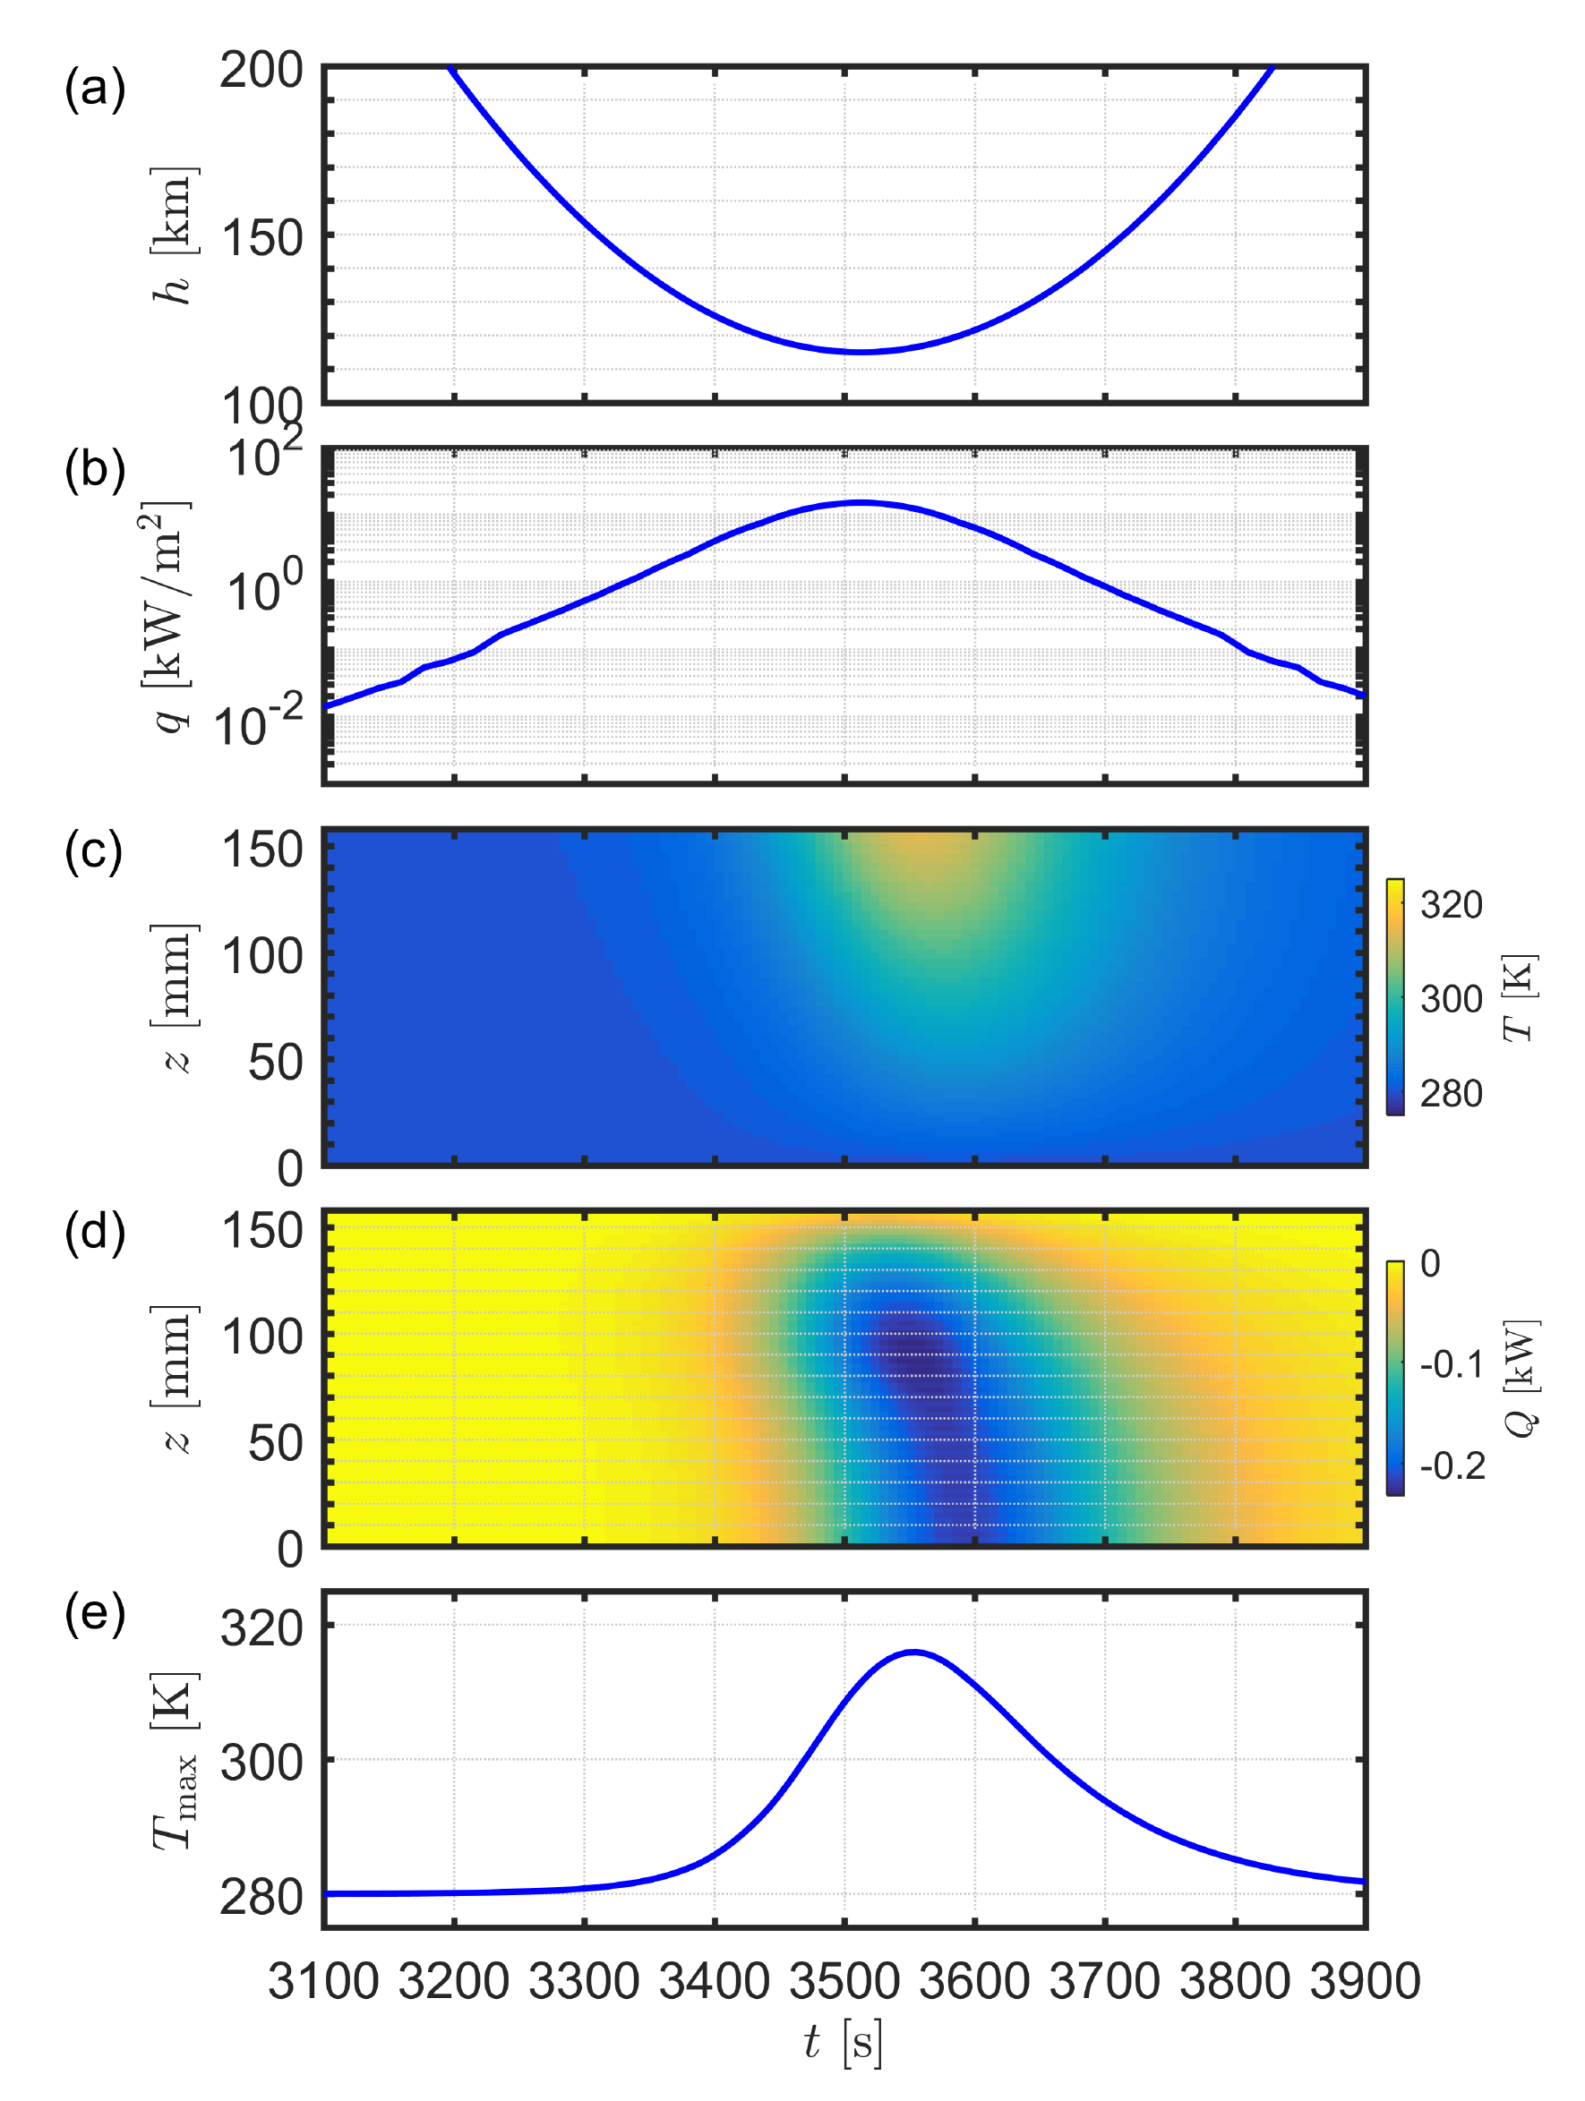
CWS instrument response during a perigee pass
The temperature distribution has been computed for the CWS sensor unit, which has a height of 160 mm, for an outer wall thickness of 4 mm and a divider wall thickness of 8 mm.
Assumption: base temperature is at a constant 280 K.
Result: peak temperature is at about 320 K. Peak temperature occurs 43 s after perigee.

Slide 11
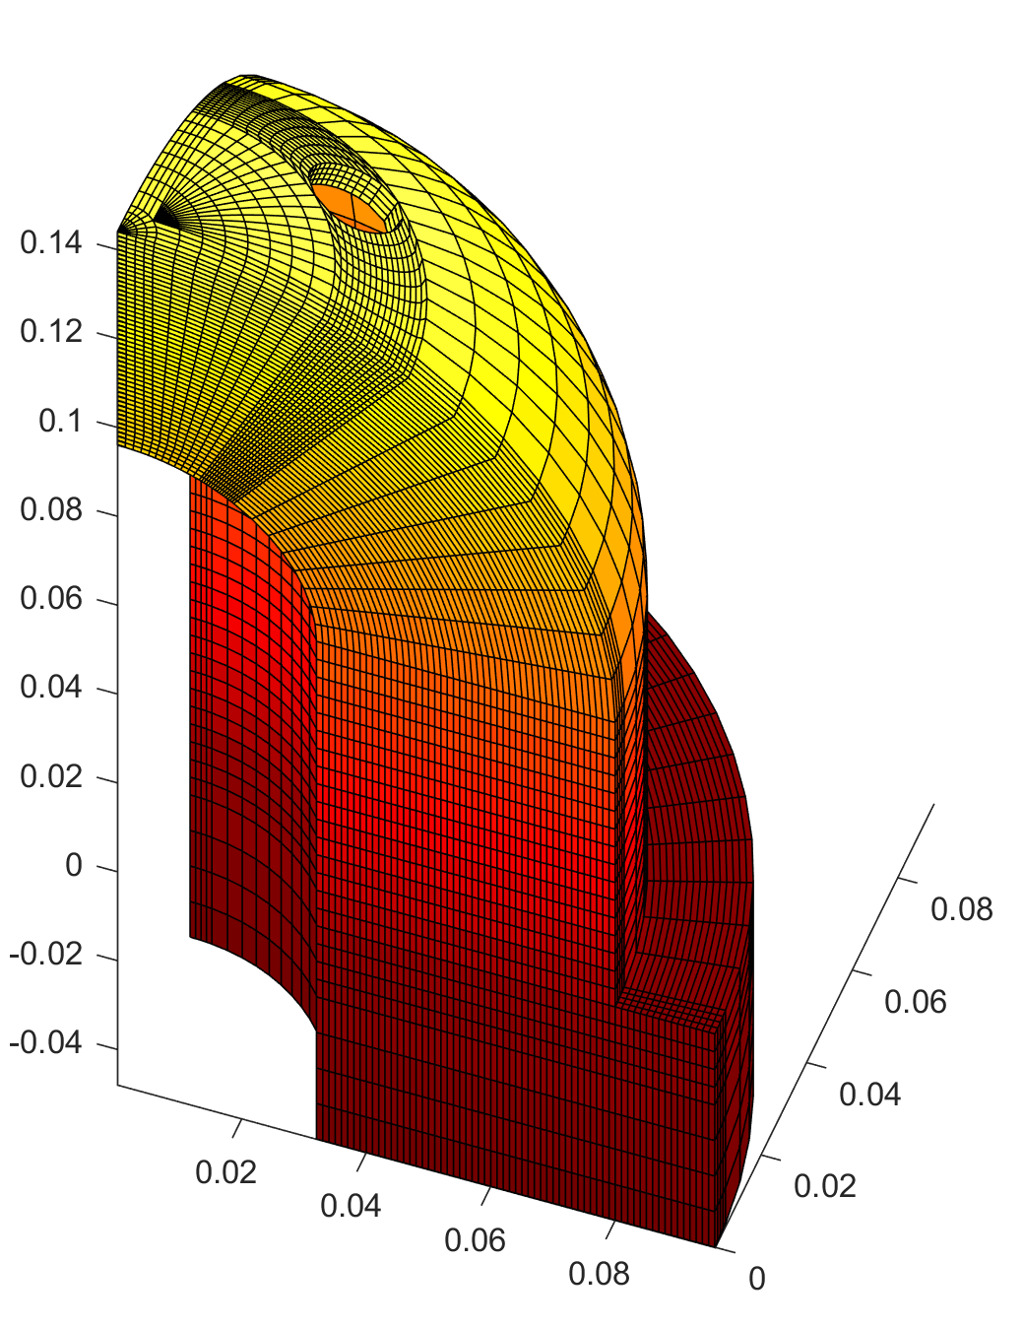
3D temperature modelling
A 3D thermal mode is used to evaluate the temperature of the outer shell under various thermal flux conditions
a fixed external heat flux along the instrument axis is imposed, projected along the surface normal, plus a small isotropic flux; no radiative heat transfer
bottom of the base plate is set to a fixed temperature (280 K)
no inner heating included yet
part of the sensor unit is modelled; periodic bcs are used

Slide 12
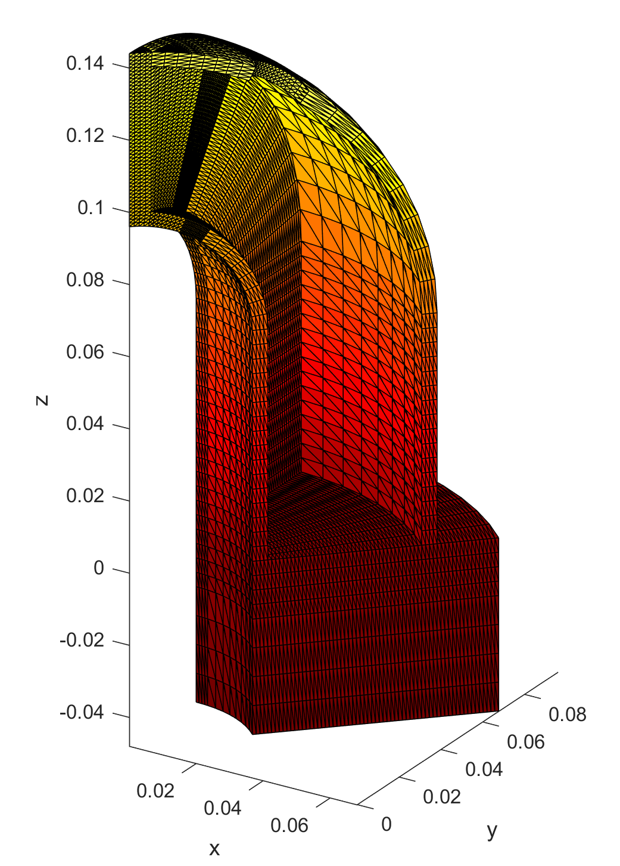
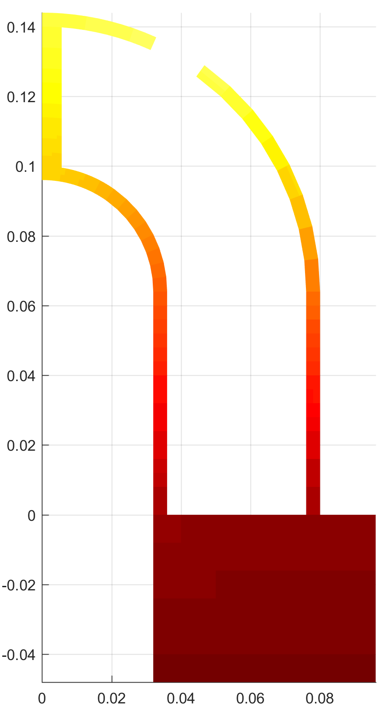
Most of the flux is deposited near the top of the instrument.
That flux is conducted to the base via the outer shell, the divider walls, and the core wall.

Slide 13
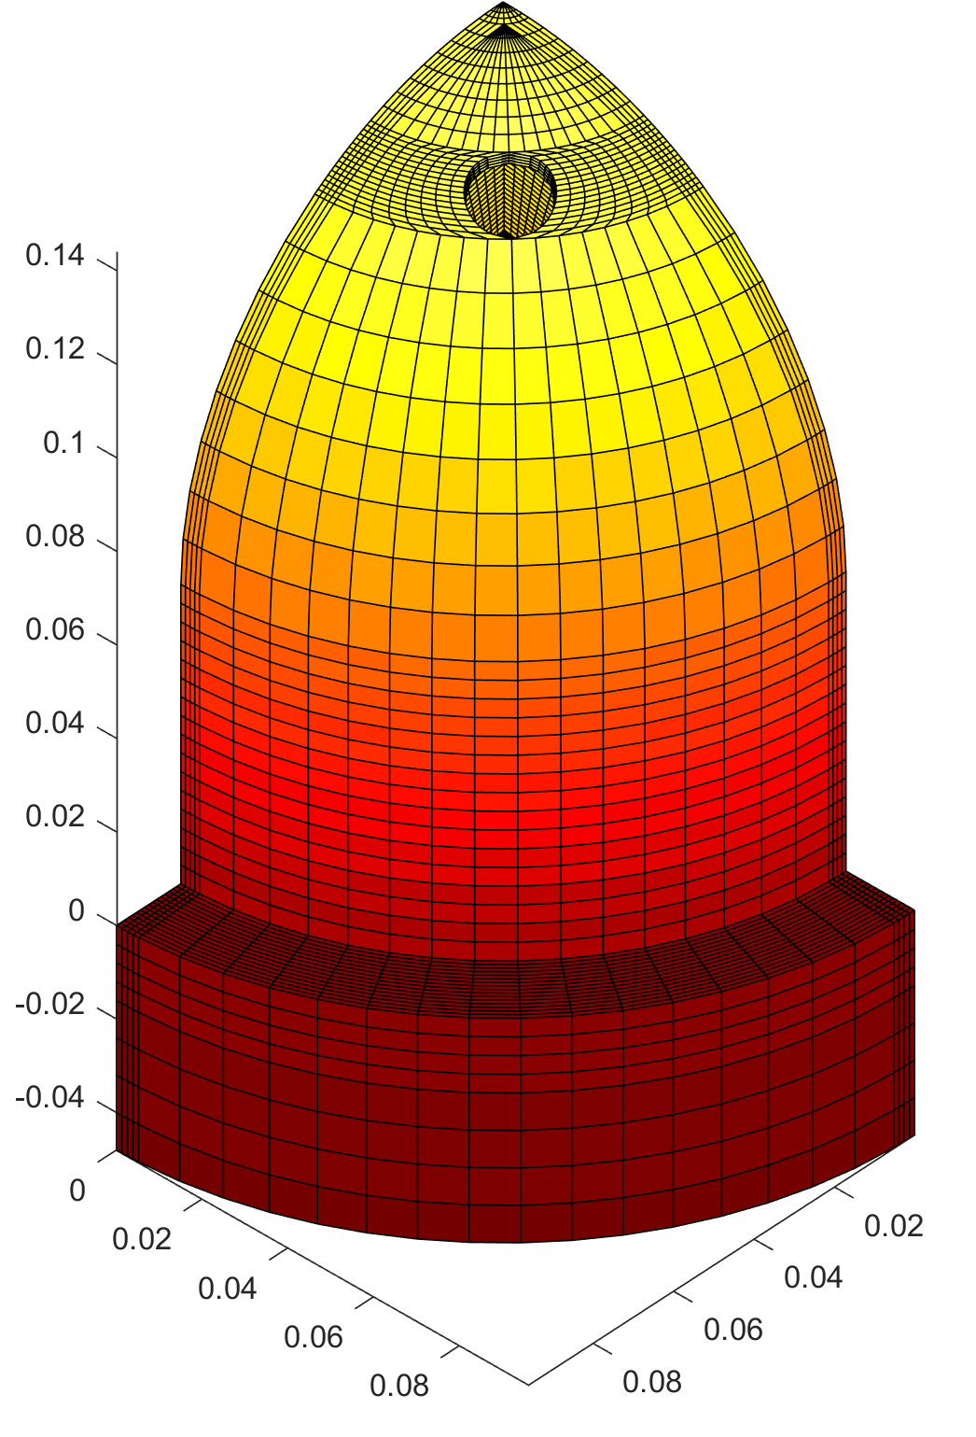
The 1D approximation seems to be satisfied reasonably well.

Slide 14
Further work
Verify time-dependent response with the 3D model
Optimize the design in terms of minimization of mass while still evacuating frictional heat flux towards the instrument base
Foresee thermally insulated inner volume walls that would have nearly homogeneous temperature, which is needed for a precise pressure measurement
Verify the thermal loads due to gas entering the volume, depending on various options to isotropise the gas and to protect the gauge from being directly hit by incoming particles
Check the possible use phase changing materials to absorb the peak heat flux.
Justify constraints on the thermal coupling to the spacecraft platform

Slide 15
Conclusion
We have described – in a generic way – the thermal challenges with which ram-facing instruments have to deal during deep incursions in the atmosphere.
With a good materials choice and adequate material thickness, the strong frictional heating flux can be evacuated fast enough, without increasing the instrument mass too much.
However, the (electrically conducting) outer surface will be subject to sputtering and erosion, especially due to intense atomic oxygen exposure. A possible coating is TiN on Al. This is not so critical for the instrument performance, but necessary from EMC considerations.

Slide 16
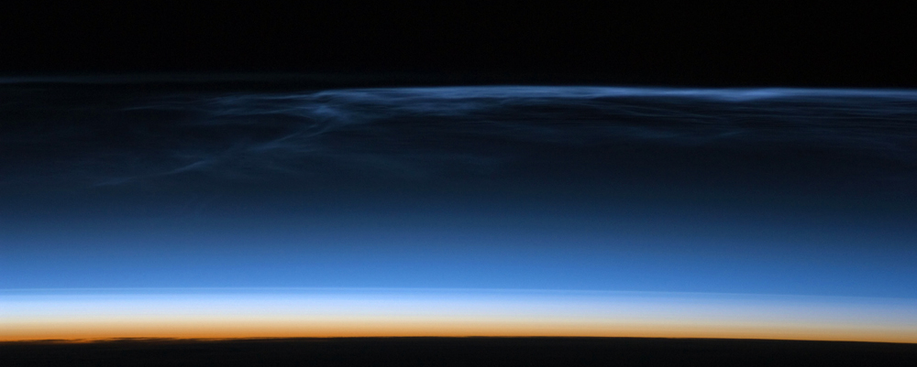

thank you!
more info?
www.aeronomie.be
Johan.DeKeyser@aeronomie.be

