Slide 1
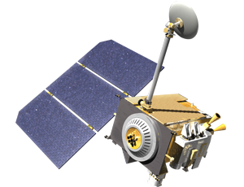
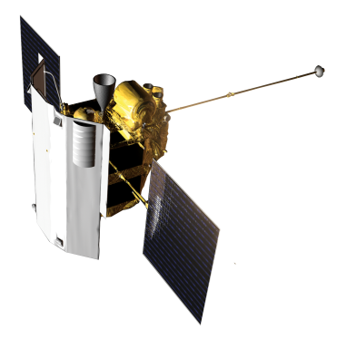
Regolith Textures on Mercury and the Moon
A.Yu. Zharkova^{1,2}, M.A. Kreslavsky³ and M.M. Kolenkina¹
¹Moscow State University of Geodesy and Cartography (MIIGAiK), Moscow, Russia;
²Sternberg Astronomical Institute, Moscow State University, Moscow, 119234, Russia;
³University of California Santa Cruz, Santa Cruz, CA, United States.
Presenting author: Anastasia Zharkova
a_zharkova@miigaik.ru
EGU | Online | 4–8 May 2020
Notes:
1

Slide 2
Our motivation
The surfaces of Mercury and the Moon are covered with a layer of regolith. Regolith’s formation, modification and transport occur due to (micro)meteoritic impacts and other processes – form short-scale textures seen in the high-resolution images.
In this presentation we aimed to answer three questions:
What textures were found?
Which one are unique to Mercury?
How regolith on Mercury is different?
We carried out a survey of short-scale textures on Mercury and compared them to better-known lunar analogs.
Notes:
2

Slide 3
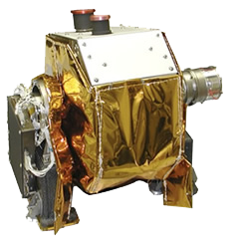
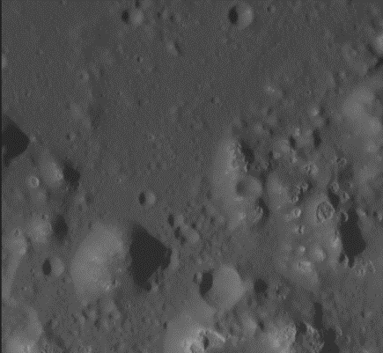
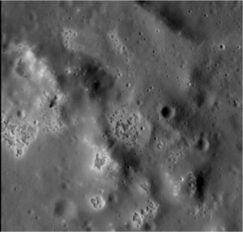
Data: Mercury
Narrow angle (NAC) images of MESSENGER MDIS (Mercury Dual Imaging System)
Very high resolution acquired from Feb. to Apr. 2015 (less than 2.5 m/pix), low S/N
Scattered along orbits – cannot be mosaicked
Often cannot be put in the context
Random samples of surface morphology
Selected for survey: ~3000 images
with smear < 10 pix
Examples of MDIS NAC images with hollows
Notes:
3

Slide 4
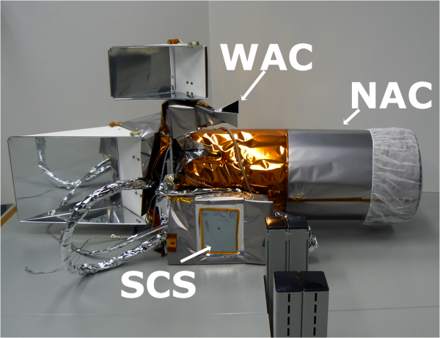
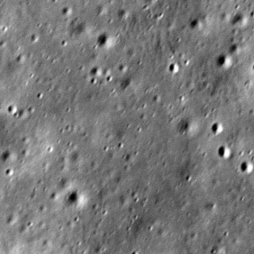
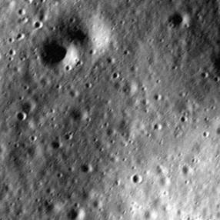
Data: the Moon
Narrow angle (NAC) images of LROC (Lunar Reconnaissance Orbiter Camera)
Resolution – from 0.5 to 3 m/pix, high S/N, different illumination conditions
Randomly extracted 0.25 m/pix samples form images of the same sampling (m/pix), incidence angle, phase angle as MDIS images
Quality reduction:
adding blur, smear, noise to reproduce MDIS image quality!
Examples of LROC NAC images
Notes:
4

Slide 5
Heavily cratered terrain
Primarily, surfaces of Mercury and the Moon as seen at high resolution are similar.
The most abundant morphological features are small impact craters of different sizes (10s and 100s of meters) at different stages of degradation.
Fresh craters are deeper and have crisp rims; the freshest are bright and have high-albedo proximal ejecta.
The majority of craters are degraded: shallow and smoothed, in a manner similar to the Moon.
Notes:
5

Slide 6
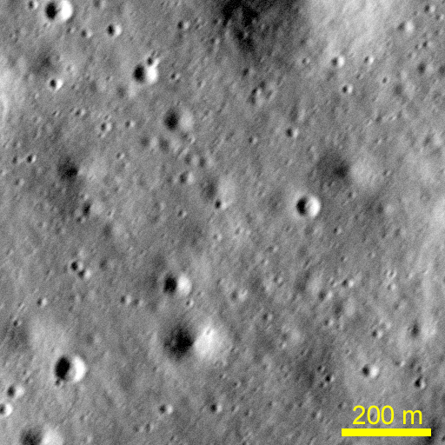
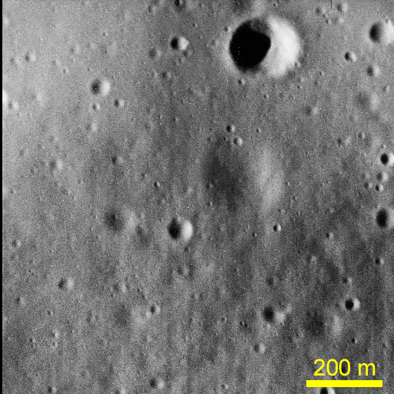
Heavily cratered terrain
a)
b)
Typical surface texture: heavily cratered terrain with small smooth craters of different degrees of degradation: a) on the Moon, portion of LROC NAC image M1170070317LC, image quality is artificially degraded to mimic MDIS NAC images; b) on Mercury, MDIS NAC image CN1066766047M.
Notes:
6

Slide 7
Impact melt on Mercury and the Moon
Small fresh impact craters with sharp rims occur in a large number of the Mercury images surveyed. Their morphology is very similar to their lunar counterparts.
The high-resolution images sampled only one large young crater – an unnamed 34-km crater. Morphologies observed there are also very similar to those in Copernican craters on the Moon. Figure (a) on next slide shows an example of characteristic textures of impact melt on a low terrace near the floor of this crater; Figure (b) shows a similar morphology on the Moon on the floor of crater Kepler. Both scenes contain knobs apparently formed by unmelted blocks, and thermal contraction cracks in impact melt partly bridged by accumulating regolith.
Also we found two small impact melt ponds to the eastern outer wall of the same crater on Mercury. Lower resolution images show abundant larger melt ponds in the same area. Such a large amount of impact melt is not observed outside craters of the same size on the Moon, likely because a lower impact velocity on the Moon leads to a lower melt volume in comparison to craters of the same size on Mercury.
Notes:
7

Slide 8
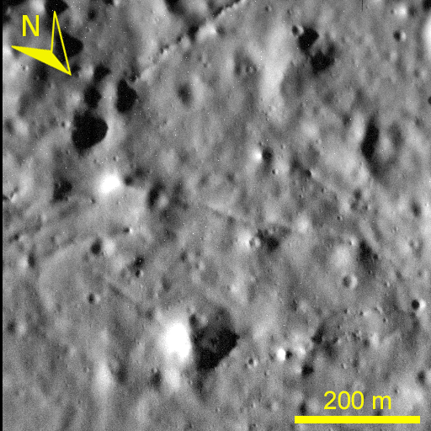
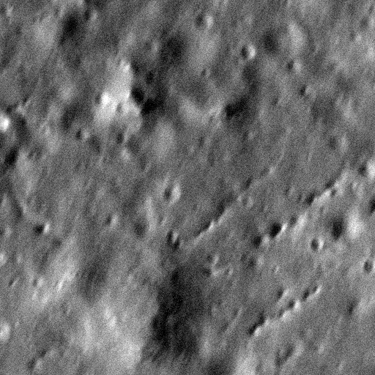
Impact melt on Mercury and the Moon
a)
b)
Morphologies of impact melt on Mercury and the Moon: a) Impact melt near the floor of an unnamed impact crater at 64.6°N 104.6°W, D = 34 km. MDIS image CN1067123666; b) Impact melt on the floor of the lunar crater Kepler. Portion of LROC image M1188607587R. Lunar image have artificially reduced image quality to mimic high-resolution MDIS NAC image quality.
Notes:
8

Slide 9
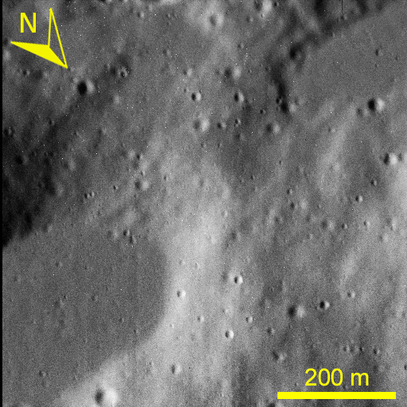
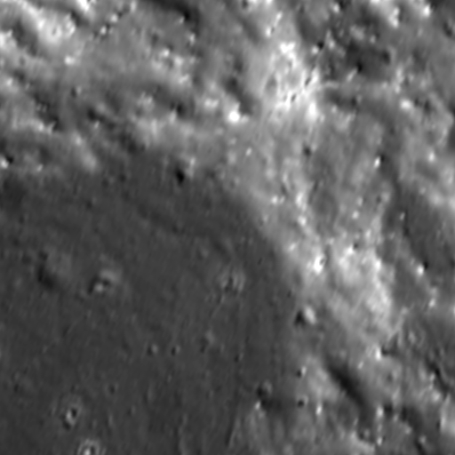
Impact melt on Mercury and the Moon
a)
b)
Morphologies of impact melt on Mercury and the Moon: a) Impact melt ponds to the east of crater at 64.6°N 104.6°W. MDIS image CN1067093876; b) Impact melt pond on the eastern outer wall of the lunar crater Tycho. Portion of LROC image M1182515316R. Lunar image have artificially reduced image quality to mimic high-resolution MDIS NAC image quality.
Notes:
9

Slide 10
Young features: small hollows
Hollows are irregular flat-floored depressions with bright interiors and halos identified in regular-resolution MDIS images. They have no obvious lunar analogues and often form large clusters covering tens or even hundreds of square kilometers.
We found 14 images with decameter-size features that are morphologically identical to “classic” hollows, but smaller. The morphological similarity suggests the same formation mechanism.
First, a number of small hollows are apparently spatially associated with large hollow clusters. Second, we found small hollows scattered within the inter-crater plains at a considerable distance from known larger hollows. We did not observe any systematic difference in their morphology. This means that small amounts of hollow-forming material are present over large areas.
The available data do not enable us to distinguish, whether this material is local or delivered to the site by distal impacts. However, the latter is less likely in the case of the dispersed small hollows: the putative volatile material is unlikely to survive the ejection and re-impact at the velocity needed to reach a range of hundreds of kilometers.
Notes:
10

Slide 11
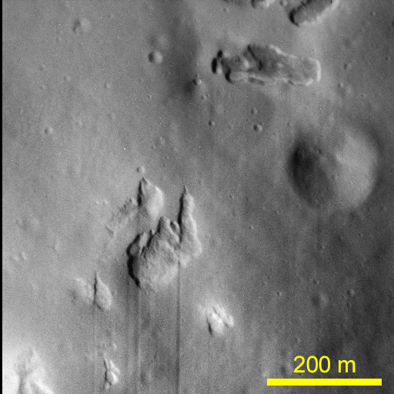
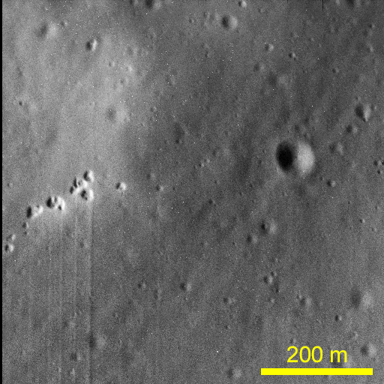
Young features: small hollows
a)
b)
Examples of small hollows on Mercury: a) MDIS NAC image CN1066557528M; b) CN1066587367M. Thin vertical lines are image artifacts.
Notes:
11

Slide 12
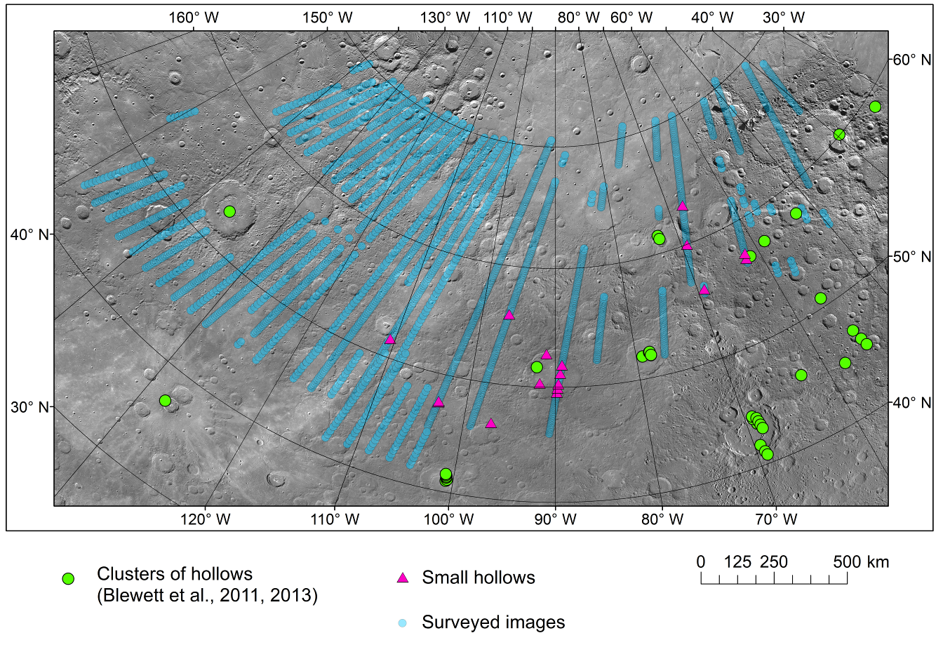
Locations of hollows
Notes:
Map of a part of Mercury (Lambert azimuthal equal-area projection) showing locations of high-resolution MDIS NAC images.
Small blue circles, all images surveyed; violet triangles, images containing small hollows. Large green circles mark centers of large hollow clusters according to Blewett et al. (2011, 2013).
Background is low-resolution MDIS image mosaic.
12

Slide 13
“Elephant hide” texture
On the Moon regolith-covered slopes – both moderately steep and gentle – have a specific subtle decameter-scale texture dubbed “elephant hide” or “leathery” texture.
On Mercury, “elephant hide” is typically not observed. The illumination geometry on all surveyed images is favorable for its identification; we very often encounter “elephant hide” in the lunar images taken under the same incidence angle.
In rare cases we do observe a texture very similar to the lunar “elephant hide” texture. In the absence of context images, it is difficult to distinguish, whether or not this pattern occurs on slopes, and is absent on horizontal surfaces (as on the Moon).
The “elephant hide” formation mechanism is unknown. Some researchers suggested seismic shaking as a factor producing the pattern but this hypothesis does not explain, why the “elephant hide” is observed only on slopes, not on horizontal surfaces. The latter fact suggests that the “elephant hide” is related to downslope regolith transport.
Notes:
13

Slide 14
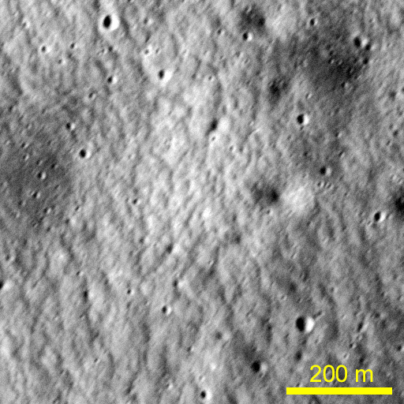
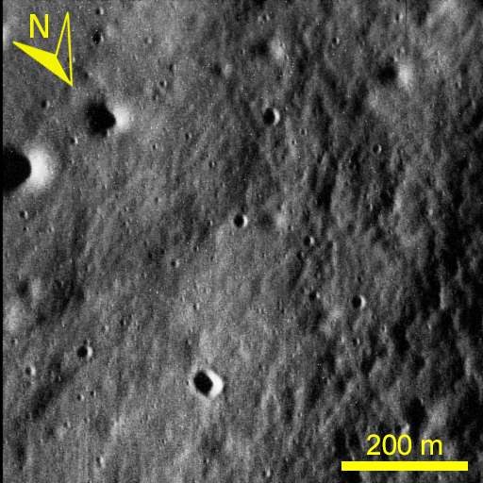
“Elephant hide” texture
a)
b)
“Elephant hide” texture: a) on the Moon, portion of LROC NAC image M1096151342LC; image quality is artificially degraded to match high-resolution MDIS NAC images; b) on Mercury, MDIS NAC image CN1067421557M.
Notes:
14

Slide 15
Finely-Textured Slope Patches
We identified another type of young fresh “crisp” morphology on Mercury with no direct lunar analog. We called this type of unusual textures “Finely-Textured Slope Patches” (FTSP) and found 7 images containing the texture.
FTSP are patches of finely (meter-scale) textured slopes. This texture is characterized by a “wavy” slightly chaotic pattern with sharp outlines. It is dissimilar from landslides or other similar formations found on the slopes of young craters of different diameters on the Moon. The relatively small size of the individual elements of FTSP's and their sharpness distinguish FTSP from the previously described “elephant hide” texture.
The locations of FTSP's examples at the global level do not reveal clear relationships with other relief features.
Crispness of morphology and the absence of superposed small impact craters suggest that FTSP formed recently. The formation mechanism is not clear.
Notes:
15

Slide 16
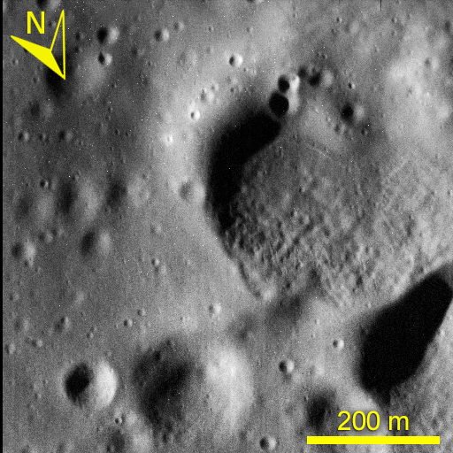
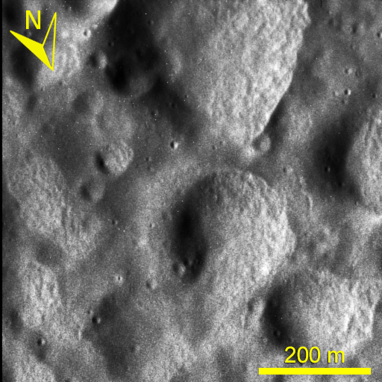
Finely-Textured Slope Patches
a)
b)
Examples of finely textured slope patches (FTSP) on Mercury: a) MDIS NAC image CN1067272492M; b) CN1067361831M.
Notes:
16

Slide 17
Chevron textures
We identified one more type of unique fresh texture on Mercury with no direct lunar analogs. We refer it as chevron texture.
The texture is formed by shallow, elongated depressions, triangular in plan form. All depressions are elongated in approximately east-west direction with the triangle tips pointing toward the west, and open sides facing the east. Sharpness and superposition over subdued relatively small craters indicates the youthfulness of this texture.
Chevron texture resembles small-scale textures produced in terrestrial environments by erosion by wind or water flow. Under present-day conditions such processes on Mercury are impossible. Another idea suggested by morphological similarity of chevron texture to terrestrial erosional morphologies is that the depressions are formed by sandblasting by fine-grained ejecta from recent impacts. But there is no large young impact crater in the immediate vicinity of the observed chevron texture.
The presence of erosion-like textures on Mercury might be explained by the presence of the predicted mechanically stronger uppermost regolith layer indurated due to sintering, as discussed above.
Notes:
17

Slide 18
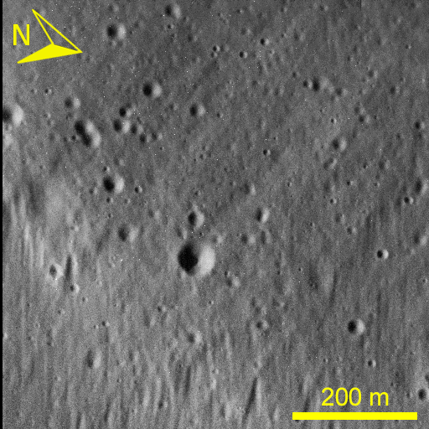
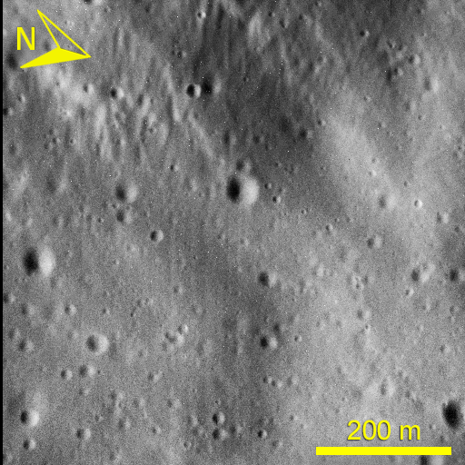
Chevron textures
a)
b)
Examples of chevron textures on Mercury: a) MDIS NAC image CN1066229937; chevron textures are seen in the lower, eastern part of the image; b) CN1066289535; chevron textures are seen in the upper, western part.
Notes:
18

Slide 19
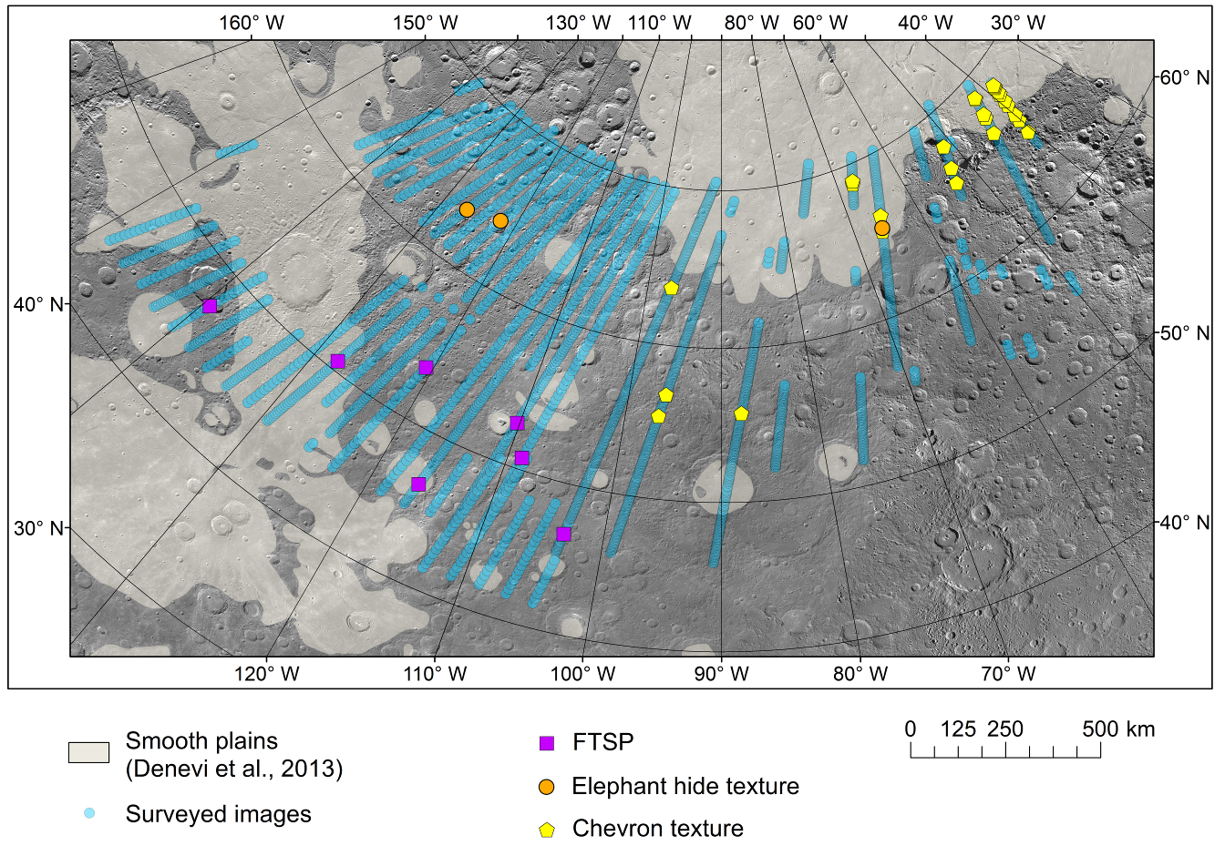
Locations of images with textures
Notes:
Map of a part of Mercury (Lambert azimuthal equal-area projection) showing locations of high-resolution MESSENGER MDIS NAC images.
Small blue circles, all images surveyed; violet boxes, images containing FTSP; orange circles, images containing “Elephant hide”; yellow pentagons, images containing chevron texture.
Background is low-resolution MDIS image mosaic; greyed area shows smooth plains according to Denevi et al. (2013).
19

Slide 20
Conclusions
We surveyed meters and tens-of-meters scale textures of the surface of Mercury and compared them to textures of observed on the lunar surface.
We clearly see morphological signs of the presence or regolith on Mercury and subdued morphologies, especially, degraded craters, smoothed due to regolith formation and transport.
The “elephant hide” texture, ubiquitous on the Moon is, however, almost absent on Mercury, at least, in the region surveyed.
We identified several types of geologically young morphological features on Mercury that do not have lunar analogs. The chevron texture and FTSP are specifically features unrelated to hollows. Their origin remains unclear.
We hypothesize that the presence of an indurated uppermost crust in the regolith may explains the presence of such features on Mercury and their absence on the Moon.
Notes:
20

Slide 21
Thank you!
Any questions?
EGU | Online | 4–8 May 2020
Notes:
21

