Slide 1
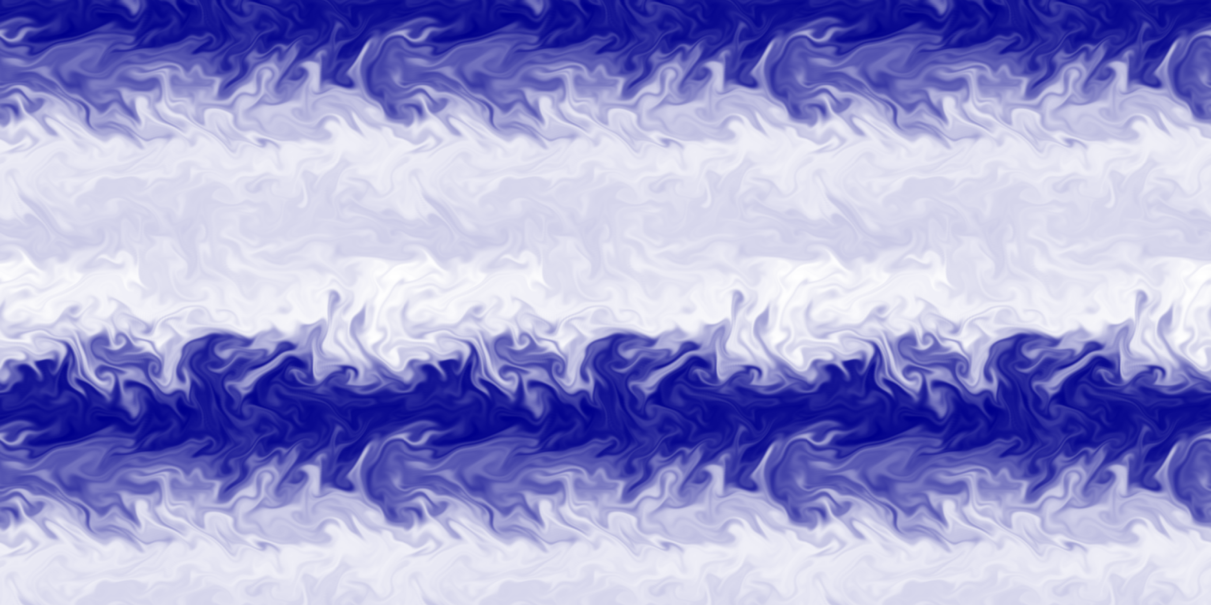
Inverse Cascade of Kinetic Energy in Two-Dimensional β-plane Magnetohydrodynamic Turbulence
Zinyakov Timofey & Petrosyan Arakel
Space Research Institute of the Russian Academy of Sciences

Slide 2
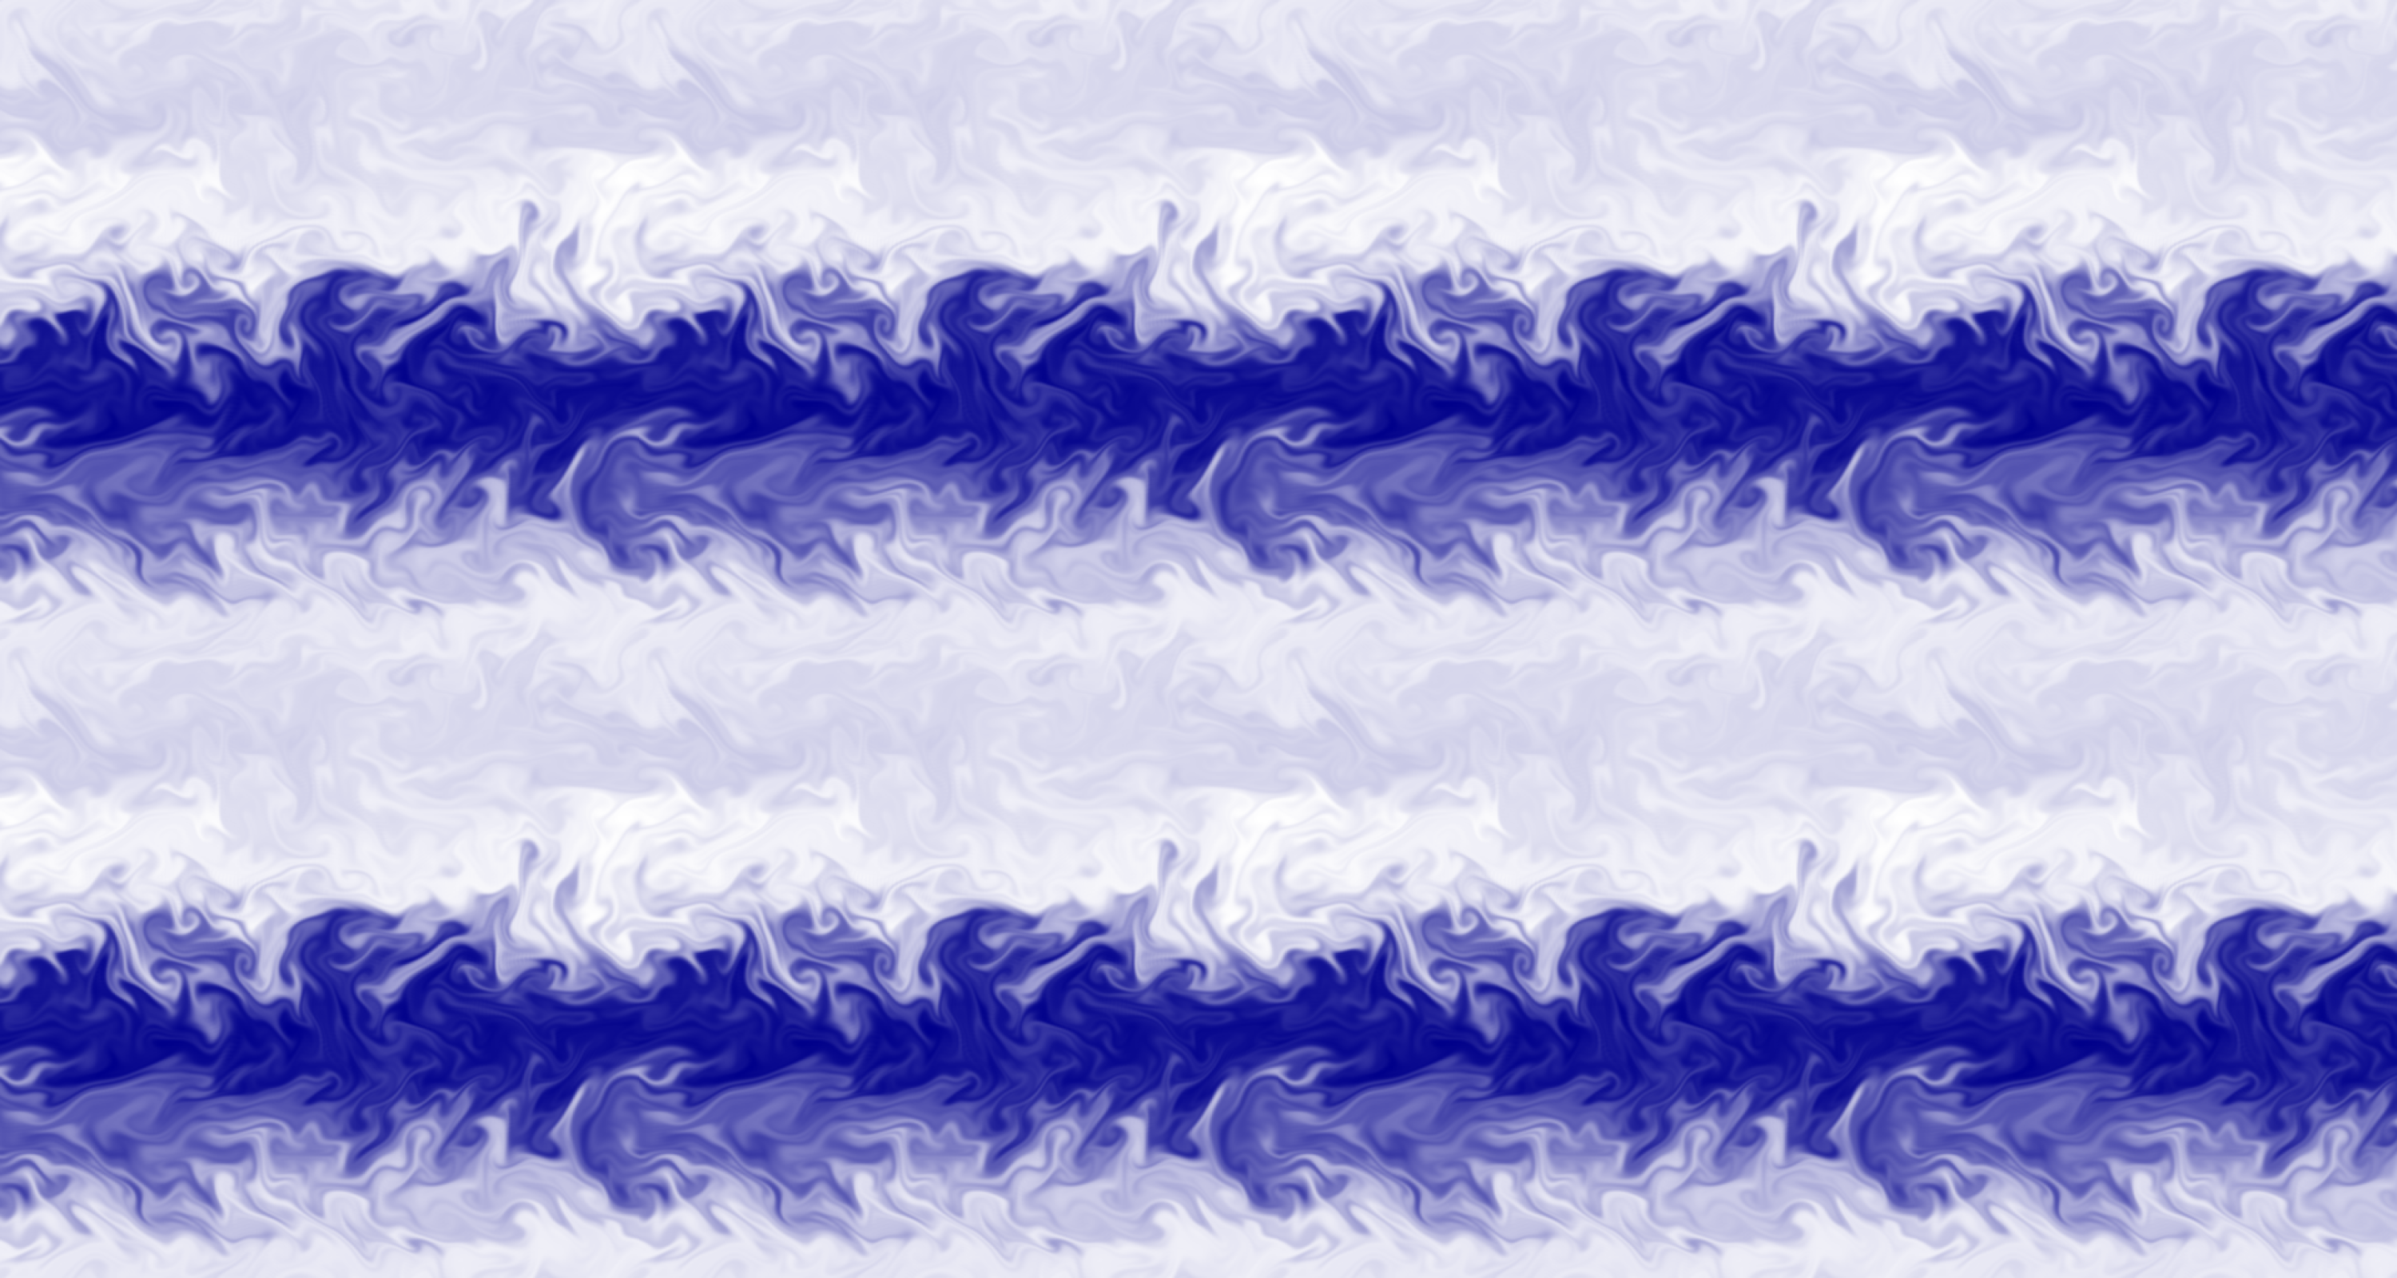
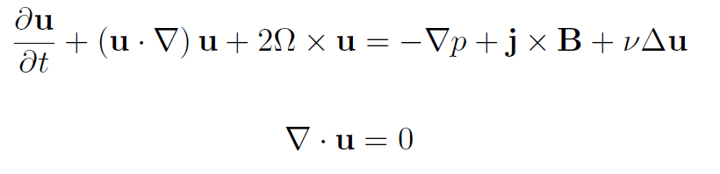

MHD equations
Navier-Stokes equation for rotating conductive incompressible fluid:
Magnetic field evolution equation:

Slide 3
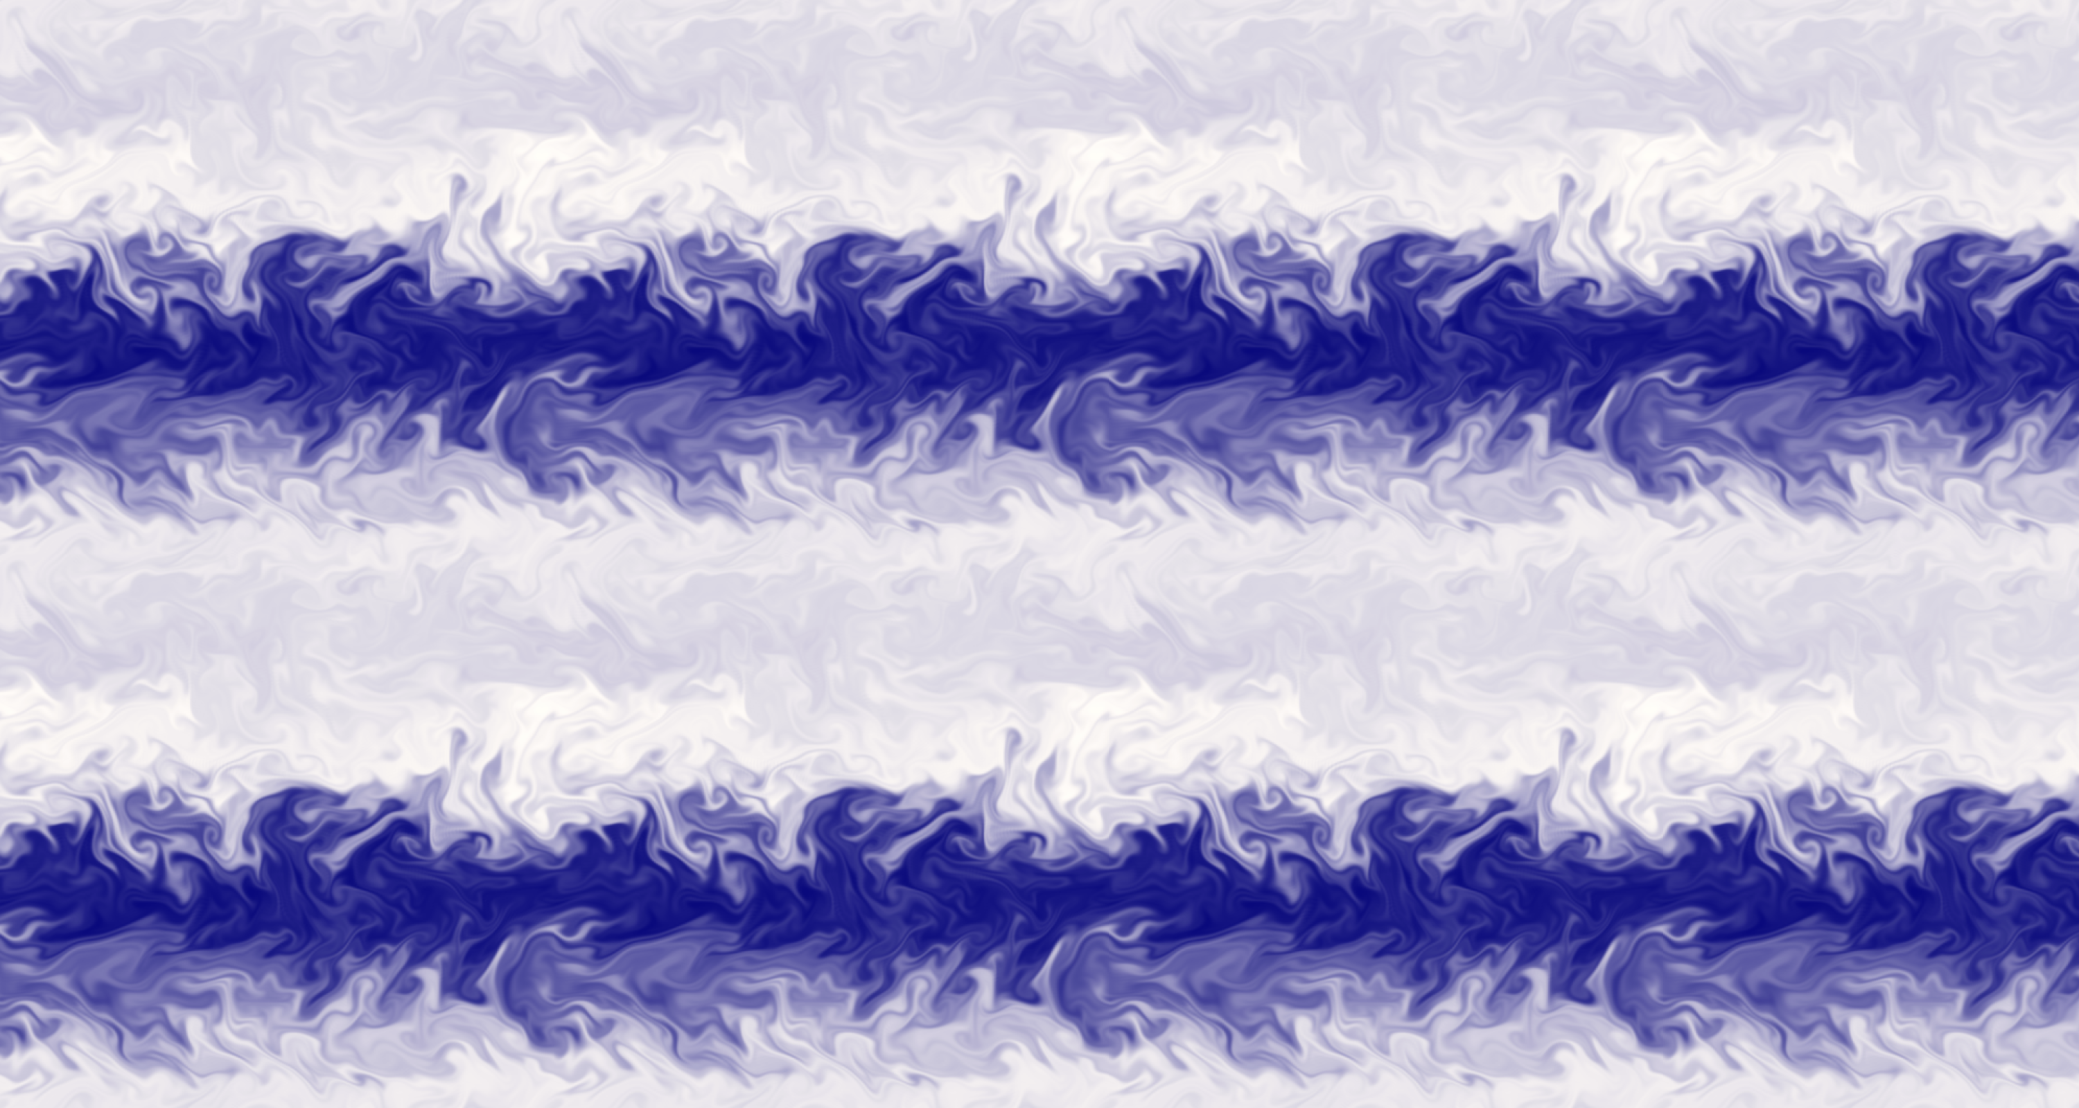
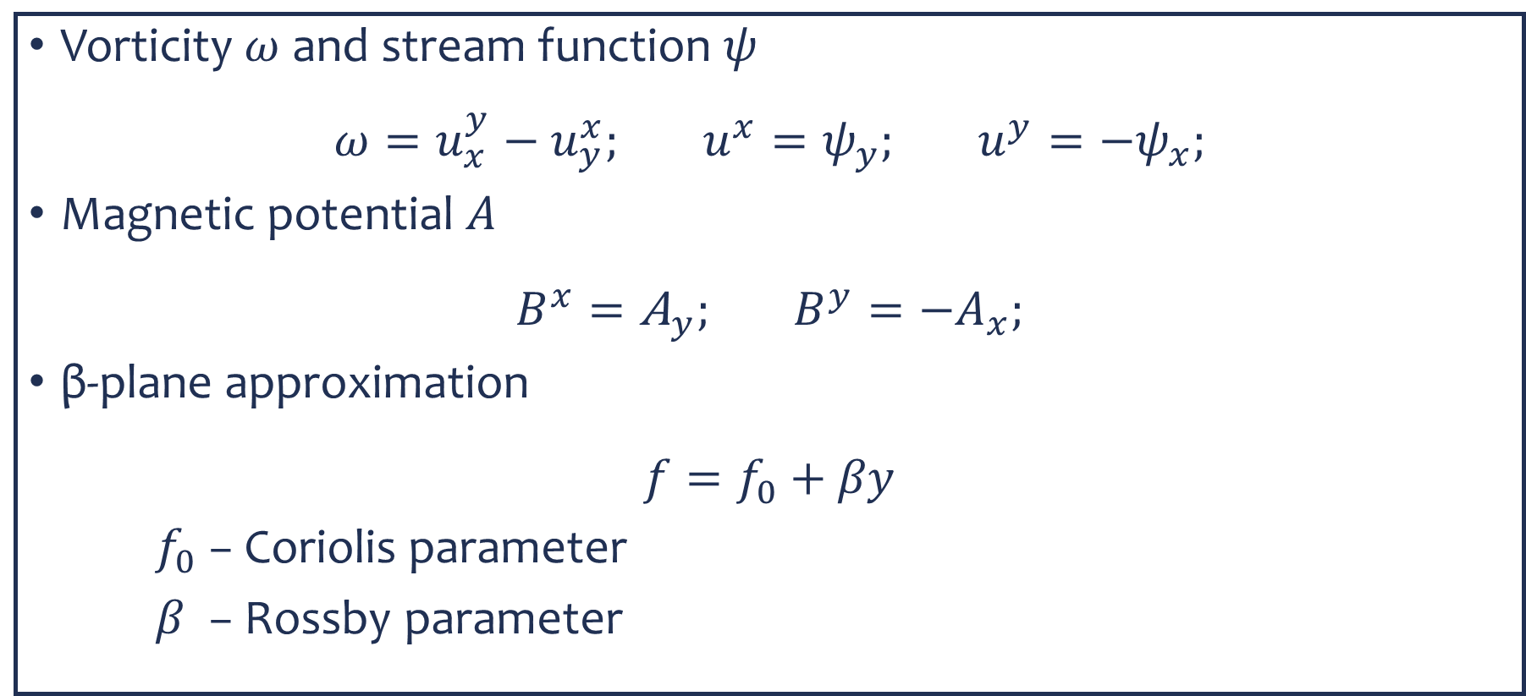
Approximation and functions
Vorticity $ω$ and stream function $ψ$
$$ω=u_{x}^{y}−u_{y}^{x}; u^{x}=ψ_{y}; u^{y}=−ψ_{x};$$
Magnetic potential $A$
$$B^{x}={\text{A}}_{y}; B^{y}=−A_{x};$$
β-plane approximation
$$f=f_{0}+βy$$
$f_{0}$ − Coriolis parameter
$β$ − Rossby parameter

Slide 4
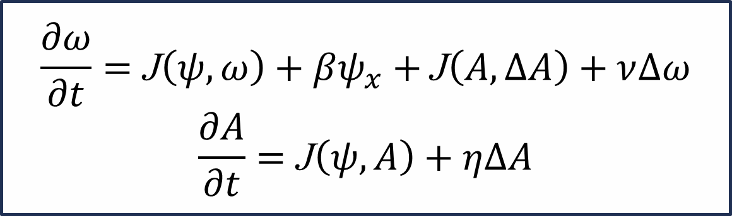
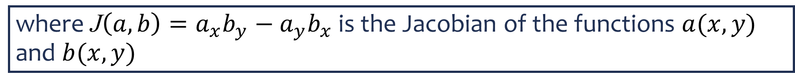

β-plane MHD equations
Equations of evolution of vorticity $ω$ and magnetic potential $A$ of two-dimensional magnetohydrodynamic flow in β-plane approximation:
$$\frac{∂ω}{∂t}=\text{J}\left(ψ,ω\right)+βψ_{x}+\text{J}\left(A,∆A\right)+ν∆ω$$
$$\frac{∂A}{∂t}=\text{J}\left(ψ,A\right)+η∆A$$
where $\text{J}\left(a,b\right)=a_{x}b_{y}−a_{y}b_{x}$ is the Jacobian of the functions $a(x,y)$ and $b(x,y)$

Slide 5
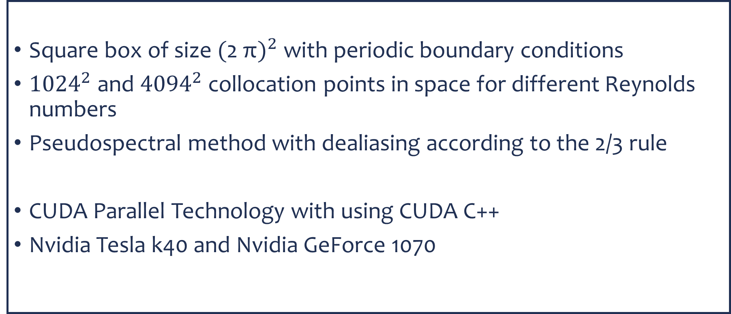
Numerical Simulation
Square box of size ${\text{(}\text{2 }\text{π})}^{2}$with periodic boundary conditions
${1024}^{2}$ and ${4094}^{2}$ collocation points in space for different Reynolds numbers
Pseudospectral method with dealiasing according to the 2/3 rule
CUDA Parallel Technology with using CUDA C++
Nvidia Tesla k40 and Nvidia GeForce 1070

Slide 6


Initial condition and parameters
β-plane decaying MHD turbulence $Re=Rm={10}^{5}$
$$β=10;25;50$$
Spatial resolution of ${1024}^{2}$
β-plane decaying MHD turbulence $Re=Rm={10}^{6}$
$$β=10;25;50$$
Spatial resolution of ${4096}^{2}$

Slide 7
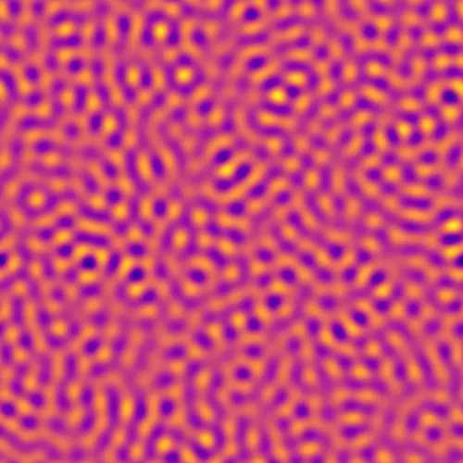

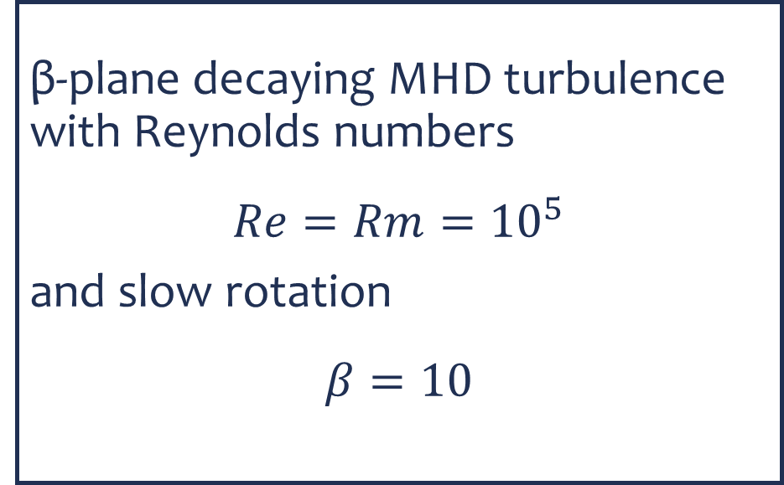
Zonal flows in β-plane decaying MHD turbulence
β-plane decaying MHD turbulence with Reynolds numbers
$$Re=Rm={10}^{5}$$
and slow rotation
$$β=10$$
Meridional
Color map of the stream function $ψ(x,y)$ over time
Zonal

Slide 8
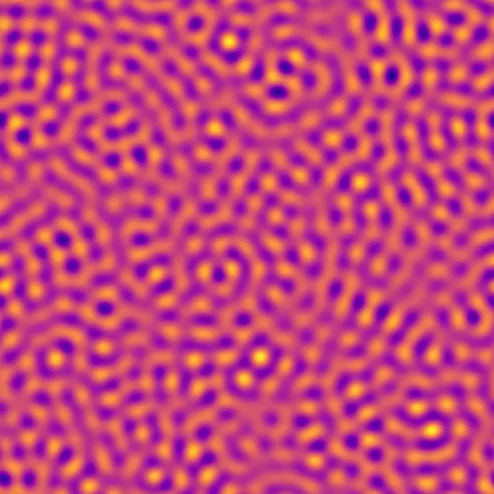
Magnetic islands in β-plane decaying MHD turbulence
β-plane decaying MHD turbulence with Reynolds numbers
$$Re=Rm={10}^{5}$$
and slow rotation
$$β=10$$
Meridional
Color map of the magnetic potential A(𝑥,𝑦) over time
Zonal

Slide 9
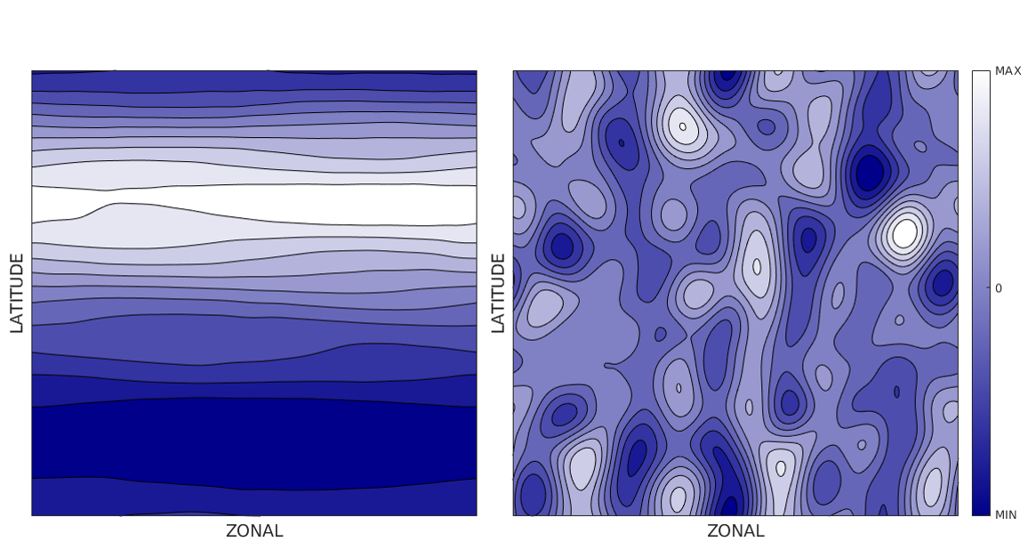
Contour lines of stream function $ψ(x,y)$ and magnetic potential A$(x,y)$
Meridional
Meridional
Zonal
Zonal

Slide 10
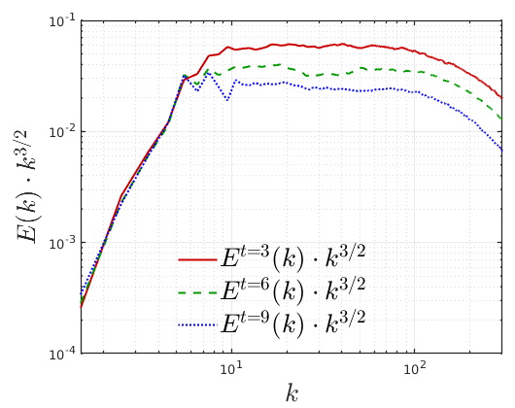
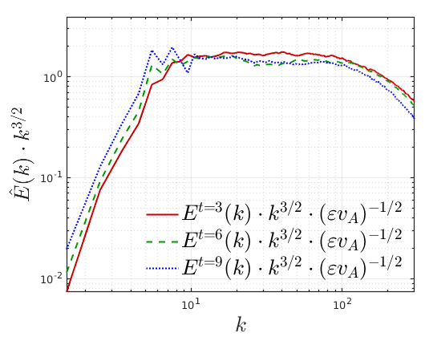
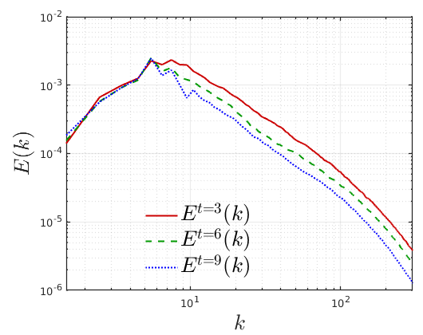
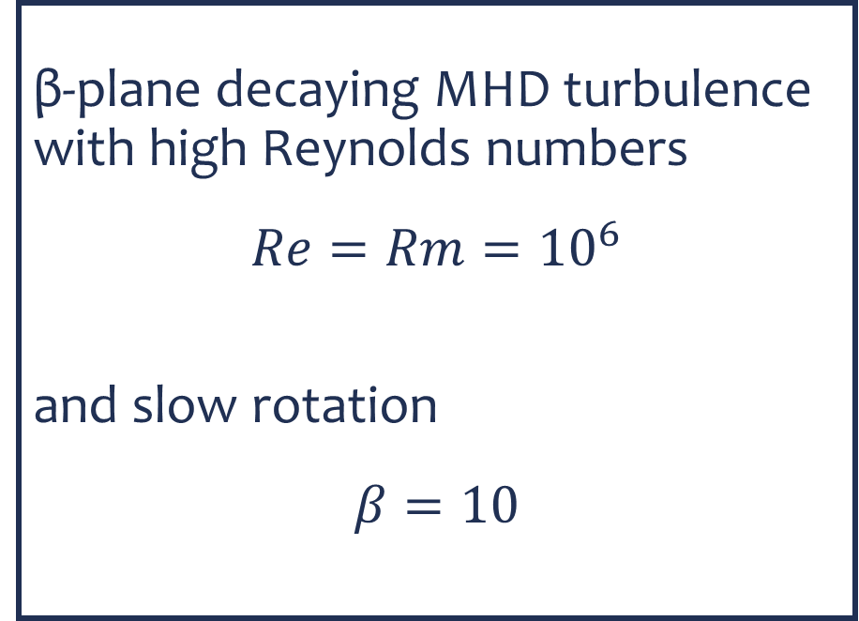
Spectrum of β-plane decaying MHD turbulence
β-plane decaying MHD turbulence with high Reynolds numbers
$$Re=Rm={10}^{6}$$
and slow rotation
$$β=10$$
Iroshnikov-Kraichnan spectrum$E_{k}=C′{(ε v_{A}^{ })}^{1/2}k^{−3/2}$

Slide 11
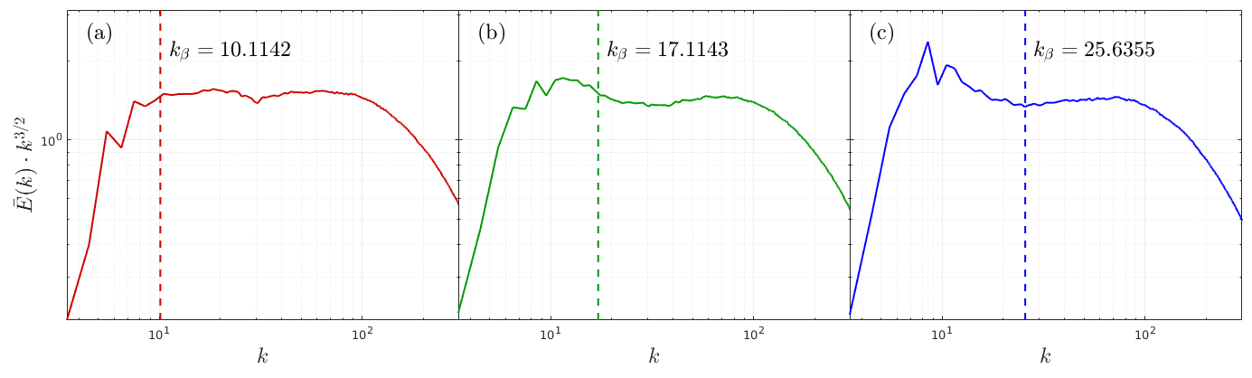
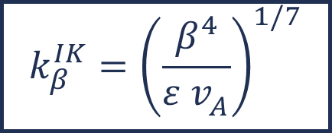



Spectra of β-plane decaying MHD turbulence
$$β=10$$
$$β=25$$
$$β=50$$
The characteristic scale of the boundary Rossby waves and inertial interval of the IK spectra
$$k_{β}^{IK}={\left(\frac{β^{4}}{ε v_{A}^{ }}\right)}^{1/7}$$

Slide 12
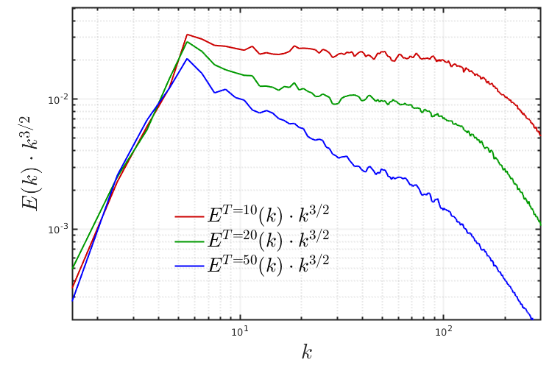
Disturbance of self-similarity of the decay
On large time scales, the self-similarity of the decay is broken.
Zonal flows are formed at this large time scales.

Slide 13
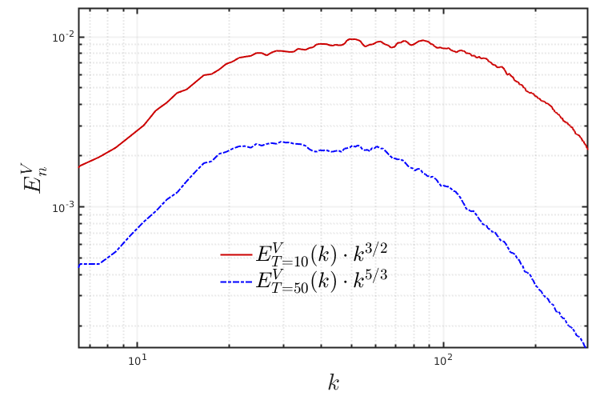
Kinetic energy spectra
On a large time scale, the Kolmogorov spectrum is formed.
The inverse energy cascade provides the formation of zonal flows.

Slide 14
Conclusion
The formation of zonal flows in β-plane decaying MHD turbulence has been demonstrated. Despite strong anisotropy, zonal flows are unsteady. Isotropic magnetic islands appearing in the system affect the flow dynamics.
It is shown that in β-plane two-dimensional decaying magnetohydrodynamic Iroshnikov-Kraichnan spectrum forms. It is found that the found spectrum self-similarly decay according to the expression of the time dependence of the Iroshnikov-Kraichnan spectrum.
It is found that at large time scales, a violation of the self-similar attenuation of the spectrum occurs and an inverse cascade of kinetic energy occurs. Zonal flows in β-plane two-dimensional MHD turbulence at large time scales occur due to the inverse cascade of kinetic energy.

Slide 15
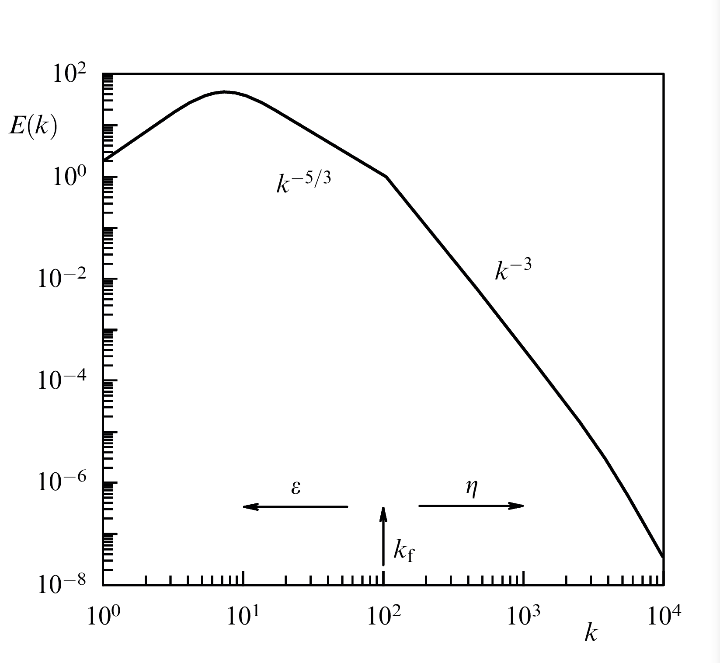
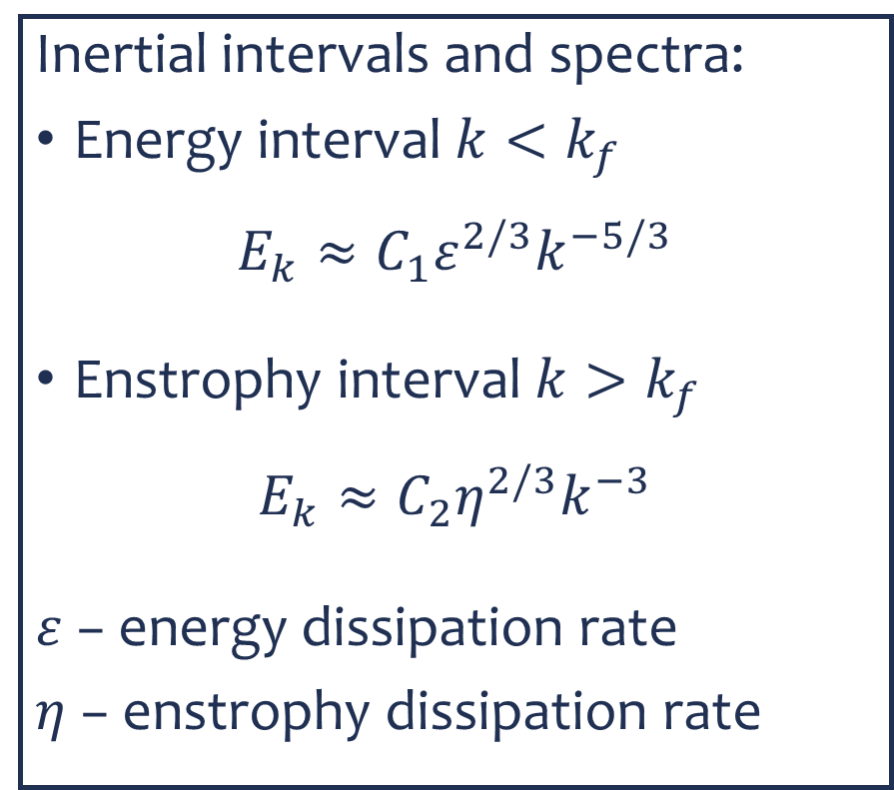
Spectral laws in two-dimensional turbulence
Inertial intervals and spectra:
Energy interval $k<k_{f}$
$$E_{k}≈C_{1}ε^{2/3}k^{−5/3}$$
Enstrophy interval $k>k_{f}$
$$E_{k}≈C_{2}η^{2/3}k^{−3}$$
$ε$ − energy dissipation rate
$η$ − enstrophy dissipation rate

Slide 16
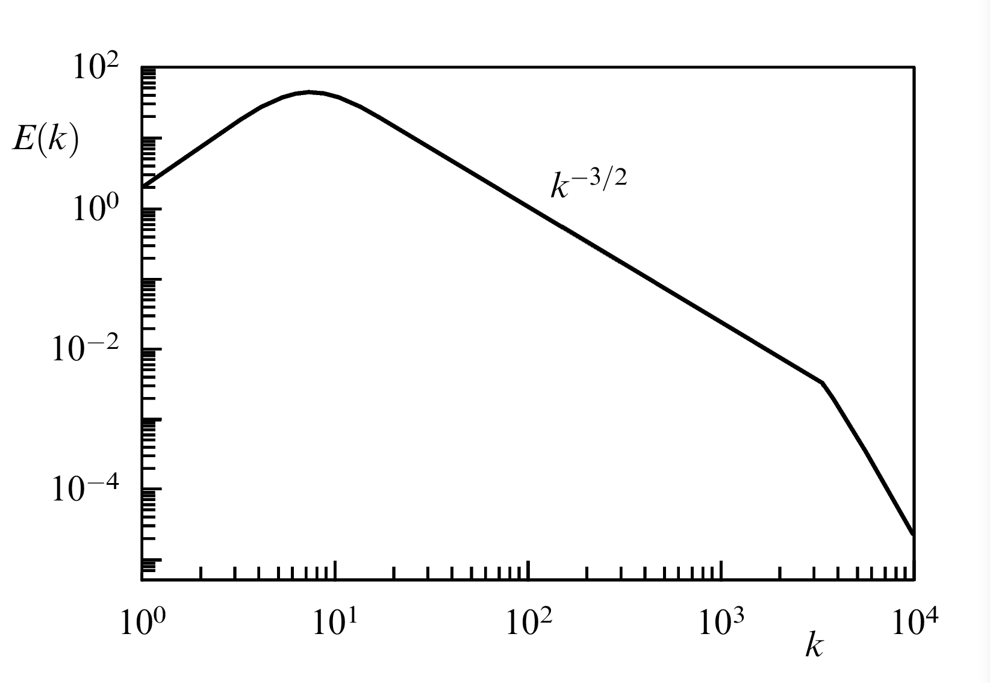
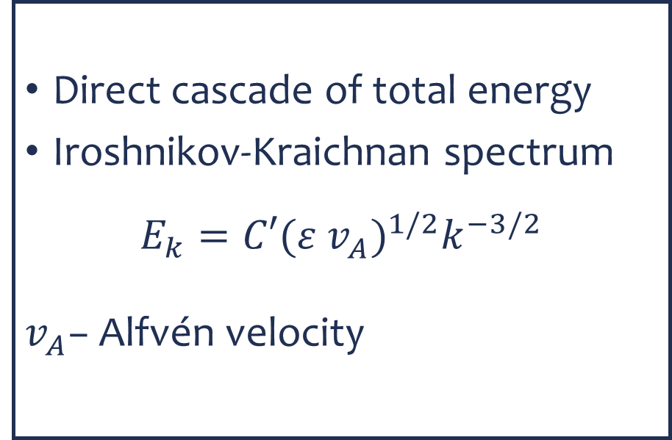
Spectral laws in two-dimensional MHD turbulence
Direct cascade of total energy
Iroshnikov-Kraichnan spectrum
$$E_{k}=C′{(ε v_{A}^{ })}^{1/2}k^{−3/2}$$
$v_{A}^{ }$− Alfvén velocity

Slide 17

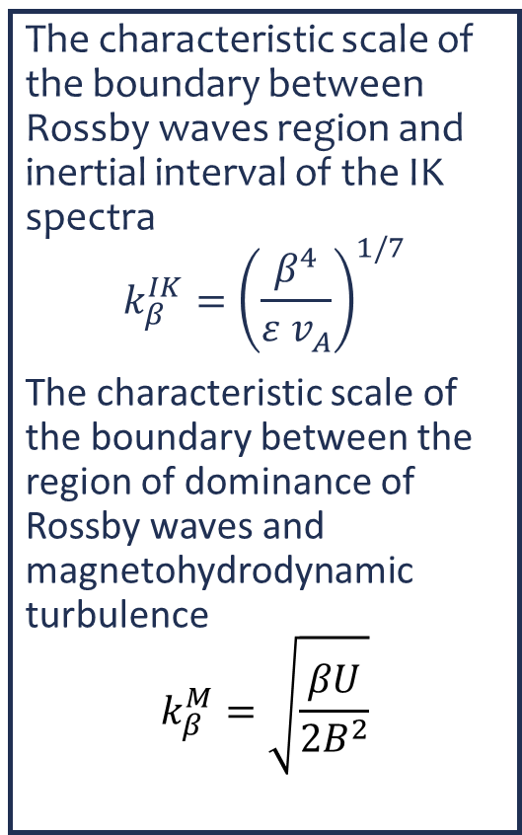








Spectrum of β-plane decaying MHD turbulence
The characteristic scale of the boundary between Rossby waves region and inertial interval of the IK spectra
$$k_{β}^{IK}={\left(\frac{β^{4}}{ε v_{A}^{ }}\right)}^{1/7}$$
The characteristic scale of the boundary between the region of dominance of Rossby waves and magnetohydrodynamic turbulence
$$k_{β}^{M}=\sqrt{\frac{βU}{2B^{2}}}$$
Iroshnikov-Kraichnan
spectrum
$$E_{k}^{total}$$
$$E_{k}^{kin}$$
$$k^{−3/2}$$
$$E_{k}^{mag}$$
$$E(k)$$
Rossby waves
Inertial interval
Dissipation interval
Dominance of Rossby waves
MHD turbulence
$$k_{β}^{M}$$
$$k_{β}^{IK}$$
$$k_{d}$$
$$k$$

Slide 18



Spectrum on large time-scale
The characteristic scale of the boundary between Rossby waves region and inertial interval of the IK spectra
$$k_{β}^{IK}={\left(\frac{β^{4}}{ε v_{A}^{ }}\right)}^{1/7}$$
The characteristic scale of the boundary between the region of dominance of Rossby waves and magnetohydrodynamic turbulence
$$k_{β}^{M}=\sqrt{\frac{βU}{2B^{2}}}$$
$$E_{k}^{total}$$
$$E_{k}^{kin}$$
$$k^{−3/2}$$
$$E_{k}^{mag}$$
$$k^{−5/3}$$
$$E(k)$$
$$k^{−3}$$
Rossby waves
Inertial intervals
Dissipation interval
Zonal flow
MHD turbulence
$$k_{β}^{M}$$
$$k_{d}$$
$$k$$

